Slide 1
UNC Flow core supplemental information

Slide 2
Take Home Messages
Know the configuration of the instrument being used (laser and filters) before you begin.
Use Fluorescence Spectral Viewers to choose fluorophores (visualize spectral overlap).
Know your dyes (size, brightness, sensitivity to fixatives).
Rate your markers for antigen density (pair dim fluorochromes with highly expressed antigens).
Select fluorophores for minimal spillover.
Place fluorophores with high spreading onto markers that occur on different cell types.
Use fluorophores that are spectrally similar for different cell subpopulations that will be gated and analyzed separately.
Titrate and optimize each antibody; building the right panel is an iterative process.
Include a cell viability dye.
Include FMOs and biologically relevant controls for low or rare expressing markers.
Run controls and compensation with each experiment; compensate on brightest sample.
Filter your samples.
Acknowledge the core in your publications.
Consult regularly with the FlowCore on your experimental design. There is no charge for this!
Follow all core rules and safety protocols.
Visit our website.

Slide 3
Introduction to Flow core staff
We are here to help in every stage for your flow experiment!

Slide 4
Staff and Responsibilities Email us at uncflowcore@med.unc.edu
Ramiro Diz: Flow Core Director. Consultation services. Oversees Aurora Training.
Janet Dow: Research Specialist. Operates the FACSAria II/III Sorters and all analyzers. Oversees training for all instruments. She also oversees training for users interested in independent sorting (given they meet the appropriate requirements outlined here).
Avinash Kollipara: Research Assistant Professor. Operates the LSR II/LSRFortessa and FACSAria sorting.
Ayrianna Woody: Research Specialist. Operates all anaylzers and FACSAria II/III sorting. Oversees training on Attune NxT and LSRFortessa.
Marie Iannone: Mass Cytometry Core Director. Manages CyTOF Helios operation

Slide 5
Introduction to our instruments
UNC Flow Core has several analyzers and sorters users may use once trained or assisted by the Core staff.

Slide 6
Analyzers We have 7 analyzers for our users to use. Consult our Instrument Decision Tree if you are unsure which instrument best fits your needs.
BSL-2
LSR II (BD): 7 lasers/18 colors
Attune NxT 1 (ThermoFisher): 4 laser/14 colors + Autosampler
Aurora (Cytek®): 5 laser/ 64 detectors + Autosampler; spectral flow cytometry
*CyTOF Helios – Mass Cytometer uses heavy metals (Lanthanides) instead of fluorophores and has a Time of Flight Mass Spec as detector. Contact Marie Iannone if interested.
LSRFortessa (BD): 5 lasers/18 colors
Attune NxT 2 (ThermoFisher): 4 laser/14 colors + Autosampler
iQue Screener PLUS (Intellicyt): High Throughput Screening, 3 lasers/13 colors – no PMT adjustments – MUST TITRATE Abs
Amnis ImageStreamX (EMD Millipore): imaging flow cytometer – no PMT, uses cameras – MUST TITRATE Abs
Optical layouts and additional information about each analyzer can be found on our website

Slide 7
Sorters
All sorters are staff operated unless user has satisfied training requirements
FACSAria II (BD): Staff-assisted BSL-1 or BSL-2+
FACSAria III (BD): user-operated independent BSL-1; staff-operated BSL-1 or BSL-2+
Optical layouts and additional information about each Sorter can be found on our website

Slide 8
Software
Acquisition
Analysis
LSRII/LSRFortessa: FACSDiva (FSC3.0)
iQue: ForeCyt (FCS3.0 and custom)
ImageStreamX MkII: IDEAS (RIF- Raw Image File)
Attune NxT: Attune NxT (FCS3.1)
Aurora: SpectroFlo (FCS3.1)
Free: Summit
Site License: FlowJo and FCS Express 7
ModFit (Verity) for DNA Analysis
Cytobank for high dimensionality analysis, especially Aurora and CyTOF data
Astrobank for turn-key high dimensional analysis, Aurora and CyTOF data

Slide 9
Where to begin
Refer to these essential links when you have questions on everything from reproducibility to where to find filters!

Slide 10
Bookmarkable links found on the UNC Flow Core Website
Resources: spectral viewers and other online tools: http://www.med.unc.edu/flowcytometry/resources-2/useful-links
Acknowledging the Core and Instrumentation in your publications: http://www.med.unc.edu/flowcytometry/resources-2/publication-acknowledgements
Rigor and Reproducibility in Flow Cytometry Experiments: http://www.med.unc.edu/flowcytometry/resources-2/guide-to-rigor-and-reproducibility-for-flow-cytometry-experiments
Cell filtration options (every sample gets filtered!!!): https://www.med.unc.edu/flowcytometry/resources/cell-filtration-options/

Slide 11
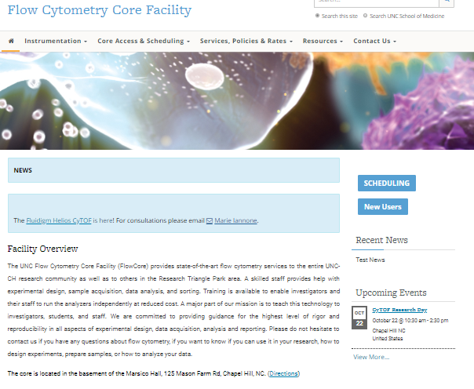
Find our Resources Tab and select ‘Useful Links’ on the dropdown menu

Slide 12
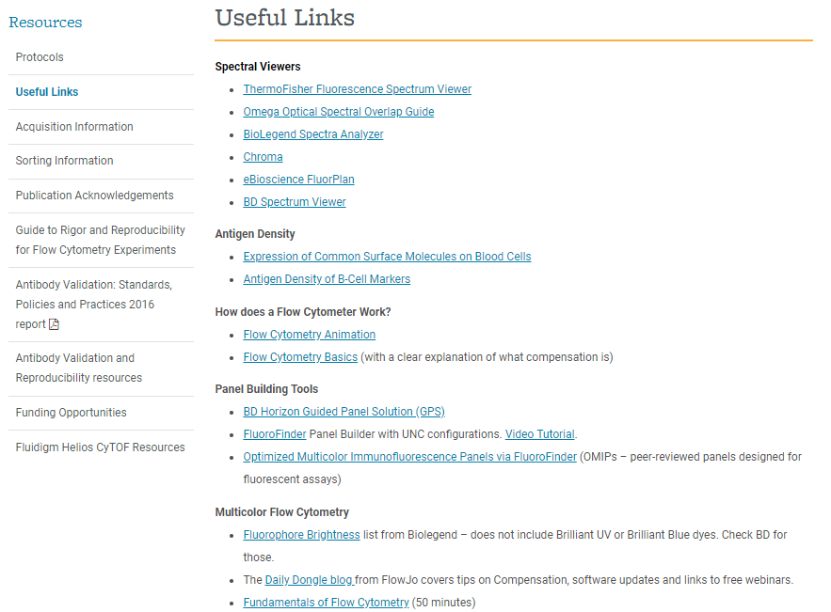
Use these spectral viewers for your experimental design
Scroll down for more helpful information an tutorials!

Slide 13
How to ensure your data is the best it can be
The key to publishable data in flow cytometry is making sure your experiments are well controlled and reproducible!

Slide 14
Principles and Guidelines for Reporting Preclinical Research
Description of biological material with enough information to uniquely identify the reagents (for example unique accession number in repository), in particular for:
Antibodies: also report source, characteristics, dilutions and how they were validated.
Cell lines: also report source, authentication and mycoplasma contamination status.
Guide to Rigor and Reproducibility: http://www.med.unc.edu/flowcytometry/resources-2/guide-to-rigor-and-reproducibility-for-flow-cytometry-experiments
http://www.nih.gov/research-training/rigor-reproducibility/principles-guidelines-reporting-preclinical-research

Slide 15
Resources
Guidelines for the use of flow cytometry and cell sorting in immunological studies. A special issue of the European Journal of Immunology devoted to flow cytometry: Cossarizza et al. This article covers a wide range of protocols and cytometric tips and tricks that will aid any cytometrist in their work. The author list is full of cytometry experts from around the globe.
Current Protocols in Cytometry – Flow Cytometry Core Facility subscription. Let us know if you need any protocols by pdf.
Experiment planning: Spectral Viewers – Invitrogen or BD Biosciences (on our website under ‘Useful Flow Cytometry Links’).

Slide 16
Controls are Essential
Negative controls and compensation controls are essential.
Adding the singlets, time, and viability & dump gates to your analysis will improve the accuracy of your results by removing cells that do not belong in your population of interest.
By activating the height value in your flow cytometer’s software package, you will be able to draw an accurate singlets gate.
By looking at time versus the flow of your cells, you will be able to evaluate whether or not the cytometer operated correctly during your collection run.
By using a viability & dump gate, you will ensure that you are only looking at your ‘living’ population of interest.
Using and communicating these gates in your flow cytometry experiments will help improve consistency and reproducibility of the overall field of flow cytometry data analysis.

Slide 17
Rigorous Flow Cytometry Experiments
Four areas of enhancing reproducibility through rigor and transparency with a focus:
Scientific premise
Rigorous experimental design
Adequate controls, statistical experimental design
Consideration of relevant biological variables
Autofluorescence, influence of dead cells, activation variables
Authentication of key biological and/or chemical resources
Titrating your antibodies

Slide 18
Policies
Relevant polices when using the core and planning experiments.

Slide 19
Important Policies
Training – do your homework!!
Instrument Scheduling - iLab
Core Etiquette
Core Rules – research use only, biosafety and radiation safety, HIPAA compliancy, instrument handling, password protection
Calendar (36 hour lock out)
Communication: Website: calendar, updates, protocols, links, etc. Listserve: important updates, events
Data storage: you will be assigned a folder on our server that will hold your data up to 3 months (monthly cleaning)

Slide 20
Safety Policy
Sorting
All human samples (primary or cell line) require a BioSafety form (Schedule F)
Any human cells are BSL-2 if unfixed
Analyzers
Analysis of unfixed human samples must be run on the iQue, ImageStreamX or LSRFortessa in room B021C (BSL-2) or Stratedigm for Microparticle analysis
The other cytometers require fixing of all human samples or pathogen-containing samples.
This is for your safety and that of other users and the flow core team.
Non-adherence to this policy will result in permanent expulsion from core usage.

Slide 21
Other Resources to Make You a Flow Pro
Join the Purdue cytometry list serve
Visit http://ucflow.blogspot.com/2011/12/10-steps-to-successful-flow-cytometry.html
Filter your samples!
Read lots of protocols

Slide 22
How to acknowledge the core instrumentation and staff

Slide 23
Acknowledging the Core Instrumentation in your Publications
All publications:
'The UNC Flow Cytometry Core Facility is supported in part by P30 CA016086 Cancer Center Core Support Grant to the UNC Lineberger Comprehensive Cancer Center.'
Most instruments have a separate funding source that needs to be acknowledged:
For instance, for the LSRFortessa: 'Research reported in this publication was supported by the Center for AIDS Research award number 5P30AI050410. The content is solely the responsibility of the authors and does not necessarily represent the official views of the National Institutes of Health.‘
All of these are listed on our website: http://www.med.unc.edu/flowcytometry/resources-2/publication-acknowledgements
We also like it when you thank the staff for their assistance!!

Slide 24
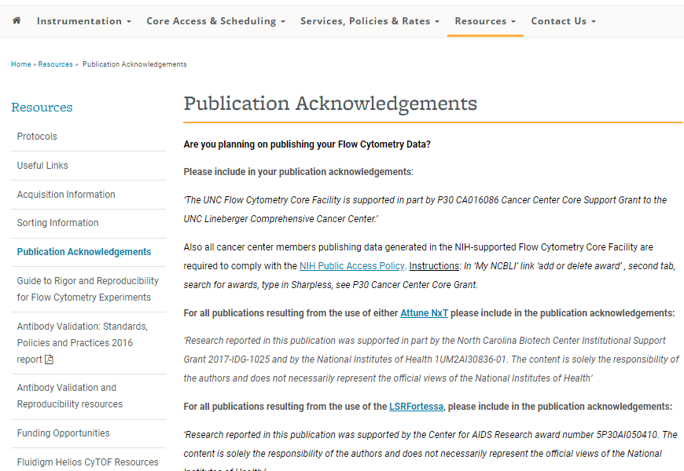
MORE

