Slide 1
HOPE in North Carolina
Brianna Doby
Johns Hopkins
HOPE in Action Team

Slide 2
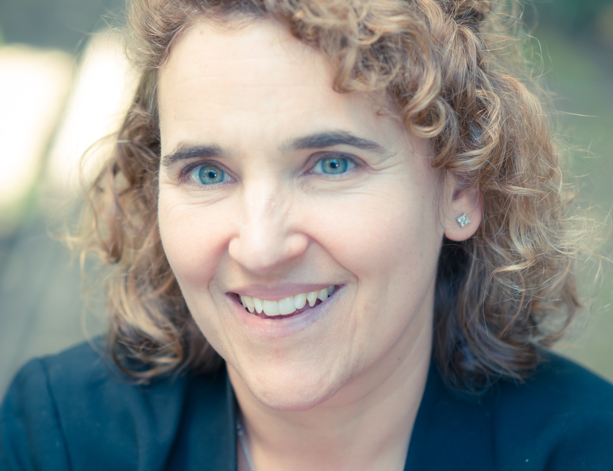
HOPE: Powered by Partnerships
Notes:
Some of our partners from OPOs and TxC around the country

Slide 3
Christine Durand
Assistant Professor, Johns Hopkins School of Medicine
Division of Infectious Diseases, Transplant Oncology Group
@CMDurandMD

Slide 4
Motivation/Significance
In Europe and North America, HIV+ individuals who are taking their medications have a near-normal life expectancy and are no longer dying of AIDS, but rather of non-AIDS-related health conditions (Haidar Transplantation 2017)
Prevalence of end stage kidney and liver disease in HIV+ individuals is increasing (Lucas CID 2014; Smith Lancet 2014)
HIV+ transplant candidates have higher waitlist mortality compared to HIV- candidates (Trullas AIDS 2011, Ragni Liver Transpl 2005)
Excellent outcomes with HIV- donor (HIV D-) organs for HIV+ recipients (HIV D-/R+) (Stock NEJM 2010, Roland AIDS 2016, Locke JASN 2015; Locke Transplantation 2016)

Slide 5
March
-Lead sponsors established
(Senators Boxer and Coburn; Representatives Capps and Harris)
-Draft legislative language
June
-Meet with HHS and Office of National AIDS Policy
-Congressional briefing
Milestones in
HOPE Act Implementation
2011-2017
January
-First HOPE trial approved
to evaluate the safety of HIV-to-HIV kidney and liver transplantation ClinicalTrials.gov NCT02602262
March
-First HIV-to-HIV kidney and liver transplants performed at JHU
1988: Use of HIV+ organs was made illegal
2011
2012
2013
2014
2015
2016
2017
February
-HOPE Act conceived at Johns Hopkins University (JHU)
March
-HIV community endorsement
April
-Front page NY Times coverage
June
-Potential HIV+ donor pool estimated (study published in AJT)
July
-Official transplant community endorsement
November
-Official AMA endorsement
February
-HOPE Act introduced
March
-Congressional Budget Office scoring
-Passes Senate HELP Committee
June
-Passes full Senate unanimously
November
-Passes House Energy & Commerce Committee
-Passes full House unanimously
-President Obama signs HOPE Act
May
-DHHS amends Final Rule to allow recovery of transplantable organs from HIV+ donors
June
-UNOS/OPTN institute policy changes and safety measures to allow for recovery and transplant of HIV+ donor organs for HIV+ recipients
-Adoption of Final Rule change
November
-National Institutes of Health publishes HOPE Safeguard and Research Criteria to guide research for HIV+ organ transplantation
July
-U01 Award from NIAID
HOPE in Action: A Multicenter Clinical Trial of HIV-to-HIV Deceased Donor Kidney Transplantation U01AI134591

Slide 6
Eligible Deceased Donor Criteria
Per Federal HOPE Safeguards ^{[14]}
No active invasive opportunistic complications of HIV infection
Permissible under current criteria:
HCV*, HBV co-infection
Prior AIDS-defining illness
Donation after cardiac death (DCD)
Prior treated opportunistic infections
Treatment naïve
-No requirement: viral load
-No requirement: CD4 count
-Required: pre-implant donor organ biopsy
-Required: description of effective post-transplant antiretroviral regimen for the recipient
[14] Federal Register / Vol. 80, No. 227 / Wednesday, November 25, 2015 / Notices
*HCV NAAT positive to NAAT negative transplants are not being done under the HOPE Act

Slide 7
Willingness to Donate Among the HIV+ Community
80% aware of organ shortage
24% aware of HOPE Act
Persons who were unwilling to be donors
Surgical concerns
Concerns about life post-donation
Concerns about HIV treatment post-donation
90% believed that HIV+ people should donate
73% believed this would reduce discrimination
Nguyen…Durand et al, JAIDS 2018

Slide 8
Since 2000…
People living with HIV who needed a transplant could be listed
Those patients received transplants from HIV- organ donors
Now, the HOPE Act permits living and deceased organ donation from HIV+ donors to HIV+ recipients

Slide 9
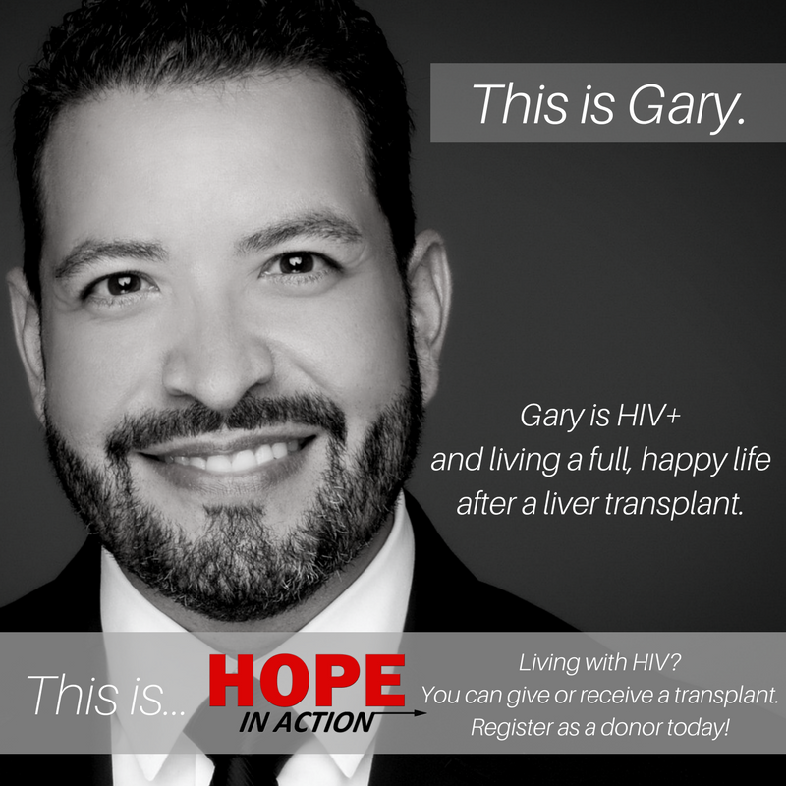
Every Patient Deserves HOPE
“It is estimated that 1–2% of the 469,000 Americans on dialysis have HIV—so that means that the need for kidney transplant could be as high as 10,000.”
“I couldn’t find a center that would list me for transplant. One doctor told me to go home and plan how to die.” – Gary Garcia

Slide 10
Nina Martinez
First living kidney donor, also living with HIV, in the US
Speaks publicly about breaking down HIV-related stigma
“Don’t call me a hero, call me the first.”

Slide 13
Teaching the Public about HOPE
Our outreach materials are intended to be culturally humble, not culturally competent.
HIV+ deceased donation is new. Educating the public about HOPE is new. We have to approach education with humility—we may get some things wrong, but we’re learning.

Slide 14
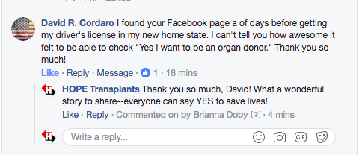
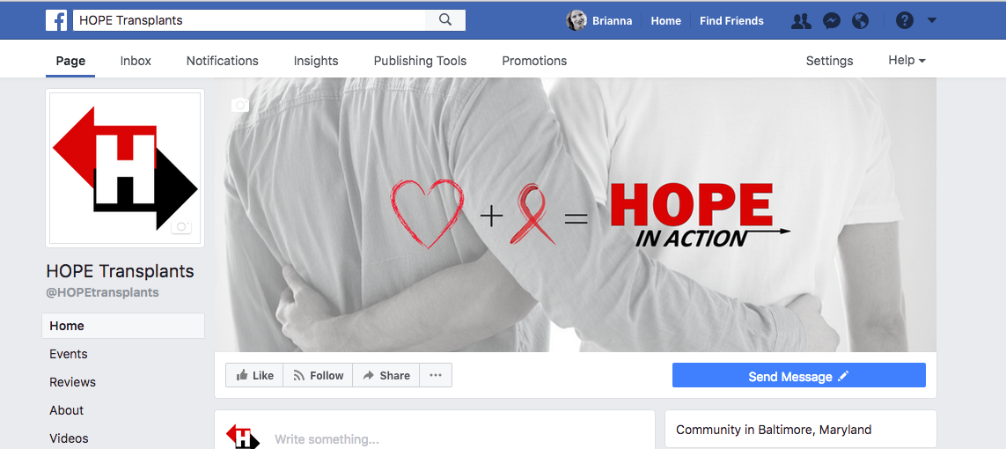
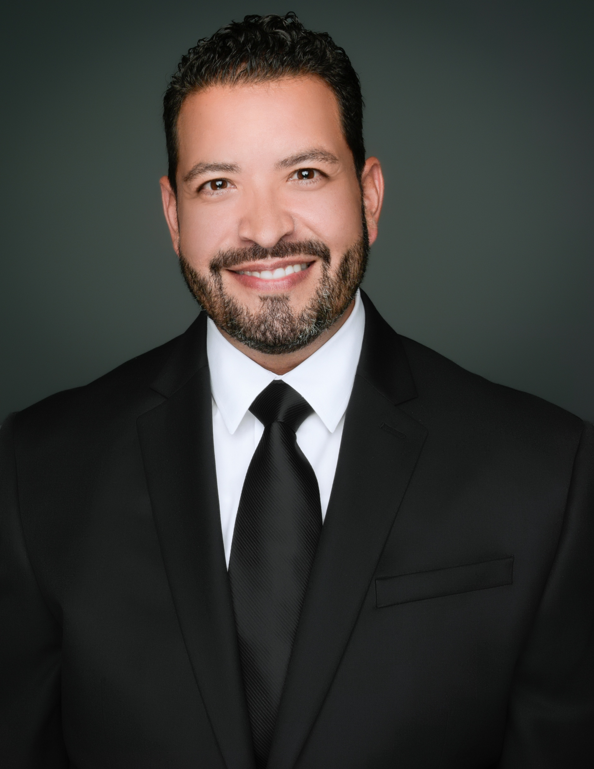
Decreasing Stigma

Slide 15
So What?
What materials would you like for yourself?
What’s important for your clients to know? To have as resources?
Is there a way our study team can better support professionals like you?

Slide 16
Thank You!
bdoby1@jhmi.edu
303-246-0647
pos_rhetoric
HopeTransplants.org

