Slide 1
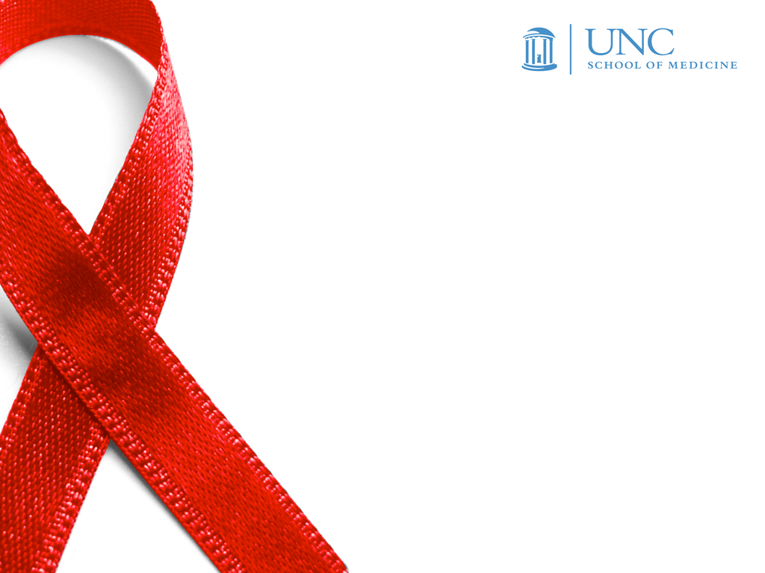
HIV in America
What’s New in 2012
Christopher Hurt, MD
Clinical Assistant Professor
NC AIDS Education and Training Center
2012 HIV Update

Slide 2
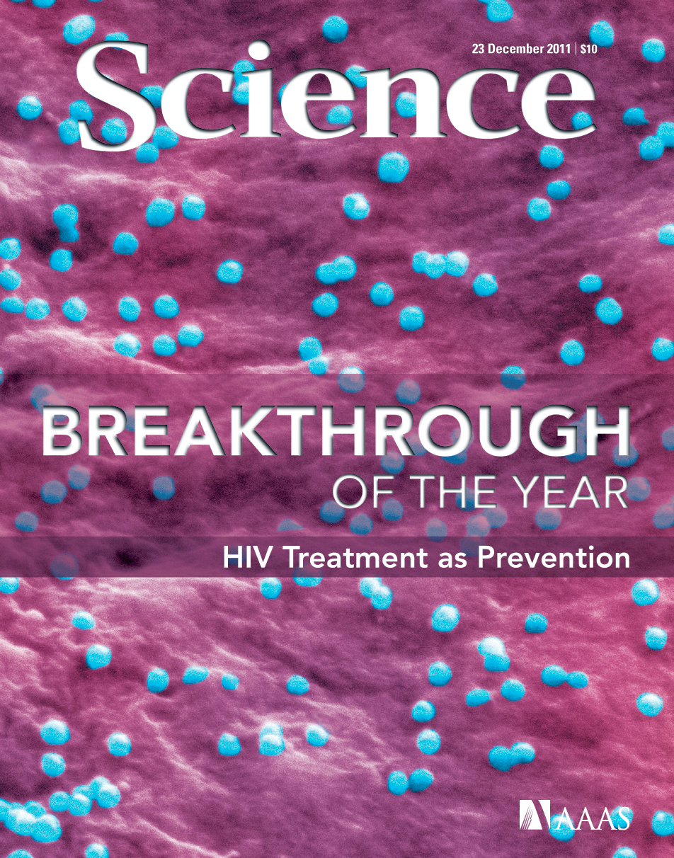
Dec. 23, 2011

Slide 3
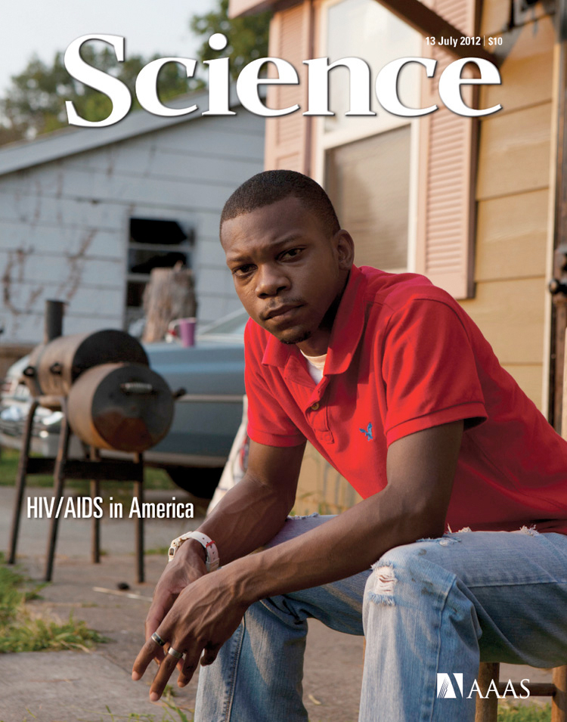
July 13, 2012
Notes:
Joshua Alexander, age 25, from Greenville, Mississippi. Diagnosed at age 19.

Slide 4
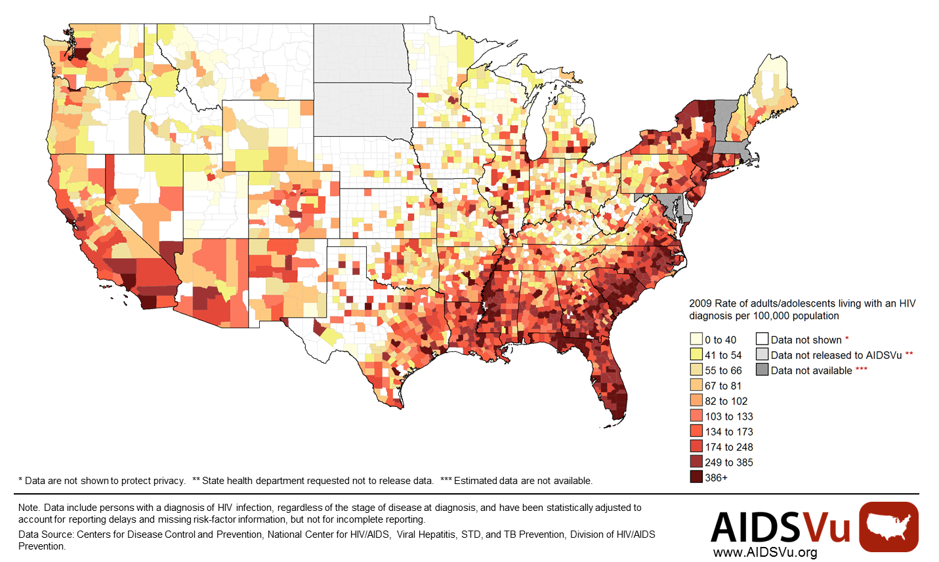
Persons living with HIV diagnosis, 2009

Slide 5
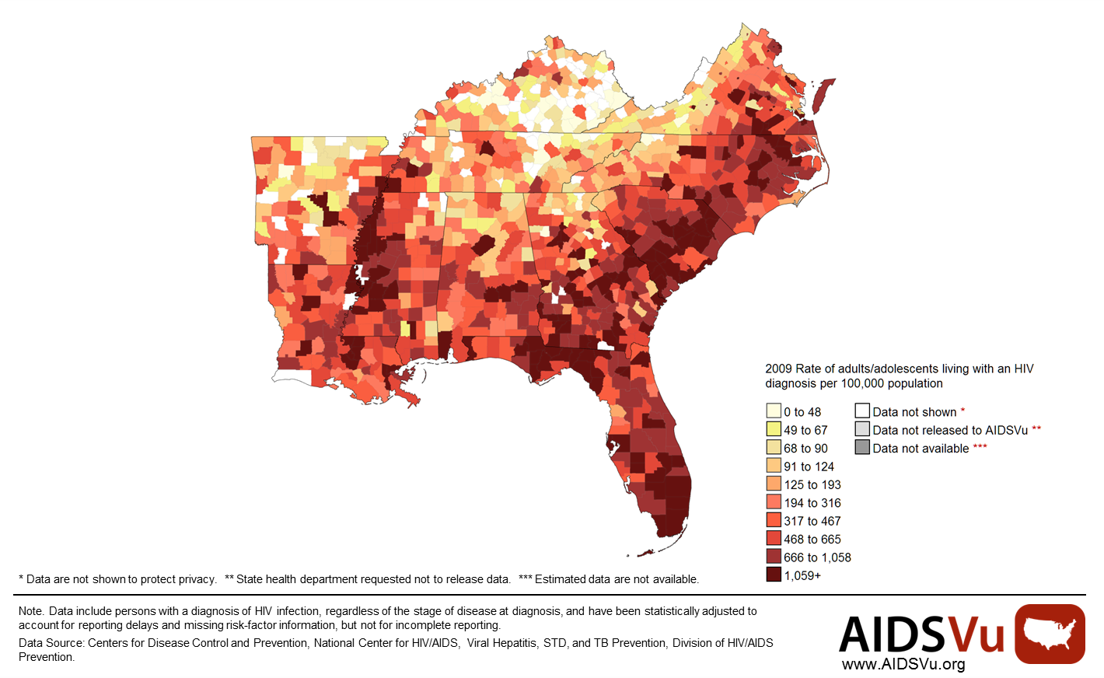
Persons living with HIV diagnosis, 2009

Slide 6
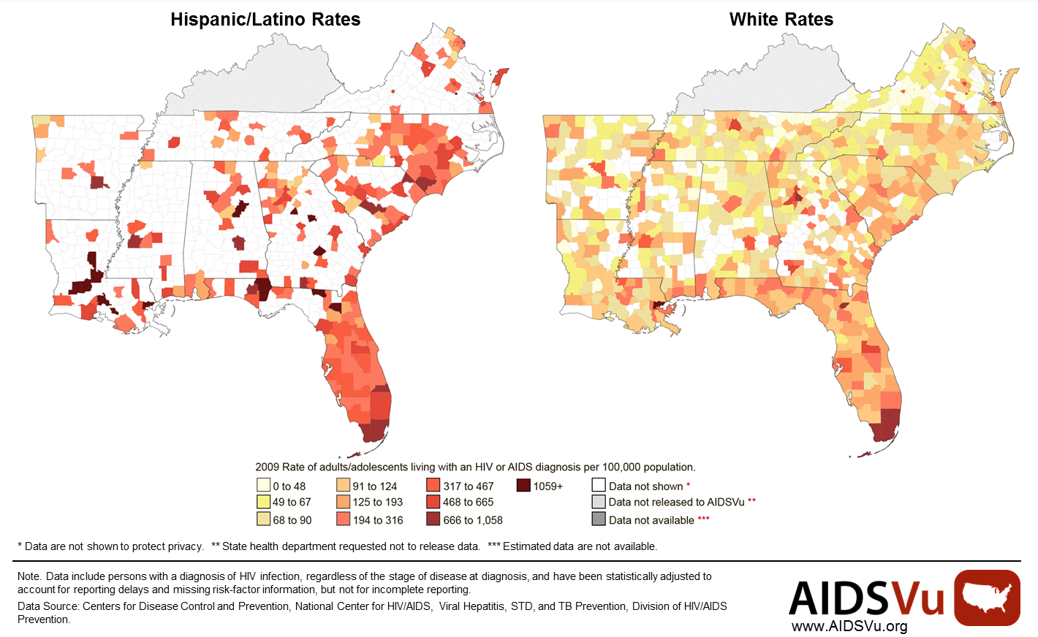
Persons living with HIV diagnosis, 2009

Slide 7
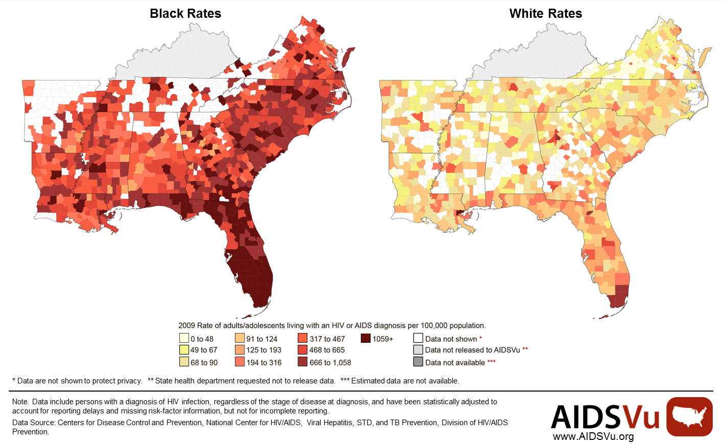
Persons living with HIV diagnosis, 2009

Slide 8
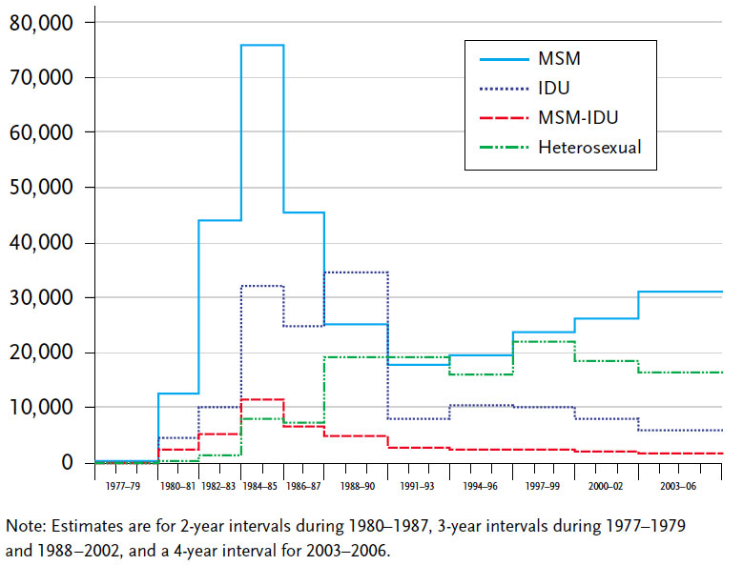
Estimated infections by subgroup, 1977-2006

Slide 9
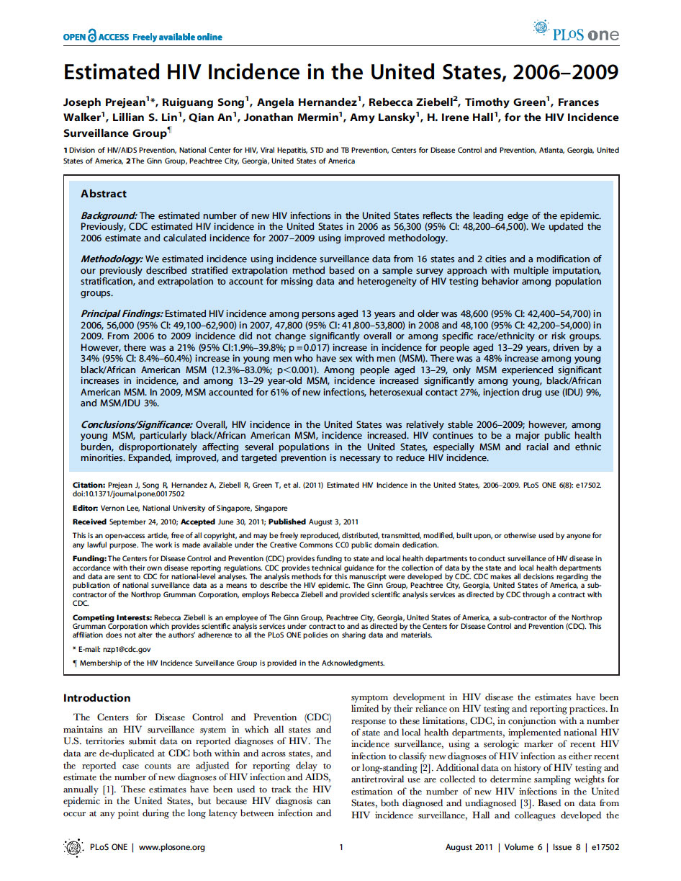
Incidence estimates updated in 2011

Slide 10
HIV incidence in United States, 2006-2009

Slide 11
HIV incidence by race and sex, 2006-2009
Black
Latino
White

Slide 12
HIV incidence among MSM by age & race, 2009

Slide 13


Two recent HIV Prevention Trials Network (HPTN) studies focused on HIV epidemiology in the U.S.
AKA The Women’s Seroincidence Study
AKA The BROTHERS Study

Slide 14
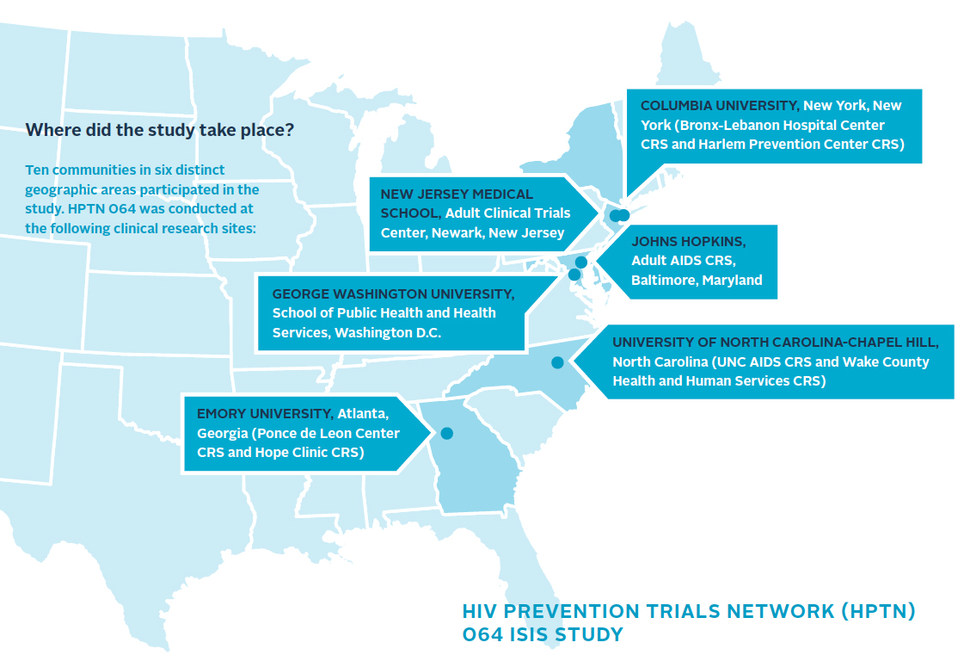
ISIS (064) recruited 2,099 women from 6 sites
Ethnographic mapping of venues frequented by at-risk women
Self-reported HIV–, with >1 individual or partner risk characteristic
Followed 6-12 months
Retrospective testing for acute HIV
Incidence calculated

Slide 15
Some baseline characteristics of participants
27%
Had at least monthly substance use (excluding marijuana)
37%
Had transactional sex
40%
Engaged in binge drinking
41%
Didn’t know HIV status of last male sex partner
46%
Endorsed food insecurity
Notes:
88% Black, 12% Latina. Median age 29.

Slide 16
An substantial proportion of women did not know they were HIV-infected, at enrollment
1.5%
Baseline HIV seroprevalence (n=32)*
*Another 2 had acute HIV at baseline
Notes:
Estimated incidence based on the 2 acute infections at baseline was significantly higher – 2.52% – but this estimate is very unstable, with a confidence interval from 0.60% to 10.7%.

Slide 17
Seroincidence in ISIS was 5x higher than CDC’s estimate for Black women in U.S.
1.5%
Baseline HIV seroprevalence (n=32)*
0.24%
Annual seroincidence, based on four seroconversions observed
(95%CI: 0.09, 0.65)
Too few seroconversions to determine factors associated with HIV incidence among participants
*Another 2 had acute HIV at baseline
Notes:
Estimated incidence based on the 2 acute infections at baseline was significantly higher – 2.52% – but this estimate is very unstable, with a confidence interval from 0.60% to 10.7%.

Slide 18
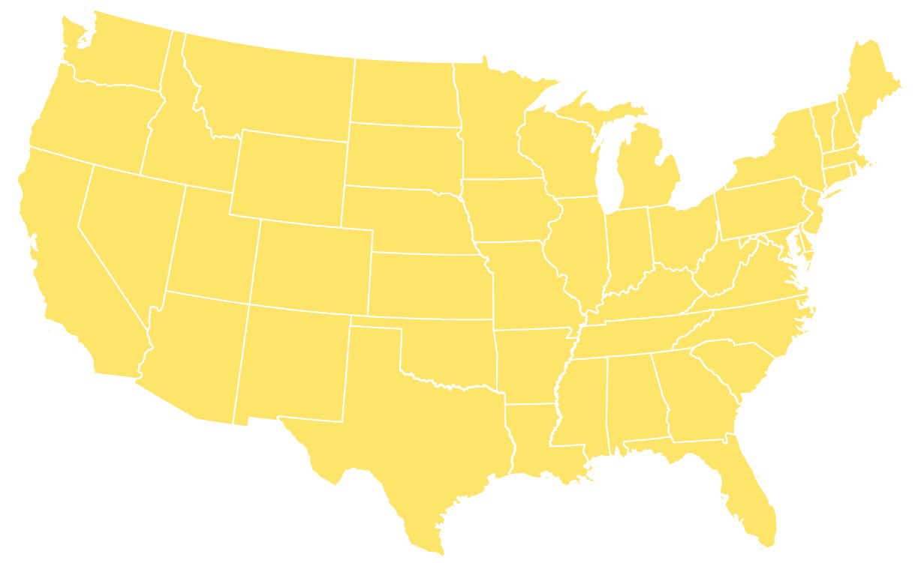
BROTHERS (061) recruited 1,553 men at 6 sites
Community recruitment or referral by sexual partner (incentivized)
Demographic and behavioral assessment by ACASI
In-person sexual/social network data
Offer of peer health navigation
Linkage to medical services, as needed
Fenway
Columbia
SF DPH
GWU
UCLA
Emory

Slide 19
Some baseline characteristics of participants
11%
Were previously diagnosed with HIV, at baseline (n=174)
12%
Were newly diagnosed at entry, including 3 with acute HIV (n=165)
30%
Self-identified as being gay or homosexual
34%
Were aged 30 or younger
60%
Had been incarcerated at some point in their lifetime

Slide 20
Seroincidence among Black MSM was very high
2.8%
Annual seroincidence, based on 26 new HIV infections observed
(95%CI: 1.8, 4.1)
Notes:
Among men reporting URAI, the estimate was 4.9%

Slide 21
Seroincidence among young Black MSM was alarmingly high – nearly 25x higher than ISIS
2.8%
Annual seroincidence, based on 26 new HIV infections observed
(95%CI: 1.8, 4.1)
5.9%
Annual seroincidence among 18-30 year-olds, based on
20 serconversions observed
(95%CI: 3.6, 9.1)

Slide 22
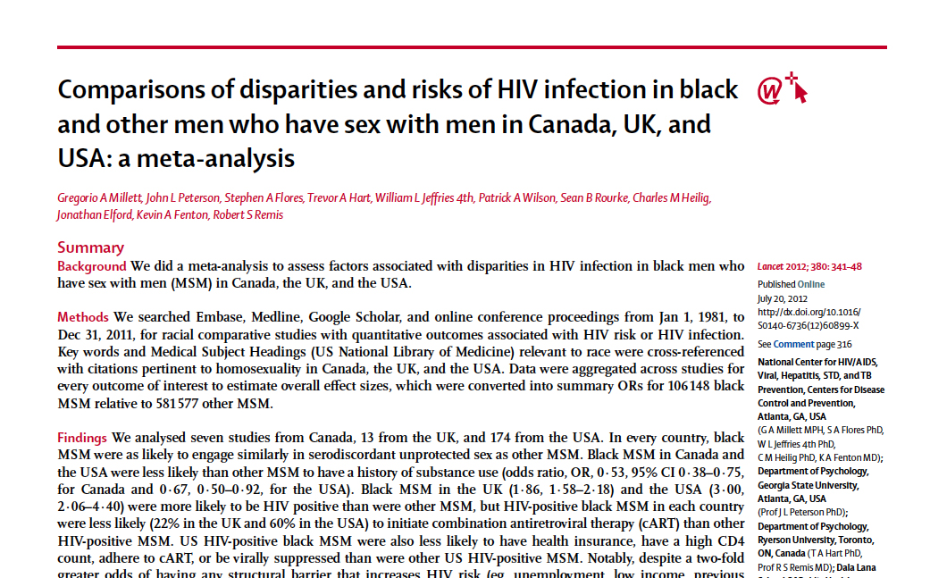
Riskier behavior does not account for the increased incidence seen among Black MSM
Lancet 2012; 380:341-48

Slide 23
Riskier behavior does not account for the increased incidence seen among Black MSM
Lancet 2012; 380:341-48
“US HIV-positive black MSM were …
less likely to
have health insurance,
have a high CD4 count,
adhere to cART,
or be virally suppressed
than were other US HIV-positive MSM.”

Slide 24
Riskier behavior does not account for the increased incidence seen among Black MSM
Lancet 2012; 380:341-48
“[D]espite a two-fold greater odds of having any structural barrier that increases HIV risk … compared with other US MSM, US black MSM were more likely to report any preventive behaviour against HIV infection.”

Slide 25
Conclusions
HIV prevalence is greatest in the Southeast U.S.
Prevalent and incident HIV is concentrated among African-Americans
Black MSM have an incidence rate of nearly 3%, or 12x higher than at-risk women of color
Young Black MSM (18-30) acquired HIV at nearly 25x the rate of at-risk women of color

Slide 26
Next steps
Prevention and test-and-treat efforts must be targeted to those communities at greatest risk
Identify and eliminate barriers to HIV testing and healthcare access – many of which are structural
Expand mechanisms for prompt linkage to and retention in HIV care (bridge counselors, etc.)
Increase capacity for treatment, including training more providers in ID and HIV medicine

Slide 27
