Slide 1

CROI Update: Best of Boston
presented by
NCATEC
March 18, 2014
David Wohl, MD
Joe Eron, MD
Conference Call Line: (919) 962-2731 - Please mute your phones.

Slide 2

CROI 2014 Update: Implications for the Future of HIV Management
Joseph Eron, MD and David Alain Wohl, MD
Global AIDS Clinical Research Unit
The University of North Carolina at Chapel Hill

Slide 3
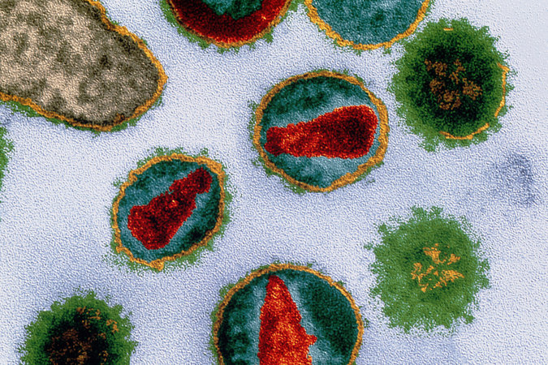
Antiretroviral Therapy
Initial Therapy

Slide 4
Efficacy and Tolerability of Atazanavir, Raltegravir, or Darunavir with FTC/TDF:
ACTG A5257
Landovitz RJ, Ribaudo HJ, Ofotokun I, Wang H, Baugh BP, Leavitt RY, Rooney JF, Seekins D, Currier JS, and Lennox JL for the A5257 Study Team

Slide 5
A5257 Study Design*
HIV-infected patients, ≥18 yr, with no previous ART,
VL ≥ 1000 c/mL at US Sites
Randomized 1:1:1 to Open Label Therapy
Stratified by screening HIV-1 RNA level (≥ vs < 100,000 c/mL), A5260s metabolic substudy participation, cardiovascular risk
ATV 300 mg QD + RTV 100mg QD
+ FTC/TDF 200/300 mg QD
RAL 400 mg BID +
FTC/TDF 200/300 mg QD
DRV 800 mg QD + RTV 100 mg QD
+ FTC/TDF 200/300 mg QD
Study Conclusion 96 weeks after final participant enrolled
Follow-up continued for 96 weeks after randomization of last subject (range 2-4 years) regardless of status on randomized ART
*With the exception of RTV, all ART drugs were provided by the study
Notes:
N=1810, is a result would consider deleting

Slide 6
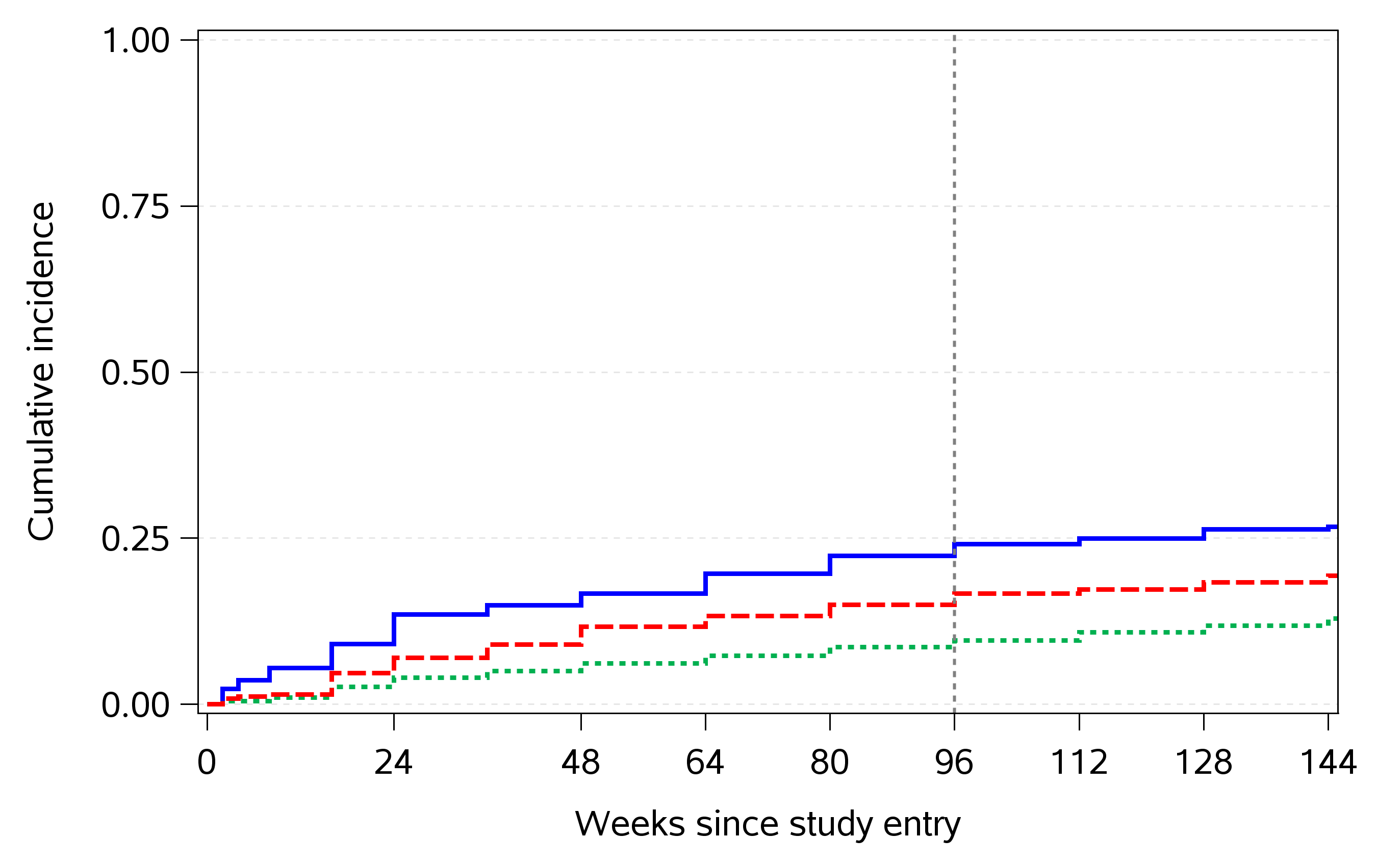
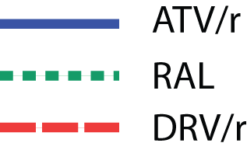
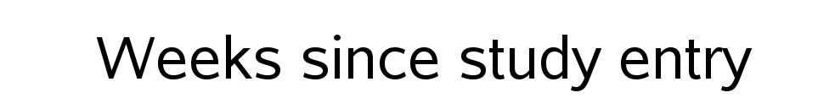
Cumulative Incidence of
Virologic or Tolerability Failure
Difference in 96 wk cumulative incidence (97.5% CI)
Favors RAL
ATV/r vs RAL
15% (10%, 20%)
Favors RAL
DRV/r vs RAL
7.5% (3.2%, 12%)
Favors DRV/r
ATV/r vs DRV/r
-20
-10
0
10
20
7.5% (2.3%, 13%)
*Consistent results seen with TLOVR at a 200 copies/ml threshold

Slide 7
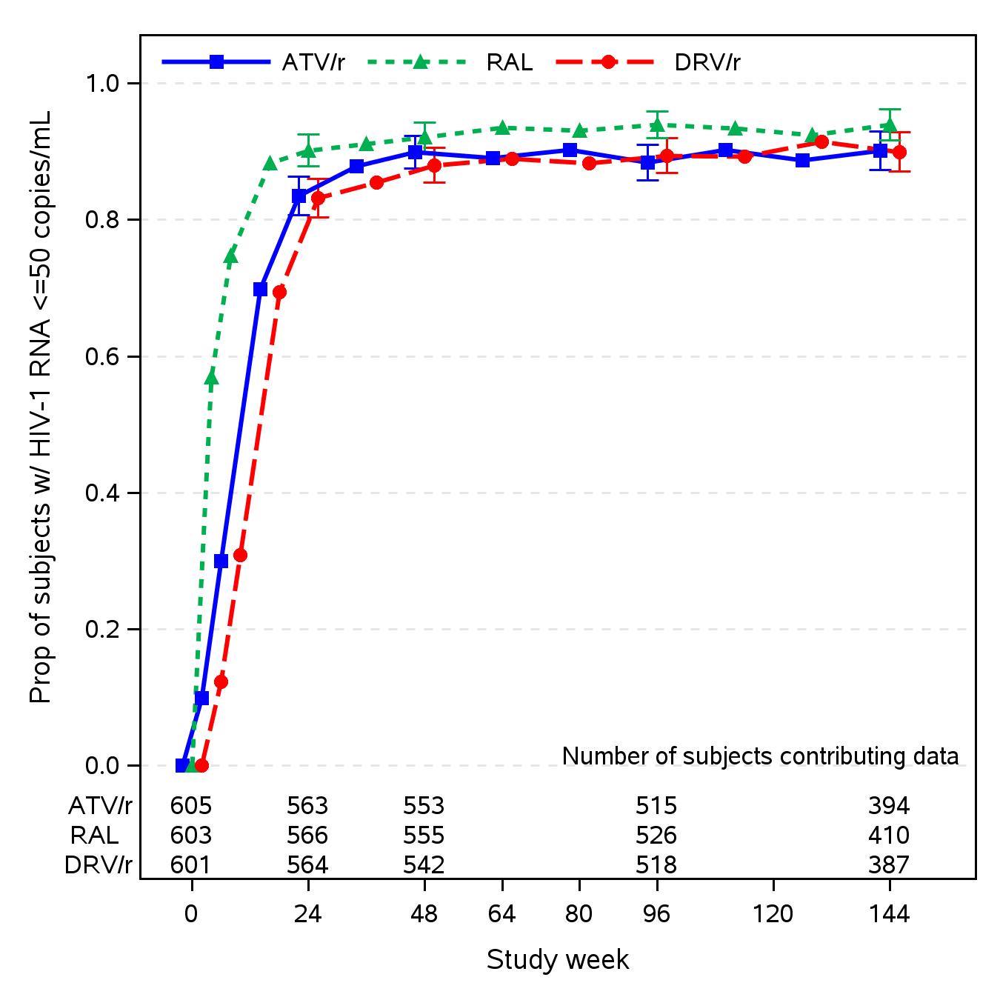
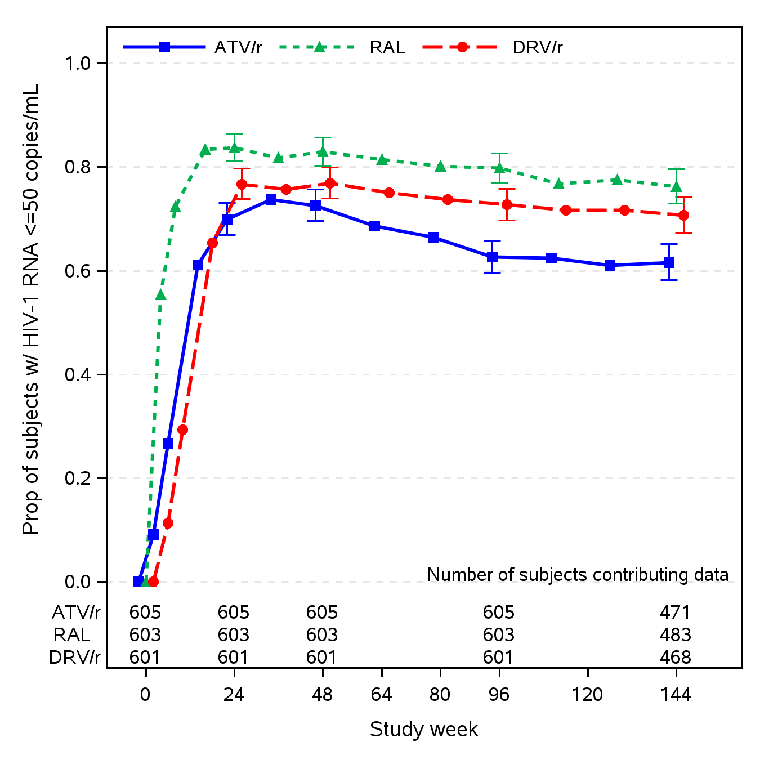
Proportion VL ≤50 copies/mL
ITT, regardless of ART change
ITT, off-ART=failure (SNAPSHOT)
 | 24 | 48 | 96 | 144
ATV/r | 83% | 90% | 88% | 90%
RAL | 90% | 92% | 94% | 94%
DRV/r | 83% | 88% | 89% | 90%
 | 24 | 48 | 96 | 144
ATV/r | 70% | 73% | 63% | 62%
RAL | 84% | 83% | 80% | 76%
DRV/r | 77% | 77% | 73% | 71%

Slide 8
ACTG 5257: Toxicity Associated Discontinuation
 | ATV/r (N=605) | RAL (N=603) | DRV/r (N=601)
Any Toxicity Discontinuation | 95 (16%) | 8 (1%) | 32 (5%)
Gastrointestinal Toxicity | 25 | 2 | 14
Jaundice/Hyperbilirubinemia | 47 | 0 | 0
Other Hepatic Toxicity | 4 | 1 | 5
Skin Toxicity | 7 | 2 | 5
Metabolic Toxicity | 6 | 0 | 2
Renal Toxicity (All Nephrolithiasis) | 4 | 0 | 0
Abnormal Chem/Heme (Excl. LFTs) | 0 | 0 | 2
Other Toxicity | 2 | 3 | 4
Landovitz L, et al. 21st CROI; Boston, MA; March 3-6, 2014. Abst. 85.

Slide 9
ACTG 5257:Bone Mineral Density at 96 Weeks
% Change from Baseline
ATV/r vs DRV/r P=0.001 ATV/r vs RAL P=0.004
PI/r vs RAL P<0.005
PI/r vs RAL P<0.001
Brown T, et al. 21st CROI; Boston, MA; March 3-6, 2014. Abst. 779.

Slide 10
Renal Outcomes in D:A:D by ARV
ARV Use at CRI and Adjusted Odds Ratios of Better Renal Outcomes
TDF
4
Never on TDF
On TDF
Off TDF<12 Months
Off TDF>12Months
2
1
0.5
0.25
0.125
ATV/r, LPV/r and Other PI/r
Adjusted OR (95%CI) of Better Renal Outcomes
(eGFR Improvement>Stabilization>Progression)
Never on ATV/r
Never on LPV/r
Never on Other PI/r
On ATV/r
On LPV/r
On Other PI/r
Off ATV/r
Off LPV/r
Off Other PI/r
4
2
1
0.5
0.25
0.125
Ryom L, et al. 21st CROI; Boston, MA; March 3-6, 2014. Abst. 792.

Slide 11
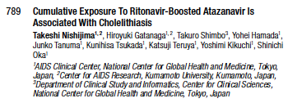
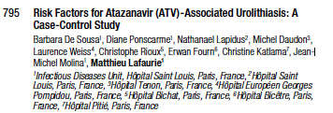
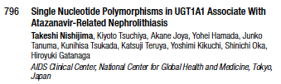
Atazanavir

Slide 12
SINGLE:
Dolutegravir + ABC/3TC vs. EFV/TDF/FTC
Screening Period
Randomized Phase
Open-label Phase
Continuation Phase
HIV-1+ ART-naive,
viral load ≥1000 c/mL,
HLA-B*5701 negative,
creatinine clearance
>50 mL/min,
stratified by baseline plasma HIV-1 RNA and CD4 cell count
DTG + ABC/3TC
+ EFV/TDF/FTC placebo
DTG + ABC/3TC
open-label
DTG + ABC/3TC
open-label
DTG placebo
+ ABC/3TC placebo
+ EFV/TDF/FTC
EFV/TDF/FTC
open-label
Randomization
Week 48
Week 96
Week 144
In each arm, 14% of patients had a CD4 cell count <200 cells/mm³
31% and 32% of patients with viral load >100,000 copies/mL
were enrolled in the DTG + ABC/3TC arm and the EFV/TDF/FTC
arm, respectively
Walmsley S, et al. 21st CROI; Boston, MA; March 3-6, 2014. Abst. 543.

Slide 13
SINGLE: Virologic Suppression
(HIV-1 RNA <50 c/mL; FDA Snapshot)
DTG: 80%
EFV: 72%
Week 96 adjusted difference in response (95% CI):
+8.0% (+2.3% to +13.8%); P=0.006
Treatment | Wk96 ∆ from BL Adjusted mean | SE | Difference in response (95% CI)
DTG + ABC/3TC QD (n=414) | 325.3 | 10.5 | 44.0 (14.3, 73.6) P=0.004
EFV/TDF/FTC QD (n=419) | 281.4 | 10.9
CD4 ∆ from BL
0
4
8
12
16
24
32
40
48
60
72
84
96
Walmsley S, et al. 21st CROI; Boston, MA; March 3-6, 2014. Abst. 543.

Slide 14
SINGLE: Resistance Mutations
Individuals Who Met PDVF Criteria
Mutation | DTG + ABC/3TC QD (n=414) | EFV/TDF/FTC QD (n=419)
NRTI TE Major Mutations | 0 | 1 (K65R)
NNRTI TE Major Mutations | 0 | 6 (K101E, K103N, G190A)
INI-r TE Major Substitution | 0 | 0
Walmsley S, et al. 21st CROI; Boston, MA; March 3-6, 2014. Abst. 543.

Slide 15
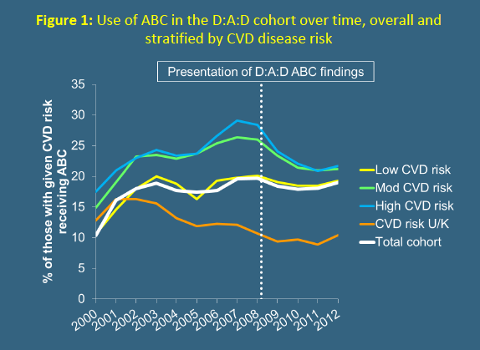
Continued risk of MI with ABC in D:A:D?
Since initial D:A:D report of association between ABC and MI, use of ABC has declined in cohort among those with highest CVD risk.
Analysis of whether channeling of such patients from ABC has influenced association between the drug and MI.
Sabin C, et al. 21st CROI; Boston, MA; March 3-6, 2014. Abst. 747LB.

Slide 16
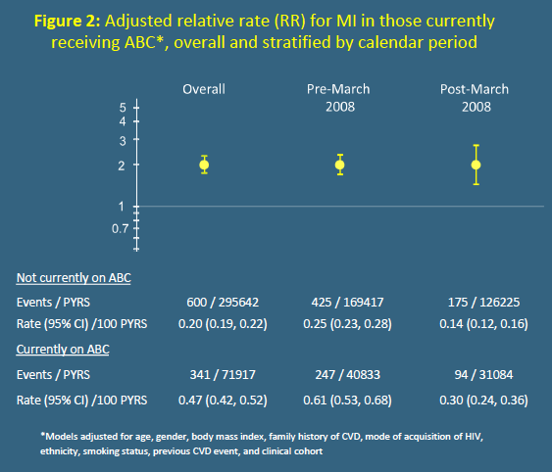
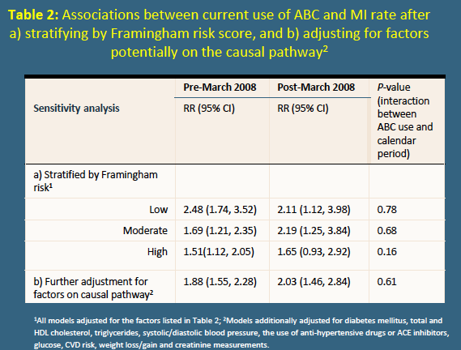
Continued risk of MI with ABC in D:A:D?
MI rates
  Current/Recent ABC 0.47 (0.42-0.52)/1000 pt yrs of FU
  No ABC 0.21 (0.19-0.22)/1000 pt yrs of FU
RR with ABC 1.98 (1.72-2.29), Pre 3/08 1.97, Post 3/08 1.97
Sabin C, et al. 21st CROI; Boston, MA; March 3-6, 2014. Abst. 747LB.

Slide 17
NEAT 001/ANRS 143 study design
NEAT 001/ANRS 143
Phase III, randomised, open-label, multicenter, parallel-group, non-inferiority, strategic trial
78 sites, 15 countries (Austria, Belgium, Denmark, France, Germany, Great Britain, Greece, Hungary, Ireland, Italy, Netherlands, Poland, Portugal, Spain, Sweden)
HIV-1 ART-naïve
≥ 18 years
HIV-1 RNA > 1000 c/ml
CD4 ≤ 500/mm³
HBs Ag negative
No major IAS-USA resistance mutations
DRV+r 800+100 mg QD + RAL 400 mg BID
DRV+r 800+100 mg QD + TDF/FTC FDC QD
Randomisation 1:1
stratified by country and participation in virology/immunology substudy
Minimum
Week 96
Composite virological and clinical primary endpoint (6 components)
34% BL HIV RNA > 100,000 c/mL, 15% BL CD4 < 200 cells

Slide 18
Primary analysis: time from randomisation to primary endpoint
NEAT 001/ANRS 143
Primary endpoint
Probability of reaching primary endpoint
 |  | RAL + DRV/r |  | TDF/FTC + DRV/r
N |  | 401 |  | 404
N with primary endpoint |  | 76 | (19%) | 61 | (15%)
V1. Regimen change for insufficient response
 | < 1 log₁₀ c/ml HIV RNA reduction W18* | 1 |  | 0
 | HIV RNA ≥ 400 c/ml W24* | 1 |  | 0
V2. HIV RNA ≥ 50 c/ml at W32* |  | 27 |  | 28
V3. HIV RNA ≥ 50 c/ml after W32* |  | 32 |  | 22
C1. Death |  | 3 |  | 1
C2. AIDS event |  | 5 |  | 3
C3. SNAIDS event |  | 7 |  | 7
1.00
RAL + DRV/r
TDF/FTC + DRV/r
0.75
0.50
log rank p=0.12
0.25
0
0
8
18
32
48
64
80
96
112
128
144
Time (weeks)
N at risk
400
384
375
347
329
317
308
211
90
11
402
395
393
361
350
340
331
215
90
12
Estimated proportion reaching primary endpoint at W96
RAL: 17.4% vs TDF/FTC: 13.7%
Adjusted difference: 3.7% (95% CI: -1.1, 8.6%)
* confirmed by a subsequent measurement

Slide 19
NEAT 001/ANRS 143
HIV-1 RNA < 50 c/ml
Percentage of participants with available data
100
91 %
93 %
80
89 %
89 %
60
RAL + DRV/r
40
TDF/FTC + DRV/r
20
0
0
4
8
12
18
24
32
48
64
80
96
Weeks
n
401
404
385
389
377
385
382
387
376
388
356
374
 | Mean (95% CI) Change From Baseline CD4⁺ Cell Count (cells/mm³)
 |  |  |  |  | W48 |  |  | W96
RAL + DRV/r |  |  |  |  | + 197 | (184, 210) |  | + 267 | (250, 285)
TDF/FTC + DRV/r |  |  |  |  | + 193 | (180, 206) |  | + 266 | (249, 283)

Slide 20
Primary endpoint at W96 by baseline characteristics
NEAT 001/ANRS 143
Overall analysis: RAL + DRV/r non inferior to TDF/FTC + DRV/r
RAL + DRV/r
TDF/FTC + DRV/r
Overall
n = 805
-1.1
8.6
17.4 %
13.7 %
Baseline HIV-1 RNA
< 100,000 c/ml
n = 530
-3.9
3.5
7 %
7 %
> 100,000 c/ml
n = 275
-0.05
19.3
36 %
27 %
p = 0.09*
Baseline CD4+
< 200/mm³
n = 123
4.7
30.8
39.0 %
21.3 %
> 200/mm³
n = 682
13.6 %
12.2 %
-3.4
6.3
p = 0.02*
9
-10
0
10
20
30
Difference in estimated proportion (95% CI) RAL – TDF/FTC; adjusted
* Test for homogeneity

Slide 21
Virological failure during follow-up and resistance data
NEAT 001/ANRS 143
 |  | RAL + DRV/r n=401 | TDF/FTC + DRV/r n=404
Protocol-defined virological failure (PDVF), n |  | 66 | 52
Number of PDVF who met criteria for genotype testing (HIV RNA > 500 copies/ml at or after W32) |  | 33 | 9
 | Number of patients with single unconfirmed value of HIV RNA > 500 copies/ml at or after W32 (meeting criteria for genotype testing) | 3 | 6
Genotype done, n |  | 28/36 | 13/15
Major resistance mutations, n |  | 5 | 0
 | NRTI | 1 (K65R) | 0
 | PI | 0 | 0
 | INI | 5 (N155H)* | -
* 1 additional patient with T97A
Protocol-defined virological failure change of any component of the initial randomised regimen before W32 because of confirmed insufficient virological response, defined as HIV-1 RNA reduction < 1 log₁₀ copies/ml by W18 or HIV-1 RNA ≥ 400 copies/ml at W24 ; failure to achieve virological response by W32 (confirmed HIV-1 RNA ≥ 50 copies/ml at W32) ; confirmed HIV-1 RNA ≥ 50 copies/ml at any time after W32
According to the protocol, genotypic testing was carried out by local laboratories when patients had a single VL > 500 copies/ml at or after W32.

Slide 22
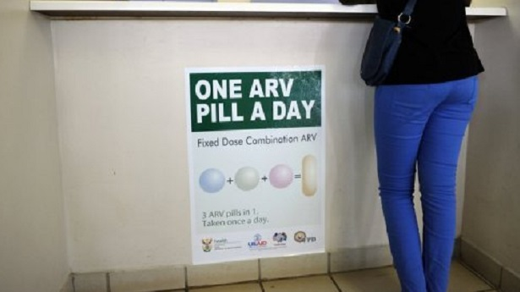
Antiretroviral Therapy
Switch and Simplification

Slide 23
STRATEGY - PI
Study Design
Multicenter, randomized, open-label, 96-week study
STRATEGY-PI
n =293
E/C/F/TDF (Stribild®)
PI + RTV + FTC/TDF
2:1
PI + RTV + FTC/TDF
HIV-1 RNA <50 c/mL for ≥6 months
≤ 2 prior ARV regimens
No resistance to FTC or TDF
eGFR_{CG} ≥70 mL/min
n =140
Week 48
Week 96
Primary endpoint: HIV-1 RNA <50 c/mL at Week 48 by Snapshot (noninferiority margin of 12%). If noninferiority is established, then superiority will be tested.
Secondary endpoint: Safety and tolerability at Week 48 & 96
Other endpoints: Patient reported outcomes*
*HIV Symptom Index, HIV Treatment Satisfaction Questionnaire, Short Form 36, Visual Analog Scale Adherence
Study GS-US-236-0115 is registered with ClinicalTrials.gov, number NCT01475838.
E/C/F/TDF: single-tablet regimen elvitegravir 150mg, cobicistat 150mg, emtricitabine 200mg, tenofovir DF 300mg; Stribild®
Notes:
CORE_Efficacy_Safety_Feb-14_SLB.ppt
3/18/14
Gilead
23

Slide 24
STRATEGY - PI
Primary Endpoint: HIV-1 RNA < 50 c/mL
95% CI for Difference
Favors
PI + RTV + FTC/TDF
Favors
E/C/F/TDF
Percentage of Subjects (%)
6.7
0.4
13.7
-12%
0
12%
Prespecified sequential testing Statistical superiority
(p = 0.025)
CD4 Cell Count (cells/mm³) | Baseline (mean) | ΔWeek 48 (mean) | P-value (Δ W48 - BL)
E/C/F/TDF | 603 | +40 | <0.001
PI + RTV + FTC/TDF | 625 | +32 | =0.025
Full analysis set excluded subjects with protocol-prohibited mutations on historical genotype and those not on PI at randomization.
Notes:
Subjects excluded from the full analysis set:
Had protocol prohibited resistance mutation(s) on historical genotypes: 3 in EVG/COBI/FTC/TDF group
Not on a RTV-boosted PI at randomization (i.e. on Atripla and randomized to remained on baseline regimen): 1 in PI+RTV+FTC/TDF group

Slide 25
STRATEGY - PI
Virologic Outcome at Week 48 (Snapshot)
 | E/C/F/TDF (n =290) ª | PI + RTV + FTC/TDF (n =139) ^{b}
Virologic Success at Week 48
HIV-1 RNA < 50 copies/mL | 272 (93.8%) | 121 (87.1%)
Virologic Failure (VF) at Week 48 | 2 (0.7%) | 2 (1.4%)
HIV-1 RNA ≥ 50 copies/mL ^{c} | 2 | 1
Discontinued study drug due to lack of efficacy | 0 | 0
Discontinued study drug due to other reasons and last available HIV-1 RNA ≥ 50 copies/mL ^{d} | 0 | 1
No Virologic Data in Week 48 Window | 16 (5.5%) | 16 (11.5%)
Discontinued study drug due to AE | 5 | 2
Discontinued study drug due to other reasons and last available HIV-1 RNA < 50 copies/mL ^{e} | 11 | 14
Missing data during window but on study drug | 0 | 0

Slide 26
STRATEGY - PI
No Treatment-Emergent Resistance
 | E/C/F/TDF (n =290) | PI + RTV + FTC/TDF (n =139)
Subjects Analyzed for Resistance*, n (%) | 0 | 0
Subjects with Data Available, n | 0 | 0
Subjects with Resistance to ARV Regimen, n (%) | 0 | 0
Any Primary Integrase-R, n | 0 | 0
Any Primary NNRTI-R or PI-R, n | 0 | 0
Any Primary NRTI-R, n | 0 | 0
No subject met the protocol defined criteria* for
treatment-emergent resistance testing with virologic rebound ≥400 c/mL
* Subjects on study drugs who experienced virologic rebound (two consecutive visits with HIV-1 RNA ≥50 c/mL and the second is ≥400 c/mL), or had HIV-1 RNA is ≥400 c/mL at Week 48 or their last visit and on study drugs.

Slide 27
STRATEGY - PI
Summary of Adverse Events
 | E/C/F/TDF (n =293) | PI + RTV + FTC/TDF (n =140)
Adverse events (AEs) | 79% | 74%
Grade 3 or 4 | 4% | 8%
Serious AEs | 6% | 6%
AEs leading to DC of study drug | 2%^{Ϯ} | 3%**
Death | 0 | <1%¥
^{Ϯ} Nausea, myalgia, headache (in 1 subject); major depression, suicide attempt (1); reduced visual acuity (1); Hodgkin’s disease (1); anxiety (1); depression (1) ** Bipolar I disorder (1); decreased eGFR (1); diarrhea (1) ** ¥ Bronchial carcinoma with liver metastases, not related to study drugs
Most adverse events were grade 1 or 2 in severity
No SAE reported by >1 subject
Adverse events leading to discontinuation were uncommon
  No cases of proximal renal tubulopathy in either treatment group
  Isolated decrease in eGFR in the PI + RTV + FTC/TDF group (1)
Safety analysis set includes subjects who were randomized and received at least one dose of study drug.
Notes:
Case: Isolated rise in SCr (i.e. 0.84 to 0.94 mg/dL, persisted over months) – associated with use of DRV+RTV + FTC/TDF. Patient was discontinued from TDF, and continued DRV + RTV + FTC. No information on SCr changes since discontinuation of TDF.

Slide 28
STRATEGY - NNRTI
Study Design
Multicenter, randomized, open-label, 96-week study
GS-US-236-0121
n =291
E/C/F/TDF (Stribild®)
NNRTI + FTC/TDF
2:1
NNRTI + FTC/TDF
HIV-1 RNA <50 c/mL for ≥6 months
≤ 2 prior ARV regimens
No resistance to FTC or TDF
CrCl ≥70 mL/min
n =143
Week 48
Week 96
Primary endpoint: HIV-1 RNA <50 c/mL at Week 48 by Snapshot (noninferiority margin of 12%). If noninferiority established, test for superiority
Secondary endpoint: Safety and tolerability at Week 48 & 96
Other endpoints: Patient reported outcomes*
*HIV Symptom Index, HIV Treatment Satisfaction Questionnaire, Short Form 36, Visual Analog Scale Adherence, State/Trait Anxiety Inventory, Center for Epidemiology Studies Depression.
Study GS-US-236-0121 is registered with ClinicalTrials.gov, number NCT01495702.
E/C/F/TDF: single-tablet regimen elvitegravir 150mg, cobicistat 150mg, emtricitabine 200mg, tenofovir DF 300mg; Stribild®
Notes:
CORE_Efficacy_Safety_Feb-14_SLB.ppt
3/18/14
Gilead
28

Slide 29
STRATEGY - NNRTI
Primary Endpoint: HIV-1 RNA < 50 c/mL
95% CI for Difference
Favors
NNRTI + FTC/TDF
Favors
E/C/F/TDF
Percentage of Subjects (%)
5.3
-0.5
12.0
-12%
0
12%
CD4 Cell Count (cells/mm³) | Baseline (mean) | ΔWeek 48 (mean) | P-value (Δ W48 - BL)
E/C/F/TDF | 586 | +56 | <0.001
NNRTI + FTC/TDF | 593 | +58 | <0.001
The full analysis set excluded subjects with prohibited mutations on historical genotype and those not on NNRTI at randomization.
Notes:
Subjects excluded from ITT analysis set:
Had protocol prohibited resistance mutation(s) on historical genotypes: 1 in E/TDF group

Slide 30
STRATEGY - NNRTI
Virologic Outcome at Week 48 (Snapshot)
 | E/C/F/TDF (n =290) ª | NNRTI + FTC/TDF (n =143)
Virologic Success at Week 48
HIV-1 RNA < 50 copies/mL | 271 (93.4%) | 126 (88.1%)
Virologic Failure (VF) at Week 48 | 3 (1.0%) | 1 (0.7%)
HIV-1 RNA ≥ 50 copies/mL ^{b} | 2 | 1
Discontinued study drug due to lack of efficacy | 0 | 0
Discontinued study drug due to other reasons and last available HIV-1 RNA ≥ 50 copies/mL ^{c} | 1 | 0
No Virologic Data in Week 48 Window | 16 (5.5%) | 16 (11.2%)
Discontinued study drug due to AE | 5 | 1
Discontinued study drug due to other reasons and last available HIV-1 RNA < 50 copies/mL ^{d} | 11 | 13
Missing data during window but on study drug | 0 | 2

Slide 31
STRATEGY - NNRTI
No Treatment-Emergent Resistance
 | E/C/F/TDF (n =290) | NNRTI + FTC/TDF (n =143)
Subjects Analyzed for Resistance*, n (%) | 1 (0.3%) | 1 (0.7%)
Subjects with Data Available, n | 1 | 1
Subjects with Resistance to ARV Regimen, n (%) | 0 | 0
Any Primary Integrase-R, n | 0 | 0
Any Primary NNRTI-R or PI-R, n | 0 | 0
Any Primary NRTI-R, n | 0 | 0
Both subjects in the resistance analysis population subsequently achieved HIV-1 RNA <50 copies/mL while on study drugs
* Subjects on study drugs who experienced virologic rebound (two consecutive visits with HIV-1 RNA ≥50 c/mL and the second is ≥400 c/mL), or had HIV-1 RNA is ≥400 c/mL at Week 48 or their last visit and on study drugs.

Slide 32
STRATEGY - NNRTI
Summary of Adverse Events
 | E/C/F/TDF (n =291) | NNRTI + FTC/TDF (n =143)
Adverse events (AEs) | 81% | 75%
Grade 3 or 4 | 7% | 6%
Serious AEs | 5% | 4%
AEs leading to DC of study drug | 2%^{Ϯ} | 1%**
Death | 0.3%¥ | 0
^{Ϯ} Dysgeusia (1); increased serum creatinine without hypophosphatemia, glycosuria, or proteinuria, associated with CHF post myocardial infarction and cocaine use (1); suicide (1); prurigo (1); acquired Fanconi syndrome (1); arthralgia, coccydynia, paraesthesia, muscle atrophy, hypoaesthesia (in 1 subject) ** Altered mood (1) ¥ Suicide
Most adverse events were grade 1 or 2 in severity
No SAE reported by >1 subject in E/C/F/TDF group
Adverse events leading to discontinuation were uncommon
  Proximal renal tubulopathy (PRT) in E/C/F/TDF group (1)
    Subject with features of PRT at baseline; resolved with study drug discontinuation
  Isolated increase in SCr in E/C/F/TDF group (1)
Safety analysis set includes subjects who were randomized and received at least one dose of study drug.
Notes:
SAE in >1 subject in NNRTI group only:
2 subject each with with MI and appendicitis in NNRTI + FTC/TDF group

Slide 33
STRATEGY – NNRTI: Efavirenz Subgroup
Patient Reported Outcomes
HIV Symptom Index
100
Vivid Dreams
Insomnia
Anxiety
Dizziness
Baseline
Week 48
E/C/FTDF
E/C/FTDF
NNRTI + FTC/TDF
NNRTI + FTC/TDF
*
**
*
% of Subject Reporting Symptoms
**
136
224
75
212
65
101
56
87
119
224
84
209
48
100
41
87
103
222
71
208
40
100
34
87
90
225
49
211
37
99
32
87
BL
W48
BL
W48
BL
W48
BL
W48
BL
W48
BL
W48
BL
W48
BL
W48
Subjects who switched to E/C/F/TDF from EFV + FTC/TDF had
  Lower rates of neuropsychiatric symptoms at Week 48 compared to baseline
  Higher treatment satisfaction scores at Week 24 (mean: 21 vs. 14, p <0.001)^
* P <0.01 & **P <0.001 (comparison with baseline within treatment group). Decreases noted at week 4 & sustained through week 48.
P <0.001, vivid dreams & P <0.01, dizziness (comparison of changes from baseline at week 48 between treatment group).
^ HIV Treatment Satisfaction questionnaire, score range: -30 to 30

Slide 34
LATTE: Study Design
Phase IIb, randomized, multicenter, partially blind, dose-ranging study comparing S/GSK744 (integrase inhibitor) to EFV –
Simplification to Integrase/NNRTI combination 744 plus RPV
Oral Induction Phase
Oral Maintenance Phase**
744 10 mg + 2 NRTIs*
744 10 mg + RPV 25 mg
HIV ART-naive
HIV RNA >1,000 c/mL
1:1:1:1 Randomization
Stratified by
VL and NRTI
744 30 mg + 2 NRTIs*
744 30 mg + RPV 25 mg
744 60 mg + 2 NRTIs*
744 60 mg + RPV 25 mg
EFV 600 mg + 2 NRTIs*
16
20
24
48
72
96
D1
Week
*ABC/3TC or TDF/FTC
**Patients on 744 + NRTI: If week 20 VL <50 c/mL - simplify to 744/RPV at week 24
Margolis D, et al. 14th EACS; Brussels, Belgium; October 16-19, 2013. Abst. PS7/1.

Slide 35
LATTE Study:
Treatment Outcomes – Maintenance Population
HIV-1 RNA <50 c/mL by Snapshot (ITT-ME)
Outcome at Week 48 | 744 10 mg n=52 | 744 30 mg n=53 | 744 60 mg n=55 | 744 total n=160 | EFV 600 mg n=47
Virologic success | 48 (92%) | 48 (91%) | 53 (96%) | 149 (93%) | 44 (94%)
Virologic failure | 3 (6%) | 5 (9%) | 1 (2%) | 9 (6%) | 2 (4%)
Data in window not <50 c/mL | 3 (6%) | 3 (6%) | 1 (2%) | 7 (4%) | 1 (2%)
Discontinued for lack of efficacy | 0 | 0 | 0 | 0 | 1 (2%)
Change in ART | 0 | 2 (4%) | 0 | 2 (1%) | 0
No virologic data at Week 48 | 1 (2%) | 0 | 1 (2%) | 2 (1%) | 1 (2%)
Discontinued due to AE | 1 (2%) | 0 | 1 (2%) | 2 (1%) | 1 (2%)
Similar response rate for 744 + RPV vs. continuing EFV + NRTIs
Similar response across 744 doses
Margolis D, et al. 21st CROI; Boston, MA; March 3-6, 2014. Abst. 91LB.

Slide 36
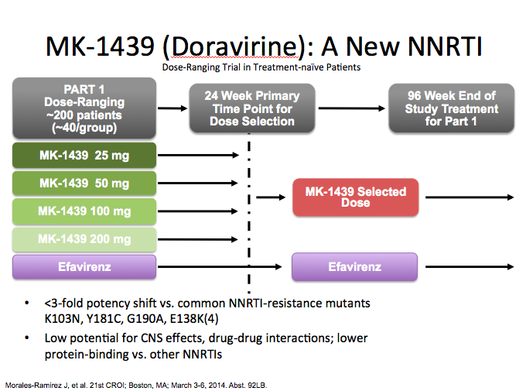


Slide 37
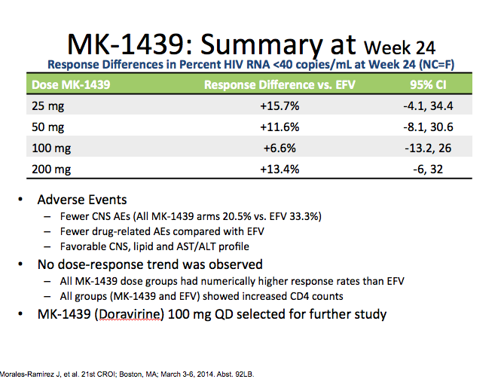

Slide 38
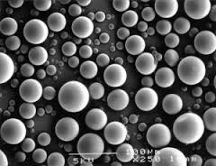
ART Toxicity, End-Organ Health, Aging

Slide 39
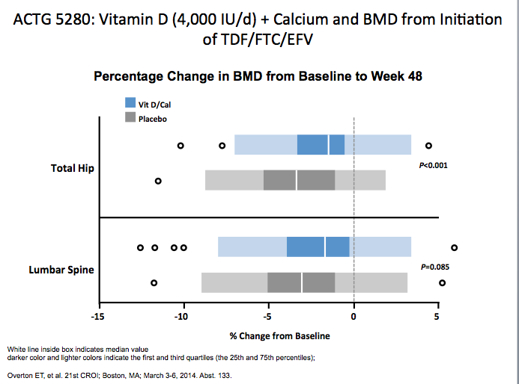


Slide 40
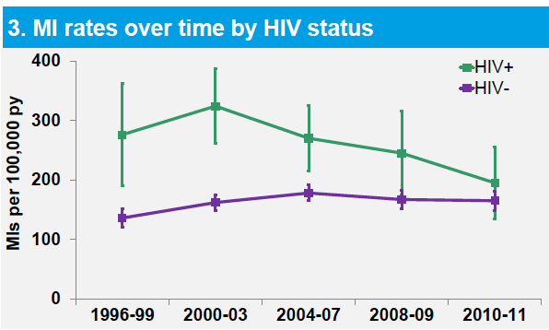
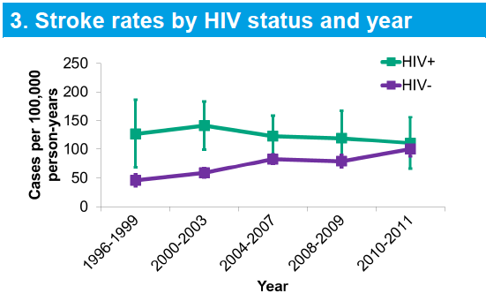
Declining rates of MI and CVA in Kaiser Permanente cohort (CA).
The reduced MI incidence rates for HIV+ in recent years is likely a result of a combination of factors such as CVD risk factor reduction, use of more lipid-friendly ART, and reduced immunodeficiency
HIV+ with recent CD4 ≥500 or recent HIV RNA <500 are not at significantly greater risk compared with HIV- individuals after adjustment for stroke risk factors, but lower recent CD4 and higher recent HIV RNA are associated with increased risk
Klein D, et al Abst 737, 741CROI 2014

Slide 41

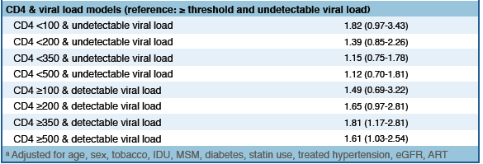
CNICS is a diverse 8-site observational HIV cohort with comprehensive clinical data on >29,000 patients, including data on traditional CVD risk factors and definitive adjudicated outcomes including MIs. Among 17,626 eligible participants, we found 128 primary and 144 secondary confirmed incident MIs.
Low CD4 count independently predicts primary MIs and shows a trend towards being a stronger predictor at lower CD4 counts.
Detectable viral load is associated with risk of primary MIs at CD4 >350 and >500 suggesting that viremia and ART may differentially impact primary MI risk at higher CD4 counts. !

Slide 42
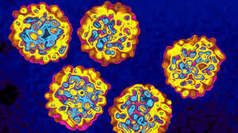
HCV Treatment
Implications for the co-infected

Slide 43
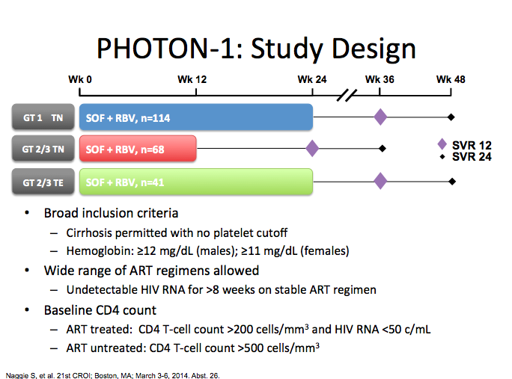

Slide 44
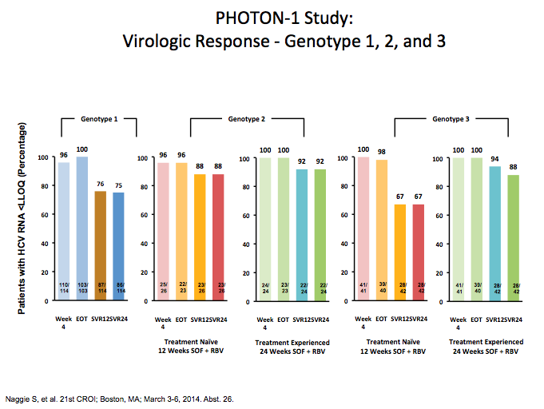

Slide 45
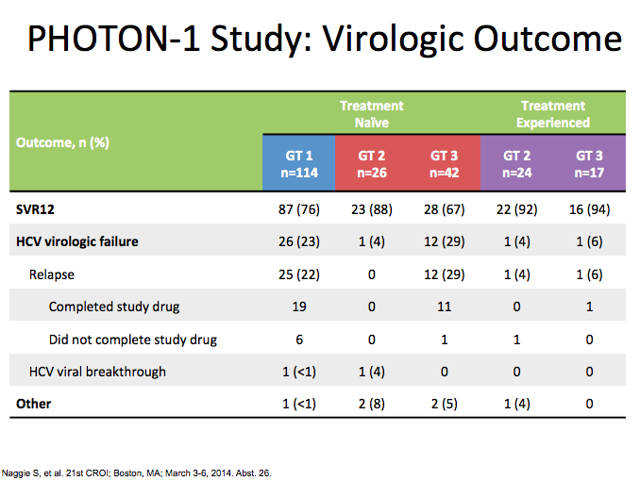

Slide 46
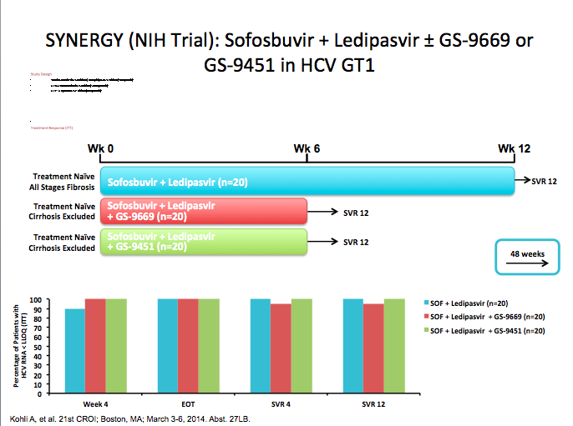

Slide 47

Cure

Slide 48
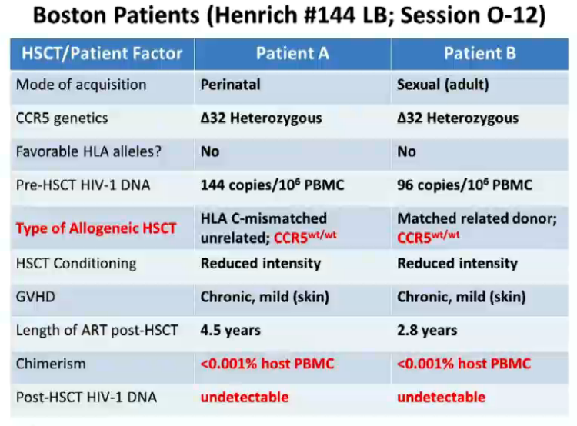

Slide 49
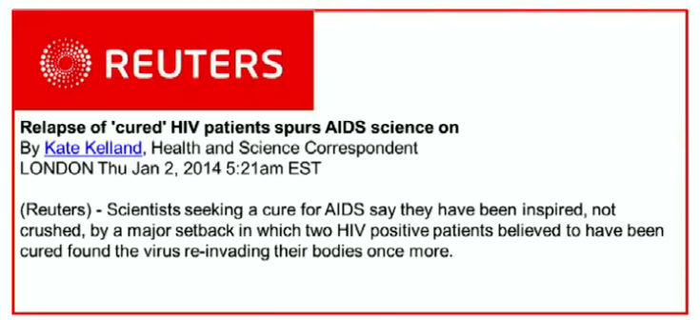

Slide 50
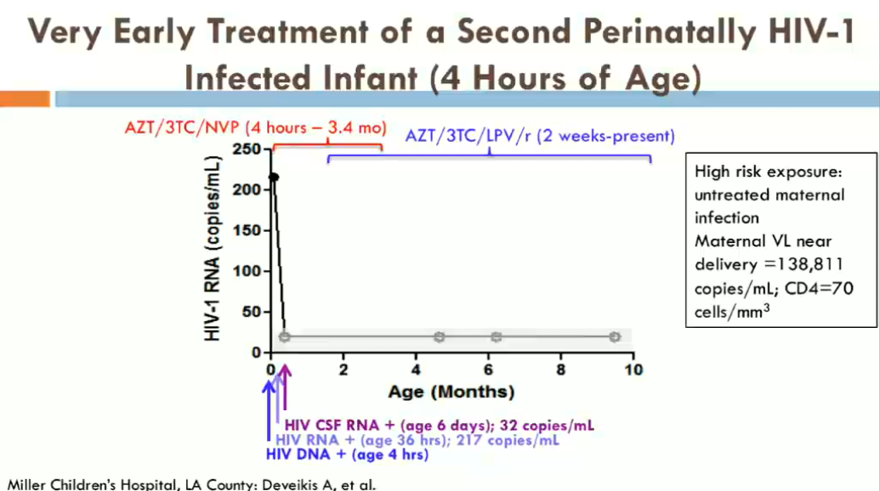

Slide 51
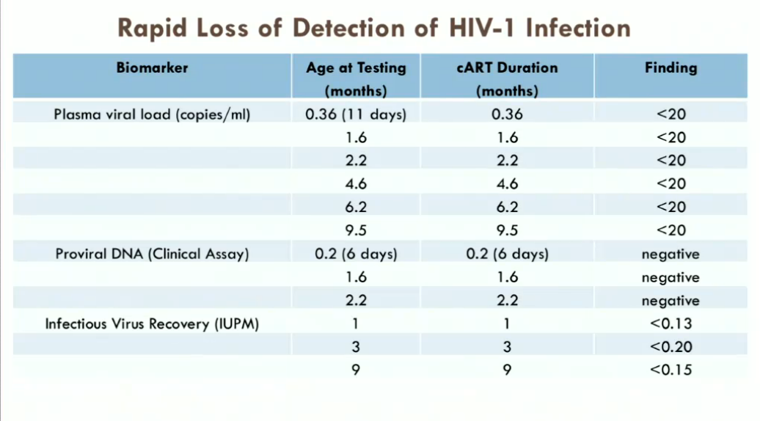

Slide 52

Questions/Comments

Slide 53


Slide 54
Visit us at www.med.unc.edu/ncaidstraining
This presentation was made possible by AETC grant award # H4AHA00067 from the HIV/AIDS Bureau of the Health Resources Services Administration (HRSA), U.S. Department of Health and Human Services (HHS). NCATEC operates an AIDS Education and Training Center (AETC) that strengthens the capacity of health care professionals to care for people living with HIV/AIDS through training and technical assistance. The information presented here is the consensus of HIV/AIDS specialists in NCATEC and does not necessarily represent the official views of HRSA/HAB.

