Slide 1
Women & HIV Risk Perception
Kimberly Smith MD, MPH
Associate Professor of Medicine
Division of Infectious Diseases
Rush University Medical Center
Chicago, IL

Slide 2
HIV Risk Perception in Women
HIV Disease Statistics for Women
Drivers of High Rates in Black Women
Data of Perception of Risk in Women
Does Risk Perception Affect Behavior?
Enhancing Prevention

Slide 3
Notes:
From 2008 though 2011, among females aged 13 years and older, black/African American females accounted for the largest estimated numbers of diagnoses of HIV infection each year in the United states and 6 dependent areas, although the number decreased from 7,973 in 2008 to 6,602 in 2011. White and Hispanic/Latino females had similar numbers of diagnoses of HIV infection each year, and in 2011, white and Hispanic/Latino females had the same estimated numbers of HIV diagnoses (1,776). In 2011, 153 diagnoses were in Asian females, 144 were in females of multiple races, 51 diagnoses were in American Indian/Alaska Native females and 10 diagnoses were in Native Hawaiian/other Pacific Islander females.
Data include persons with a diagnosis of HIV infection regardless of stage of disease at diagnosis. All displayed data are estimates. Estimated numbers resulted from statistical adjustment that accounted for reporting delays, but not for incomplete reporting.
Hispanics/Latinos can be of any race.

Slide 4
Notes:
This slide shows the estimated numbers and rates of diagnoses of HIV infection among female adults and adolescents in the United States.
In 2011, the estimated rate (per 100,000 population) of diagnoses of HIV infection among black/African American females (40.0) was 20 times as high as the rate for white females (2.0) and approximately 5 times as high as the rate for Hispanic/Latino females (7.9).
Relatively few diagnoses of HIV infection were among Asian, American Indian/Alaska Native and Native Hawaiian/other Pacific Islander females, and females of multiple races; however, the rates for these populations were all higher than the rate for white females.
Data include persons with a diagnosis of HIV infection regardless of stage of disease at diagnosis. All displayed data are estimates. Estimated numbers resulted from statistical adjustment that accounted for reporting delays, but not for incomplete reporting.
Hispanics/Latinos can be of any race.

Slide 5
Notes:
This slide presents the estimated rates (per 100,000 population) of diagnoses of HIV infection in 2011 among adult and adolescent black/African American, Hispanic/Latino and white females by region of residence in the United States. Most diagnoses of HIV infection among adult and adolescent females were among those who resided in the Northeast and the South.
The highest rates of diagnoses of HIV infection were among black/African American females in the Northeast (51.6) and in the South (43.1).
The highest rate of diagnoses of HIV infection among Hispanic/Latino females was in the Northeast (20.4).
Data are not shown for Asian, American Indian/Alaska Native and Native Hawaiian/other Pacific Islander females or females of multiple races because the estimated numbers when stratified by region of residence are small.
Regions of residence are defined as follows:
Northeast—Connecticut, Maine, Massachusetts, New Hampshire, New Jersey, New York, Pennsylvania, Rhode Island, Vermont Midwest—Illinois, Indiana, Iowa, Kansas, Michigan, Minnesota, Missouri, Nebraska, North Dakota, Ohio, South Dakota, Wisconsin South—Alabama, Arkansas, Delaware, District of Columbia, Florida, Georgia, Kentucky, Louisiana, Maryland, Mississippi, North Carolina, Oklahoma, South Carolina, Tennessee, Texas, Virginia, West Virginia West—Alaska, Arizona, California, Colorado, Hawaii, Idaho, Montana, Nevada, New Mexico, Oregon, Utah, Washington, Wyoming
All displayed data are estimates. Estimated numbers resulted from statistical adjustment that accounted for reporting delays, but not for incomplete reporting.
Hispanics/Latinos can be of any race.

Slide 6
Notes:
The pie chart on the left illustrates the percentage distribution of diagnoses of HIV infection among adult and adolescent females in 2011 by race/ethnicity in the United states. The pie chart on the right shows the distribution of the female population of the United States in 2011.
In 2011, black/African American females made up 12% of the female population in the United States but accounted for an estimated 64% of diagnoses of HIV infection among females. Hispanic/Latino females made up 15% of the female population in the United States but accounted for 15% of diagnoses of HIV infection among females. White females made up 66% of the female adult and adolescent population in the United States but accounted for 17% of diagnoses of HIV infection among females.
Asian females accounted for approximately 2% of diagnoses of HIV infection among females. American Indians/Alaska Natives and females of multiple races each accounted for approximately 1%, and Native Hawaiians/other Pacific Islanders accounted for less than 1% of diagnoses of HIV infection.
Data include persons with a diagnosis of HIV infection regardless of stage of disease at diagnosis. All displayed data are estimates. Estimated numbers resulted from statistical adjustment that accounted for reporting delays, but not for incomplete reporting.
Hispanics/Latinos can be of any race.

Slide 7
Notes:
This slide shows the percentage distribution of diagnoses of HIV infection among adult and adolescent black/African American, Hispanic/Latino, and white females by transmission category in the United States and 6 dependent areas. Blacks/African Americans had the highest percentage of diagnosed HIV infections attributed to heterosexual contact among the three groups (89%), followed by Hispanics/Latinos (86%) and whites (75%). The percentage of diagnosed HIV infections attributed to injection drug use was highest among white females (25%) followed by Hispanic/Latino (14%) and black/African American (11%) females. Less than 1% of diagnoses were attributed to other causes among each racial/ethnic group.
Data include persons with a diagnosis of HIV infection regardless of stage of disease at diagnosis. All displayed data are estimates. Estimated numbers resulted from statistical adjustment that accounted for reporting delays and missing transmission category, but not for incomplete reporting.
Hispanics/Latinos can be of any race.
Heterosexual contact is with a person known to have, or to be at high risk for, HIV infection.
Other transmission categories include blood transfusion, perinatal exposure, and risk factor not reported or not identified.

Slide 8
ISIS/HPTN 064: High HIV Incidence Among At-Risk Women in US
2099 women recruited from US communities with high HIV prevalence^{[1]}
88% black, 12% Hispanic, 8% white
1.5% of women newly diagnosed with HIV at baseline
Events Analyzed | Number of Women Analyzed | Number of Events | Window Period | Annual Incidence Estimates, % | 95% CI, %
Acute infection at enrollment | 2064 | 2 | 2 weeks | 2.52 | 0.60-10.7
Seroconversion | 1951 | 4 | -- | 0.24 | 0.09-0.65
Annual HIV incidence 5x higher than CDC’s 0.05% estimate for black women^{[2]}
Comparable to adult incidence rates in Sub-Saharan Africa (0.28% for Congo and 0.53% for Kenya)^{[3]}
1. Hodder S, et al. CROI 2012. Abstract 1048. 2. Prejean J, et al. PLoS Once. 2011;6:e17502. 3. UNAIDS Report on the Global AIDS Epidemic; 2010.

Slide 9
What Are the Drivers of High HIV/AIDS Rates in US Blacks?
Sexual
Networks/
Concurrent
Partnerships
Behavioral
High risk environment +/- high risk behavior
Low perception of risk
Concurrent Partnerships
Disassortative sorting
Mixing of high risk and low risk individuals
Substance use
Crack, IVDU, alcohol
Mental Illness
Environmental
Poverty
Poor access to care
Low Health Literacy
Incarceration
High STI prevalence
High STI
prevalence
Incarceration
HIV
Epidemic
in
US Blacks
Substance
Use
Poverty
Notes:
174/200 (87%) were categorized into the HR group. Of these, 137 (79%) perceived themselves as LR or no risk

Slide 10
Why Black Women?
Physical/Emotional Vulnerability
Biological vulnerability
Violence against women
Low Self Esteem/Dependence on men
Poverty
Dependence on men financially
Sex as commodity
Concurrency
5-yr prevalence: Black = 21%, general population = 12%
Black women’s marriage rates ~ 50% those of other racial/ethnic groups
Concurrency correlates: marital status, age, age at first sex, partner incarceration
Pregnancy Desires/Benefits
Mental Illness
Substance Use
Lack of access
Information/Education gap
Health Care access gap
A tragic story of the life experience of a poor young black woman, intertwined with a not too subtle message of low health literacy, misconceptions of HIV risk and competing priorities that contribute to excess HIV disease and excess mortality…
“they tell me I have HIV and I could die, but I can’t worry about that, I gotta take care of these kids”
Hessol et al. CID 2007:44:287-94; ¹Adimora AA, Schoenbach VJ. Epidemiology. 2002;13:320–327.
²Adimora AA, Schoenbach VJ. Am J Public Health. 2007;97:2230–2237

Slide 11
High Risk Environment +/- High Risk Behavior
Black youth with low risk behavior 25x more likely than whites to acquire STD
Low risk defined as having few partners, low alcohol, tobacco or other drug use
Heterosexually Acquired HIV: African Americans in North Carolina
In a case control (HIV+/HIV-) study of AA women, 27% of cases had no “high risk behavior”
Independent risk factors for HIV among lower risk cases:
Less than HS education (OR 5.2; 95% CI: 2.2, 11.1)
Food insecurity (OR 3.7; 95% CI: 1.5, 8.9)
Non–monogamous sex partner (OR 2.9; 95% CI: 1.3, 6.4)
CDC-Funded National HIV Behavioral Surveillance (DC HIV Epidemic among heterosexuals)
750 persons surveyed- 93% African-American, 60% annual income <10K
5.2% HIV+ (6.3% W,3.9% M)
> 50% h/o incarceration (M>W)
46% women had one sexual partner in past yr
Condom use higher among Blacks and Hispanic than other groups
Hallfors DD, et al. Am J Public Health. 2007;97(1):125-132.;Adimora AA, Schoenbach VJ, et al. JAIDS. 2006;41:616–623. Magnus et al. JAIDS 2009 Reese, M et al. The Journal of Sexual Medicine. Volume 7, Issue Supplement s5, pages 266–276, October 2010

Slide 12
HIV Infection Among Heterosexuals at Increased Risk — United States, 2010
National HIV Behavioral Surveillance System (NHBS) monitors HIV prevalence and HIV-associated behaviors among populations at high risk for acquiring HIV in 21 metropolitan statistical areas with high prevalence of AIDS.
Among the 8,473 participants, 197 (2.3%)* tested positive for HIV infection, and prevalence was similar for men (2.2%) and women (2.5%)
HIV prevalence was 2.8% among blacks and 1.2% among Hispanics or Latinos.
Less than a high school education (3.1%) vs. high school education (1.8%)
annual household income <$10,000 (2.8%) vs. >$20,000 or more (1.2%)
Higher for those reporting using crack cocaine in the past 12 months (6.3%) vs. not reporting crack cocaine use (1.8%)
Highest among those living in the Northeast (4.1%) and South (3.9%) regions of the United States.
*vs. 2.0% in 2006-7
MMWR March March 15, 2013 / 62(10);183-188

Slide 13
High Risk Environment +/- High Risk Behavior
Black MSM less likely that whites to engage in high risk behavior
Meta-analysis, compared to white MSM, black MSM had
Lower no. partners
Similar rates of UAI
Higher rates of STIs
Washing ton DC Study, compared to white MSM, black MSM
Higher HIV prevalence
fewer male sex partners
fewer had ever engaged in intentional unprotected anal sex,
more used condoms at last anal sex.
less likely to have health insurance, have been tested for HIV, and disclose MSM status to health care providers..
Baltimore (BESURE Study)
MSM HIV prevalence in 2008: Overall 37.5%; Black MSM 44.7 (2.5 fold higher than white MSM)
Prevalence of unrecognized HIV infection among Black MSM: 76.9%
High prevalence of HIV within BMSM community leaves no room for error
Millet et al. AIDS 2007, 21: 2083-2091, Magnus et. al, AIDS Patient Care STDS. 2010 Oct;24(10):615-22; German et al, JAIDS May 2011 Vol 57, No. 1

Slide 14
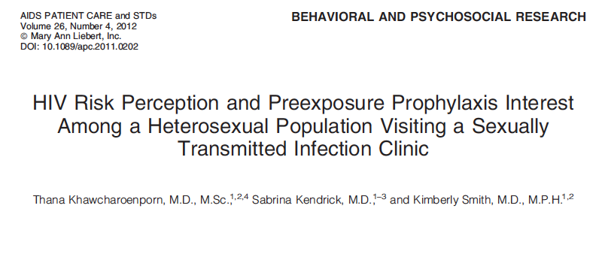
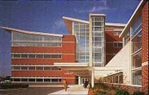
An anonymous survey was conducted at in STI clinic in August 2010.
503 participants
9 were excluded due to known HIV positive status
Sexual orientation
Heterosexual 88%
Homosexual 6%
Bisexual 6%
Risk categories
High 83%
Moderate 10%
Low 7%

Slide 15
Median age 30 years (range 23-68 years)
234 males (65%); 125 females (35%)
Employment rate 36%
Monthly household income (figure)

Slide 16
Sexual history of the study participants
Sexual history | All (N=359) | Male (N=234) | Female (N=125) | P value
Having vaginal sex | 333 (93%) | 211 (90%) | 122 (98%) | 0.009
Having oral sex | 284 (79%) | 195 (83%) | 89 (70%) | 0.007
Having anal sex | 74 (21%) | 48 (21%) | 26 (21%) | 0.95
Number of different sexual partners (median)-within last 30 days | 2 | 2 | 1 | 0.04
Number of new sexual partner (median)-within last 30 days | 1 | 1 | 0 | 0.03
Inconsistent condom use for vaginal sex | 283/333 (85%) | 176/211 (83%) | 117/122 (96%) | 0.005
Inconsistent condom use for oral sex | 264/284 (93%) | 184/195 (94%) | 80/89 (90%) | 0.36
Inconsistently condom use for anal sex | 62/74 (84%) | 39/48 (81%) | 23/26 (89%) | 0.73

Slide 17
Sexual risk behaviors of the study participants
Sexual risk behaviors | All (N=359) | Male (N=234) | Female (N=125) | P value
Exchanging sex for money or drugs | 33 (9%) | 14 (6%) | 19 (15%) | 0.004
Drinking alcohol with sex at least a half of the time | 90/237 (38%) | 63/158 (40%) | 27/79 (34%) | 0.20
Using drugs with sex at least a half of the time | 55/121 (46%) | 36/86 (42%) | 19/35 (54%) | 0.55
Ever injected drugs with needles | 16 (5%) | 12 (5%) | 4 (3%) | 0.59
Ever shared needles for injecting drugs | 8 (2%) | 6 (2%) | 2 (2%) | 0.72
Ever been in a jail or a prison | 158 (44%) | 129 (55%) | 29 (23%) | <0.001
Having STIs within the past year | 133 (37%) | 82 (35%) | 51 (41%) | 0.16

Slide 18
Environmental risks of the study participants
Environmental risks | All (N=359) | Male (N=234) | Female (N=125) | P value
Having a sexual partner who exchanged sex for money or drugs | 7 (2%) | 6 (3%) | 1 (1%) | 0.18
Having a sexual partner who used drugs | 51 (14%) | 34 (15%) | 17 (13%) | 0.81
Having a sexual partner who had been in a jail or a prison | 72 (20%) | 22 (9%) | 50 (40%) | <0.001
Having a sexual partner who had STIs within the past year | 97 (27%) | 60 (26%) | 37 (30%) | 0.46
STIs = sexually-transmitted infections

Slide 19
HIV risk perception among the high-risk participants
P = 0.25

Slide 20
Acceptance of PrEP among 359 high-risk heterosexual participants
Would you take a pill for PrEP?
p = 0.04

Slide 21
Acceptance of PrEP among 359 high-risk heterosexual participants
What options are preferred for taking PrEP?
All comparisons with p value > 0.05

Slide 22
Acceptance of PrEP among 359 high-risk heterosexual participants
Reasons for not taking a pill for PrEP

Slide 23
Univariate analysis for factors associated with no interest in PrEP
Characteristics | Interest in PrEP |  | p
 | No (N = 30) | Yes or uncertain (N = 329)
Age (years, median, IQR) | 29 (25-34) | 30 (26-39) | 0.30
Male sex (%) | 23 (77) | 211 (64) | 0.17
Black ethnicity (%) | 23 (77) | 247 (75) | 0.85
Some high school education or less (%) | 11 (37) | 56 (17) | 0.01
Psychedelics use within 30 days (%) | 2 (7) | 7 (2) | 0.16
History of STIs in the past year (%) | 7 (23) | 126 (38) | 0.10

Slide 24
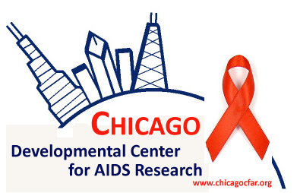
Does HIV Risk Perception Affect Condom Use and Pre-exposure Prophylaxis (PrEP) Interest? An Examination of Sexually Transmitted Infection Clinic Attendees and Black Gay Pride Event Participants Thana Khawcharoenporn, MD^{1,2}, Sabrina Kendrick, MD^{1,2,3}, Kimberly Smith, MD^{1,2} ¹Rush University Medical Center, Chicago, IL, USA, ²The Ruth M. Rothstein CORE Center, ³Stroger Hospital of Cook County, Chicago, IL, USA

Slide 25
Demographic characteristics of all participants

Slide 26
Does HIV Risk Perception Affect Condom Use and Pre-exposure Prophylaxis (PrEP) Interest? An Examination of Sexually Transmitted Infection Clinic Attendees and Black Gay Pride Event Participants

Slide 27
Does HIV Risk Perception Affect Condom Use and Pre-exposure Prophylaxis (PrEP) Interest? An Examination of Sexually Transmitted Infection Clinic Attendees and Black Gay Pride Event Participants

Slide 28
Does HIV Risk Perception Affect Condom Use and Pre-exposure Prophylaxis (PrEP) Interest? An Examination of Sexually Transmitted Infection Clinic Attendees and Black Gay Pride Event Participants

Slide 29
PrEP interest among the high-risk participants
P <0.001

Slide 30
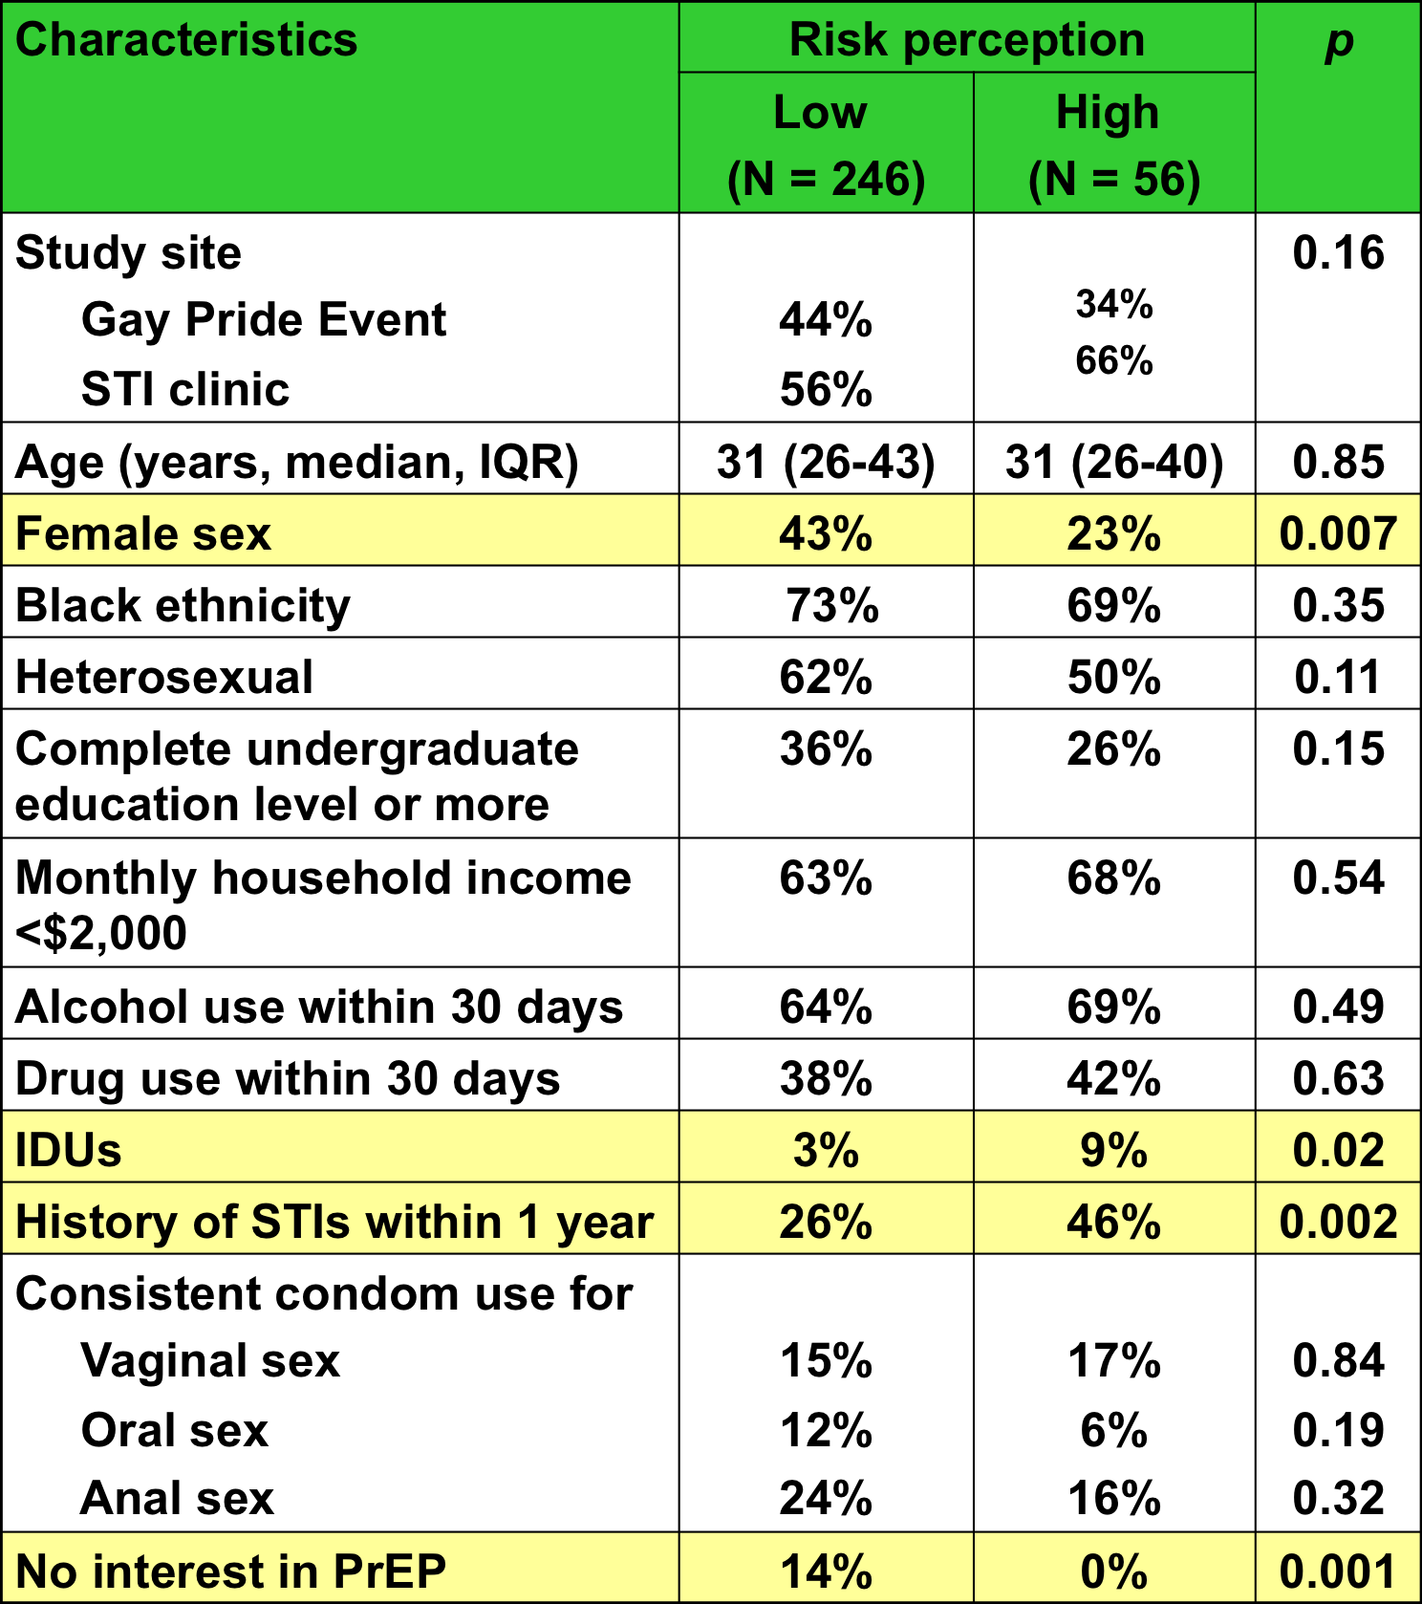
Univariate analysis of factors associated with low risk perception

Slide 31
Multivariate analysis of factors associated with low risk perception

Slide 32
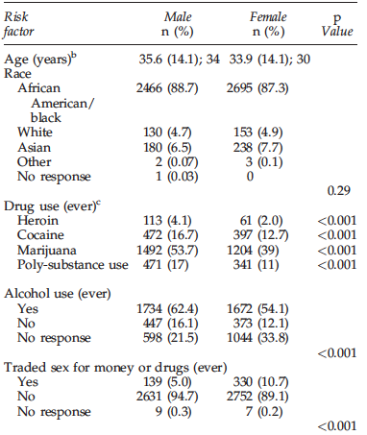
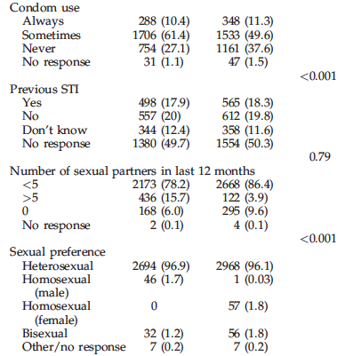

Slide 33
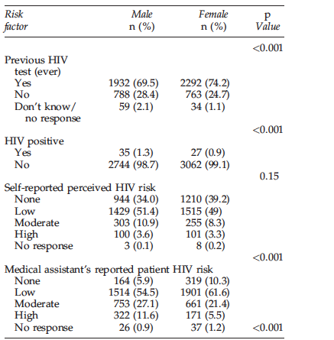

Slide 34
Does Risk Perception Affect Behavior?

Slide 35
Partners PrEP: TDF and TDF/FTC Significantly Reduce HIV Acquisition
4747 HIV-negative partners in HIV-serodiscordant heterosexual couples randomized to receive oral TDF, oral TDF/FTC, or placebo
Both PrEP strategies associated with significant reduction in HIV transmission vs placebo in both men and women^{[1]}
TDF efficacy: 71% in women, 63% in men
TDF/FTC efficacy: 66% in women, 84% in men
In contrast to FEMPrEP, adherence levels high
Estimated that 97% of pills were taken based on monthly pill counts^{[1]}
TDF detected in plasma at higher rates in uninfected pts vs those who seroconverted, according to case cohort study^{[2]}
Infected pts with detectable TDF in TDF and TDF/FTC arms: 31% and 25%
Uninfected pts with detectable TDF in TDF and TDF/FTC arms: 83% and 81%
1. Baeten J, et al. CROI 2012. Abstract 29. 2. Donnell D, et al. CROI 2012. Abstract 30.

Slide 36
VOICE – Vaginal and Oral Interventions to Control the Epidemic- MTN 003
Marrazzo et al. CROI 2013

Slide 37
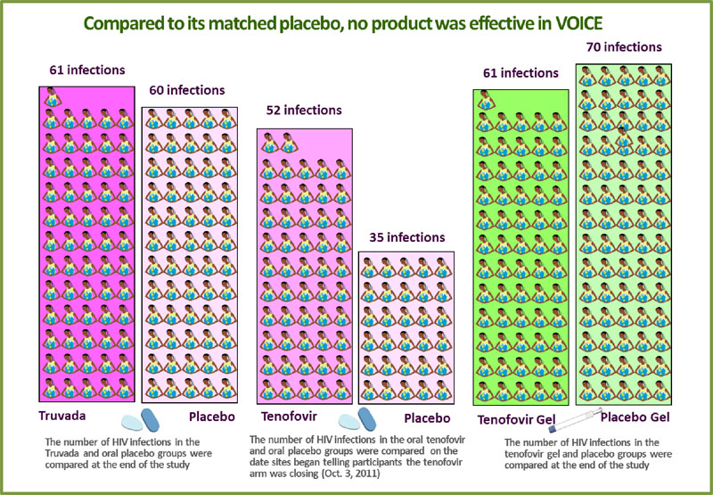
Adherence was low across all groups, drug was detected in 29 percent of the blood samples from women in the Truvada group, 28 percent of the blood samples of those in the oral tenofovir group and 23 percent among those in the tenofovir gel group. Patient reported adherence ~90% Marrazzo et al. CROI 2013

Slide 38
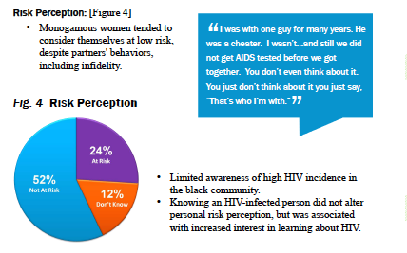
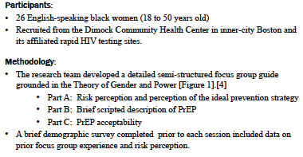
C.A.Flash, et al. Acceptability of oral or vaginal HIV pre-exposure prophylaxis among at-risk black women in the United States. : 19th International AIDS Conference: Abstract no. LBPE41

Slide 39
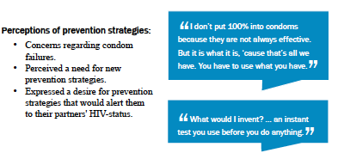
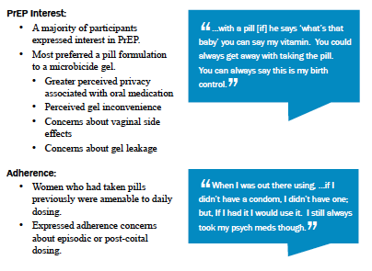
C.A.Flash, et al. Acceptability of oral or vaginal HIV pre-exposure prophylaxis among at-risk black women in the United States. : 19th International AIDS Conference: Abstract no. LBPE41

Slide 40
Enhancing Prevention
Increased HIV Awareness/decreased denial
Media
Testing
Decrease HIV related stigma
Challenge “high risk” determination
“Like me”- real life stories of HIV+ women
Encourage group solidarity
Empowerment
Enhanced Self Esteem –”Greater than AIDS” “#Empowered”
Women controlled prevention methods
Treatment as Prevention
PREP- coital linkage may improve acceptability, adherence
Link HIV Prevention and Birth Control
Combination vaginal ring, diaphragm, ect

