Slide 1

Boone
June 2019
HIV Treatment in 30 minutes (or less)
David Alain Wohl, MD
Professor of Medicine
Division of Infectious Diseases
University of North Carolina at Chapel Hill
Site Leader
Global Prevention & Treatment Clinical Research Unit
UNC Institute of Global Health and Infectious Diseases
Notes:
40 mins

Slide 2
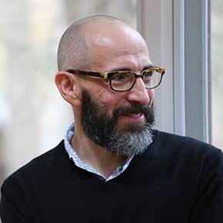
David Alain Wohl, MD
Professor of Medicine
Site Leader, The Global HIV Prevention and Treatment Research Site
Co-Director, North Carolina AIDS Training & Education Center
Co-Director, Viral Hemorrhagic Fever Clinical Research Group
Institute for Global Health & Infectious Diseases
The University of North Carolina (UNC) at Chapel Hill
School of Medicine
Dr. Wohl serves as UNC site PI for studies funded by Gilead Sciences, Merck, and ViiV. Additional research funding is received from the NIH.
He participates in advisory boards for Gilead, Merck, Janssen, and ViiV.

Slide 3
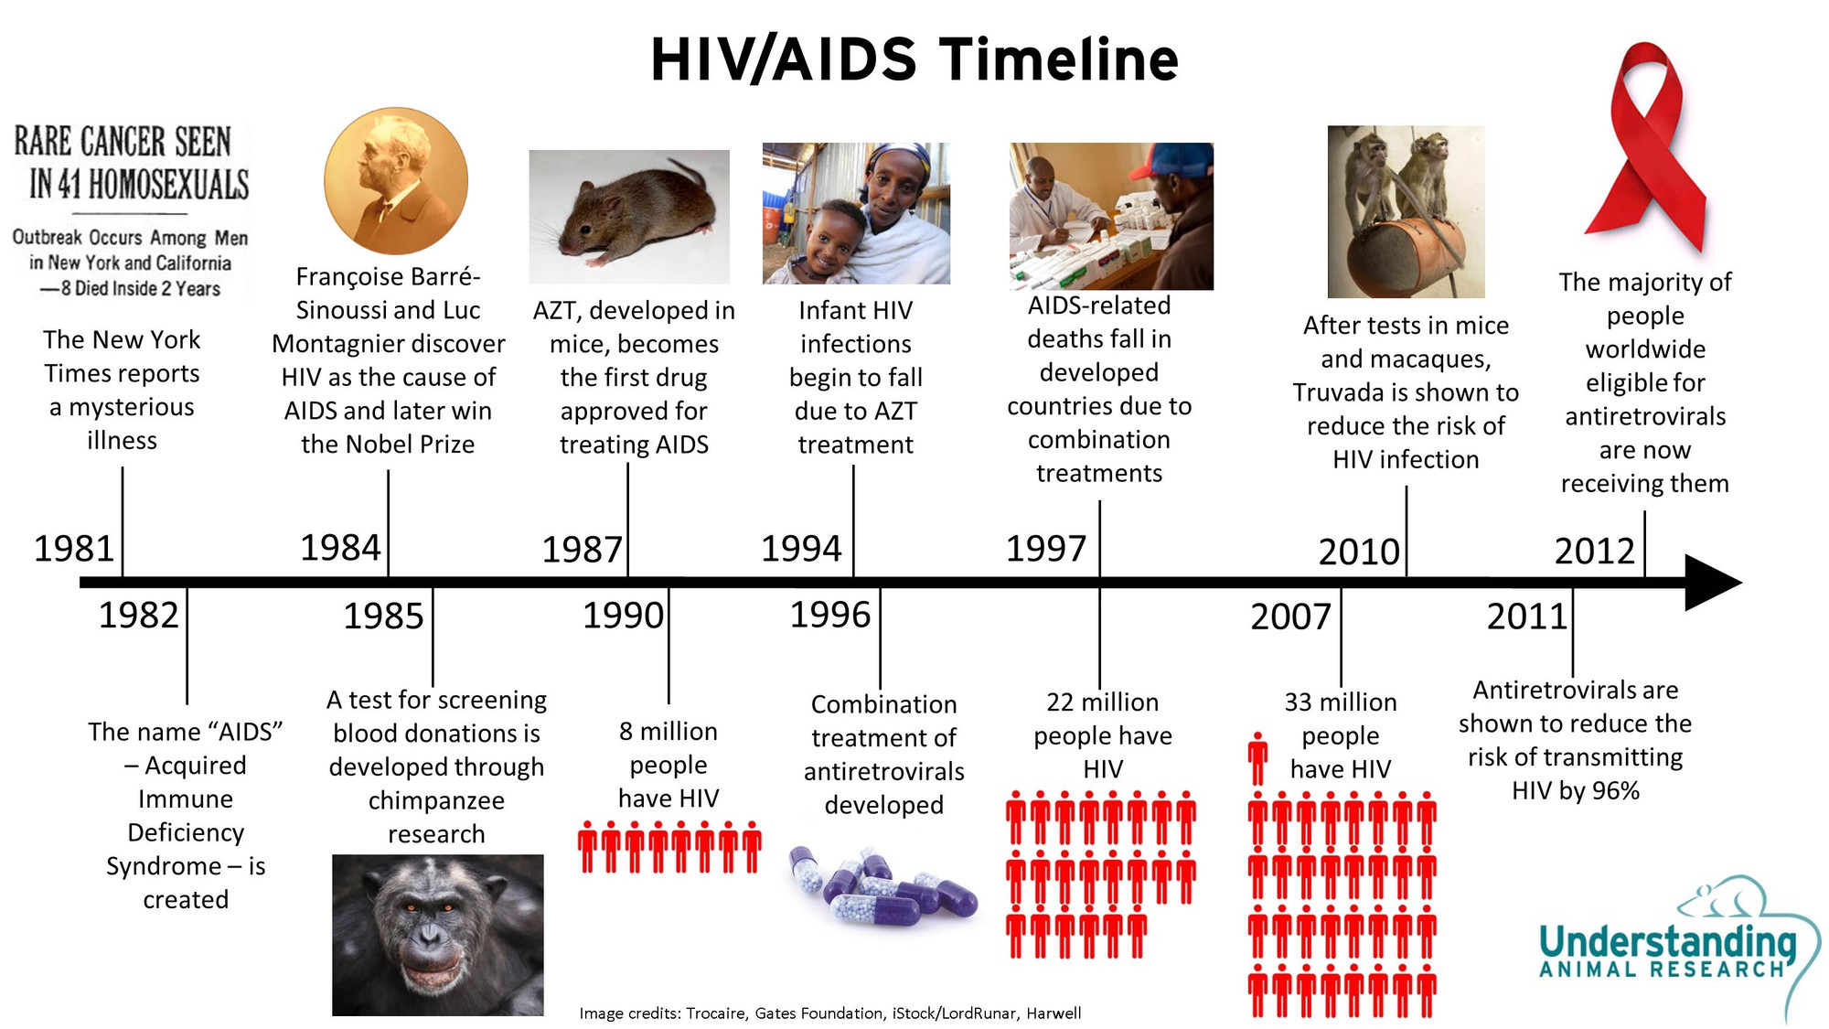
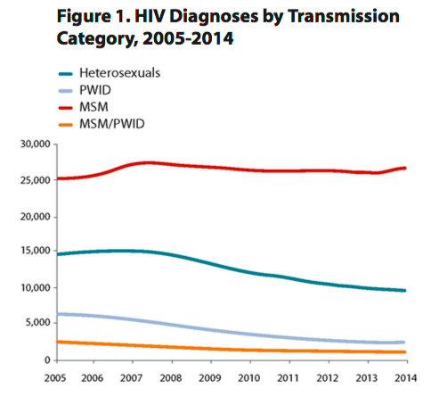
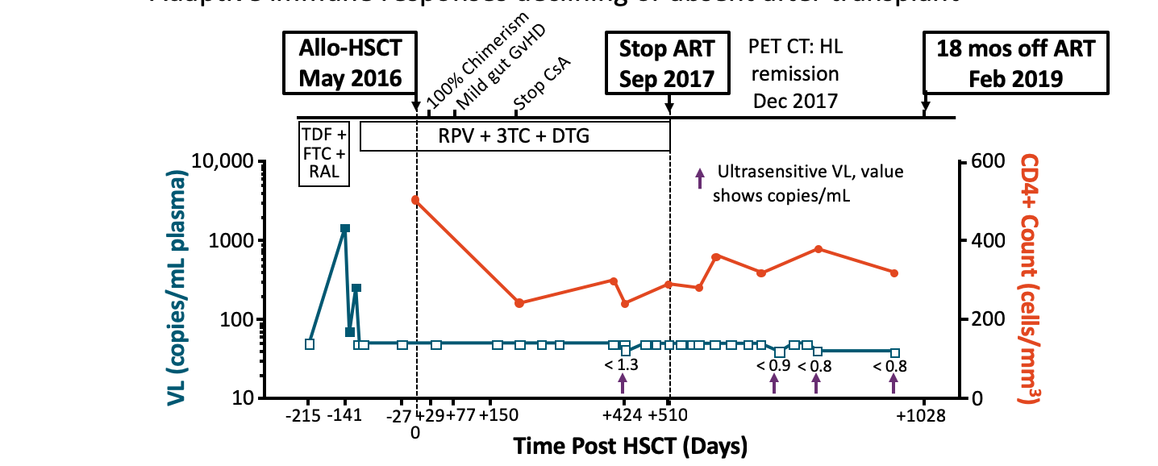

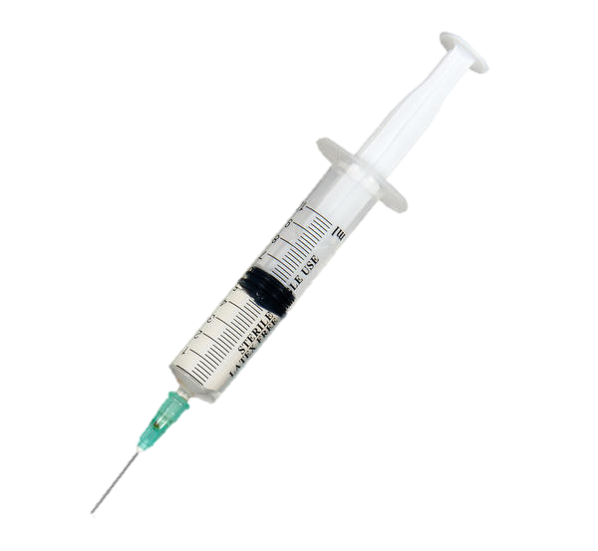
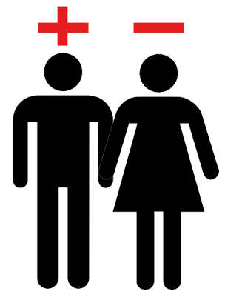

Cure for one
90:90:90
New infections falling
Second cure
2016
2019
PrEP demonstrated to work.
Long-acting
ART
http://www.ema.europa.eu/ema/index.jsp?curl=pages/medicines/landing/epar_search.jsp&mid=WC0b01ac058001d124 [Accessed March 2019].
http://www.UNAIDS.org/accessed March 2019

Slide 4
Treatment options – 1983

Slide 5
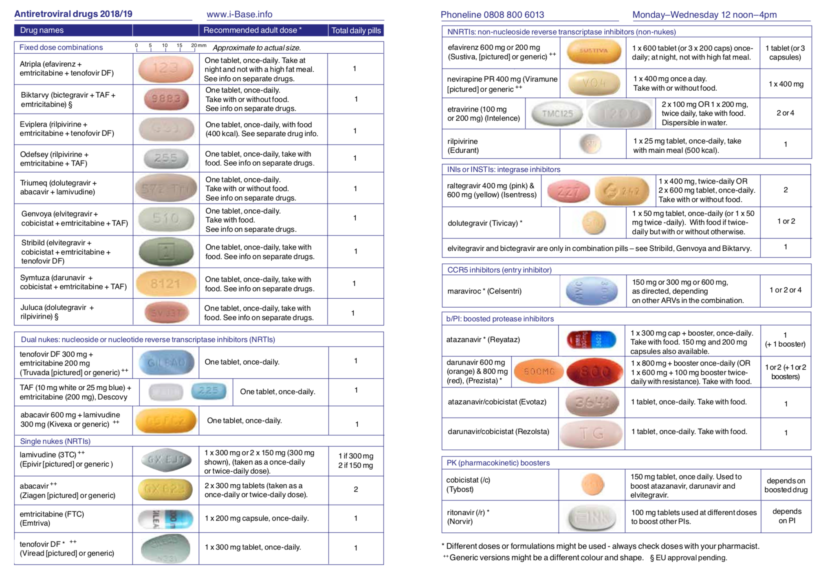
Treatment options – 2019
Efavirenz
Efavirenz+FTC+TDF
Nevirapine
Bictegravir+FTC+TAF
Etravirine
Rilpivirne+FTC+TDF
Rilpivirine
Rilpivirne+FTC+TAF
Dolutegravir+3TC+ABC
Raltegravir
Elvitegravir+Cobicistat+ FTC+TAF
Dolutegravir
Elvitegravir+Cobicistat+ FTC+TDF
Darunavir+Cobicistat+ FTC+TAF
Maraviroc
Dolutegravir+Rilpivirine
Atazanavir
FTC+TDF
Darunavir
FTC+TAF
Atazanavir+Cobicistat
3TC+ABC
Darunavir+Cobicistat
3TC
Adapted from http://www.UNAIDS.org/accessed March 2019
ABC
Cobicistat
FTC
Ritonavir
Not all drugs mentioned here are registered in all countries
TDF

Slide 6
Evolution in HIV Therapy
1 drug
NRTI
2 drug
2NRTI
3 drug
PI + 2NRTI
150
CD4⁺ cell count,
cells/mm³
100
50
0
–0.5
-50
Monotherapy
Plasma HIV-1 RNA,
log₁₀ c/mL
Dual therapy
-100
-100
–1.0
Triple therapy
-150
–1.5
-200
–2.0
1985
1986
1987
1988
1989
1990
1991
1992
1993
1994
1995
1996
1997
1998
1999
2000
Years

Slide 7
Evolution of HIV Therapy: Less Toxicity and Greater Potency
TOXICITY
POTENCY

Slide 8
Evolution of HIV Therapy: Less Toxicity and Greater Potency
TOXICITY
POTENCY

Slide 9
Evolution of HIV Therapy: Less Toxicity and Greater Potency
POTENCY
RESISTANCE BARRIER
POTENCY
TOXICITY

Slide 10
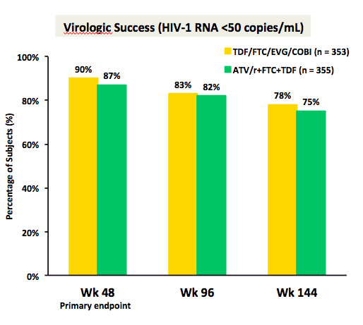
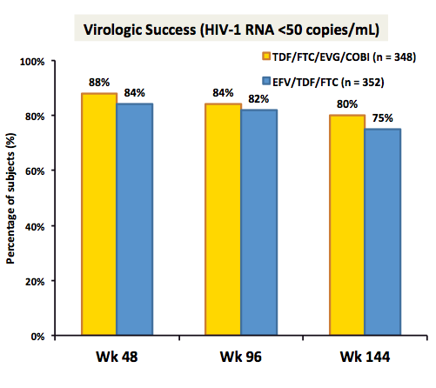
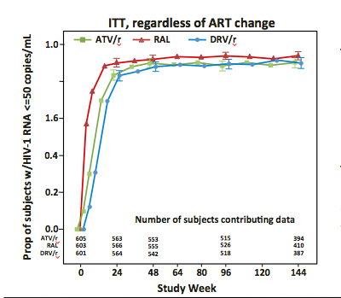
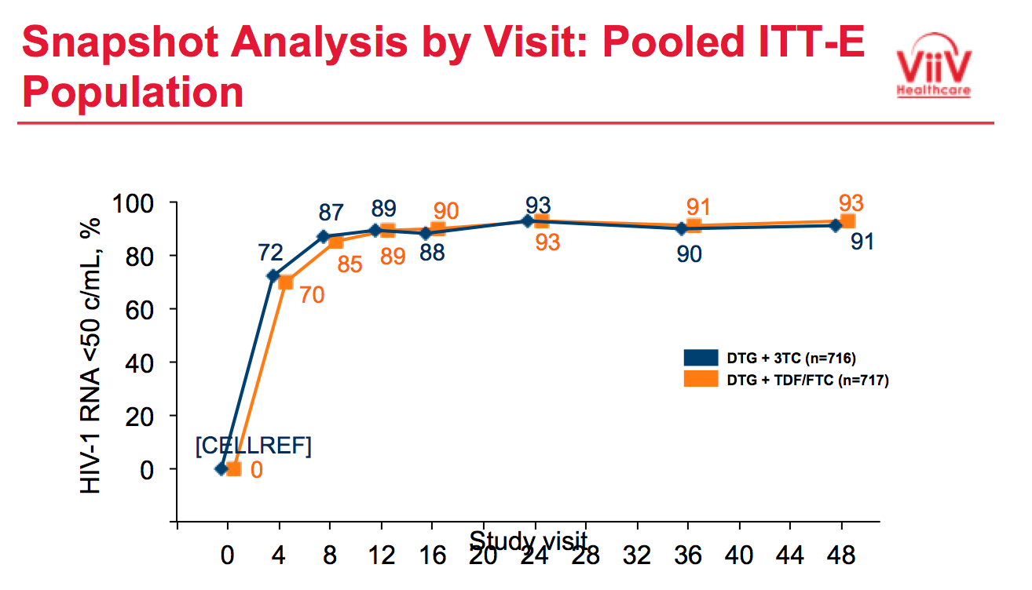
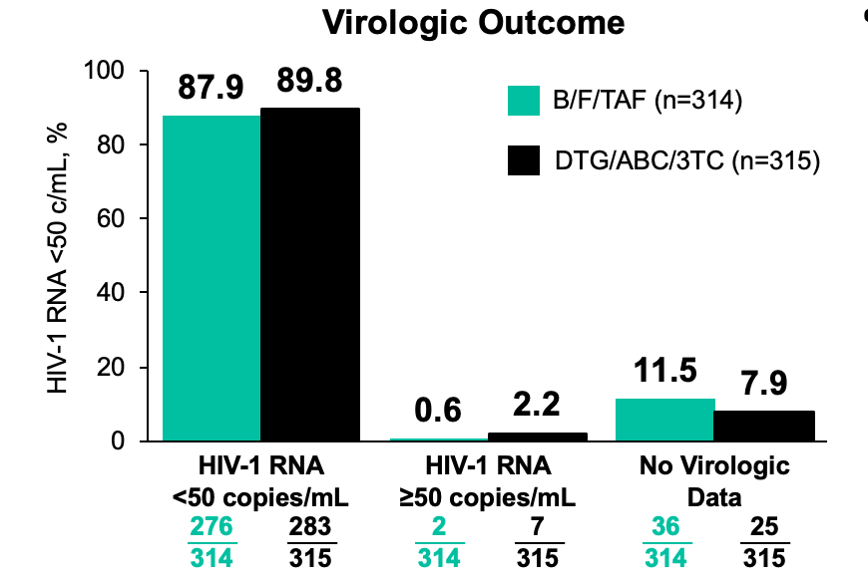
Modern-era HIV therapies are highly efficacious

Slide 11
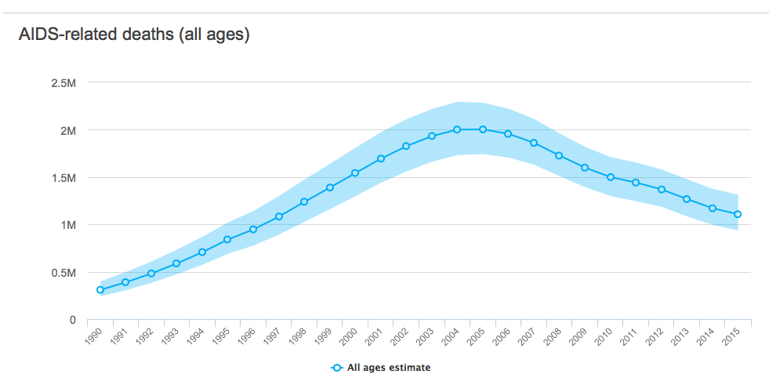
Potent antiretroviral therapy has greatly reduced global HIV mortality
Worldwide

Slide 12
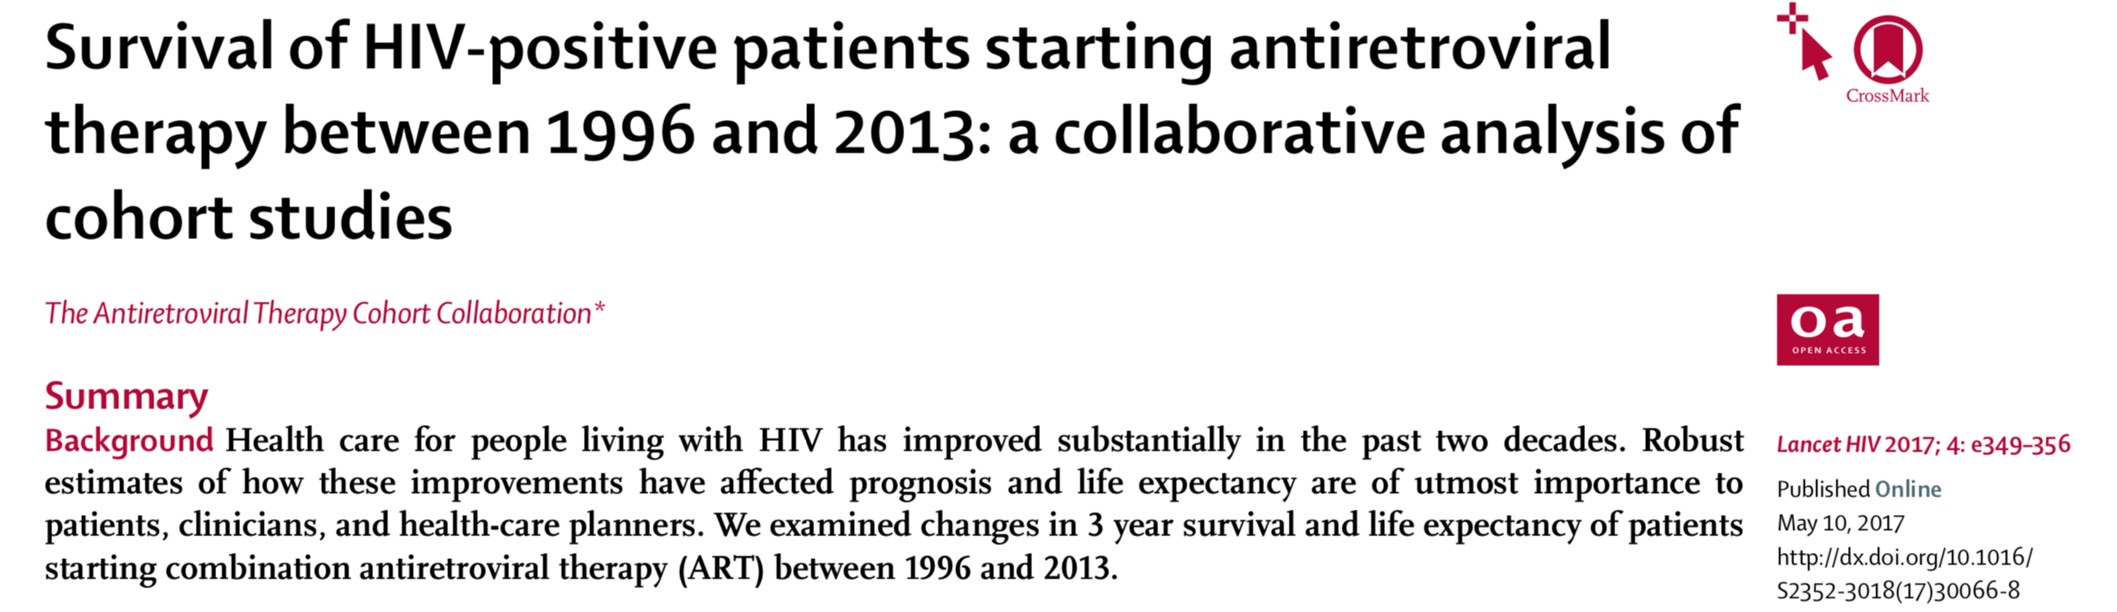
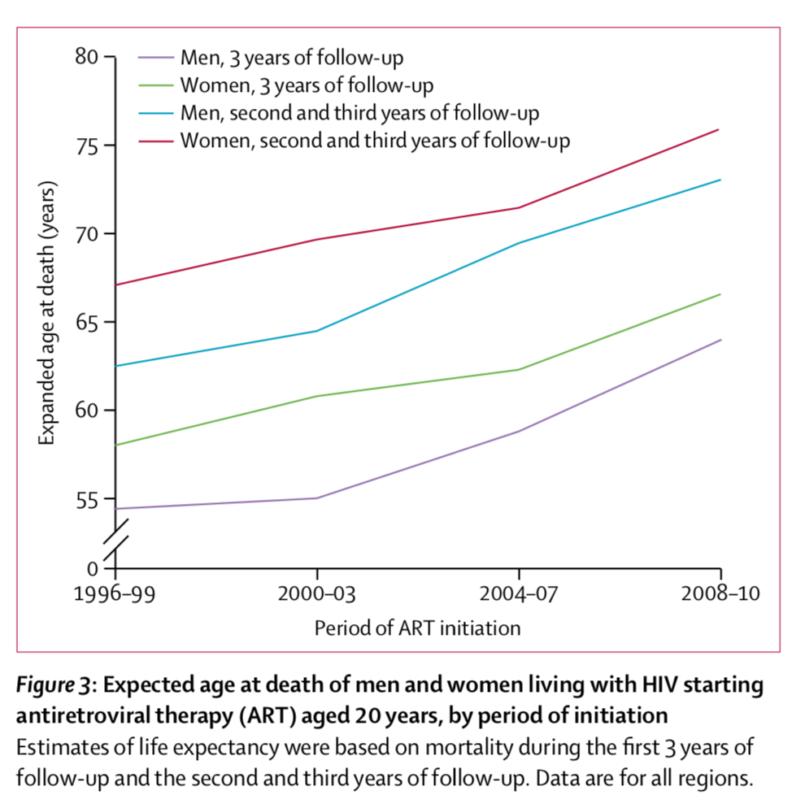

Slide 13

Potent antiretroviral therapy greatly reduces risk of HIV transmission

Slide 14
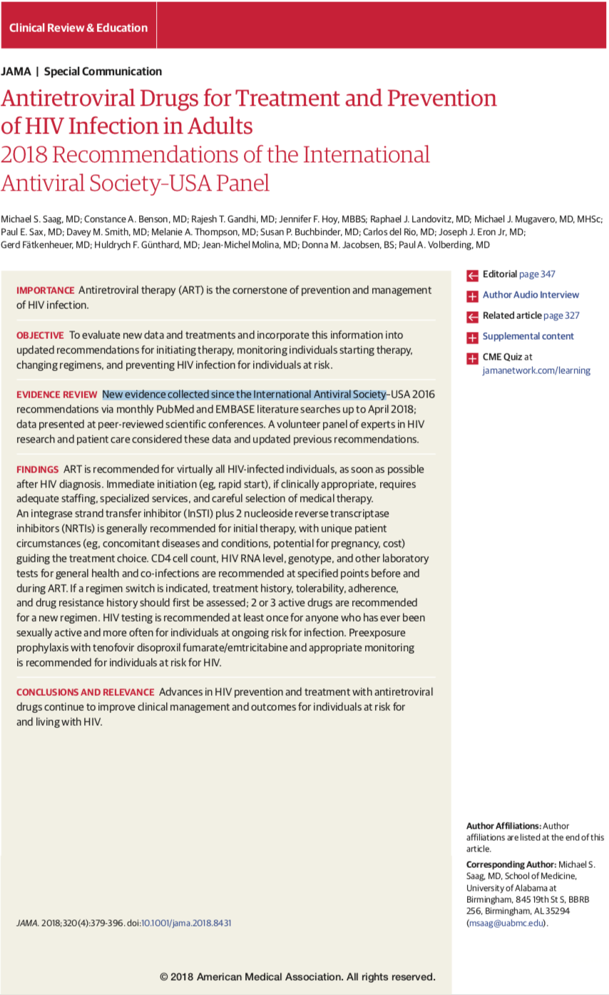
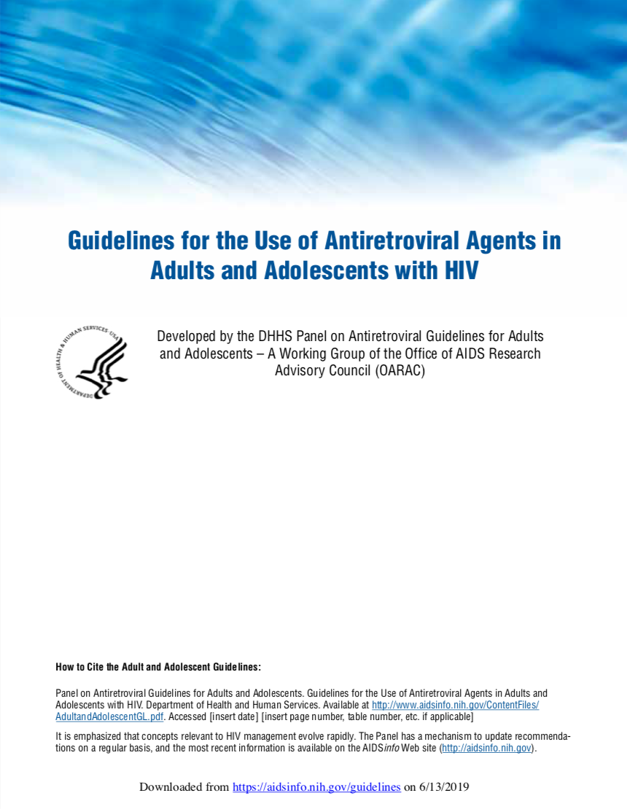
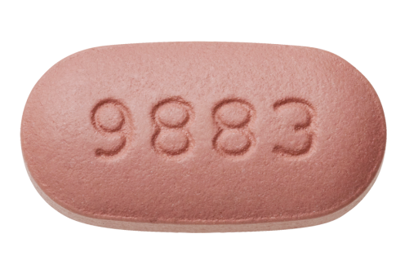
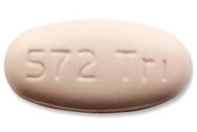
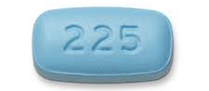
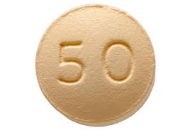
Current Guidelines for Initial HIV Therapy
Treat regardless of CD4
Benefits of therapy clearly outweigh any risks
Recommended Regimens (IAS-USA)
Bictegravir - FTC - TAF
Dolutegravir - FTC - Abacavir
Dolutegravir + FTC - TAF
Based on efficacy and safety in clinical trials

Slide 15
DHHS, IAS-USA Guidelines: Recommended Regimens for First-line ART in Most Patients With HIV Infection
Class | DHHS^{[1]} | IAS-USA^{[2]}
INSTI | BIC/FTC/TAF* DTG/ABC/3TC* DTG + FTC/(TAF or TDF) RAL + FTC/(TAF or TDF) | BIC/FTC/TAF* DTG/ABC/3TC* DTG + FTC/TAF
*Single-tablet regimens.
Recommendations may differ based on baseline HIV-1 RNA, CD4+ cell count, CrCl, eGFR, HLA-B*5701 status, HBsAg status, osteoporosis status, and pregnancy status or intent
No currently recommended first-line regimens contain a pharmacologic-boosting agent
With FDA approval of 1200-mg RAL,^{[3]} all options now available QD (except in pregnancy)^{[4]}
Guidelines have shifted
TO
Newer Integrase Inhibitors
Single Tablets
TAF
AWAY FROM
Pharmacological Boosters
Higher side effect rates
Limitations based on CD4/Viral load
1. DHHS ART. Guidelines. October 2018. 2. Saag. JAMA. 2018;320:379.
Notes:
3TC, lamivudine; ABC, abacavir; BIC, bictegravir; CrCl, creatinine clearance; DHHS, US Department of Health and Human Services; DTG, dolutegravir; eGFR, estimated glomerular filtration rate; FTC, emtricitabine; HBsAg, hepatitis B surface antigen; IAS, International Antiviral Society; RAL, raltegravir; TAF, tenofovir alafenamide; TDF, tenofovir disoproxil fumarate.
This slide reviews the recommended regimens based on the DHHS and the IAS-USA guidelines. One should notice that all of the recommended regimens are INSTI based. The only difference between the two organizations’ recommendations is that the DHHS guidelines include raltegravir, whereas the IAS-USA guidelines do not. A very recent change is that elvitegravir/cobicistat regimens are no longer included in the recommended group, largely due to drug–drug interactions with cobicistat. All the options are once-daily regimens now that raltegravir has a once-daily formulation; however, the raltegravir regimen is not coformulated into a single tablet.

Slide 16

Samuel
Samuel is a 22 year old man who presents to clinic with a new diagnosis of HIV infection
He went for HIV test after receiving a text from a recent sexual partner who reported that he had tested positive for gonorrhea.
Data:
  HIV p24/Ab - positive
  HIV-1 Ab - positive
  HIV NAAT – detected
  RPR – 1:2
    [Had syphilis 1 year ago and treated with IM penicillin]
  Gonorrhea NAAT – Positive in urine and rectal swab
    [Treated with IM ceftriaxone and oral azithromycin]
  HCV Ab – positive; HCV RNA – undetectable
  HBsAb - positive

Slide 17
Samuel (cont’d)
Feels well. Denies flu-like illnesses, weight loss, swollen lymph nodes.
Only significant past medical history is seasonal allergies and chronic sinus congestion for which he uses fluticasone nasal spray daily
He is a man who has sex only with men.
  Top or bottom
  Last HIV test before the recent positive was 2 years ago and that was negative.
  He has never used PrEP. Had an appointment at local clinic to be assessed for PrEP but he could not afford the clinic visit fee, so he did not show.
Denies smoking, illicit drugs. Drinks 2 drinks on weekend nights.
On Exam
  Awake and alert thin man
  Normal oral mucosa, no lymphadenopathy, chest clear, heart normal, skin without rash.

Slide 18
Samuel (cont’d)
What regimen should Samuel be prescribed?

Slide 19
Samuel (cont’d)
Shared Decision-Making considerations:
  Potential for transmitted resistance
    High for NNRTI, Med for NRTI, Low for PI and INSTI
  Potential for intolerance
    Abacavir hypersensitivity if HLA-B*5701 present
  Barrier to resistance
    High for newest INSTIs and boosted PIs
  Comorbidities
    CVD risk, renal disease, hepatic insufficiency, neuropsychiatric disorders, low bone density, obesity
  Drug-Drug Interactions
    PK boosters and inducers
  Pregnancy intentions (for women)
  Preference
    Meal requirements, pill burden, pill size, dosing
  Cost
    Co-pays, out-of-pocket costs, prior approval

Slide 20
Samuel (cont’d)
What regimen should Samuel be prescribed?
Bictegravir - FTC - TAF
Dolutegravir - FTC - Abacavir
Dolutegravir + FTC - TAF

Slide 21
Samuel (cont’d)
When should Samuel start his meds?
Bictegravir - FTC - TAF
Dolutegravir - FTC - Abacavir
Dolutegravir + FTC - TAF

Slide 22
San Francisco Experience:
Same-Day Observed ART Initiation vs. Standard of Care
Compared to historic controls, rapid ART initiation associated with:
Significantly shorter time to viral suppression (P<0.0001)
Similar rates of loss to follow-up (10 v 15%)
Most same-day patients received
INSTI-based regimens
Time to HIV RNA <200 Copies/mL
Same-Day
(median: 1.8 months)
Universal ART
(median: 4.3 months)
Proportion with Viral Suppression
CD4-Guided ART
(median: 7.2 months)
All comparisons to
same-day ART (P<0.0001)
0 10 20 30
Time From Clinic Referral (months)
Colasanti J. ACTHIV 2017, Dallas, TX. 4.21.17.
Pilcher CD, et al. JAIDS. 2017;74:44-51.

Slide 23
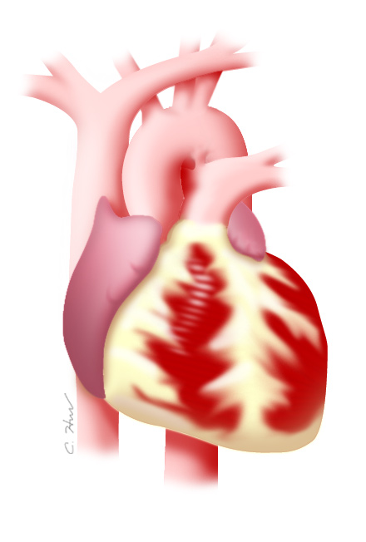
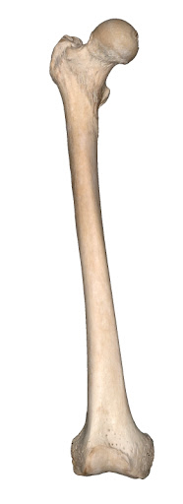
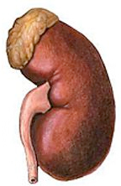

What about Adverse Effects?
TDF | Yes | No | Yes | No | No
TAF | No | No | No | No | Maybe
ABC | No | Yes | No | No | No
Protease Inhibitors | No | Yes for most | No | No | No
Integrase Inhibitors | No | No | No | Yes | Yes
Non-Nucleosides | No | No | No | Some | No
Notes:
23

Slide 24

What about Adherence? Challenges:
  Regimen factors
    Complexity
    Palatability
    Adverse effects
  Host factors
    Cognition
    Motivation
    Self-efficacy
    Knowledge
    Mental health
    Substance use
  Structural factors
    Cost
    Access
    Stigmatization
Social Service Interventions
Advocacy
Policy
Simplify
High-barrier regimen
Evidence-based:
Counseling
Treatment
https://effectiveinterventions.cdc.gov/

Slide 25
What is new/coming along?
Less is More
Less medication: 2 drug regimens for initial and maintenance therapy
Dolutegravir + 3TC as initial ART
Rilpivirine + Dolutegravir as maintenance ART
Less cost?
Less frequent: Injectable Long-Acting ART
Monthly or every 2 months
Less stigma?

Slide 26
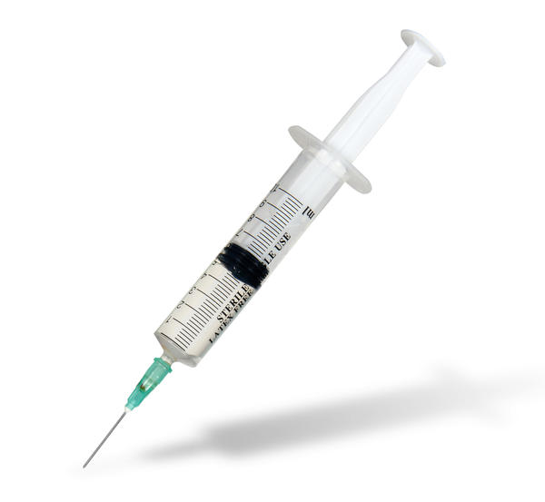
Long acting injectable ART
Two long acting injectable HIV meds are being studied
  Rilpivirine and Cabotegravir
Administered every 1-2 months subcutaneously (under skin)
Will require a ‘lead in’ of pills
Being studies as PrEP

Slide 27
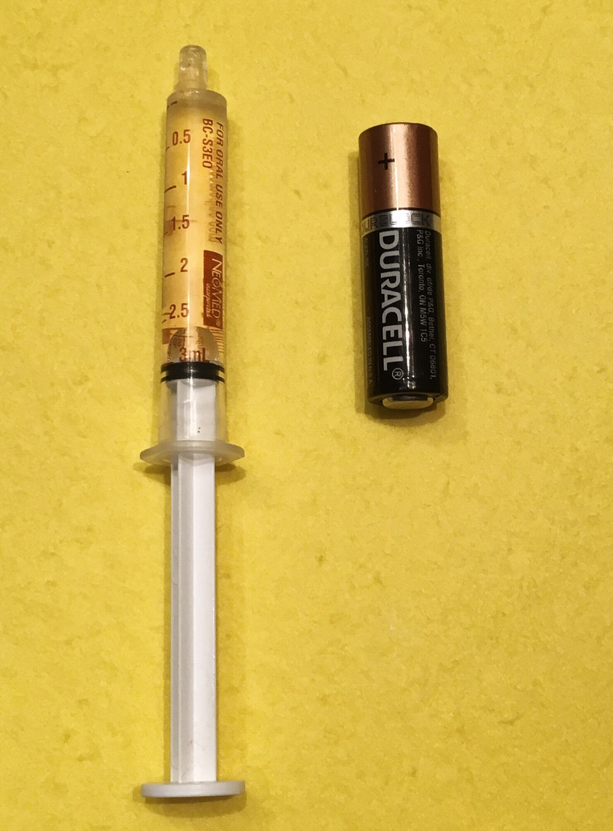
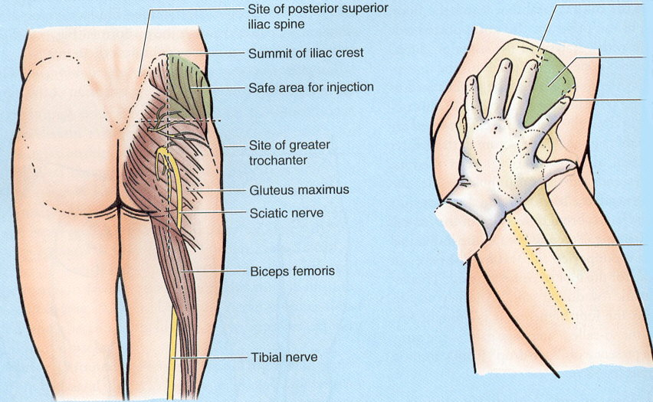
Cabotegravir IM + Rilpivirine IM for Long-Acting Maintenance ART
Q8W dose is two 3-mL injections

Slide 28
HIV Care Cascade
Racism
Poverty
Homophobia misogyny
conventionalism
SHAME
Violence
STIGMA
marginalization
homelessness
CLASSISM
BAR BEFORE THE BARS | DIAGNOSED | LINKED TO CARE | RETAINED IN CARE | PRESCRIBED ART | VIRALLY SUPPRESSED
https://www.nastad.org/domestic/hiv-prevention-health-equity

Slide 29
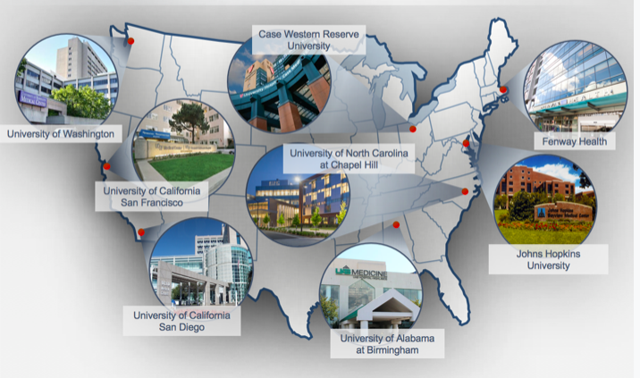
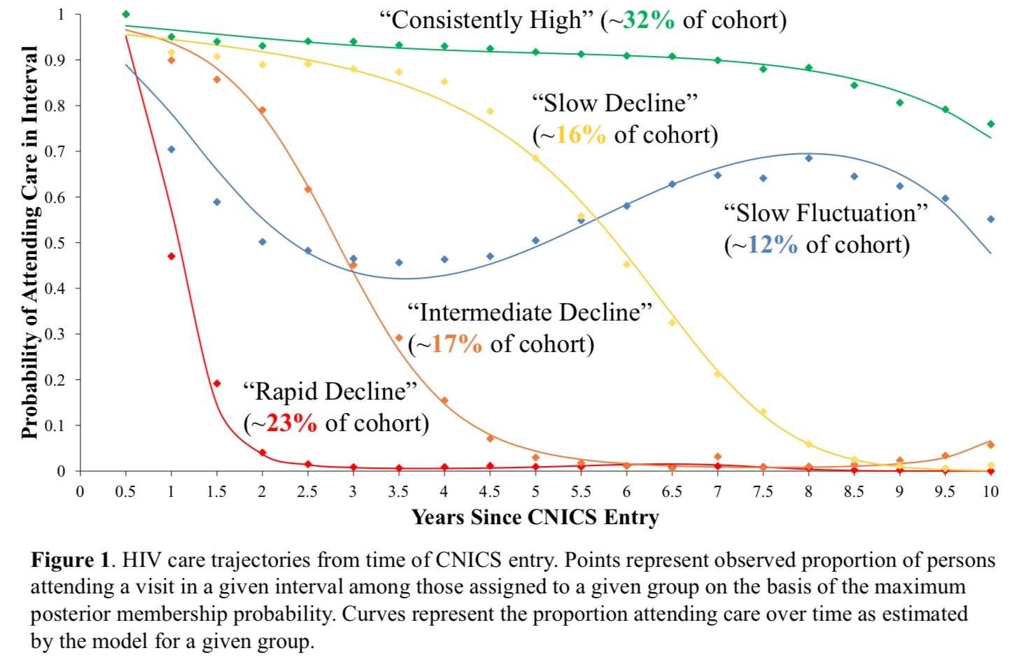
Trajectories of HIV Care – CNICS cohort
Newly entering care 2005-2015
Powers K, et al. CROI2019 #1036

Slide 30
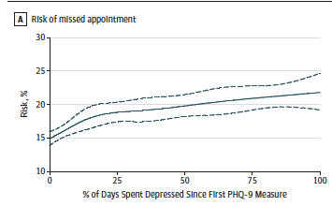
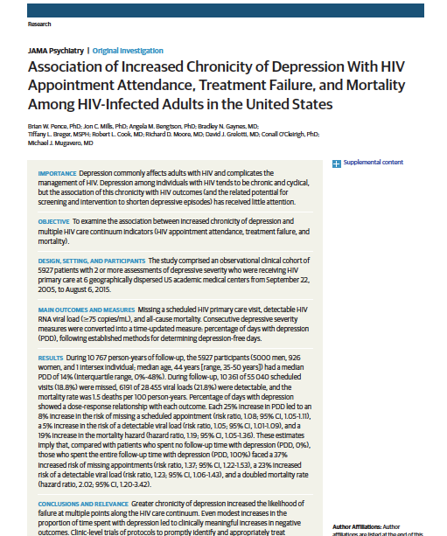
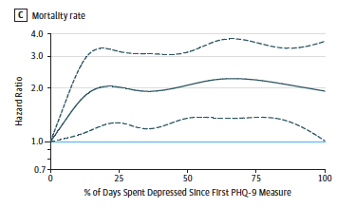
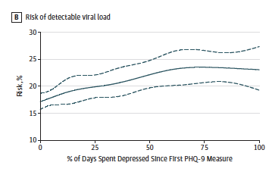
Pence B, et al. JAMA Psych, 2018

Slide 31
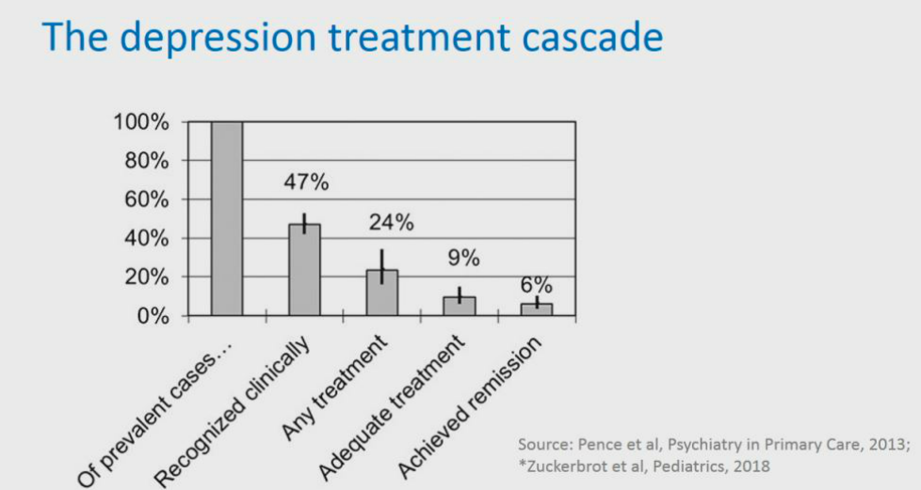

Slide 32
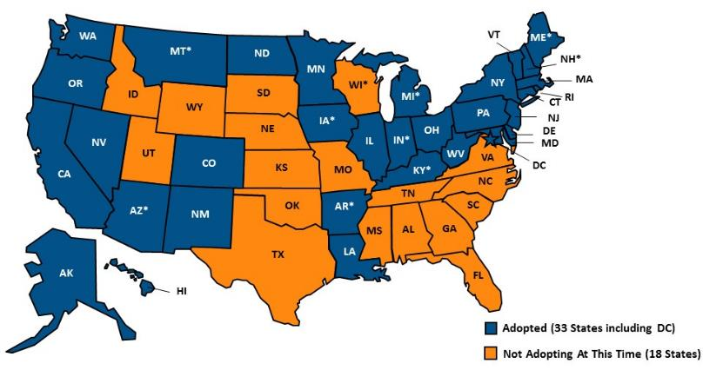
Current Status of State Medicaid Expansion Decisions
Notes: Current status for each state is based on KFF tacking and analytics of state executive activity. * AR, AZ IA, IN, KY, MI, MT, and NH have approved
Section 1115 expansion waivers. KY initially adopted expansion through a state plan amendment but received CMS approval for the Kentucky HEALTH
expansion waiver January 12, 2018: implementation will start in April 2018 with full implementation by July 2018. ME adopted the Medicaid expansion
through a ballot initiative in November 2017; the ballot measure requires submission of a state plan amendment within 90 days and implementations
of expansion within 180 days of the measure’s effective date. WI covers adults up to 100% FPL in Medicaid, but did not adopt the ACA expansion.
SOURCE: “Status of State Action on the Medicaid Expansion Decision” KFF State Health Facts, updated January 16, 2018.
http://kff.org/health-reform/state-indicator/state-activity-around-expanding-Medicaid-under-the-affordable-care-act/

Slide 33
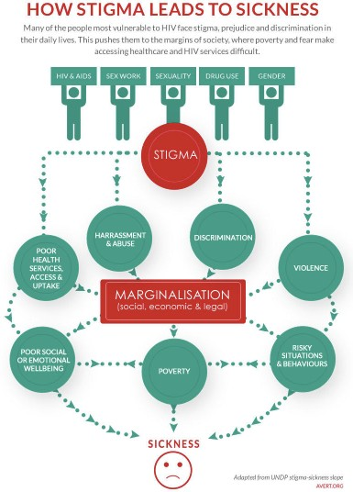

Slide 34
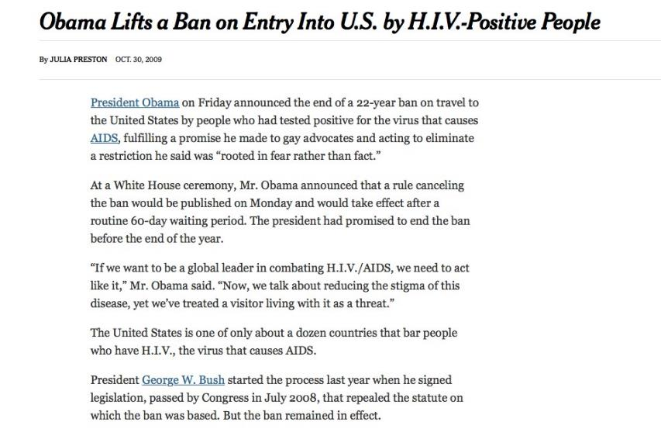


Slide 35
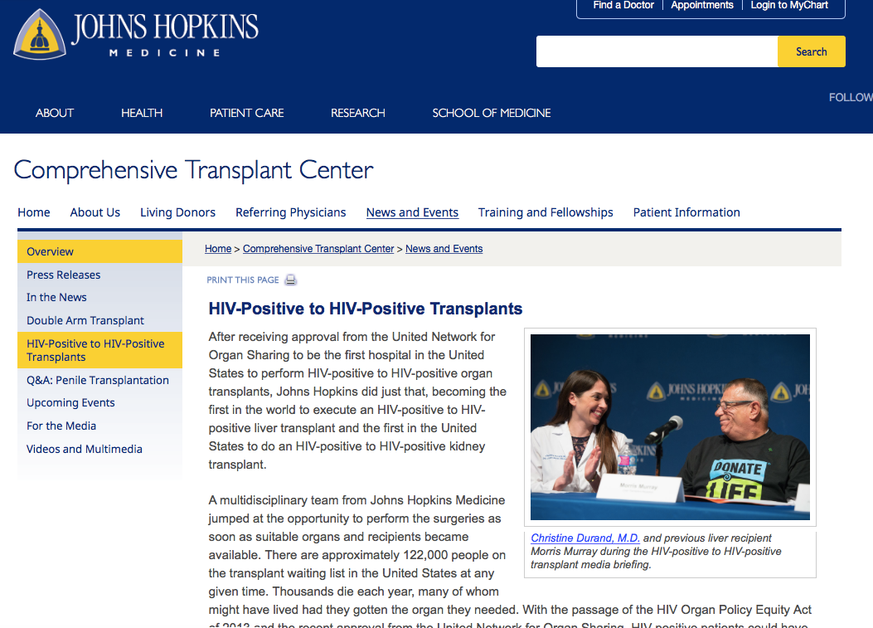


Slide 36


Slide 37

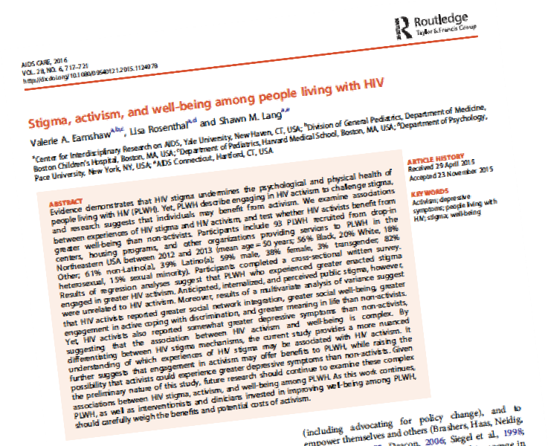



Slide 38

Thank You

Slide 39
Discussion/Questions
HIV/ME/19-02//1129a
Date of Preparation April 2019

