Slide 1
Infection Prevention for Persons who Inject Drugs HIV/HCV Coinfection in 2019, Regional Update West June 14, 2019
Asher Schranz MD
Fellow, Infectious Diseases
UNC Chapel Hill
Notes:
Thank you for giving me the opportunity to present.

Slide 2
Disclosures
Training grant from NIH (T32AI070114)

Slide 3
Educational Objectives
Be familiar with the infections of particular concern to persons who inject drugs (PWID)
Understand the growing impact of infective endocarditis among PWID
Know the tools available for infection prevention in PWID

Slide 4
Outline
Quick take on opioid crisis
Infections of concern to people who inject drugs
Epidemiology of infective endocarditis
Recent data on NC
Prevention strategies and harm reduction
Notes:
-Here is an outline of what I want to discuss today. I’m going to try to give a little bit of everything from some basic review of clinical concepts, some novel research of mine and others, and some practical clinical pearls. Because this such a broad scope, I’m going to move quick so we can leave time for more questions about specific aspects later.
We’ll first discuss the epidemiology of drug-associated infective endocarditis during the opioid epidemic. I’lll say that you might see different terms for this throughout, such as injection drug-associated endocarditis. I use drug-associated endocarditis or DA-IE.
-I’ll present recent data from my research on endocarditis in North Carolina.
-We’ll discuss some of the challenges posed in treating endocarditis for someone who injects drugs.
-I’ll present what I think are the novel ways to treat endocarditis in this population.
-Lastly, I’ll review other important ID issues that you must consider when caring for people who inject drugs.

Slide 5
Outline
Quick take on opioid crisis
Infections of concern to people who inject drugs
Epidemiology of infective endocarditis
Recent data on NC
Prevention strategies and harm reduction
Notes:
-Here is an outline of what I want to discuss today. I’m going to try to give a little bit of everything from some basic review of clinical concepts, some novel research of mine and others, and some practical clinical pearls. Because this such a broad scope, I’m going to move quick so we can leave time for more questions about specific aspects later.
We’ll first discuss the epidemiology of drug-associated infective endocarditis during the opioid epidemic. I’lll say that you might see different terms for this throughout, such as injection drug-associated endocarditis. I use drug-associated endocarditis or DA-IE.
-I’ll present recent data from my research on endocarditis in North Carolina.
-We’ll discuss some of the challenges posed in treating endocarditis for someone who injects drugs.
-I’ll present what I think are the novel ways to treat endocarditis in this population.
-Lastly, I’ll review other important ID issues that you must consider when caring for people who inject drugs.

Slide 6
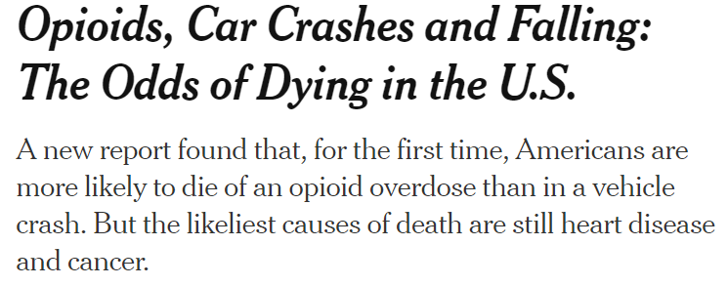

Slide 7
Opioid Epidemic - US

Slide 8
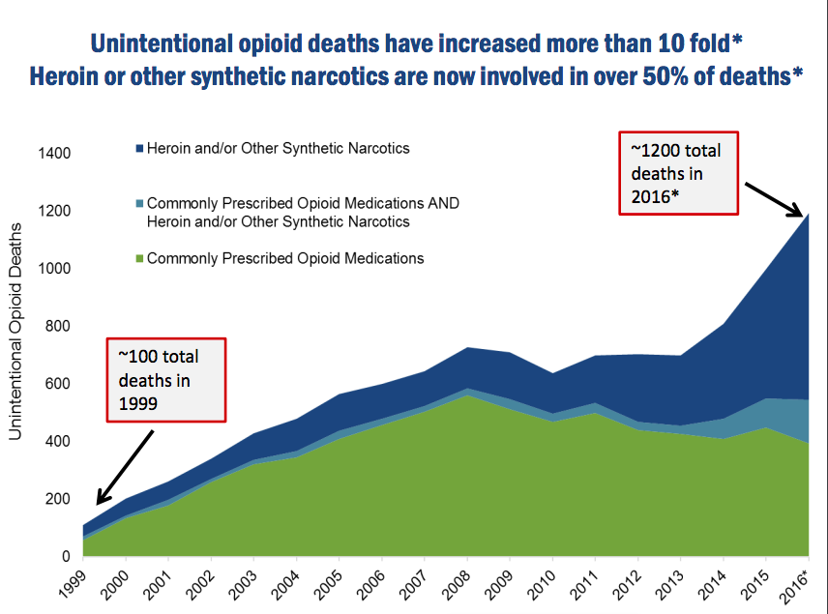
Opioid Epidemic – North Carolina
NC Opioid Action Plan, 2017

Slide 9
Opioid Epidemic – What’s Next?
Overdoses among persons using stimulants?
Fentanyl contamination of other drugs
Seth, MMWR 2018

Slide 10
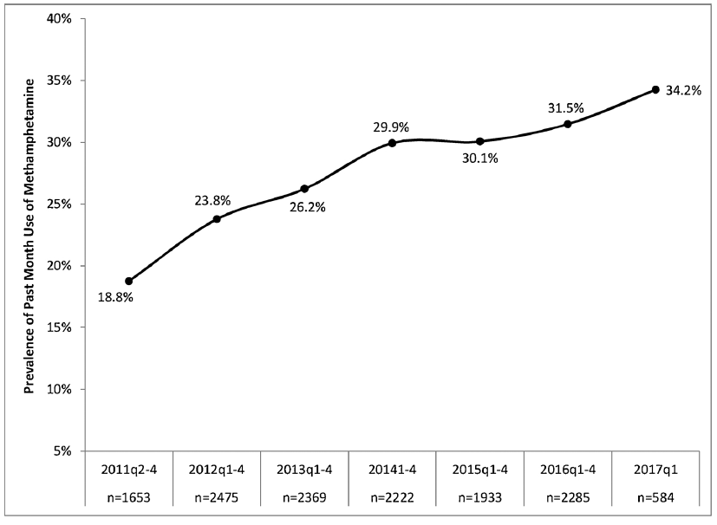
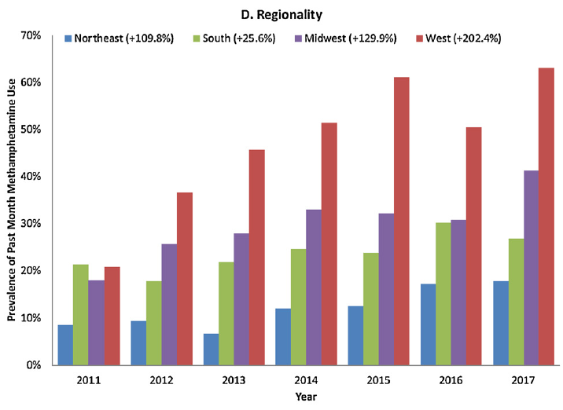
Opioid Epidemic – What’s Next?
Increasing methamphetamine use
Ellis, Drug Alc Dependence 2018

Slide 11
Outline
Quick take on opioid crisis
Infections of concern to people who inject drugs
Epidemiology of infective endocarditis
Recent data on NC
Prevention strategies and harm reduction
Notes:
-Here is an outline of what I want to discuss today. I’m going to try to give a little bit of everything from some basic review of clinical concepts, some novel research of mine and others, and some practical clinical pearls. Because this such a broad scope, I’m going to move quick so we can leave time for more questions about specific aspects later.
We’ll first discuss the epidemiology of drug-associated infective endocarditis during the opioid epidemic. I’lll say that you might see different terms for this throughout, such as injection drug-associated endocarditis. I use drug-associated endocarditis or DA-IE.
-I’ll present recent data from my research on endocarditis in North Carolina.
-We’ll discuss some of the challenges posed in treating endocarditis for someone who injects drugs.
-I’ll present what I think are the novel ways to treat endocarditis in this population.
-Lastly, I’ll review other important ID issues that you must consider when caring for people who inject drugs.

Slide 12
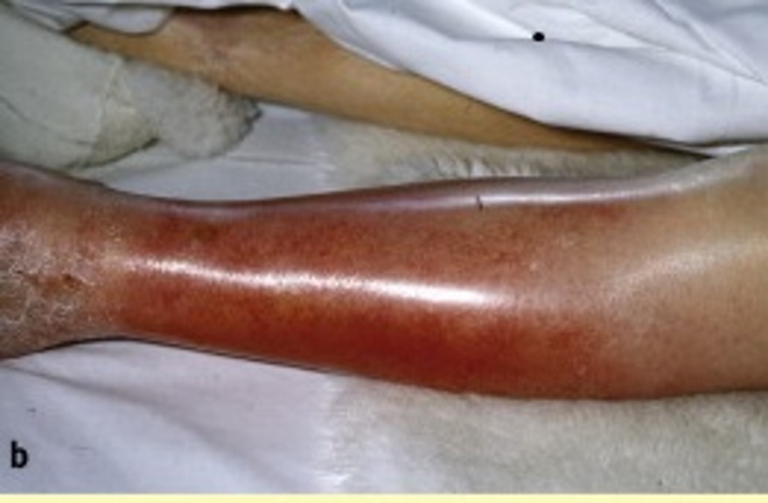
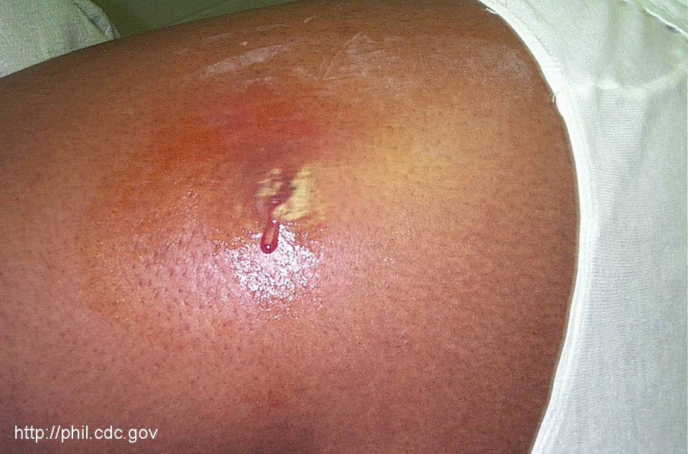
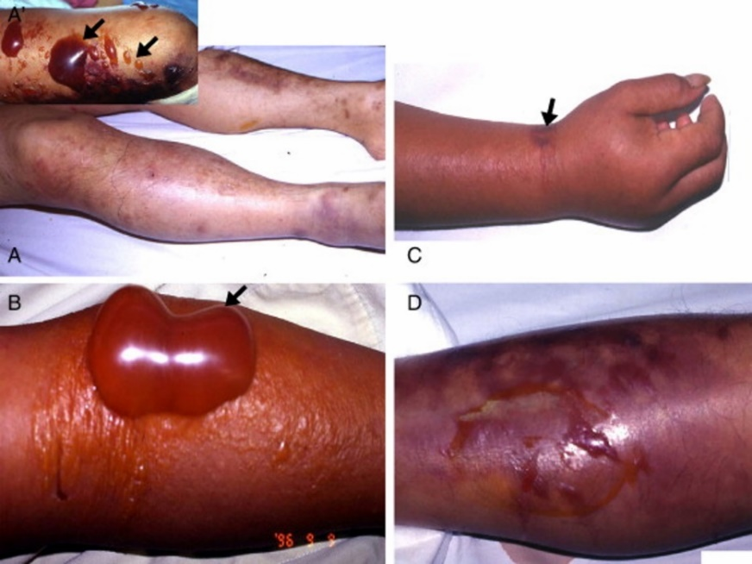
Skin and Soft Tissue Infections
Cellulitis
Abscess
Necrotizing Fasciitis
Lowe, Medicine 2009
CDC, CDC.gov
Lee C-C, Diagn Microbiol Infect Dis 2008

Slide 13
Cellulitis and Abscess
Common
Up to 65% of PWID in past-year
Associated with injecting “under the skin”
Philips KT, J Addict Med 2017. Harris RE, Drug Alcohol Depend 2017. Wurcel AG, Clin Infect Dis 2015.

Slide 14
Pathogens
Staphylococcus aureus (“Staph”), including MRSA
Streptococci
…but think about other exposures
Requires special consideration of antibiotic choice

Slide 15
Necrotizing Fasciitis
Rare but severe
Characteristic findings:
Dusky skin, excessive pain on exam, bullae
Associated with black tar heroin use
Clostridium spp., but others possible
Needs prompt emergency care
Gonzales y Tucker, Anaerobe 2014. Frazee, J Emerg Med 2008.

Slide 16
Skin and Soft Tissue Infections
Attempts at self-treatment
Delayed presentation to care
Concern for progression…
Harris RE, Drug Alcohol Depend 2017

Slide 17
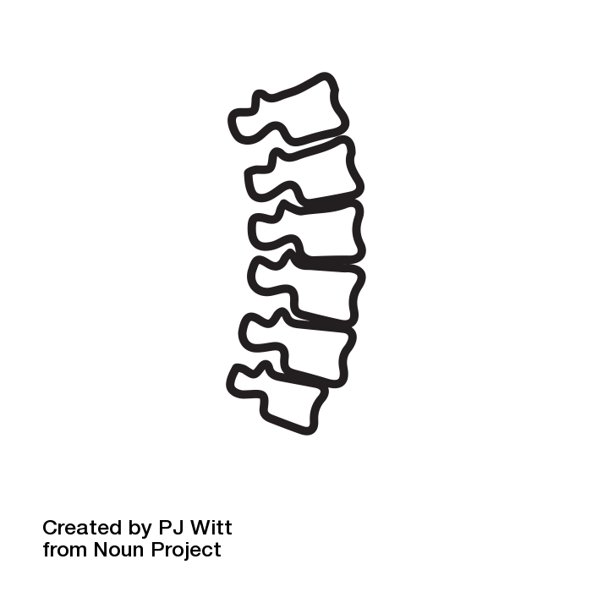
Other Severe Infections
Endocarditis
Osteomyelitis
Septic arthritis
Spine infections

Slide 18
Other Severe Infections
Ronan, Health Aff 2016

Slide 19
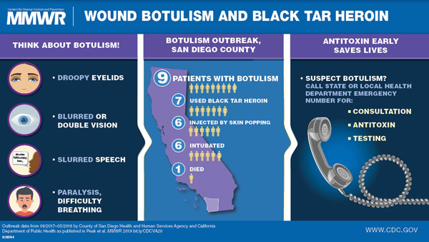
Botulism
Peak, MMWR 2019

Slide 20
Tetanus
CDC, MMWR 1998

Slide 21
Viral Infections (very abbreviated)
Hepatitis A
Recent outbreaks among people injecting drugs
Vaccine-preventable
Hepatitis B
Vaccinate – or consider confirming immunity
Hepatitis C
Guidelines endorse treating all persons
Success in people injecting drugs
Treatment as prevention
HIV
Outbreaks among PWID
PrEP

Slide 22
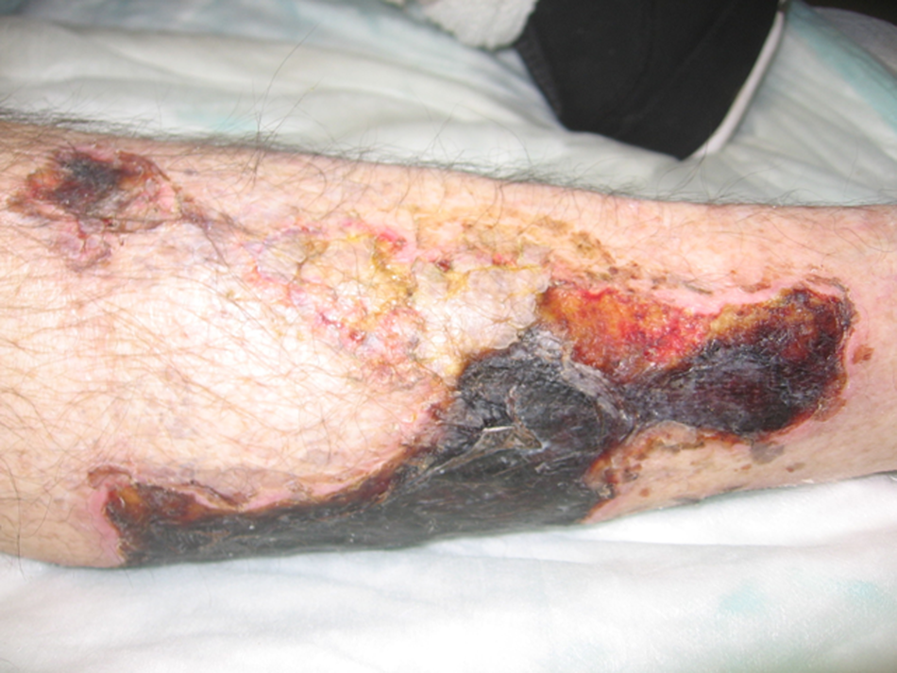
…And Some Mimics
Vasculitis
Levamisole (ANCA+)
Cotton fever
Sepsis syndrome with injecting- fever and leukocytosis
Sterile cultures
Drug effects
Serotonergic
Autonomic
Xie Y, J Gen Intern Med 2016. Wurcel AG, Clin Infect Dis 2015

Slide 23
Outline
Quick take on opioid crisis
Infections of concern to people who inject drugs
Epidemiology of infective endocarditis
Recent data on NC
Prevention strategies and harm reduction
Notes:
-Here is an outline of what I want to discuss today. I’m going to try to give a little bit of everything from some basic review of clinical concepts, some novel research of mine and others, and some practical clinical pearls. Because this such a broad scope, I’m going to move quick so we can leave time for more questions about specific aspects later.
We’ll first discuss the epidemiology of drug-associated infective endocarditis during the opioid epidemic. I’lll say that you might see different terms for this throughout, such as injection drug-associated endocarditis. I use drug-associated endocarditis or DA-IE.
-I’ll present recent data from my research on endocarditis in North Carolina.
-We’ll discuss some of the challenges posed in treating endocarditis for someone who injects drugs.
-I’ll present what I think are the novel ways to treat endocarditis in this population.
-Lastly, I’ll review other important ID issues that you must consider when caring for people who inject drugs.

Slide 24
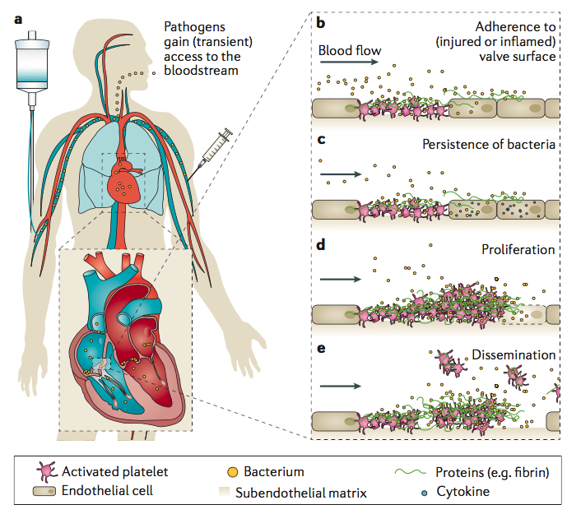
What is Infective Endocarditis?
Infection of heart valves by bacteria or fungus
Commonly: older persons with degeneration of valves
Holland, Nat Rev 2016
Notes:
So a brief review - Infective endocarditis is an infection of the heart valves by bacteria or fungus. This can disseminate and affect numerous parts of the body.
Most commonly, endocarditis occurs when normal aging leads to damaged heart valves that can then become infected. So, therefore, endocarditis is typically thought of as a disease affecting older persons.
But, again, endocarditis can also be caused by injection of material – such as any illicit drug – that can irritate the heart valve and lead to bacteria growing there.

Slide 25
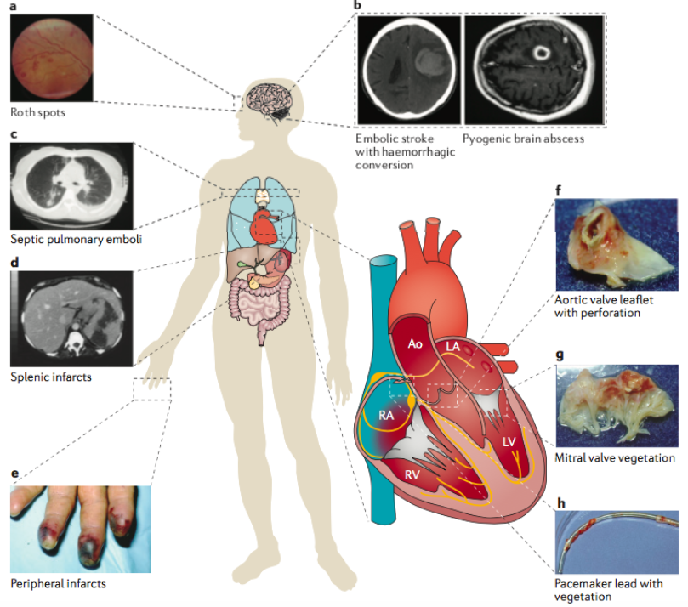
What is Infective Endocarditis?
Presentation
Nonspecific and mild
… Or overt and severe
Management
6 weeks of IV antibiotics
Surgical replacement of valve
Estimated 25-60%
Holland, Nat Rev 2016
Notes:
Endocarditis is managed by 6 weeks of IV antibiotics in virtually all cases. Optimal management often requires heart valve replacements, which are estimated to occur in between 25 and 60% of infections.
It is a severe multisystem disease - the infection can cause problems all over the body including strokes and brain abscesses, leading to permanent disability.

Slide 26
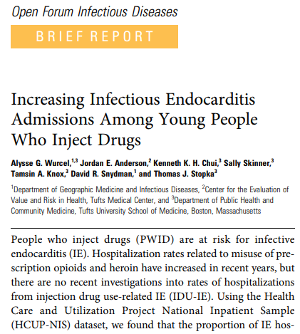
What’s going on with endocarditis?
First signal in 2016
Wurcel, Open Forum ID 2016

Slide 27
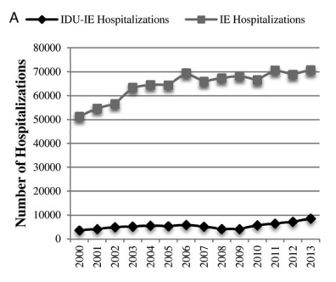
What’s going on with endocarditis?
From 2000 to 2013:
2-fold rise in injection drug-associated endocarditis
Wurcel, Open Forum ID 2016

Slide 28
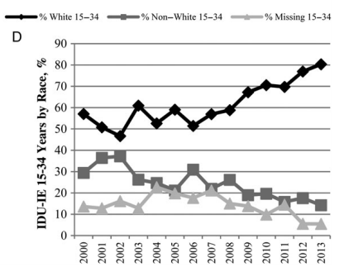
What’s going on with endocarditis?
From 2000 to 2013:
2-fold rise in injection drug-associated endocarditis
White + 15-34 = 80%
Wurcel, Open Forum ID 2016

Slide 29
Well, what’s going on in North Carolina?
Notes:
First, we sought to update the epidemiology of endocarditis in North Carolina. Second we asked what the burden of heart valve surgery has been for drug associated endocarditis. Third we examined the demographic profile of persons undergoing valve surgery. And lastly we looked at the hospital charges, length of stay and disposition following surgery. And we aimed to compare to all persons with endocarditis not due to drug use.

Slide 30
Infective Endocarditis Hospitalizations
Notes:
Here is just the drug-associated endocarditis admissions alone.

Slide 31
Well, what about surgery?

Slide 32
Heart Valve Replacement in People Who Use Drugs
Concerns of heart valve replacement:
Reinfection of prosthetic valve
Repeated sternotomies
Technically difficult surgeries, increasingly high-risk
Absence of consensus in surgical community

Slide 33
Well, what about surgery?
Notes:
I think a lot of the real-world issues about this problem are really well-conveyed by this New York Times article that you may have seen discussing the problem in Tenessee.

Slide 34
Well, what about surgery?
Notes:
Here are some quotes that represent some of the problems.
Read –
These are not necessarily our views but it represents the diverse attitudes of providers towards caring for these patients.

Slide 35
IE Hospitalizations with Surgery
Notes:
Again, broken down by drug use status, you can se e that the non-drug cases – the orange line – are fairly constant over time, while the blue line – the drug associated cases – increased from under ten per year statewide to 109 in the last year. In the final year, drug-associated cases accounted for almost half of all valve surgeries for endocarditis.

Slide 36
Endocarditis Surgeries Trends, by Drug
Notes:
Of the drugs linked to these hospitalizations, opioids were the most common, but prevalence of all drugs increased over the period.

Slide 37
Endocarditis Surgeries: Insurance Status
Notes:
This slide shows insurance status between the groups.
-Persons with drug associated disease were largely uninsured or insured by Medicaid comprising about 75% as seen in the yellow boxes on the left.
-In non-drug associated cases, Medicare and private insurance accounted for the vast majority, as demonstrated by the bottom two grey boxes on the right.

Slide 38
Endocarditis: Length of Stay and Hospital Charges
Medial length of stay 27 days
Median hospital charges $250,994 per hospitalization
Notes:
Lastly we looked at hospital charges between the groups. Drug-associated endocarditis had higher median hospital charges, over a quarter million dollars per stay. Across the ten-year period, charges for drug associated endocarditis hospitalizations with valve surgery totaled nearly $80 million dollars for 282 cases.

Slide 39
State of Endocarditis in NC
Drug-related endocarditis is sharply increasing
Hospitalizations have risen >12-fold
Driven by misuse of opioids and, increasingly, other drugs
Long and expensive hospitalizations
Notes:
-To summarize the epidemiology: Endocarditis overall is rising sharply in North Carolina driven by young persons who use drugs. If not already, you will encounter these patients.
-Valve surgery for drug associated endocarditis rose over ten fold, starting in 2015. Currently drug associated cases comprise over 40% of all surgery done for endocarditis, and that number is rising.
-The costs of care are high and fall most strongly on Medicaid and hospitals.

Slide 40
Challenges in Management
Underlying addiction is not addressed
Medication for opioid use disorder is rarely started
In-hospital drug use
Against medical advice discharge
13-22%
Missed opportunity for harm reduction
Rosenthal E, Am J Med 2016.
Schranz AJ, unpublished data.
Notes:
-As you saw patients typically have very long hospital stays. The standard of care currently for endocarditis in general is 6 weeks of IV antibiotics typically given at home through a long-term IV, or PICC line. These are outpatient parenteral antibiotics programs or “OPAT”. However people who inject drugs are often excluded from going home with an IV and thus remain in the hospital to complete their full IV antibiotic course.
-Secondly, despite long hospital stays, the underlying addiction is often not addressed, which is the root cause of their infection. In such a setting, many patients leave against medical advice.
-So, given all of this, are there any new ways we might try to manage this population?

Slide 41
Long-Term Outcomes
Rodger L, JAMA Open 2018.

Slide 42
Outline
Quick take on opioid crisis
Infections of concern to people who inject drugs
Epidemiology of infective endocarditis
Recent data on NC
Prevention strategies and harm reduction
Notes:
-Here is an outline of what I want to discuss today. I’m going to try to give a little bit of everything from some basic review of clinical concepts, some novel research of mine and others, and some practical clinical pearls. Because this such a broad scope, I’m going to move quick so we can leave time for more questions about specific aspects later.
We’ll first discuss the epidemiology of drug-associated infective endocarditis during the opioid epidemic. I’lll say that you might see different terms for this throughout, such as injection drug-associated endocarditis. I use drug-associated endocarditis or DA-IE.
-I’ll present recent data from my research on endocarditis in North Carolina.
-We’ll discuss some of the challenges posed in treating endocarditis for someone who injects drugs.
-I’ll present what I think are the novel ways to treat endocarditis in this population.
-Lastly, I’ll review other important ID issues that you must consider when caring for people who inject drugs.

Slide 43
What’s the process?
Courtesy of CB Hurt
Getting Off Right Safety Manual - Harm Reduction Coalition, 2012

Slide 44
What’s the process?
Dissolving solids
Licking needles
Specific drugs and injecting practices
Unique pathogens
Bisbe, Clin Infect Dis 1992
Deutscher, Int J Drug Policy 2008

Slide 45
What’s the process?
“Sharing drugs”
Can mean different things
MQI, Safer Injecting.

Slide 46
Cleaning injection equipment
Avoid reuse if possible

Slide 47
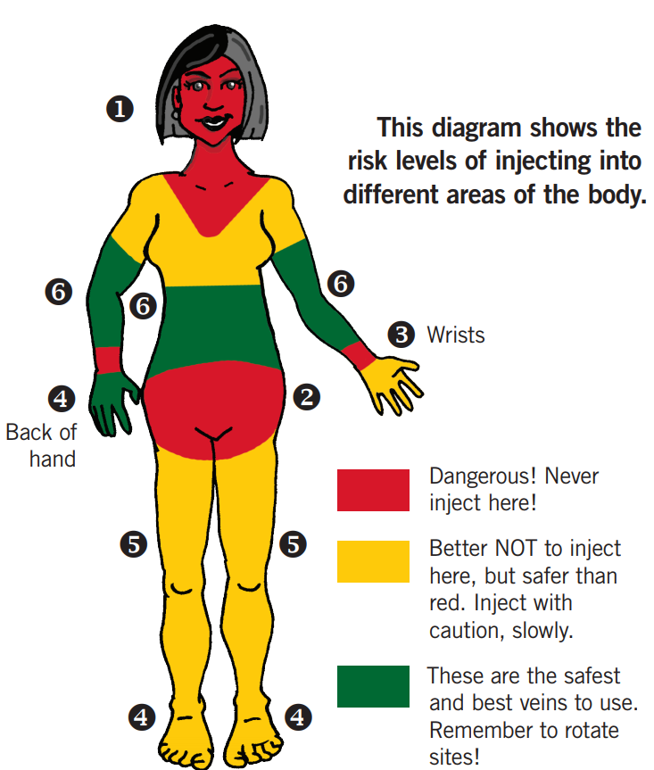
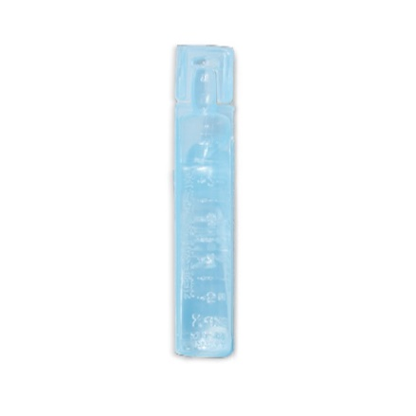
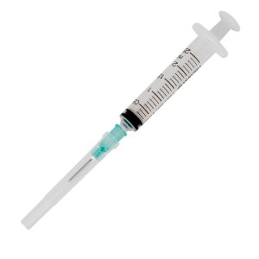
Safer Injection Technique
Aseptic technique
Small needles (higher gauge)
Sharp needles
Bevel up
CATIE, Sharp Shooters 2018

Slide 48
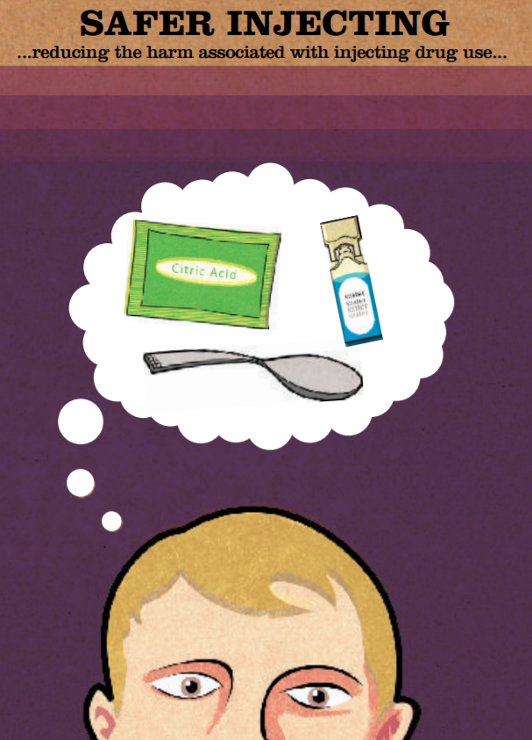
Where to learn more?
Getting Off Right (Harm Reduction Coalition)
Sharp Shooters (CATIE)
Safer Injecting (Merchants Quay Ireland)

Slide 49
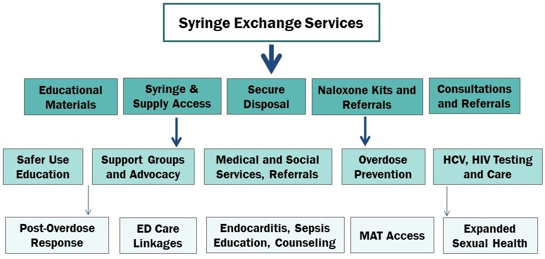
Syringe Exchange Programs
Legal in NC as of July 2016
Active list with contacts maintained at NC DHHS website
Services offered:
Sterile injecting equipment
Secure disposal of used equipment
Naloxone
Education
Many other services
NC DHHS, ncdhhs.gov
NC Harm Reduction Slides, injuryfreenc.ncdhhs.gov, 2019

Slide 50
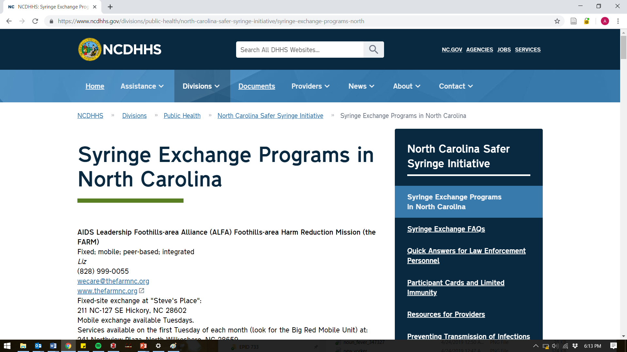
B
Search “NC DHHS Syringe Exchange”

Slide 51
Medications for Opioid Use Disorder
Detoxification alone ineffective (60-81% relapse in one year)
Treatments for methamphetamine or cocaine - tougher
Medication | Mechanism of Action | Notes
Methadone | Full opioid agonist | Must be delivered in Opioid Treatment Program (aka methadone clinic)
Buprenorphine | Partial opioid agonist | -Delivery in primary care settings – need “X” waiver -In-hospital use by anyone -Precipitated withdrawal risk
Naltrexone | Opioid antagonist | -IM injection q28 days -Precipitated withdrawal risk
Gossop M, Br J Psychiatry 1989. Broers B, Drug Alcohol Depend 2000. Gossop M, Adddiction 2002.
Notes:
This first thing would be to provide comprehensive inpatient addiction care. This is being done at some otherhospitals aggressively. Here is a model of a project in Portland Oregon, describing how they’re using the hospitalization as a “reachable moment” to engage patients, to prescribe drugs to treat addiction, to provide inpatient consults with a multidisciplinary team and improve access to residential and outpatient care. However, this approach relies on having a robust outpatient infrastructure for addiction care that is accessible to patients.

Slide 52
Where to learn more?
NC Injury and Violence Prevention Branch
Poisoning statistics
NC DHHS Syringe Exchange Registry
Harm Reduction Coalition
NCHRC.org
CDC.gov
PCSSnow.org (Buprenorphine waiver)

Slide 54
Conclusions
Bacterial infections are common in people who inject drugs, and can range from mild to severe
Be mindful of atypical infections in persons who inject drugs
Ask what drugs patients use and how they use them
Harm reduction and addiction treatment are key elements of infection prevention
Notes:
So, in summary, drug associated endocarditis is markedly rising in North Carolina. And so too are heart valve surgeries.
Persons undergoing valve surgery are young and have long, expensive hospital stays and the costs falls to individual hospitals and Medicaid.
Overall, the epidemiology of endocarditis is being fundamentally reshaped, at least in North Carolina.

Slide 55
Acknowledgments
UNC Infectious Diseases
David Rosen MD PhD
Christopher Hurt MD
Joseph Eron MD
Myron Cohen MD
UNC Epidemiology
Brian Pence PhD
Steve Meshnick MD PhD
Support from NIAID:
T32AI070114 TIDE
NC Division of Public Health
Aaron Fleischauer PhD
State Center for Health Statistics
Duke
Vivian Chu MD
Li-Tzy Wu ScD
UNC Addiction Medicine
Michael Baca-Atlas MD
Robyn Jordan MD PhD
Contact:
aschranz@med.unc.edu
Notes:
I’m always happy to discuss treatment issues, getting patients into my clinic or research or QI ideas.

Slide 56
Additional References
1. Peters PJ, Pontones P, Hoover KW, et al. HIV Infection Linked to Injection Use of Oxymorphone in Indiana, 2014–2015. N Engl J Med. 2016;375(3):229-239. doi:10.1056/NEJMoa1515195
2. Freyer FJ. HIV outbreak in Lawrence, Lowell is bigger than officials thought. BostonGlobe.com. https://www.bostonglobe.com/metro/2018/07/25/hiv-outbreak-lawrence-lowell-bigger-than-officials-thought/szlLL75UDcNTPeB022NptI/story.html. Accessed December 19, 2018.
3. MacDonald M, Crofts N, Kaldor J. Transmission of Hepatitis C Virus: Rates, Routes, and Cofactors. Epidemiol Rev. 1996;18(2):137-148. doi:10.1093/oxfordjournals.epirev.a017921
4.Paintsil E, Binka M, Patel A, Lindenbach BD, Heimer R. Hepatitis C Virus Maintains Infectivity for Weeks After Drying on Inanimate Surfaces at Room Temperature: Implications for Risks of Transmission. J Infect Dis. 2014;209(8):1205-1211. doi:10.1093/infdis/jit648
5.Nelson P, Mathers B, Cowie B, et al. The epidemiology of viral hepatitis among people who inject drugs: Results of global systematic reviews. Lancet. 2011;378(9791):571-583. doi:10.1016/S0140-6736(11)61097-0
6.North Carolina’s Opioid Action Plan. June 2017. https://drive.google.com/file/d/0B9NAvIvnEGfGMnM4Qjl4ck5WV2M/view. Accessed February 20, 2018.
7. Hepatitis B Questions and Answers for the Public | CDC. https://www.cdc.gov/hepatitis/hbv/bfaq.htm. Published June 13, 2018. Accessed December 16, 2018.
8. Lowe G, Tait C. Limb pain and swelling. Medicine (Baltimore). 2009;37(2):96-99. doi:10.1016/j.mpmed.2008.11.015
9. MRSA Photos | Community | MRSA | CDC. https://www.cdc.gov/mrsa/community/photos/index.html. Accessed December 18, 2018.
10. Lee C-C, Chi C-H, Lee N-Y, et al. Necrotizing fasciitis in patients with liver cirrhosis: predominance of monomicrobial Gram-negative bacillary infections. Diagn Microbiol Infect Dis. 2008;62(2):219-225. doi:10.1016/j.diagmicrobio.2008.05.016
11. Mylonakis E, Calderwood SB. Infective endocarditis in adults. N Engl J Med. 2001;345(18):1318-1330. doi:10.1056/NEJMra010082

Slide 57
Additional References
12. Details - Public Health Image Library(PHIL). https://phil.cdc.gov/Details.aspx?pid=851. Accessed December 18, 2018.
13. Ronan MV, Herzig SJ. Hospitalizations Related To Opioid Abuse/Dependence And Associated Serious Infections Increased Sharply, 2002–12. Health Aff (Millwood). 2016;35(5):832-837. doi:10.1377/hlthaff.2015.1424
14. Schranz A, Fleischauer A, Chu V, Wu L-T, Rosen D. Trends in Drug Use–Associated Infective Endocarditis and Heart Valve Surgery, 2007 to 2017. Ann Intern Med. In press.
15. Bisbe J, Miro JM, Latorre X, et al. Disseminated Candidiasis in Addicts Who Use Brown Heroin: Report of 83 Cases and Review. Clin Infect Dis. 1992;15(6):910-923.
16. NCDHHS: Syringe Exchange FAQs. https://www.ncdhhs.gov/divisions/public-health/north-carolina-safer-syringe-initiative/syringe-exchange-faqs. Accessed December 19, 2018.
17. NC Harm Reduction Data Slides October 2018. https://www.injuryfreenc.ncdhhs.gov/DataSurveillance/StatewideOverdoseSurveillanceReports/NC-HarmReductionMonthlySlides/NCHRC-ReversalSlides-11012018.pdf. Accessed December 18, 2018.
18. 90-113.27. Needle and hypodermic syringe exchange programs authorized; limited immunity. https://www.ncleg.net/EnactedLegislation/Statutes/PDF/BySection/Chapter_90/GS_90-113.27.pdf. Accessed December 18, 2018.
19. Oramasionwu CU, Bailey SC, Moore HN, Oramasionwu CO, Russell AL, Zule WA. Dead space in over-the-counter syringes: The implications for HIV and HCV transmission. Int J Drug Policy. 2015;26(12):1282-1284. doi:10.1016/j.drugpo.2015.08.002
20. Zule WA. Low dead-space syringes for preventing HIV among people who inject drugs: promise and barriers. Curr Opin HIV AIDS. 2012;7(4):369-375. doi:10.1097/COH.0b013e328354a276
21. Choopanya K, Martin M, Suntharasamai P, et al. Antiretroviral prophylaxis for HIV infection in injecting drug users in Bangkok, Thailand (the Bangkok Tenofovir Study): a randomised, double-blind, placebo-controlled phase 3 trial. The Lancet. 2013;381(9883):2083-2090. doi:10.1016/S0140-6736(13)61127-7
22. Martin M, Vanichseni S, Suntharasamai P, et al. The impact of adherence to preexposure prophylaxis on the risk of HIV infection among people who inject drugs. AIDS. 2015;29(7):819-824. doi:10.1097/QAD.0000000000000613
23. Deutscher M, Perlman DC. Why some injection drug users lick their needles: a preliminary survey. Int J Drug Policy. 2008;19(4):342-345. doi:10.1016/j.drugpo.2007.06.006
24. Getting Off Right Safety Manual - Harm Reduction Coalition. 2012. https://harmreduction.org/drugs-and-drug-users/drug-tools/getting-off-right/. Accessed December 19, 2018.

Slide 58
Image credits
https://p.globalsources.com/IMAGES/PDT/B1155062142/Medical-Alcohol-Pads-Alcohol-Swabs.jpg
https://www.cdc.gov/hiv/risk/prep/index.html
https://www.raffleshealth.com/pub/media/catalog/product/cache/image/e9c3970ab036de70892d86c6d221abfe/t/e/tetanus_diphtheria_pertussis_vaccine.jpg
https://www.arrowheadforensics.com/sterile-water-ampule.html
https://www.thevetstore.net/shop/syringe-with-needle/
Malika Favre, New Yorker 2017
Noun project
Woman by monki
Hospital by ProSymbols
fever by Lorie Shaull
Drug by Shastry
blood bag by Manop Leklai
Calendar by mynamepong
virus by Nuttapon Pohnprompratahn
Health check by Eucalyp

Slide 59
Addiction Care in the Inpatient Setting
https://www.aha.org/system/files/content/17/opioid-ohsu-case-study.pdf

Slide 60
Opioid Epidemic - NC
NC Opioid Action Plan, 2017
Notes:
I’ll start by highlight that overdose deaths are still rising in NC. The epidemic is shifting away from prescription opioids, as seen in the bottom green and light blue color, to drugs such as heroin and synthic narcotics, which is the dark blue area on the top.

Slide 61
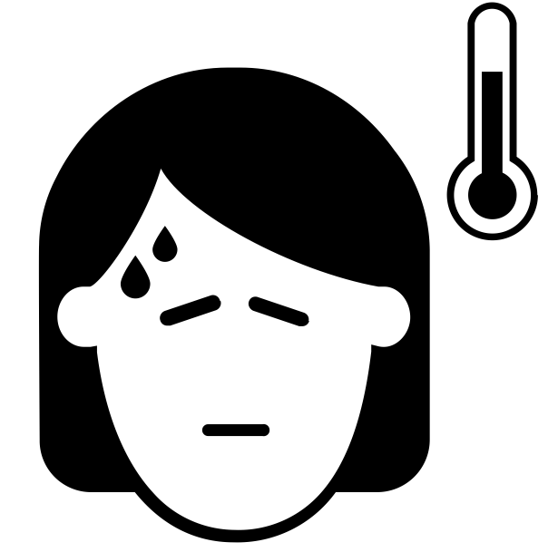
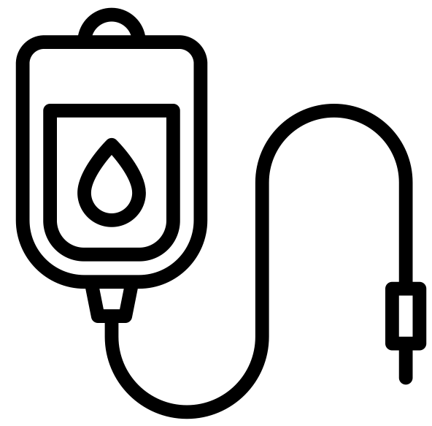
Back to Case
HIV antigen/antibody negative
Hepatitis A IgG positive
Hepatitis B surface antigen negative
Hepatitis B core IgG negative
Hepatitis B surface antibody positive
Hepatitis C antibody positive
HCV RNA 3,000,000

Slide 62
Hepatitis A
Hep A
Sporadic outbreaks among people who inject drugs, homeless, male-to-male sexual contact
Check IgG and immunize if negative
Notes:
Hepatitis A has had frequent outbreaks across the country, largely affecting people who inject drugs, homeless persons and men who have sex with men.
In terms of Hepatitis B, many of these patients with, say, endocarditis, will be immunized as a child. However, immunity can wane over time. The CDC recommends to immunize for Hep A and Hep B for persons who inject drugs. So in a second I’ll discuss more how to check for immunity.

Slide 63
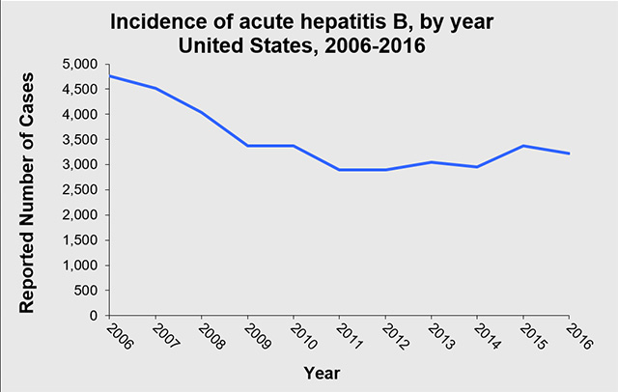
Hepatitis B
Hep B
HBV incidence declined through 2012, stable since
Recommended to immunize all infants (1991)
Many young PWID will be immune
To do:
Check HBsAg, HBcAb and HBsAb
If all negative, then immunize
Recommended by CDC for PWID
Pattern | Meaning
sAg+ | HBV-infected -Further evaluation
sAb+ | HBV-immune
cAb+ only? | Likely exposed, consider window period. Unlikely need to immunize
Conventional/Twinrix
3 doses: 0, 1, 6 months
Novel Adjuvant
(Heplisav)
2 doses: 0 and 1 month
Notes:
Hepatitis A has had frequent outbreaks across the country, largely affecting people who inject drugs, homeless persons and men who have sex with men.
In terms of Hepatitis B, many of these patients with, say, endocarditis, will be immunized as a child. However, immunity can wane over time. The CDC recommends to immunize for Hep A and Hep B for persons who inject drugs. So in a second I’ll discuss more how to check for immunity.

Slide 64
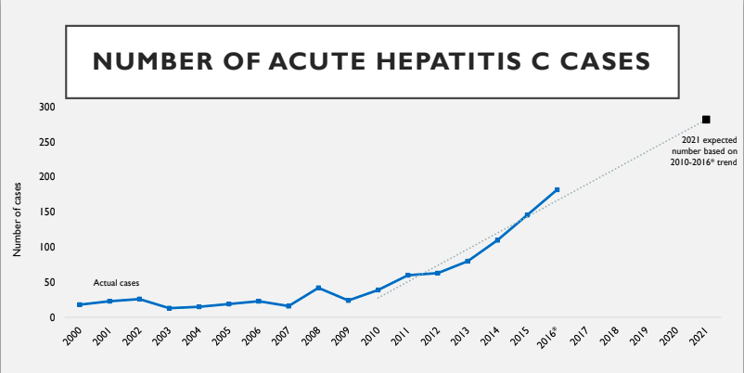
Hepatitis C
Hep C
Widely prevalent among current or prior people injecting drugs
Higher risk of acquisition (than HIV)
>40-60% currently or previously infected
Efficient transmission by injecting
Can persist on inanimate surfaces for six weeks
Acute HCV
Viral syndrome, elevated LFTs, recent exposure
Infrequent and often missed
NC Opioid Action Plan, 2017; Macdonald, Epidemiol Rev 1996
Paintsil, J infect Dis 2014; Nelson, Lancet 2011
Notes:
-Hepatitis C is highly infectious by blood exposure. Therefore it is widely prevalent among people who have ever injected drugs.
About a quarter will clear spontaneously without treatment – these persons will have a Hep C antibody positive but it will not confer immunity to reinfection.
-Acute Hepaittis C is a real syndrome. Patients typically present with an acute viral syndrome and elevated LFTs with a recent exposure. It is often missed, but if you’re taking of someone who has recent exposure, such as an injection drug user, with high LFTs, you should check a Hepatitis C RNA.
-After infection, most people progress to chronic hepatitis C which causes cirrhsosis over the course of years.
-As you know, the world of hepatitis C treatment has dramatically changed in the past five years. There are many, highly-effective options. Interferon is essentially never used.
The new drugs have almost no side effects, very rare failures, and are as short as 8 to 12 weeks. Again, people can still get reinfected after treatment if they have ongoing exposure.
-The guidelines indicate that persons with ongoing injection drug use should definitely be treated. Part of this rationale stems from the benefit it will have in eliminating forward transmission.
-Yet the drugs are expensive… but – In our experience the majority of people who need treatment and are injection drug users are uninsured. We’ve found that this is one of the easiest populations to obtain treatment for through pharmaceutical company assistance programs. So it can be done, and please send these patients to us.

Slide 65
Chronic Hepatitis C
Hep C
Treatment highly effective and nontoxic
Direct acting antivirals (DAAs) – many, many options
85-100% cured among people who inject drugs
8-12 week courses
Reinfection is possible after treatment
AASLD/IDSA Guideline to treat all persons with HCV
Regardless of ongoing IDU
Expensive?
Yes, but…
Available through drug assistance programs.
Medicaid coverage available
HCVguidelines.org
Notes:
-Hepatitis C is highly infectious by blood exposure. Therefore it is widely prevalent among people who have ever injected drugs.
About a quarter will clear spontaneously without treatment – these persons will have a Hep C antibody positive but it will not confer immunity to reinfection.
-Acute Hepaittis C is a real syndrome. Patients typically present with an acute viral syndrome and elevated LFTs with a recent exposure. It is often missed, but if you’re taking of someone who has recent exposure, such as an injection drug user, with high LFTs, you should check a Hepatitis C RNA.
-After infection, most people progress to chronic hepatitis C which causes cirrhsosis over the course of years.
-As you know, the world of hepatitis C treatment has dramatically changed in the past five years. There are many, highly-effective options. Interferon is essentially never used.
The new drugs have almost no side effects, very rare failures, and are as short as 8 to 12 weeks. Again, people can still get reinfected after treatment if they have ongoing exposure.
-The guidelines indicate that persons with ongoing injection drug use should definitely be treated. Part of this rationale stems from the benefit it will have in eliminating forward transmission.
-Yet the drugs are expensive… but – In our experience the majority of people who need treatment and are injection drug users are uninsured. We’ve found that this is one of the easiest populations to obtain treatment for through pharmaceutical company assistance programs. So it can be done, and please send these patients to us.

Slide 66
HIV
Sporadic outbreaks among people who inject drugs
Inefficiently transmitted by injection drug use
Peters, NEJM 2016.
MMWR 2019

Slide 67
HIV
Event/act with HIV+ partner | Per-Event/Act Probability (%) | One transmission approximately every…
Blood transfusion | 88.3 -100 | 1 transfusion^{1,2}
Bottoming (RAI) | 0.73 - 1.7 | 140 times bottoming²⁻⁵
Shared needles / works | 0.63 - 2.4 | 160 injections¹
Vaginal sex (M-to-F)* | 0.08 | 1250 times having sex^{2,3}
Topping (IAI) | 0.06 - 0.62 | 1700 times topping^{2,5-7}
Vaginal sex (F-to-M)* | 0.04 | 2500 times having sex^{2,3}
Oral sex (fellating) | 0.01 - 0.17 | 10000 acts performed^{6,8}
1 Baggaley AIDS 2006;20(6):805-12 2 Patel AIDS 2014;28(10):1509-10 3 Boily Lancet ID 2009;9(2):118-29
4 Baggaley Int J Epi 2010;39(4):1048-63 5 Scott JAIDS 2014;65(1):115-21 6 Vittinghoff Am J Epi 1999;150(3):306-11
7 Jin AIDS 2010;24(6):907-13 8 Baggaley Int J Epi 2008;37(6):1255-65 * high-income / low-prevalence countries
Courtesy of CB Hurt

Slide 68
HIV
Testing
4th generation antigen/antibody test
Consider HIV RNA if concern for acute HIV
Notes:
The standard HIV test at UNC is a combined antigen-antibody test. This is pretty good for detecting HIV at any point but not perfect for acute HIV. So in a high-risk individual, such as an injection drug user, with a compatible clinical syndrome for acute HIV, you can send an RNA as well.
Regardless, every person admitted with a complication of injection drug use must get an HIV test.

Slide 69
Pre-Exposure Prophylaxis for HIV
Combination antiretrovirals for prevention of HIV acquisition
Tenofovir disoproxil fumarate / emtricitabina (Truvada) once daily
One study of directly-observed PrEP among PWID in Bangkok
Adherence is important
Recommended by CDC for PWID
Choopanya, Lancet 2013
Martin, AIDS 2015

Slide 70
Results: Target Valve
Notes:
This chart demonstrates the valves that were operated on. Involvement of left sided heart valves were common in both groups but drug-associated patients had noticeably higher number of tricuspid valve surgeries. Classically, drug-associate dendocarditis affects the tricuscpid valve – so this is a good indicator that we had accurately identified the drug-associated population.

Slide 71
Infective Endocarditis Hospitalizations
Notes:
Here are overall trends in endocarditis hospitalizations in NC. I included total number of hospitalizations here to give a sense of the magnitude. You can see a s ignificant rise starting around 2013-2014.

Slide 72
Infective Endocarditis Hospitalizations
Notes:
When breaking down by drug-associated status, it is clear that a rise in drug-associated endocarditis is driving this.

Slide 73
IE Hospitalizations with Surgery
Notes:
Here are all hospitalizations where valve surgery was performed for endocarditis

Slide 74
IE Hospitalizations with Surgery
Notes:
Again, broken down by drug use status, you can se e that the non-drug cases – the orange line – are fairly constant over time, while the blue line – the drug associated cases – increased from under ten per year statewide to 109 in the last year. In the final year, drug-associated cases accounted for almost half of all valve surgeries for endocarditis.

