Slide 1
University of North Carolina at Chapel Hill Department of Allied Health Sciences Division of Occupational Science & Occupational Therapy UNC MSOT INFORMATION SESSION

Slide 2
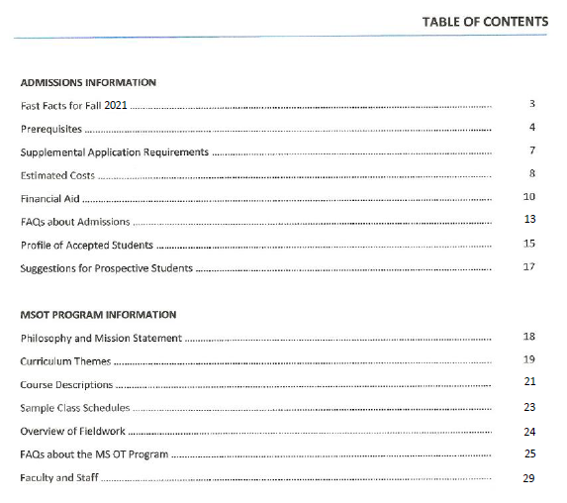
Handouts…
UNC OT Website
(www.med.unc.edu/ahs/ocsci)
Prospective Students
Information Sessions

Slide 3
The ACOTE mandate for a single, doctoral-level entry to the profession was rescinded in April of 2019. A motion to move to doctoral entry level was again submitted to the AOTA Representative Assembly in November of 2019 but was defeated by a large margin.
Entry-level OT education is at a Master’s level (MSOT or MOT) or doctoral level (OTD or “clinical doctorate”)
Entry-level OT Assistant education is at an Associate’s degree level or Bachelor’s level.
The faculty of the UNC OT program have made the decision to continue the MS program so as not to increase costs for students, and to maintain our commitment to diversity, which we feel could be affected by moving to an OTD.
Bureau of Labor Statistics Occupational Outlook Handbook https://www.bls.gov/ooh/

Slide 4
THEMES (p.19)
COURSES (p.21)
Context & Community
Human Capacity for Action
Occupation
Ethics, Justice, and Care
Leadership & Collaboration
Inquiry, Scholarship, and Innovation
Therapeutic Processes
I-III
FIELDWORK
(p.24)
Level I
Level II
CURRICULUM

Slide 5
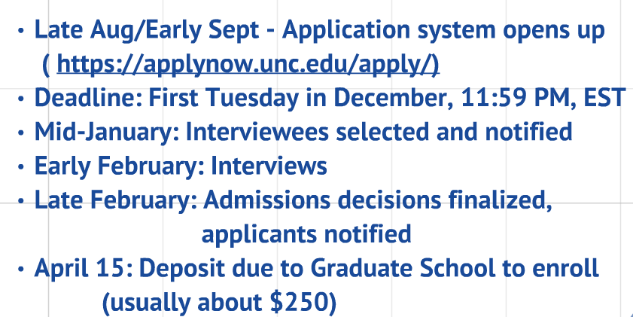
TIMELINES
(see also “Fast Facts” document on page 3 of handouts)
ADMISSIONS

Slide 6
APPLICATION REQUIREMENTS
GRE NO LONGER
REQUIRED!
GRE (Graduate Record Exam)
Undergraduate transcripts
CV/Resume
3 Letters of Recommendation (1 OT)
Statement of Purpose Essay
Prerequisite Courses
Record of OT Observations
Reflective Essay on Occupation Prerequisite
See also: https://gradschool.unc.edu/admissions/instructions.html
ADMISSIONS

Slide 7
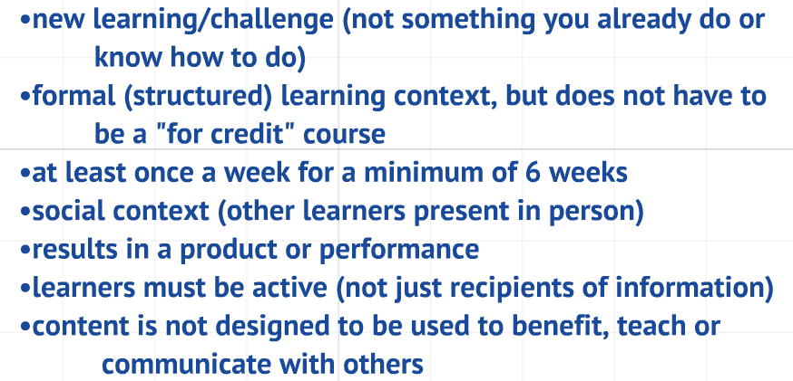
OCCUPATION
Fixed Prerequisites
2 semesters human anatomy & physiology with lab
Statistics
Abnormal Psychology
Flexible Prerequisites
Human Development/Behavior
Social Institutions/Systems
Modes of Reasoning
Occupation
https://youtu.be/S6izc_Mu8eg
PREREQUISITES (p. 4)

Slide 8
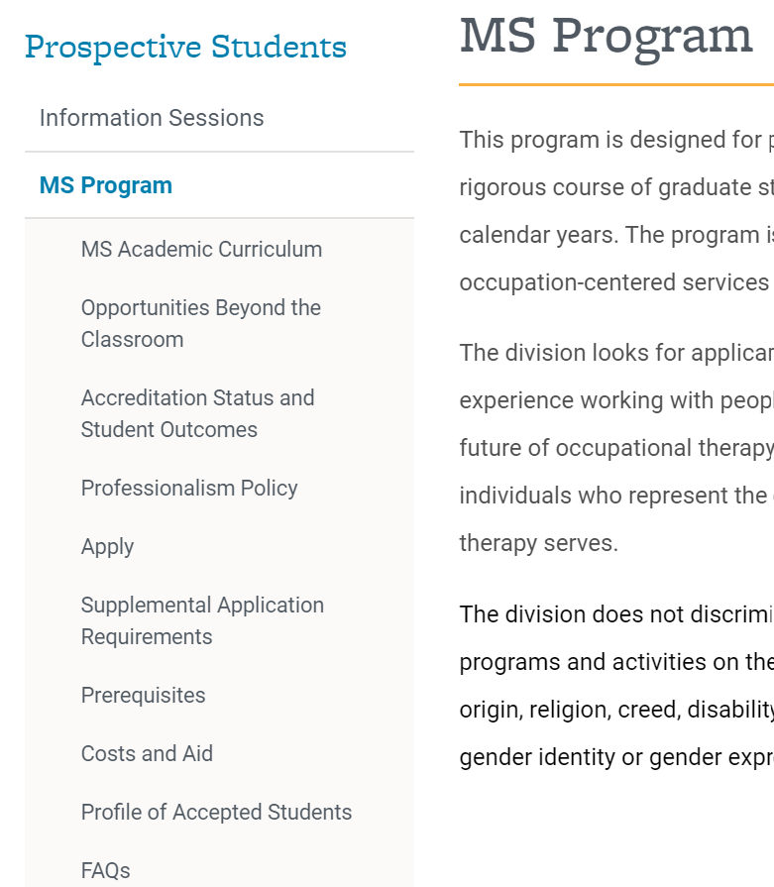
ADDITIONAL INFORMATION

Slide 9
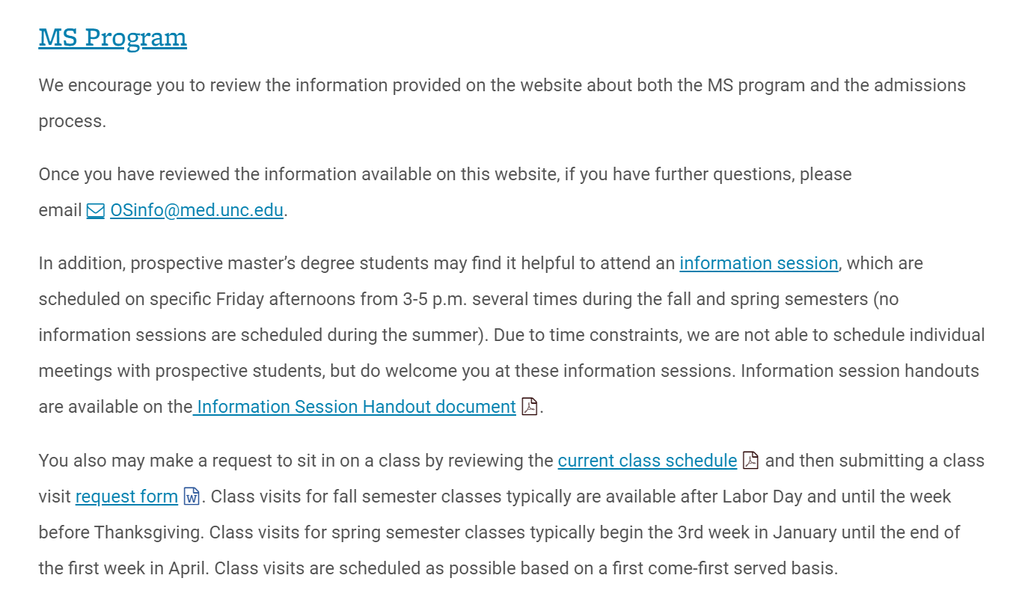
ON THE “PROSPECTIVE STUDENTS” PAGE…
ADDITIONAL INFORMATION

Slide 10
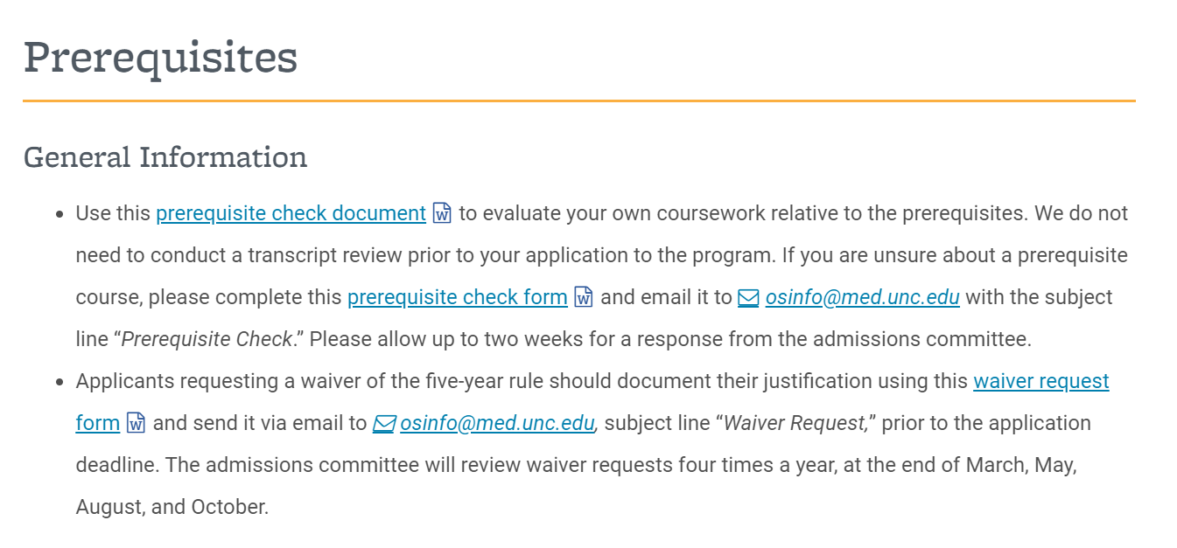
ON THE “PREREQUISITES” PAGE…
ADDITIONAL INFORMATION

Slide 11
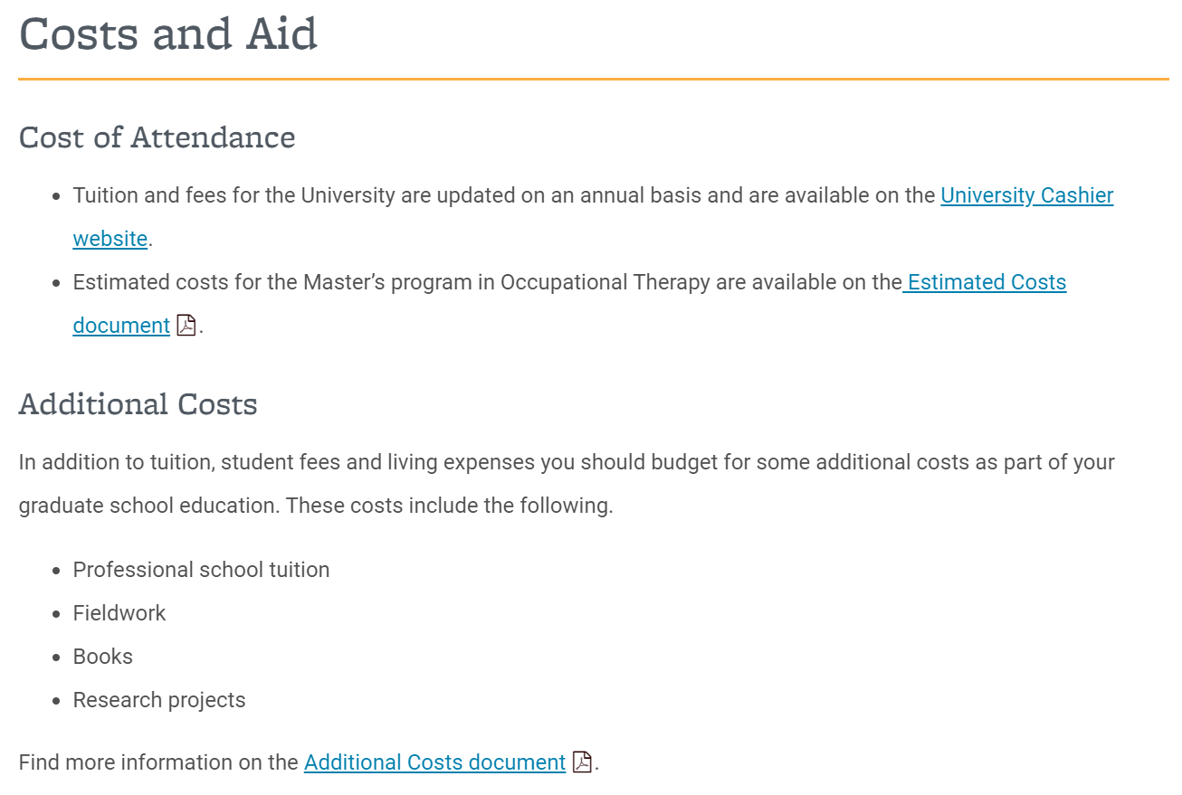
ON THE “COSTS AND AID” PAGE…
ADDITIONAL INFORMATION

Slide 12
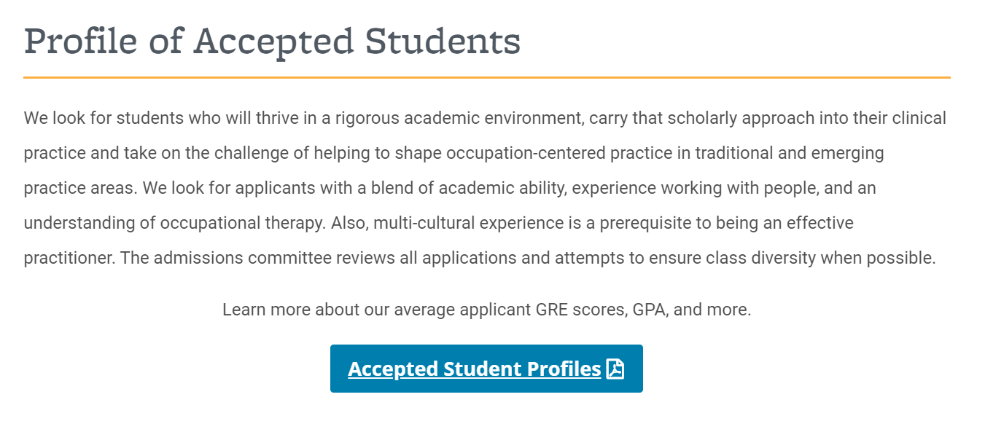
ON THE “PROFILE OF ACCEPTED STUDENTS” PAGE…
ADDITIONAL INFORMATION
(Page 15 in Handouts)

Slide 13
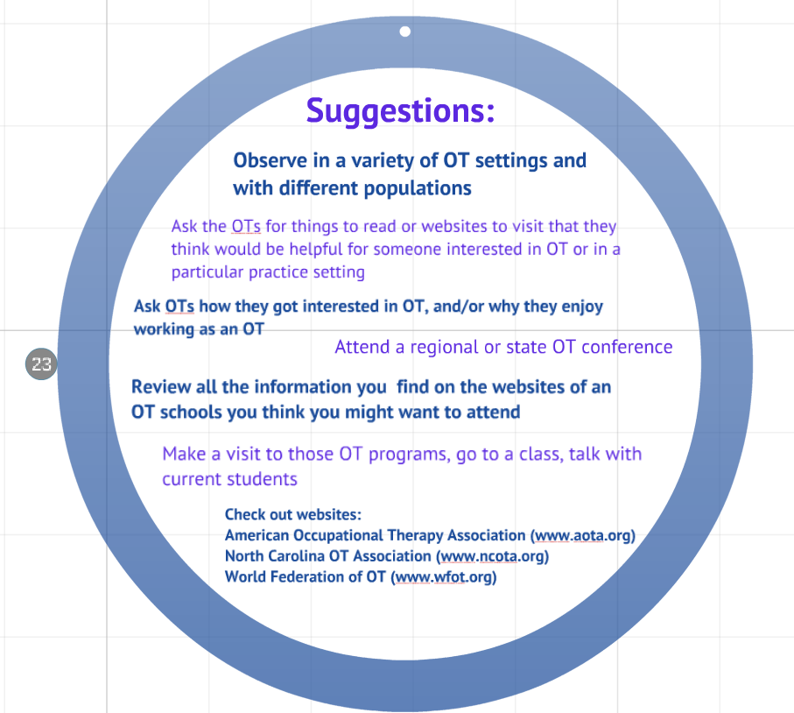
After you have reviewed
the information in these slides and the handout package that goes with them, and the information on our website, if you have questions, please send them to: osinfo@med.unc.edu
(Page 17 in Handouts)

Slide 14
THANK YOU!

