Slide 1
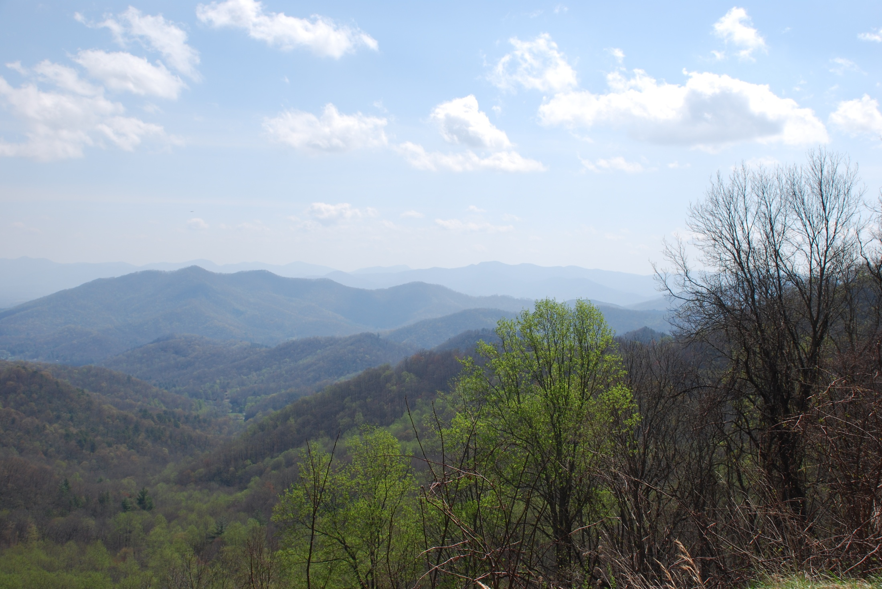
Katharine R. Meacham, Ph.D., Mars Hill University
University of North Carolina School of Medicine-Asheville
Arlene M. Davis, J.D., UNC Center for Bioethics,
Dept of Social Medicine, UNC SOM
Director, Clinical Ethics, UNC Hospitals
MORAL IMAGINATION & applied medical education
Notes:
“Moral Imagination” = term coined by 19th century “father of conservatism” Edmund Burke (!), used widely today, and especially in the past 20 years by ethicists and philosophers who pick up from Mark Johnson’s 1993 book on moral imagination. His argument: humans are imaginative beings, and doing ethics well, with evidence from cognitive sciences, requires cultivating and exercising imagination, as well as critical thinking and application of principles.
The irony of using that term is this: Burke would never approve of Mark Johnson’s use of the term, of taking “evidence” from something called “cognitive science,” and of using it on behalf of a contextual, narrative ethics that encourages the individual’s use of creative thinking.
Burke defines “moral imagination” as that which “the heart owns and the understanding ratifies” – being the inheritance of Plato, Virgil, Dante… and NOT that of any Enlightenment rationalist or revolutionary spirit which his 18th century colleagues, especially those across the pond in France, were championing. Burke used the term to refer to the responsibility of those in power to choose words that will help guide those they influence toward developing appropriate virtues, skills, and knowledge appropriate to their leadership roles. Choosing words ethically requires moral imagination. Developing virtues, skills and knowledge of ‘the good’ requires moral imagination.
Arlene and I are using that term because of its inherent irony – the father of conservatism who would be dismayed at the primary of reason/ evidence-based medicine, cf/ vs the wisdom of the ages and on the other hand, the encouragement from the practice of teaching medical ethics in such a way that encourages individual imagination in response to ethical quandaries in which students find themselves.
Here’s our plan of action for the next 40 minutes:
I’ll present the integrated clinical ethics curriculum in Asheville’s longitudinal clerkship;
Arlene will present how clinical ethics is done for med students and residents in the hospital here.
We will outline preliminary results of the comparative ethics education study done between a cohort of Chapel Hill MS3s and the Asheville group from 2012-13, and
Open for questions.
TOMORROW, 12-1, we’ve planned a workshop to do conversation about some possibilities for using insights from the Asheville program as the TEC curriculum “threads” ethics and professionalism into the Application Phase…

Slide 2
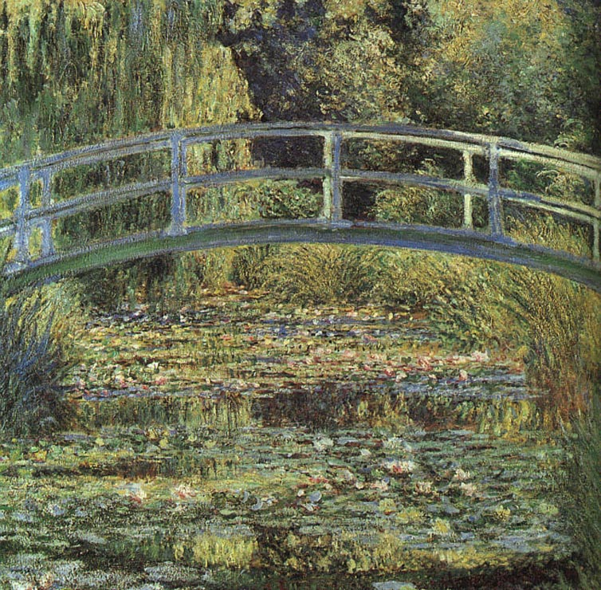
SOM-Asheville Ethics Curriculum
Desired Outcomes:
For the students to be able to identify an ethical issue when they see one
For students to be able to imagine more than one possible response—at least in retrospect
…in a safe, dialogical space
Cohn, Felicia and Bill Rudman. “Ethics Education in the Clinical Setting.” Academic
Exchange, Fall 2004: 111-115.
Eckles, RE, et al. “Medical ethics education: where are we? where should we be going? A
Review.” Academic Medicine, December 2005: 1143-52.

Slide 3
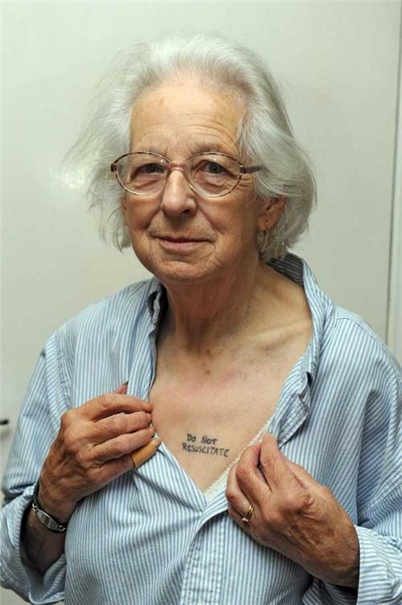
Longitudinal ethics @ UNC SOM-A
Continuity care w/ patients
In-patient rounds on ob
Art of Medicine seminars*
Master Clinician cases
Free clinic i-disciplinary teams
Ethics notes in clinical logs
Logs are “mined”
Monthly ethics case study
Ethics research google-gp
Hospital Ethics Committee
Individual conferences &
writing

Slide 4
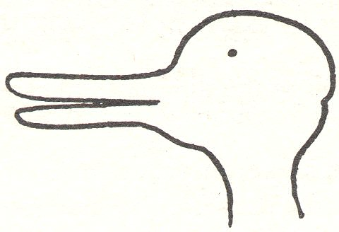
Monthly Ethics Case Conversations: a modest narrative ethics methodology
Situation*
Tensions**
Options***
Resolution****
You*****
* Cases : student-identified ethical quandaries
** Telling the story from different perspectives ➔ ethical differential ➔
identification of ethical tensions
*** Options for resolution: moral imagination required
**** Resolution = recommendation for next step out of this messy story
***** YOU – feelings, your own stories, have a place … here….

Slide 5
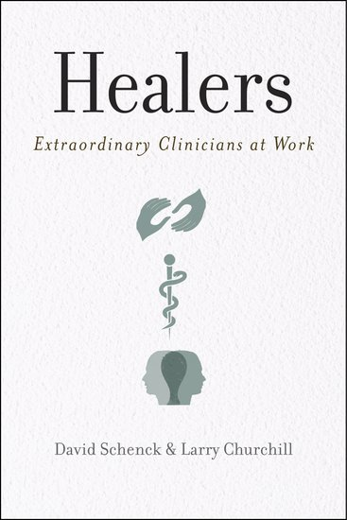
* ART of Medicine sessions
Habits of the Excellent MD **
Ethical dilemmas: MDs’ stories
Mistakes & bad outcomes
Literature, Writing & Medicine ***
Family Life & Medicine-balance??
Treating family, friends & self?
** E.g.,

Slide 6
***Literature and Medicine: e.g., the 55-word story
A Parent is Born
Emma is young, her reasoning concrete. She looks up with frightened eyes, startled by the intensity of labor. Holding my hand, she finally agrees to push. A daughter is born and placed in Emma’s arms –crying, sucking, needing. I want to tell Emma the hard part is over, but I know it has just begun.
Jessica Waters Davis, MD (MS3 in 2011-12)
.
A man struck by an aberrant car.
Brain swelling beyond return to his previous life.
100 people in support waiting outside the ICU doors.
I sob after I leave.
Months later,
I meet.
The woman who hit him
Alone, crushed, traumatized
Her mind broken.
Both lives destroyed by an inattentive moment.
I am a witness.
Katie Jordan, M.D. (MS3 in 12-13)

Slide 7
He gasped when he saw her. Really? I thought doctors had seen it all.
Her brain tumor was protruding through her skull. Not normocephalic. A botched skin graft left exposed bone above her orbit.
She turned from the tv and smiled. “I love it when the Red Sox win!”
Thin line between cadaver and human.
By Alexandra Werner MS3 13-14

Slide 8
UNC-CH Ethics Education
Clerkship and Residency

Slide 9
Current Ethics Education
MICU (Carson/Yankaskas)
PICU (Joyner)
SICU (Gala)*
FM (Ossman)*
EM (Martin)
Pediatric Residents (Peds Chiefs)
CEGR (Center for Bioethics/HEC)
MS CEDG & HEC
Science of Medicine (MS4)
Medicine & Society* (MS1)
HSS Selectives (MS2)*
Clinical Skills 1 & 2*
Clerkship directors*
Capstone*

Slide 10
Snap Shot
2011-2013 Ethics Education at UNC SOM CH

Slide 11
Clinical Ethics Education Series
PICU (2006): 37
MICU (2008): 39
Pediatric Residency (2008): 22
Pilot SICU, Gala (12/12): 63
Pilot FM, Ossman (12/12): 47
Science of Medicine elective (2009): 30*
Introduction to ethics: Medicine & Society and HSS selectives – now PD 1-3

Slide 12
Overview: All Ed & Consults*
*excludes the Ethics Advisory Project in the SICU and Family Medicine
Services | Totals
Education | 273
Level I/II | 181
Level III | 161

Slide 13
What’s Next?
Adding ethics session in Respiratory Course (Henderson)
Adding HEC as advisory body to CEDG
Planned research study (Joyner, Cadigan, others) to evaluate
current ethics education series (resident, med student, faculty)
incoming residents
4th year medical students, and
a subset of hospital staff

Slide 14
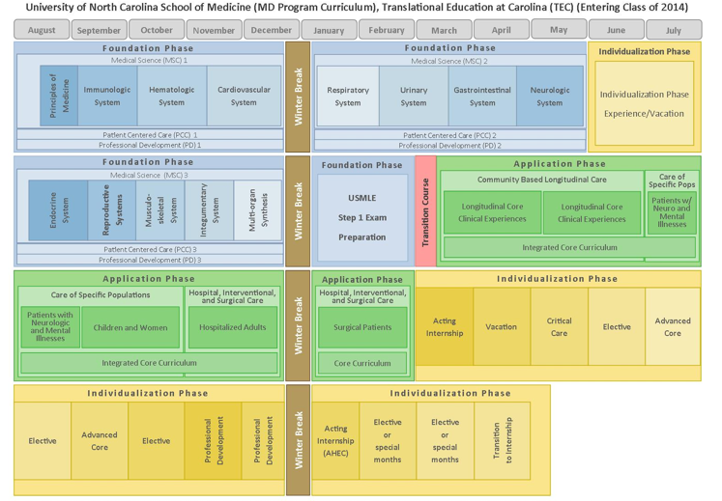

Slide 15
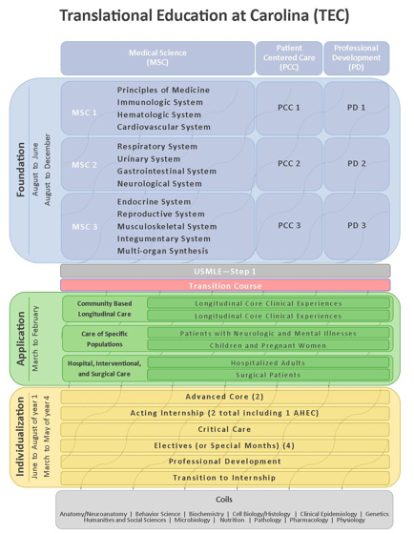

Slide 16
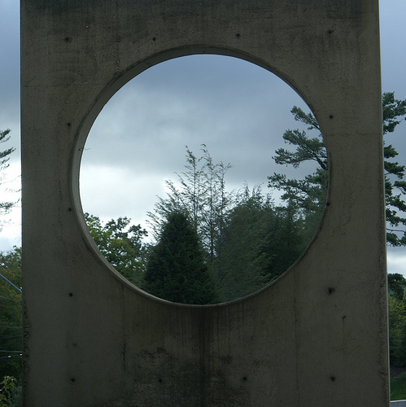
Comparative study on ethics ed UNC SOM-CH and UNC SOM-A 12-13
Research questions:
How well do MS3s on the two campuses identify ethical issues and exercise moral imagination in responding to them?
What kind of moral distress does each group of MS3s experience?

Slide 17
Methods of data collection
3 open-ended Qs
Pre-test at start of year
Post-test at end of year
2 “Post-then-Pre” Qs
Pilot
“Moral Distress Inventory” (Catherine Wiggleton, et al) –used by permission
Medical Educational Evaluation Survey and PPOS --Patient-Practitioner Orientation Scale –(Ed Krupat, et al, Harvard)—used by permission

Slide 18
Open-ended Pre- & Post-questions
1. Name the kinds of ethical issues you expect to encounter/ encountered in your clinical work this year.
2. What makes those specific issues you listed "ethical”?
3. Select TWO of those identified issues and write what you hope you would do to respond in a morally reasonable way to that situation. Write what you did and one other way of responding that would also be morally reasonable.
Photo: Patricia Hinz, MD. Palo Alto Med Fndation. Santa Cruz, CA
http://blogs.adobe.com/conversations/2012/08/adobe-stories-photography-as-another-type-of-medicine.html

Slide 19
VERY PRELIMINARY OVERVIEW of : Pre- and Post-tests
Pre- tests: no difference between A & CH!!
Q1: ethical issues expected?
Q2: functional def of “ethical issue”
Q3: pick two & say what you’d hope you’d do in response
Post-tests: some difference
Q1: A students identified more issues than CH
Q2: relatively similar
Q3: CH students identified issues that were framed more as “right v. wrong” and A students identified issues that were framed more as “right v. right”…

Slide 20
Q #1 Pre-test: Name the kinds of ethical issues you expect to see this year
UNC SOM-Asheville =
UNC SOM-Chapel Hill
Informed consent
Conflicts of interest (pharma, etc)
Access to good care
Different values from patients
Medical education & ethics
Respect for patients (jokes, derogatory comments, etc.)
Patient autonomy v. clinical beneficence
Informed consent
Conflicting values with attendings, residents
Conflicting values from patients
Medical education & ethics
Access to good care
Respect for patients (etc.)
Patient autonomy v. clinical beneficence

Slide 21
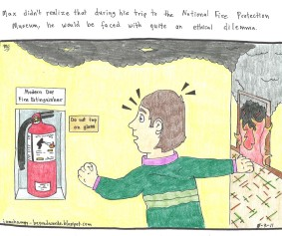
Q2 – What makes those issues “ethical”?
SOM-Asheville =
SOM-Chapel Hill

Slide 22
Q #3 post-test: select two cases; tell story; imagine alternative resolution
CH themes (prioritized)
Asheville themes (prioritized)
MD responsibilities –respect, communication, power, informed consent & Pt rgts
End-of-Life issues
Systems/ economic justice/ access to care
Medical education and ethics
Beginning of life (abortion)
MD responsibilities, disclosure, respect, communication, informed consent & Pt rts
End-of-Life issues
Access/ economic justice / systems
Medical education & ethics
Beginning of life issues (management of complex cases)

Slide 23
SOM-A
The end-of-life
cases are the
most difficult.
Mr. O had MOST
form, but his SNF &
family sent him to the hospital, the ICU… NOT what he’d said.
I’m concerned about this issue and am trying to
be active in addressing it in my career.
SOM-CH
My first day on a service – MVA. After
2 successful surgeries,
Pt crashed. Pt’s partner came. Code. Attending talked after pt died. Partner returned with more ?. Attending refused to talk: “I already did.”
Then partner spoke to
me, but I didn’t know
why patient crashed.
felt terrible. … Our
team did not help
process that tragedy.

Slide 24
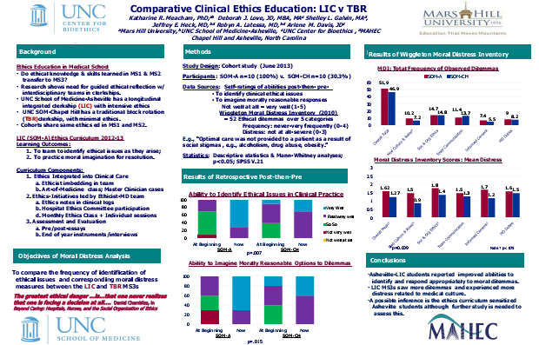
RESULTS: Moral Distress Inventory*
Wiggleton, C.M. (2010). Medical Students’ Experience of Moral Distress.
Academic Medicine, 85 (1), 44-49.

Slide 25
RESULTS – end of year survey including the PPOS* (Patient-Practitioner Orientation Scale)
No difference between CH and A students in PPOS scores➔ same philosophy of shared decision-making
Asheville students have more confidence about their ability to respond to ethical issues than CH students;
Asheville students feel more prepared to practice by including patients in decision-marking.
Krupat, Ed. “Patient-Practitioner Orientation Scale (PPOS)”. Harvard Medical School Center for Evaluation

Slide 26
Were ethics sessions helpful?
SOM-A
SOM-CH
I can't tell you how much the ethics curriculum enriched my clinical experience and I am very appreciative of the opportunities it provided to share my thoughts/ concerns during the year.
I highly valued a curriculum that explicitly valued my character as
a student and future provider. I am glad this was not shoved aside, and that I was encouraged to grow and develop as a person, with support, as my medical
knowledge also grew.
“ It snowed that day and was cancelled.”
I wish I'd been keeping a log of the kinds of ethical issues you asked about. I know that lots of them happened, but at this point I can only really remember the ones that caused me moderate to severe distress or that were more recent.”
Notes:
.

Slide 27
Moral Imagination & Professionalism
Moral Imagination , redux…
Professionalism & TEC
PROFESSIONAL
Virtues: compassion, respect, responsibility, integrity, self-awareness, social concern, commitment
Skills: competence, listening, speaking, team-work, advocacy, accountability
“lifetime of reflection”

Slide 28
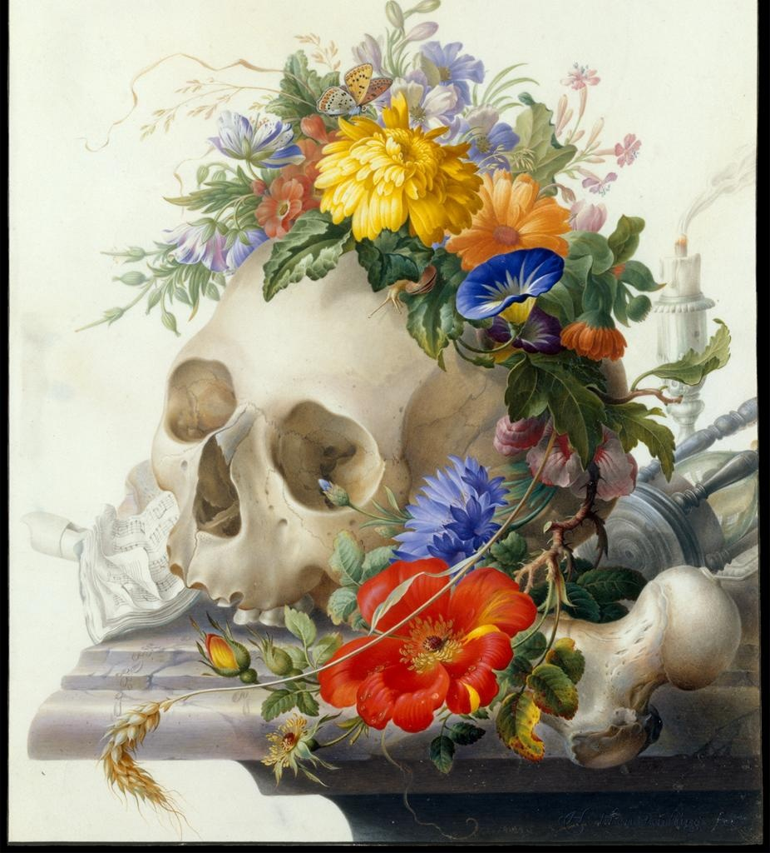
I’ve seen that medical care does not always help, can’t always help. I’ve seen that often what matters most is being heard, being listened to, being understood. I’ve seen that often the best thing I can do is absolutely nothing, besides be there for someone when they need it. I hope I will never forget this year. Patients come in every day, and trust us with their most intimate secrets, fears, and moments. They share their vulnerability with us, and we have to cherish that.
Jacob Stein, SOM-A MS3 2012-13
Recently completed MPH;
MS4 at CH to begin July 1, 2014

Slide 29
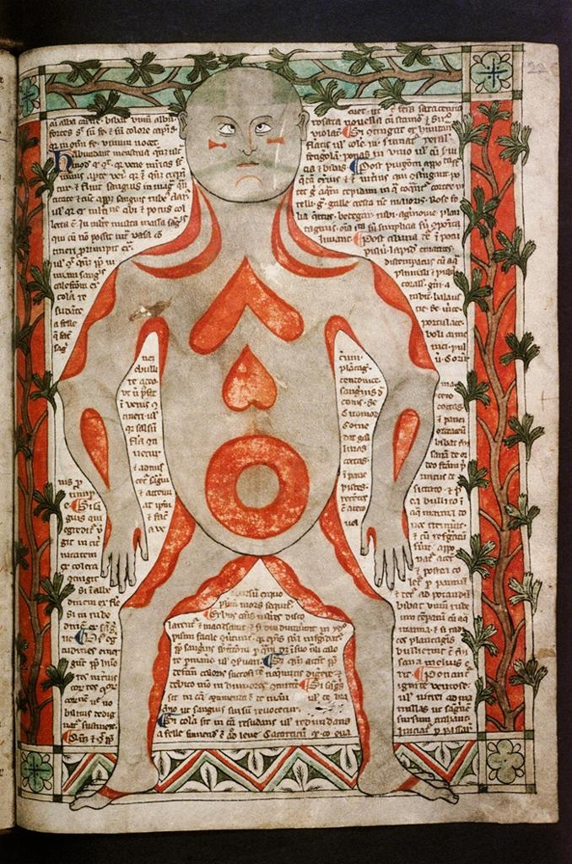
What I learned this year is while medicine is often about algorithms, evidence, and consensus statements that clearly delineate “correct” from “incorrect,” medical ethics is devoid of such clear-cut “rights” and “wrongs.” These issues were ethical because there was no clear answer, no single direct course of action, no algorithm to solve them.
Rebekah Macfie, M.D., SOM-A 2011-2012

