Slide 1
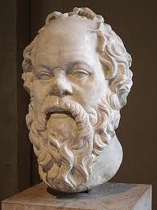
TEC-thics: Can Virtue Be Taught?
Kathy Meacham
Arlene Davis
AOE Workshop, June 2014
Notes:
Abstract: Participants in this workshop, co-led by Arlene Davis, JD and Kathy Meacham, PhD, will wrestle with the question Socrates raised but never answered, as we translate this classical conundrum into the design of the Application Phase. The framework of the TEC curriculum provides creative ways of integrating ethics education through the Professional Development Thread and the Humanities Coil.

Slide 2
Objectives
To imagine robust responses to common pitfalls in clinical ethics education;
To imagine specific possibilities for integrating ethics education into mastery of medical care for hospital and community based patients-.

Slide 3
Things to Keep in Mind
Professionalism : UNC SOM TEC curriculum…
The integrity of both the profession and the person you are
Moral reasoning approaches = well-embedded in the “Professionalism” vision statement
Privilege = implicated into any “profession”
Key Themes for Teaching Ethics in “Application Phase”
Small adjustments in clinical habits of learners ➔ rich learning
Open-ended comments embedded in clinical logs
Safe environment for analysis of clinical ethics quandaries
based on student experiences and encounters
Developing habits for “a lifetime of reflection & refinement”
(Professionalism vision statement, TEC)

Slide 4
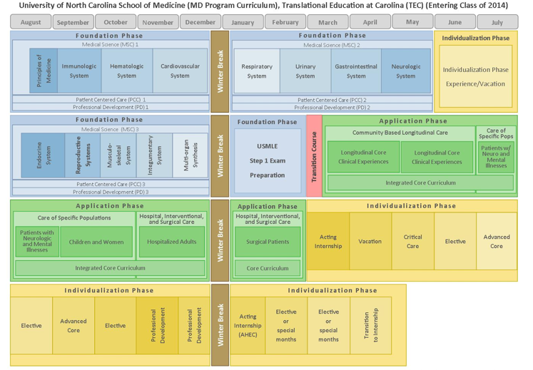

Slide 5
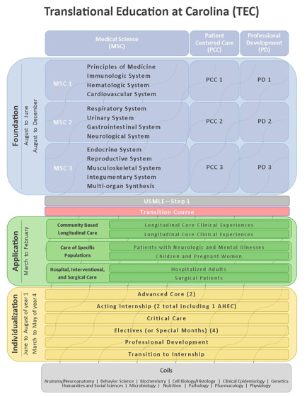

Slide 6
6 Problems/ Challenges
“Hidden curriculum” (or not so hidden?)
Reductionist conceptions of “ethics”
Virtue can’t be taught; just need role models
Moral distress of students
Assumption that ethical knowledge and skills don’t need practice as much as clinical knowledge and skills
Not seeing ethical issues in the first place…

Slide 7
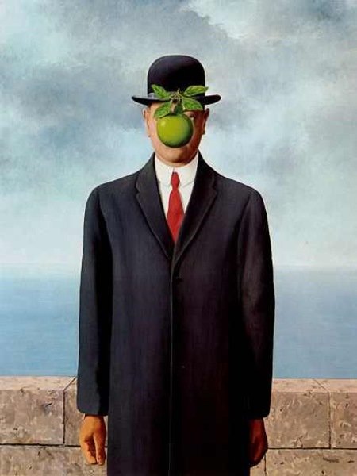
Problem #1
hidden
hidden
curriculum
Hidden curriculum
Results in “change of ethical integrity, emotional neutralization, and the adoption of a “ritualized professional identity”
(Lempp, 2004).
curriculum
hidden
curriculum
hidden
hidden
Combating the hidden curriculum requires the “teaching of ethics . . . throughout the medical curriculum.”
(Hafferty, 1994)
curriculum
curriculum
.

Slide 8
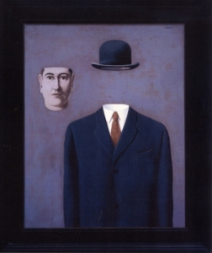
Clinical knowledge & skills
Professional-ism
Ethical knowledge & skills
GOOD
DR
Problem #2
Ray Barfield, MD, PhD, Duke: The problem is that too often, ethics is reduced to “professionalism” and “autonomy.”

Slide 9
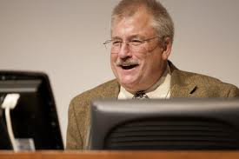
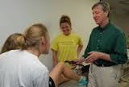
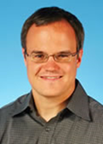
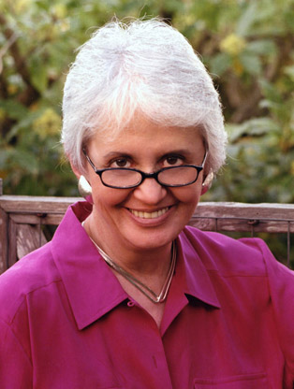
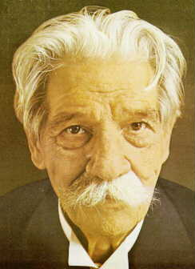
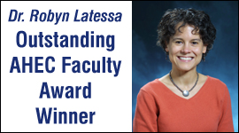
Problem #3: all MS3s need is role models?
(Thulesius, 2007), (Nicholas, 1999), (Erde, 1997)
Marcus Welby MD
Rachel Naomi Remen, MD &
Albert Schweitzer, MD
Robyn Latessa, MD

Slide 10
“Our confidence in our own integrity is frequently overrated.”
Problem #3, Part B: dazzling diagnosticians, superb surgeons…
Bazerman & Tenbrunsel: http://www.nytimes.com/2011/04/21/opinion/21bazerman.html?src=me&ref=general

Slide 11
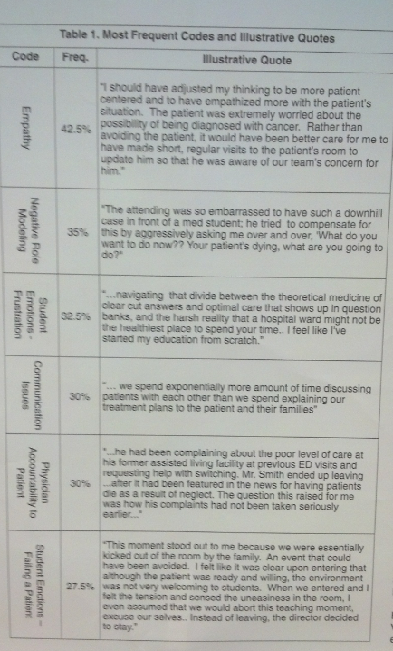
Thematic Analysis of Critical Incident Reports.
Weil, Gupta, Thomson, Reynolds, Chuang

Slide 12
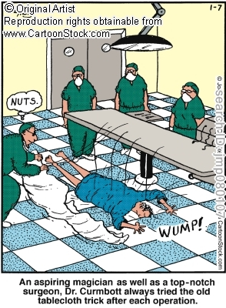
Problem #4: students experience MORAL DISTRESS, even in the best programs
“When placed in positions of moral distress, our ethics meetings gave me a safe place to process the tensions I experienced.”
R. Macfie, SOM-A MS3, 2011-12
White, AA et al. Academic Medicine. 2008 March.

Slide 13
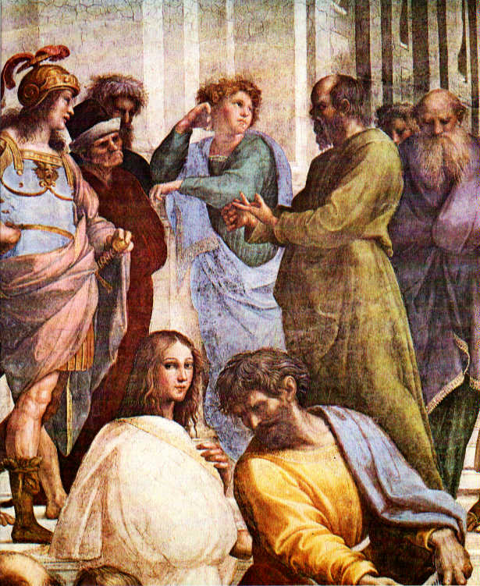
Problem #5 Ethical skills & knowledge — like clinical skills & knowledge — need practice.
Eckles, et al. Academic Medicine.2005 Dec. Also: Bell et al., Brodwin, Brown&DeRenzo, Caldicott&Danis, Cohn&Rudman, Cooper&Tauber Fard et al., Fryer-Edwards et al., Kesselheim&Joffe, Legel&Olthius, Lehrmann et al., Martinez, May, Miller, Molewijk, Musick, Nicholas, Olukoya, Pelligrino&Thomasma, Pruitt, et al., Roberts, Savulescu, Shelp, Singer, Steinkamp, Stolpeer, Thodes, Thulesius et al., White et al.

Slide 14
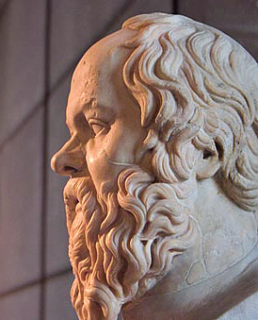
In the midst of it all… Problem #6
"The greatest ethical danger . . .is not that when faced with an important decision one makes the wrong choice, but rather that one never realizes that one is facing a decision at all.”
Donald Chambliss, Beyond Caring:
Hospitals, Nurses, and the Social
Organization of Ethics, 1996
I am only wise insofar as what I don't know, I don't think I know.
Plato, The Apology of Socrates
ἓν οἶδα ὅτι οὐδὲν οἶδα hen oída hoti oudén oída
Socrates

Slide 15
Opportunities in TEC
Application Phase

Slide 16
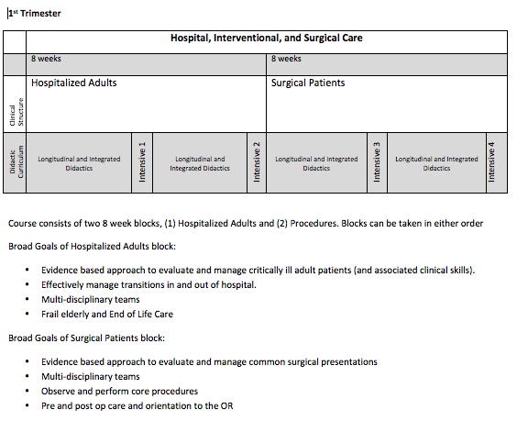
Notes:
Draft only

Slide 17
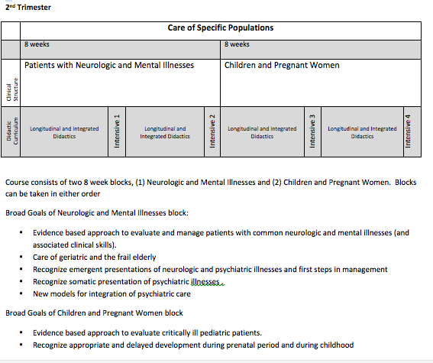
Notes:
Draft only

Slide 18
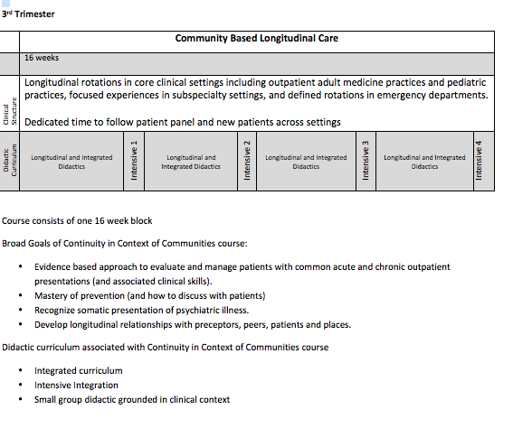
Notes:
Draft only

Slide 19
EXERCISE
1. Choose a trimester of the App Phase:
Hospital, Interventional, and Surgical Care
Care of Specific Populations (neuro/psych; women & children)
Community-based Longitudinal Care
2. Choose a scrivener.
3. Imagine: you are advising Intensives Directors in TEC re integrating ETHICS into the Application Phase.
➔

Slide 20
Design a 2-hour applied ethics class for EACH intensive:
a. Use “broad goals” in learning outcomes—as
clinical contexts for doing applied ethics
b. Analyze ethics case studies from students-ID’d
ethical quandaries from previous month
Creating safe dialogical space (recurring
small group of students/teachers?)
Applying knowledge, skills, values from PD
c. Recall the habits that clerkship mentors modeled
& invite reflection on those habits;
d. Students articulate and develop best practices
for themselves as they develop identities as
“good doctors.”

Slide 21
Questions? Next steps?

