Slide 1
Teaching Through a Critical Incident Curriculum
Amy Weil, MD FACP
Associate Professor of Medicine and Social Medicine
UNC School of Medicine

Slide 2
Outline
Inspiration
History of Critical Incident Reports
Genesis at UNC
Enactment
Experience
Future hopes

Slide 3
Inspiration - Suicide
The suicide rate among male doctors is 40 percent higher than that among men in general, whereas the rate among female doctors is 130 percent higher than that among women in general ¹
11.2% of medical students have experienced suicidal ideation ²
¹Schernhammer ES, Colditz GA. Suicide rates among physicians: a quantitative and gender assessment (meta-analysis). Am J Psychiatry 2004;161:2295-2302
²Dyrbye LN, Thomas MR, Massie FS, Power DV, Eacker A, Harper W, Durning S, Moutier C, Szydlo DW, Novotny PJ, Sloan JA, Shanafelt TD. Burnout and suicidal ideation among U.S. medical students. Ann Intern Med. 2008 Sep 2;149(5):334-41.

Slide 4
Causality – Explanatory Models Schernhammer, Eva. Taking Their Own Lives — The High Rate of Physician Suicide N Engl J Med 2005; 352:2473-2476 June 16, 2005
Higher prevalence of depression among MDs
Higher rates of drug abuse/ alcoholism
Physicians choose effective methods
Sexual harassment as a factor in women
Being single (women)
Professional burden leads to social isolation
Physicians neglect themselves
More self critical
Take personal losses harder

Slide 5
Inspiration - Burnout
What is Burnout?
emotional exhaustion (EE)
depersonalization (DP)
low sense of personal accomplishment (PA)
48.7% of physicians report at least one symptom of burnout¹
49.6 % of medical students²
¹“Burnout and Satisfaction With Work-Life Balance Among US Physicians Relative to the General US Population,” Archives of Internal Medicine, 2012.
²Dyrbye LN, Thomas MR, Massie FS, Power DV, Eacker A, Harper W, Durning S, Moutier C, Szydlo DW, Novotny PJ, Sloan JA, Shanafelt TD. Burnout and suicidal ideation among U.S. medical students. Ann Intern Med. 2008 Sep 2;149(5):334-41.

Slide 6
Inspiration - Values
A majority of medical students noted erosion of moral values as clinical clerks¹
¹Feudtner C, Christakis DA, Christakis NA. Do clinical clerks suffer ethical erosion? Students’ perceptions of their ethical environmental and personal development. Academic Medicine 1994;69:670–9.

Slide 7
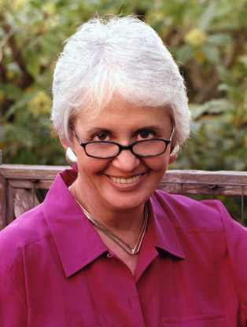
Inspiration - A loss of meaning
Rachel Naomi Remen and the power of stories

Slide 8
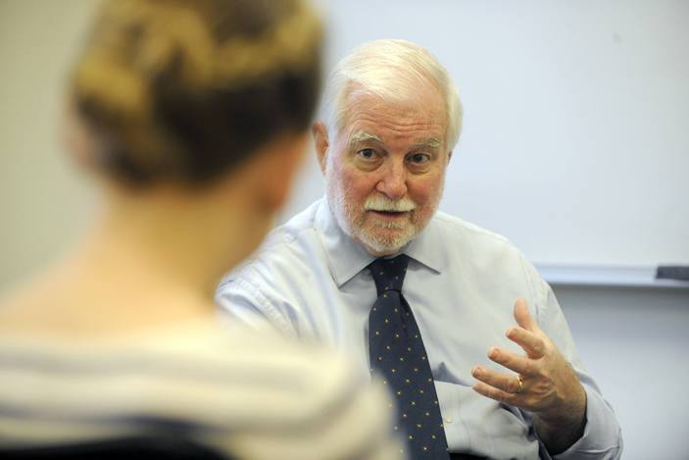
Partial Antidote: Critical Incidents

Slide 9
History of Critical Incident Reports The Power of Transformative Learning¹
Bear witness from the heart about an event chosen by the writer because of its influence
Make a discovery
Grapple with developmental issues
Discussion in group
Explore moral values and attitudes – solidify values
Explore negative professional experiences in a safe space
Gain support from the group to act well
¹Branch, William. Use of Critical Incidents in Medical Education – A Perspective. JGIM 2005 20:1063–1067

Slide 10
Emotion is good for learning McConnell MM, Eva KW. The role of emotion in the learning and transfer of clinical skills and knowledge. Academic Medicine 2012Oct;87(10):1316-22.
Emotion is a powerful tool for encoding memory
Negative emotions are good for encoding detail
Involuntary memories associated with highly negative life events were more prevalent than the involuntary recollections of highly positive ones
Positive emotions generate more flexible thinking
Global processing styles (i.e., focusing on the “big picture”) appear to lead to more associative and relational connections between relevant learning events, which should promote the transfer of knowledge to new situations by enabling individuals to detect analogies across novel tasks.

Slide 11
Appreciative Inquiry
People do their best work when they are doing things that they find personally meaningful, and when they feel that their work makes a difference.
In every society, organization, or group, something is working.
Looking for what works well and doing more of it is more motivating and effective than looking for what does not work and doing less of it.
The act of asking questions of an organization or group influences or changes the group in some way.
Systems move toward what they choose to study
People have more confidence and comfort to journey into the future (the unknown) when they carry forward parts of the past (the known). In other words, continuity is as important as change.
The collective creation of a desired future is most powerful when it is based on the best of what already exists.

Slide 12
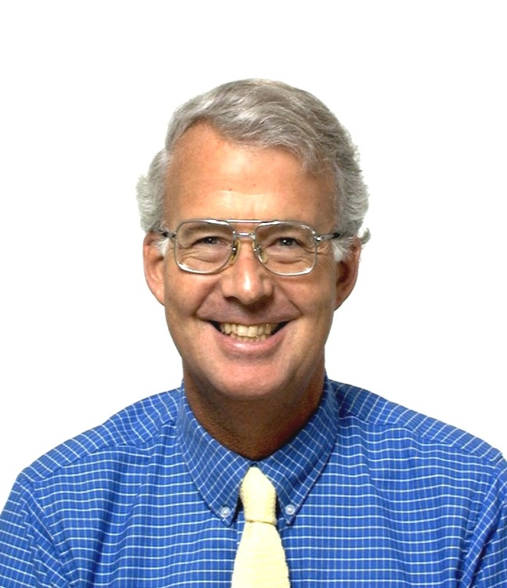
Genesis at UNC - AOE dinner 2010

Slide 13
Enactment
3rd year IM students at midpoint of Inpatient
They write 1 page reflection
I read all and send them comments
For students who agree they are de-identified and bundled by Jeri Copeland and distributed to students and the Advisor volunteer to read prior to meeting
Provided lunch and discussion on Friday

Slide 14
Critical Incident Assignment
Medicine Clerkship – Humanities in Medicine Seminar
Welcome to your Inpatient Medicine rotation! During these 2 months you will work hard and learn a lot. You will take care of very sick people and work in teams, teaching each other. This is where the proverbial ‘rubber meets the road’. The abstractions of your lecture halls, seminar rooms and texts/downloads will now yield to the visceral particularity of your suffering patients, their families and the examples of your colleagues and mentors. You and your team will diagnose, treat, educate, discharge. Sometimes you will cure or heal someone.
There will be times when you are overwhelmed by the enormity of what you still do not know or understand about biomedicine. Though you will do your best, sometimes you will be flummoxed by patients’ problems, unsure of what to do or say next, awed by your colleagues’ approach, shocked by decisions with which you disagree, frustrated by the social/cultural/financial barriers that make it difficult for you/your team to help your patients, improve their quality of life, keep them out of the hospital.

Slide 15
Critical Incident Assignment (cont)
As we discussed in Medicine and Society, many factors enter into situations you face in the real life practice of medicine. Please notice when you have a visceral reaction to a situation (when you feel that something is unfortunate / wrong / unfair /well done) and then jot down the scenario and your reactions. So called Critical Incident Reports (CIRs) offer a unique opportunity to enhance your learning and make you a better doctor.
Please take no more than 1 page to describe briefly the scenario that moved you and begin to analyze it. Please remember HIPAA and try to “de-identify” in order to protect patients and others involved and to free you to discuss the situations frankly.

Slide 16
Critical Incident Assignment (cont)
Examples: patient discharged prematurely due to illegal status (what could you do to help this patient?); experience of racism/sexism etc by patient or staff (what could you have done?); ethical dilemma in care (what did you think was the “right” decision and why?); your own reactions to situations influenced by your life story; an awesome job done by a colleague (why was it great?).
Send your 1 page to amy_weil@med.unc.edu by the end of Friday of the third week of the clerkship. Dr. Weil, along with available Advisors and other faculty, will facilitate discussion beginning with your reports. If you would NOT be willing to have your case shared among your peers, please indicate this on your report. Selected CIRs will be distributed in advance for review. From 12-1pm on the fourth Friday of the clerkship (after the UNC Exam), you will meet for lunch (which we will provide) to learn from each others’ experiences and brainstorm ways optimize outcomes in situations like these.
Questions to consider when reading the CIRs:
1. Have you experienced something similar?
2. Do you agree/resonate with the framing of the dilemma?
3. How would you improve/act differently in the situation?
Optional reading for inspiration: The Good Doctor, by Susan Onthank Mates (available via link on clerkship website)

Slide 17
What do the students write about?
Witnessing, Becoming
Social Determinants of Health Impacts
Family situations
Ethical Dilemmas/Coming to terms with limits
Role models – positive and negative
End of life issues
The meaning of life and work

Slide 18
Witnessing
Performing CPR on a human being, as opposed to a mannequin was a quintessential medical experience. There are a few mile stones in medical school that I feel set it apart from some other graduate programs. For instance, when you receive your first white coat, you meet your cadaver, the first time you feel confident enough in a diagnosis to tell the patient what you think – before talking to an attending, and performing CPR in the hospital. It is an odd, terrible excitement to perform CPR on a patient – especially one that you spoke with just an hour prior. It is the odd pride of having taken part in a code, marred by its conclusion. Afterwards I want to tell me colleagues that I did CPR on a person, just as if a surgeon had let me cut or sew tissue or if I had been allowed to perform a thoracocentesis. However, in this case I feel ashamed of my excitement and my feeling of a new badge being sewn onto my white coat. The man died, his son collapsed in the waiting room, and I was excited to perform chest compressions.

Slide 19
Witnessing
Writing a reflection paper on something that “moved me viscerally” is a surprisingly difficult thing for me to do. On several occasions I have witnessed events unfolding that I am sure should have moved me but for some reason did not. Perhaps spending a month on trauma surgery dulled my emotions to extreme events. Maybe my involvement in EMS subconsciously dampened the significance of a code in my mind. …At times, I even find myself thinking that we are a fighting a battle that maybe shouldn’t be fought: why fight so hard to keep someone barely living for a few more weeks or months?
So lost was I that I turned to a close friend..Her response was to remind me of Mr. and Mrs. X.
Somehow, I’d forgotten about Mr. and Mrs. X until then….during the outpatient medicine clerkship ..I met the 95 and 94 year old Mr. and Mrs. X who had spent more than 70 years of their lives together. Yet, the simple mention of their story brought back the emotions that I felt that day.
Mr. and Mrs. X came to the clinic as new patients looking to establish care in this rural section of eastern North Carolina. ..in their notes was “elderly couple, both with Alzheimer’s. caregiver coming with them to establish care.” Looking back, I am ashamed that as I was walking to their clinic room, I was thinking how frustrating this encounter was likely to be.
What I found after I knocked on the door was an elderly African-American couple, so thin that they managed to share a seat on the patient bench that was really meant for one. They had both been diagnosed a few months previously with Alzheimer’s dementia but these were not Alzheimer’s patients. These were patients with Alzheimer’s. Despite their cognitive declines, they were together, and they were happy. Every 4-5 minutes, one would turn to the other and would ask with a strong southern drawl “You’ OK?” and the other would turn and answer “I’m OK. You’ OK?” “Yeah…” would answer the first. According to their caregiver, this happened all day, every day. To them, each other’s answer was the most important thing.

Slide 20
Witnessing (cont)
The treatment for Alzheimer’s does notoriously little to prolong the life of patients with Alzheimer’s adding perhaps 6-12 months of mild cognitive improvement. What do those 6-12 months mean? To a cynic like me, it may have seemed like very little. But to Mr. and Mrs. X, those 6-12 additional months of living happily together could not mean more. This realization was a much-needed wake-up call for me to the patient’s experience of disease. In some ways, this simple interaction with Mr. and Mrs. X was the reminder I needed that why as health care professionals, we fight so hard every day for those extra few months of life. As corny as it sounds, it gave me a warm feeling deep inside. It made me happy.
Sometimes in the business of medicine, it is possible to forget why you went in in the first place. When asked about visceral feelings, it is easier to think of deep fear, sorrow, or anger. Sometimes tougher to do is think of the visceral feeling of happiness that this field has to offer. More than anything, it is important not to forget these, because these feeling are why we are here.

Slide 21
Witnessing
The large single rooms, sweeping views, and hardwood floors of the cancer hospital feel like an apology from society. We are so sorry for your cancer diagnosis, please be as comfortable as possible. …When there are no more rooms available, we round on patients on other floors. Those rooms are small, double-occupancy,-- a place that you want to leave as soon as you possibly can.
When we came to Mr. H’s room on 6 bedtower … he was the last patient on our rounds list. He was sitting up, legs over the side of the bed. His son and daughter sat in the two available chairs. We filed past his roommate into the cramped space, one attending, one resident, one intern, and two medical students standing awkwardly close to each other. I hovered by the privacy curtain to try to make more room. As Dr. R introduced herself, two more family members (sister and brother-in-law) arrived at the doorway, blocked from the room by the mass of medical personnel.
“We are the cancer team, Mr. H. We have been looking at the lymph node sample from your biopsy yesterday, and it definitely looks like a lymphoma. I’m not sure exactly what kind, but all of the options need chemotherapy right away, so I would like to get a port in you today, before the weekend.” …
Mr. H’s daughter was crying. She squeezed by us and went out to the hallway. In my head, I though “oh my god, this is how they are finding out about a cancer diagnosis. In a cramped hospital room, on rounds with residents and students watching.” Of course, they knew that the biopsy was looking for lymphoma, but this made it real. An oncologist made it real.
In the next few weeks, they will learn the lingo—the RCHOP, cell counts, and chemo side effects. And they will have a private room on the 4th floor of the cancer hospital. But when they think about the beginning—they will picture that small room with 5 doctors crowding around, listening to their life-changing moment.

Slide 22
Social Determinants of Health Impacts
During rounds this morning, I found myself in a situation that did not sit quite right.
…I found my mind wandering as it often does during rounds and life in general. First to the worries of the day and the work that must be done before I can home. Secondly to how many more patients we had to see before rounds would be over. Next to what I would have for lunch and what lecture would be on today. But then finally as I was looking around the room, all the while trying to stay focused on what the resident was saying and at least attempting to appear as if I was paying attention, I took notice of the dichotomy that had presented itself before me. For the first time I noticed that my entire medical team, which included two interns, a resident, an attending, a pharmacist, a pharmacy student, and myself, were all Caucasian while the patient, her mother, and boyfriend were all African American. It was at this point that I began to take inventory of all the things which could possibly be posing a barrier between my team and our patient.

Slide 23
Social Determinants of Health Impacts (cont)
I began to think of how we (the medical team) were in a familiar place, a place we spend the majority of our time each day, a place where we were comfortable and sure of ourselves. I then thought of how the patient and her family were in place that was scary, uncomfortable, and new, one with which, at her young age and minimal past medical history, I’m sure our patient was vastly unfamiliar.
I also began to take into consideration the language which was being used to explain the illness to this 19-year-old. Words and phrases such as “systemic lupus erythematosus” and “rapidly progressing glomerulnephritis” which I barely understand as a third year medical student. I wondered how these words must sound to a young teenage girl who had dropped out of high school to raise a child. Throughout the conversation she politely nodded and listened intently, but only seemed to do so to move the conversation along while her mother stared at us with a wide eyes and a confused look on her face.
I began to take note of little things. How we were all dressed in dress pants, ties, dresses and white coats while they all wore their street clothes. How we were all standing and they were all sitting. How we were close to the door and every so often glancing or inching towards that direction. How when we asked, “Do you have any questions?” it sounded less like an actual question and more like a statement that said, “We have to go now.”
My final thought was how this is the first time this girl had probably ever thought or heard about lupus and what she must feel like. And then I thought of how we see lupus everyday and it’s just another diagnosis to us…
It just didn’t sit right.

Slide 24
Family situations
Hey, have you ever given a Mini-Cog to a patient?” the resident asked me….. It’s a great way to assess dementia and cognitive impairment.”
I knocked on the door of a patient, who I had never before met. I had done a quick read-through of her last inpatient note so I knew something about her story: LH, a 57 year old with stage IV carcinoma of the tongue base to lung and ribs, presenting with altered mental status. The resident was concerned about whether or not she was capable of making her own health care decisions. I opened the door to see a slender woman sitting up in bed. Her lack of hair and frail appearance made her look much older than her age. I introduced myself to the patient, her sister sitting on the couch, and the nurse in the room.
“Ms. H, I’m here to give you a pop quiz,” I say.
“Oh no, I haven’t had one of those in a long time,” she responds with a smile.
“Don’t worry, it’s only two questions and it won’t go on your report card.” I say the three words to her and ask her to repeat them. She does, but says paper instead of pencil. She laughs a little when I correct her, and repeats the original three. Next I explain the clock-draw and hand her a thin notebook and pen. She starts slowly and carefully. I sit next to her sister on the couch and we make small talk instead of staring at the patient while she works. Both of us steal occasional quick glances at Ms. H. She is leaned over the notebook, brow furrowed, with great concentration. Every few seconds she gives a sigh of frustration. Her sister hands over her reading glasses for more help.

Slide 25
Family Situations (cont)
“Here, try this,” the nurse says, bringing a magazine to the patient. “It’ll be easier to write on top of here.” She had noticed the patient struggling, as well.
“Is it OK if I start over?” Ms. H asks. “I’m having trouble making the numbers fit.” I tell her she can try as many times as she wants. Her first few attempts, she only made it half-way around with the numbers before starting again. On her next, she tries a new method and draws the numbers before drawing a circle, but realizes it doesn’t come out in the right shape. She doodles a few swoops to make sure the pen is working correctly, and starts in on her last try. After a good five minutes, she is done and hands me the notebook. I didn’t ask her to draw the hands for 11:10. Her sister leans over to look at the drawings and I can see a surprised, yet disappointed look on her face. “How did I do?” Ms. H asks. I wasn’t ready for that question.
“Well, it’s a little hard to read the numbers but I think you got them all in there. I’ll show this to the doctor and see what he says.” I ask her to repeat those three words from before.
“Apple, house…” she stares up at the ceiling for a minute. “Ugh, I just can’t remember that last one! Paper?” I tell her she’s close, but it was pencil. “So what was this test for?” Ms. H asks me. I wasn’t ready for that question, either. I tried to explain that it’s a quick way to look at memory and concentration. She nods without saying anything, obviously saddened and letdown.
I leave the room wishing I had better answers to her questions, or some words of comfort and reassurance. As a medical student so often at a loss for the perfect response, I am always amazed when doctors say just the right thing during moments like these. Whenever I witness such an interaction, I memorize the doctor’s reply and store it away for future use. I know that with time I’ll eventually have the experience to handle most situations. In the meantime, however, I often get frustrated with how far I have to go.

Slide 26
Ethical Dilemmas/Coming to Terms
…Ms. S has been on our service for most of my rotation with a severe, refractory cytopenia. Her AML and subsequent chemotherapy had rendered her bone marrow totally fibrotic; where most patients’ cell counts and platelets rebound in time, hers never did; moreover, she proved refractory to platelet transfusions, having mounted antibodies against all donor platelets to which she was exposed. She hasn’t been sick, just imprisoned by her consistently single digit platelet count, which, on a good day, might bump up into the teens directly after transfusion. All she has wanted to do is to go home, and each day on rounds she sighs sadly as we come in from the chair by the window where she is usually curled up. She tries to put a brave face on but is unable to mask her profound disappointment as we tell her again that there is nothing we can do but continue to keep her on a platelet drip and watch, as she can’t be safely sent home with platelets <10. She was discharged briefly after an HLA-matched unit was administered to bring her platelets above 30, but was back within two days, looking so much the sadder for having experienced a brief release from the hospital only to be brought right back with a hematoma. Her virtual lack of primary hemostasis has rendered her totally fragile, such that the slightest bump may lead to a massive bleed.
Our efforts to find compatible platelets which might alleviate her symptoms have revealed that there are only 3 matched donors in the country, two of whom are unable to be contacted and the third unable to donate for several weeks. Indeed, the promise of potential matched donors has likely only increased the disappointment as this theoretical panacea has proved to be illusory. A hematopoietic stem cell transplant to attempt to introduce new megakaryocytes into Ms. S’s wrecked marrow would provide the only possibility of cure, but for various reasons the odds are not favorable, there are financial and other obstacles, and, more problematically, it could not be done until weeks from now at the earliest. In the meantime, we recently learned that the blood bank is unable to maintain the 4 daily platelet drips, the rate which Ms. B requires. Very soon, we will have to sit down with her and have a bleak conversation about our utter lack of options, and discontinue the near-continual platelet drips that are sustaining her. I’ve managed to remain reasonably stoic in most situations during this clerkship – but this, this one really breaks my heart.

Slide 27
Role models – positive and negative
We had a patient on our service who was terminally ill with hepatocellular carcinoma. He has had multiple hospitalizations in the past several months for several complications of his cancer; however it was obvious that he and his wife were not under the impression that this was a life-ending diagnosis. On admission to our service last week, his wife presented with the “positive notebook sign” and had a list of complaints, questions, and demands that she wanted addressed. She was not pleased with the lack of direction/plan during the previous hospitalizations and felt nobody was stepping up to make medical decisions for her husband. Past the stern tone, you could tell that she was merely frustrated. After reviewing her husband’s records and consult notes, we realized there was no documented conversation about the fact that her husband was dying. Even during the first few days on our service, the residents and attending were tip-toeing around this fact by using phrases like “we are out of options for now” or “we are stuck right now.”

Slide 28
Role models – positive and negative (cont)
It wasn’t until yesterday, when a new attending came on, that the much needed conversation was finally addressed. A plan was made to clarify her husband’s condition and help set some realistic and practical goals for his care. We were all dreading it. The conversation started off pretty rough, the notebook was in hand and the wife did not look happy. Apparently certain expectations she had were not met over the holiday weekend. Despite the awkward setting, with misplaced blame and unnecessary attitude toward our resident, our attending (who had just come on service that day), completely rocked it. By that I mean, she somehow found a way to calm the wife, gain her trust, and have what I think to be one of the hardest conversations with a patient, all in a matter of minutes. She did it so elegantly. I wish I could remember the whole conversation. After reassuring the wife that we were on her team and that her frustration was misplaced, she asked point blank, “may I have permission to speak very bluntly with you?” And then the phrase that had been avoided for months finally came out, “Your husband is dying. He is on the path of death right now.” There were a few seconds of awkward silence, but then you could almost see that a wall was broken down. It seemed to even be a relief for her to hear the words out loud. We all came out of the room after an hour or so, blown away at how well that went. The other medical student and I were both stirred by the conversation. Our new attending made a meaningful and lasting first impression on us, as well as having a huge impact on this patient and his wife. I have no doubt I will learn more from her interactions with patients during these next two weeks. I hope that as I develop my own “style” as they call it, that my discussions with patients and their families would be as gracefully honest as this attending. I hope I will never take the easy way out by avoiding the difficult conversation, expecting that someone else will respect the patient enough to have it.

Slide 29
Evaluation
Thank you for participating in our Humanities in Medicine seminar during your Inpatient Medicine rotation. We have a few questions to evaluate and improve your experience.
1. This is a helpful complement to my experiences on the wards.
2. The written assignment enabled me to reflect on important experiences.
3. Discussion with my peers gave me insight into aspects of
my and others' experience that I had not considered.
4. I enjoyed meeting with my Advisor/College facilitator in
this role.
5. My Advisor was able to facilitate this seminar with skill
6. I think this should be integrated into the rotation.
I recommend the following changes to improve the seminar:

Slide 30
Evaluation comments
This was a great way to stay connected to the reasons we went into medicine and not become jaded - an excellent way to remember the humanity behind medicine and the ideals of patients care we want to uphold despite what we observe older practitioners doing.
I liked it as it was. I thought writing a paper, albeit a short one, on a memorable experience allowed us to share the experience with others as well as allow us to process it better in retrospect.
It was just a great experience. I initially thought of it as a waste of time, another task in a sea of tasks. But, it forced me to really sit down and think about my patient and my experiences. I have thought about other experiences with patients since in a new light because of my peers input as well.
I think we needed more than an hour to fully discuss the issues that came up.
I think this was a great activity that helps with reflecting and processing. Can't think of anything that needs to be changed.

Slide 31
More interesting evaluation
Changes in students
Wellness
Empathy
Stress
Motivation
Professionalism

Slide 32
Your assignment
Think of a clinical or teaching moment that moved or disturbed you. Please write for a few moments about it.

Slide 33
Future Hopes
I feel that ‘humanism’ activities like this are a bridge between ‘wellness’ and ‘professionalism’.
Extend reflective writing to more clerkships.
Extend reflective writing longitudinally, within the Advisory Colleges during Intersessions
Gold Humanism students would like to staff reflective opportunities as they feel this is a gap in their learning.

Slide 34
Thank you
William Branch, MD
Alan Cross, MD
Rachel Naomi Remen, MD
Georgette Dent, MD
Christopher Klipstein, MD
Advisory College Advisors Old and New
Jeri Copeland
Carol Carden
Students who agreed to share their pieces
Beat Steiner, MD
Julie Byerley, MD

