Slide 1
Promoting the Health and Well-Being of Biomedical Trainees
Dr. Sharon L. Milgram, Director NIH OITE
Sharon.milgram@nih.gov // www.training.nih.gov

Slide 3
A Philosophy
All of us do best when we…
know our strengths, developmental needs and vulnerabilities
have access to critical resources WITH FEW BARRIERS
feel a part of important communities
feel seen and heard as the diverse and multi-faceted people we are
drive the agenda, at least some of the time
know our values and how our values impact our actions
have time take care of ourselves and our lives
And when we work in a culture that embraces this philosophy and provide us with a sense of safety and purpose

Slide 4
Psychological Safety
A belief system and culture shared by members of the team -- articulated and modeled by the group leader.
Involves two key elements
The belief that you won’t be punished or humiliated for speaking up….
with ideas, questions, concerns, needs
after mistakes happen
when you are struggling
The belief that feedback and difficult conversations have benefits when “done well”
Does not mean people always get along or are always nice.
https://www.ccl.org/articles/leading-effectively-articles/what-is-psychological-safety-at-work/#:~:text=Psychological%20safety%20is%20the%20belief,punish%20them%20for%20speaking%20up.

Slide 5
Mentors/Bosses Play a Large Role..
but are not the sole factor
toxic
unkind
neutral
good enough
good
Healthy environments

Slide 6
A Lot Depends On….
How well we handle situations in the moment
frustration tolerance // anger management
being able to let go (dropping the rope)
taking time to calm down, get advice, and/or prepare when a conversation is needed (striking when the iron is cold)
putting aside our focus on work to focus on the person
And based to some degree on our various perspectives and unique ways of being at work
Communication, conflict and work styles
This means we…

Slide 7
This Means We…
Need to deal with our stress and take good care of ourselves
Need a greater focus on enhancing our leadership and management skills
AND helping our trainees and staff do the same

Slide 8
We Are Scientists And Understand Data
Important protective factors for [mental] health and well-being (= thriving)
learning and using positive coping styles (developing our resilience)
finding connection and support, including positive mentoring relationships
taking time to develop hobbies, be with loved ones, and to rest and recharge (without substantial amounts of guilt)
a sense of financial stability

Slide 9
Supportive and Directive Behaviors
Supportive behaviors (relationship focused)
involves talking with and listening to people, providing support for their efforts, and facilitating their involvement in problem-solving and decision making
focus is on building a relationship to promote psychological safety, their ability to make decisions and contribute in the long-term
Directive behaviors (task focused)
focus is on what to do, how to do it, when to do it, closely monitoring behavior
focus is on getting the work done the way you want it done
https://cmoe.com/blog/directive-and-supportive-leadership-which-one-to-use-and-when/

Slide 10
Important To Remember
It takes time to build trust (and no time at all to break it)
Our physiology limits our response options
There is likely a lot happening that we do not know about or fully understand
We want to avoid taking over, dismissing concerns, or jumping right to problem solving
Communication and other style differences add complication
Hierarchy adds even more complication

Slide 11
Communication/Work Styles
AMIABLE/SUPPORTIVE
EXPRESSIVE/EMOTIVE
Fast-paced and use gestures
Takes initiative
Controls flow of discussion
Interrupt a lot; not good listeners
Encourages informality
Shares emotions and feelings
Easily reaches out
Listens attentively
Use warmth to connect
Avoids using power
Decisions are slow and people-based
RESPONSIVENESS (RELATIONSHIP)
ANALYTICAL/REFLECTIVE
DRIVER/DIRECTIVE
Controlled and outwardly unemotional
Likes order and time to prepare
Often hold their opinions back
Express measured opinions
Seems hard to get to know
Get right to the point
Lack outward warmth
Interrupt a lot; not good listeners
Like to control agendas
Make quick decisions
high
ASSERTIVENESS (TASK)
Bolton and Bolton, People’s Styles At Work and Beyond

Slide 12
All Styles Have Strengths
high
Supportive/Amiable
Emotive/Expressive
warm
diplomatic
caring
persuasive
enthusiastic
fun-loving
RESPONSIVENESS
Reflective/ Analytical
Directive/Driver
logical
systematic
serious
efficient
decisive
candid
high
ASSERTIVENESS

Slide 13
But Strengths Over-used (Or Used At the Wrong Time) Become Liabilities
Directive/Driver | A cold and abrasive person who does not listen or care, often alienating others
Emotive/Expressive | A poor listener who is impatient and impractical and who often fails to honor commitments
Supportive/Amiable | A nice person who never takes a stand and avoids conflict at all costs
Reflective/Analytical | A stand-offish cold person who does not really care and takes perfection to an extreme

Slide 14
Styles and Conflict
Directive/Driver | autocratic; believe their way is the only way. Can feel threating, especially for less assertive people and across a hierarchy.
Emotive/Expressive | quick to anger – quick to forget, but damage may already be done. Takes frustration out on others.
Supportive/Amiable | overly agreeable; agrees but does not necessarily mean it. Body language and words are often incongruent.
Reflective/Analytical | Avoids conflict and withdraws; issues can fester when not dealt with.

Slide 15
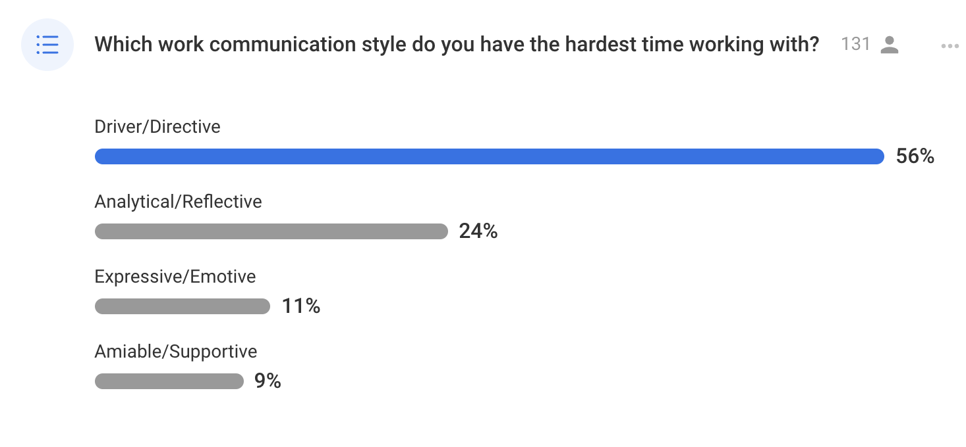
What Trainees Say….
With some caveats…..

Slide 16
Some Key Questions
What is your style?
What about the style of others in your group?
Where is your style helpful? Where can it get you in trouble?
What can you do to smooth out the rough edges?

Slide 17
Stages Of A Discussion
Opening
establish connection and trust
explain the purpose(s) of the interaction
Fact finding/position sharing
listen to understand
ask non-judgmental questions
use I statements and avoid exaggerations
Shared problem-solving (and resource sharing)
with an eye toward expanding options, hearing priorities and sharing autonomy
Closing
summarize action plan
discuss specific follow-up
voice appreciation

Slide 18
Some Thoughts About Positive Coping Strategies
Includes….
resilience training and an appreciation of the principles of positive psychology
understanding the stress continuum (from eustress to distress) and the relationship between stress, burnout, health, and mental health
dispelling or softening myths that can get in our way
Highly personal given since prior experiences and identities play a major role
Workshops in the absence of sustained efforts, personally and institutionally, will not move the needle

Slide 19
Resilience
The way an individual [or organization] responds to setback and absorbs strain and…
continues to function as effectively as possible in the face of the adversity
minimizes damage for long-term effectiveness
normalizes behaviors and activities after the stressor passes
Resilience is not…
working to exhaustion because work is important
persisting no matter what
being strong as people ignore our boundaries and treat us poorly
A group is only as resilient as the individuals that make up that group AND resilience starts at the top
Resilience is a skill that can be developed with education, self-reflection, practice, and coaching

Slide 20
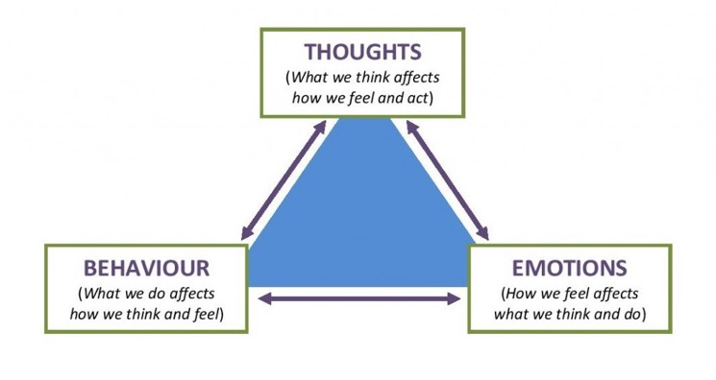
A Model For Building Resilience
And two questions:
helpful or unhelpful?
comfortable or uncomfortable?
This is also a helpful management model –
changes
in one will impact the other two
https://beckinstitute.org/cognitive-model/
Notes:
One of the most highly researched ways of treating anxiety is CBT

Slide 21
With the Goal of AIR
ATTITUDES
satisfied/unsatisfied
connected/disconnected
WORK EVENTS
Daily hassles
Daily up-lifts
THOUGHTS and FEELINGS
Comfortable/Uncomfortable
Helpful/Unhelpful
BEHAVIORS
helpful/unhelpful
engage/withdraw
persist/give up
Awareness
Accurate Interpretation
Regulation

Slide 22
Becoming A Resilient Scientist Series
Five lectures followed by five facilitated group discussions
an introduction to wellness and resilience
understanding distorted self-talk and imposter fears
self-advocacy and assertiveness in the workplace
developing feedback resilience
mentoring up and improving mentoring relationships
In-depth evaluation demonstrates strong benefits
trainee recommendations to others
trainee self-reported well-being and ability to thrive
paired pre/post intervention assessments with validated scales
effective at all trainee levels and across various identities
https://www.training.nih.gov/nih_becoming_a_resilient_scientist_series

Slide 23
Raising a Resilient Scientist Series
Five webinars followed by facilitated discussions
empathic communication to promote resilience
promoting trainee resilience (growth mindset, cognitive distortions, imposter fears, psychological safety)
cultivating belonging and an inclusive research group
having high-stakes conversations and giving feedback
promoting trainee mental health and well-being
Initial evaluation is promising
Most impactful with follow-up discussion (stress management and case study groups) and individual coaching

Slide 24
Academic/Research Culture Is a Barrier

Slide 25
NIH OITE Climate Assessment
Assesses:
Overall lab environment
Overall lab working conditions
Sense of belonging in lab
Witnessing bullying in lab
Experience bullying in lab
Sexual Harassment in lab
PI’s conduct (respectfulness)
PI’s approachableness
Sexual harassment by the PI
Witnessing bullying by the PI
Experience bullying By the PI
Mentoring – Providing career opportunities
Mentoring – Providing scientific guidance
Overall, PI experience
Overall, NIH training experience
Hours worked on average
Weekends/Holidays worked on average
Pressure to work and the ability to take sick or personal days
Occupational depression score
Can detect both thriving and toxic research environments
Uses individual scores and group level standard deviations from the mean (of all past scores) to understand individual research climates
Notes:
Assesses

Slide 26
What the Data Look Like
Example : My research group has a collegial atmosphere.
Notes:
Here you see, the X Axis is the standardized mean scores where the mean is 0.
Because most labs are very collegial and are hitting the ceiling in terms of the scores , we don’t see SDs greater than a bit over 1.
BUT you can quickly see NOT collegial labs.. In fact, this both of these cases OITE and/or civil intervened.

Slide 27
Occupational Depression Inventory (ODI)
Assesses depressive symptoms that individual specifically attribute to their work (“unresolvable work stress”)
Depressed mood, sleep alterations, fatigue/loss of energy, feelings of worthlessness, cognitive impairment, decreased psychomotor functioning due to work related stress
Significant predictor of intent to leave the current position
(Bianchi & Schonfeld, 2020)

Slide 28
Preliminary Lessons Learned
The PI’s ability to resolve conflict in a calm manner is a significant negative predictor of bullying/harassment in research groups (p<0.001)
When the PI bullies/harasses individuals, members of the group are more likely to bully/harass each other (incivility is a learned skill)
50% of individuals who report being harassed by the PI also report harassment by others in the lab
Things that correlate with higher rates of occupational depression:
toxic work environments
healthy environments where people consistently over work
Several mentoring functions strongly associate with positive group cultures
the PI explicitly…
supports career/professional development activities
supports trainees to expand their research network
has career conversations with trainees (with some caveats)
addresses personal (and broader) issues while maintaining boundaries

Slide 29
These Data Provide a Roadmap for Culture Change
Better balance
More training
Mentoring networks
Baseline monitoring
Early interventions

Slide 30
Acknowledgements
OITE staff – past and current
OITE well-being advisors
NIH leadership, especially Drs. Francis Collins, Michael Gottesman, and Larry Tabak
The students and trainees who have trusted me with their stories

Slide 31
OITE Resources
YouTube channel https://www.youtube.com/c/NIHOITE
Learn about activities open to folks outside of the NIH https://www.training.nih.gov/sas/_20/426/

Slide 32
To Do Well We Have To Be Well
To Treat Others Well We Have To Be Well Ourselves

