Slide 1
BCBP Faculty Meeting
June 25th, 2020
Congratulations/welcomes (Brian)
Updates on University policy for resumed operations (Brian/Lynn)
Traffic flow in GMB (Brian/Lynn)
How do people think things are going w/ reopening? Suggestions/concerns?
Updates on fall classes/BBSP (Wolfgang/Jean)
Updates on parking/hiring (Brian/Steven)
Current events and anti-racism. What can we all do to get involved. (Silvia)

Slide 2

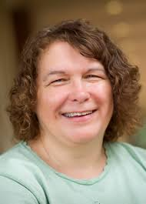
Congratulations Brenda!
Full Professor!

Slide 3
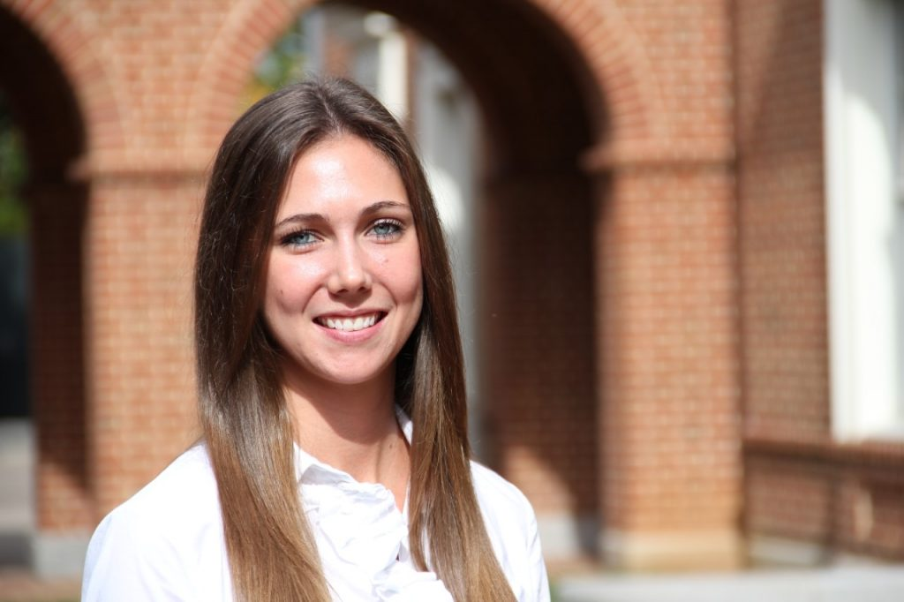
Welcome Holly!
Our new BCBP Student Services Manager

Slide 4
BCBP Resumed Operations
Updates
Currently, no major changes to the SOM guidelines; SOM plans remain the same through July
UNC will be rolling out testing in July (PCR, Ab, contact tracing)
All labs must maintain 50% occupancy
Everyone wears masks and wash hands frequently
Maintain 6ft as much as possible; face shields ideal for training
Shared equipment is disinfected before and after use
Meeting rooms can be used for eating; disinfect before and after use
Undergrads can work but count towards the 50%
Notify UNC Occupational Health and Safety immediately at 919-966-9119 if you or someone in your lab isn’t well; we will be told if someone in the buillding becomes infected

Slide 5
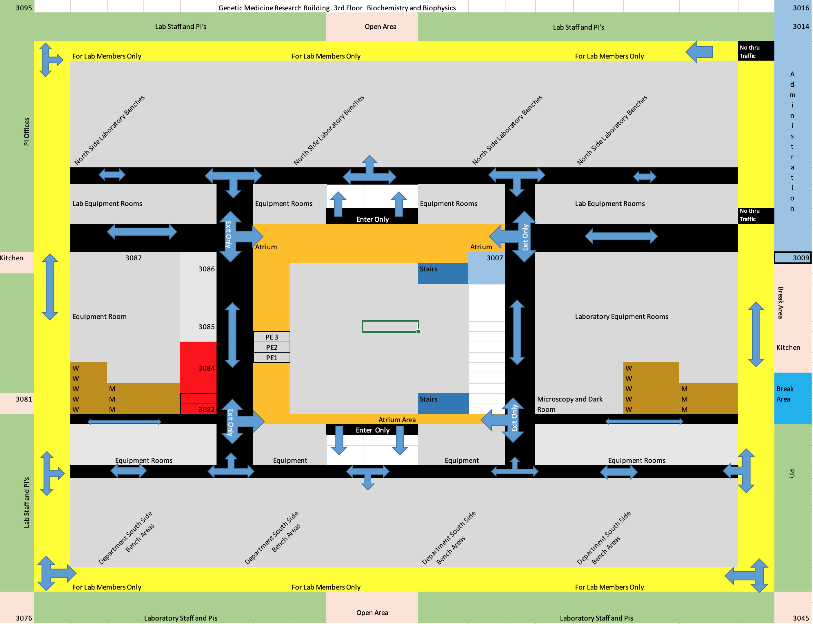
BCBP Resumed Operations

Slide 6
BCBP Resumed Operations
Parking
Permits not required through July
Permit start date likely now Aug 1st
Will be teleworking/day options for those not coming in often (2 times/week)
Student evening passes start at 4 pm instead of 5 pm
Virtual permits/ license plate will be the permit
There are passes for those with special needs; just need to ask
Still no sharing permits at this point.
Chapel Hill Transient to remain at 50%; but there is an expected reduced demand.
How is it going? Any suggestions or concerns?

Slide 7
Fall classes:
8/10/20 – Thanksgiving; course registration period July 29 until August 7 (late deadline is August 16) -> how to best get information to students about BCBP and course selection?
Social distancing rules apply – we requested larger rooms (Marsico)
More time in between classes (30 minutes) – longer days for students; disrupting rotations?!
Plan to do teaching in person; but if possible create recordings

Slide 8
BBSP class of 2020-2021 (n ≤ 116)
First day of Fall classes - 8/10/20
Fall rotation - 8/24/20 - 11/6/20
Winter rotation - 11/9/20 - 1/29/21
Spring rotation - 2/1/21 - 4/9/21
Start in thesis labs - 4/19/21
  For students who completed Summer rotations thesis lab start as early as Feb.
Rotation students should be treated as regular lab members subject to the covid-19 policies in place at the time. Work with your Chair to plan the use of your particular physical space.
Carefully plan trainings requiring closer proximity – face shields, video, Zoom, etc.
Consider adjusting schedules to ensure interaction with each lab member, navigate classes, transportation, etc.
Set realistic expectations! Communicate clearly and often.
Best practices for rotations faculty panel discussion July 8, 11-12:15. Details from Dave McDonald and Donita Robinson coming.

Slide 9
Hiring
BCBP Resumed Operations
Updates
Hiring freeze in effect with no set end date yet.
Applies to all employee types
Exceptions to above:
Patient facing/Clinical support or 100% grant funded position or Mission Critical position.
If none of above apply, must get prior approval for hire via Essential Hire Action request form justify why this new hire cannot wait until freeze is lifted.
New hires will need CDME designations if they’re to be on campus
I will need to know if new hires will be working 2nd shift because if they’re SHRA Perm employees, it’s mandatory that they receive 10% shift premium pay.
Questions?

Slide 10
Salary Increases
BCBP Resumed Operations
Updates
There’s currently a freeze on salary increases with no end date set yet.
Exceptions to above:
Increases associated with promotions, Post-docs being reappointed and being increased to match NIH salary recommendations, regulatory requirement such as GRA increases due to coming off training grant, Visa related increases such as prevailing wage requirements, etc.
If none of above apply, must wait until freeze is lifted.
It’s undetermined at this time if retroactive increases will be allowed.

Slide 11

A PERFECT STORM!
Chance to shift the strategic landscape?
Silvia B Ramos, MD PhD
BCBP Diversity Liaison
06/25/2020

Slide 12


COVID-19 PANDEMIC
Health Disparities
POLITICAL LASHES
POLICE BIAS VIOLENT ACTS
RACIAL ACTIVISM
Social Inequalities
TECHNOLOGY &
SCIENTIFIC KNOWLEDGE
Educational Gap
GREAT RECESSION
Unemployment Affecting Minorities
Rise of Centennials & Millennials
Political & Legal Threats to Diversity

Slide 13
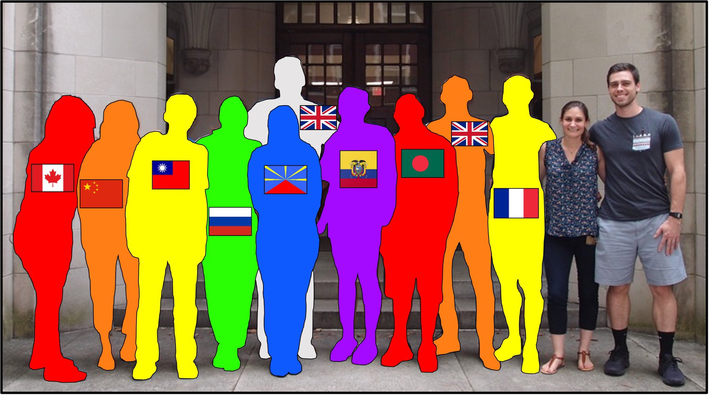
New emerging issue, Immigration Restrictions
White House extends immigration restrictions to include H-1B, other visas
The move temporarily bars a variety of employment-based visas through the end of the year
https://www.rollcall.com/2020/06/22/white-house-extends-immigration-restrictions-to-include-h-1b-other-visas/
https://article.wn.com/view/2020/06/23/White_House_extends_immigration_restrictions_to_include_H1B_/
https://www.msn.com/en-us/news/politics/white-house-extends-immigration-restrictions-to-include-h-1b-other-visas/ar-BB15QCqc

Slide 14
What is included in the diversity umbrella?
Blacks + Browns
Immigrants (All Nationalities, including Asians, Indians etc.)
Women
LGBTQ (Lesbian, Gay, Bisexual, Transgender, Queer)
Indigenous
Native Americans
Religious minorities
So called, URMs: Underrepresented Minorities

Slide 15
Diversity Inclusion Equity goal
Is to start inter-sectional conversation where race, gender, sexuality, and feminism are concerned.
Conversation may trigger discomfort because we shall face people’s ignorance and lack of knowledge of the differences… our own cultural ignorance!!
The Diverse cultures are not competing with American culture so much as collaborating within it.
Resources:
SOM D & I https://www.med.unc.edu/diversity/
UNC D & I best practices & other resources https://diversity.unc.edu/resources/best/
our site https://www.med.unc.edu/biochem/about-us/diversity-and-inclusion/

Slide 16

Nikea Pittman, PhD, is a structural biologist and SPIRE postdoctoral scholar at the UNC School of Medicine. She utilizes cryo-electron microscopy to capture three-dimensional images of membrane proteins in the laboratory of Saskia Neher, PhD.
Nature on June 22
Look what happened!! Yes, that’s MY name and MY voice printed in @Nature, along with 5 other phenomenal Black scientists! We talk about what your university can start doing right NOW to start making a difference.
What Black scientists want from colleagues and their institutions
https://www.nature.com/articles/d41586-020-01883-8

Slide 17

Lab Diversity Statements
Diversity, Equity and Inclusion
The Dowen Lab is committed to providing a safe, inclusive, and supportive environment. We welcome individuals from all backgrounds and groups, including those under-represented in higher education and the scientific community. This commitment to diversity and inclusion allows us to:
Stimulate creativity and innovation in our academic endeavors
Value multiple ways of thinking and individual styles
Celebrate our differences and use them to strengthen our science
Ensure individuals feel supported and invested in the lab mission
Foster leadership and mentoring that lifts up others

Slide 18

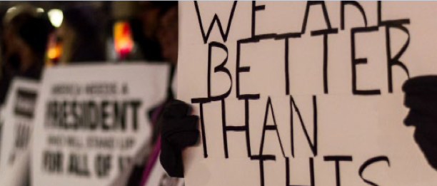

Slide 19
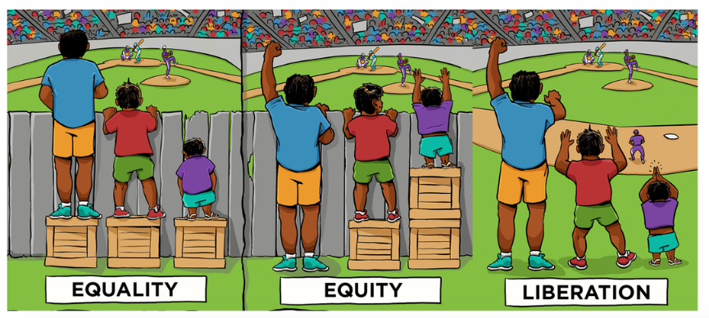
BCBP: Embrace, Educate, Empower!

Slide 20

“Race Matters: What Can I Do?” | Infographic from Korn Ferry
https://diversity.unc.edu/files/2020/06/Korn-Ferry-Race-Matters-What-Can-I-Do.pdf
“The Fire Next Time” | Book by James Baldwin
https://www.penguinrandomhouse.com/books/7753/the-fire-next-time-by-james-baldwin/9780679744726/teachers-guide/
“The Warmth of Other Suns” | Book by Isabel Wilkerson
https://www.penguinrandomhouse.com/books/190696/the-warmth-of-other-suns-by-isabel-wilkerson/
“Your Kids Aren’t Too Young to Talk About Race” | Links for Parents
https://www.prettygooddesign.org/blog/Blog%20Post%20Title%20One-5new4
13th | Movie by Ava DuVernay
https://www.netflix.com/title/80091741
“America’s Racial Contract Is Showing” | Article by Adam Serwer
https://www.theatlantic.com/ideas/archive/2020/05/americas-racial-contract-showing/611389/

