Slide 1

Penicillin Allergy Assessments
Renae Boerneke, PharmD, BCPS, CPP
This resource is part of the Penicillin Allergy Assessment Toolkit, a collaboration of the UNC Medical Center’s Carolina Antimicrobial Stewardship Program, the UNC Division of Rheumatology, Allergy & Immunology, and the UNC Institute for Healthcare Quality Improvement. See additional resources at https://www.med.unc.edu/casp/educational-resources/.
Notes:
Hello, My name is Renae Boerneke and I am one of the infectious disease pharmacists at UNC medical center. In the next 20 minutes, and this presentation will equip you with the basic information you need to know about penicillin allergies and how to conduct a thorough allergy assessment.

Slide 2
Overview
Overview of Beta-Lactams and the Importance of Penicillins
Penicillin Allergy and Impact
Strategies for Penicillin Allergy De-labeling
Notes:
During this presentation, we will first to first focus on the beta-lactam antibiotic class and the specific importance of penicillin class antibiotics. We will also talk about the mechanism of penicillin allergies and also the impact having an allergy can have on the patient and the healthcare system. Next we will discuss the various strategies for allergy de-labeling and how to conduct a thorough allergy assessment.

Slide 3
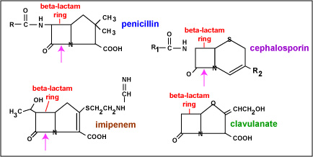
Overview of Beta-Lactam Antibiotics
Beta-lactams are the most commonly used antibiotic group in the U.S
Beta-lactam ring = Core structure
  Variable side chains at the R site
Different side chains = different spectrum of activity and duration of action
Penicillin class antibiotics: amoxicillin, amoxicillin-clavulanic acid, ampicillin, ampicillin-sulbactam, dicloxacillin, oxacillin, nafcillin, penicillin, piperacillin-tazobactam
  CDC, 2018: Penicillins → 59 million prescriptions
Notes:
The beta-lactam group of antibiotics are the most commonly utilized antibiotic class in the US. The beta-lactam family is comprised of penicillins, cephalosporins, carbapenems, and also the beta-lactamase inhibitors. As you can see, they all share the beta-lactam ring in common and have various substituents at different positions that change the spectrum of activity and also the duration of action. According the to CDC outpatient antibiotic prescription report from 2018, penicillins accounted for roughly 59 million precriptions. Penicillins are the treatment of choice for various bacterial infections and are relatively inexpensive. During this presentation we will solely be focusing on the pencillin class antibiotic family which includes the antibiotics listed.

Slide 4
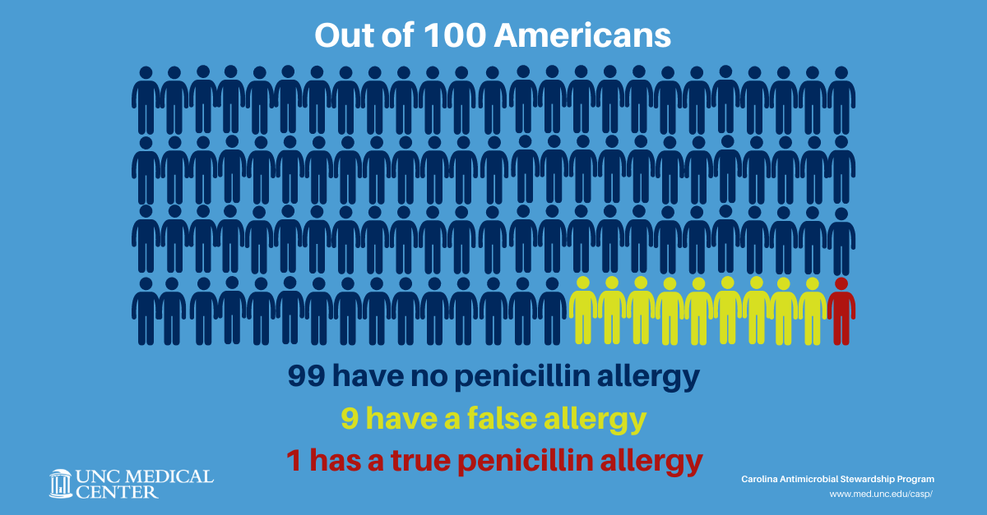
Penicillin Drug Allergy
Why are patients not truly allergic?
  Most studies report only a third of patients can describe their allergic reaction
    Unrelated symptoms attributed to PCN
  Rash with concomitant viral infection
  Immunoglobulin E (IgE) mediated PCN allergy wanes with time
Notes:
Unfortunately 10% of the population reports a penicillin allergy but in reality < 1% of the whole population is truly allergic to penicillins.
So why do so many patients claim an allergy but actually don’t have one? One of the challenging issues with penicillin allergies is many of these reactions occur when patients are younger and cannot remember the reaction. In a study conducted by Preston and colleagues, only a third of patients were able to describe the reaction. Another challenge is that many patients are unable to differentiate the difference between an allergy and an intolerance. In this same study, ~17% of patients claimed to be allergic but their reaction was an intolerance like nausea or stomach upset. We also know that many patients can break out in a rash if they take a penicillin class antibiotic when they have a concomitant viral infection. This is an idiosyncratic reaction that is not an allergic reaction. Lastly we know that the immunoglobulin E antibodies responsible for the penicillin allergy wane over time. Its estimated that 5 years after a true IgE mediated allergy, roughly 50% of patients lose their IGE mediated sensitivity and 80% lose their sensitivity after 10 years.
70-100% of individuals with Epstein Barr virus develop a rash with concomitant amoxicillin
IgE waning : 50% at 5 years and 80% at 10 years

Slide 5
Why do we want to eliminate a penicillin allergy from a patient’s record?
Notes:
Why is this such a big deal?
Exactly, penicillin allergies are not a benign finding in a patients chart. It is well documented that being labeled with a penicillin allergy can have negative impacts both to the patient and on the healthcare system which is why it is important to ensure a patient’s allergy hx to the penicillin class is accurate.

Slide 6
Cost of Penicillin “Allergy”
Cost to the Patient:
  Providers are forced to prescribe broad-spectrum antibiotics
  Increased rates of adverse reactions
  Higher Rates of multidrug-resistant organisms
30.1%
VRE
23.4%
C. diff
14.1%
MRSA
Macy EM, Chen LH. J Allergy Clin Immunol. 2017;139:AB33.
Notes:
It is important to understand the various costs associated with penicillin allergy. First off, providers are faced with the challenge of prescribing an appropriate antibiotic to treat the patients infection. Many of these antibiotic alternatives have a broader spectrum than penicillins and are not typically first line to treat the infection. Additionally, there can be higher rates of adverse events associated with use of these antibiotic alternatives. Use of broader spectrum antibiotoics can lead to higher rates of multi-drug resistant organisms. In a study conducted by Eric Macy, he compared the prevalence of multi-drug resistant organisms in hospitalized patients with an allergy to those without a penicillin allergy. They found that patients with penicillin allergies had increased prevalence VRE, c diff, and MRSA compared to patients without a penicillin allergy.

Slide 7

Cost of Penicillin “Allergy”
Cost to Healthcare:
  Increased rate of hospitalizations
  Prolonged length of hospitalizations
  Antibiotic alternatives are more costly
Inpatient:
$ 0 – 609/PCN allergic patient
Outpatient:
$14 –193/PCN allergic patient
Notes:
Many of the costs to the patient are reflected in the costs incurred to the healthcare system. The same study conducted by Eric Macy also found that patients with penicillin allergies have increased rates of hospitalizations, longer hospitalizations, and alternative antibiotic therapy is more expensive.
In a meta-analysis conducted by Mattingly and colleagues that evaluated the various costs associated with penicillin allergies, they found on average that inpatient antibiotic costs for patients with penicillin allergies ranged from 0 to 600 dollars more per patient compared to non-allergic patients. Similarly outpatient prescriptions costs ranged from $14 – 200 dollars higher for penicillin allergy patients.

Slide 8
Gell and Coombs Hypersensitivity Reactions
Type I
  Rapidly progressive (minutes to hours), potentially fatal and becomes more severe with repeated exposure
  Mediated by IgE → urticarial, angioedema, wheezing, edema, hypotension, anaphylaxis
Type II
  Variable onset (hours to days)
  Mediated by IgG and complement → hemolytic anemia (1 in a million), neutropenia (2-15 per million), thrombocytopenia (unknown)
Type III
  1 – 3 weeks post exposure
  IgG and IgM complexes precipitate in tissues → drug fever, immune-complex glomerulonephritis, and serum sickness (7 – 40 per 100,000 prescriptions)
Type IV
  Days to weeks
  T-cell mediated delayed hypersensitivity reactions → contact dermatitis, Stevens-Johnson syndrome, toxic epidermal necrolysis, eosinophilia, immune hepatitis
Notes:
Now that we’ve discussed the various costs associated with having a penicillin allergy, I would like to briefly discuss the classification of immunologic drug reactions. Gell and Coombs divides allergies into four pathophysiological types, namely the immediate (type I), cytotoxic (type II), immune complex-mediated (type III), and delayed hypersensitivity (type IV) reactions. Type I reactions are typically what most people think of when a patients has an allergic reaction. This reaction is typically progressive, can be fatal and becomes more severe with repeated exposure. This is mediated by IgE and symptoms can include urticarial, angioedema, wheezing, and so on. Type II allergies have a variable onset and are mediated by IgE and complement. Some examples of this reaction include hemolytic anemia, neutropenia, thrombocytopenia. Type III reactions occur 1-3 weeks post exposure and are mediated by IgG and IgM complexes that form and precipitate in tissue. Type III reaction can include drug fever, immune complex glumeronephris and serum sickness. Finally Type IV reactions can occur in days to weeks and are mediated by T cells. Severity of the reaction can range from benign skin rashes to steven’s johnsons. Penicillin class antibiotics are associated all 4 of these types, however for the remainder of this presenations, we will be exclusively talking about Type 1 reactions mediated by IgE.

Slide 9

Metabolites in Penicillin Allergy
Penicillins are rapidly metabolized into benzylpenicilloyl
  Major determinant of penicillin allergy
  Accounts for the metabolism of > 95% of native penicillin
  Benzylpenicilloyl binds to protein conjugate → potentially immunogenic haptens
Remaining metabolites of penilloate, penicilloate, and native penicillin = minor determinants
Hypersensitivity to one determinant does not typically result in cross-reactivity to another determinant
Allergies to side chains are possible (e.g. amoxicillin, ampicillin)
Notes:
Its also important to understand the metabolites indicated in a type 1 IgE mediated penicillin allergy. Penicillins are rapidly metabolized into benzylpenicilloyl which is the major determinant of penicillin allergy. Benzylpenicilloyl accounts for > 95 % of native penicillin. This compound can bind to protein conjugates and form potentially immunogenic haptics. The remaining metabolites of penicillins include penilloate, penicilloat, and native penicillin and are minor determinants in penicillin allergy. Hypersensitivity to one determinant does not typically results in cross reactivity to another and allergies to side chains are allow possible.

Slide 10
Cross Reactivity Among Beta-Lactams
Cephalosporins:
  Widely cited “10%” from publications by Dash and Petz overestimated true cross-reactivity
  True cross-reactivity is estimated ~2 - 3%
  In vitro studies have shown that cephalosporin side chains constitute the major determinants of cephalosporin allergy
Carbapenems:
  <2% rate of hypersensitivity reactions in patients with IgE-mediated penicillin allergies receiving carbapenems
Notes:
Even though we are focusing on penicillin allergies I would like to briefly touch on cross reactivity as it is important to understanding this concept to safely utilize these medications in the setting of a true penicillin allergy. The previously cited 10% cross reactivity of cephalosporins overestimated true cross reactivity. At that time, the definition of penicillin allergy was loose and cephalosporin preparations were crude and contained penicillin. True cross reactivity is estimated at 2-3%. In comparison to penicillins, where benzylpenixcily is responsible for the majority of penicillin allergie, cephalosporin side chains make up the major determinants of cephalosporin alleriges. Cross-reactivity between penicilins and cephalosporins is generally mediated by similarities in side-chain structures. Its estimated that carbapenems have < 2% cros reactivity in patient’s with known IgE mediated penicillin allergies. However, if a patient has a anaphylactic history to a penicillin class antibiotic, utilization of cephalosporins and carbapenems should only be considered in monitored settings.

Slide 11
Evaluating Penicillin Allergy
Notes:
Now that we have a better understanding of mechanism of penicillin allergies and the negative impact that being labeled (especially if the allergy is not true) can have on patient care, we are going discuss how penicillin allergies can be evaluated and also removed from the medical record, which is also referred to as de-labeling.

Slide 12
Qualifications for PCN Allergy Assessment
Inclusion
Exclusion
Any IgE-mediated allergic reaction
Intolerance that is listed as an allergy
Severe Risk Allergy: Severe exfoliative dermatoses (SJS/TEN), serum sickness, DRESS, thrombocytopenia, hemolytic anemia, hepatitis, nephritis
Intolerance to penicillin class antibiotic that is correctly identified as an intolerance
Notes:
Type of reactions that should be assessed through an allergy assessment include: any IgE mediated type allergy or an intolerance that is inaccurated labeled as an allergy in Epic.
Reactions that do not need an allergy assessment include any of the Type II – Type IV reactions such stevens johnsons, dress, hepatis, or nephritis. Additionally patient’s with a listed intolerance that is correctly identified as an intolerance do not need further assessment.

Slide 13
How can a PCN allergy be de-labeled?
Get an accurate allergy history!
  When the reaction occurred
  Timing of reaction in relation to drug administration
  What infection was being treated
    Any potential confounders (underlying viral infections)
  Symptoms experienced
  Treatment administered, response, and duration of reaction
  Was the medication or similar medication taken and tolerated thereafter
  EPIC Dot phrase: .PENICILLINALLERGYASSESS
Shenoy ES, et al. JAMA. 2019;321(2):188-199.
Notes:
The first step in de-labeling a penicillin allergy is getting an accurate and thorough allergy history. We want to know how long ago did this happen, how soon after the medication was taken did the reaction happen. Its also helpful to ask the patient if they remember the infection being treated to identify any potential confounders. A key aspect of the history is documenting the symptoms experienced and if any treatment was required. Lastly, its important to ask the patient if he or she has taken and tolerated a penicillin class antibiotic since this reaction. A dot phrase has been created in epic that includes all of this information and can be utilized to help conduct a thorough allergy assessment.

Slide 14


Slide 15
Risk History Stratification
Not Allergic
Documented evidence or patient report of receiving and tolerating a penicillin class antibiotic since initial reaction
Low Risk
Family History Unknown reaction >10 years ago Itching without a rash Patient denies allergy but is on record Delayed onset cutaneous reaction in childhood
Moderate-High Risk
Urticaria, pruritic rashes IgE-mediated reactions excluding anaphylaxis Anaphylaxis Recurrent penicillin reactions Hypersensitivities to multiple beta-lactams
Severe Risk
SJS TEN Serum sickness DRESS Thrombocytopenia Hemolytic anemia Hepatitis Nephritis
De-label PCN allergy and educate patient
Allergy Referral for oral amoxicillin challenge
Allergy Referral for penicillin skin test and oral amoxicillin challenge if reaction occurred > 5 years ago
No testing; PCN allergy remains. Future use contraindicated.
Shenoy ES, et al. JAMA. 2019;321(2):188-199.
Macy EM, Chen LH. J Allergy Clin Immunol. 2017;139:AB33.
Notes:
Once the allergy history has been obtained, the allergy history can be stratified into three main categories. If your patient has documented evidence or reports receiving and tolerating a penicillin class antibiotic since their initial reaction, their penicillin allergy should be removed from the medical record and the patient should be educated that they are not allergic to penicillin. If a patient’s history is deemed low risk such as having a family history, unknown reaction, itching without a rash, deny the allergy but its on their record, or they report a delayed onset cutaneous reaction in childhood, they should be offered a referral to allergy/immunology for an oral amoxicillin challenge. If the patient’s allergy history is deemed moderate to high risk, which includes any IgE mediated type reaction including anaphylaxis, they should be offered a referral to allergy/immunology for a skin test and oral challenge. If you are doing an allergy assessment on a patient and note that their allergy history was likely a type II, III, or IV mediated allergy or a non-IgE mediated allergy, please update their allergy history in epic accordingly but no further testing is indicated for this patient. Future use of the antibiotic that caused their reaction is contraindicated. that caused their reaction i can be stratified into stratify the patient into Low or moderate to high risk based on their reaction history. Low risk allergies include family history, unknown reaction greater than 10 years ago, itching without a rash, patient denies the allergy but its on record, or a delayed onset cutaneous reaction. Moderate risk reactions include urticarial, prurititis and other IgE mediated reaction including anaphylaxis. High risk reactions include anaphylaxis which requires signs or symptoms in at least 2 of the following
Anaphylaxis requires signs or symptoms in at least 2 of the following systems:
Skin: Hives, flushing, itching, and/or angioedema
Respiratory: Cough, nasal congestion, SOB, chest tightness, wheeze, throat closing, laryngeal edema
Cardiovascular: Hypotension, faintness, tachycardia, loss of consciousness, chest pain
Gastrointestinal: Nausea, vomiting, diarrhea, abdominal cramping

Slide 16
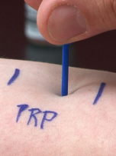
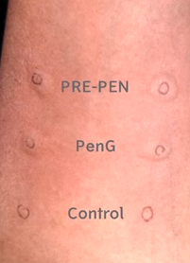
Penicillin Skin Test/Oral Challenge
Skin Scratch test
Small drop of four reagents placed on forearm: histamine (+ ), normal saline (-), PRE-PEN (PRP), and PenG (PG)
Intradermal test
Oral Challenge
Scratch through drop using testing device
Measure results after 15-20 minutes → Continue to intradermal test if positive histamine test (> 5 mm wheal) and all other reagents are negative
Administer 250 mg dose of amoxicillin or penicillin VK
Observe the patient for an hour in an inpatient setting or clinic setting
Duplicate 3 mm intradermal blebs of PRP, PG and Saline creating 3 mm are placed on opposite forearm
After 15-20 minutes, blebs are measured → positive result will be 2-3 mm larger than original bleb
Proceed to oral challenge if negative
Notes:
I want to briefly discuss the penicillin skin test process in so that you feel equipped to discuss the process with the patient if they are interested in receiving this test through allergy and immunology. The first step in the skin test is a scratch test. A drop of four reagents is placed on the patients forearm and a scratch device is used to gentle stratch the skins service. Histamine serves and the positive reagent to insure the patient can have an allergic reaction in their skin, normal saline is the negative reagent to ensure the patient does not have overreactive skin. Pre-pen is benzpeniho which is our major determinant in penicillin allergy a and pen G serves as the minor determinant. 15 minutes after the skin scratch, the reaction in the skin is measured. The clinician can proceed to the intradermal test if the histamine test is positive and all other reagents are negative.
The intradermal test consists of duplicate intradermal blebs of each of the 3 reagents (prepen, peng and NS). After 15 minutes, each bleb is measured. A positive test is if the bleb is 2-3 mm larger than the original bleb. If all the blebs are negative, the patient can proceed to the oral amoxicillin challenge.
For the oral challenge, the patient is given a graded challenges oral amoxicillin. They are first given a low dose and monitored for 15 minutes. If the patient does not have any reaction, they are given the remaining dose of amoxicillin and monitored for an additional 45 minutes. If the patient does not have any reactions, the penicillin allergy is removed from the patients allergy record.

Slide 17
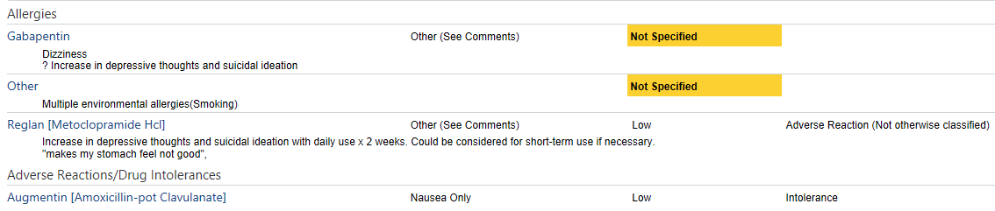
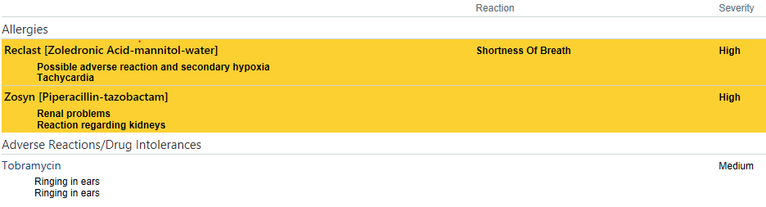

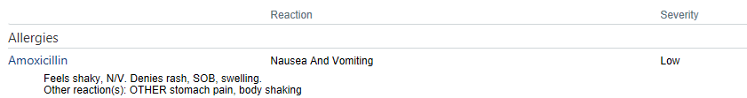
Patient Examples
Notes:
First one – not an allergy – do not assess
Second chart – chart review shows patient does actually remember allergy history
Third one- chart review shows patient did receive a shot of IM pencillin in the buttocks – no documented ADR, 3 years later she has an allergy listed to PCN
4th one – true eosinophilia and AIN with ampicillin – would not assess or give any penicillin class antibiotic patient
5th one – not assessable
6th one – not an allergy
Other miscellenous listed “ADRs” - Yeast infection, behavorial changes

Slide 18
What to do when….
Patient has an allergy to piperacillin, nafcillin, or amoxicillin but can tolerate penicillin?
  Update allergy history to include all pertinent details in addition to what penicillin class antibiotics patient has tolerated

Slide 19

Chart Review Tips
Searching the chart for administration of penicillin class antibiotic
  Chart review → Meds Tab
  Unclick “Current Meds Only”
  Select “Abx” → scroll through listed inpatient and outpatient orders
    Inpatient order: can verify administration
    Outpatient: inquire if patient remembers taking
Search in Search box for “Penicillin” or antibiotic from index reaction
Notes:
Some of you may be familiar with this function, but I wanted to briefly review some quick tips for searching through the patients chart to identify if any penicillin class antibiotics have been prescribed to the patient.

Slide 20
Qualifications for De-labeling
If patient/caregiver is confident that he/she has tolerated a penicillin class antibiotic since the index reaction
  Ideally this should be verified through a fill history or inpatient administration
Documented administration in the EMR of a penicillin class antibiotic that was tolerated since the index reaction
If patient has a history of an intolerance (GI upset, chills, headache, fatigue) that is listed as an allergy or adverse reaction, the EMR should be updated to reflect an intolerance.
Notes:
The following are qualifications the patient must meet in order to be de-labeling

Slide 21
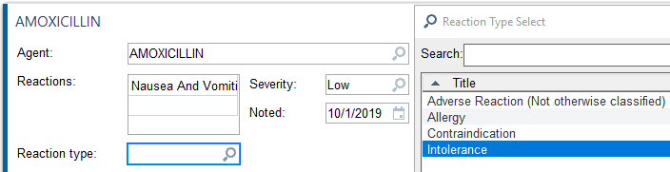
Updating the Allergy History
  If symptoms are listed as an allergy but are actually an intolerance:
    Click into the allergy and choose “Intolerance” for reaction type

Slide 22
Updating the Allergy History
De-labeling Process
  If patient is not allergic or intolerant, allergy should be removed completely
    Select “Delete”
    Choose the most applicable option for de-labeling reason:
      Entry determined to be clinically insignificant
      Entry miscategorized as an allergy
      Erroneous Entry
      Wrong allergy selected
      Wrong patient selected
  If you do not feel 100% confident in removing the penicillin allergy by chart review and patient history → Recommend a referral to allergy!

Slide 23
Referral to Allergy and Immunology
Qualifications for direct oral challenges with amoxicillin:
  Unknown, remote (>10 year ago) reaction
  Itching (pruritus) without rash
  Family history
  Patient denies allergy or unsure of where it came from but cannot confirm he/she tolerates a penicillin class antibiotic by patient history or chart review
  Delayed onset cutaneous rash in childhood
Qualifications for penicillin skin test followed by oral challenge:
  Moderate – High risk allergy histories that occurred > 5 years ago
Who should NOT be referred for skin testing/oral challenge:
  An anaphylaxis type reaction or true IgE-mediated allergy that has occurred in the last 5 years
  Any type IV or non-IgE mediated reaction

Slide 24
Referral to Allergy and Immunology
Allergy Referral
  UNC Allergy Farrington Rd Chapel Hill
  Select “penicillin allergy” as the associated diagnosis
Cost for skin test and oral challenge is dependent on patient’s insurance
  Referral is covered 100% for patients on charity care
Penicillin Skin Test and Oral Challenge are currently two separate appointments

Slide 25
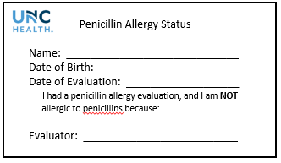
Patient Education
If a patient is de-labeled, patient education is key!
The patient should not consider themselves allergic to penicillin and should no longer claim it as an allergy
Wallet Card
Encourage patient to update allergy history at pharmacy and outside health entities to avoid re-labeling
Notes:
Lhttps://www.cdc.gov/antibiotic-use/community/for-hcp/Penicillin-Allergy.html

Slide 26
Summary
Penicillins are a clinically important class of antibiotics
Penicillin allergies are commonly documented but are typically inaccurate for a myriad of reasons
Penicillin allergies are associated with various negative impacts on both patients and the healthcare system
Assessment of penicillin allergy by medication review and patient interview is an excellent and efficient strategy for allergy de-labeling and improving accuracy of the medical record

Slide 27
Questions?
Contact Information:
Email: Renae.Boerneke@unchealth.unc.edu
Notes:
Thank you so much for listening. If you have any questions please contact me at the email address listed below.

Slide 28
References
Preston SL, Briceland LL, Lesar TS. Accuracy of penicillin allergy reporting. Am J Hosp Pharm 1994; 51:79-84.
Sade K, Holtzer I, Levo Y, Kivity S. The economic burden of antibiotic treatment of penicillin-allergic patients in internal medicine wards of a general tertiary care hospital. Clin Exp Allergy. 2003. Apr; 33(4): 501-506.
PRE-PEN ® [package insert] Plainville, CT: ALK-ABELLO, Inc; 2013.
Macy E, Contreras R. Health care use and serious infection prevalence associated with penicillin “allergy” in hospitalized patients: A cohort study. J Allergy Clin Immunol. 2014;133:790-6
Plessis T, Walls G, Jordan A, Holland DJ. Implementation of a pharmacist-led penicillin allergy de-labelling service in a public hospital. J Antimicrob Chemother. 2019;doi:10.1093.
Shenoy ES, Macy E, Rowe T, Blumenthal KG. Evaluation and management of penicillin allergy: A review. JAMA. 2019 Jan 15;321(2):188-199.
CDC. Evaluation and diagnosis of penicillin allergy for healthcare professionals. [updated 2017 Oct 31; cited 2019 Apr 1]. Available from: https://www.cdc.gov/antibiotic-use/community/for-hcp/Penicillin-Allergy.html.
Mattingly TJ, Fulton A, Lumish RA, et al. The Cost of Self-Reported Penicillin Allergy: A Systematic Review. J Allergy Clin Immunol Pract. 2018 Sep - Oct;6(5):1649-1654.

