Slide 1
Updates in the Management of Urinary Tract Infections
Nicholas Kane, PharmD
PGY2 Infectious Diseases Pharmacy Resident
University of North Carolina Medical Center

Slide 2
Guideline Overview
Definitions & Diagnosis
Delirium & UTI
Antimicrobial Therapy
Urine Culture Interpretation
Key Points
Notes:
This presentation will address new evidence on UTIs and many common questions pharmacists encounter:
-Asymptomatic bacteriuria
-Cystitis, pyelonephritis, and bacteremia from urinary source
-Durations of therapy
-IV vs PO beta-lactams
-Role of aminoglycosides
Check out the guideline highlights featured in CASP News

Slide 4
Guideline Overview
Definitions & Diagnosis
Delirium & UTI
Antimicrobial Therapy
Urine Culture Interpretation
Key Points

Slide 5
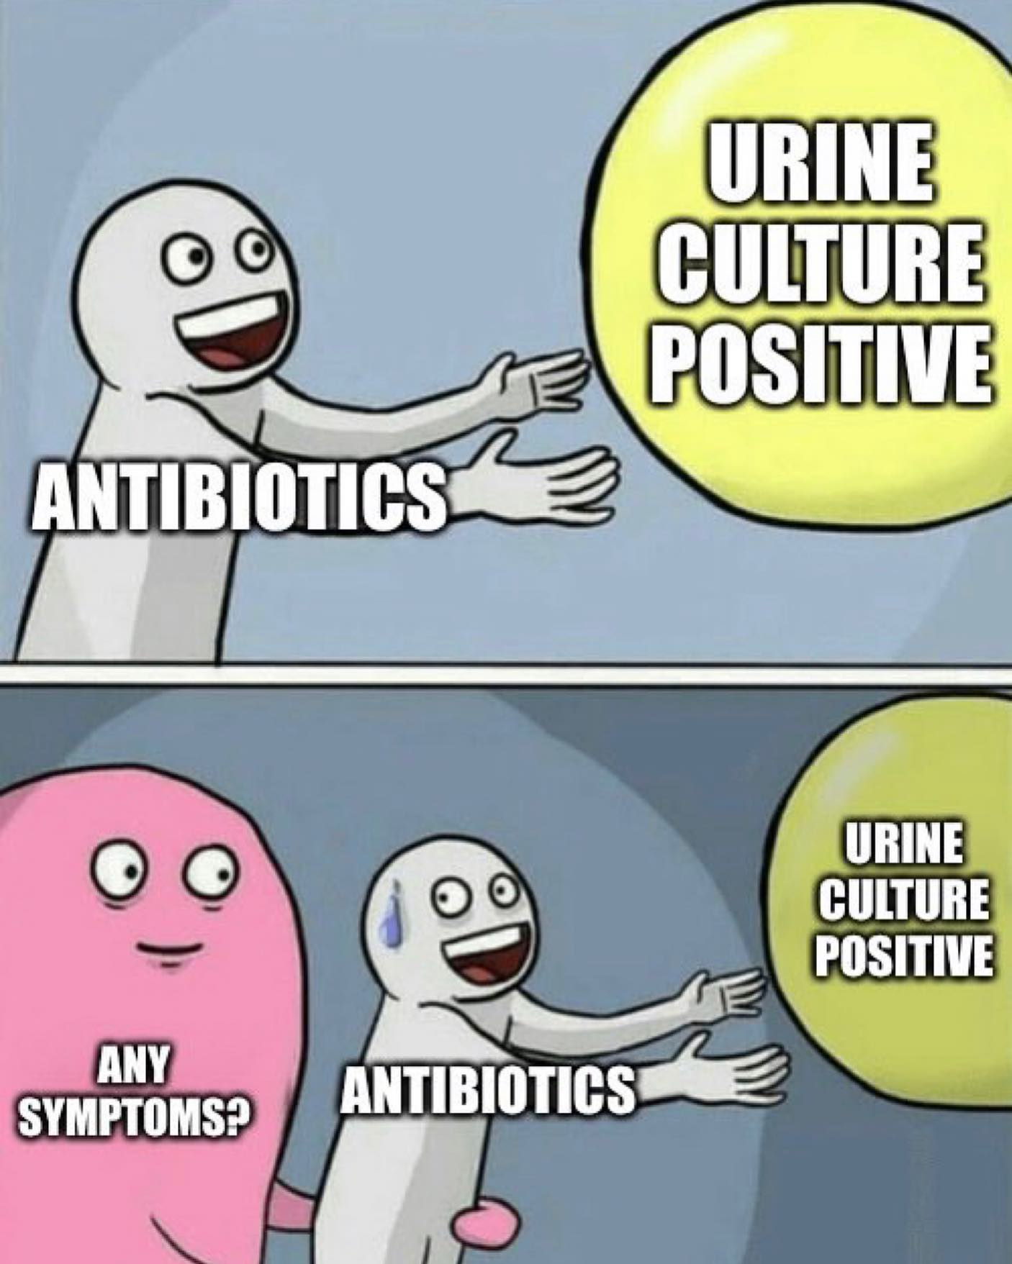
Major Updates – Diagnosis
Emphasizes importance of assessing symptoms
Notes:
Emphasized importance of assessing symptoms
Defined ASB and importance of not treating
Added urinary symptoms that are non-specific to UTI
Malodorous or cloudy urine, increased urine sediment, falls or altered mental status
Removed definitions for uncomplicated vs complicated UTI
Management differences addressed in algorithms
Added non-UTI factors that cause abnormal UA results
Sterile pyuria: STI, genital dermatitis, inflammatory or autoimmune disease vs no identified cause

Slide 6
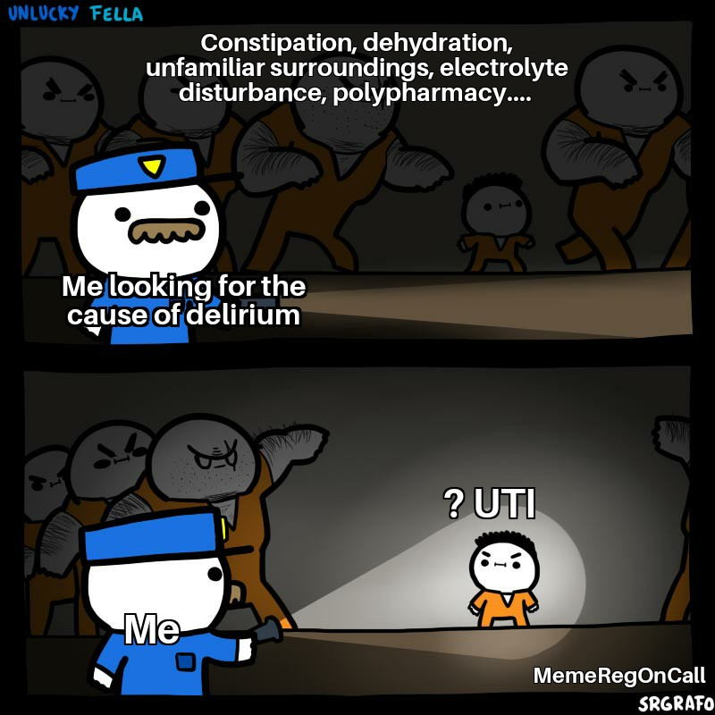
Major Updates – Diagnosis
Emphasizes importance of assessing symptoms
Clarifies common, non-UTI-specific urinary symptoms
Notes:
Emphasized importance of assessing symptoms
Defined ASB and importance of not treating
Added urinary symptoms that are non-specific to UTI
Malodorous or cloudy urine, increased urine sediment, falls or altered mental status
Removed definitions for uncomplicated vs complicated UTI
Management differences addressed in algorithms
Added non-UTI factors that cause abnormal UA results
Sterile pyuria: STI, genital dermatitis, inflammatory or autoimmune disease vs no identified cause

Slide 7
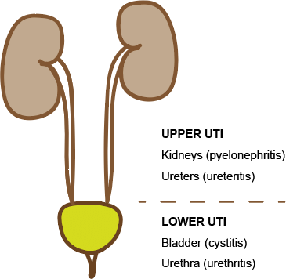





Major Updates – Diagnosis
Pyelonephritis
Emphasizes importance of assessing symptoms
Clarifies common, non-UTI-specific urinary symptoms
Removes definitions for uncomplicated vs complicated UTI
Cystitis
Kaufman J. 2019. PMID: 31646191.
Notes:
Emphasized importance of assessing symptoms
Defined ASB and importance of not treating
Added urinary symptoms that are non-specific to UTI
Malodorous or cloudy urine, increased urine sediment, falls or altered mental status
Removed definitions for uncomplicated vs complicated UTI
Management differences addressed in algorithms
Added non-UTI factors that cause abnormal UA results
Sterile pyuria: STI, genital dermatitis, inflammatory or autoimmune disease vs no identified cause

Slide 8
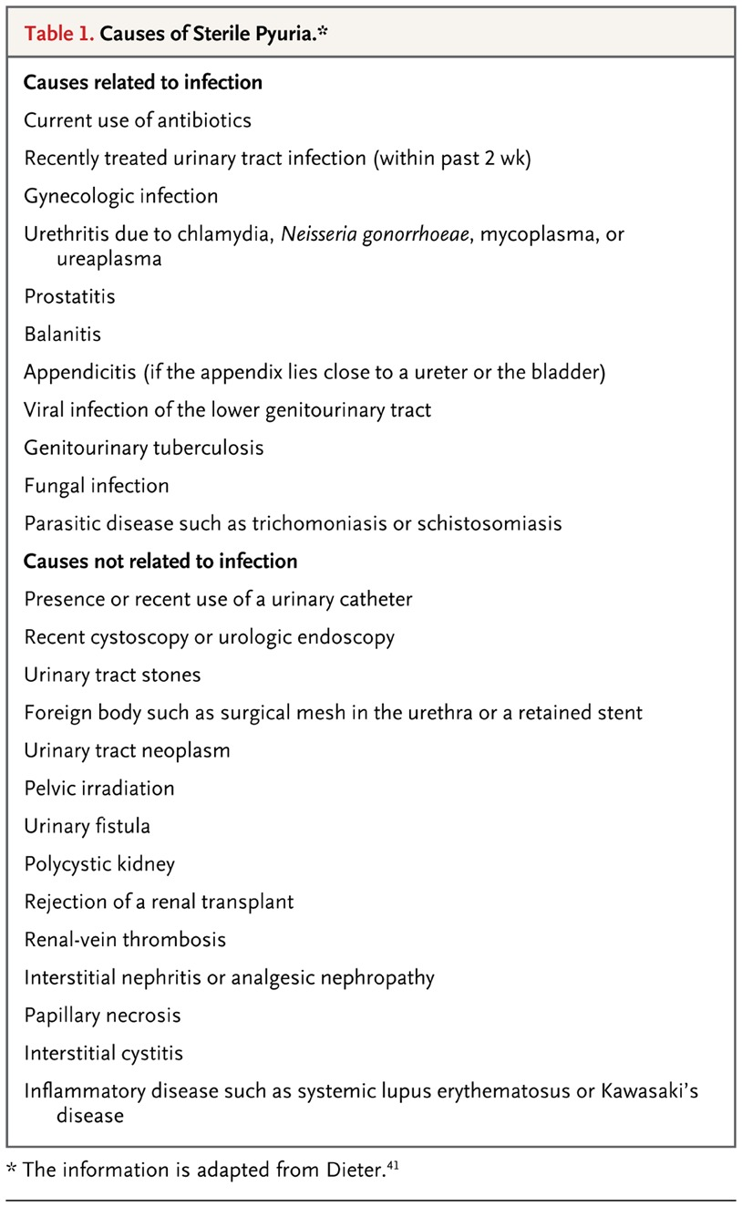
Major Updates – Diagnosis
Emphasizes importance of assessing symptoms
Clarifies common, non-UTI-specific urinary symptoms
Removes definitions for uncomplicated vs complicated UTI
Includes non-UTI factors that cause abnormal UA results (i.e. sterile pyuria)
Wise GJ. 2015. PMID: 25760357.
Notes:
Emphasized importance of assessing symptoms
Defined ASB and importance of not treating
Added urinary symptoms that are non-specific to UTI
Malodorous or cloudy urine, increased urine sediment, falls or altered mental status
Removed definitions for uncomplicated vs complicated UTI
Management differences addressed in algorithms
Added non-UTI factors that cause abnormal UA results
Sterile pyuria: STI, genital dermatitis, inflammatory or autoimmune disease vs no identified cause

Slide 9
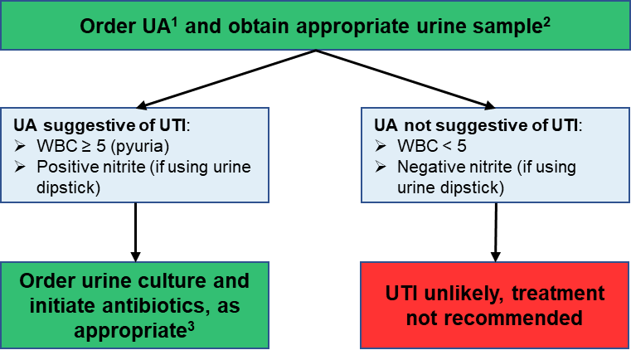
Pyuria Threshold
Role of WBC on Urinalysis
    Significant pyuria: depends on quantification method and patient population
    No pyuria = UTI likely ruled out
      Highly sensitive with great NPV for UTI
    Pyuria = UTI cannot be excluded
      Non-specific with poor PPV for UTI
UA & Reflex Culture: urine will be automatically cultured if any of the following criteria are met:
    WBC ≥ 5 wbc/hpf
    Nitrite positive
HPF: high-powered field; NPV: negative predictive value;
PPV: positive predictive value; UA: urinalysis
Notes:
No pyuria = high NPV. Useful to help labs prevent unnecessary workload.

Slide 10
Guideline Overview
Definitions & Diagnosis
Delirium & UTI
Antimicrobial Therapy
Urine Culture Interpretation
Key Points

Slide 11
Altered Mental Status Algorithm
Obtain History
Evidence-Based Screening
Clinical Evaluation
Delirium: acute, fluctuating
Dementia: gradual, steady
Floor status: 4 A's Test or 3D-CAM
ICU status: CAM-ICU
UTI-specific symptoms or unstable → send UA
Clinically stable and no symptoms: defer UTI workup

Slide 12
Guideline Overview
Definitions & Diagnosis
Delirium & UTI
Antimicrobial Therapy
Urine Culture Interpretation
Key Points

Slide 13
Cystitis – Major Updates
Cefdinir no longer recommended
Cephalexin dose recommendation increased from BID to TID
Gentamicin now recommended as a 2nd line treatment option

Slide 14
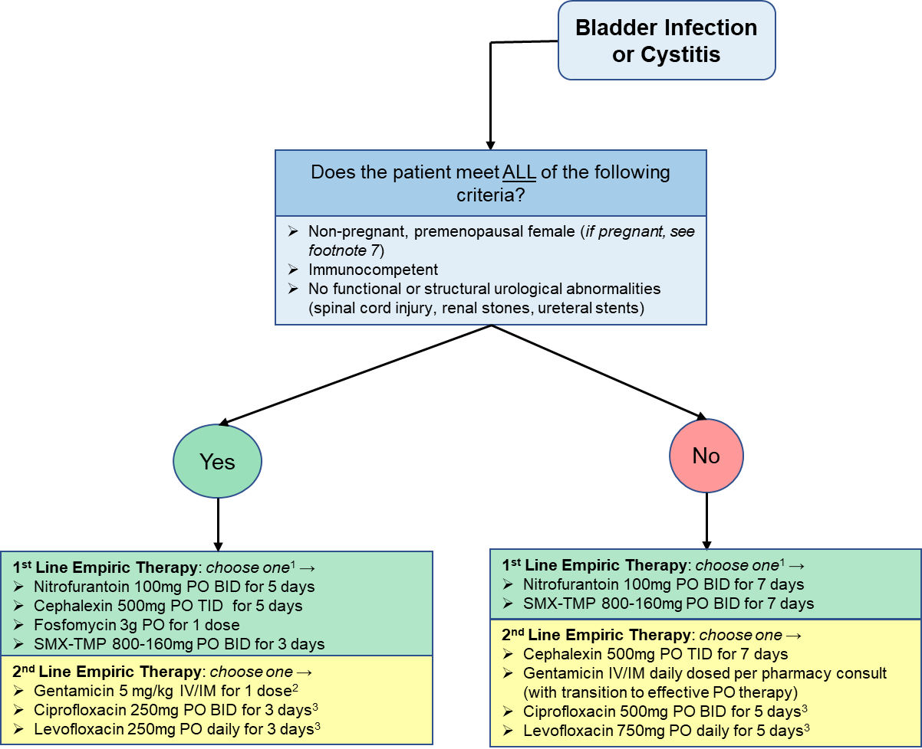
Cystitis – Optimal Durations
Uncomplicated: 1 dose to 5 days
Complicated: ~7 days

Slide 15
Cystitis – Fosfomycin
Who: most data in women with cystitis
What:
    (uncomplicated) Cystitis: 3g x1 dose
    (complicated) Cystitis: 3g PO q48-72h
When: cystitis, as empiric or pathogen-directed therapy (spectrum includes E. coli, Citrobacter spp., Proteus spp., E. faecalis, and S. saprophyticus)
Where: outpatient, ED, floor patients
Why:
    Well tolerated and little collateral resistance
    Possible option in patients with multiple allergies
    Inferior to nitrofurantoin (Huttner et al)
Huttner A. 2018. PMID: 29710295.

Slide 16
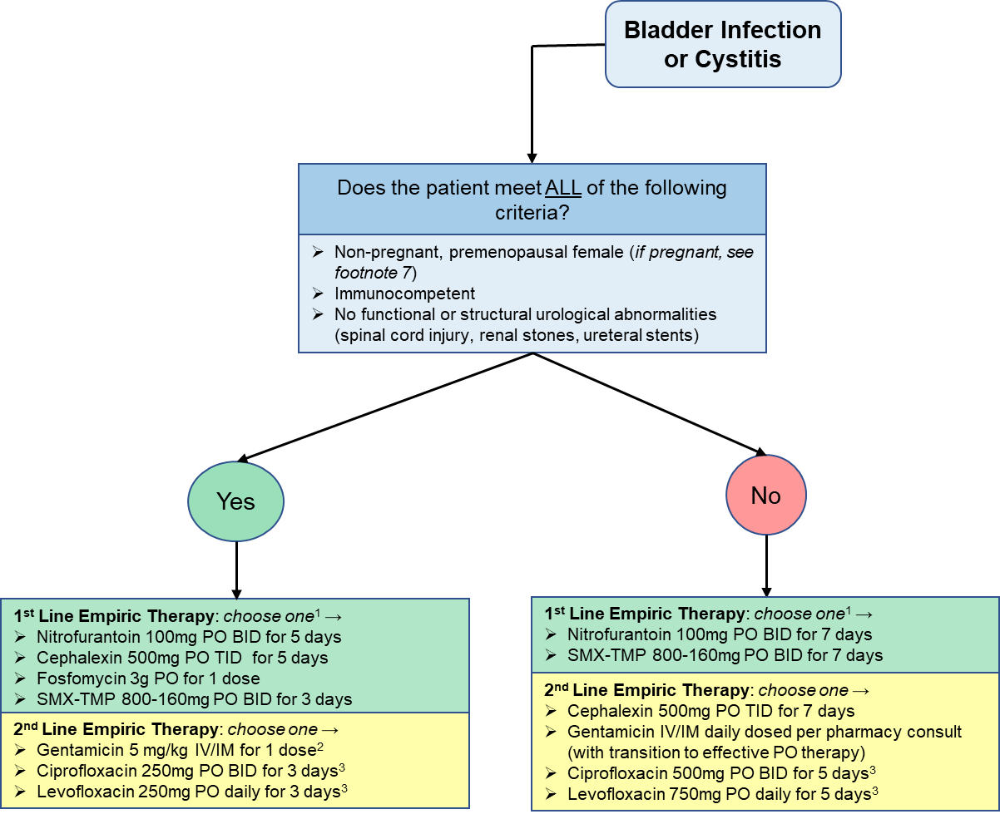
Cystitis – Aminoglycosides
Who: extensive data in children, adults, & older adults
What: gentamicin, dosing varies per indication
    Uncomplicated: 5 mg/kg IV or IM for one dose
    Complicated: daily dosing per pharmacy consult
MDR: multidrug resistant
Notes:
Duration for complicated: empiric until susceptibilities result, then narrow or complete ~7d (per EPIC RCT of plazomicin vs meropenem for cUTI)
EPIC Study criteria:
Complicated UTIs were indicated by at least two signs or symptoms (chills, rigors, or fever [temperature >38°C]; dysuria or urinary frequency or urgency; lower abdominal or pelvic pain; or nausea or vomiting) and at least one complicating factor (a history of urinary retention [in male patients], current indwelling urinary catheter, obstructive uropathy, or any functional or anatomical abnormality).
Acute pyelonephritis was indicated by at least two of the following symptoms: chills, rigors, or fever; flank pain; tenderness in the costovertebral angle; and nausea or vomiting. Details of eligibility criteria are provided in Table S1 in the

Slide 17

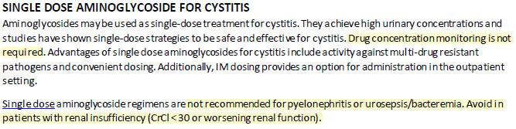

Cystitis – Aminoglycosides
Who: extensive data in children, adults, & older adults
What: gentamicin, dosing varies per indication
    Uncomplicated: 5 mg/kg IV or IM for one dose
    Complicated: daily dosing per pharmacy consult
When: cystitis in a patient without CKD/AKI
    May be ideal if at risk for MDR pathogen, to facilitate ED discharge, or to avoid allergies
Where: outpatient, ED, or inpatient
Why…?
MDR: multidrug resistant
Notes:
PK: Urinary concentrations remain therapeutic for ~72h
Why:
Broad spectrum coverage with minimal collateral resistance potential
Clinical outcomes
Generally well tolerated

Slide 18
Local Microbiology
TMP-SMX: trimethoprim-sulfamethoxazole

Slide 19
A systematic review of single-dose aminoglycoside therapy for urinary tract infection: is it time to resurrect an old strategy?
Goodlet KJ, et al. Antimicrob Agents Chemother. 2019.
Clinical cure: 82.8-94.7% (only two studies reported)
Safety of Single Dose
Any adverse effect: 54/13,804 (0.5%)
Efficacy of Single Dose
Microbiologic cure: 94.5% ± 4.3% (no difference between comparators)
Sustained microbiologic cure (at 30 days): 73.4% ± 9.6% (no difference between comparators)
Tinnitus or vertigo: 53 cases
Nephrotoxicity: 7 cases
No cases of hearing loss
Notes:
13 articles included representing 13,804 patients
Mostly females with E. coli. No bacteremia or sepsis included in this analysis.
Plazomicin:
Once-daily plazomicin was noninferior to meropenem for the treatment of complicated
UTIs and acute pyelonephritis caused by Enterobacteriaceae, including multidrug-resistant strains.
Non-inferior to meropenem. Superior microbiolgic eradication.

Slide 20

Learning Question #1
A 33-year-old female that is otherwise healthy presents with dysuria, fever, and flank pain. She has a recent history of ESBL E. coli cystitis that was treated with a single dose of fosfomycin 1 month ago.
Is she an appropriate candidate for single-dose gentamicin?
    Yes
    No

Slide 21
Learning Question #1
A 33-year-old female that is otherwise healthy presents with dysuria, fever, and flank pain. She has a recent history of ESBL E. coli cystitis that was treated with a single dose of fosfomycin 1 month ago.
Is she an appropriate candidate for single-dose gentamicin?
    Yes
    No

Slide 22
Learning Question #2
A 33-year-old female that is otherwise healthy presents with complaints of only dysuria. She has a recent history of ESBL E. coli cystitis that was treated with a single dose of fosfomycin 1 month ago. The ED provider planned to discharge on oral therapy, but now feels obligated to admit her for a course of IV antibiotics.
Is she an appropriate candidate for single-dose gentamicin?
    Yes
    No

Slide 23
Learning Question #2
A 33-year-old female that is otherwise healthy presents with complaints of only dysuria. She has a recent history of ESBL E. coli cystitis that was treated with a single dose of fosfomycin 1 month ago. The ED provider planned to discharge on oral therapy, but now feels obligated to admit her for a course of IV antibiotics.
Is she an appropriate candidate for single-dose gentamicin?
    Yes
    No

Slide 24
Pyelonephritis – Major Updates
Ceftriaxone
1g vs 2g
Cons
↑ cost
Potential unnecessary ↑ exposure
Pros/Benefits
Overcome resistance
Better outcomes in certain groups
Well tolerated
Ceftriaxone dose recommendation increased from 1 gram to 2 grams
Added criteria for PO transition in gram negative bacteremia from urinary source
Added durations of therapy per agent, route, and presence or absence of bacteremia

Slide 25
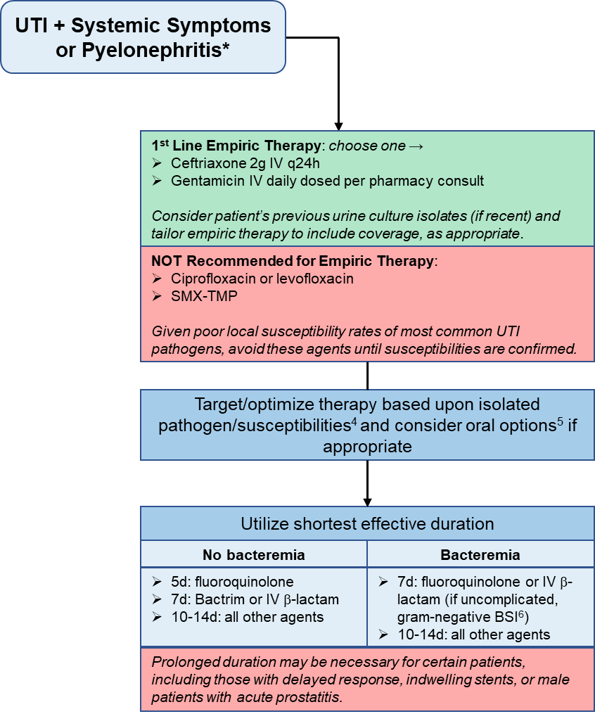
Pyelonephritis – Optimal Durations
No bacteremia: 5-10 days
Uncomplicated bacteremia: 7-10 days
    Criteria: clinical improvement within 72 hours, identified source, source control (if appropriate), and immunocompetent
Complicated bacteremia: patient-specific approach
Unanswered questions:
    Duration of therapy if using oral β-lactams
    Utility of oral β-lactams for pyelonephritis
Notes:
Methods
24 sites - mixture of academic medical centers, community hospitals, and Veterans Affairs hospitals with locations in the United States as follows: Northeast (14), Midwest (6), Mountain West (3), and West (1).

Slide 26
Defining the optimal duration of therapy for hospitalized patients with complicated urinary tract infections and associated bacteremia
McAteer J, et al. Clin Infect Dis. 2023.
Methods
Retrospective, multicenter cohort
Included ≥ 18y, cUTI, GN BSI
IPTW analysis
Outcomes of Interest
Primary: recurrent UTI ≤ 30 days of completing therapy
Secondary: resistant infection with same bacterial species within 30 days of treatment completion
Population
Included 1099 patients: 7 (n=265), 10 (n=382), or 14 (n=452) days
E. coli (59%), K. pneumoniae (16%)
Mostly males (66%)
Table 1. Primary outcome.
IV β-lactam or Highly Bioavailable
7-day (n=243; 39%) and 14-day (n=384; 61%)
aOR 0.76 (95% CI: 0.38-1.52)
Suboptimally dosed oral β-lactams drove recurrence rate
Resistance Development
76 recurrent infections from any source within 30-days of antibiotics
7-day 2 (11%), 10-day 2 (10%), and 14-day 10 (36%) (p=0.10)
Table 2. Oral antibiotic therapy utilized for 7 vs 14-days of cUTI therapy.
Durations | aOR | 95% CI
10 vs 14-day | 0.99 | 0.52-1.87
7 vs 14-day | 2.54 | 1.40-4.60
Antibiotic Regimen | 7d (n=110) | 14d (n=302)
amoxicillin/clavulanate 875mg BID | 3 | 13
cefdinir 300mg BID | 7 | 12
cefpodoxime 200mg BID | 2 | 21
cefuroxime 500mg BID | 8 | 4
ciprofloxacin 500mg BID | 45 | 141
levofloxacin 750mg QD | 18 | 18
TMP-SMX 1-2 DS BID | 21 | 44
aOR: adjusted odds ratio; BSI: bloodstream infection;
GN: gram negative; IPTW: inverse probability of treatment weighting;
TMP-SMX: trimethoprim-sulfamethoxazole
Notes:
Relapsed UTI = infection within 2 weeks of treatment. They extended the definition to 30 days
Methods
24 sites - mixture of academic medical centers, community hospitals, and Veterans Affairs hospitals with locations in the United States as follows: Northeast (14), Midwest (6), Mountain West (3), and West (1).
IPTW factors: age > 65y, male sex, weight, BMI > 30, immunecompromise, ICU on day 1, pitt BSI score > 3, charlson comorbidity index > 4, DM, CVD, RRT, active empiric therapy, Pseudomonas, ESBL, source control
Used to account for differences in baseline severity of illness
cUTI: (male, renal transplant, structural or functional abnormality)

Slide 27
Defining the optimal duration of therapy for hospitalized patients with complicated urinary tract infections and associated bacteremia
McAteer J, et al. Clin Infect Dis. 2023.
7 days of IV or highly bioavailable therapy is effective for cUTI with associated gram-negative bacteremia
10-14 days of therapy may be necessary if unable to use IV or highly bioavailable agent
Unclear role of highly bioavailable β-lactam agents (amoxicillin & cephalexin)
Prolonged therapy may increase risk for subsequently resistant infection

Slide 28


Antimicrobial for 7 or 14 days for febrile urinary tract infection in men (PROSTASHORT)
Lafaurie M, et al. Clin Infect Dis. 2023.
Methods
Multicenter (France), randomized, double-blind, placebo-controlled
Noninferiority
Outcomes of Interest
Primary: Treatment success per microbiological, clinical success (afebrile) and no antibiotics received from end of treatment to 6 weeks
Secondary: recurrent UTI (from weeks 6-12)
Inclusion Criteria
Men ≥ 18y
Febrile UTI: ≥ 38°C or < 36°C
Urinary symptom(s)
Pyuria (WBC ≥ 10 cells/µL)
Single, susceptible uropathogen
Day 2-3
Stratified Randomization
Start placebo at Day 7
Treatment success at Week 6
3GC IV
Ofloxacin PO
200mg BID
Ofloxacin
200mg BID
Recurrent infection risk through Week 12
Stop at Day 14
Table 1. Primary and secondary outcomes between 7 and 14-day durations.
Analysis | 7-Day (n=115) | 14-Day (n=125) | Risk Difference (95% CI)
Treatment success | 64 (55.7%) | 97 (77.6%) | -21.9 (-33.3 to -10.1)
Microbiological success | 91 (79.1%) | 117 (93.6%) | -14.5 (-23.5 to -6.0)
Clinical success | 110 (95.6%) | 125 (100%) | -4.3 (-9.8 to -1.3)
No new antibiotics | 93 (80.9%) | 116 (92.8%) | -11.9 (-20.9 to -3.5)
Recurrence of UTI | 2 (1.7%) | 5 (4.0%) | N/A (p=0.45)
3GC:3rd generation cephalosporins
Notes:
antibiotic treatment for UTI (except if a new antimicrobial was prescribed for another infection and had no effect on the initial uropathogen).

Slide 29
Antimicrobial for 7 or 14 days for febrile urinary tract infection in men (PROSTASHORT)
Lafaurie M, et al. Clin Infect Dis. 2023.
Conclusions
7-day course had ↓ microbiological cure and ↑ use of additional antibiotics at 6 weeks
Clinical success largely similar between 7 and 14-day groups
Limitations
Ofloxacin dosing intensity
  = ~ciprofloxacin 250 mg BID
Endpoints of limited clinical utility
Outcome Comparison
Afebrile UTI in men successfully treated with 7-days of optimally dosed ciprofloxacin or TMP-SMX
cUTI with BSI successfully treated with 7-days of IV β-lactam or highly bioavailable agent
Conflicting evidence on optimal treatment duration for men with pyelonephritis
7-days likely adequate with optimally dosed antibiotics
Drekonja DM. 2021. PMID: 34313686.
McAteer J. 2023. PMID: 36633559.
BSI: bloodstream infection; TMP-SMX: trimethoprim-sulfamethoxazole
Notes:
Afebrile UTI trial looked at primary outcome was resolution of UTI symptoms by 14 days after completion of active antibiotic treatment

Slide 30
Pyelonephritis – Aminoglycosides
Who: uncomplicated pyelonephritis (not septic and low concern for non-urinary infectious sources)
What: gentamicin or tobramycin (targeted coverage of Pseudomonas) with pharmacy to dose consult
When/where: same situations as single-dose in cystitis
Why: evidence less robust, but remains encouraging
    Clinical response: no difference between comparator agents (β-lactam or fluoroquinolones)
    Microbiologic cure: older data less favorable, but newer data with comparable eradication rates
    Relapse or reinfection: no difference between comparator agents (β-lactam or fluoroquinolones)

Slide 31
Learning Question #3
A 55-year-old male presented with fever, flank pain, and rigors. He was found to have K. pneumoniae bacteremia from a urinary source. He was started on ceftriaxone and had rapid clinical improvement. He has received 4 doses of ceftriaxone and the team wants to transition to PO levofloxacin to complete the course, as the isolate was pan-susceptible.
How many days of levofloxacin would you recommend to complete the course?
    1 day (to complete 5 days)
    3 days (to complete 7 days)
    6 days (to complete 10 days)
    10 days (to complete 14 days)

Slide 32
Learning Question #3
A 55-year-old male presented with fever, flank pain, and rigors. He was found to have K. pneumoniae bacteremia from a urinary source. He was started on ceftriaxone and had rapid clinical improvement. He has received 4 doses of ceftriaxone and the team wants to transition to PO levofloxacin to complete the course, as the isolate was pan-susceptible.
How many days of levofloxacin would you recommend to complete the course?
    1 day (to complete 5 days)
    3 days (to complete 7 days)
    6 days (to complete 10 days)
    10 days (to complete 14 days)

Slide 33
Guideline Overview
Definitions & Diagnosis
Delirium & UTI
Antimicrobial Therapy
Urine Culture Interpretation
Key Points

Slide 34
Major Updates – Urine Culture Interpretation
Incorporates McLendon Lab’s reporting policies with diagnostic and treatment recommendations
Encourages clinicians to assess pathogen and patient-specific factors
New algorithmic approach for urine culture interpretation

Slide 35
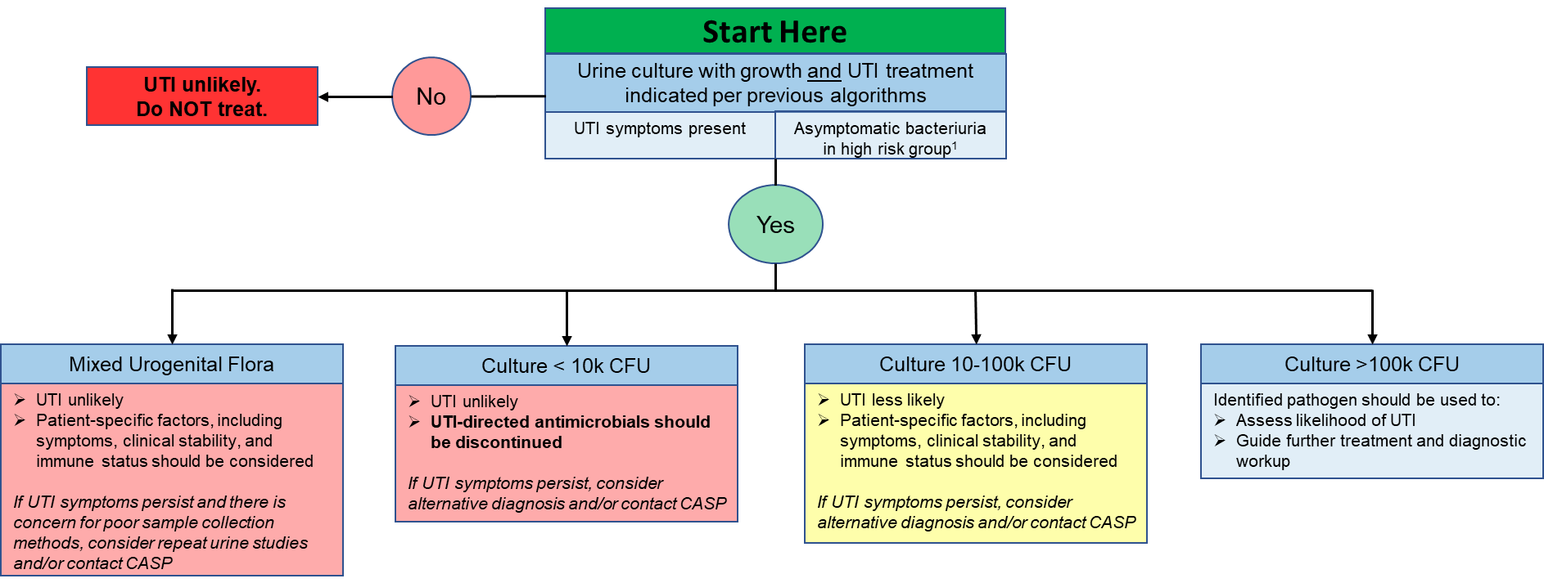
Urine Culture Interpretation

Slide 36
Guideline Overview
Definitions & Diagnosis
Delirium & UTI
Antimicrobial Therapy
Urine Culture Interpretation
Key Points

Slide 37
Key Takeaways
Inappropriate urine culture orders lead to misdiagnosis and unnecessary use of antibiotics
Treatment of asymptomatic bacteriuria offers no benefit and may cause patient harm
Nitrofurantoin and gentamicin are efficacious, broad-spectrum agents with minimal risk for collateral resistance development
The shortest effective treatment durations should be utilized

Slide 38
Updates in the Management of Urinary Tract Infections
Nicholas Kane, PharmD
PGY2 Infectious Diseases Pharmacy Resident
University of North Carolina Medical Center

