Slide 1
NC CMEP Provider Portal Features & Instructions
NC Child Medical Evaluation Program

Slide 2
Features of the CMEP Provider Portal
The CMEP Provider Portal enables providers to:
Securely send CME documentation to CMEP for reimbursement and for review
Track reimbursement status of cases
Retrieve Checklist for CME Reporting (DMA-1061) forms for cases that have been approved by CMEP for submission to Medicaid
Upload annual signed CMEP Letters of Agreement
Submit AMA PRA Category 1 CME credits to CMEP
Notes:
This should be relevant to assessments, in-home and foster care

Slide 3
Registering for the CMEP Provider Portal
To create your CMEP Provider Portal account, please contact CMEP at cmep@med.unc.edu.
A CMEP administrator will send you an email to register for the portal.
Notes:
This should be relevant to assessments, in-home and foster care

Slide 4
CMEP Provider Portal Reimbursement Process

Slide 5
Features of the CMEP Provider Portal
The CMEP Provider Portal enables providers to:
Securely send CME documentation to CMEP for reimbursement and for review
Track reimbursement status of cases
Retrieve Checklist for CME Reporting (DMA-1061) forms for cases that have been approved by CMEP for submission to Medicaid
Upload annual signed CMEP Letters of Agreement
Submit AMA PRA Category 1 CME credits to CMEP
Notes:
This should be relevant to assessments, in-home and foster care

Slide 6
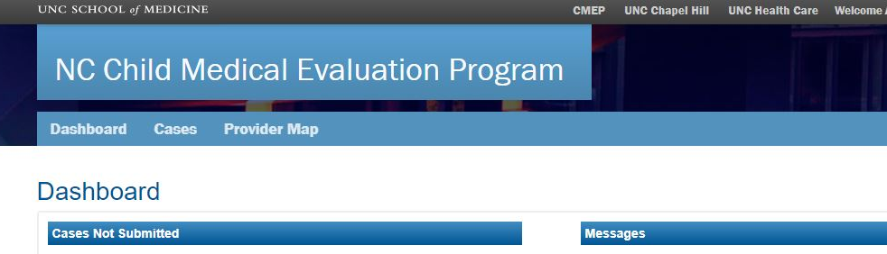
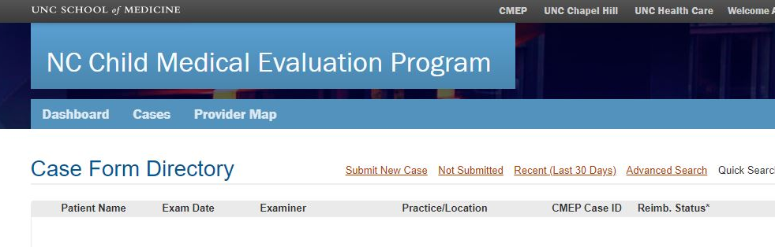
Submitting a new case to CMEP
From the homepage, select Cases.
This will bring you to
your Case Form
Directory.
2. From the Case Form
Directory, select
Submit New Case.

Slide 7
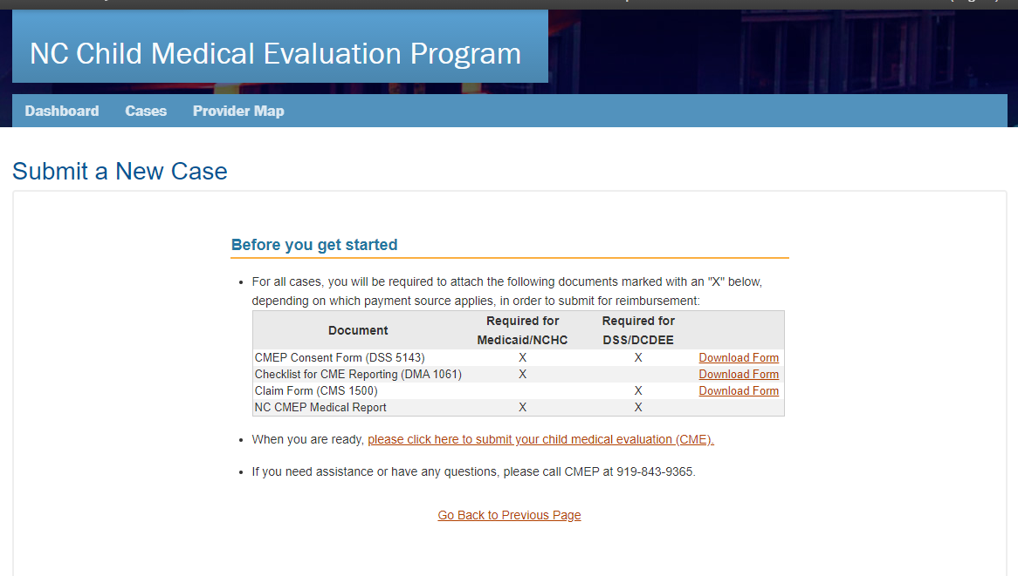
Submitting a new case - Required documents
For payment source: Medicaid/NCHC, you will be required to upload:
DSS-5143 consent form or DCDEE consent form,
CME Report,
Checklist for CME Reporting (DMA 1061)
For payment source: DSS/DCDEE, you will be required to upload:
DSS-5143 consent form or DCDEE consent form,
CME Report,
Claim form(s),
Case Conference Form (if necessary)

Slide 8
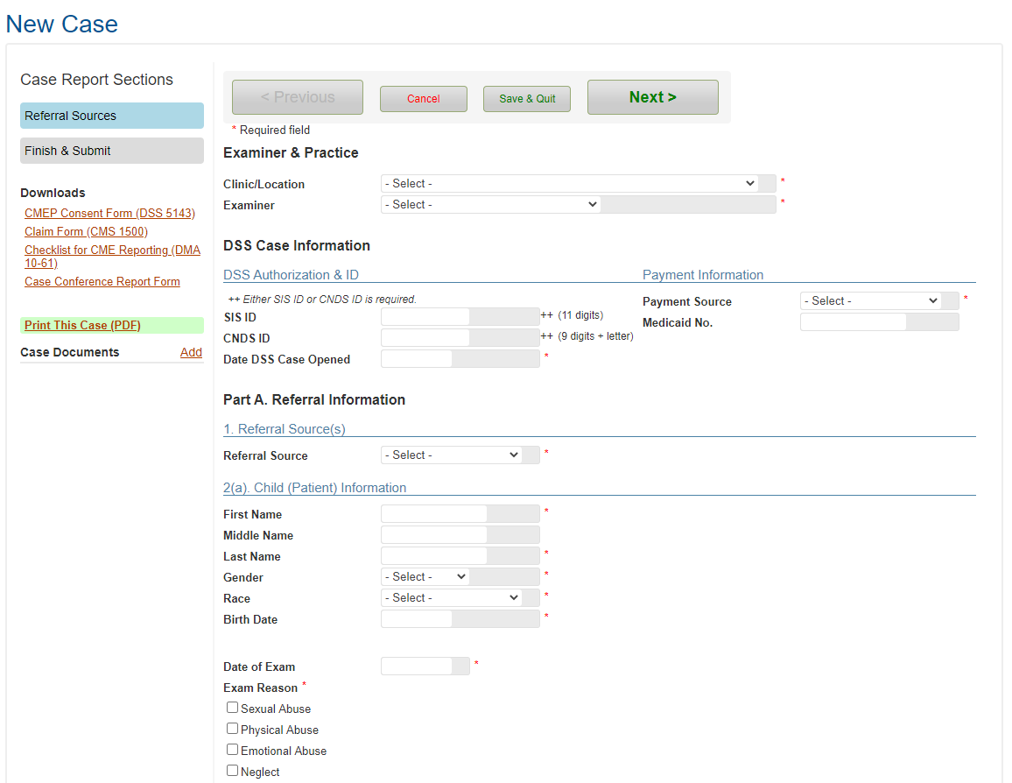
Submitting a new case– Choosing the Payment Source
Select Payment Source: DSS if the CME was referred by DSS and the child has private insurance, no insurance, or if Medicaid is secondary to private insurance
Select Payment Source: DCDEE if the CME was referred by DCDEE and the child has private insurance, no insurance, or if Medicaid is secondary to private insurance
Select Payment Source: Medicaid if the CME was referred by DSS or DCDEE and the child has Medicaid as primary insurance
Select Payment Source: For review only if the CME was referred by Law Enforcement

Slide 9
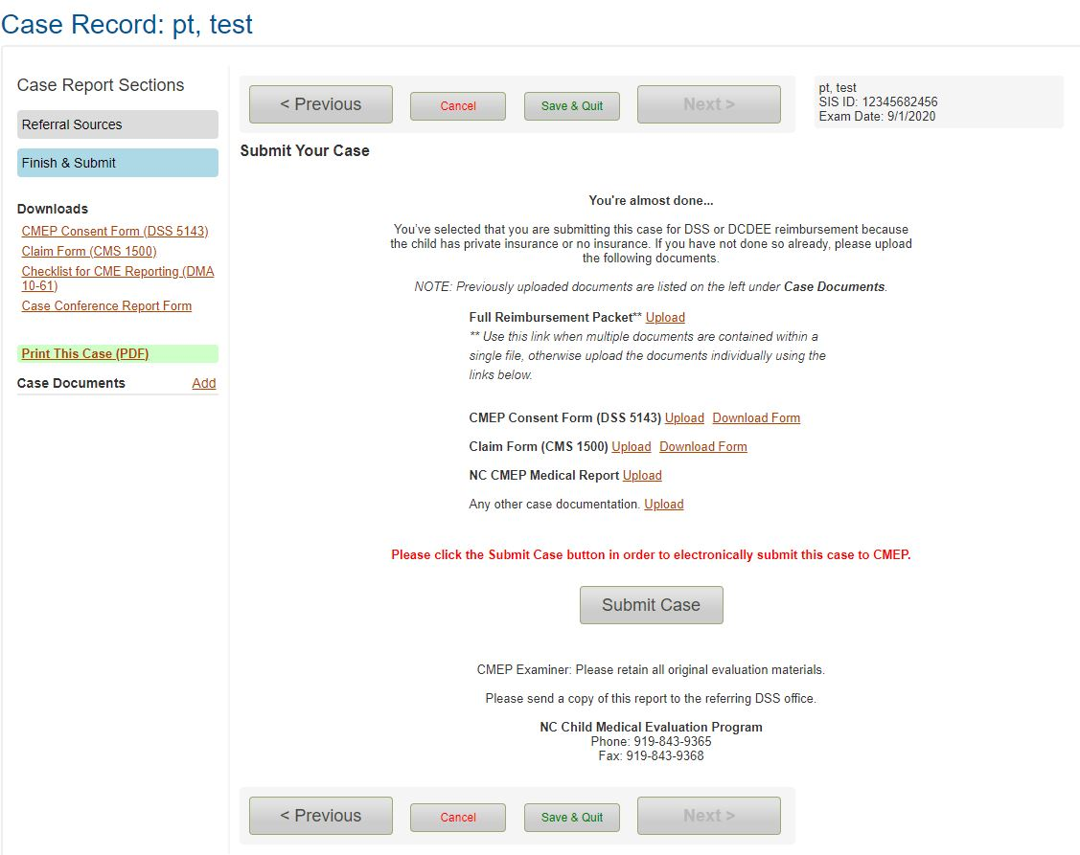
Submitting a new case – Uploading documentation
Upload required documentation. Each document that has been successfully uploaded will appear under Case Documents
When all required documentation is uploaded, select Submit Case to submit the case to CMEP.
*Keep in mind that you can save and return to a case at any time. Any case that has been initiated but not submitted to CMEP will appear for all portal users associated with your practice as Not Submitted in the Case Directory and on the Dashboard

Slide 10
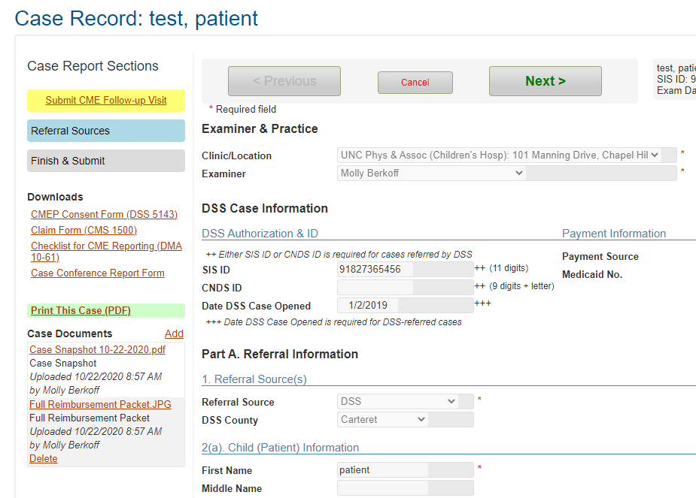
Submitting documentation for a follow-up exam
Return to the CMEP-approved case to submit documentation for a CME follow-up visit
Select Submit CME Follow-up Visit, and upload the claim and associated medical notes.
*You do not need to re-upload the consent form or medical report, as they are already saved with the case.

Slide 11
Features of the CMEP Provider Portal
The CMEP Provider Portal enables providers to:
Securely send CME documentation to CMEP for reimbursement and for review
Track reimbursement status of cases
Retrieve Checklist for CME Reporting (DMA-1061) forms for cases that have been approved by CMEP for submission to Medicaid
Upload annual signed CMEP Letters of Agreement
Submit AMA PRA Category 1 CME credits to CMEP
Notes:
This should be relevant to assessments, in-home and foster care

Slide 12
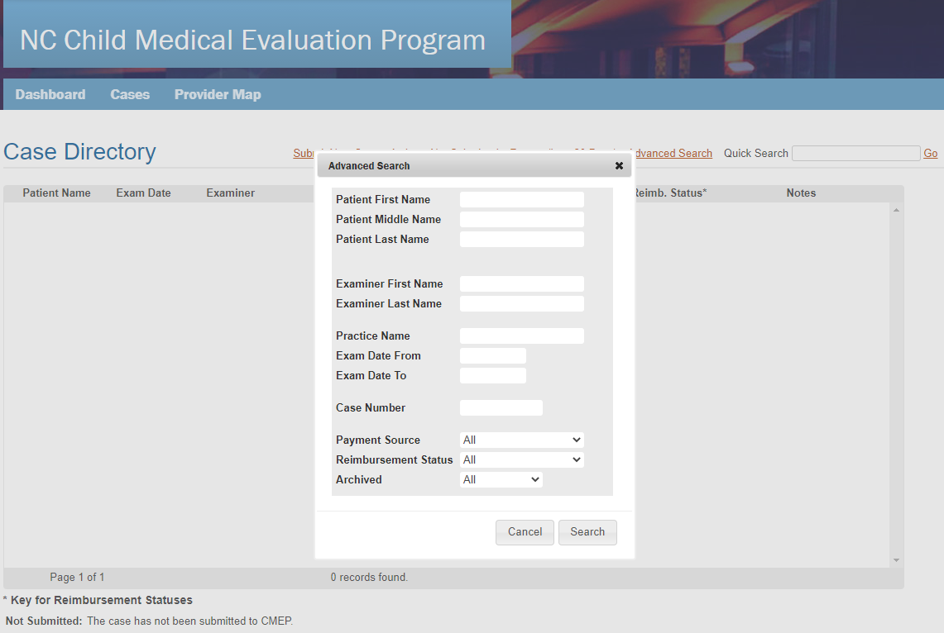
Tracking Reimbursement Status
To check on the reimbursement status of submitted cases, navigate to the Case Directory, then select Advanced Search
You can search by Payment Source to view just Medicaid or just DSS cases.
Select Reimbursement Status: All from the drop-down menu to pull up a list of all cases that have been submitted to CMEP from your practice.

Slide 13
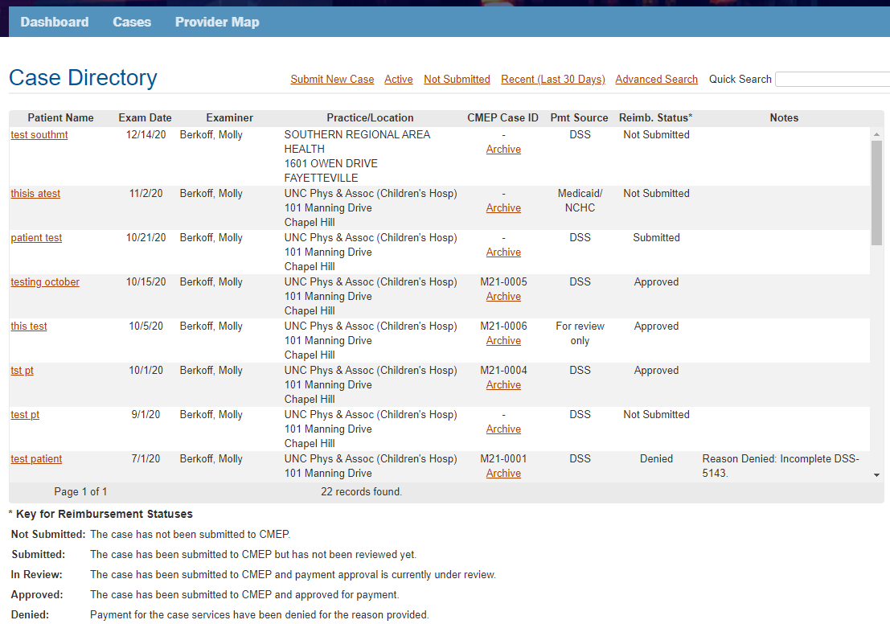
Tracking Reimbursement Status
Reimbursement Status appears for each case that has been initiated for your practice
Denials
If a case has been denied by CMEP and is still eligible for reimbursement, open the case and upload the corrected or missing documentation. CMEP will be notified of your upload and can then approve the case.
Archiving
You have the ability to archive cases if you’d like to use your Case Directory as a work queue to see only what is still pending or needs your attention. If you archive a case, it will be archived for all providers and coordinators. You can find archived cases by clicking Advanced Search.
For definitions of Reimbursement Status, consult the Key at the bottom of the page

Slide 14
Features of the CMEP Provider Portal
The CMEP Provider Portal enables providers to:
Securely send CME documentation to CMEP for reimbursement and for review
Track reimbursement status of cases
Retrieve Checklist for CME Reporting (DMA-1061) forms for cases that have been approved by CMEP for submission to Medicaid
Upload annual signed CMEP Letters of Agreement
Submit AMA PRA Category 1 CME credits to CMEP
Notes:
This should be relevant to assessments, in-home and foster care

Slide 15
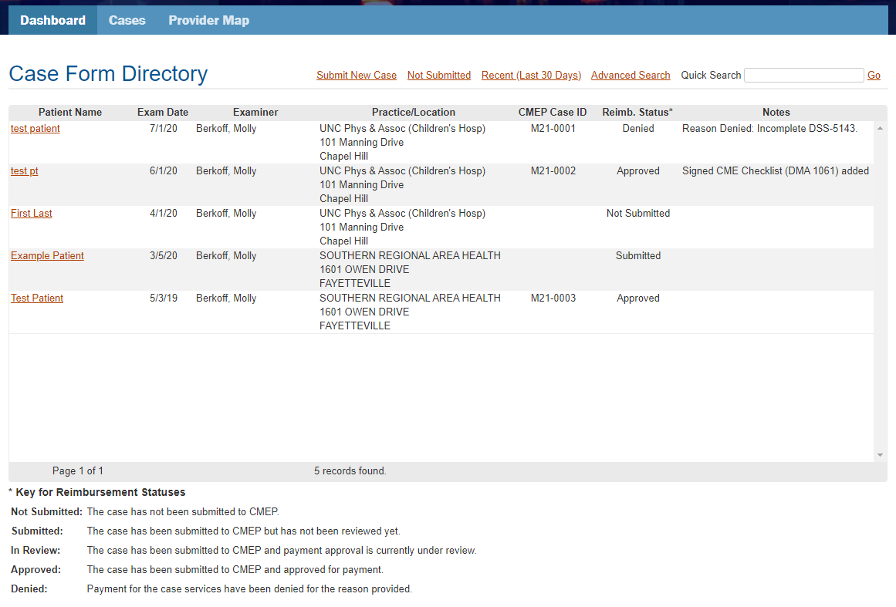
Retrieving Checklists for CME Reporting (DMA-1061) for submission to Medicaid
Once a Medicaid case has been approved by CMEP, a note will appear in the Case Directory: Signed CME Checklist (DMA 1061) added
Click on the patient’s name to retrieve the Signed CME Checklist (DMA 1061) from the Case Documents to be used for submission to Medicaid.
Submit the CMEP-authorized CME Checklist (DMA 1061) along with the 99499 claim to Medicaid for reimbursement. As a reminder, the CMEP-authorized CME Checklist is required to accompany the 99499 claim for reimbursement.

