Slide 1
UNC Health
Department of Physician Compliance
Emergency Medicine Documentation and Coding

Slide 2
Agenda
Review basic principles of coding and documentation of emergency medicine services
Review resident/fellow supervision and documentation requirements for Medicare, Medicaid, and TRICARE
Review data replication and scribe policies

Slide 3
Coding and Documenting Emergency Medicine Services

Slide 4
Billing Professional Services
Every billed service is assigned codes used for reimbursement, statistics, research, and other purposes.
The complexity of the patient’s condition, as documented in the note, drives the level of evaluation and management (E/M) service delivered, recorded, and billed.

Slide 5
Valuing the Work of E/M Services
The Level of Service provided is based on:
    Your resource expenditure
    Patient’s presenting illness or condition
Documentation should support:
    The severity of the patient’s condition/diagnosis
    Your effort in managing or treating the diagnosis
      Components of the history and exam
      Other work, such as reviewing notes or images
      Complexity of case

Slide 6
Three Key Components of E/M Coding
  History
    History of Present Illness (HPI)
    Review of Systems (ROS)
    Past, Family, Social History (PFSH)
  Examination
  Medical Decision Making
NOTE: All three key components are required for emergency medicine coding.

Slide 7
Chief Complaint
The chief complaint (CC) is a concise statement describing the symptom(s), problem(s), condition(s), diagnosis, or other factor that is the reason for the patient encounter.
  Required for all E/M services
  Typically provided by the patient in their own words but can be the observation of the provider if the patient is unable to provide
  Must be clearly documented

Slide 8
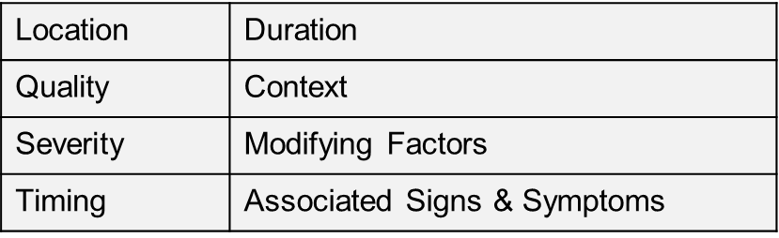
History of Present Illness (HPI)
A chronological description of the development of the patient’s present illness from the first sign/symptom to the present.
Two HPI Levels:
  Brief (1-3 elements) 99281–99283
  Extended (4+ elements) 99284–99285
Document using the below descriptors:

Slide 9
The Review of Systems (ROS) is the most often missed subcomponent of the history
    For a complete (10 or more) ROS, it is acceptable to use the statement "All others Negative" and "No other complaints" as long as the pertinent systems/symptoms/problems were addressed and documented.
    Avoid using statements like: "10 systems negative, 12 systems negative, etc."
≥ 1 ROS required for level 1-3 ED visit/99281–99283
≥ 2 ROS required for level 4 ED visit/99284
≥ 10 ROS required for level 5 ED visit/99285

Slide 10


Past Medical, Family, and Social History (PFSH)
    If the any of the history is unobtainable from the patient or other source, please document the reason why it was unobtainable (e.g., “patient was adopted”).
    If there is no pertinent family or social history, please document what you asked the patient (e.g., “No family history of CKD”).
    A ROS and/or a PFSH obtained during an earlier encounter do not need to be re-recorded if there is evidence the previous information was reviewed.
≥ 1 PFSH required for level 3 new/consult
All 3 PFSH required for levels 4–5 new/consult

Slide 11
Physical Examination Component

Slide 12
1995 CMS Documentation Guidelines include 8 body areas OR 8 organ systems
The body areas recognized are:
The organ systems recognized are:
Head, including the face
Neck
Chest, including breasts and axillae
Abdomen
Genitalia, groin, buttocks
Back, including spine
Each extremity:
  Right Arm
  Left Arm
  Right Leg
  Left Leg
Constitutional
Eyes
Ears, Nose, Mouth and Throat
Cardiovascular
Respiratory
Gastrointestinal
Genitourinary
Musculoskeletal
Skin
Neurologic
Psychiatric
Hematologic/Lymphatic/
  Immunologic
Notes:
There are two versions of the documentation guidelines – the 1995 version and the 1997 version.
The 1995 guidelines recognize 10 body areas and 12 organ systems
The 1997 guidelines require more detail in the documentation but allow for comprehensive levels for specialty specific exams.

Slide 13
The 1995 guidelines recognize 10 body areas and 12 organ systems
Problem Focused 99281 | Expanded Problem Focused 99282–99283 | Detailed 99284 | Comprehensive 99285
Affected Body Area | Affected Area + Up to 6 others | 2–7 Areas, more detail | 8+ Areas
Affected Organ System | Affected Area + Up to 6 others | 2–7 Areas, more detail | 8+ Systems or Complete Single Organ System Exam
Reminder: The 1995 examination is based on either body areas or organ systems, not a combination of both.
    'More detail' consists of at least two findings for at least two 'body areas' or 'organ systems.'
    Detailed Example:
      Cardiovascular: RRR, no murmurs, rubs, or gallops
      Respiratory: Lungs CTA, no wheezing, or rhonchi

Slide 14
1997 Documentation Guidelines
    There are two types of 1997 examinations:
      One General Multi-System
      Ten Different Single Organ System Exams
    Each level is comprised of examination elements identified by bullet points within specific body areas and organ systems. Bullet points must be documented exactly as provided in the CMS exam templates.
    The 1997 exam guidelines are typically used more by specialists than primary care. However, most providers tend to document based on the 1995 exam (body areas/organ systems).

Slide 15
Medical Decision Making Component

Slide 16
Medical Decision Making (MDM) refers to the work performed by a provider to establish a diagnosis and/or select management or treatment options.
The level of MDM is based on two out of these three elements:
  The number of diagnoses and treatment options
  Amount and/or complexity of data reviewed
  Patient risk for morbidity and mortality
Four Levels of MDM
Straightforward
Low
Complexity
Moderate
Complexity
High
Complexity

Slide 17
Number of Diagnoses and/or Management Options
Problem(s) Status | Number | Points | Result
Self-limited or minor (stable, improved, or worsening) | Max = 2 | 1
Est. problem (to examiner); stable, improved |  | 1
Est. problem (to examiner); worsening |  | 2
New problem (to examiner); no additional workup planned | Max = 1 | 3
New problem (to examiner); additional workup planned |  | 4
 | Total (Max = 4)
Ensure documentation is reflective of the problem(s)
status to receive credit for the work involved.

Slide 18
Amount and/or Complexity of Data Reviewed/Ordered
 | Points
Review and/or order of clinical lab tests (CPT 8XXXX series) Max = 1 | 1
Review and/or order of tests in the radiology section of the CPT (CPT 7XXXX series) Max = 1 | 1
Review and/or order of tests in the medicine section of the CPT (CPT 9XXXX series) Max = 1 | 1
Discussion of test results with performing physician Max = 1 | 1
Decision to obtain old records and/or obtain history from someone other than the patient Max = 1 | 1
Review and summarization of old records and/or obtaining history from someone other than the patient and/or discussion of case with another health care provider Max = 2 | 2
Independent visualization of image, tracing, or specimen itself (not simply review of the report) Max = 2 | 2
Total (Max = 4)
Document ALL the work that you do to ensure that you
get credit for all the work that you do!

Slide 19
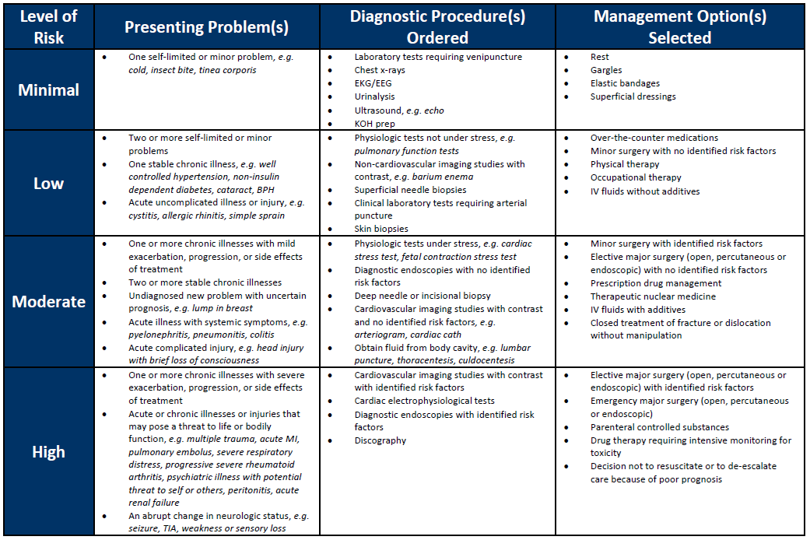
Table of Risk
Notes:
https://unchcs.intranet.unchealthcare.org/dept/ACP/compliance/Documents/EM/EM_Risk_Table.pdf
The third component is the table of risk. Per the CMS Documentation Guidelines, “[The] table may be used to help determine whether the risk of significant complications, morbidity, and/or mortality is minimal, low, moderate, or high. Because the determination of risk is complex and not readily quantifiable, the table includes common clinical examples rather than absolute measures of risk. The assessment of risk of the presenting problems is based on the risk related to the disease process anticipated between the present encounter and the next one. The highest level of risk in any one category determines the overall risk.

Slide 20
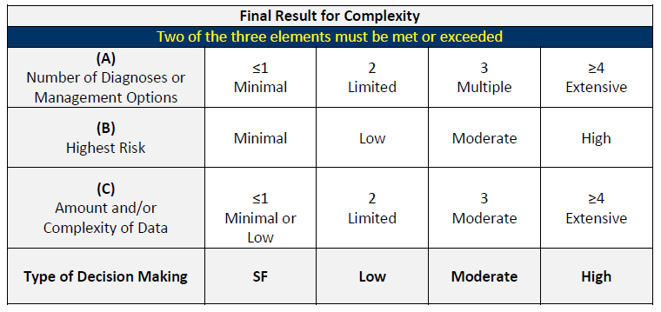
MDM calculation example

Slide 21
Medical Decision Making – Documentation Tips
Document the discussion of test results with performing physician (e.g., radiologist).
Document the review and summarization of old records and/or obtaining history from someone other than the patient and/or discussion of case with another health care provider.
      Example: “Patient’s wife states…” ; or “I have reviewed previous records from…”
Document if you independently visualized an image, tracing, or specimen itself (not simply review of the report).
      Example: “ I have independently viewed the MRI of the brain from 03/10/16 and….”
Document the patient’s clinical risks if the patient has a high risk for morbidity/mortality.

Slide 22
Putting It All Together
History
History
Examination
Medical Decision Making
Patient
CPT
&
1995 Exam
1997 Multi System
# of Dx
Procedures/tests
Management
Type
Code
Exam
HPI
ROS
PFSH
Organ System/
Exam Elements
and/or Risk of
ordered and amt
Options
Type
Body Area
Complications
of data
ED
99281
Problem
Brief (1–3)
N/A
N/A
1 Organ System/
1–5 Elements
Minimal
Minimal
Minimal
Focused
Body Area
99282
Expanded
Brief (1–3)
Pertinent (1)
N/A
2–7 Limited Exam Org
6–11 Elements
Low
Low
Problem
Syst/Body Areas
Low
Focused
99283
Expanded
Brief (1–3)
Pertinent (1)
N/A
2–7 Limited Exam Org
6–11 Elements
Moderate
Moderate
Moderate
Must
Problem
Syst/Body Areas
Address
Focused
All 3
99284
Detailed
Extended (4)
Extended (2–9)
Pertinent (1)
2–7 Extended Exam
12–17 Elements
Moderate
Moderate
Moderate
Org Syst/Body Areas
99285
Compre-
Extended (4)
Complete (10+)
Complete (2 of 3)
8+ Organ Systems
2 Elements from 9
High
High
High
hensive
Organ Systems

Slide 23
Medicare Teaching Physician Guidelines

Slide 24
Why compliance?
    Two main problems cause the majority of refunds and penalties for Academic Medical Centers:
      The Teaching Physician (TP) billed and though they may have been present and participated in the care, they did not document appropriate presence.
      The documentation in the note did not support the level of service or procedure billed.
Notes:
Medicare pays for Resident Physician services through Medicare Part A to the hospital. Medicare makes the payments based on the proportionate share of Medicare patients seen at the teaching hospital.
Teaching Physicians (TPs) are paid by Medicare Part B on a fee-for-service basis.
Medicare Part B will pay for TP services with the Resident Physician when the Teaching Physician participates and documents his/her involvement in the service.
If the TP does not participate in a given patient service when a Resident is involved, and meet specific documentation requirements, the TP may not bill for the service.

Slide 25

Why the stringent Medicare requirements? Medicare does not want to pay twice!
    Medicare pays for Resident Physician services through Part A.
    Medicare Part B will pay for TP services with the Resident Physician when the TP participates and documents the TP’s involvement in the service.
    If the TP does not participate in a given patient service when a Resident is involved and meet specific documentation requirements, the TP may not bill for the service.

Slide 26
TP supervision requirements for Medicare
    For purposes of Medicare payment, Evaluation and Management (E/M) services billed by Teaching Physicians (TP) require that the medical record demonstrate:
      The TP performed the service or was physically present during the key or critical portions of the service when performed by the Resident; and
      The participation of the TP in the management of the patient.
    The patient medical record must demonstrate the extent of the TP’s participation in the review and direction of the services furnished to each beneficiary.
SmartPhrase .TP01:
“I saw and evaluated the patient, participating in the key portions of the service. I reviewed the resident’s note. I agree with the resident’s findings and plan. TP Name”
Notes:
**UNC Health follows Medicare guidelines for Medicare Advantage Plans.

Slide 27
Billing minor procedures to Medicare
    For minor procedures of 5 minutes or less, the TP must be present the entire time in order to bill.
      Example: cerumen removal
    The patient medical record must demonstrate the extent of the TP’s participation in the service(s) furnished.
SmartPhrase .TP06 (E/M & Present Entire Procedure):
“I saw and evaluated the patient, participating in the key portions of the E/M service. I discussed the findings, assessment and plan with the resident and agree with resident’s findings and plan as documented in the resident’s note. I was present for the entirety of the procedure(s). TP Name”
Notes:
For procedures that take only a few minutes (5 minutes or less) to complete, e.g., simple suture, and involve relatively little decision making once the need for the operation is determined, the TP must be present for the entire procedure in order to bill for the procedure.

Slide 28
Unacceptable TP attestations for Medicare
  Examples: Unacceptable Attestations
    “Agree with above.”
    “Rounded, Reviewed and Agree.”
    “Discussed with Resident. Agree.”
    “Seen and Agree.”
    “Patient seen and evaluated.”
    “I was available.”
    An electronic countersignature or identity alone
Notes:
Such documentation is not billable, because the attestation does not make it possible to determine whether the TP was present, evaluated the patient, and/or had any involvement with the plan of care.

Slide 29
TRICARE Teaching Physician Guidelines

Slide 30
TP supervision requirements for TRICARE
    The Teaching Physician must be on the provider’s premises and available to provide immediate and personal assistance and direction if needed.
    “Personal” assistance means in person and not by telephone or other means.”
For purposes of meeting the TRICARE Teaching Physician requirements, the TP will be held to the same standard of personal documentation requirements as required by Medicare.

Slide 31
TP supervision requirements for TRICARE, cont.
  For TRICARE, the Teaching Physician must:
    Review the patient’s history, physical examination, and tests;
    Personally examine the patient;
    Confirm or revise the diagnosis to determine the course of treatment to be followed;
    Assure that any supervision needed by the Residents was furnished;
    Make frequent review of the patient’s progress;
    Either perform the physician’s services required by the patient or supervise the treatment so as to assure that appropriate services are provided by Residents and that the care meets a proper quality level;
    Be present and ready to perform any service performed by an attending physician in a nonteaching setting when a major surgical procedure or a complex or dangerous medical procedure is performed; and
    Be personally responsible for the patient’s care, at least through the period of hospitalization
Notes:
The attending physician’s services to the patient must be of the same character in terms of the responsibilities to the patient that are assumed and fulfilled as the services rendered to other paying patients.

Slide 32
TP documentation requirements for TRICARE
    The patient’s medical record must contain notes and orders which are either written, countersigned, or initialed by the Teaching Physician.
    The notes and orders must confirm that the Teaching Physician met the TRICARE Teaching Physician guidelines.
For purposes of meeting the TRICARE Teaching Physician requirements, the TP will be held to the same standard of personal documentation requirements as required by Medicare.
SmartPhrase .TP01:
“I saw and evaluated the patient, participating in the key portions of the service. I reviewed the resident’s note. I agree with the resident’s findings and plan. TP Name”

Slide 33
NC Medicaid Teaching Physician Guidelines

Slide 34
TP supervision requirements for NC Medicaid
The degree of supervision remains the responsibility of the Teaching Physician and is based on the skill level, experience and level of training of the Resident, and the complexity and severity of the patient's condition.
E/M Services
Procedures
  The Teaching Physician must be “immediately available” to supervise services provided by Residents and billed to NC Medicaid.
  The service must be furnished under the Teaching Physician’s overall direction and control but the Teaching Physician’s presence is not required.
  The Teaching Physician must be available via phone or pager.
  Direction supervision is required, meaning the Teaching Physician is present on-site and immediately available to furnish assistance and direction throughout the procedure.
  The Teaching Physician does not, however, need to be present in the room where the service is performed.
Notes:
When providing care and billing the Medicaid program for services to patients, Teaching Physicians assume full responsibility for the health and safety of the patient.

Slide 35
TP documentation requirements for NC Medicaid
  Written documentation in the medical record must clearly designate the Teaching Physician and must be signed by that physician.
SmartPhrase .TP11 (E/M):
“I was immediately available via phone/pager or present on site. I reviewed and discussed the case with the Resident, but did not see the patient. I agree with the assessment and plan as documented in the Resident's note. TP Name”
SmartPhrase .TP20 (Procedure):
“This service was rendered under my overall direction and control. I was immediately available in the procedural suite providing direct supervision. TP Name”

Slide 36
Critical Care Services

Slide 37
Billing critical care
Appropriate E/M Code
CPT 99291
+ CPT 99292 X 1
0-29 minutes
30-74 minutes
Each additional 30 minutes
0’
30’
75’
105’+
  Billing Requirements for Critical Care:
    Critical care is defined as the direct delivery of medical care for a critically ill or critically injured patient.
    A critical illness or injury acutely impairs one or more vital organ systems such that there is a high probability of imminent or life threatening deterioration in the patient’s condition.
    Critical care involves high complexity decision making to assess, manipulate, and support vital system functions to treat single, or multiple, vital organ system failure; and/or to prevent further life threatening deterioration of the patient’s condition. Examples of vital organ system failure include (but are not limited to):
      Central nervous system failure;
      Circulatory failure;
      Shock;
      Renal, hepatic, metabolic, and/or respiratory failure.
Notes:
Codes 99291 and 99292 are used to report the total duration of time spent providing critical care services to a critically ill or critically injured patient, even if the time spent providing care is not continuous.
When a provider is providing critical care services, the individual must devote their full attention to the patient and therefore, the provider may not provide services to any other patient during the same period of time.
Critical Care time includes the time that is spent engaged in work directly related to the individual patient’s care whether the time is spent at the bedside of the patient or elsewhere on the unit or floor.

Slide 38
Critical care guidelines
  Billing Requirements for Critical Care:
    Critical care services must be medically necessary and reasonable.
    While critical care is usually given in a critical care area such as a coronary care unit, intensive care unit, respiratory care unit, or the emergency department, payment may also be made for critical care services that you provide in any location as long as this care meets the critical care definition.
    The provider must devote their full attention to the patient and therefore may not provide services to any other patient during the same period of time.
    Critical Care time includes the time that is spent engaged in work directly related to the individual patient’s care whether the time is spent at the bedside of the patient or elsewhere on the unit or floor.
    Codes 99291 and 99292 are used to report the total duration of time spent providing critical care services to a critically ill or critically injured patient, even if the time spent providing care is not continuous.
Notes:
Critical care services must be medically necessary and reasonable. In some instances, the patient may require critical care for the first day, but not on subsequent days as their condition has stabilized.
While critical care is usually given in a critical care area such as a coronary care unit, intensive care unit, respiratory care unit, or the emergency department, payment may also be made for critical care services that you provide in any location as long as this care meets the critical care definition.
When a provider is providing critical care services, the individual must devote their full attention to the patient and therefore, the provider may not provide services to any other patient during the same period of time.
Critical Care time includes the time that is spent engaged in work directly related to the individual patient’s care whether the time is spent at the bedside of the patient or elsewhere on the unit or floor.
Codes 99291 and 99292 are used to report the total duration of time spent providing critical care services to a critically ill or critically injured patient, even if the time spent providing care is not continuous.

Slide 39
Critical care time
CPT Code | Description
99291 | Critical care, evaluation and management of the critically ill or critically injured patient; first 30-74 minutes
+ 99292 | each additional 30 minutes
Total Duration of Critical Care Codes
Less than 30 minutes | Appropriate E/M service
30-74 minutes (30 minutes - 1 hour 14 minutes) | 99291
75-104 minutes (1 hour 15 minutes – 1 hour 44 minutes) | 99291 and 99292
105-134 minutes (1 hour 45 minutes – 2 hours 14 minutes) | 99291 and 99292 X2
135-164 minutes (2 hours 15 minutes – 2 hours 44 minutes) | 99291 and 99292 X3
165-194 minutes (2 hours 45 minutes – 3 hours 14 minutes) | 99291 and 99292 X4
195 minutes or longer (3 hours 15 minutes – etc.) | 99291 and 99292 as appropriate

Slide 40
Physicians and APPs may not combine critical care time
    A split/shared E/M service performed by a physician and a qualified NPP of the same group practice (or employed by the same employer) cannot be reported as a critical care service, per Medicare.
    The service should be billed using the APP’s individual NPI number.
Critical Care Different Specialty/Same Group:
“Medically necessary critical care services provided on the same calendar date to the same patient by physicians representing different medical specialties that are not duplicative services are payable. The medical specialists may be from the same group practice or from different group practices.”
– Palmetto GBA, North Carolina’s Medicare Administrative Contractor, July 2019
Notes:
https://www.palmettogba.com/palmetto/providers.nsf/DocsCat/Providers~JM%20Part%20B~EM%20Help%20Center~Weekly%20Tips~9CZPSV6620?open

Slide 41
Documenting critical care
In order to bill critical care, the documentation must demonstrate:
    Time that was spent providing critical care (excluding procedures)
    That the patient was critically ill or critically injured when treated
    What made the patient critically ill or critically injured
    What the provider did to treat or manage the patient during the time spent
SmartPhrase .TP36:
“I personally provided critical care services to assess, manipulate, and/ or support vital system functions(s) to treat single or multiple vital organ system failure and/or to prevent further life threatening deterioration of the patient’s condition of ***. This included **** minutes that I personally spent performing critical care services, excluding procedures. Provider Name”

Slide 42
Documentation Integrity In the Medical Record

Slide 43
Data Replication in Electronic Documentation
Altering notes improperly may undermine the integrity of the electronic health record (EHR) and jeopardize reimbursement and patient safety.
    Medicare does allow documentation changes within limits, including amendments, corrections, addenda, and delayed entries if they are clearly identified and there is no tampering with original content.
The billing provider is responsible for the entire content of the documentation including its accuracy and any copied information.
Clinical documentation must demonstrate clearly distinct variation between notes.
The HPI, ROS, exam, and impression and plan must demonstrate documentation relevant to EACH clinical encounter and be reviewed and edited appropriately.
When possible, the use of copying and pasting of laboratory, pathology or radiology results in its entirety should be minimized in order to reduce “note bloat”. Summarizing findings and medical judgment is encouraged.
See PolicyStat ID: 5153534 Copying and Pasting and Data Replication in Electronic Documentation.

Slide 44
What are auditors looking for?
Inaccurate or outdated information
Redundant information, which makes it difficult to identify the current information
Inability to identify the author or intent of documentation
Inability to identify when the documentation was first created
Propagation of false information
Internally inconsistent progress notes
Unnecessarily lengthy progress notes

Slide 45
“Make Me the Author” Function in Epic
Allows a provider to substitute their signature for that of another person who entered notes in the EHR.
This function does not replace the attestation requirement for a Teaching Physician working with a Resident physician as it does not support the documentation by the Teaching Physician of their face-to-face involvement with the patient during the patient encounter.

Slide 46

UNC Health policy on use of scribes
Scribes May | Scribes May NOT
Review medical records for completeness | Enter medication orders on behalf of providers
Gather and document clinical information from other current or historical records under the direction of the provider | Provide any clinical care to patients while acting as scribes
Assist with medication reconciliation, documenting procedures, documenting non-medication related orders | Interject their own observations, impressions, or recommendations for care into the EHR
Provide communication assistance (e.g., messaging other providers, scanning, copying medical records) | Enter medication orders if not authorized
Pend medication orders
Scribes MUST
Accurately enter information into the EHR as directed by the provider | Enter the information under his/her own EHR log-in
Be proficient in computer documentation | Complete all annually required training related to HIPAA and sign a confidentiality agreement
See PolicyStat: Documentation of Care and Health-Related Data by Scribes

Slide 47
Required documentation
Scribe Required Documentation | Provider Required Documentation
The scribe’s note should include: The name, title, and signature of the scribe. The name of the provider providing the service. Scribe Documentation Example: Entered by ***, acting as scribe for ***. Signature *** Use the APP only as a scribe following the scribe policy | The treating (billing) provider is responsible for the note and signs the encounter note. The treating physician's or treating LIP's signature on a note indicates that the physician/LIP affirms that the note adequately documents the care provided. As long as the treating provider signs and dates the note, they do not need to complete a separate statement of attestation. The provider utilizing the scribe is responsible for timely reviewing the scribe’s recorded documentation and authenticating/signing the encounter.

Slide 48
Contact us – We are here to help!
    PhysicianCompliance@unchealth.unc.edu
    https://unchcs.intranet.unchealthcare.org/dept/ACP/compliance/
EXECUTIVE DIRECTOR
Robin Davis Shuping, RN, MHA, CPC | Executive Director, Physician Compliance UNC Health Phone 984.974.1017 Robin.Shuping@unchealth.unc.edu
ASSOCIATE DIRECTOR
Noel Wagner, RN, MSN, CPC | Associate Director, Physician Compliance
UNC Health
Phone 984.974.1308
Noel.Wagner@unchealth.unc.edu
Confidential Hotline: 1-800-362-2921 http://hotline.unchealthcare.org

Slide 49
Thank you!

