Slide 1
Purchasing Services – Optimizing the Purchasing Process

Slide 2
Who are we?
An arm of Procurement Services.
Commodity Based Agents
Lynn Barello – Scientific Equipment, Furniture and Flooring
Steve Gale – Scientific Supplies and Equipment Maintenance Agreements
Mark Sillman – University Service Contracts
Alicia Waymack – Information Technology Hardware
Danesha Little – Software
Veronica Green – Information Technology Services
Christy Baldridge – Travel, Entertainment, and Printing Services
Joe Eubanks – Material Repair and Operations (MRO) and Vehicles
Ted Bohlin – Contingent Workforce Agreements

Slide 3
When to engage my team?
Early and often
RFI or RFP process
Prevention of rework
Identification of other contracting avenues
Anytime a supplier is asking for a signature related to purchase of goods or services
Guidance on purchasing process

Slide 5
The Purchasing Process
It all starts with the Requisition
New requirements
Change Orders
CFS Changes
Contract Reviews
What are we looking for?
Well defined requirements
Directional comments and POCs
Supporting Documentation
Scope of Work/Product List
Supplier Quotes
Data-Protection Checklists
Waiver of Competition
Trade-In Documents
BAA/CDA/NDA

Slide 6
How to Buy
Purchase of goods or services <=$5K
BuyCarolina First – check to see if item is available via one of our catalog vendors
PCARD – purchase any item not on the exception list via PCARD
No need to add vendor to the system
Receipt necessary to reconcile PCARD in BoA Worx
Campus Voucher for necessary invoice payments
Purchase of goods or services >$5K
All purchases start with a requisition
BuyCarolina First up to $25K
Check STC/UTC/Consortium contracts
Informal Competition $5K < P <= $25K
Requisition will include quotes from three vendors if available
Waiver of Competition/SSJ necessary at this level
RFQs will be sent to the selected vendor to get concurrence on University terms and conditions
RFP/IFB may be used at agent’s discretion if deemed appropriate for complexity or public advertisement
IPS may be used to solicit responses

Slide 7
How to Buy (cont)
Formal Solicitations > $25K
IFB/RFP documents are mandatory
Bid posting timelines (min 10 days still apply)
For solicitations >$500K where flexibility does not apply
State P&C will need to pre-screen the RFP/IFB document prior to posting
Once bid tabulations are complete and a vendor has been selected, RFP/IFB responses and vendor selection letter will need to be forwarded to P&C for approval prior to award
Notice of high value contracts (> $1M)

Slide 8
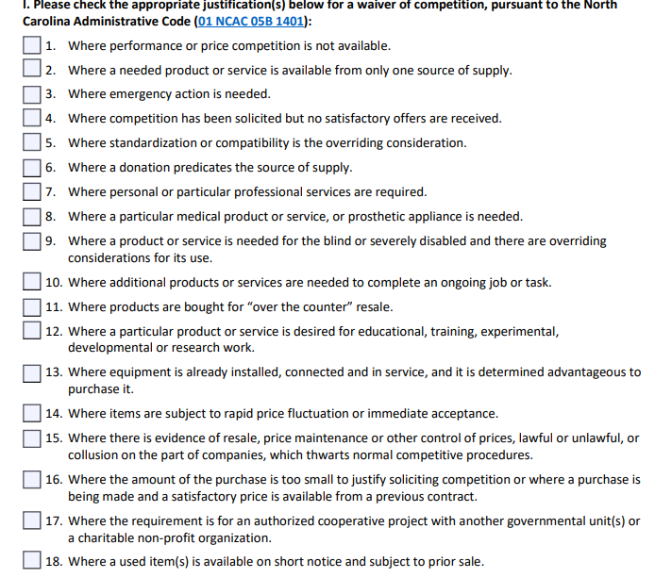
Waiver of Competition
Are you using the latest form? https://finance.unc.edu/wp-content/uploads/sites/298/2021/07/1232-1-1f.pdf
Brand Specific vs Sole Source – What's the difference?
Section 1 of the form – Choose your reason(s)

Slide 9
Waiver of Competition (cont)
Section II – What color green are you using?
Section III – Why is this the Only Product or Supplier Capable of meeting your need?
Comments Block has 1000 character limit
If you need more room, just say “See attachment” and attach separate document.

Slide 10
Waiver of Competition (cont)
Section IV – Conflict of Interest
Signature Block
Not Signed, Not Valid.

Slide 11
Contract Reviews
Do you have signature authority for contracts? – Chances are No!
All contracts requiring signature need to be submitted to purchasing via a requisition regardless of $$$.
Contracts < Small Purchasing Threshold will be reviewed, signed, and returned with instructions on proper payment method.
Supplier Name “Contract Review Only” for small dollar contracts so the supplier does not need to be added to the system.

Slide 12
Misuse of Funds
Departments do not have the authority to enter into any contractual agreements with vendors.
Contracting for goods or services in excess of $5K is considered a mis-use of funds regardless of the fund source.
Departments requesting Purchase Orders for payment of invoices are required to submit a Misuse letter with the requisition and invoice.
Why procedures were not followed?
What mitigating steps are being implemented to prevent future occurrences?
Why is it in the best interest of the state to pay the bill?

Slide 13
Change is a coming! July 1st
The solicitation method is generally determined by the estimated dollar value of the product or service to be purchased. The following dollar thresholds apply:
Dollar Range |  | Solicitation Process
$0 | $5000 | Small Purchase Buy Carolina – UNC-CH most preferred option for small purchases. Gives access to cross catalog shopping and individual supplier punch-out catalogs. Contracts – existing state, consortium, and university contracts in place to facilitate small purchase. PCARD – allows for purchase below $5,000 and does not require supplier to be added to the system.
>$5000 | $25,000 | Buy Carolina – UNC-CH most preferred option for small purchases. Gives access to cross catalog shopping and individual supplier punch-out catalogs. Contracts – existing state, consortium, and university contracts in place to facilitate small purchase. Requires a requisition to ensure all Capital Assets are identified, tagged and tracked in accordance with State policy. No Waiver of Competition or Sole Source Justification required. Seeking multiple quotes still highly encouraged.
> $25,000 | $100,000 | Informal solicitation requiring at least 3 quotes. > $25K- 100K- Quotes will be solicited via a University Request for Quote (RFQ) which will include University terms as well as EO50 language for North Carolina businesses. (May differ for IT)
> $100,000 | + | Formal competitive solicitation by Purchasing Services may be required. When the expected value of the total contract is expected to exceed $75,000, departments should consult with purchasing services staff to determine the most appropriate procurement method. Solicitation is required to be advertised on the state IPS system. Waiver of Competition and customer justification may be used as appropriate if competitive products or services cannot meet required specifications.

