Slide 1
Core Director Meeting
September 2023

Slide 2
Core Director Meeting
September 2023

Slide 3
Agenda
Core infrastructure at UNC - organization chart
Fixed-term faculty promotion advocacy
Data Management and Sharing Plans
Rigor and Reproducibility
MAD SSCi wrap up
Planning for core instrumentation needs
Upcoming ORT events
Acknowledgment tracking
OSP metrics
iLab website updates and asset tracking updates
Financial reporting
Resources available for equipment grants (Nate Blouin)
Working with external customers (Kickstarter)

Slide 4
Core Infrastructure at UNC
Research Core Development Team (OSP/VCR)
BEN WRIGHT – Director RCD
MEGHAN KRAFT – Interim Director Research Core Strategy
MICHAEL AKRIDGE – Financial Analyst
Office of Research Technologies (SOM)
CHRIS GREGORY – Director
KARA CLISSOLD – Assoc. Director
Lineberger Comprehensive Cancer Center (SOM)
HOLLY DRESSMAN – Asst. Dir. of Shared Resources and Operations
UNC College of Arts and Sciences
JIM CAHOON – Exec. Dir. of Research Core Facilities
OSP Cost Analysis & Compliance
BRIAN BERTLSHOFER – Director
JR PIKE – Manager
LATOIA SMITH – Lead
DAVID COYLE – Analyst
VALESHIA DOBSON - Analyst

Slide 5
Core Infrastructure at UNC
Research Core Development Team (OSP/VCR)
Office of Research Technologies (SOM)
Lineberger Comprehensive Cancer Center (SOM) Asst. Director
UNC College of Arts and Sciences Exec. Director
OSP Cost Analysis & Compliance Team
Partner with departments, schools, and existing recharge centers to develop a campus-wide Core strategy
Survey equipment and resources to establish a central asset repository
Consult on core management, business process improvement and marketing
Manage iLab adoption and training
Supports cores with all operational processes, from starting a new core to rate reviews and developing operating plans
The Core Facility Advocacy Committee (CFAC) provides funding
Advocates within the School of Medicine with a commitment to all cores within the UNC Chapel Hill ecosystem
Educates core personnel on areas of interest, including providing ABRF membership and supporting grant writing, career development and sustainability initiatives
Partner with existing recharge centers in LCCC to support operations, finance, funding requests, etc.
Consult on core management and business process improvement
Assist with solutions for marketing core facility services
Partner with existing recharge centers in CAS to support operations, finance, funding requests, etc.
Consult on core management and business process improvement
Assist with solutions for marketing core facility services
Serve as liaison with Research Core Development Team (OSP/VCR) and ORT (SOM)
Serve as ad hoc member of CFAC
Initiate rate reviews on biannual basis
Approve rates and provide MOAs
Review operating plans and rate development worksheets
Ensure compliance to financial policies for recharge centers
Serve as ad hoc member of CFAC
Serve as ad hoc members of CFAC
Provide options for treatment of volatile rates and assist with more frequent rate reviews

Slide 6
Fixed-Term Faculty Promotion for Core Directors
Core directors who are fixed-term faculty are eligible for promotion in rank. Departments must initiate the promotion process (chair, ACA, HR) but you may need to advocate for yourself
Administration, Clinical, Community Professional Service, Education and Research
“Meet the mark” criteria are included in the SOM APT Guidelines (see next slide). While other schools may not have these criteria, the documentation required is the same
Documentation required: CV in SOM format; reference letters from outside of home department (2 required, no more than 4); evidence of teaching/mentoring/training (with student surveys/letters and a peer evaluation letter); chair’s letter recommending the promotion, chair’s checklist
Committee approvals required after submission by HR – Fixed-Term Promotions Committee and Dean’s Advisory Committee (both meet monthly)
Timeframe for completion of process - ~ 6 months. Collecting reference letters is the bottleneck

Slide 7
“Meet the Mark” Criteria for Research
Assistant to Associate Professor
(Research Track)
Documentation of substantial research activity and productivity
Excellent local reputation as a researcher documented in letters of reference external to the department
Scholarship – minimum of five examples of scholarship (progressive and enduring)
One of the following demonstrating progressive achievement
-Successful operation of a core facility
-External funding
-Key role in facilitating research activity for dept or center
Associate to Full Professor
(Research Track)
Documentation of substantial research activity and productivity
Excellent regional or truly exceptional local reputation as a researcher documented in letters of reference external to the department
Scholarship – minimum of five examples of scholarship (progressive and enduring)
One of the following demonstrating progressive achievement
-Successful operation of a core facility
-External funding
-Key role in facilitating research activity for dept or center

Slide 8
Core Survey: Data Management and Sharing Plans
NOT-OD-21-013: Final NIH Policy for Data Management & Sharing​
Went into effect on January 25, 2023​
Applies to all research, funded or conducted in whole or in part by NIH, that results in the generation of scientific data.​
"Scientific data" is defined as: ​
  “data commonly accepted in the scientific community as of sufficient quality to validate and replicate research findings, regardless of whether the data are used to support scholarly publications.”​
  Includes any data needed to validate and replicate research findings​
  Excludes lab notebooks, preliminary analyses, completed case report forms, drafts of scientific papers, plans for future research, peer reviews, communications with colleagues, or physical objects such as lab specimens
If your core will be generating scientific data for a grant, you should build a DMSP to be included in the application

Slide 9
Six Elements of a DMS Plan
Plan Elements
Data Type
Related tools, Software and/or Code
Standards
Data Preservation, Access and Associated Timelines
Access, Distribution, or Reuse Considerations
Oversight of Data Management and Sharing
Data type
  Identifying data to be preserved and shared
Related tools, software, code
  Tools and software needed to access and manipulate data
Standards
  Standards to be applied to scientific data and metadata
Data preservation, access, timelines
  Repository to be used, persistent unique identifier, and when/ how long data will be available
Access, distribution, reuse considerations
  Description of factors for data access, distribution, or reuse
Oversight of data management and sharing
  Plan compliance will be monitored/ managed and by whom
NIH Program staff will assess DMS Plans, but not part of overall impact score
See Writing a Data Management & Sharing Plan for details
Notes:
Expectation to maximize data sharing with caveats​
Expectation that data are of sufficient quality to validate and replicate research finding​
Not training grants, fellowships, conferences (see specific activity codes)​

Slide 10
DMP Tool
Is a free web-based form managed by the California Digital Library ​
Used by institutions around the world (82,235 users), updated based on user feedback: view example public plans​
Provides guidance from NIH and your institution, suggested answers, and additional resources for each part of the plan​
Also has templates for other federal and private funders (i.e. NSF)​
Machine actionable DMP - allows for automated exchange of information about your research by connecting to ORCID iD (useful for funded projects, tracking over time)
https://dmptool.org Sign in with SSO; UNC has an institutional account

Slide 11
Rigor and Reproducibility
Thank you!
UNC Chapel Hill is the standard for developing rigor and reproducibility statements within the ABRF core community. The ORT R&R template has been posted on the ABRF website and published in a recent JBT manuscript
If you are a new core director, are updating your website, or need to add a rigor and reproducibility statement to your website, please visit:
  https://www.med.unc.edu/corefacilities/rrt/

Slide 12
MAD SSCi
Thank you for all who attended, presented, and assisted in making this meeting successful!
If you enjoyed MAD SSCi, please consider attending again next year (Rutgers University, NJ) or attending the national ABRF meeting ( Minneapolis, MN)
  Expenses for conferences can be built into your rates, ORT/CFAC can also provide funding for conference attendance.
  Have an idea for future sessions? oc@maddsci.abrf.org

Slide 13
Planning for Instrumentation Needs and Lifecycles
“Knowledge is power”
  What is the expected lifecycle of your equipment? Will it need replacement sooner due to heavy usage, pace of technological development, etc.?
Develop a plan
  CFAC Emergency funds should not be the planned financial avenue when you know your instrumentation is reaching or has surpassed its end of life.
  CFAC Fall/Spring RFAs can be an avenue to replace aging instrumentation.
  Cost-shares, either for grants or with other internal entities, can be submitted alongside RFAs, or submitted at other strategic timepoints to coordinate with cost-share requests that go through the OVCR.
  NCBC, NIH S10 or R24, NSF, DoD DURIP, etc.
  NCBC IIG grant deadline is October 3, 2023
Communicate early
  Let ORT or your CFAC representative know what your needs are or will be if you plan to use a CFAC funding mechanism (even matching funds).

Slide 14
Instrumentation Grant Panel
October 12, 2023, 12-1:30pm
Roundtable discussion with your peer core directors who have successfully submitted grant applications as well as a PI who has participated in the NIH S10 study sections. They will present their own grants as case studies and discuss tips and tricks, timelines, how to secure matching funds, and more
  Ashutosh Tripathy, Pablo Ariel, Josh Chen, Brandie Ehrmann, Paul Maddox
In person meeting - lunch will be provided. Open to core directors and stakeholders across all schools. RSVPs will be required - keep an eye out for a meeting invitation.
Please attend if you are planning or considering submitting an instrumentation grant (NCBC, NIH, NSF, DoD)

Slide 15
Peer Mentoring
Several core directors expressed interest in peer mentoring and networking events
We will be hosting a small-group session 11/13/2023 to brainstorm what this would look like. If you would like to participate in the organization and structure of this mentorship opportunity please reach out to Kara Clissold (kara_clissold@med.unc.edu)
Aim to begin events in January 2024

Slide 16
Acknowledgment Tracking Update
Chris presented a poster outlining our comprehensive search strategy at the 2022 ABRF meeting in Boston
We are working on a sustainable, AI-database driven tool for acknowledgment tracking with a reporting feature that could be used campus-wide. In the meantime, we are continuing to collect historic acknowledgment data for our cores and the search terms we discover will be used to drive the AI software. Thank you to those who have helped us amass this data.
If you need assistance with acknowledgment tracking for grant reporting or other needs please reach out to Kara (kara_clissold@med.unc.edu)

Slide 17
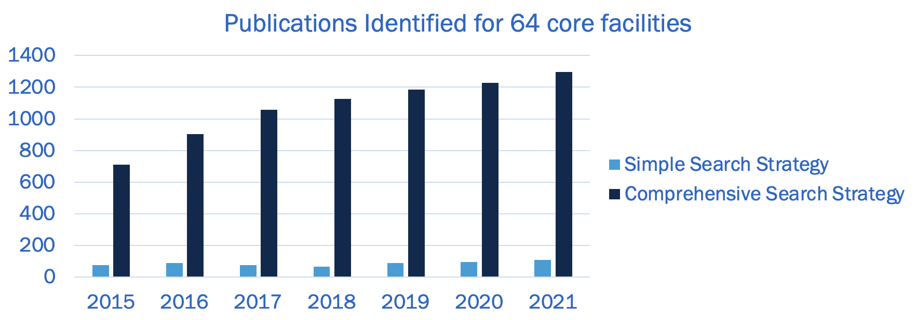
Acknowledgment Tracking Data

Slide 18
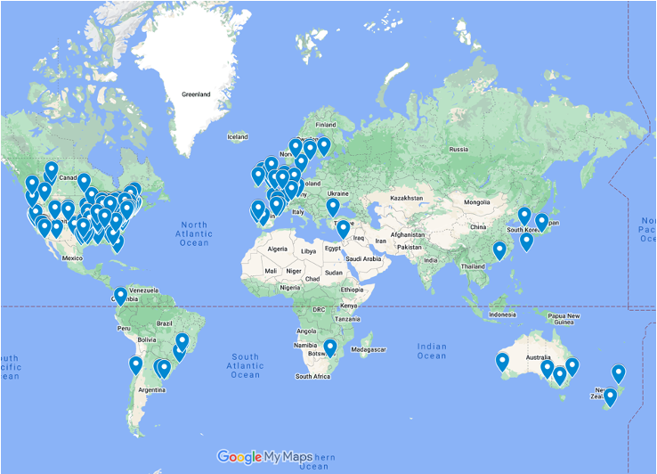
Worldwide Impact of Core Facilities
Google Scholar searches for 64 core facilities yielded 2,453 acknowledgments of those cores in student dissertations and theses at institutions around the world to date.
Customized Google Map. 190 pins correspond to a unique institution where a student dissertation or thesis acknowledged a UNC-Chapel Hill core facility.

Slide 20
Research Core Development
Meghan Kraft, Interim Director of Research Core Strategy
Ben Wright, Director of Research Core Development

Slide 21
FY2023 Highlights
110 official recharge centers; approx. 125 total research cores​
Total Revenue Generated: $43 million ($41 million FY2022) ​
Research Supported:​
700 labs on campus​
40 external universities​
40 external businesses​

Slide 22
FY2023 Revenue Metrics
​Sponsored Research
$7.6 million generated in F&A
2,152 projects charged
Total impact to research: $1.6B​*

Slide 23
Research Core Development Outreach
58 core tours CY2023
Thank you!
UNC Symposium for Research Administrators
Thursday September 27 - Friday September 28
https://symposium.web.unc.edu/
RCD Updates and Initiatives
Rate Reviews (OSP CAC and RCD)
Contracts with External Customers
iLab: General Info, Tips, and Tricks

Slide 24
Rate Reviews
OSP Cost Analysis and Compliance Team performs reviews
Reviews completed since October 2022: 63
Median time to complete rate review: 92 days
Rate review status information available in Tableau "Totals" dashboard
Templates and FAQs available on RCD webpage

Slide 25
Financial Reporting
Financial reporting tools available via Tableau
Now available! Access for over 100 cores and 300 users
https://tableau.unc.edu/#/site/oris/projects/1282
For questions, technical issues, or to request access changes, please contact RCD@unc.edu
Link, training session recording, and FAQ document located on RCD Webpage ​​
Rate Review status available via “Cores – Totals” dashboard​

Slide 26
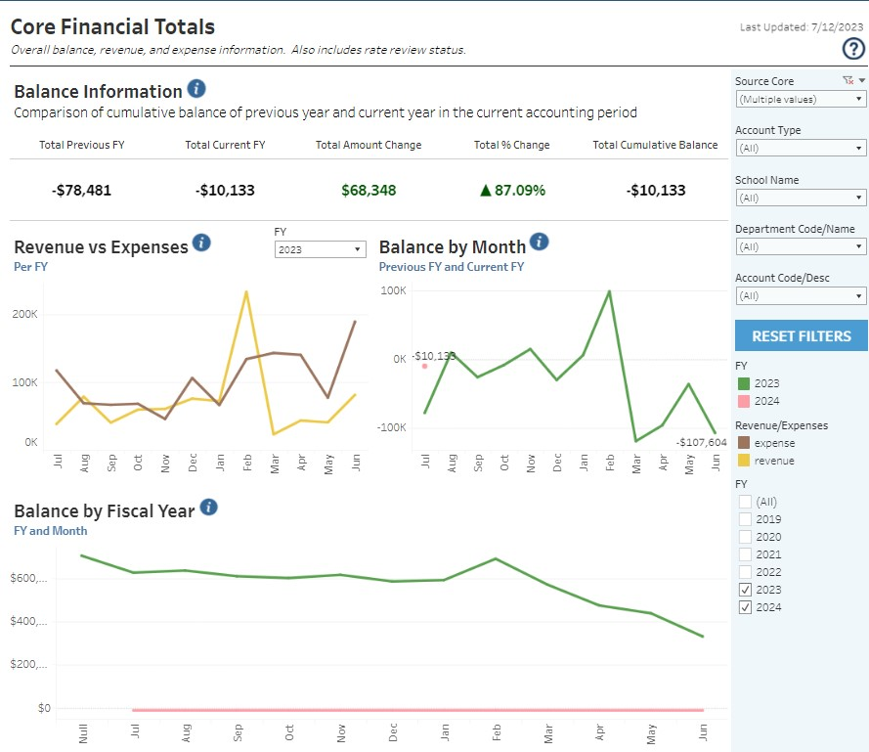
Cores - Totals
Revenues
- Expenses
+ Balance Carryforward
+ Transfers___________
Total Balance
One-stop-shop for all financial data
Reports expenses and revenue charged to core source – no subsidies or grant funding yet
Filters at right can be used to refine data shown
FY filters available for most elements
Rate review information at bottom of dashboard

Slide 27
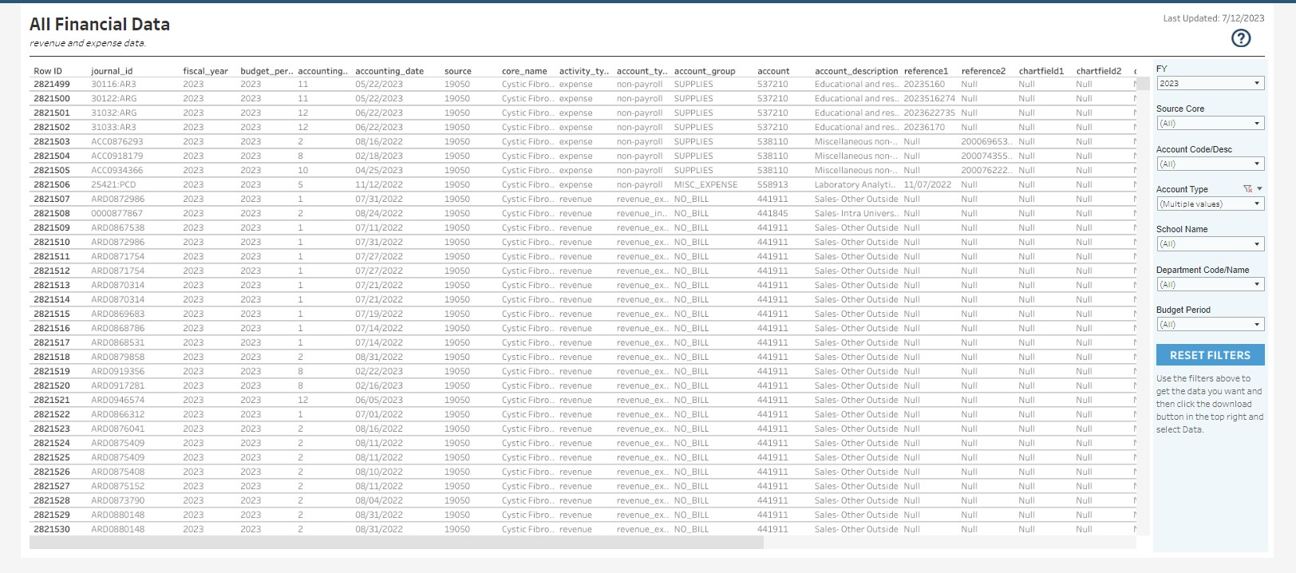
Cores – Financial Data
Transactional detail for core since 2018
Filters available at right
Ability to export to Excel
Accounting Date and Transaction ID included

Slide 28
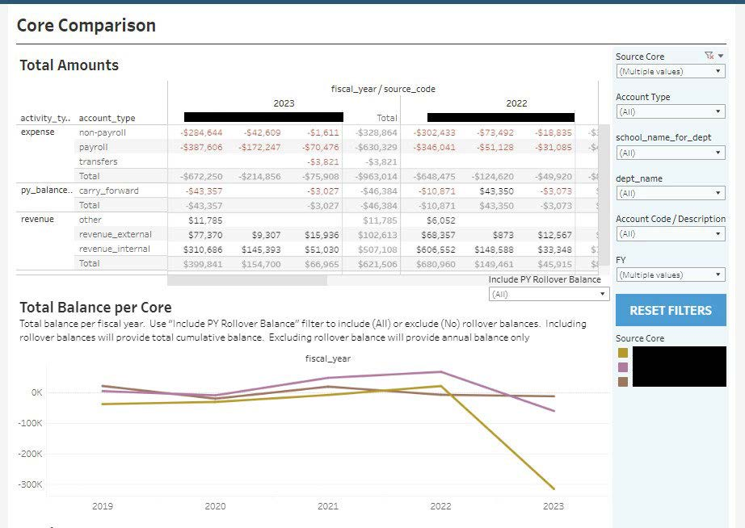
Core Comparison
Information for multiple cores
Each core presented separately
Use filters to adjust view as needed
Cores are limited to user’s access

Slide 29
iLab Information and Updates
CoreSupport@med.unc.edu for iLab support ​
Michael Akridge, Financial Analyst, OSP
7 cores onboarded during CY2023
If interested in more information or a demo, contact us

Slide 30
iLab Improvements
Training and guidance documents coming soon!​
Let us know what you need. ​​
Subsidy Function​
Collaborating Cores Function

Slide 31
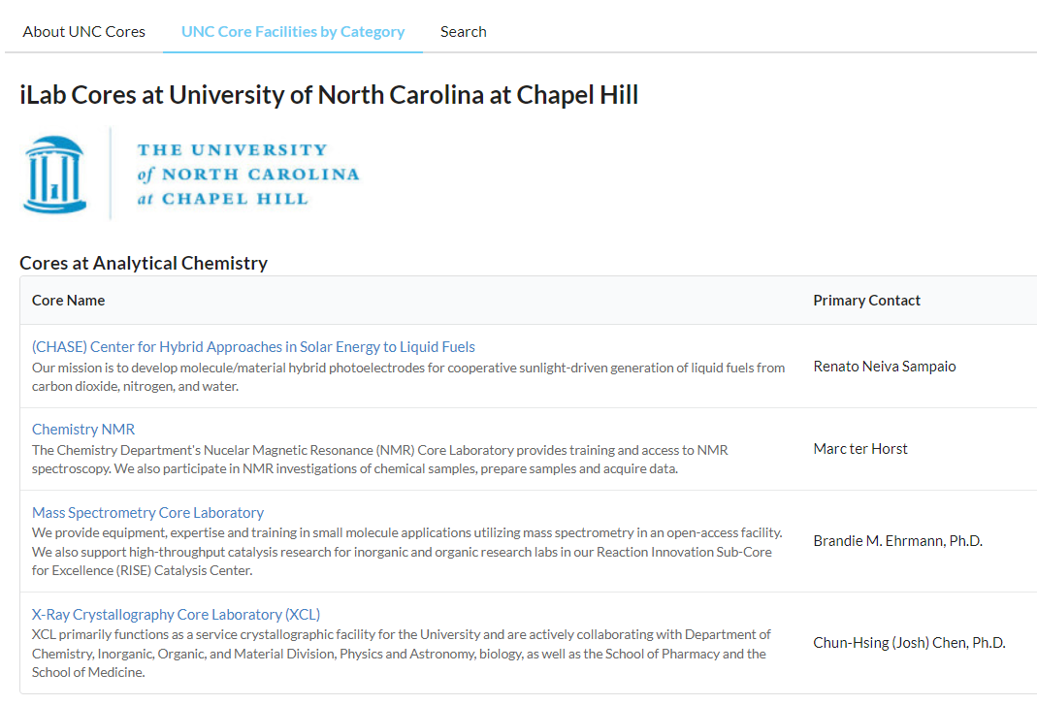
iLab Institutional Landing Page

Slide 32
RCD Webpage
FAQs, rate review document templates, and guidance documents
Financial reporting link, guidance, and training presentation
Research core agreements
Future enhancements
https://research.unc.edu/sponsored-programs/resources/research-core-development/

Slide 33
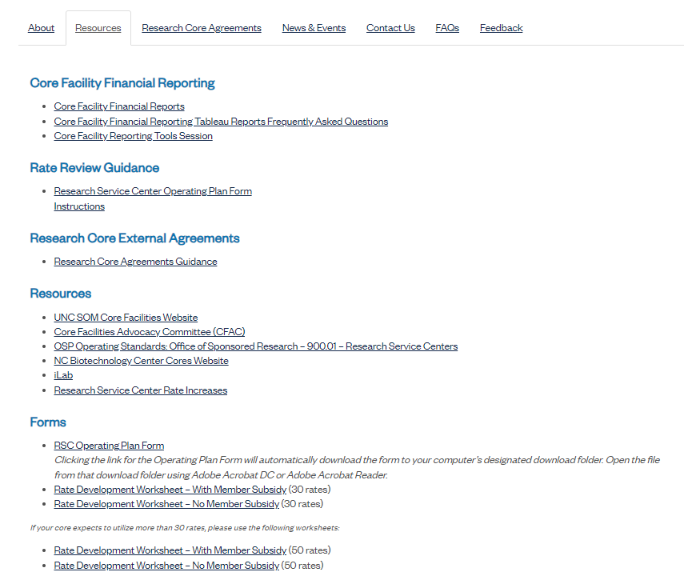
RCD
Webpage

Slide 34
Asset & Equipment Database
RCD currently working with ORIS to create an asset database
Ability to record and track equipment and service contracts
Greater discounts on purchases and service contracts
Ability to forecast useful life and anticipate replacements

Slide 35
Questions?
Ben Wright
Director, Research Core Development
bwright1@email.unc.edu
Meghan Kraft
Interim Director, Research Core Strategy
kraftmeg@unc.edu
Michael Akridge
Financial Analyst
michael_akridge@med.unc.edu
iLab Support
coresupport@med.unc.edu

Slide 36

Core Facilities proposal coordination discussion
Nathan Blouin, MBA, CRA
Director
nathan_blouin@unc.edu
Rachelle Davenport
Limited Submissions and Administrative Coordinator
rachedav@unc.edu
UNC Office of Research Development
September 14, 2023

Slide 37
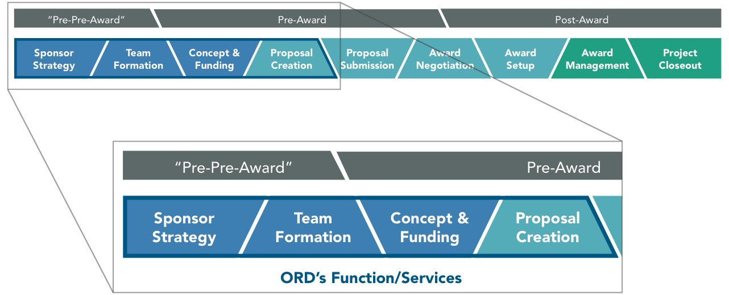
What is Research Development?

Slide 38
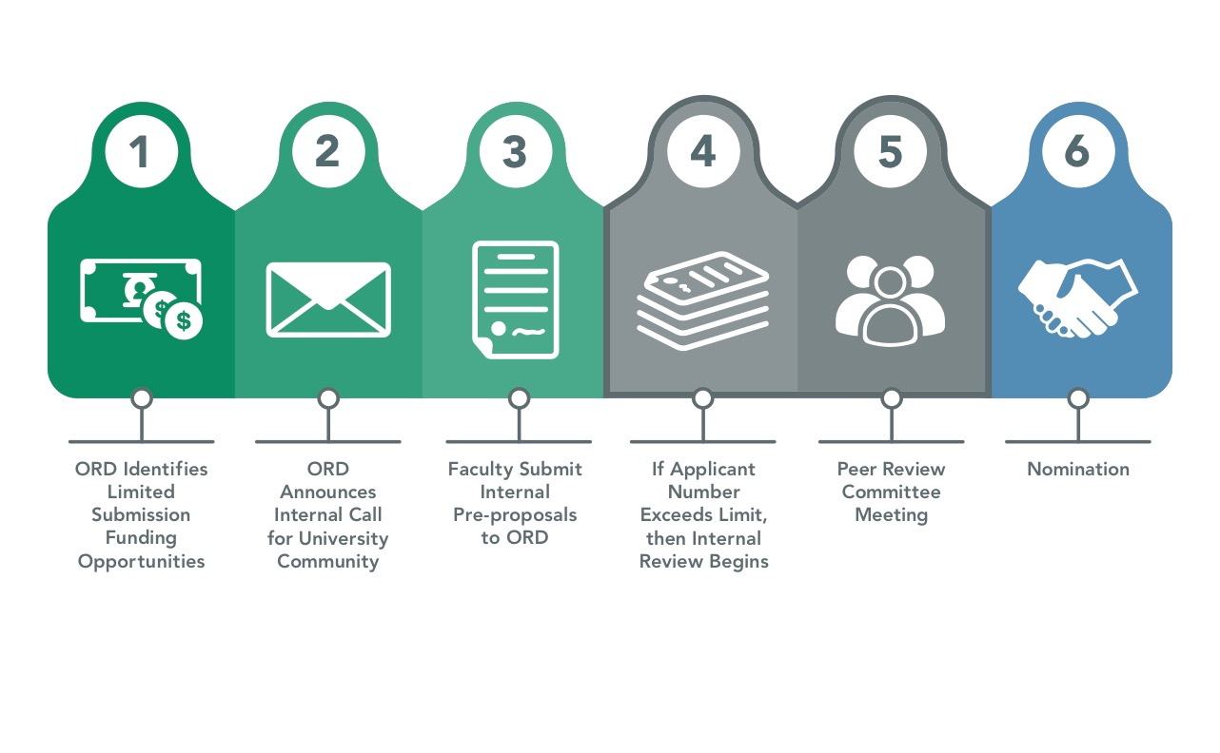
UNC Limited Submissions Process Flow Chart – adapted!

Slide 39
UNC Limited Submissions Process Flow Chart – adapted!
Long cycle internal competitions on NSF, NIH, DoD/DURIPs etc., to help centralize equipment planning and resource alignment
  Purchase & Acquisition timelines
  Space upfits & Construction
  Installation
  Integration with current lifecycles
  Cost-share request alignment
Builds flexibility for strategic equipment requests based on leadership need
Neutral-party moderated stakeholder peer-review

Slide 40
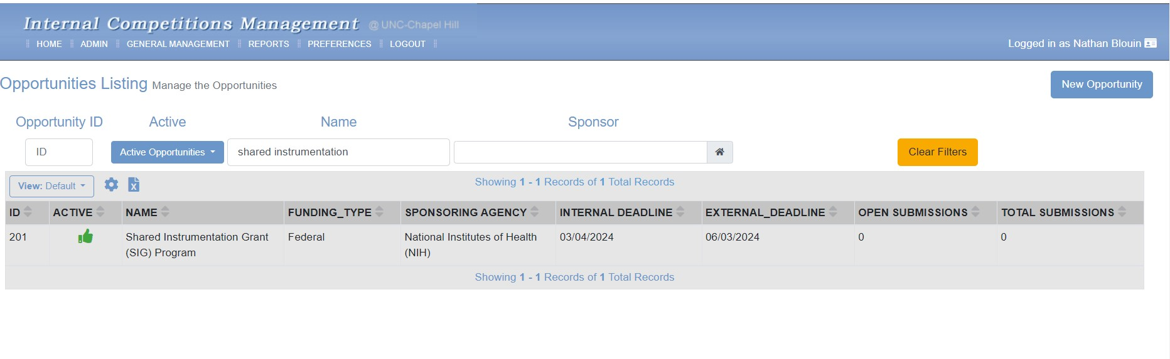
Limited Submissions Management System (LAMSeS)

Slide 41
Opportunity Intake Plans
Standard Channels
Agency Announcements
State Bulletins
INFO Ed SPIN
Targeted Channels
NIH Institute & Director Mtgs
NSF Webinars & DCLs
Distribution Plans
Broad Platforms
Limited Submissions listserves
FUNDAMentals
Targeted Channels
This group
Others?

Slide 42
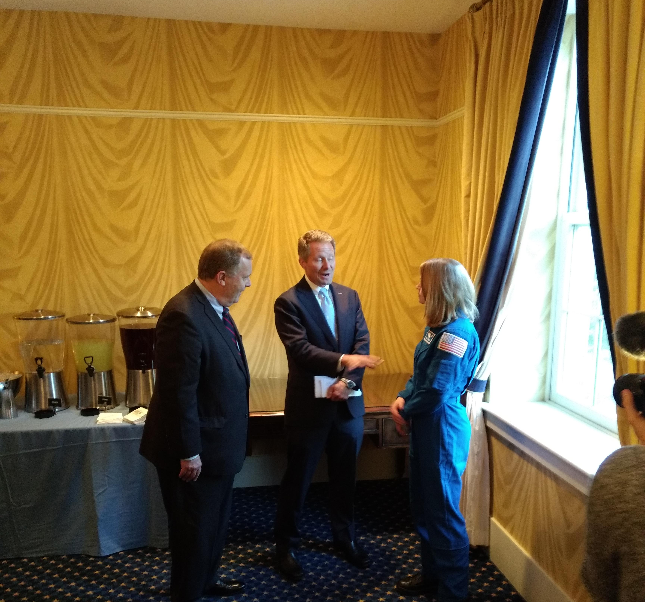
QUESTIONS?
Contact:
research.unc.edu/research-development
ord@unc.edu
nathan_blouin@unc.edu
rachedav@email.unc.edu
limited_submission@unc.edu
919-962-7504
UNC Alum and Astronaut Candidate, Zena Cardman

Slide 43

KickStart Venture Services
Jeff Speakman, PhD
KickStart Accelerator

Slide 44
THE KICKSTART TEAM

Slide 45

MISSION
Support​ ​IP-based ​startup​ ​formation,​business​ ​development​ ​& growth​ ​by​:
Providing​ ​coaching​ ​and​ ​ mentoring,​ ​
Early-stage​ ​funding,​ ​
Connection​ ​with​ ​key​ ​service providers,​ ​management,​ ​& investors​ ​and​
Incubation ​space
05
04
Graduate
03
Grow
VC funding
Partnerships
IPO
Intros to potential management
SBIR Grant application support
7,500 SF Wet-lab space
Showcase & networking events
Board set-up advice & connections
Launch
02
Streamlined incorporation
Connection to service providers
Venture Catalyst Fellows program (MBAs and PhD students)
KVS PoC Awards
01
Assess
Business case support
Entrepreneurs-in-Residence
Advisory panels
IP and Market Landscape services
I-Corps Program
Educate
KickStart Workshops
Customer Discovery & SBIR/STTR workshops
1:1 Meetings with researchers

Slide 46












Startup SUPPORT
TRANSLATIONAL RESEARCH SUPPORT
Service provider & Management network
Educational Resources
IP & Market Research
Startup Guidance
Incubator Facilities
Fellows and Interns
PoC Awards
Commercialization Advice
STTR/SBIR Grant Writing
University Partners
Investor connections
I-Corps

Slide 47




KICKSTART METRICS
# Portfolio Companies
158 Companies
122 Active
36 Inactive
# Startups Incorporated
CY18-CY22: 46
CY13-CY17: 57
Funding Raised
Funding Raised: $7.6B
SBIR/STTR Grants: $244M
Revenues & employees
2022 Employees: 2,171
2022 Revenues: $277M
Innovate Carolina data Jan 2023

Slide 48
KICKSTART AWARDS (SINCE 2010)
$2.8M in KVS awards to 75 UNC IP-based Startups
Up to $100K per award
For technology commercialization /business development
GRANT WRITING SUPPORT SERVICES (SINCE 2017)
Intelispark
Grant Engine
Support from Grant writing firms:
Eva Garland Consulting
Helps de-risk technologies and makes them more competitive for dilutive and non-dilutive funding
Inspiralia
MICROSTART AWARDS
Up to $5k
Work with service providers
KICKSTART FUNDING FOR STARTUPS

Slide 49
PROGRAM IMPACT
STTR/SBIR Growth
KVS Award Leverage
Grant writing support impact
22 wins
18 not funded
5 pending
3 wins
24 not funded
Our startups have received over >$140M STTR/SBIR funding since KickStart programmatic support was established in 2009
Up to $100K Award (since 2009)
69 companies supported (75 awards)
43X leverage non-dilutive funding
274X leverage dilutive funding
$8.9M funded proposals since 2018
$21.6M additional SBIR/STTR raised by companies receiving grant writing support from KickStart.
Innovate Carolina data June 2023

Slide 50
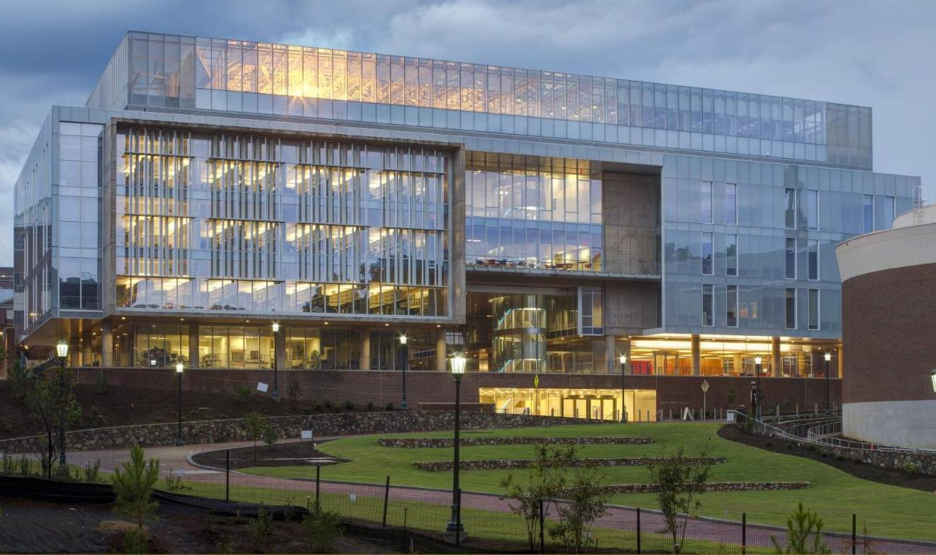

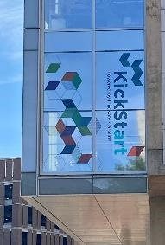
Located in the Genome Sciences Building:
Key location with proximity to UNC research & core labs
KICKSTART ACCELERATOR: A FLEXIBLE SPACE FOR EARLY-STAGE STARTUPS
(well suited for P1 STTR/SBIRs)

Slide 51
KICKSTART ACCELERATOR COMPANIES
Current Companies
AccuNovo Biotechnologies Inc.
AnelleO, Inc.
BlueSky Polymers
Delgen Biosciences
LED RadioFluidics
NeuroGT, Inc.
Perotech Inc.
Syzygy Optics LLC
Accelerator Graduates
Enzerna Biosciences
Triangle Biotechnology Inc.
Vast Therapeutics
Codetta Bio Inc.
Irex Pharma LLC
Enfuego Therapeutics
Epigenos Biosciences, Inc.

Slide 52
Accelerator Lab Overview
  7,500 square-foot facility in UNC’s Genome Science Building.
  The lab opened in late 2019.
  8 companies currently occupy accelerator space.
  7 companies have successfully graduated to larger lab space in the RTP area.
  4–5 additional UNC faculty led startups have expressed interest and are in process of applying for lab space.
  9 full (21’) or 18 half (10.5’) benches available for UNC IP-based startups (2 full benches currently rented).
  6 private lab spaces available for lease (2 currently rented).
  Currently at ca. 35% occupancy and expect to be at ca. 70% occupancy in Q1 2023.

Slide 53


7,500 SF lab space for UNC IP-based startups
Powered by Innovate Carolina
2244
Wet Lab Space
2242
Office Cubicles
2250
Conference Room 1
Shared lab space/equipment (ca. 1600 sf)
Lockers
2252
Conference Room 2
Shared Equipment
Private lab space (ca. 1000 sf)
2254
Office
Open Wet Lab Space (ca. 2800 sf)
Coffee/Snacks
2246
Walk-in Hood
2248
Molecular biology
2238A Private lab
2236
Private Lab
2251
Tissue Culture
2255
Storage
2256
Office
Cubicle Space / Hot Desks (ca. 850 sf)
Refrigeration
2245
Cold Room
2253
Private Lab
KickStart Admin Space (ca. 1100 sf)
2258
Office
2247
Private lab
2238
Autoclaves
2234
Private lab
2232
Private lab
Phone Booths
Shared conference rooms (ca. 300 sf)
Condenser Room
2260
Office
Packages
Keycard Access

Slide 54
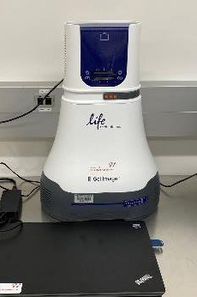
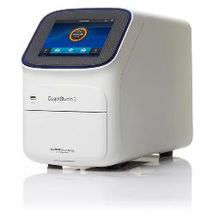
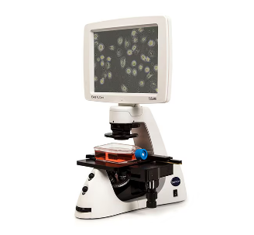
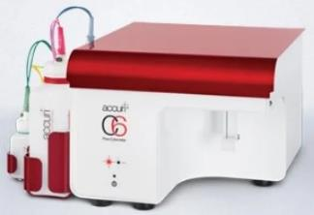
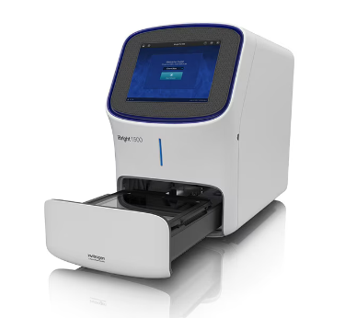
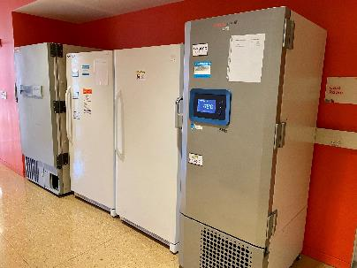
KickStart Accelerator Shared Equipment

Slide 55
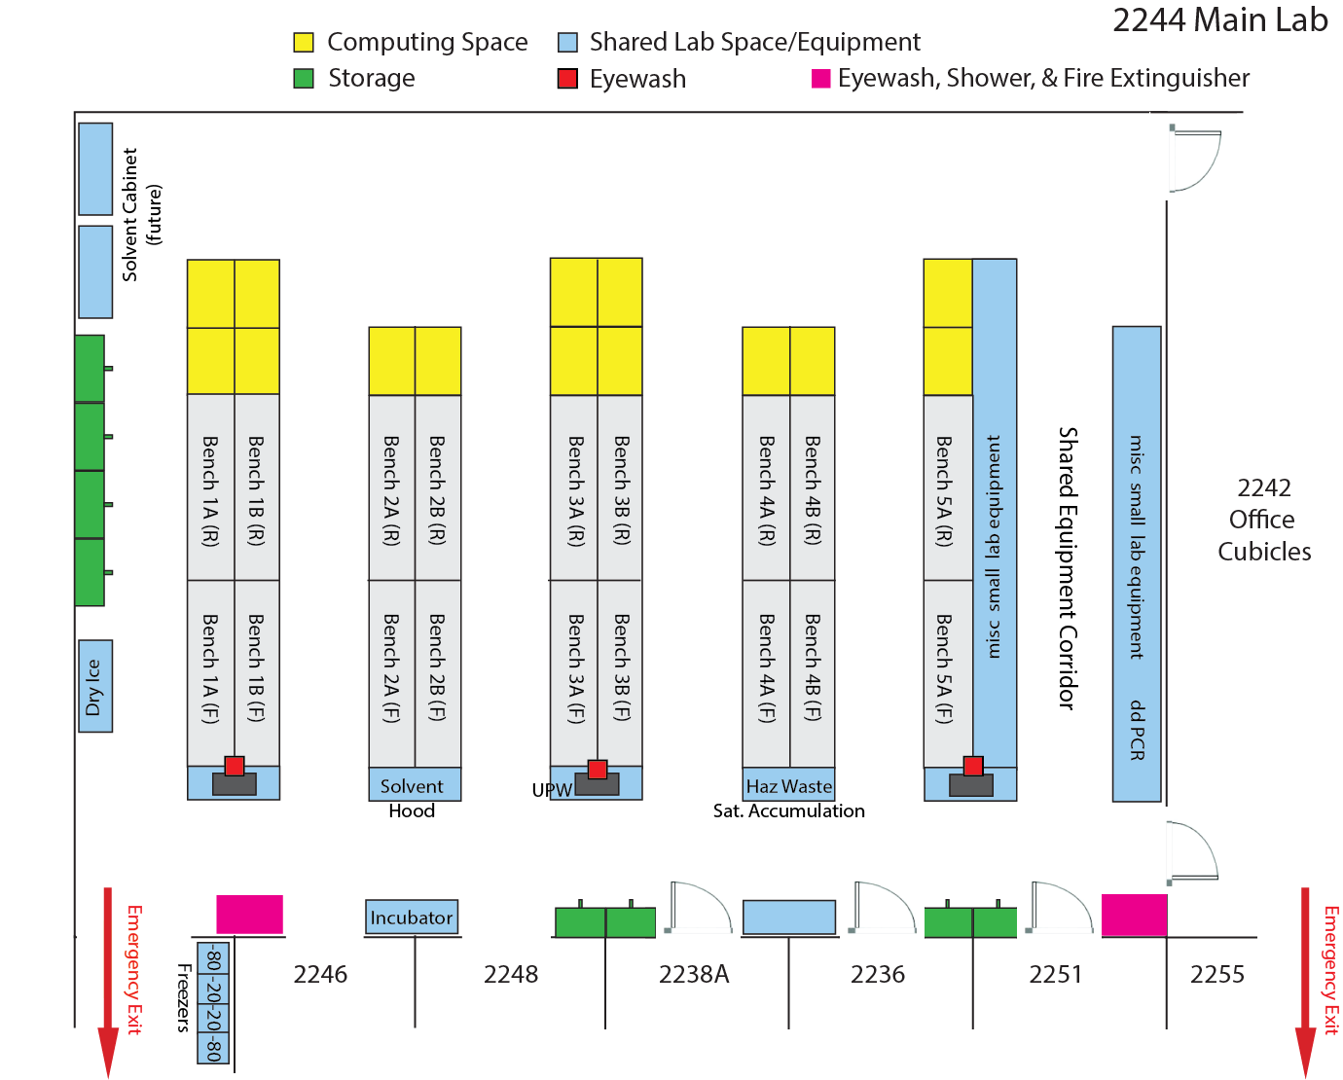
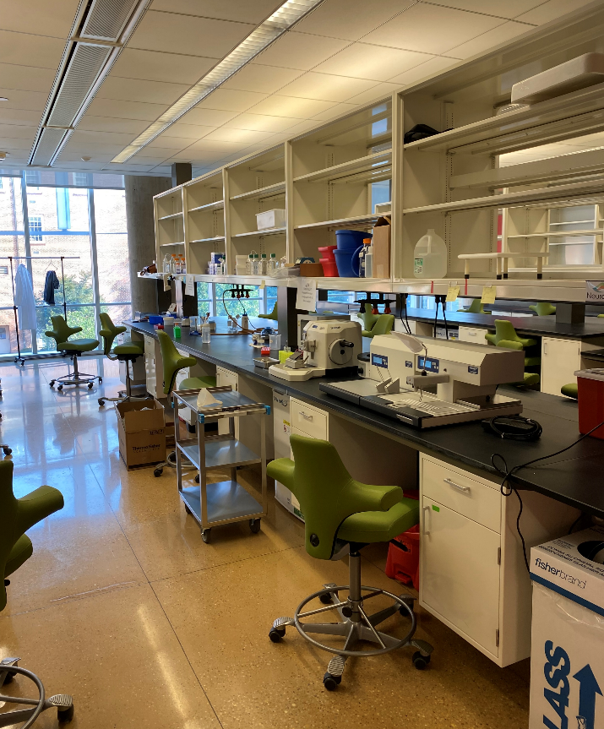
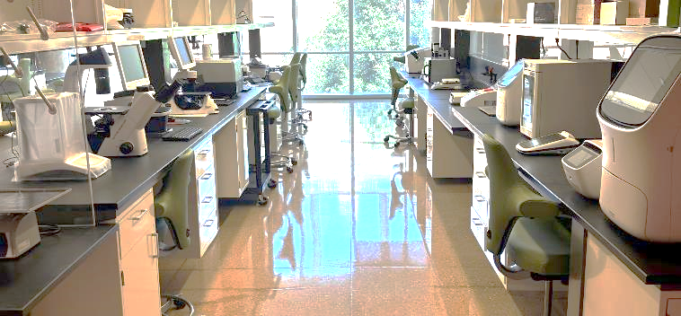
Main Lab & Shared Equipment Corridor

Slide 56
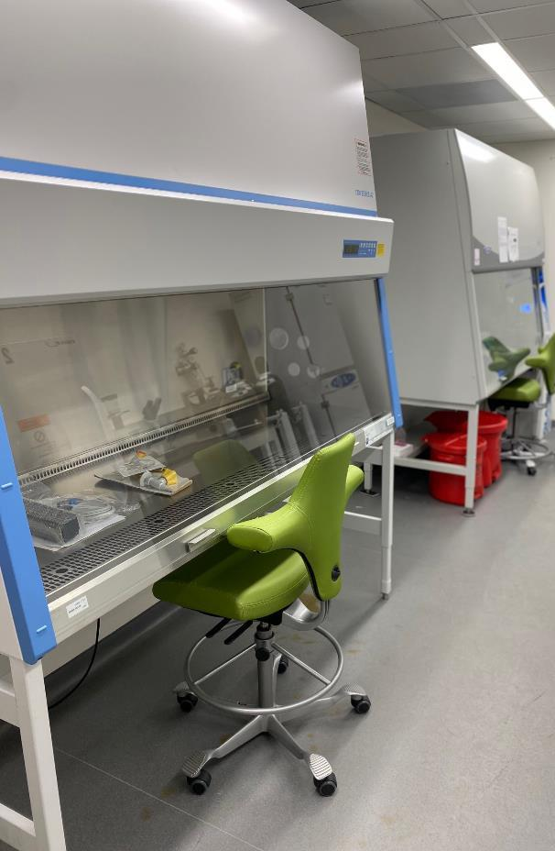
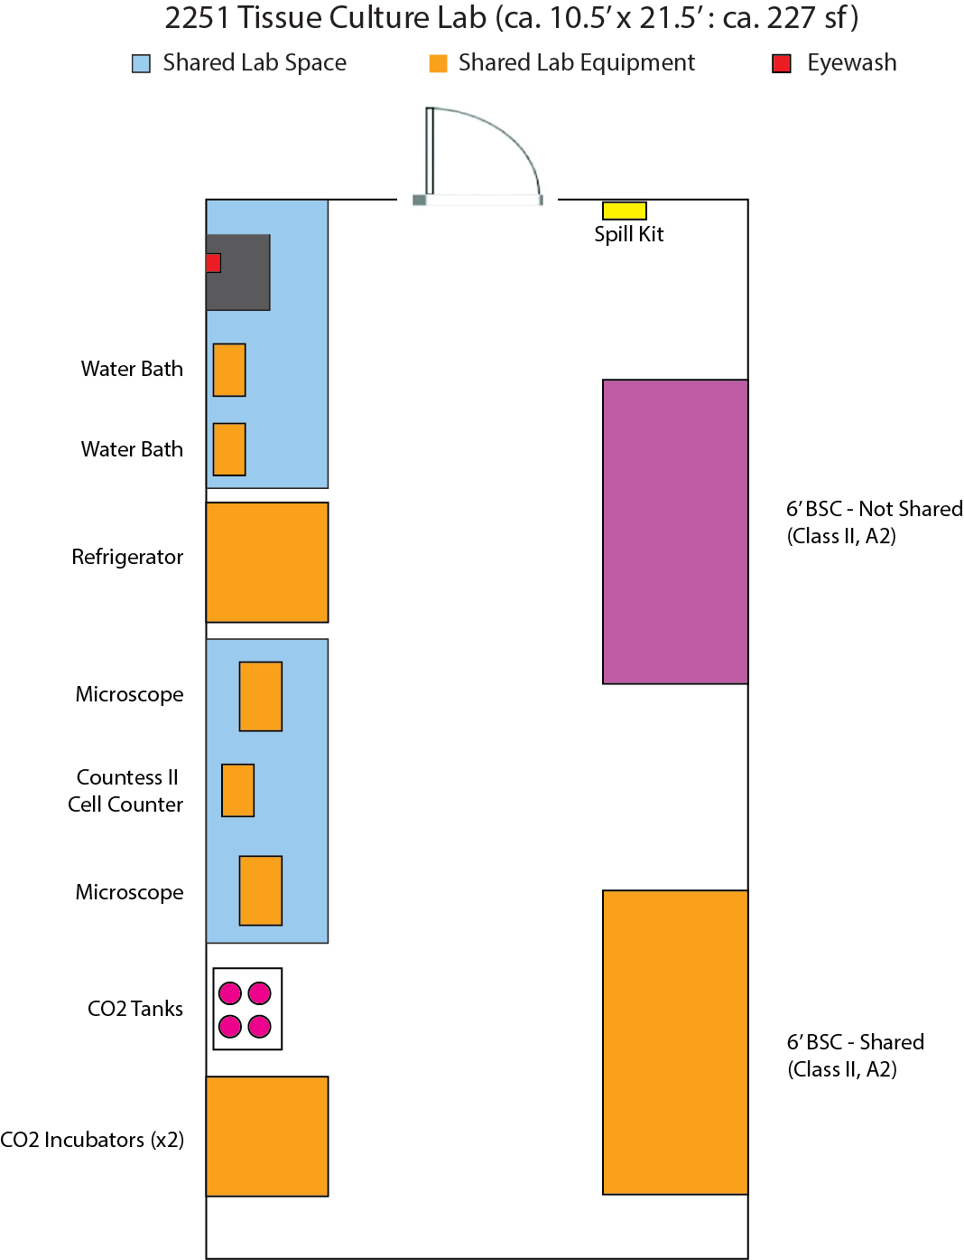
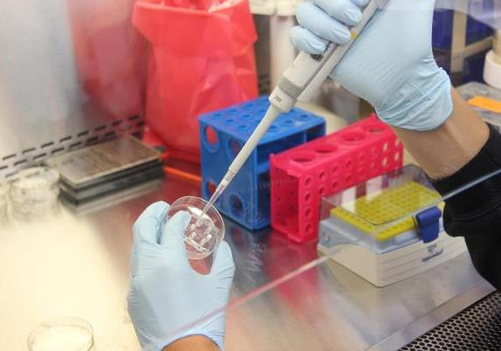
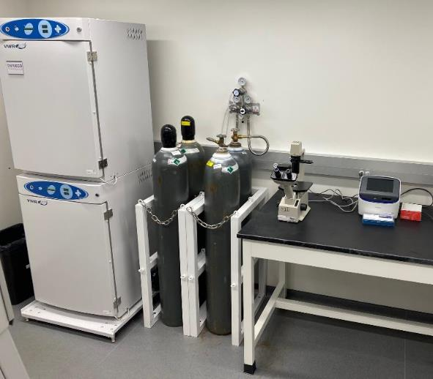
BSL-2 Lab

Slide 57
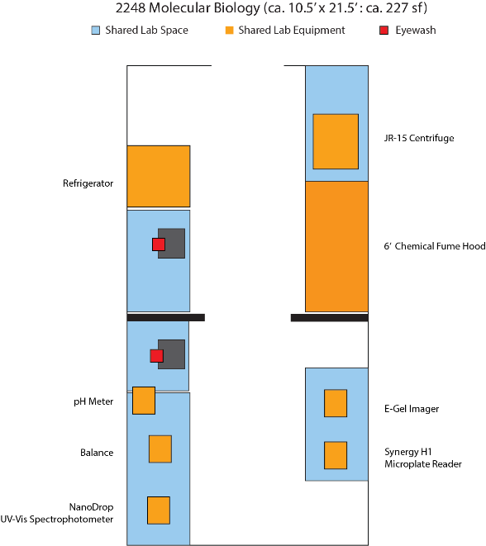
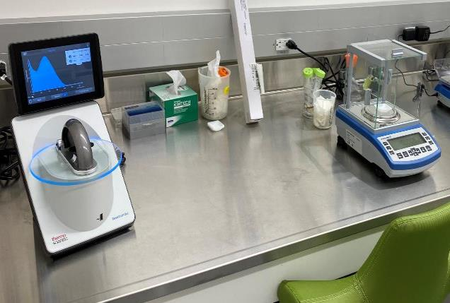
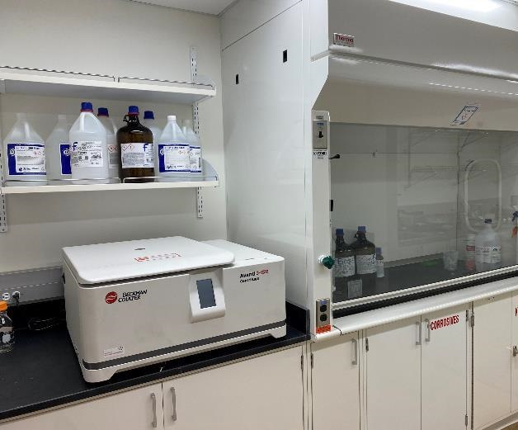
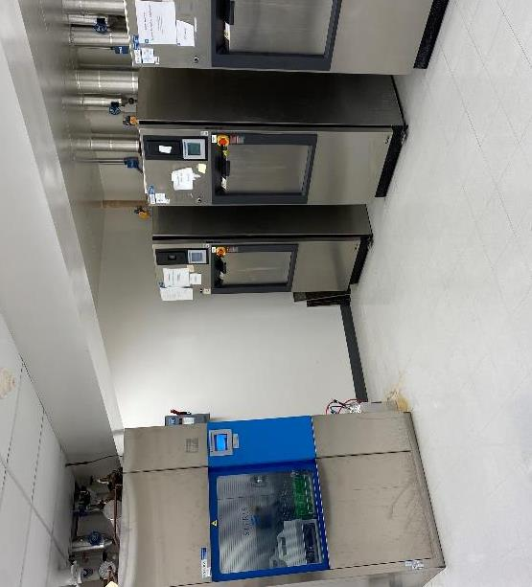
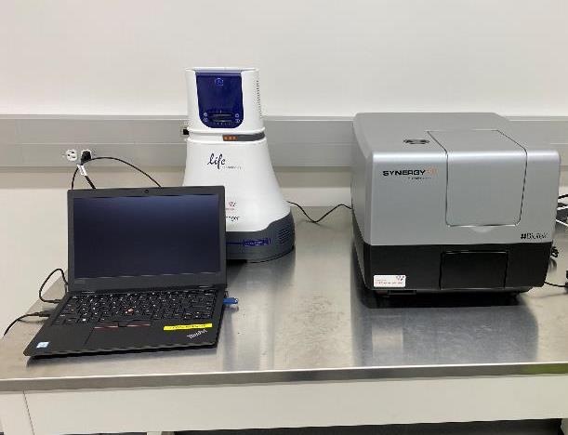
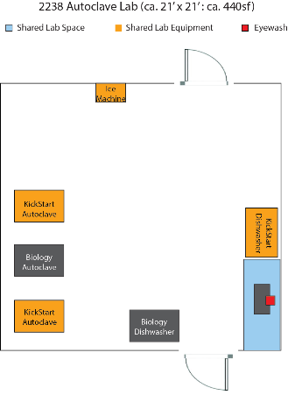

Slide 58
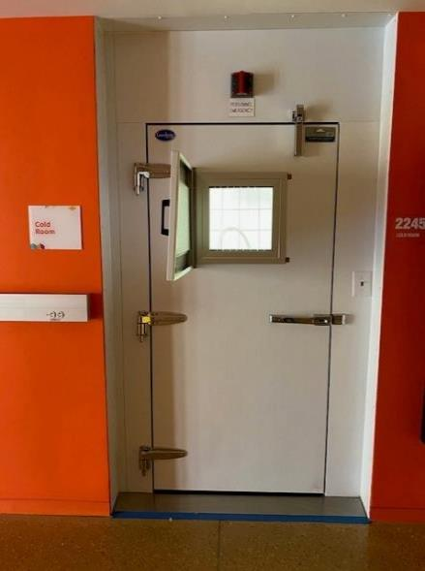
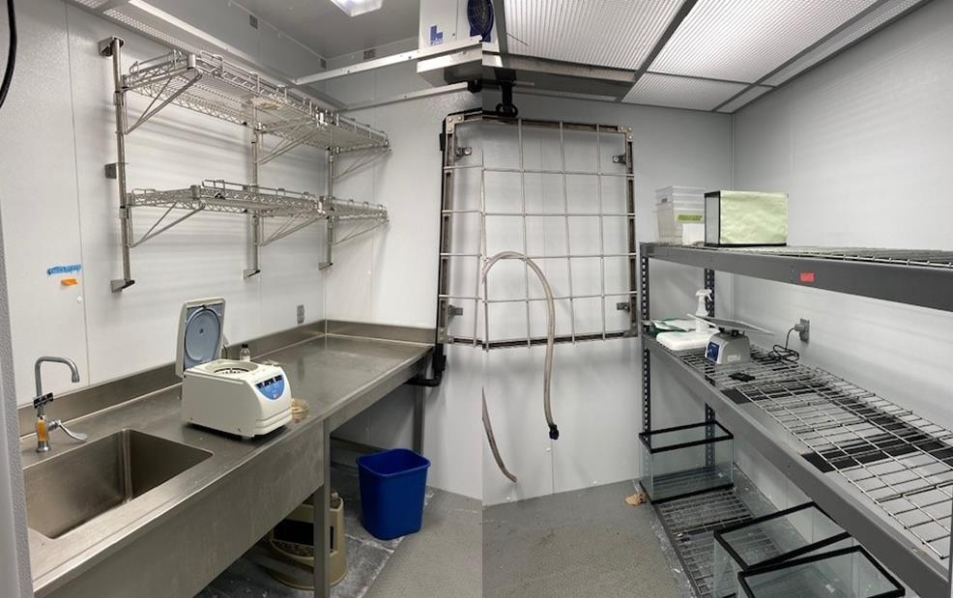
Cold Room

Slide 59
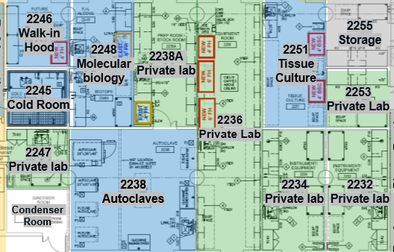
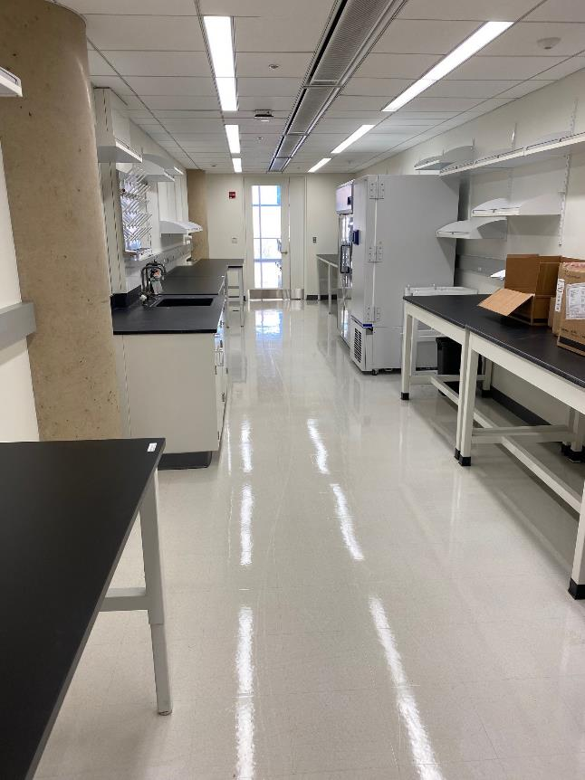
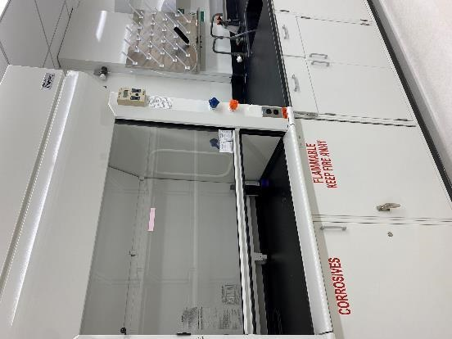
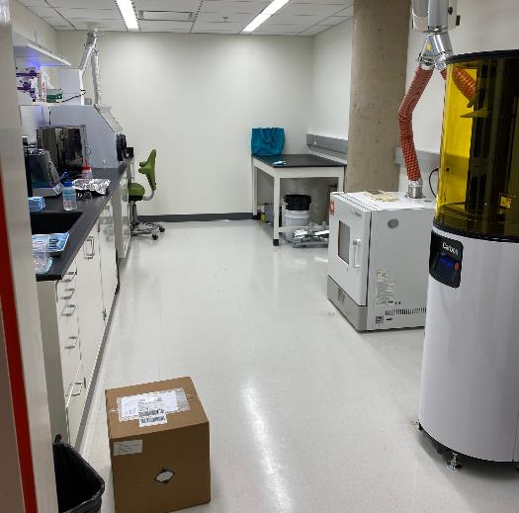
6 Private Lab Spaces

Slide 60
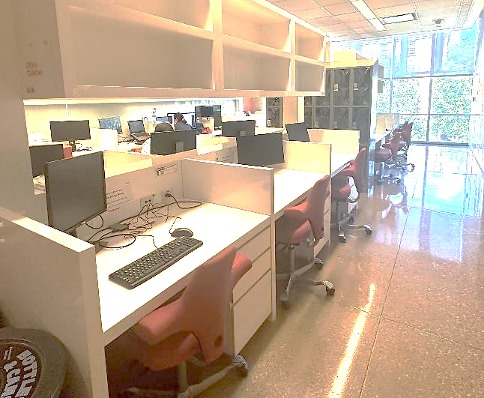
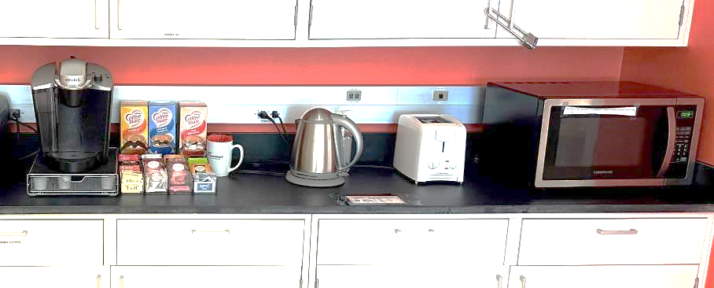
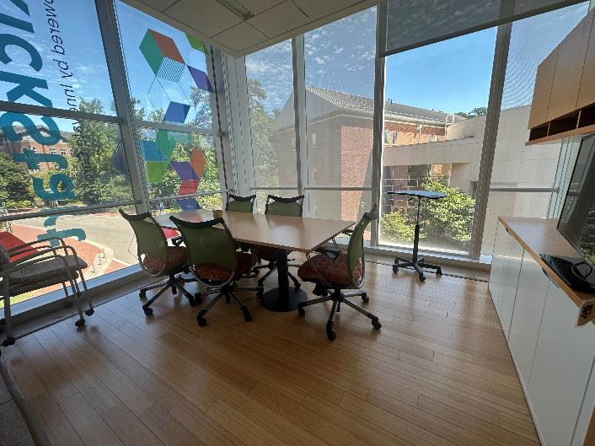
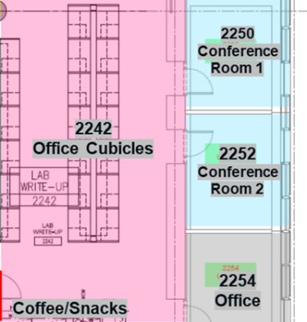
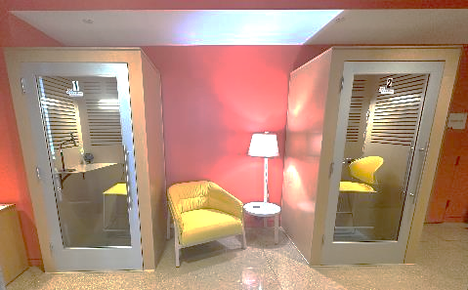
KickStart Accelerator Amenities

Slide 61
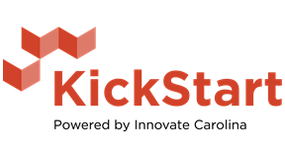
For Additional Information about KickStart Venture Services Contact:
Mireya McKee mireya.mckee@unc.edu
To Schedule a Tour of the Accelerator Lab Contact:
Jeff Speakman rspeakman@unc.edu

Slide 62
Core Director Meeting
September 2023

Slide 63
Core Director Meeting
September 2023

