Slide 1
Core Director’s Meeting
January 2024

Slide 2
UNC Research Data Management Core
Jonathan Crabtree, Ph.D.
RDMC Director

Slide 3
NIH Data Management and Sharing Policy
NIH has issued the Data Management and Sharing (DMS) Policy to promote the sharing of scientific data. Sharing scientific data accelerates biomedical research discovery, in part, by enabling validation of research results, providing accessibility to high-value datasets, and promoting data reuse for future research studies.
OSTP Memo: Increasing Access to the Results of Federally Funded Scientific Research
Request for Comments on the DRAFT NIH DMS Policy
NIH Data Sharing Policy
JAN 25
2023
2003
2013
2019

Slide 4
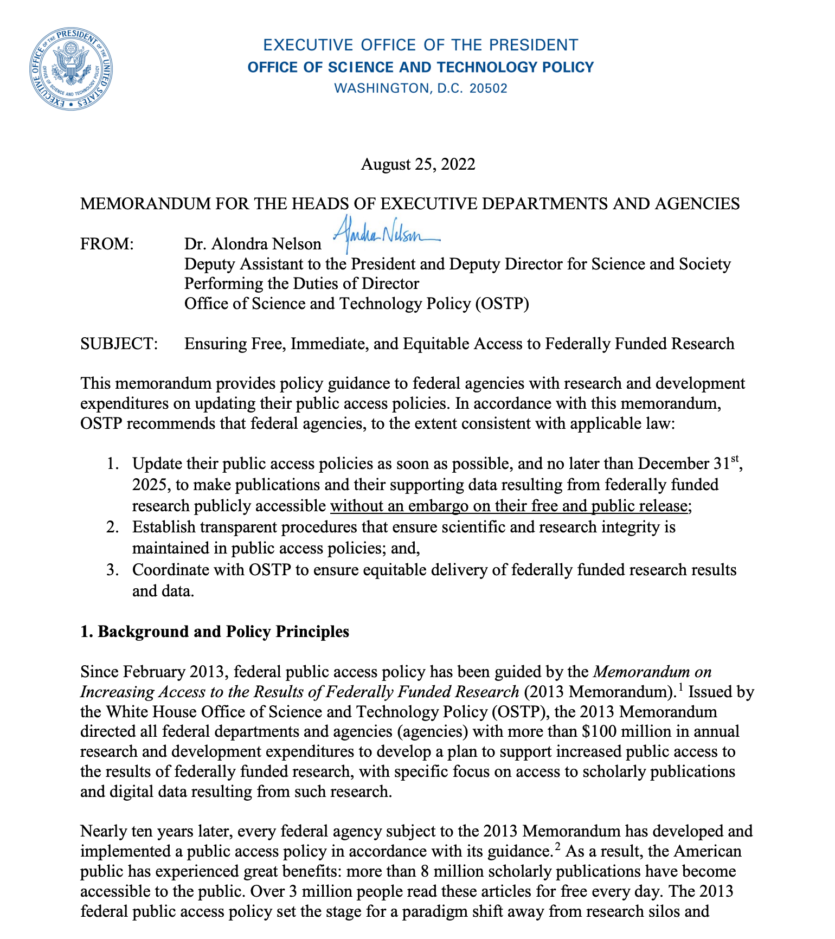
NIH Data Management and Sharing Policy…
…OSTP recommends that federal agencies…update their public access policies as soon as possible, and no later than December 31st, 2025, to make publications and their supporting data resulting from federally funded research publicly accessible without an embargo on their free and public release…
https://www.whitehouse.gov/wp-content/uploads/2022/08/08-2022-OSTP-Public-Access-Memo.pdf

Slide 5
Establishing a New DMS Support Unit at UNC
UNC Research Data Management Core (RDMC)
Funded and supported by the OVCR and new RDMC Fee
Tasked with coordinating campus data management infrastructure, training, policy, and compliance
Focused on collaborative approaches that include alignment, integration, and coordination
Notes:
Working Groups

Slide 6
Funding Research Data Management
New RDMC Fee implemented in November 2023
Applies to most sponsored research projects (excludes technical assistance, training, etc)
0.38% of Modified Total Direct Cost (MTDC) expenditures for that month
The MTDC is not included in the MTDC calculation, so fee is not circular
Notes:
Working Groups

Slide 7
Funding Research Data Management
Why not fund this from F&A?
NIH does not have any ability to affect changes to the F&A model
The current F&A model was created in 1991 by Congress; Only Congress can revise the model
Supports Facilities & Administrative Costs
No matter a university’s rate, only 26 points of the total can be recovered for Administrative Costs
Notes:
Working Groups

Slide 8
Funding Research Data Management
What has changed since 1991? A Lot!
Most of these represented unfunded mandates
NIH knew that it could not force another unfunded mandate
Specifically permitted to charge direct costs for data management
Conflict of Interest
Export Compliance
Securing Materials / Select Agents
Ethics & Transparency Requirement
Sub Recipient Monitoring
Science & Security / Global Program Restrictions
Data Management
Notes:
Working Groups

Slide 9
UNC Research Data Management Core
Data Management and Sharing Policy Compliance Strategy
Support and promote standards and best practices for research data management and sharing
Coordinate across IT service providers to develop, maintain, and validate research data information systems
Research Data Stewardship
Research
Data Infrastructure
Research Data Policy Compliance
Align research data management and sharing strategies with disciplinary standards and norms
Domain Expertise
Administration & Operations
Perform administrative functions that support research data management strategies and initiatives
Notes:
Working Groups

Slide 10
UNC Research Data Management Core
Factors Informing the RDMC Strategy
Data stewardship
Research lifecycle approach to data management support
Federated IT approach by linking and integrating systems
Accelerate availability of new technologies that fill identified gaps
Policies and support that empower researchers to adopt data management and sharing best practices
Need for tracking systems to enable automated compliance reporting
Notes:
Next steps

Slide 11
UNC Research Data Management Core
RDMC Services and Activities
Education and training. RDMC will offer workshops and guidance materials on DMS policy requirements, writing a DMS plan, and DMS best practices.
Consultation. RDMC staff will provide guidance on appropriate strategies for research data management and sharing.
Policy compliance. RDMC staff will review and audit DMS plans to ensure policy compliance and grant competitiveness
Infrastructure. RDMC will coordinate, build, and maintain infrastructure to support research data management and sharing across the research lifecycle.
Notes:
Next steps

Slide 12
UNC Research Data Management Core
RDMC Services and Activities
Education and training. RDMC will offer workshops and guidance materials on DMS policy requirements, writing a DMS plan, and DMS best practices.
Data curation training for project teams and investigators
Training for data management and sharing policy requirements
Training for existing campus research data platforms and systems
Open, continuing education program for data management and sharing best practices based on existing and emerging standards
Training and continuing education program for unit-embedded data stewards and domain experts across campus
Campus-wide data management curriculum development program for integration into graduate and undergraduate training
Notes:
Next steps

Slide 13
UNC Research Data Management Core
RDMC Services and Activities
Consultation. RDMC staff will provide guidance on appropriate strategies for research data management and sharing.
On-demand support for DMS plan development and implementation using the DMPTool
Assistance with identifying appropriate data repositories that meet funder requirements for long-term data management and sharing
Access to critical tools and infrastructure to support data management across the research lifecycle
Referral and coordination of research data support units and experts across campus to maximize value of existing resources and minimize costly redundancies
Identification of data management challenges and working to design collaborative, intra-institutional solutions to address these challenges
Notes:
Next steps

Slide 14
UNC Research Data Management Core
RDMC Services and Activities
Policy compliance. RDMC staff will review and audit data management and sharing (DMS) plans to ensure policy compliance and grant competitiveness
Development of pipeline for data management and sharing plan review, implementation and audit
Establishment of ongoing tracking and audit mechanism for data management and sharing plan implementation
Pre-review of DMS plans to be submitted as part of grant funding applications
Ongoing monitoring and auditing of DMS plan implementation to ensure compliance with funder policies
Notes:
Next steps

Slide 15
UNC Research Data Management Core
RDMC Services and Activities
Infrastructure. RDMC will coordinate, build, and maintain infrastructure to support research data management and sharing across the research lifecycle.
Planning, scoping, and implementation of a campus-wide research data management ecosystem that includes integrations among campus data sources, stores, and tools
Development of the RDM web portal that provides a single access point to RDM resources, including a repository/storage finder
Support and maintenance for UNC Dataverse, which features the NIH-defined desirable characteristics for data repositories
Archival storage of up to 2TB of data per research project
Support and maintenance for validated secure clinical data repository platform including workflows for ingest and retrieval of data subject to 21 CFR part 11
Management and customization of DMPTool to ease the burden of writing DMS plans that meet funder policy requirements
Notes:
Next steps

Slide 16
UNC Research Data Management Core
Broader Impacts
Establish a high standard for faculty excellence in research data management and sharing practices
Prepare the next generation of researchers through research data management training as part of graduate and undergraduate curriculum development
Enhance and sustain the value of UNC research data assets by applying FAIR standards to scientific outputs
Ensure access to a campus-wide research data ecosystem to support research data management and access across the research lifecycle
Promote the competitiveness of UNC's $1 billion enterprise by increasing the likelihood of success of sponsored programs
Notes:
Next steps

Slide 17
Impact on existing UNC Cores
RDMC is not designed to replace any existing services.
RDMC is a coordinating and facilitating effort designed to enhance the research process and promote compliance.
RDMC interested in understanding the gaps in the research data workflows.
RDMC seeks to promote data sharing and archiving not only for compliance's sake but also to ensure access to UNC valuable data.

Slide 18
How can RDMC help your groups?
Where are your pain points with the emerging policies?
Where are resources needed?
??

Slide 19
Thank You
Jonathan_Crabtree@unc.edu
https://researchdata.unc.edu

Slide 21
Office of Research Technologies
Updates for Core Directors

Slide 22
ABRF Annual Meeting 2024
Registration is open!
Let Chris or Kara know if you are attending.

Slide 23
ABRF: Technical Reviewers
ABRF Committee on Core Rigor and Reproducibility (CCoRRe) has initiated an agreement with AACR journals to provide technical reviewers. Core directors and staff are encouraged to volunteer. Genomics expertise is the initial focus
Improves rigor and reproducibility
Provides career development opportunity
Provides an advance look at new technologies
There will be a session at the ABRF Annual Meeting discussing this initiative
If you are interested in volunteering, please let Chris know

Slide 24
Spatial Technology Discussions
ORT has facilitated two meetings focused on a spatial ‘omics strategy for UNC Chapel Hill
November 2023 - met with core directors and super-users to discuss current state of spatial biology on campus and conducted a gap analysis
December 2023 - met with a small group of core directors to discuss specific, targeted action items
There will be additional follow up and likely an open forum inviting anyone interested in spatial biology

Slide 25
SOM Voucher Program Update
Thank you to the core directors who met with customers developing applications for the voucher program
$282,303 was allocated to 30 vouchers (out of 82 submitted) for use in 26 SOM core facilities
Funds should be spent by June 30, 2024
Awardees will be asked to provide outcomes of the projects (grants, papers, theses, etc.) after 12 months
CFAC intends to run this program again in Fall FY25

Slide 26
CFAC Spring RFA
Opened this week and closes February 16, 2024. Awards will be decided mid-March
Applications should be for method development, equipment or general core needs
Funds must be spent by June 30, 2024 – please plan accordingly
Requests focused on “Spatial ‘Omics” technologies encouraged, especially multi-core proposals or method development benefitting a broad customer base.

Slide 27
Travel Awards
CFAC is funding two sets of travel awards this calendar year for cores who are open recharge core facilities (OSP-driven rate development)
First round of funding applications due 1/31/24. Second round will be open for submission during July 2024.
Up to 5 awards of up to $1,000 each available for funding in each cycle

Slide 28
Accounts Receivable (A/R) Reports:
Accounts Receivable – money owed by customers for your core services, classified as an asset, considered delinquent after 60 days
Ben Wright and Kara Clissold are currently reviewing A/R for all cores that utilize iLab for billing and may reach out to you (if we haven’t already) to discuss any outstanding A/R you may have
A/R for cores who bill through Infoporte will be reviewed this spring but if you have questions now, please reach out.
Please mark invoices as paid in iLab once payment is received. If you are unsure how to do this, contact Kara, Ben, or Michael Akridge to assist you with the process. It is a straightforward process and ensures accuracy in our A/R data.

Slide 29
Accounts Receivable: Resolving Payments
If you have customers who say payment was remitted and you suspect payment may have ended up at a different unit on campus:
Request the billing address, check number, total dollar amount, and any other identifying information from the customer
Ben and Kara can both assist in inquiring with different units if the payment appeared there
If you have a customer who has not paid within 90 days of invoicing:
We encourage you to stop working on any other projects, beginning new projects, or providing final data until previous invoices are paid
Kara and Ben can assist in identifying the best way to escalate either within the customer’s organization or at UNC Chapel Hill

Slide 30
Contact Us
Chris Gregory: christopher_gregory@med.unc.edu
Kara Clissold: kara_Clissold@med.unc.edu
ORT/CFAC: corefacilities@med.unc.edu

Slide 31
Research Core Development
Office of the Vice Chancellor for Research
Meghan Kraft, Interim Director of Research Core Strategy
Ben Wright, Director of Research Core Development

Slide 32
OVCR Cost Sharing Program
The Office of the Vice Chancellor for Research (OVCR) contributes matching funds, or cost-share, for costs related to enhancing research at UNC. The OVCR will consider cost-share funding requests for the following:
Extramural grant proposals that require matching funds
New technologies that facilitate the advancement of research at the university
Other specific needs that are of strategic importance to research for the university
More info here: https://research.unc.edu/researchers/programs-projects-services/

Slide 33
OVCR Cost Sharing Program
Submission deadlines:
CYCLE | COST SHARE REQUEST SUBMISSION DEADLINE | NOTIFICATION OF FUNDING DECISION
CYCLE 1 | October 31 | Mid November
CYCLE 2 | January 2 | Mid January
CYCLE 3 | February 28 | Mid March
CYCLE 4 | April 30 | Mid May
CYCLE 5 | June 30 | Mid July
CYCLE 6 | August 31 | Mid September
Matching commitments need to be obtained from department chair(s) and dean(s) and other relevant units with the appropriate approvals by the submission deadline.

Slide 34
OVCR Cost Sharing Program
Financial Requests- make sure Meghan Kraft is aware (kraftmeg@unc.edu)
1/3 rule – funding from sources 1/3 1/3 1/3
Timing is key!
Criteria for funding of cost-share requests:
Leverages external funds
Benefits multiple departments and schools
Avoids unnecessary duplication of resources
Matching funds are provided by participating units (e.g. departments and schools, center/institutes, offices)
Responsive to current university strategic priorities
Availability of funding

Slide 35
FY2024 (1st Half) Highlights
Through 12/31/2023
$14.7 million internal revenue
$4.0 million external revenue
Over 1,500 unique project IDs
$3.4 million in F&A generated
# labs
# external customers
# of depts using core services

Slide 36
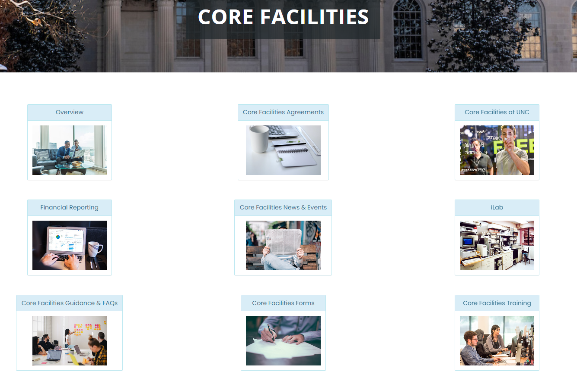
New RCD Webpage
Core Facilities List
Contact RCD for changes/updates
iLab training videos
“Core Facility Forms” for RDW templates
https://osp.unc.edu/core-facilities/

Slide 37
iLab
As of February, expanded UNC license to 60 seats
3 cores onboarding in March/April; 7 seats left for CY2024
Institutional Landing Page now live
First page for anyone not yet logged in
Core list, description, and contact information
Contact RCD for changes/updates
iLab training resources available on RCD webpage
CoreSupport@med.unc.edu

Slide 38
Advance Payments
Customers might ask if they can pre-pay for services not yet rendered
Not allowable
If PI requests, feel free to reach out to us
Memo going out to campus soon

Slide 39
External Accounts Receivable - iLab
ORT and RCD currently reviewing external A/R in iLab to clean up
If you or your business staff are not marking invoices as “Paid” in iLab, let us know
Tableau A/R Report for iLab coming soon
Cores can use this information in rate reviews on the operating plan and fund balance
Tableau A/R for Infoporte coming later this year

Slide 40
Contact Information
Research Core Development Team Inbox: RCD@unc.edu
Meghan Kraft: KraftMeg@med.unc.edu
Ben Wright: BWright1@email.unc.edu
Michael Akridge: Michael_Akridge@med.unc.edu
iLab Support: CoreSupport@med.unc.edu

