Slide 1
Core Director’s Meeting
August 13, 2025
SOM Office of Research Technologies

Slide 2

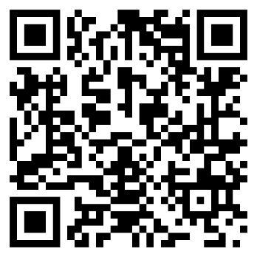
Research Core Development
Meghan Kraft – Director, Research Core Facilities, OVCR
Ben Wright – Director, Research Core Development, OSP
Michael Akridge – Financial Analyst, OSP

Slide 3
Core Facility Metrics
 | FY2023 | FY2024 | FY2025
Internal Revenue | $ 32.4 m | $ 33.1 m | $ 32.7 m
External Revenue | $ 8.6 m | $ 8.6 m | $ 9.3 m
Total Revenue | $ 41.0 m | $ 41.7 m | $ 42.0 m
Unique Projects | 2,127 | 2,085 | 2,147

Slide 4
Core Facility Metrics

Slide 5

Research Core Development Updates
Pre-billing is generally not allowed
  Pre-billing for supplies/consumables is allowable in some cases
  If you have questions, let us know and we can work with you
Overtime/rush rate model
  Allows overtime to be included in rates; MUST be approved before use
  If interested, please let us know and we can help set this up – RCD@unc.edu
OSP CAC Team is currently understaffed
  If you experience delays or need a review expedited, please let us know

Slide 6
Core External Agreements
Terms and conditions can now be included in iLab
  Standard T&Cs in iLab; negotiations follow current process
  Must be built and activated for each core within iLab
  If you are interested, please let us know – CoreSupport@med.unc.edu
Core Agreements will shift to Single Submission
  Non-iLab cores and iLab cores that do not include T&Cs within iLab
  iLab cores that have agreements that require negotiation/use of customer’s agreement
  Effective date: TBD but coming soon

Slide 7

Core Facility Asset Database
Now in production environment!
Will be soliciting information and updates soon
Access for campus coming soon
  Will be based on core; aka only core personnel and applicable dept staff will have access to core’s information
Will help inform campus equipment purchases and streamline service agreements
  Important that information is accurate and up to date

Slide 8
Core Facility Bandwidth Board
Tool for cores to use to identify, find, and advertise available personnel resources
Effort to reduce impact of potential decreases in staff and hiring constraints
Utilizes Microsoft Planner
If anyone is interested, please let us know – RCD@unc.edu

Slide 9
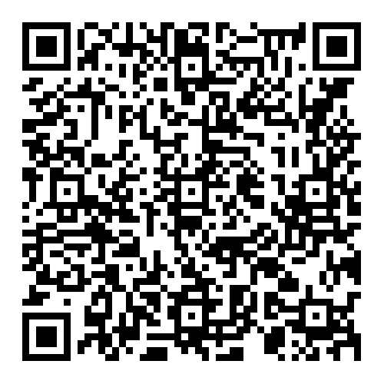
New Purchasing Threshold
https://finance.unc.edu/news/2025/07/28/updates-to-small-purchase-and-bidding-thresholds/
Small Purchase Benchmark has increased from $25,000 to $30,000
Purchases between $5,000 and $30,000
  A Waiver of Competition Form is not required in this range
  A requisition and purchase order are required to ensure Capital Assets are captured properly
  Requisition may be submitted with a single quote as sufficient documentation unless the procurement requires a data protection checklist (IT, services, and equipment purchases)
Purchases between $30,000 and $100,000
  3 formal quotes needed, but no RFP or IFB (no statement of work required)
Purchases exceeding $100,000
  Request for Proposal (RFP) or Invitation for Bid (IFB) and scope of work required

Slide 10
New Equipment Review
When faculty or departments want to purchase equipment outside of a core that performs similar services, the goal is to ensure the decision is well-justified, coordinated, and not harmful to institutional sustainability.
The threshold for this process is $100,000.
If a similar service or instrument exists in a core facility the purchasing unit must provide:
  Justification for need outside of a core facility
  Projected usage
  Funding information
  Life cycle replacement/new equipment
  Interest in shared access

Slide 11
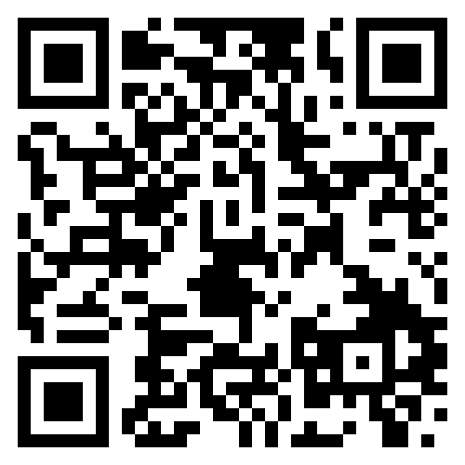
Federal Actions and Impact
Questions should be directed to VCR@unc.edu
  Information and Office Hours recordings available here: https://research.unc.edu/executive-actions/
  Register for OVCR Office Hours
Project terminations
  If you aware of projects that have been terminated, bill as quickly as possible for allowable charges
  OVCR/CFAC is not able to cover revenue that cannot be generated by the appropriate sources
  Customers that have projects terminated should discuss with their departments to determine how post-termination charges should be handled
Pre-billing of internal customers is generally not allowable
  Billing for supplies/consumables once purchased is allowable
    To the extent the expenses can be accurately allocated
    Be sure to save documentation of allocation calculation
  Cores able to bill after the termination date if services were rendered prior to termination date

Slide 12
Federal Actions and Impact
Be as prepared as possible (easier said than done)
  Planning for different scenarios
Sharing of employees and salary support
  Rate revisions may not be necessary
  Reach out to other core directors to see if they have bandwidth or needs
  Reach out to RCD and SOM ORT
Advocacy is just as important now more than ever
  Open lines of communication between cores and departments
  RCD can help with this

Slide 13
Federal Actions and Impact: FAQs
I am in Core Z in Department A. I heard Core X in Department B is not allowed to travel to conferences or hire new personnel. Am I allowed to?
  Departments and Schools have leeway to respond differently at the moment.
    Operate according to your department’s restrictions
    SOM has reinitiated processes/policies used during the pandemic to review any unbudgeted hiring and expenses – work with your HR and business managers
My customer has a grant termination notice, but I have completed some work that was funded by that grant. Unfortunately, I hadn’t billed yet. Can I collect these funds?
  YES. Any work performed can and should be billed, as long as the work was performed prior to a stop work order or grant termination notice. It does not matter if the full request has been completed.

Slide 14
Federal Actions and Impact: FAQs
Customers are asking if I can pre-bill for work. What am I allowed to do?
  You can bill for any services rendered. For example, rates that may have costs related to consultations built into a more global rate could be broken into smaller sectors
  Think creatively and encourage PIs to think creatively. Are there other pieces of the puzzle (bioinformatics cores, etc.) that can absorb some costs?
My department is pressuring me to cut staffing due to my deficit
  Stay tuned for an update from the OVCR on how year-end negative balance carryovers are expected to go
  If you have short-term needs to offset or add staff capabilities We plan to provide support to try and match any skilled individuals with other cores that might need part time or short term help.
  We need to know! Please let ORT AND OVCR hear about these concerns. We are happy to meet with department leadership to discuss concerns

Slide 15
Federal Actions and Impact: FAQs
I am in the middle of a rate review. How should I determine costs and operating level with this much uncertainty.
  Not a one size fits all solution
  If you have received notice of stop work orders or grant terminations, reduce your operating level accordingly.
  It is reasonable to assume price increases could happen, but they should be based on concrete information
    Could bill volatile supplies as a pass through
    If you are confident you would purchase a service contract over multiple years, consider negotiating multi-year contracts at current prices.

Slide 16
Research Core Development Contact Information
Meghan Kraft
Director, Research Core Facilities
Office of the Vice Chancellor for Research
kraftmeg@unc.edu
Ben Wright
Director, Research Core Development
Office of Sponsored Programs
bwright1@email.unc.edu
Michael Akridge
RCD Financial Analyst
Office of Sponsored Programs
michael_akridge@med.unc.edu
RCD@unc.edu
CoreSupport@med.unc.edu

Slide 17
New Year, New Rate Review (maybe)
You might need to do a rate review if...
There are staffing or salary changes
Service contracts or supplies change significantly in cost
Your operating level is significantly different than you expect it to be
You offer new services or get new equipment
Your subsidy changes or is different from what you utilized in your last rate review
Other salary sources for core personnel changes
ORT and the RCD teams are happy to help you look at any of these changes and see how they may affect your rates to determine if an off-cycle or full review is necessary
OSP cost analyst team may be understaffed in the short term. Thanks for your patience. The more you work with us during the rate review and submission process the more we can help expedite reviews where possible.

Slide 18
CFAC Fall Funding Opportunities
Fall RFA
  Opened this week with applications due September 12th
  Soliciting applications for method development, equipment, matching funds, and general core needs
    Matching funds requested for NCBC IIG applications will receive expedited review
Voucher Program
  Applications open August 18th with applications due September 22nd
  May not award as many as in previous years
  You may set parameters around how far in advance of the deadline you will accept consultation requests

Slide 19
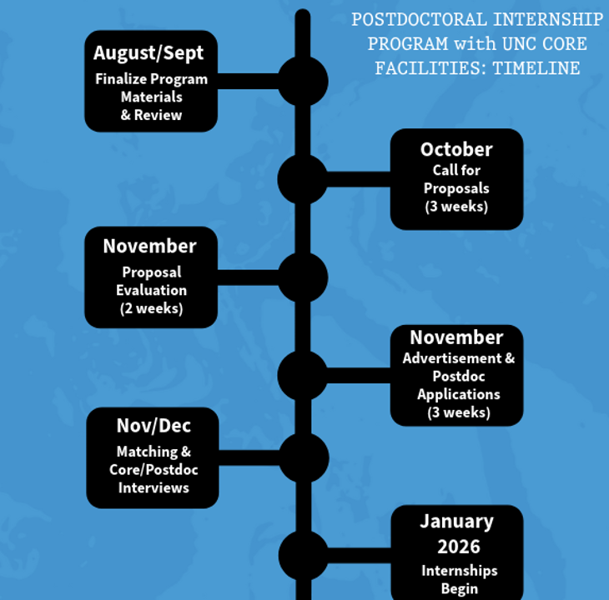
Postdoctoral Internship in Cores Program
Operational documents have been developed
  Thanks for those of you who have helped review these documents!
Website is in the works
Official call for proposals will be in early October

Slide 20
MAD SSCi and ABRF
Mid-Atlantic Directors and Staff of Scientific Cores (MAD SSCi) meeting being held at Virginia Commonwealth University in Richmond, VA on September 15-17th
  Business Skills Workshop on 9/15
  Sessions include talks on animal model cores, spatial biology, and rigor and reproducibility
ABRF New Member Orientation
  Wednesday, September 10th at 4-5 pm

Slide 21
Upcoming Core Report
ORT is working on a SOM/CFAC core report for FY25
  Tell our collective story to leadership – why our cores and our science matter, what all of you have accomplished, and why cores should be part of the solution in current uncertainty.
  Thank you for sending me highlights in your annual core survey. If you are a SOM core or a core that received CFAC funds in FY25 and have anything else to share from last fiscal year- pictures, publications you were authorship on, customer testimonials, etc. please continue to send them to Kara Clissold

Slide 22
Discussion: How Will New NIH Guidelines Affect UNC Cores?
NIH (7/18/25) – NIH will no longer develop new funding opportunities focused exclusively on animal models of human disease. Applicants may continue to propose research exclusively involving human participants (like clinical trials), particular laboratory animals, real-world data, in vitro methods, mathematical models, artificial intelligence, in silico approaches, other alternative approaches, or a combination of models.
  Testing cells and tissues in test tubes or cell cultures
  3D tissue culture, also referred to as organs-on-a-chip
  Computational and mathematical models, such as for toxicity testing
  Stem cell research
  Non-invasive diagnostic imaging
  Clinical research involving people

Slide 23
SOM Guidance to Investigators
On 7/28/2025, SOM Office of Research sent a memo to chairs and center directors (for distribution) with specific guidance on preparing Vertebrate Animal sections of grants – to satisfy the new requirements
The memo also highlighted cores as the perfect resource to provide advice to PIs for study design, alternative models, rigor and reproducibility, etc.
Webinar: "Pioneering the Future of Biomedical Science: NAMs, NATs, and Core Collaboration at UNC," August 21, 2025, 3:00-4:00 PM. Speakers are Dr. Adriana Beltran (Human Pluripotent Cell Core) and Dr. Scott Magness (Advanced Analytics Core)
You are encouraged to organize workshops or schedule talks if your core can provide alternative models for grant applications – we have an opportunity to increase our support of research at UNC!

Slide 24
Durham Tech Students – Temp Hires?
We attempted to set up a process for cores to hire Durham Tech graduates or Biowork program students in Fall 2024
Given the current hiring freeze, is there interest from cores to hire DTCC folks as temporary employees (since temps are not subject to the freeze)?
Show of hands if interested

