Slide 1
Core Director Meeting
Office of Research Technologies
December 3rd, 2025

Slide 2
Guest Speakers from Singularity
Core Marketing

Slide 3
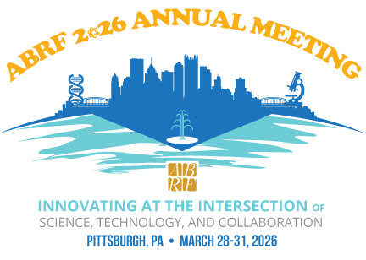
ABRF 2026
ABRF 2026 will be March 28-31 in Pittsburgh, PA
  Pre-Meeting Workshops in Lean Management, Data Analysis and Visualization, and Nextflow for bioinformatics/computational pipelines
  Mini-Workshops and daily agenda with both core management topics and technology-specific topics
Lightning Talk abstracts accepted through Friday Dec 5th
Poster abstracts accepted through Monday Dec 15th
ORT Travel Award Applications will prioritize funding
for ABRF presenters

Slide 4
Travel Awards
The Office of Research Technologies will accept applications for Core Staff Travel Awards 1/2/26 through 1/30/26
Conference travel should be between February and August 2026
Up to $1,000
  Please provide a specific budget! We award the amount requested. Any other travel expenses must come from another fund source
    Suggest using Concur to help develop the budget to ensure you aren’t surprised by total travel costs

Slide 5

PULSE Postdoc Experiential Program
PULSE (Postdoc Upskilling in Laboratory & Specialized Expertise) is now accepting project proposals from core directors
  Postdocs are expected to dedicate 10–20% of their effort (typically 4–8 hours/week) for the duration of the project (usually up to 3 months)
  Projects may include instrumentation training, workflow or protocol development, data analysis, training material creation, or other technical and service-oriented tasks.
  Must submit description of mentorship component and training plan as part of the proposal
Project proposals due Friday, December 5th!

Slide 6
CFAC Spring RFA
The SOM Dean’s Office needed additional funds to support programs for faculty labs that have experienced grant terminations and delays in funding this year
CFAC received a $100K budget cut (from strategic funds) last month

Slide 7
CFAC Spring RFA
Small equipment purchases
Matching funds for S10s or other external instrumentation grants
Specific requests to offset ”unrecoverable” core expenses
  e.g., salaries of core staff on FMLA during FY26
Proposals to subsidize a specific core service to incentivize usage, particularly for cores who lost customers (due to pricing, equipment downtime, etc.) – the idea is to get customers back

Slide 8
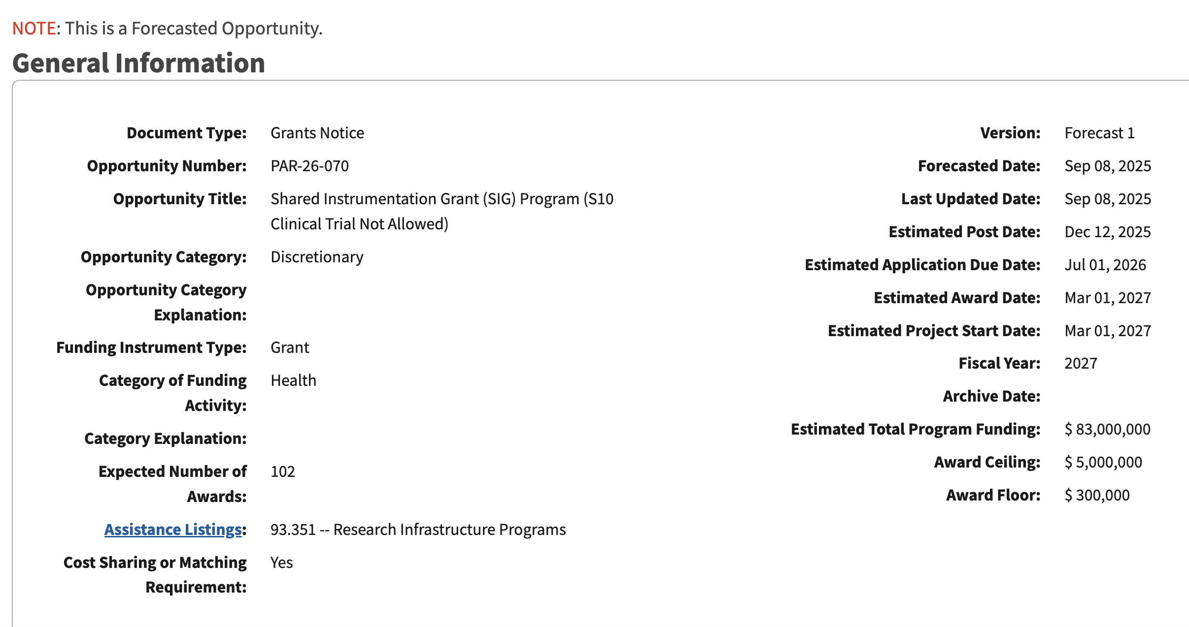
Federal Instrumentation Grant Opportunities
S10 program is FORECASTED and expected to be posted later this month
HEI and SIG (and BIG) are combined—award range is $300K - $5M
Internal Submissions Due March 2nd
Application Due Date is July 1st

Slide 9
NEW Seed Grant from ORIP
This Notice of Funding Opportunity (NOFO) aims to build new research capacity by supporting the purchase of a single commercially available biomedical research instrument currently unavailable in the institution.
Instruments funded through this program must be shared among the users to create new research opportunities, enable reproducible data generation, encourage collaborative research and training, and strengthen long-term research capabilities.
Seed Instrumentation Support (SIS) Grant is forecasted and expected to be posted in February
Award range is $50K - $400K

Slide 10
NSF Major Research Instrumentation (MRI) Grants
Track 1 MRI proposals are those that request funds from NSF greater than or equal to $100,000^{[1]} and less than $1,400,000 (limit of 2 per institution).
Track 2 MRI proposals are those that request funds from NSF greater than or equal to $1,400,000 up to and including $4,000,000 (limit of 1).
Track 3 MRI proposals are those that request funds from NSF greater than or equal to $100,000^{[1]} and less than or equal to $4,000,000 for the purchase, installation, operation, and maintenance of equipment and instrumentation to reduce consumption of helium (limit of 1).
NSF MRI is forecasted to be back for 2026 with a submission window of October 15– November 16
Anticipate $75M in awards

Slide 12

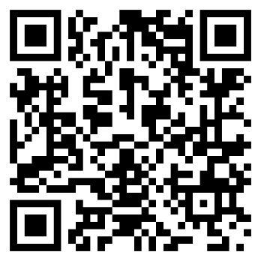
Research Core Development
Meghan Kraft – Director, Research Core Facilities, OVCR
Ben Wright – Director, Research Core Development, OSP
Michael Akridge – Financial Analyst, OSP

Slide 13
Infoporte Cores and iLab
UNC ITS is decommissioning Infoporte Cores at end of CY2026
Cores currently utilizing Infoporte Cores will transition to iLab during CY2026
RCD will be developing an onboarding schedule for CY2026
  Communication to applicable cores coming soon
If you’d like to be first to onboard into iLab, let us know
iLab Training Manual coming soon

Slide 14

Core Facility Asset Database
You now have access! Asset Management
Email sent to cores Thursday November 20th
Campus access is currently read-only
Access is based on the core facilities the individual is associated with
Guidance document available via email and on RCD webpage soon
If any information needs to be added/changed, contact RCD_Assets@unc.edu
For access requests, contact RCD_Assets@unc.edu

Slide 15
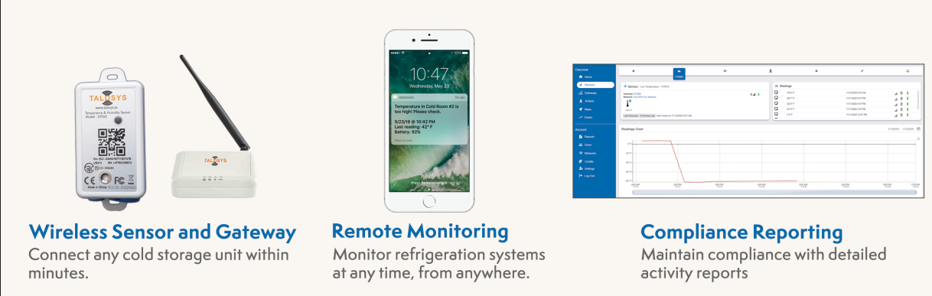
Talosys Contract for Freezer Monitoring
Talosys Wireless Ultra-Low Temperature Monitoring System
Continuously monitors and logs temperatures in the range of -328°F (-200°C) to 325°F (162°C).
Sends automatic text/email alerts if a preset temperature condition is breached.
If interested, contact Meghan Kraft at KraftMeg@unc.edu
Pricing
Year 1 + Installation: $166
Annual Monitoring: $65

Slide 16
Subsidy Policy
During the annual core rate review process, departments will be required to review and sign off on all committed subsidy allocations, including the designated source of funds
Will help prevent discrepancies in subsidy committed vs. subsidy provided
An MOU will be required to be signed by the subsidizing unit as part of the rate review
Changes must be communicated to core director proactively
Policy document, MOU, and FAQ document coming soon

Slide 17
Fiscal Year-End Balance Policy
The core’s year-end deficit does not exceed 10% of its annual expenses (this is the maximum allowable negative carryforward)
If the current negative balance is greater than this allowable threshold, it may still be reduced based on the following qualifying factors:
  The core has accounts receivable (AR) that sufficiently reduce the negative balance. All AR must be less than 6 months old.
  The core has unbilled supply costs that are project specific that will reduce the negative balance to within the allowable 10%.
  Revised recharge rates were submitted and approved within the last 6 months to account for the deficit.
  A large, one-time expense posted within 6 months of the deficit date, with proper justification, can be used to reduce the deficit.

Slide 18
Tariff Guidance
All purchases—regardless of funding source—must comply with State procurement regulations and UNC Purchasing Office procedures. Departments and vendors are not authorized to independently negotiate or accept tariff surcharges without institutional approval.
Prior Approval Required for Any Tariff or Surcharge
  Any vendor requesting to apply a tariff must meet directly with Purchasing to discuss justification, documentation, and compliance requirements.
  Approved tariffs will be added through a formal amendment to the existing purchase order (PO) contract, and a change order requisition to the PO, before payment is issued.
Requirements for New Purchase Orders
  All new PO requests must include tariff information upfront.
All new PO requests must include tariff information upfront.
  If a vendor seeks to add a tariff to an existing PO, contact Connie Dragicevich for supply POs or Lynn Barello for equipment POs, in Purchasing before the vendor issues an invoice.

Slide 19
RCD Survey Results
  Need for more robust financial reporting
  Need for stronger accounting and administrative support from departments
  Access to key metrics – publications and contracts/grants funding supported
  Website support
  Increased need for marketing
    To both internal and external customers
  iLab improvements
    Accounts Receivable tracking
    Training
    Administrative burden
Thank you for completing the survey!

Slide 20

New Equipment Review
When faculty or departments want to purchase equipment outside of a core that performs similar services, the goal is to ensure the decision is well-justified, coordinated, and not harmful to institutional sustainability.
The threshold for this process is $100,000.
If a similar service or instrument exists in a core facility the purchasing unit must provide:
  Justification for need outside of a core facility
  Projected usage
  Funding information
  Life cycle replacement/new equipment
  Interest in shared access

Slide 21
Research Core Development Contact Information
Meghan Kraft
Director, Research Core Facilities
Office of the Vice Chancellor for Research
kraftmeg@unc.edu
Ben Wright
Director, Research Core Development
Office of Sponsored Programs
bwright1@email.unc.edu
Michael Akridge
RCD Financial Analyst
Office of Sponsored Programs
michael_akridge@med.unc.edu
RCD@unc.edu
RCD_Assets@unc.edu
CoreSupport@med.unc.edu

