Slide 1
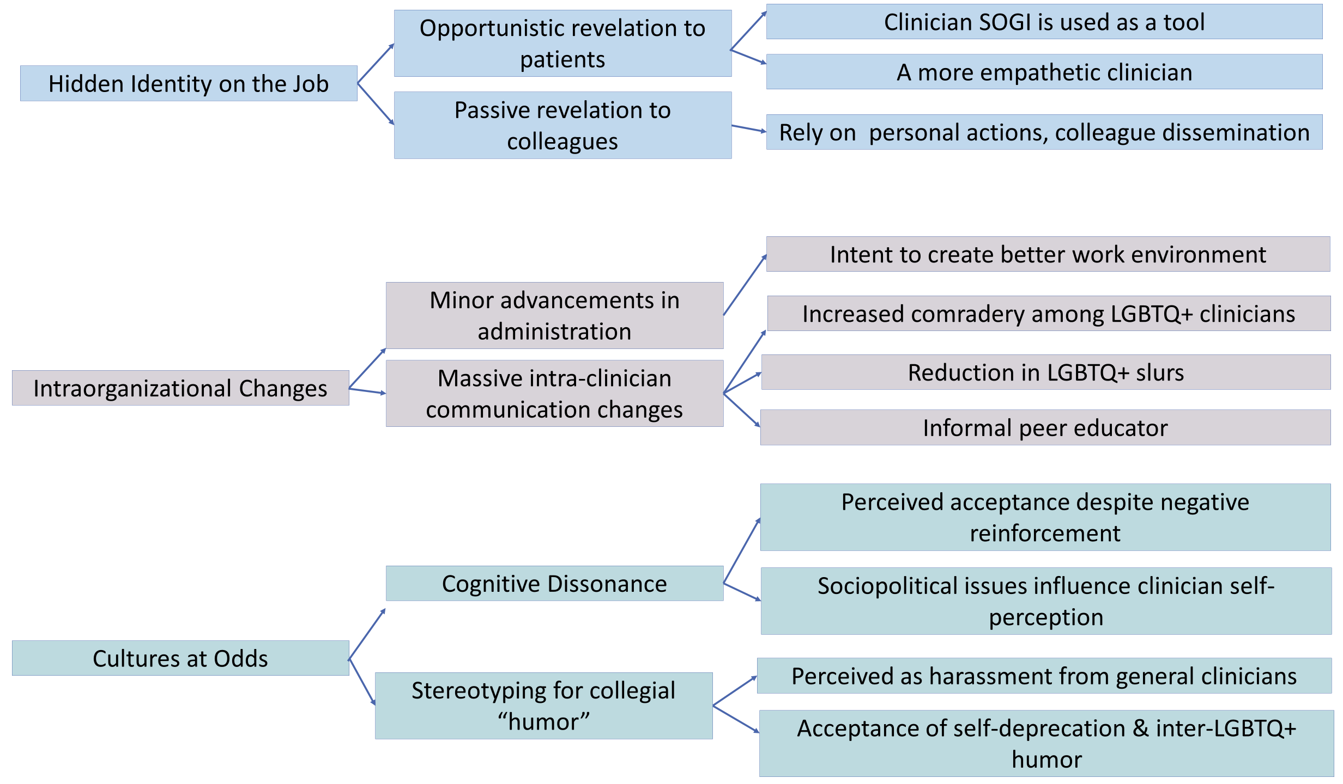
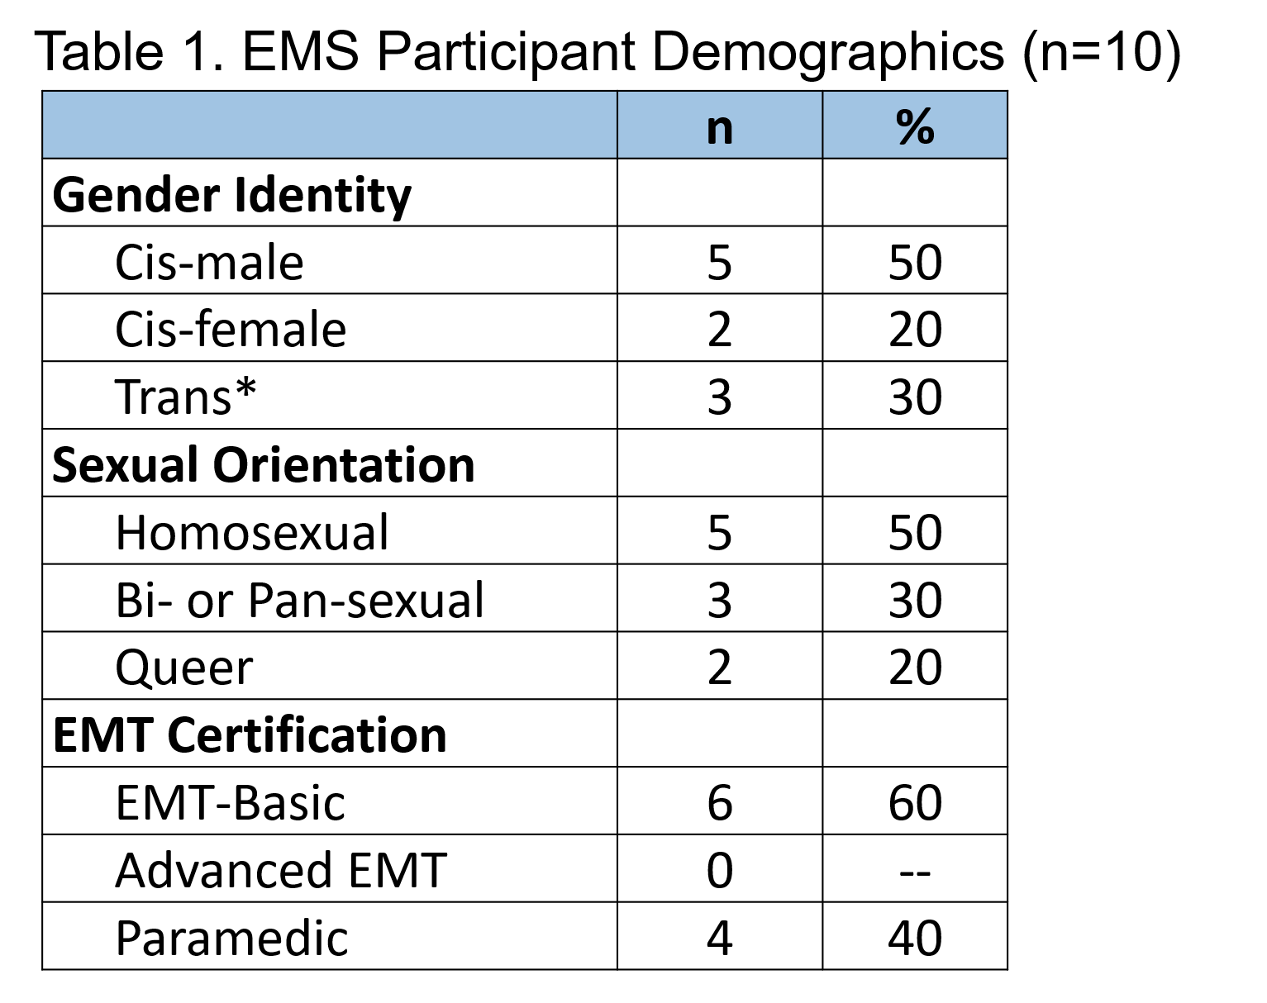
Queer Identity in the Workplace: The Lived Experience of LGBTQ+ EMS Clinicians
Julianne M. Cyr, MPH, CPH
Department of Emergency Medicine, The University of North Carolina at Chapel Hill
Introduction
Results
The Emergency Medical Services (EMS) workforce is composed of prehospital clinicians who provide care and transport to patients in need of medical attention.
EMS is largely composed of White male clinicians.^{1,2}
There is discussion on whether increasing EMS workforce diversity is necessary, whether this will result in improved patient care, and whether recruitment tactics could result in a more diverse workforce.^{1,3}
Public discourse on LGBTQ+ presence within the EMS profession has only recently began,^{4,5} while research has remained silent on LGBTQ+ EMS presence.
EMS LGBTQ+ representation and the intersectionality of these identities remains largely unknown.
“You say what [patients] want to hear and keep them happy.”
Figure 1. Thematic Coding
“[EM Administrator] said ‘If you get any shit for being who you are, tell me and I will take care of it’.”
Objectives
The objective of this study was to understand how LGBTQ+ identity functions within first responder culture. More specifically, this study sought to explore the lived experiences of LGBTQ+ EMS clinicians, how LGBTQ+ clinicians self-identify on the job, and the effects of SOGI disclosure.
“The problem is that, that, Trump made a political issue out of ‘Do you support public safety?’, which therefore made being in public safety difficult…”
Methods and Participants
This phenomenological study was approached from a constructive epistemology.⁶
Participant inclusion criteria were: ≥18 years of age, LGBTQ+ identity, and current EMS service in the United States.
Participants were recruited through social media and word-of-mouth.
Unstructured interviews were conducted via phone or ZoomTM in January-April 2021 and were 1-2 hours in length. Interviews were recorded and transcribed. Inductive thematic coding is ongoing.
“I didn’t understand [my LGBTQ+ identity] was a tool I could use to help people…”
Conclusions
“…She called me…‘scary lesbian dictator’, which between her and I, was funny, …But then, umm, the membership learned the nickname and it became a thing. And It went from funny to not funny very fast.”
LGBTQ+ clinicians hide identities, both actively from patients and passively from colleagues. However, identity is used as a tool when caring for patients in need. The presence of out LGBTQ+ clinicians changes administrators’ actions and the communication and comradery between clinicians. Cultural conflicts exist between LGBTQ+ and EMS identities, with or without active mental recognition by EMS, and are moderated by the style of humor used by EMS and modified by LGBTQ+ identity.
“They’re like ‘Wait, I thought that there were only two genders?’ And I’m like, ‘Well, I’m not offended, but there is a difference between sex and gender…’
Contact
References
Acknowledgements
Julianne Cyr (she/her)
Email: jcyr@med.unc.edu
Twitter: @j_cyriously
1. Crowe, R.P. et al. (2020). Females and minority racial/ethnic groups remain underrepresented in emergency medical services: A ten-year assessment, 2008-2017. Prehospital Emergency Care, 24(2), 180-187.
2. Rivard, M.K. et al. (2021). Demography of the national emergency medical services workforce: A description of those providing patient care in the prehospital setting. Prehospital Emergency Care, 25(2), 213-220.
3. Shaw, G. (2020). Special report: Building a diverse emergency medicine. Emergency Medicine News, 42(3), 20-21.
4. Schwester, D. (2020). Transgender awareness with Taylor Sprecher and Matt Streger (No. 68). The Overrun Podcast. Retrieved from https://www.overrunproductions.com/podcast/tag/Transgender.
5. Washick, M. J. (2020, June 3). Minnesota EMS providers share results of research on EMS care of transgender patients. Journal of Emergency Medical Services. Retrieved from https://www.jems.com/patient-care/minnesota-ems-providers-share-results-of-research-on-ems-care-of-transgender-patients/.
6. Petty, N.J. et al. (2012). Ready for a paradigm shift? part 2: Introducing qualitative research methodologies and methods. Manual Therapy, 17(5), 378-384.
This project was assisted by some lovely research assistants, including Emily Hutchens, Emilee Liggins, and Christina Boelkins, who assisted with assessing rigor in design (EH, EL) and interview transcription (EL, CB).

