Slide 1


Coping After Trauma & Resources for our Faculty and Staff

Slide 2
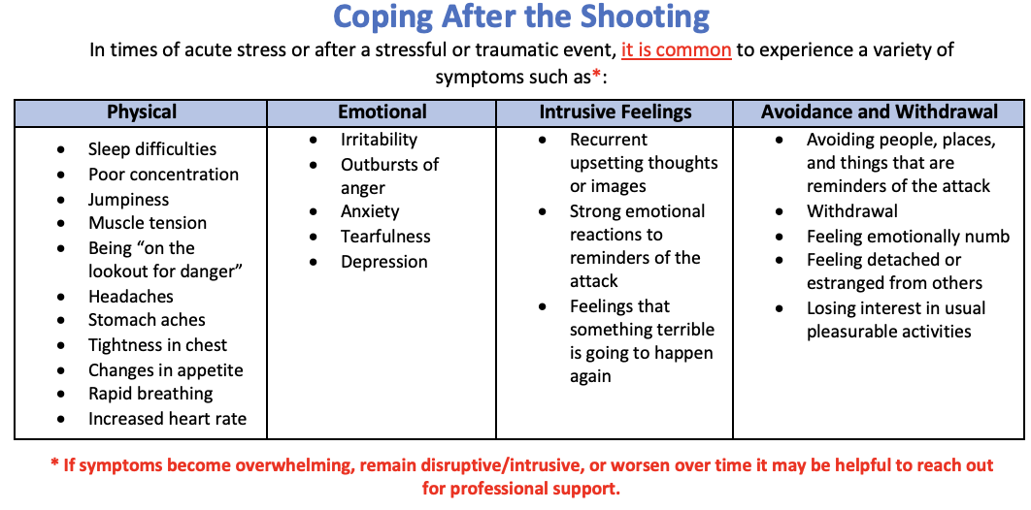
Experiences After a Traumatic Event

Slide 3
Coping and Self-Care Strategies
Identify and talk about your concerns with a trusted support
Avoid watching too much news and avoid social media all together, measure your exposure
Keep up your healthy routine as much as possible (get enough sleep, eat and exercise regularly, and drink plenty of water).
Spend time with family and friends
Get outside, walk, purposefully take breaks
Incorporate moments and activities that are relaxing
Ground self in practices of joy and gratitude
Pay attention to your thoughts. When you find you are thinking about things that make you upset, nervous or angry, notice them and stop or change them. You can distract yourself by changing activities
Get involved. Volunteer with a non-profit, private, or community organization
Attend services or gatherings that resonate with you

Slide 4
Coping Strategies for Self and Others
To Dos
What to Minimize in Group Settings
1. Acknowledge
2. Validate
3. Repeat
…and
4. Demonstrate grace and compassion to others…
and self
5. Model vulnerability
6. Remind all of community
7. Familiarize yourself with resources
Recounting of traumatic events or in-depth personal experiences
Conversations that that may excessively emphasize points of distress or concern of what is “broken” – can shift to “what are actions we can take now”
It’s okay to open conversation to how are we currently doing, but then frame with an additional positive
”What is something that has been helpful”
“What is something that helped you relax or find positive distraction”
If you feel stuck, it is okay, just take a deep breath and recenter on 1, 2, 3
https://cfe.unc.edu/teaching-and-learning/teaching-through-tragedy/

Slide 5
UNC SOM/UNC Health Based Resources
Well-Being Program Resources
The Well-Being Program offers support and grief groups as well as other resources that can be scheduled for your teams/units/divisions.
You may go to our website at https://www.unchealth.org/for-unch-health-professionals/well-being-for-unc-health-teammates for more information, including to sign up for these services.
For additional questions or needs, you may email the Well-Being Program at WellBeing@unchealth.unc.edu
Mental Health Support and Services:
Taking Care of All Healthcare and SOM Teammates
The Taking Care of Our Own Program offers virtual visits for support and wellness and is available to all UNC faculty and staff throughout the health system.
Note that insurance is billed for clinical services rendered and a co-pay may apply in accordance to your plan; for SOM faculty TCOOO is fully in network
This clinic can be reached at 984-974-5217, option 2 during routine business hours or messages can be left and will be retrieved generally on the next business day.

Slide 6
Additional Resources
Employee Assistance Program Provides a limited number of free visits with counselors in the community
UNC Health State Employees (855) 394-5547
UNC Health Non-State Employees (844) 869-2365
School of Medicine/University Employees (877) 314-5841
Residents (833) 955-3392
Hope4NC Helpline, available 24/7 If you are experiencing a mental health crisis or just need someone to talk to, you can call the Hope4NC Helpline (1-855-587-3463)
Suicide Prevention Lifeline, available 24/7 988 or visit https://suicidepreventionlifeline.org/

