Slide 1

Coping After Trauma & Resources

Slide 2
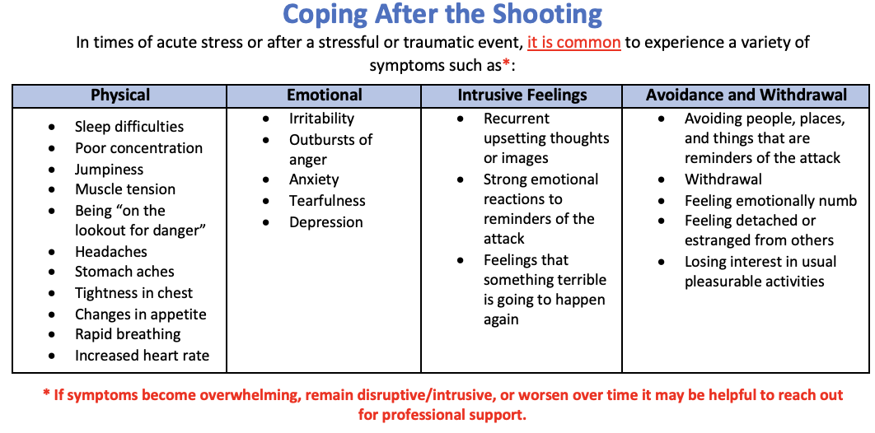

Slide 3
Coping and Self-Care Strategies
Identify and talk about your concerns with a trusted friend, family member, professor or counselor.
Avoid watching too much news about the recent trauma or the recovery efforts, and restrict social media use that may have this information as well. Although you may understandably want to know “the facts,” the repetitious recycling on the news/social media may make you feel worse about the future and leave you more worried, angry, or depressed.
Keep to your healthy routine as much as possible (get enough sleep, eat and exercise regularly, and drink plenty of water).
Spend time with family and friends, guard against isolation
Focus on your breathing. Slow down as you inhale and exhale when you are upset
Take a walk, connect with nature
Listen to soothing music
Daydream. Imagine things that calm you. Picture people or places that have brought you joy.
Write in a journal
Do activities and things with others that make you happy
Pay attention to your thoughts. When you find you are thinking about things that make you upset, nervous or angry, notice them and stop or change them. You can distract yourself by changing activities.
If you have faith in a Higher Power, use it to elevate your thoughts and connect with others who have similar faith backgrounds.
Get involved. Volunteer with a non-profit, private, or community organization.
Be it for coping, engaging or getting involved – choose activities that resonate with you – what gets your time should deserve your time
Be intentional about checking in with yourself from time to time

Slide 4


GET HELP: UNC Resources
Have a low threshold to reach out.
Taking Care of Our Own Program (TCOOO)
https://www.med.unc.edu/psych/wellness-initiatives/taking-care-of-our-own/
Provides counseling, supportive and well-being services.
No cost for our medical students
Online form is available on the website, 24/7
During normal business hours, you can also call (984) 974-5217, Option 2

Slide 5
GET HELP: Outside UNC
Headspace (free for AMA members)
Calm / Simple Habit
DHHS Hope4Healers (24/7)
(919) 226-2002
Substance Abuse and Mental Health Services Administration (SAMHSA) 24/7
1-800-662-HELP
National Suicide Lifeline
988
Notes:
Therapy Aid was formerly project parachute

