Slide 1


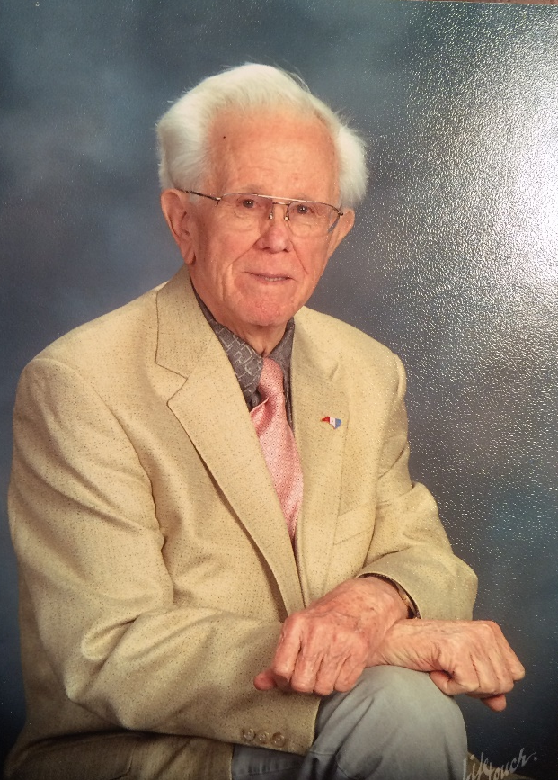
In Honor of John Henley
North Carolina AHEC

Slide 2
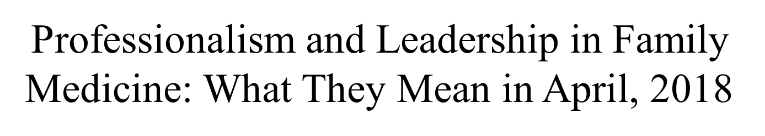
The John Henley Lectureship
Warren Newton, MD, MPH
Vice Dean and Director of North Carolina AHEC
North Carolina AHEC

Slide 3

Thank all of you!
Set the scene – healthcare, professionalism and leadership in 2018
Describe aspects of professionalism related to leadership
Review leadership lessons learned
North Carolina AHEC

Slide 4
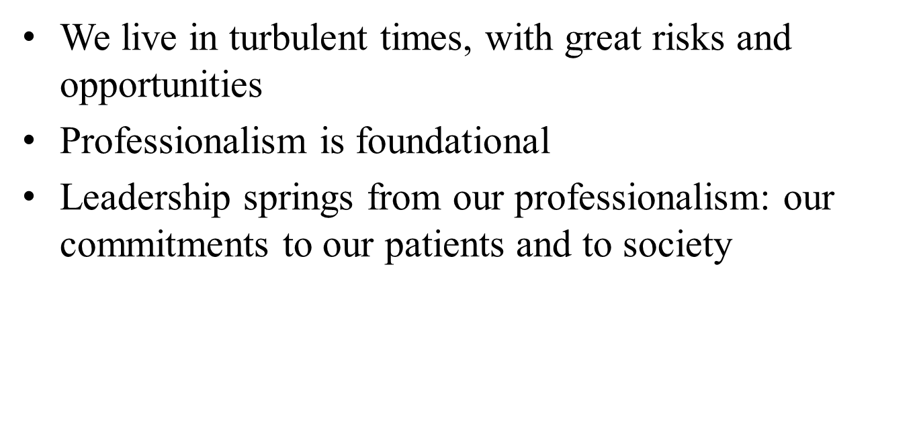
Key Messages
North Carolina AHEC

Slide 5
Caveats
I live in a glass house…
The 10,000 foot (and somewhat selective) perspective
Time for dialogue…
North Carolina AHEC

Slide 6
A Time of Transformation
North Carolina AHEC

Slide 7
Dramatic Changes in Health Care
Consolidation, Integrated EHRs
Employment of Physicians
Leadership Changes in North Carolina
Market Changes: Medicaid Reform, Commercial Pay for Value…CVS/Aetna; Amazon/Bershire; Walmart/Humana
North Carolina AHEC

Slide 8
Family Physicians
Rapid changes in scope of practice
Unbundling of first contact, coordination and comprehensiveness of care
Burnout and resilience
North Carolina AHEC

Slide 9

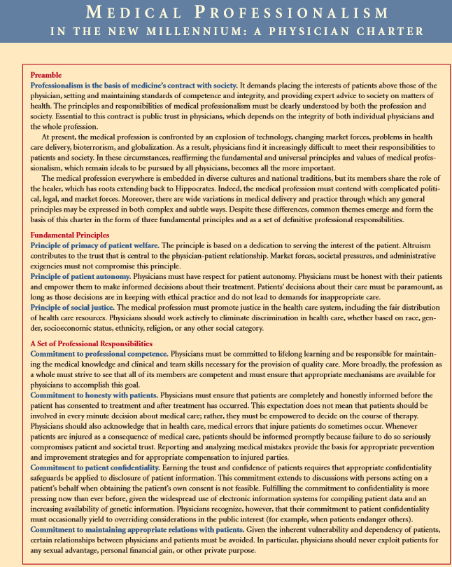
A Short History of Professionalism
North Carolina AHEC

Slide 10
A Time of Both Opportunity and Challenge
North Carolina AHEC

Slide 11


Slide 12
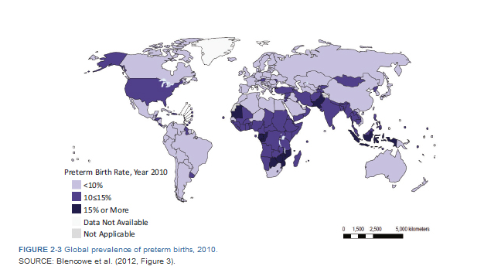
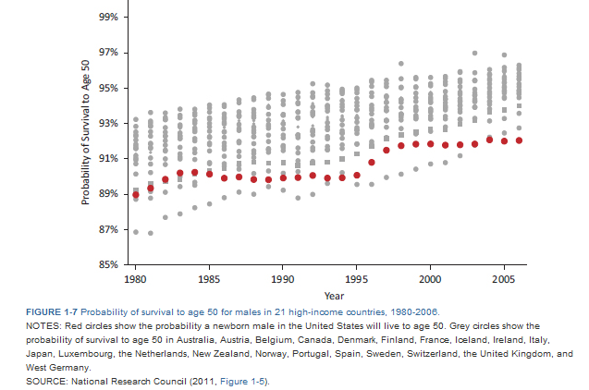
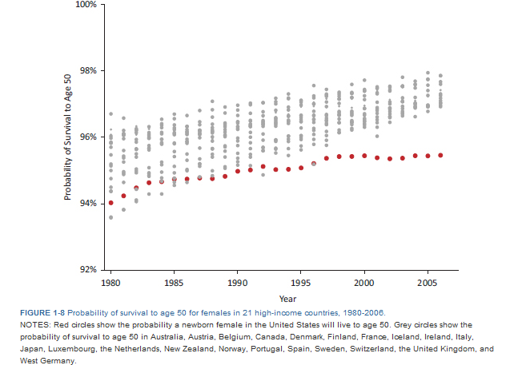
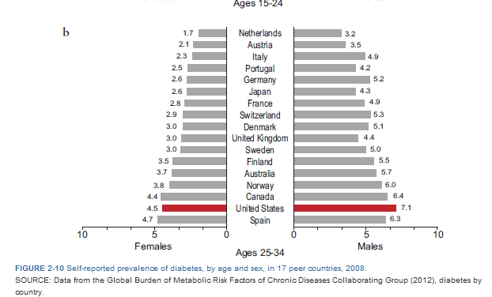
Shorter Lives, Poorer Health

Slide 13
Key Features of Professionalism
North Carolina AHEC

Slide 14
“Professionalism is the word your generation uses when you don’t like you what my generation is doing…”
UNC MS3 in 2010
North Carolina AHEC

Slide 15
How is a Doctor Different Than a Doorman?
North Carolina AHEC

Slide 16
North Carolina AHEC

Slide 17
Behaviors Matter
Dress – “professional dress”; white coats?
Timeliness
Doing what you say you are going to do
North Carolina AHEC

Slide 18
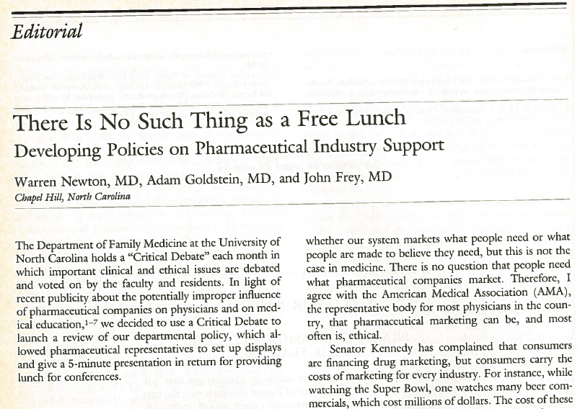
Other Dimensions of “Appearance”…
W. Newton, A. Goldstein, J. Frey. There is no such thing as a free lunch. Journal of Family Practice. 1992; 34:32-34.
North Carolina AHEC

Slide 19
Opening the Black Box of Problems in the Learning Environment
“There are patients that residents and attendings make fun of in unprofessional ways…there is often judgment about whether they have had too many kids, shouldn't have kids, about their social situation, about whether they can afford kids, and most often that they are large.”
UNC Medical Student, 2011
North Carolina AHEC

Slide 20
Respect
Portal of Empathy for Patients
Foundation of Teamwork with Patients and Other Professionals
A Condition for Learning from others
North Carolina AHEC

Slide 21
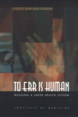

Making it Better
North Carolina AHEC

Slide 22
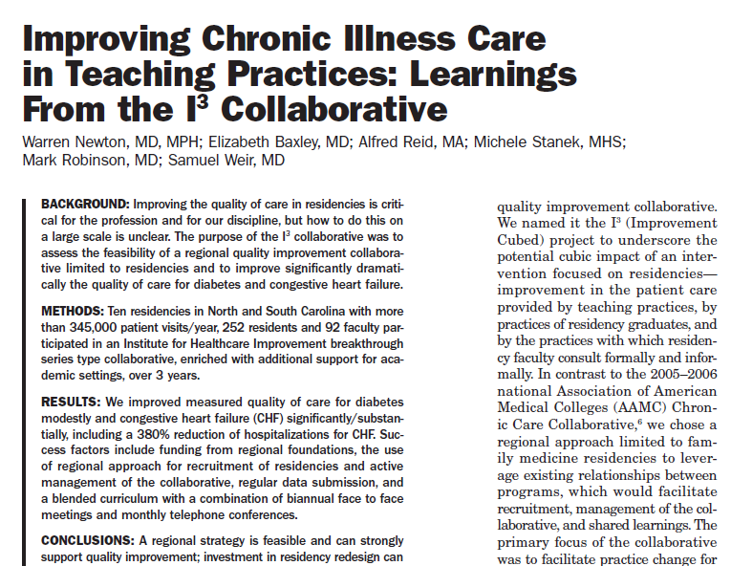

Making it Better
Each at our own Level
For Individual Patients
For Systems of Care
North Carolina AHEC

Slide 23
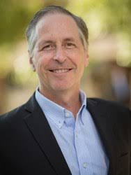
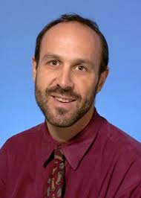
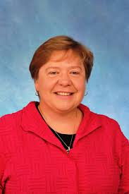
Advocacy as Part of our Responsibility to Society
Some Local Hero/Heroines
North Carolina AHEC

Slide 24
What can we learn from Pediatrics?

Slide 25
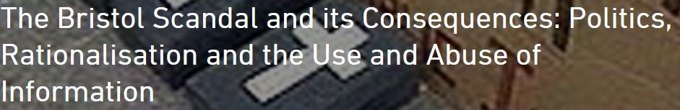
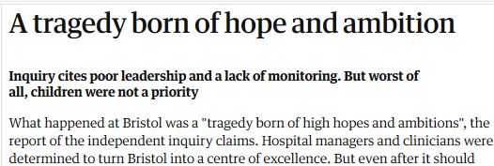

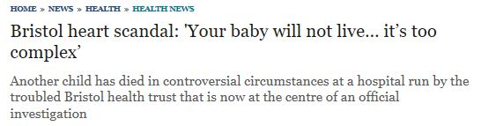
What happens if we don’t?
The Bristol Heart Scandal
North Carolina AHEC

Slide 26
What Might be our Bristols?
Opiates
Cost of Care
Patient Experience of Care
North Carolina AHEC

Slide 27
Leadership Learnings
Family Physicians in
Leadership Roles
North Carolina AHEC

Slide 28
Integrity and Relationships
The Limits of Transparency
North Carolina AHEC

Slide 29
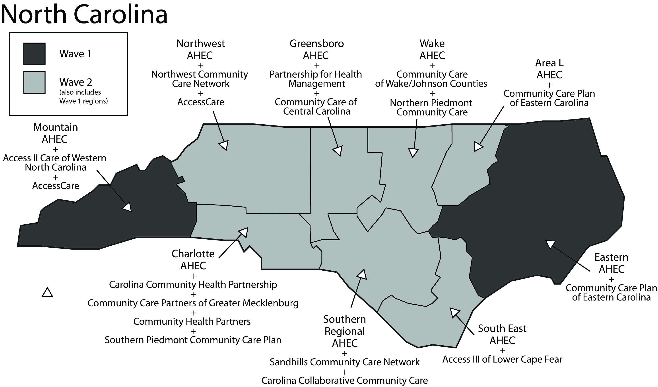
Vision
`Make no little plans; they have no magic to stir men`s blood…Make big plans; aim high in hope and work, remembering that a noble, logical diagram once recorded will never die—Daniel Burnham, 1907
North Carolina AHEC

Slide 30

The Practical Arts
Being Organized
Being Persistent
North Carolina AHEC

Slide 31
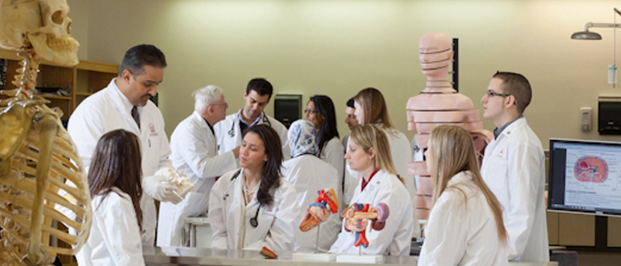
Passing it on…
Sustainability
Teaching
North Carolina AHEC

Slide 32
Responding to the Medical Student
Professionalism is the foundation of our work--our hope for meaning and durability in a chaotic world.
Respect, Commitment to Make it Better and Advocacy are the springboard for leadership
Our contract with society demands leadership, each at his/her own level
North Carolina AHEC

Slide 33
Thank You!
Questions, Comments?
North Carolina AHEC

