Slide 1
Intensive Behavioral Interventions to Help Obese Patients Lose Weight
Laurel Sisler, LCSW, LCAS, CTTS
Adam Goldstein, MD, MPH
UNC WEIGHT MANAGEMENT Program

Slide 2
Objectives
Call to action – obesity treatment in primary care
Effective counseling strategies
Higher levels of care
Resources & Cases

Slide 3
Definitions
Overweight
BMI of 25 to 29.9 kg/m²
Obesity
BMI of ≥30 kg/m²
Severe obesity
BMI ≥40 kg/m² (or ≥35 kg/m² in the presence of comorbidities)
Notes:
40% women. Higher for latino & AA. Most 50% for AA.
Rates by state – nationally & NC
Health impact – separate slide
What about actual treatment components?? Its own slide.

Slide 4
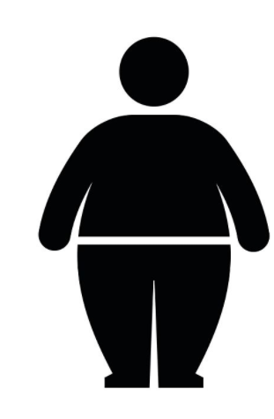
Call to Action
70%
United States
38%
North Carolina
32%
66%
BOTTOM LINE:
Almost ALL primary care visits = patient with obesity or excess weight
Adults w/ obesity
Overweight & obesity
Bardia A, Holtan SG, Stezak JM, et al. Diagnosis of obesity by primary care physicians and impact on weight management. Mayo Clin Proc 2007;82:927–32
Notes:
40% women. Higher for latino & AA. Most 50% for AA.
Rates by state – nationally & NC
Health impact – separate slide
What about actual treatment components?? Its own slide.

Slide 5
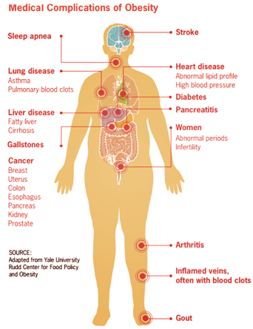
Call to Action: Impact
Individuals with a BMI of 35- 40 kg/m² are at high risk
Individuals with a BMI > 40 kg/m² are at very high risk
Notes:
40% women. Higher for latino & AA. Most 50% for AA.
Rates by state – nationally & NC
Health impact – separate slide
What about actual treatment components?? Its own slide.

Slide 6
Call to Action: Impact
Notes:
40% women. Higher for latino & AA. Most 50% for AA.
Rates by state – nationally & NC
Health impact – separate slide
What about actual treatment components?? Its own slide.

Slide 7
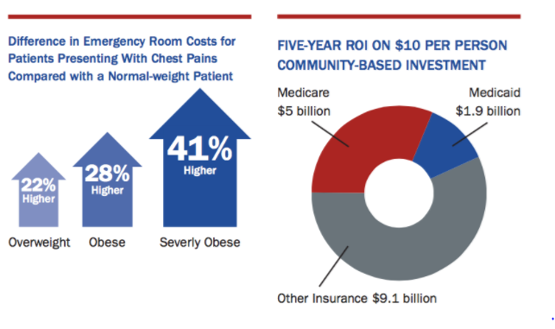
Call to Action: Impact
Direct healthcare costs:
$147-210 billion / year
$506 / employee with obesity / year
The State of Obesity: https://stateofobesity.org/healthcare-costs-obesity/
Notes:
40% women. Higher for latino & AA. Most 50% for AA.
Rates by state – nationally & NC
Health impact – separate slide
What about actual treatment components?? Its own slide.

Slide 8
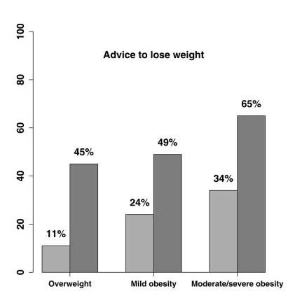
Call to Action
How many receive obesity treatment by PCP?
Obesity diagnosis: 29%
Waring ME, Roberts MB, Parker DR, Eaton CB. Documentation and management of overweight and obesity in primary care. J Am Board Fam Med. 2009;22(5):544-552
Bleich SN, Pickett-Blakely O, Cooper LA. Physician practice patterns of obesity diagnosis and weight-related counseling. Patient Educ Couns. 2011;82(1):123-129.
.
Notes:
Management of overweight/obesity by documentation of overweight/obesity and degree of overweight/obesity
The light grey bars represent patients without documented overweight/obesity and the dark grey bars represent patients with documented overweight/obesity.
10. Bleich SN, Pickett-Blakely O, Cooper LA. Physician practice patterns of obesity diagnosis and weight-related counseling. Patient Educ Couns. 2011;82(1):123-129.
11. Waring ME, Roberts MB, Parker DR, Eaton CB. Documentation and management of overweight and obesity in primary care. J Am Board Fam Med. 2009;22(5):544-552.
12. Kraschnewski JL, Sciamanna CN, Stuckey HL, et al. A silent response to the obesity epidemic: Decline in US physician weight counseling. Med Care. 2013;51(2):186-192.

Slide 9
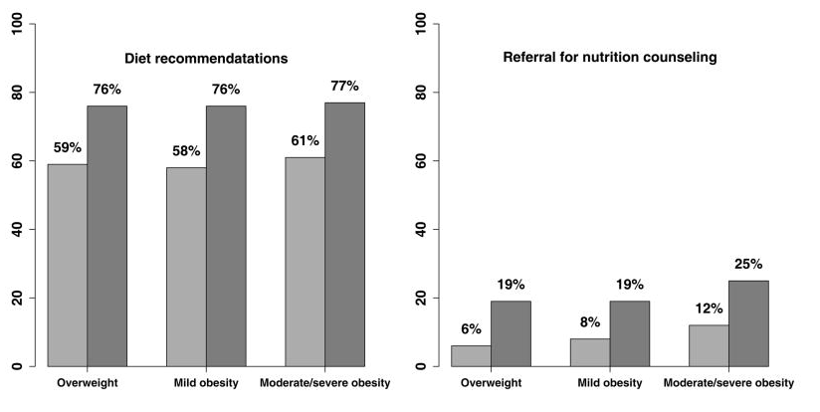
Call to Action
How many receive components of obesity treatment treatment by PCP?
Waring ME, Roberts MB, Parker DR, Eaton CB. Documentation and management of overweight and obesity in primary care. J Am Board Fam Med. 2009;22(5):544-552
Notes:
Management of overweight/obesity by documentation of overweight/obesity and degree of overweight/obesity
The light grey bars represent patients without documented overweight/obesity and the dark grey bars represent patients with documented overweight/obesity.
10. Bleich SN, Pickett-Blakely O, Cooper LA. Physician practice patterns of obesity diagnosis and weight-related counseling. Patient Educ Couns. 2011;82(1):123-129.
11. Waring ME, Roberts MB, Parker DR, Eaton CB. Documentation and management of overweight and obesity in primary care. J Am Board Fam Med. 2009;22(5):544-552.
12. Kraschnewski JL, Sciamanna CN, Stuckey HL, et al. A silent response to the obesity epidemic: Decline in US physician weight counseling. Med Care. 2013;51(2):186-192.

Slide 10
What works?
WEIGHT LOSS SURGERY:
Most significant & sustained health improvements. Underutilized. Relatively low-risk surgery.
WEIGHT MANAGEMENT MEDICATIONS:
Underutilized. Many patients w/ obesity could benefit.
PROFESSIONAL-LED LIFESTYLE INTERVENTION: Many different models proven effective
SELF-HELP: 45% of National Weight Control Registry participants lost weight without program or professional help

Slide 11
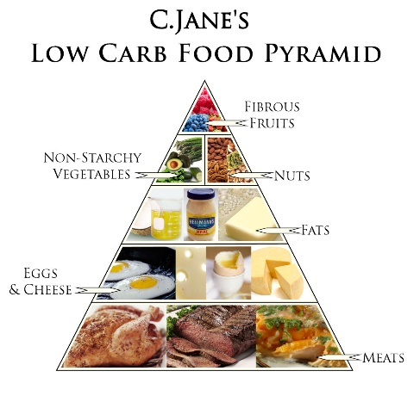
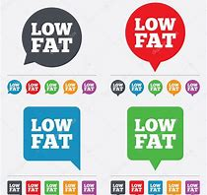
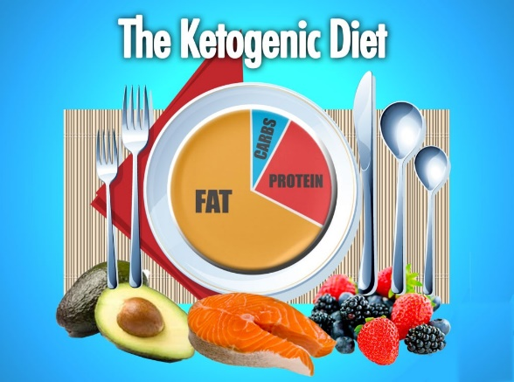
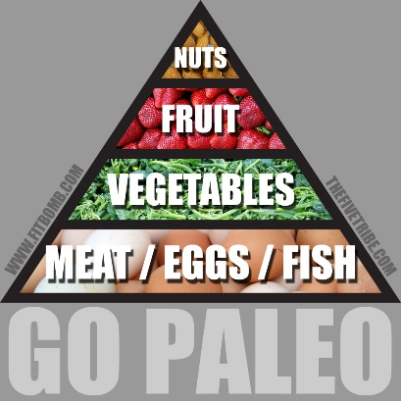
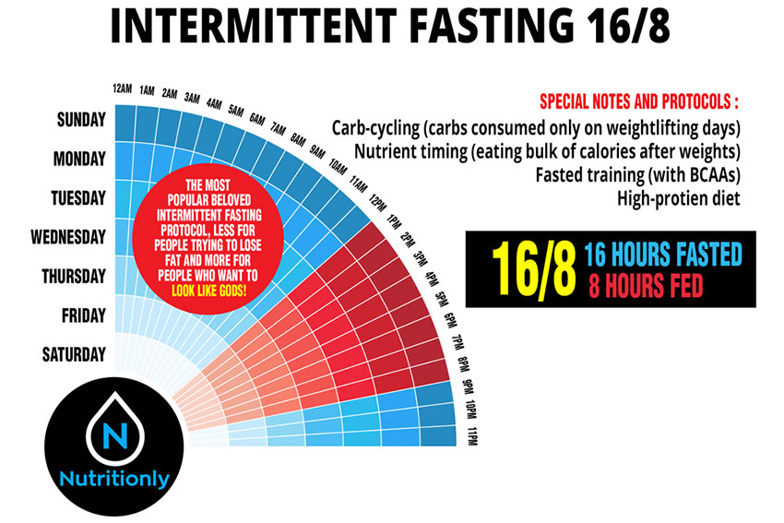
What works?

Slide 12
Setting Expectations
Behavioral intervention:
Initial weight loss goal of 5 -10% typical
Pharmacologic therapy + behavioral therapy:
10 - 15% is a very good response
Weight loss > 15% is considered excellent response

Slide 13
What works?
USPSTF Grade B recommendation: screen all adult patients for obesity and offer intensive counseling and behavioral interventions
CMS definition of intensive behavioral therapy for obesity:
- Weekly visits for Month 1;
- Biweekly visits for months 2-6;
- Monthly visits for months 7-12
Coding: G0447 if spend >15 minutes counseling
5A’s model
BOTTOM LINE:
At least monthly visits
Preventive Services Task Force. Screening for obesity in adults: recommendations and rationale. Ann Intern Med 2003;139:930-932
CMS Decision Memo for Intensive Behavioral Therapy for Obesity (CAG-00423N)

Slide 14
In a 10-20 min office visit…
Ask - Open-ended, directed
Tell me some of your concerns related to your weight…
Advise
Assess
Assist
Arrange
Fitzpatrick et al. An Evidence-based Guide for Obesity Treatment in Primary Care. Am J Med. 2016 Jan;129(1):115.e1-7.
Notes:
Separate out on separate slides
Data on counseling, impact of counseling in primary care setting
Look at old slides again

Slide 15
In a 10-20 min office visit…
Ask
Advise - Clear, strong, personalized
Losing 20 lbs (or cutting out soda) is the most important thing you can do to control your diabetes. With just this amount of weight loss, you may be able to reduce the amount of medications you take for diabetes and I believe you will feel a lot better.
Assess
Assist
Arrange
Fitzpatrick et al. An Evidence-based Guide for Obesity Treatment in Primary Care. Am J Med. 2016 Jan;129(1):115.e1-7.
Notes:
Separate out on separate slides
Data on counseling, impact of counseling in primary care setting
Look at old slides again

Slide 16
In a 10-20 min office visit…
Ask
Advise
Assess - shared-decision making to reach treatment goals
What changes are you considering related to your diet or exercise routine?
What have you already been doing to improve your diet?
Assist
Arrange
Fitzpatrick et al. An Evidence-based Guide for Obesity Treatment in Primary Care. Am J Med. 2016 Jan;129(1):115.e1-7.
Notes:
Separate out on separate slides
Data on counseling, impact of counseling in primary care setting
Look at old slides again

Slide 17
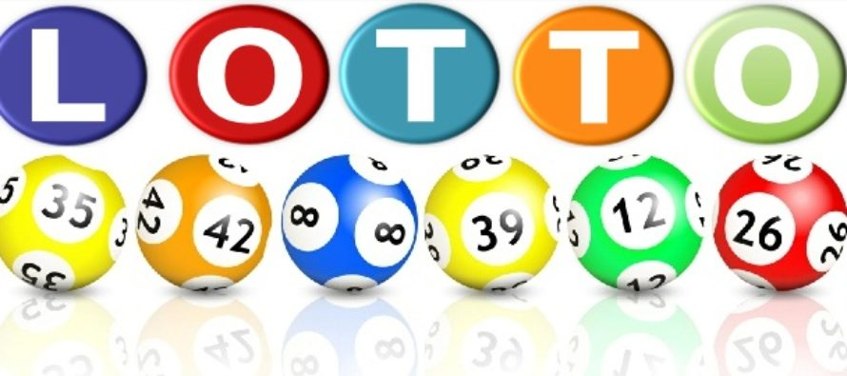
Assist: 5-10% Weight Loss
Results in significantly increased odds of achieving:
0.5% point reduction in HbA1c
5-mmHg decrease in diastolic & systolic blood pressure
5 mg/dL increase in HDL cholesterol
40 mg/dL decrease in triglycerides
(Compared to weight stable patients)
Odds even greater in those who lost 10-15%
Benefits of Modest Weight Loss in Improving Cardiovascular Risk Factors in Overweight and Obese Individuals With Type 2 Diabetes. Rena R. Wing, Wei Lang, Thomas A. Wadden, Monika Safford, William C. Knowler, Alain G. Bertoni, James O. Hill, Frederick L. Brancati, Anne Peters, Lynne Wagenknecht, the Look AHEAD Research Group. Diabetes Care Jul 2011, 34 (7) 1481-1486; DOI: 10.2337/dc10-2415

Slide 18
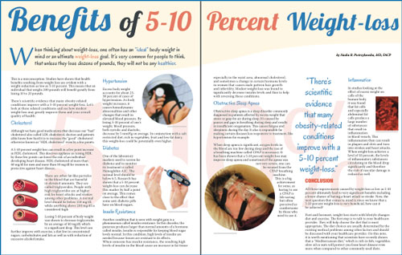
Assist: 5-10% Weight Loss
Often achievable through behavioral interventions alone
Patients feel it is realistic & achievable
<10% does not seem to trigger defense of “set point”
Benefits of Modest Weight Loss in Improving Cardiovascular Risk Factors in Overweight and Obese Individuals With Type 2 Diabetes. Rena R. Wing, Wei Lang, Thomas A. Wadden, Monika Safford, William C. Knowler, Alain G. Bertoni, James O. Hill, Frederick L. Brancati, Anne Peters, Lynne Wagenknecht, the Look AHEAD Research Group. Diabetes Care Jul 2011, 34 (7) 1481-1486; DOI: 10.2337/dc10-2415

Slide 19
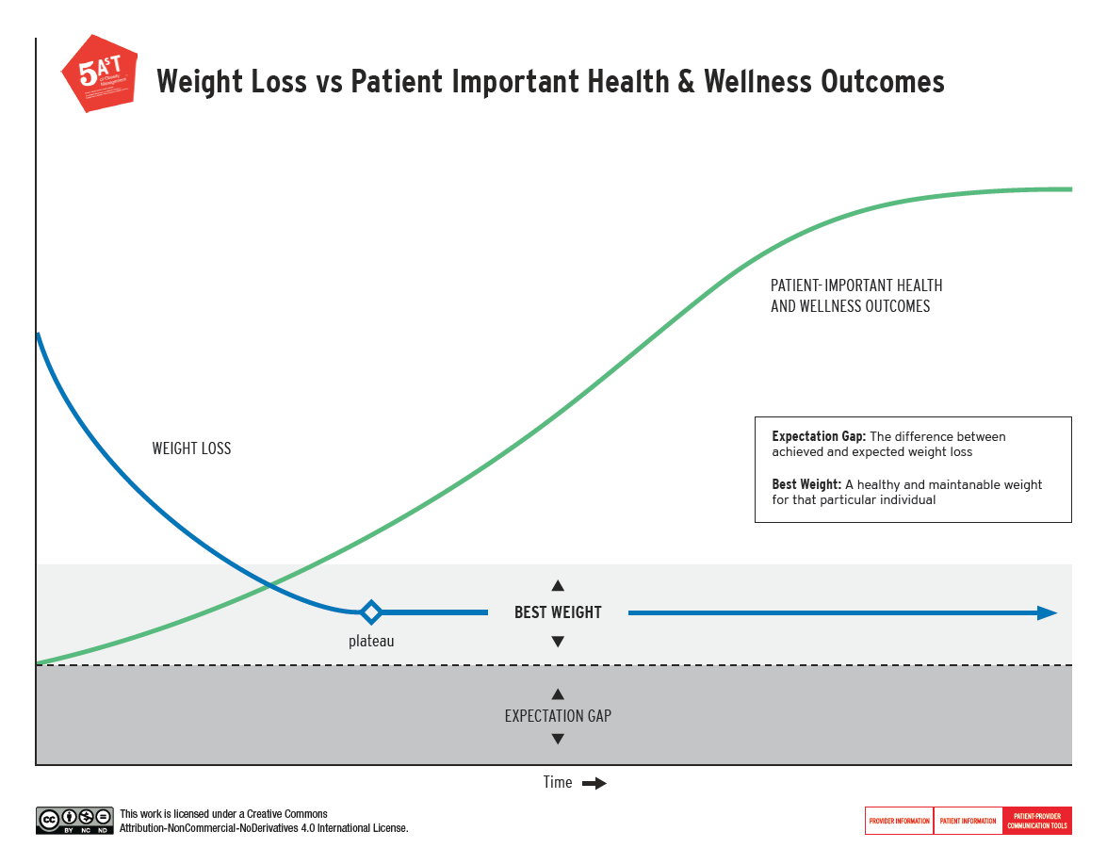
Assist
Emphasize the benefits of losing 5-10%
300 lbs
270 lbs
180 lbs
Fitzpatrick et al. An Evidence-based Guide for Obesity Treatment in Primary Care. Am J Med. 2016 Jan;129(1):115.e1-7.

Slide 20
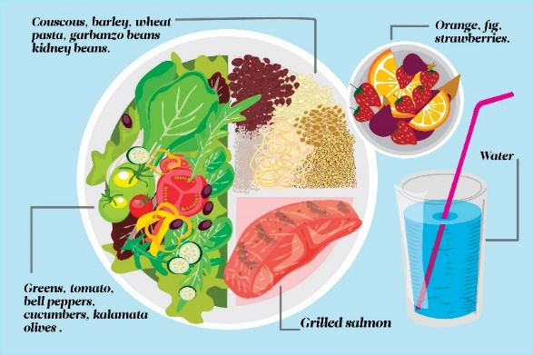
Strategies for achieving 5-10% Weight Loss
What works best? The plan that is sustainable long-term
Evidence for:
Low-fat or low-carb
Mediterranean diet
Keys: avoid hunger, make it easy
Gardner, Trepanowski, Del Gobbo, et al. Effect of Low-Fat vs Low-Carbohydrate Diet on 12-Month Weight Loss in Overweight Adults and the Association With Genotype Pattern or Insulin Secretion: The DIETFITS Randomized Clinical Trial. JAMA, 2018.
Shai, I., Schwarzfuchs, D., Henkin, Y., Shahar, D.R., Witkow, S., Greenberg, I. et al, Weight loss with a low-carbohydrate, Mediterranean, or low-fat diet. N Engl J Med. 2008;359:229–241.

Slide 21
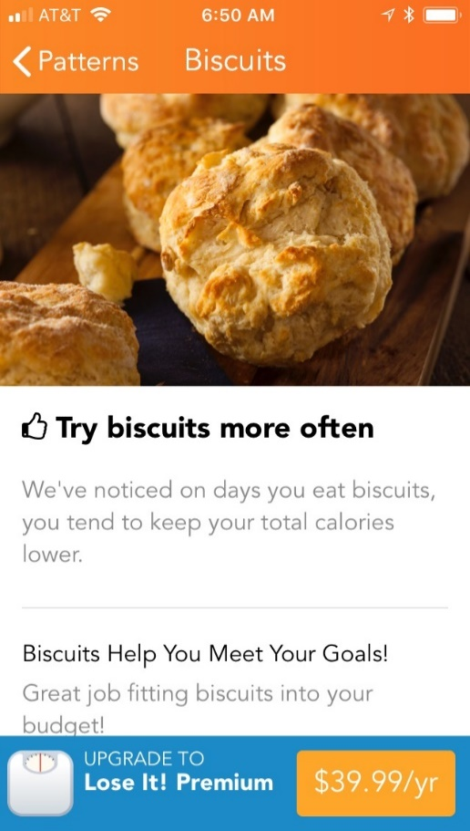
Strategies for achieving 5-10% Weight Loss
Caloric deficit of 250-500 calories/day
But there are some pitfalls…
Don’t:
Overly focus on # of calories without also paying attention to quality of calories
Do:
Set specific behavioral goals & track progress closely with regular check-ins

Slide 22
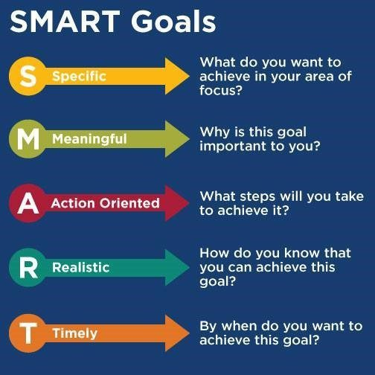
TIP: Ask them to WRITE their goal down and read back to you
Example #1: I want to lose 10 lbs over the next 3 months
Measurable
Example #2: I will eat 2 servings of vegetables, 5 out of 7 days per week. I will track using notes section on phone and review weekly by myself and monthly with PCP. Next appointment: ___
Example #3: I will walk 4/5 weekdays during lunch break for 20 minutes. I will track using physical calendar displayed at my desk. Will review weekly by myself and monthly with PCP. Next appointment: ___

Slide 23
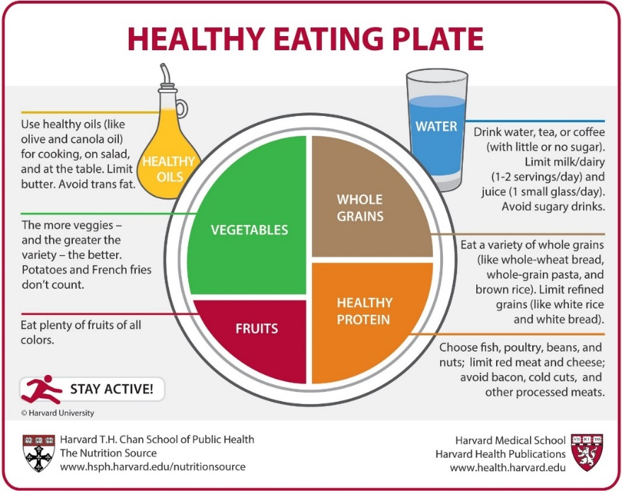
DO / INCREASE | AVOID / DECREASE
Stop eating when full | Going hungry
Consistent meal schedule | Skipping meals
Follow the Healthy Eating Plate model | Grazing between meals
 | Eating late at night
 | Processed foods like canned meats or frozen meals
 | White (sugar, breads, pasta)
 | Sugary drinks
 | Alcohol
 | Trans fats or saturated fats (butter, red meats, fried foods, chips)

Slide 24
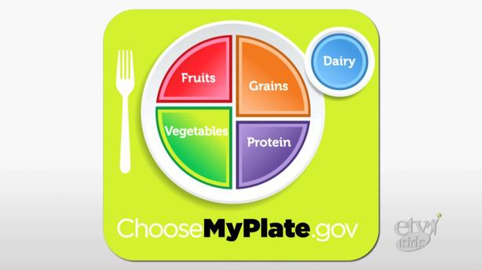
Healthy fats, not low-fat
Limit red meat, cheese, dairy and processed meats
More specific directions re quality of calories

Slide 25
Strategies for maintaining weight loss: NWCR
Physical activity becomes extremely important
77%: 60 mins daily, walking most frequently cited
78%: eat breakfast daily
77%: weigh at least weekly
Catch slips before they turn into relapse
Consistent eating habits, independent weekday vs weekend
National Weight Control Registry: http://www.nwcr.ws/research/
N = >4000

Slide 26
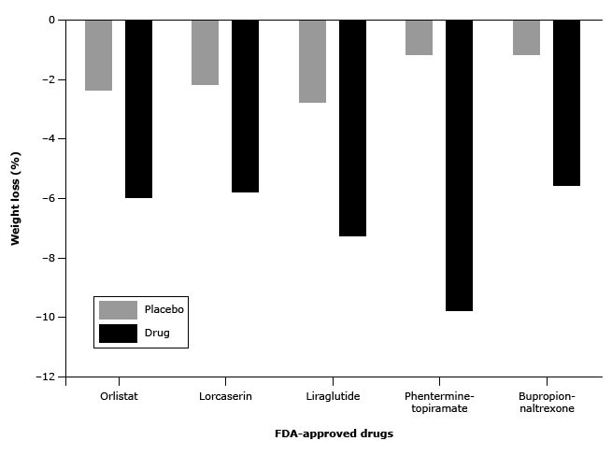
Weight Management Medications BMI >30 BMI >27 with obesity-related comorbidity
Khera R, Murad MH, Chandar AK, et al. Association of pharmacological treatments for obesity with weight loss and adverse events: A systematic review and meta-analysis. JAMA 2016; 315:2424. doi: 10.1001/jama.2016.7602
Notes:
Separate out what a comprehensive lifestyle intervention is and duration of treatment
Outline what the best practice versus reality
Add in slide about medications

Slide 27
Weight Management Medications BMI >30 BMI >27 with obesity-related comorbidity
FDA-Approved Weight Management Medications | Phentermine-Topiramate (Qsymia) | Liraglutide (Saxenda, Victoza) | Lorcaserin (Belviq) | Naltrexone SR-Bupropion SR (Contrave) | Orlistat (Alli/Xenical)
Class/Mechanism | Anorexiant; Anticonvulsant; Sympathomi-metic | Glucagon-Like Peptide-1 (GLP-1) Receptor Agonist | Serotonin 5-HT_{2C} Receptor Agonist | Dopamine/Nor-epinephrine-Reuptake Inhibitor; Opioid Antagonist | Lipase inhibitor
Avg Weight Loss at 1 year | 10% | 9% | 6% | 6% | 2-3%
Side Effects | CV, CNC, GI, Resp | CV, CNS, GI, Local | CNS, MSK, Resp | CV, CNS, Endo | CNS, ID, GI
Cost (month) | $220 | $288 | $317 | $290 | $50
Notes:
Separate out what a comprehensive lifestyle intervention is and duration of treatment
Outline what the best practice versus reality
Add in slide about medications

Slide 28
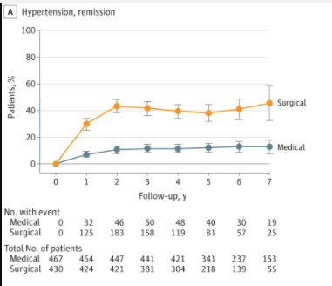
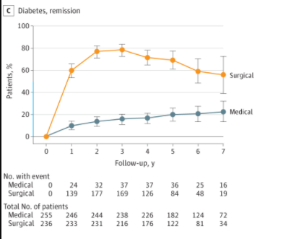
Bariatric Surgery
Notes:
Talking about 100-120 lbs for gastric bypass on average. Similar for sleeve gastrectomy and less for the gastric band.
http://vb3lk7eb4t.scholar.serialssolutions.com/?sid=google&auinit=GS&aulast=Jakobsen&atitle=Association+of+Bariatric+Surgery+vs+Medical+Obesity+Treatment+With+Long-term+Medical+Complications+and+Obesity-Related+Comorbidities&id=doi:10.1001/jama.2017.21055&title=JAMA+:+the+journal+of+the+American+Medical+Association&volume=319&issue=3&date=2018&spage=291&issn=0098-7484

Slide 29
What Works
Weight loss:
Lifestyle: 5-10%
Medications: 5-20%
Surgery: 30-40%

Slide 30
Assist: Key Take-Aways
Emphasize benefits of losing 5-10%
Help patients set realistic long-term weight loss goals AND short-term behavioral SMART goals
Reward progress!
Prescribe & Refer

Slide 31
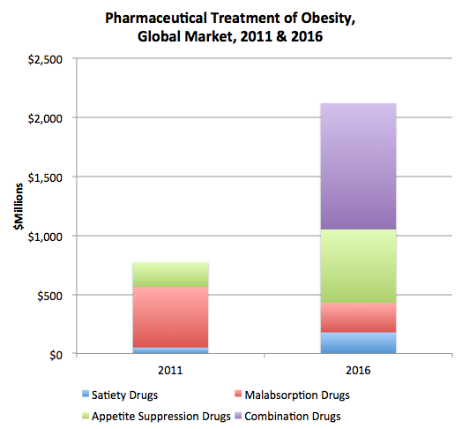
Future Steps
Obesity is heterogeneous disease with heterogeneous responses
Combination therapies
Obesogenic environment
Primary prevention

Slide 32
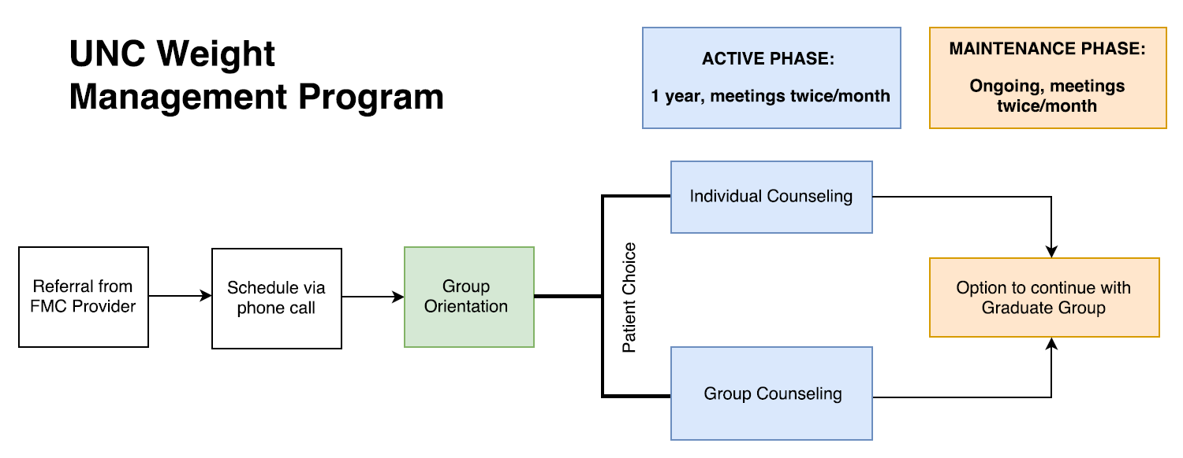
UNC Weight Management Program
Enrolled = 4 or more sessions (n=149)
25% clinically significant weight loss (>5%)
Average decrease in HbA1c of 1.95 for patients who started program with HbA1c >9

Slide 33
UNC Weight Management Program

Slide 34
Case #1
64yo White Female
Initial presentation: 195 lbs, BMI 33, prediabetes, hypertension, OSA
1 year later:
- 13 completed sessions
- No prediabetes
- Decreased metoprolol
- Lost 50 lbs or 26%
Next steps: continue to work on psychological aspects & join graduate groups
Key Behavioral Strategies:
Measure nuts, 1/4 cup = serving
2) Bring lunch from home
3) Track using MyFitnessPal

Slide 35
Case #2
50yo Black Female
Initial presentation: 344 lbs, BMI 48, hypertension, OSA
1st year:
- 16 counseling sessions
- 10-20 lbs weight loss (5%)
- Tried orlistat/alli 60mg tid (Medicaid)
2nd year:
- Sleeve gastrectomy at Nash General
- 100 lbs weight loss (29%)
- Graduate groups
Key Counseling Strategies:
Eat consistent meals of high nutritional value
Risks/benefits bariatric surgery

Slide 36
UNC Weight Management Program

Slide 37
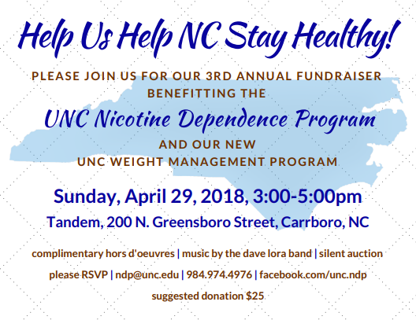
Resources
UNC Weight Management Program:
Stay tuned for future CME in obesity tx!
Clinical program open to external
referrals this summer
UNC Med-South Lifestyle Program: http://hpdp.unc.edu/research/medsouth/
Harvard’s Healthy Eating Plate: https://www.hsph.harvard.edu/nutritionsource/healthy-eating-plate/

Slide 38
Questions?
UNC Weight Management Program
984-974-4976
laurel@unc.edu
https://www.med.unc.edu/fammed/weightmanagement/

