Slide 1
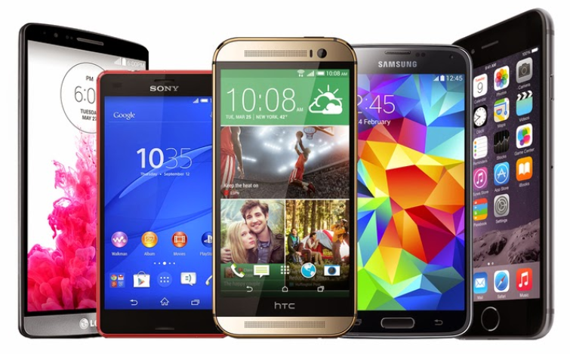
Poll everywhere sign up
Please sign up at Please sign up at PollEv.com/dananeutze007
Or text DANANEUTZE007 to 37607 to join the session

Slide 2
Making use of Quality Improvement
Dana Neutze, MD PhD
April 14th, 2018

Slide 3
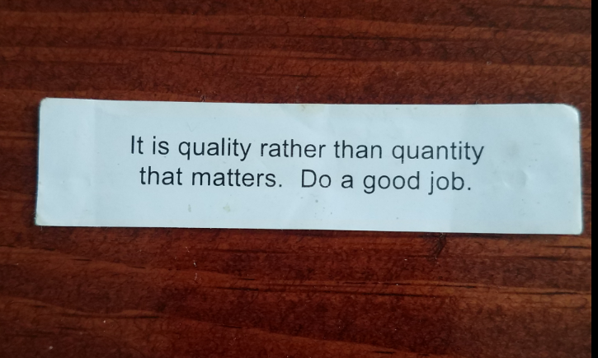

Slide 4
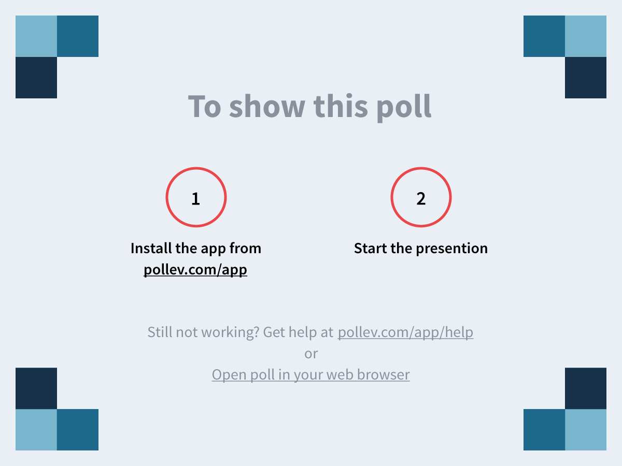
Notes:
How much quality improvement do you do? https://www.polleverywhere.com/multiple_choice_polls/gjCa2jb6ozowINp
What is “quality improvement”?
I remember doing an R3 project but haven’t done anything since.
I have been involved with several projects
I have done so many projects I can sleep through this lecture as I was up late last night partying

Slide 5
How much quality improvement do you do?
What is “quality improvement”?
I remember doing an R3 project but haven’t done anything since.
I have been involved with several projects
I have done so many projects I can sleep through this lecture as I was up late last night partying

Slide 6
Outline
Definition and why it is important
Road map
Data
Sustain the gain
i.e. don’t fall asleep

Slide 7
Definition
In health care, quality improvement (QI) is the framework we use to systematically improve the ways care is delivered to patients.
-AHRQ “Practice Facilitation Handbook: Module 4.
Approaches to Quality Improvement”
https://www.ahrq.gov/professionals/prevention-chronic-care/improve/system/pfhandbook/mod4.html
framework
systematically
care is delivered

Slide 8
Why is it important?
Poll everywhere

Slide 9
Notes:
Why is quality improvement important? https://www.polleverywhere.com/free_text_polls/DjwzdCGbMf16lMV

Slide 10
Why is Quality Improvement important
Improves the care of patients (outcomes, quality of life, experience)
Improves efficiency
Data is reportable (rankings)
Reimbursement based on quality- MIPS (MACRA), ACO, commercial contracts
Improves cost?

Slide 11
What is an area you could do a QI project?

Slide 12
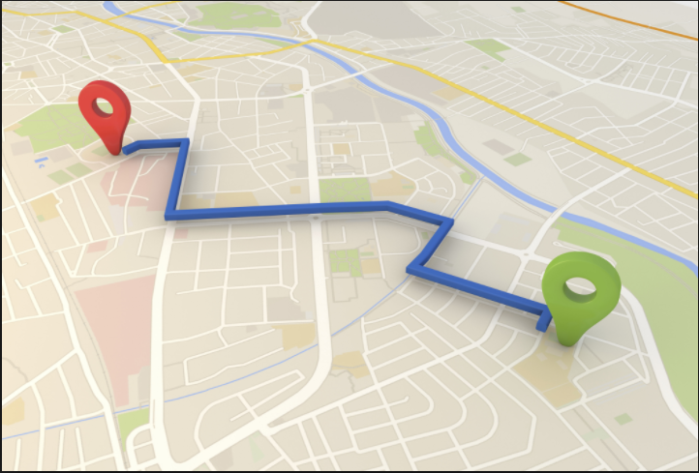
The Road Map- “framework”

Slide 13
Notes:
What model do you use? https://www.polleverywhere.com/multiple_choice_polls/V38DEmuToPWXZvd

Slide 14
What model do you use?
IHI Model for Improvement – Associates in Process Improvement 1993
Lean – from the Toyota Production System, (1948-75) coined in 1990
Six Sigma- Motorola 1986
Other
I don’t use a model. I just make changes and hope there is improvement

Slide 15
Why? | GAP(s)
Current | Experiments i.e. PDSAs Plan Do Study Act
Goal | Sustain/Lessons learnt

Slide 16
Why? Bedroom is always a mess and it stresses me out | GAP(s) I am too tired to take the dirty clothes to the laundry room at bedtime I am in a rush the next morning and don’t stop to take them to laundry room
Current Clothes are all over the floor | Experiments i.e. PDSAs Plan- Locate a laundry basket Do- Basket placed at foot of bed Study- Noted how many days the floor remained clean Act- Decided it was worth it to keep the basket there
Goal Everything put away in place | Sustain/Lessons learnt Basket gets returned to the foot of the bed after clothes are taken to the laundry room

Slide 17
Why? Bedroom is always a mess and it stresses me out | GAP(s) I am too tired to take the dirty clothes to the laundry room at bedtime I am in a rush the next morning and don’t stop to take them to laundry room
Current Clothes are all over the floor | Experiments i.e. PDSAs Plan- Locate a laundry basket Do- Basket placed at foot of bed Study- Noted how many days the floor remained clean Act- Decided it was worth it to keep the basket there
Goal Everything put away in place | Sustain/Lessons learnt Basket gets returned to the foot of the bed after clothes are taken to the laundry room

Slide 18
Which box is most critical?
Why? | GAP(s)
Current | Experiments i.e. PDSAs Plan Do Study Act
Goal | Sustain/Lessons learnt

Slide 19
“Every system is perfectly designed to get the results it gets”
- Paul B. Batalden, MD, IHI

Slide 20
Why? | GAP(s)
Current | Experiments i.e. PDSAs Plan Do Study Act
Goal | Sustain/Lessons learnt

Slide 21
Data

Slide 22
%

Slide 23
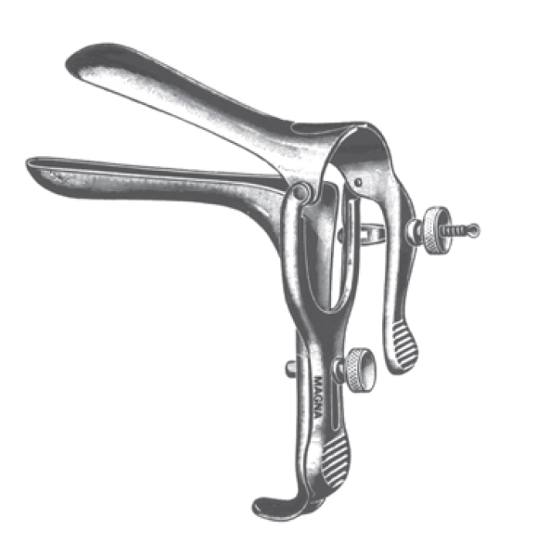
How?

Slide 25
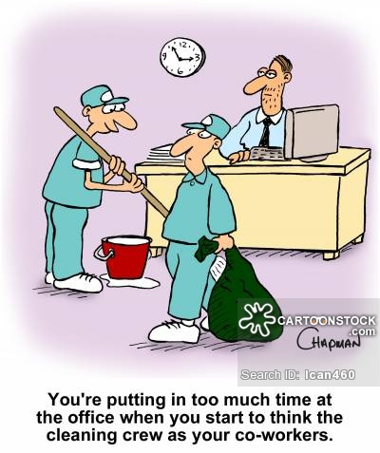
Cleaning up data
Check once
Get credit for what has been done
Outside records
Document in the right place
Remove those who don’t belong
Moved
Deceased
, twice
, three times

Slide 26
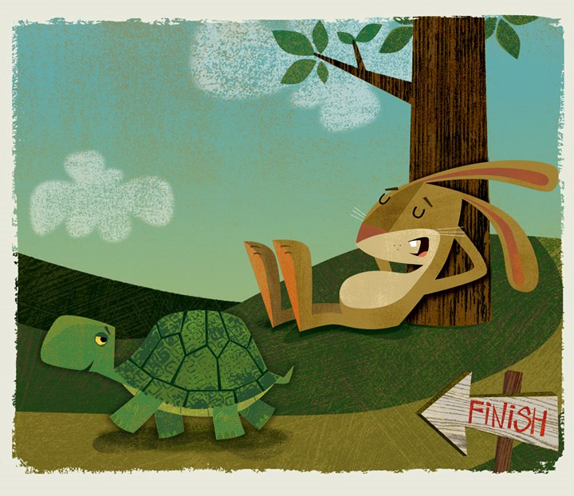

Slide 27
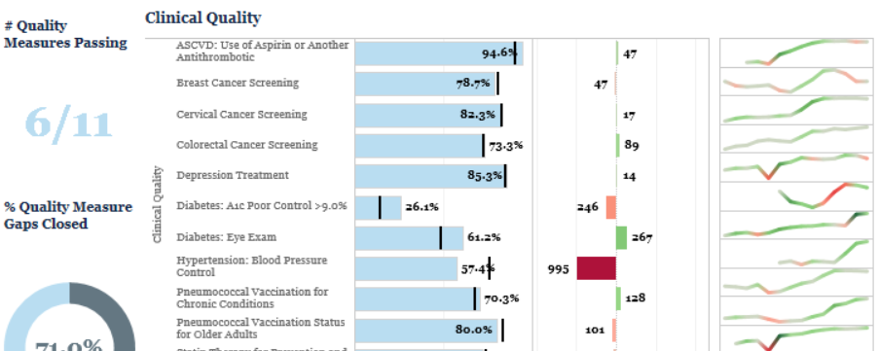
Tableau

Slide 28
%

Slide 29
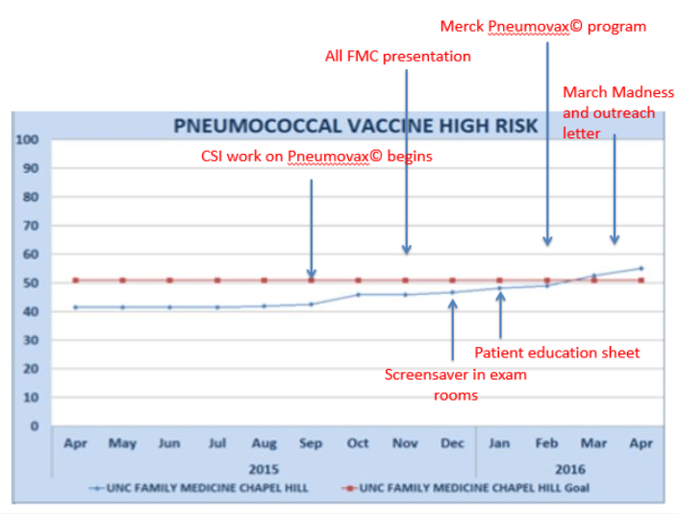
Data Graph
Run chart

Slide 30
Notes:
Who can see the data? https://www.polleverywhere.com/multiple_choice_polls/IRzDw4p1GFyqdPU

Slide 31
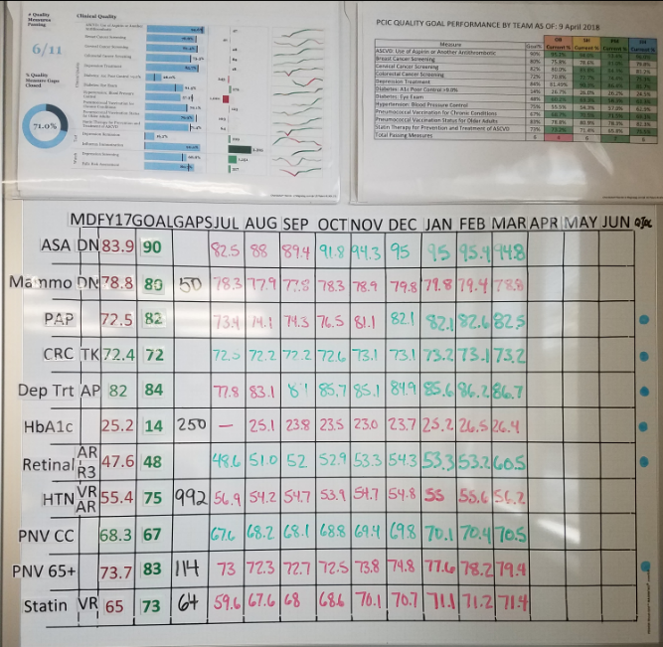
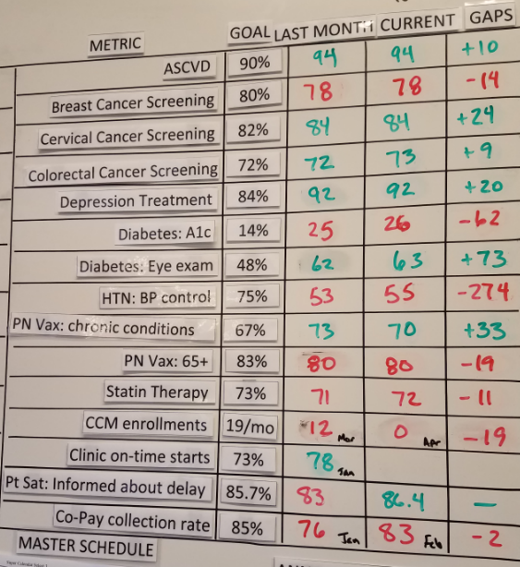
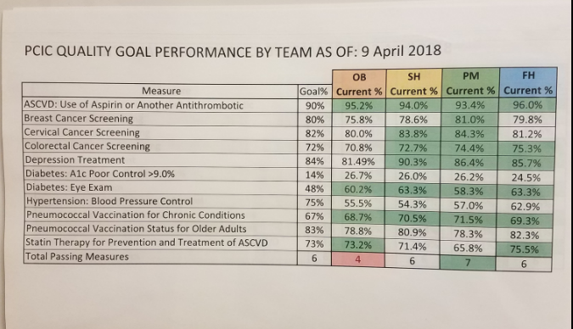

Slide 32
Lessons learnt

Slide 33
Summary

