Slide 1
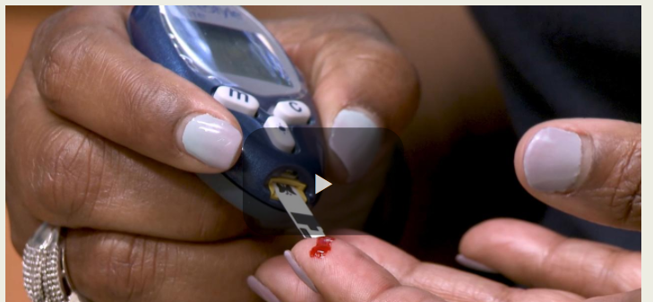
What is the Value of Home Glucose Monitoring?
Katrina Donahue, MD, MPH
Professor, UNC –Chapel Hill Department of Family Medicine
UNC Family Medicine Alumni Weekend
Innovation in Chronic Disease Prevention & Management
April 13, 2018

Slide 2
Investigative team
Laura Young, MD, PhD
John Buse, MD, PhD
Mark Weaver, PhD
Maihan Vu, DrPH
C. Madeline Mitchell, MURP
Tamara Blakeney, BS
Kimberlea Grimm, BA
Jennifer Rees, RN, CPF
Franklin Niblock, BS, MS4
Katrina Donahue, MD, MPH
MONITOR trial Group
April Reese, BSW, MPH
Joanne Rinker, MS, RD, CDE, LD
Jan Hutchins, RN
Melvin Dubose,DD
Michael Pfeifer, MD, MS
Nellie Lewis, RN
Paula LeClair, MBA
Val Atkinson
Jim Straight, BA
Students-Kamaara Lucas, BA, Rachel Fuchs, MS, Alexa Waters, BS, Paul Alvarez, BS, Caroline Grandis, BS, Sara Kowitt, MPH
15 Participating Primary Care Practices and key clinicians and staff

Slide 3
COI Disclosures
Dr. Donahue: UNC has licensed its interest in copyright works to Telcare of a glucose messaging and treatment algorithm for the purposes of commercialization.

Slide 4
Objectives
Review and Interpret findings from the MONITOR SMBG trial
Apply findings from the MONITOR trial in primary care patients with non-insulin treated type 2 diabetes

Slide 5
Background
Guidelines are inconsistent regarding the role of glucose self monitoring (SMBG) in adult patients with non-insulin treated type 2 diabetes
Recommendations from health care providers vary widely
Numerous stakeholders have an interest in this debate

Slide 6
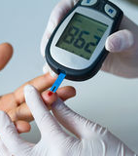
SMBG (Self Monitoring of Blood Glucose)
Widely practiced in patients with diabetes
Conducted since 1980s
Benefits well-established in Type 1 diabetes and Type 2 diabetes on insulin

Slide 7
SMBG Context
Glycemic Benefits of SMBG are minimal at best
Tests of simple SMBG A1c values reduces on average 0.2%
‘Enhanced SMBG’ (patients/providers given education & feedback) reductions closer 0.5%
Thus patient and provider must be actively engaged
SMBG may improve self-efficacy
Potential Obstacles
Invasive, interrupts life
Cost
May increase depressive symptoms

Slide 8
Guideline recommendations
Source | Recommendation
American Diabetes Association | YES-May guide treatment and management (expert opinion). Insufficient when and how often
American College of Endocrinology | YES
International Diabetes Federation | YES- When results are reviewed and acted upon by health provider
National Diabetes Educators | YES
Canadian Diabetes Association | YES- Especially if newly diagnosed or not meeting glycemic targets
Society for General Internal Medicine (Choosing Wisely Campaign | NO

Slide 9
To test or not to test? Trial idea

Slide 10
Stakeholders
NC Diabetes Advisory Council
UNC Family Medicine Patient Advisory Board
UNC Physicians Network
THE MONITOR TRIAL
Stakeholder Engagement Leader
UNC Diabetes Care Center Patient Registry
Greensboro Community Advisory Board
American Diabetes Association
National Diabetes Education Program
Industry

Slide 11
Project Overview
Assess impact of 3 SMBG testing approaches over 1 year
450 patients with non-insulin treated T2DM
15 primary care practice sites
Group 1: No SMBG Testing
Group 2: Once daily SMBG Testing with standard patient feedback
Glucose values reported on monitor
Group 3: Once daily SMBG Testing with enhanced patient feedback
Glucose values reported on monitor plus a tailored feedback message delivered to the patient through the monitor

Slide 12
Tailored messaging

Slide 13
Study Population
Primary care patients
Age 30 and over
Type 2 diabetes, not on insulin
A1c 6.5%-9.5%
English speaking
Non pregnant

Slide 14
Outcomes
Primary
Change in A1c from baseline to 52 weeks
Health Related Quality of life (HRQOL-SF-36, Mental and Physical)
Secondary
Diabetes Related Quality of Life (DSC-R, PAID, DES-SF)
Diabetes Self-Care (SDSCA)
Diabetes Treatment Satisfaction (DTS)
Patient-Provider Communication (CAT)
Health Care Utilization (Inpatient, Outpatient and ED visits via EMR and self-report
Treatment Modification (change in DM meds)
Hypoglycemia frequency (self report, EHR)

Slide 15
Baseline Characteristics
 | No Testing n=152 | Testing, No Messaging n=150 | Testing, with Messaging n=148
Age, mean | 60.9 | 59.9 | 60.7
Sex, male, % | 48.7 | 44.7 | 44.6
Race, % Black White Other | 27.6 68.4 3.9 | 36.7 59.3 4.0 | 34.5 58.1 7.4
Ethnicity, Non-Latino Hispanic, % | 97.4 | 98.7 | 98.6
BMI, mean | 33.8 | 34.1 | 35
Years with diabetes, mean | 7.7 | 8.3 | 8.6
Current use of SMBG testing, % | 75.0 | 72.0 | 78.4

Slide 16
Primary Outcomes: No difference in A1c at 1 yr
A1c Outcomes by Randomization Group
 | Randomization group
 | No testing | Testing No Messaging | Testing with Messaging | Overall Pvalue | Contrast Pvalue
 | Means
Hemoglobin A1c
Baseline | 7.52 | 7.55 | 7.61
1 yr Follow-up | 7.55 | 7.49 | 7.51
Change | 0.04 | -0.05 | -0.10 | 0.740 | 0.483

Slide 17
No difference in Quality of Life at 1 year
Quality of Life Outcomes by Randomization Group
 | Randomization group
 | No testing | Testing No Messaging | Testing with Messaging | Overall P value | Contrast P value
 | Means
Health-related quality of life, SF-36
Physical score
1 yr Change | -0.43 | 0.07 | -0.35 | 0.481 | 0.504
Mental score
1 yr Change | -0.94 | -0.71 | -1.39 | 0.899 | 1.000

Slide 18
Secondary Outcomes
No significant differences for
Problem Areas In Diabetes (PAID)
Diabetes Symptoms Checklist (DSC)
Diabetes Empowerment Scale (DES-SF)
Diabetes Treatment Satisfaction
Communication Assessment Tool
Summary of Diabetes Self-Care Activities was significant (but related to the blood sugar testing in arms)

Slide 19
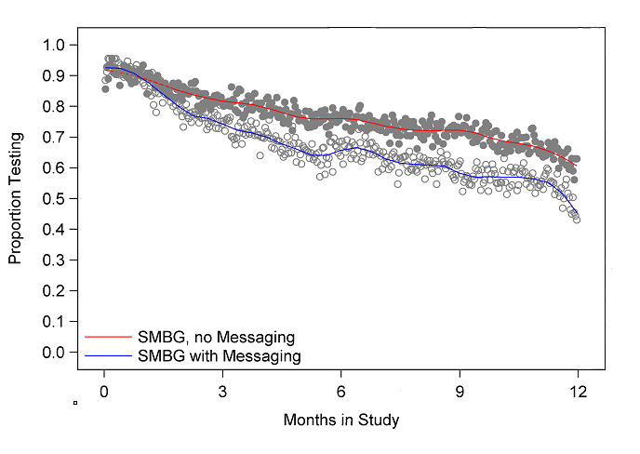
Glucose monitoring data:
Daily Proportions of Patients testing in the SMBG groups

Slide 20
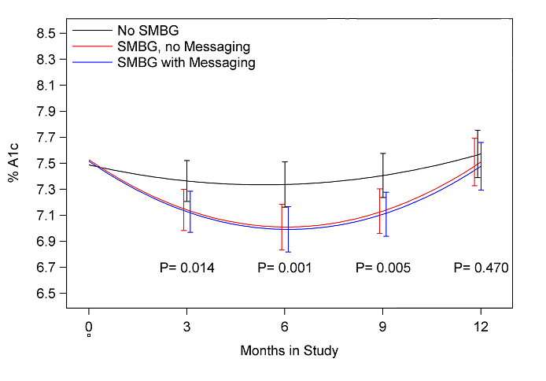
EHR data: Mean A1c levels by study arm over time

Slide 21
Adverse Events: NO study related events
1 severe hypoglycemia (secondary to urosepsis)
62 hospitalizations (no difference by arm)
2 deaths

Slide 22
Limitations
Test of continuing monitoring rather than initiating monitoring
Not all patients adhered to the group assigned; however no difference in ITT and per-protocol analyses
Patients belonged to one health care system
Findings do not apply to patients on insulin

Slide 23
Conclusions
Over the course of one year, there were no clinically or statistically significant differences in glycemic control or quality of life between patients with non insulin treated DM who perform SMBG compared to those who do not perform SMBG.
The addition of tailored feedback provided through messaging via a glucometer did not provide any advantage in glycemic control.

Slide 24
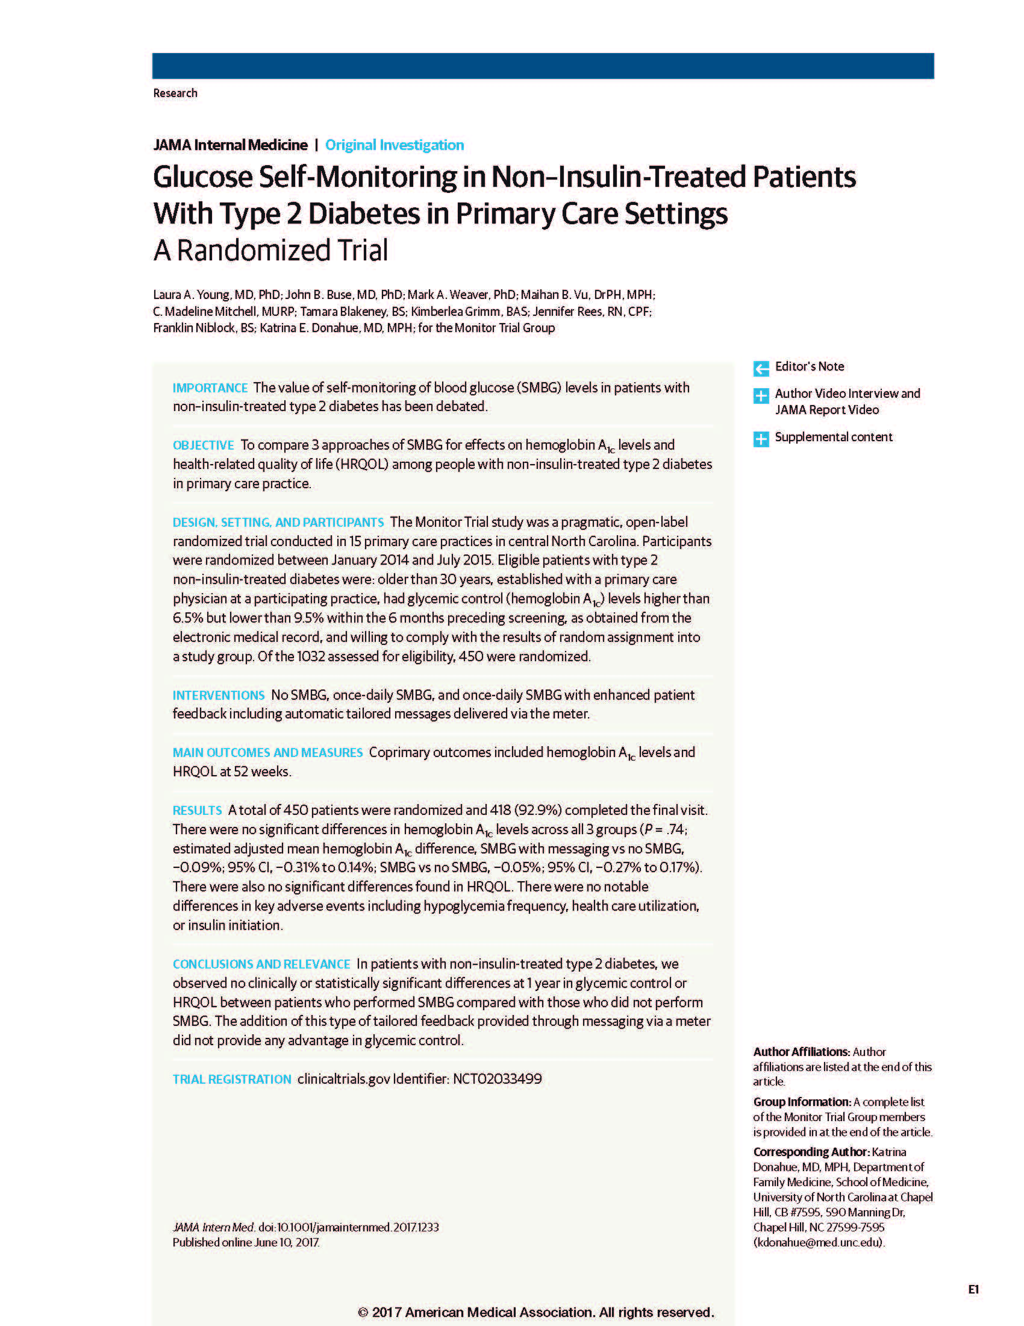
Young LA, Buse JB, Weaver MA, et al.
Glucose Self-Monitoring in Non-Insulin-Treated Patients With Type 2 Diabetes in Primary Care Settings: A Randomized Clinical Trial
Published online June 10, 2017

Slide 25
Thank You!

