Slide 1
Drivers of Health Care Costs
Susan Keen, MD
Marci Morgenlander, MD MPH
Deborah Porterfield, MD MPH

Slide 2
Welcome to POPTOPs
Population Health Topics brought to you by the UNC Preventive Medicine Residency
Bringing population health information to providers in our state
This project is made possible through an AHEC Innovations Grant

Slide 3
What is Preventive Medicine?
One of 24 recognized board specialties
Definition from ACGME:
the medical specialty which focuses on the promotion, protection, and maintenance of health and well-being and the prevention of disease, disability, and the premature death of individuals in defined populations
Quick definition: population health practice
2 main settings:
Governmental public health
Health care
Notes:
Specialties: Aerospace, Occupational Medicine, Public Health/Gen. Prev Med
Subspecialties: Addiction Medicine, Clinical Informatics, Medical Toxicology, Undersea/Hyperbaric Medicine

Slide 4
What is PM training?
2 years following one clinical year
MPH or equivalent degree
required rotations
individual patient care
governmental public health
clinical population health
electives
Additional requirements
teaching
research

Slide 5
Population health definition
Health outcomes of a group of individuals and the distribution of defined outcomes within the group.
(Kindig, 1988)

Slide 6
Why “Drivers of Health Care Costs” as a Population Health Topic?

Slide 7
Why should you as a provider care?
The American public and your patients are increasingly aware of the rising cost of health care.
Changes are occurring in the US and in NC that may:
affect the way you practice medicine;
affect your paycheck; or
affect the health outcomes of the patients you serve.
You have a role.
Notes:
Before we go further, let’s address a question that may have come to your mind: Why should I care?

Slide 8
Learning objectives
Understand the sources of the continued rise in health care costs in the US
Articulate top conditions and settings deserving of increased attention to control health care costs
Describe at least 2 interventions being implemented by health care systems and payers to decrease costs
Understand the role of the federal government in controlling health care costs
Understand your individual role as a provider in controlling health care costs

Slide 9
The continued rise in health care costs
In 2019, 4.6% rise in total health care costs
$3.8 trillion
$11.6k/person
17.7% of the GDP (similar to 2018)
(CMS, 2020)
Notes:
Notes: Spending grew by a greater percentage in 2019 compared to 2018 for hospital care (6.2 percent), physician and clinical services (4.6 percent), and retail purchases of prescription drugs (5.7 percent). However, these accelerations were offset by a 3.8-percent decline in expenditures for the net cost of health insurance, which were lower because of the suspension of the health insurance providers’ tax in 2019. The overall share of gross domestic product (GDP) related to health care spending was 17.7 percent in 2019, which is roughly the same as 2018’s share (17.6 percent).
The insured share of the population was 90.3 percent in 2019, down slightly from 90.6 percent in 2018.

Slide 10
How does the US compare to other nations?
Lt. Total
Dk. Public
Med. Private
(Papnicolas, 2018)
Notes:
Notes: The US was #1 in terms of total health spending (17.6 of GDP; range of other countries was 9.6-12.4) at about the mean of other countries public/government health spending (8.3%). #1 in mean spending on health 9403/capita. #2 is Sweden 6808. Interestingly, the utilization rates in the US were largely similar to those in other nations; prices of labor and goods and administrative costs appeared to be the major drivers of the difference in overall costs between the US and these other high-income countries.

Slide 11
Who is driving health care costs?
The top 1%:
21.9% of health care costs
Average $110k in 2016
The bottom 50%:
2.8% of health care expenditures
Average $276 in 2016
(Mitchell, 2016)

Slide 12
What conditions are driving health care costs?
(Dieleman, 2016)
Notes:
A study that estimated US spending on health care from 1996 to 2013 and disaggregated costs by 155 conditions found that among the 155 conditions, diabetes had the highest health care spending in 2013, with an estimated 101.4B in spending. Spending increased for 143 of the 155 conditions from 1996 through 2013, with spending on low back and neck pain and on diabetes increasing the most over the 18 years.

Slide 13
What services or settings?
(CMS, 2020)
Notes:
Health Spending by Type of Service

Slide 14
Understanding underlying trends
Outcome: annual change in spending (1996-2013)
Total and by top 6 disease types
By setting
“5 factor decomposition”: what is the role of
Population size
Population age
Disease prevalence/incidence
Service utilization
Service price and intensity
(Dieleman, 2017)

Slide 15
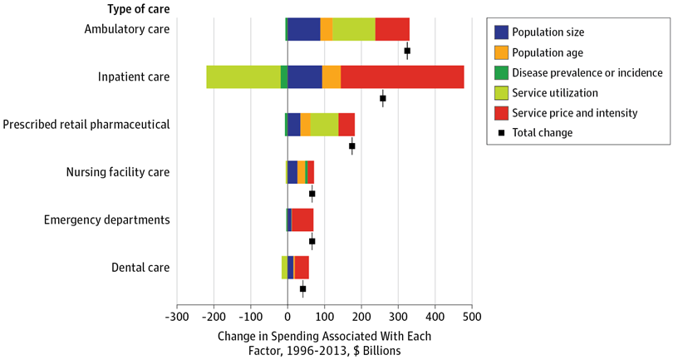
(Dieleman, 2017)
Notes:
The decomposition analyses associating each of those 5 factors with annual spending by type of care between 1996 and 2013
Each colored bar corresponds to 1 of 5 factors and reflects the amount of spending change associated with that factor. Bars to the left of the black vertical line (no change) indicate factors associated with decreased spending; to the right of the line, factors associated with increased spending within that type of care. The sum of the 5 bars equals the total spending change, 1996 through 2013, indicated with a black square marker.
For example, annual spending on inpatient care increased during this time period. Population size and population age structure were associated with increases in inpatient spending. Interestingly, service utilization and service price had oppositite relationships with inpatient spending, Service utilization in an inpatient setting has decreased between 1996 and 2013, meaning there were in general fewer inpatient bed-days per prevalent or incident case. This is observed for many health conditions, including cardiovascular conditions, labor and postpartum care, and low back and neck pain. This likely corresponds to encouragement from insurers and other groups to minimize the number of inpatient days associated with each admission.²⁷ However, concurrent with reductions in inpatient days, there have been increases in inpatient prices and intensity of services. This relationship is somewhat tautological, because for many cases the number of inpatient services may have been compressed into a smaller number of days, thus leading to more spending per day. For most health conditions, however, the increase in inpatient spending associated with increases in price and intensity was greater than the reduction in spending associated with reductions in inpatient utilization, yielding a net increase in inpatient spending.

Slide 16
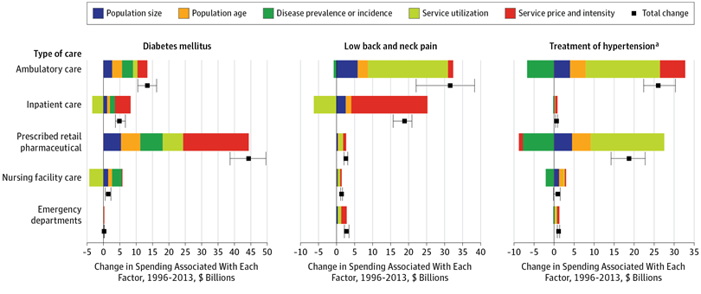
(Dieleman, 2017)
Notes:
Multiple interesting findings by disease type
For example, the increase in annual diabetes spending in this time period was $64.4B, $44.4B of which was from pharmaceutical spending. And within retail pharmaceuticals, all 5 factors were associated with spending growth: there were more people, the people were generally older, age-standardized diabetes prevalence increased, there were more retail pharmaceutical prescribed per prevalent case and the mean spending per pharmaceutical increased
The health condition with the second largest increase in annual spending was low back and neck pain. Within this condition, the largest increases in annual spending were for ambulatory care as well as inpatient care, and the main factor driving these were service utilization for ambulatory care and service price and intensity for the inpatient care

Slide 17
Bottom line:
Overall, service price and intensity had the strongest associations with increased spending (compared to population size, age, and disease prevalence) and accounted for more than 50% of spending increase
(Dieleman, 2017)
Notes:
Note: Found that service price and intensity alone accounted for more than 50% of the spending increase although the association of the 5 factors with spending varied by type of care and health condition
Understanding the factors associated with health care spending increases and their variability across conditions and types of care can inform policy efforts to contain health care spending

Slide 18
Triple/Quadruple Aim
Population Health
Experience of care
Per capita cost
(www.ihi.org)

Slide 19
Health insurance and health care system
Decrease utilization
Eliminate unnecessary care (e.g., “high utilizer interventions”)
Reduce cost of care
Bundled payments
Managed care organizations
Accountable care organizations

Slide 20
Federal policy to control health care costs
ACA
CMS Centers for Medicare and Medicaid Innovation
Payment and delivery models
Value based program
Decreasing drug prices
American Patients First
(https://www.hhs.gov/about/leadership/secretary/priorities/drug-prices/index.html)

Slide 21
Role of the individual physician
High value care
For example, the American College of Physicians “…provide the best possible care to their patients while simultaneously reducing unnecessary costs to the healthcare system”
Choosing Wisely Campaign
(https://www.acponline.org/clinical-information/high-value-care; www.choosingwisely.org)

Slide 22
Thank You!
University of North Carolina Preventive Medicine Residency Program
https://www.med.unc.edu/fammed/education/prevmed/

Slide 23
Resources
Centers for Medicare and Medicaid Services (CMS). 2020. National Health Expenditures 2019 Highlights. Available at https://www.cms.gov/files/document/highlights.pdf.
Papanicolas I, Woskie LR, Jha AK. 2018. Health Care Spending in the United States and Other High-Income Countries. JAMA. Mar 13;319(10):1024-1039.
Mitchell, E. Concentration of Health Expenditures and Selected Characteristics of High Spenders, U.S. Civilian Noninstitutionalized Population, 2016. Statistical Brief #521. February 2019. Agency for Healthcare Research and Quality, Rockville, MD. https://meps.ahrq.gov/data_files/publications/st521/stat521.shtml
Dieleman JL, Squires E, Bui AL, Campbell M, Chapin A, Hamavid H, Horst C, Li Z, Matyasz T, Reynolds A, Sadat N, Schneider MT, Murray CJL. 2017. Factors Associated With Increases in US Health Care Spending, 1996-2013. JAMA. Nov 7;318(17):1668-1678.
Centers for Medicare and Medicaid Services. 2016. National Health Expenditures Accounts: Methodology Paper, 2016. Available at: https://www.cms.gov/Research-Statistics-Data-and-Systems/Statistics-Trends-and-Reports/NationalHealthExpendData/Downloads/DSM-17.pdf.

Slide 24
US Spending on Personal Health Care and Public Health, 1996-2013.Dieleman JL, Baral R, Birger M, Bui AL, Bulchis A, Chapin A, Hamavid H, Horst C, Johnson EK, Joseph J, Lavado R, Lomsadze L, Reynolds A, Squires E, Campbell M, DeCenso B, Dicker D, Flaxman AD, Gabert R, Highfill T, Naghavi M, Nightingale N, Templin T, Tobias MI, Vos T, Murray CJ. JAMA. 2016 Dec 27;316(24):2627-2646.
American College of Physicians. 2019. Resources for Physicians. https://www.acponline.org/clinical-information/high-value-care/resources-for-clinicians.

Slide 25
Extra slides

Slide 26
(CMS, 2016)

