Slide 1

North Carolina Medicaid Transformation
Marci Morgenlander, MD MPH & Lee Miller, MD MBA
12/11/2020

Slide 2

Welcome to
POPTOPs
Population Health Topics brought to you by the UNC Preventive Medicine Residency
Bringing population health information to AHEC residents in our state

Slide 3
This project is made possible through an
AHEC Innovations Grant
Notes:
2 fold purpose 1. increase pop health knowledge
2. increase awareness of preventive medicine as a specialty and UNC program in particular

Slide 4
What is Preventive Medicine?
One of 24 recognized board specialties
Definition from ACGME:
  the medical specialty which focuses on the promotion, protection, and maintenance of health and well-being and the prevention of disease, disability, and the premature death of individuals in defined populations
Quick definition: population health practice.
2 main settings:
  Governmental public health
  Health care management
Notes:
Specialties: Aerospace, Occupational Medicine, Public Health/Gen. Prev Med
Subspecialties: Addiction Medicine, Clinical Informatics, Medical Toxicology, Undersea/Hyperbaric Medicine

Slide 5
What is PM training?
2 years following one clinical year
  MPH or equivalent degree
  Required rotations (ACGME)
    4m total in individual patient care
    2m in governmental public health
40+ competencies; 20+ milestones
At UNC, additional requirements
  teaching
  research
  additional rotations specific to grant funding
  electives

Slide 6
Residency Mission
increase the number of appropriately trained, board-certified preventive medicine physicians (total and underrepresented minority) in practice in North Carolina and the nation;
increase access to quality primary care and population health practice in North Carolina and the nation; and
improve the quality of the preventive medicine workforce by ensuring competency-based evaluations of residents and annual data-driven program improvement

Slide 7
Definitions
Population health
  health outcomes of a group of individuals and the distribution of defined outcomes within the group (Donabedian, 1988)
Population health improvement/management
collective systems and policies that affect health care quality, access, and outcomes for a defined population (Meiris, 2008)
Population medicine
design, delivery, coordination, and payment of high-quality health care services to manage the Triple Aim for a population, using the resources available within a health care system (Lewis, 2014)
Notes:
Cost, quality, patient experience
Quadruple aim includes physician wellness

Slide 8
Why Medicaid as a Population Health Topic?
Notes:
Brief interactive discussion of what is population health and why we chose this topic.
Population Health Milestones in Graduate Medical Education (Duke, UNC, ECU, AAMC – CDC funded project on pop health in GME) was basis for our survey
21/25 AHEC Residency Program Directors Responded , etc.

Slide 9
NC Medicaid Agenda
Pertinence to Primary Care Residents
Medicaid & Medicare History
Medicaid in NC
  Current state
  Transformation
Take Home Points

Slide 10
Why should you as a resident care about Medicaid
1 in 5 Americans are covered by Medicaid
  Medicaid recipients and the uninsured include our most vulnerable populations
Changes are occurring in the US and in NC. These changes will:
  affect the way you practice medicine.
  affect your paycheck.
  affect the health outcomes of the patients you serve.
Notes:
Before we go further, let’s address a question that may have come to your mind: Why should I care?
About 73 million of 326 million Americans are covered by Medicaid (about 22 %); In NC 18% in 2017 (kff.org)
Medicaid doll 17% health care costs, third largest payer after private insurance and Medicare thus hugely affects delivery of healthcare. Also important in NC due to reform happening right now! (https://www.statista.com/statistics/245347/total-medicaid-enrollment-since-1966/)

Slide 11
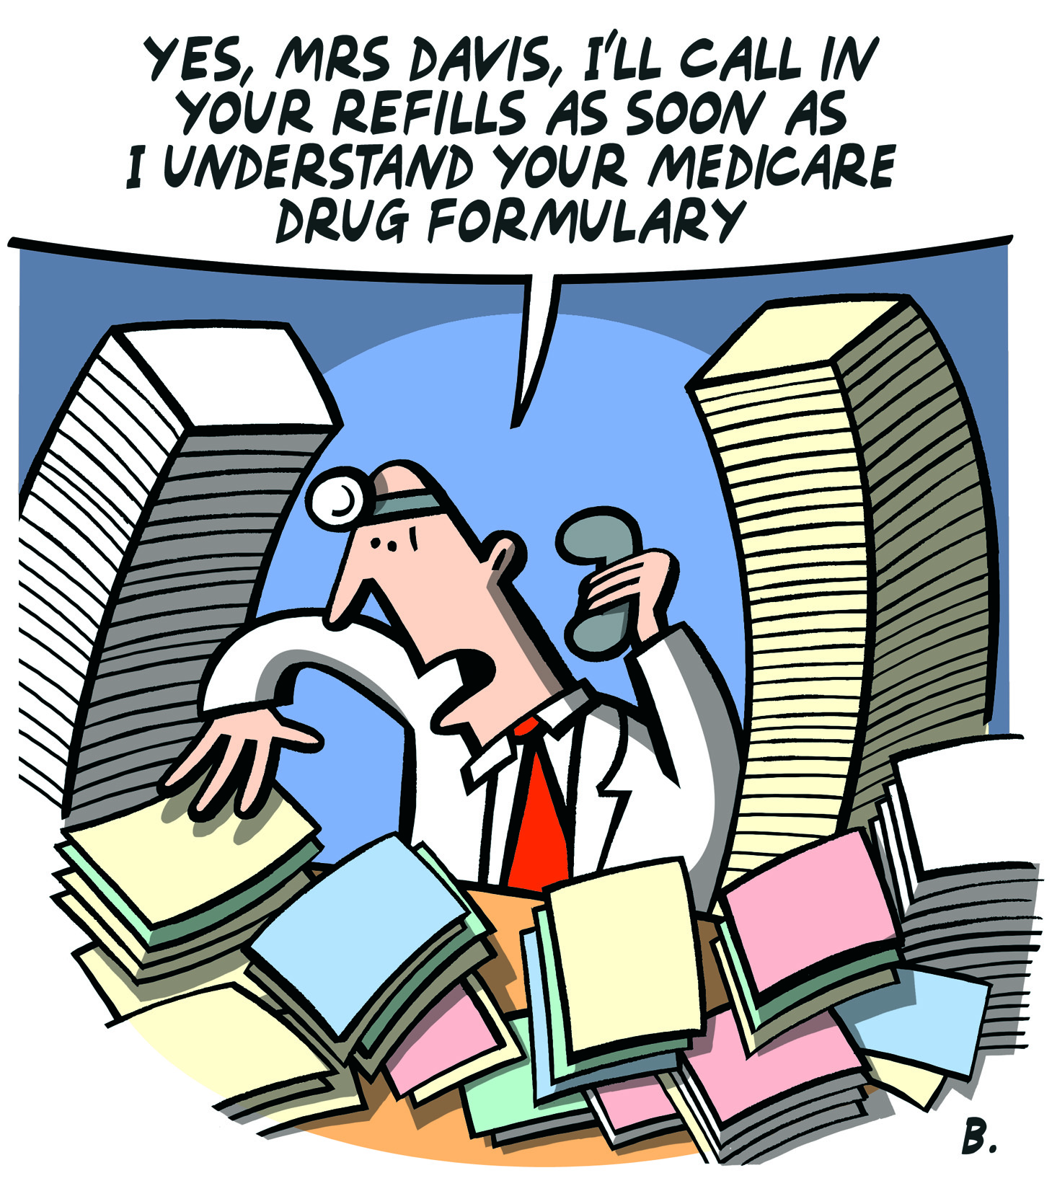
Notes:
It is likely that if you practice primary care in NC, you will be taking care of patients covered by Medicaid. Thus, as Medicaid goes, so goes your practice. This is actually a Medicare slide and we’ll talk about the difference, but the point remains that the demands of insurers to some extent determine what our days look like.
Ask what they are experiencing right now in regard to Medicaid, or insurance coverage of their patients.

Slide 12
History of Medicaid and Medicare
Social Security Amendments of 1965
Title XIX of the Social Security Act
Established along with Medicare as an entitlement program
  Medicare contributory, Medicaid non-contributory
(https://www.kff.org/medicaid/report/medicaid-at-50/)
Notes:
July 30, 1965, LBJ signed the SS Amendments of 1965 into law.

Slide 13
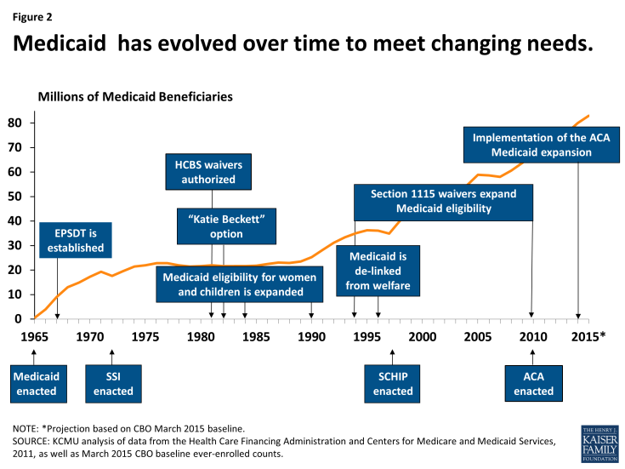
50+ Years of Medicaid
https://www.kff.org/report-section/medicaid-at-50-low-income-pregnant-women-children-and-families-and-childless-adults/
Notes:
EPSDT Early and Periodic Screening Detection and Treatment Program; HCBS Home and Community Based Services ; Katie Beckett or TEFRA Tax Equity and Fiscal Responsibility Act home care for kids 0-18 with complex care/long term disability; TANF Temporary Assistance for Needy Families decouples Medicaid from welfare ; SCHIP State Children’s Health Insurance Program Balanced Budget Act of 1997 block grant covers children with family income <200% poverty level; ACA , Patient Protection and Affordable Care Act 2010 Medicaid expansion to low income adults up to 138% FPL ($34,638 family of 4 2019; 100% $25,100)

Slide 14
Contrasting Medicaid and Medicare
Medicaid
Low-income
Jointly funded state & federal
State run
Little to no cost sharing
Medicare
Elderly
Federally funded and run
Cost sharing
Entitlements
Care & Meds
Dual-Eligible
Notes:
Lest you think that healthcare reform is “new” Medicare came into being after more than half a century of debate over a national healthcare system, opposed by the AMA and a conservative Congress. One strategy employed by opponents was the label “socialized” medicine which raised associations with socialism in the era of the cold war. In the 50s, focus shifted to the elderly- high needs; had paid in to SS. LBJ landslide elected – democratic congress – Wilbur Mills added Medicaid (attempt to cover another population that might be targeted in a “national “ healthcare plan – those who live in poverty. Review the differences (Medicare – universal, federal Medicaid entitlement, federal and state partnership) Now that we are clear on difference, we’ll move on to Medicaid. (another fun fact, Medicaid contributes over $2billion annually to GME, Medicare 9.5 billion – another reason for residents to care about it!)

Slide 15
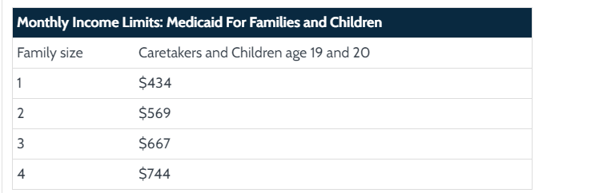
Medicaid in NC- Who is Eligible?

Slide 16
A Note on Medicaid Expansion

Slide 17
Medicaid: The Move to Transform
Medicaid Managed Care
Establishment of CMMI
  Social Security Act section 1115A Innovation Models
  Quality Payment Program
Notes:
While intending to serve those most in need, Medicaid had ballooned large, unwieldy, expensive. AND technological advances allowed different (better?) ability to track data. The notion of MMC introduced in 1970s some early demonstration projects showed flaws of low rates (and thus nonparticipation), fraud, poor access, poor quality; ACA established CMMI to examine payment and service delivery models; another function was to implement the Quality Payment Program authorized under MACRA (Medicare Access and CHIP Reauthorization Act of 2015) to provide physician incentives for quality care delivered to their populations
This represents a shifting focus to population health

Slide 18
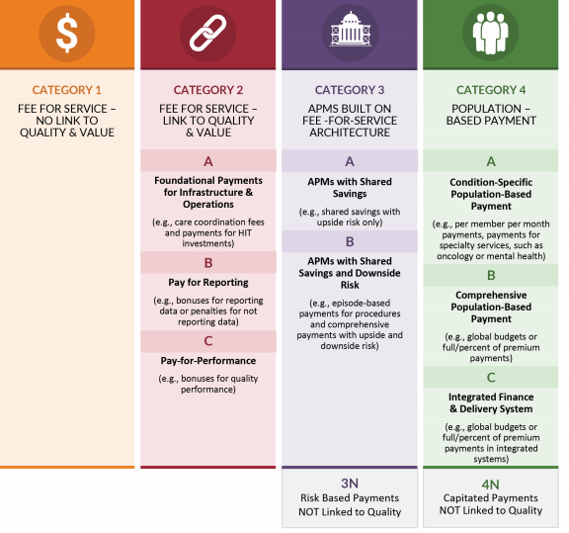
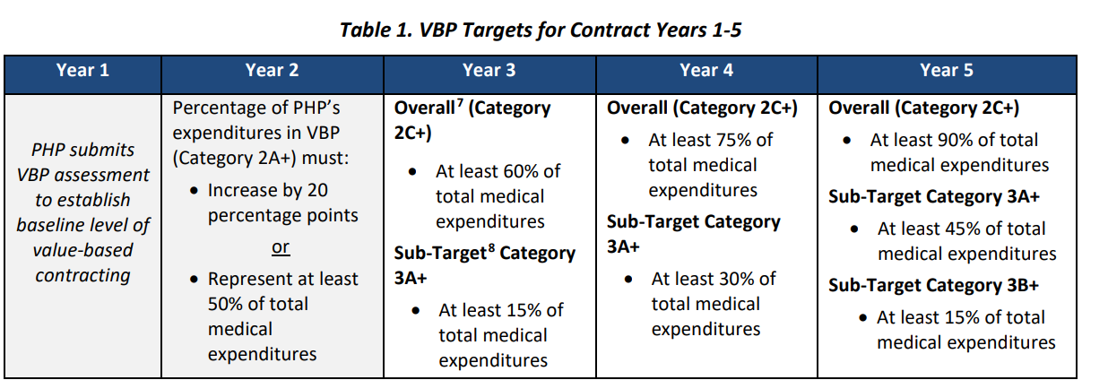
VOLUME
VALUE

Slide 19
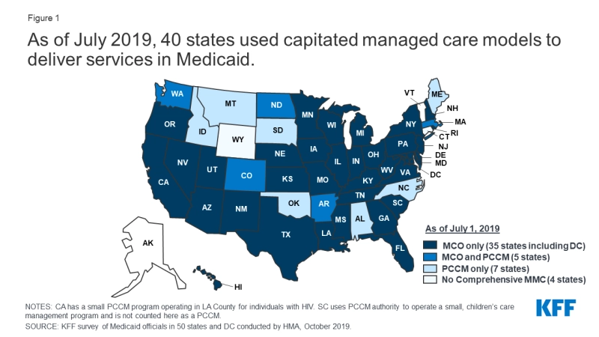
Managed Care in the US

Slide 20
NC Medicaid Current State
As of 11/2018
  2 million North Carolinians covered by Medicaid (1 in 5)
  Additional 103,000 covered by NC CHIP named Health Choice
  $12.382 B Annual Spend
    FMAP 67.12%
  Operates as fee for service with state as payer
    Care coordination through CCNC for physical health
    “Carve Outs” for mental health, SUD, IDD paid through Local Management Entities
    PACE
Notes:
Across the country Medicaid payments and service delivery vary greatly because of the flexibility of the state/federal partnership. Let’s move from the backdrop of the national landscape into our own state
Federal Medical Assistance Percentage (FMAP) – federal govt portion of state’s Medicaid expenses

Slide 21
NC Medicaid –Transformation Background
NC General Assembly instructed NC DHHS to change NC’s current FFS structure to one that relies on managed care organizations (called Prepaid Health Plans or PHPs) to deliver care (Session Law 2015-245)
DHHS submitted 1115 waiver to CMS in 2016, amended waiver in Nov. 2017.
  Waiver approved October 19, 2018.
Notes:
Explain “waiver” to the residents

Slide 22
NC Medicaid
Legislation requires NC DHHS to contract with four statewide PHPs and up to 12 regional PLEs to cover 6 regions. PHPs could be either:
Commercial plans (eg commercial HMOs), or Provider Led Entities (PLEs)* that are controlled by North Carolina providers for standard plans
LME/MCOs are authorized to serve as the PHP for the tailored plans
* PLEs are similar in concept to ACOs. For PLEs a majority of voting members of the governing body must be NC physicians, PAs, NPs, or psychologists, at least 25% whom must have received Medicaid reimbursement sometime in last 24 months.
Notes:
Prepaid health plan: Standard covers physical, behavioral pharmacy services
Tailored includes IDDs/foster care
We’ll come back to standard plans/tailored plans in a moment

Slide 23
NC Medicaid
NC DHHS issued RFP for PHPs 8/9/2018 ; began accepting proposals 10/12/2018
Eight organizations submitted plans:
  Aetna
  AmeriHealth Caritas North Carolina
  BCBSNC Healthy Blue
  Carolina Complete Health (partnership between Centene and NC Medical Society, NC Community Health Center Assoc)
  My Health by Health Providers (partnership of 12 NC hospital/health systems)
  Optima Health, part of Sentara
  United Health Care
  WellCareHealth Plans
Notes:
Cone part of My Health

Slide 24
NC Medicaid- And the Winners Are…
Announced 2/4/2019
  4 statewide PHPs
    AmeriHealth Caritas North Carolina, Inc.
    Blue Cross Blue Shield of North Carolina, Inc.
    United Healthcare of North Carolina, Inc.
    WellCare of NC, Inc.
  1 Regional PLE
    Carolina Complete Health (Regions 3 & 5)

Slide 25
NC Medicaid Regions
Notes:
Cone is in Region 2 – Guilford County (phase 1 rollout)

Slide 26
NC Medicaid Transformation Vision
“To improve the health of North Carolinians
through an innovative, whole-person centered,
and well-coordinated system of care
that addresses both medical and
non-medical drivers of health.”
- Mandy Cohen, MD MPH
NCDHHS Secretary

Slide 27
NC Medicaid Waiver Highlights
2 phase implementation of managed care standard plans in November 2019/Feb. 2020
Incorporation of delivery system innovations
  Behavioral Health Integration, Tailored Plans, Specialized Health Homes
  Opioid Strategy (including outpatient coverage and increased access to inpatient/residential treatment)
  Healthy Opportunities Pilots (2-4 regions will work on most cost effective ways to deliver care with focus on SDH of housing, food insecurity, transportation, employment, interpersonal safety)

Slide 28
NC Medicaid Waiver Highlights
Evaluation
  3rd party evaluation of health outcome metrics at midpoint and endpoint of 5 year demonstration period
Budget Neutrality
First set of activities finalized with continuing negotiation on pending issues
  Uncompensated care pool for Tribal providers
  Innovation Workforce Fund
  Behavioral Health Home Capacity Building Funds
Notes:
Members of Native American tribes are exempt from individual mandate, thus provided care is “uncompensated”- waiver requests monies to compensate care providers
Loan Repayment for those filling Medicaid care gaps
Funds for health home care management for IDD/significant behavioral health needs

Slide 29
Beneficiaries
Summer 2019
  Eligible beneficiaries will receive welcome packets with information on enrollment/choosing PHPs
July-September 2019
  Beneficiaries in regions 2 and 4 scheduled for Phase 1 (to begin November 2019) will choose PHPs
September 2019
  Beneficiaries who did not choose a PHP will have one auto-assigned based on a DHHS algorithm
  Beneficiaries may change provider for no cause within 90 days and twice a year with cause
Notes:
What will this look like to the beneficiaries? Best case scenario, everyone keeps same provider and has same or better coverage. Worst case scenario, many with unstable housing, low health literacy or other barriers don’t enroll and are auto enrolled in a PHP to which their usual provider is not contracted.

Slide 30
Beneficiaries
All services covered under FFS Medicaid will be covered under managed care, thus coverage should be equal or expanded.

Slide 31
Providers
Previously Medicaid/Healthchoice providers enrolled in NC Tracks, submitted claims and were paid directly by the department
Providers will still enroll in NC Tracks but will contract with PHPs (beginning June 2019), submit claims, and receive payments through them
State role will be credentialing providers and overseeing PHP quality and timely payments
Notes:
What will this look like from provider perspective?
Providers will enroll in NC Tracks and contract with PHPs as they now contract with commercial health insurance plans.
When deciding which PHPs to contract with, practices should pay attention to the rate floor and know the provisions for incentive payments if they choose to meet the criteria to participate as an AMH

Slide 32
Providers
PHPs will continue to reach out to practices to ensure required network adequacy
PHPs may not exclude provider from network unless provider is not credentialed, fails to meet requirements or refuses the PHP network rates
DHHS mandates rate floor will be 100% current FFS payments; PHP/provider may negotiate different rates

Slide 33
Providers
Efforts to reduce administrative burden
  Centralized, uniform credentialing with single electronic application
  State approved contracts and standard language for PHP/provider negotiations
  Single formulary across PHPs

Slide 34
Providers
Retained focus on care management with PHPs and AMH sharing responsibility
DHHS will provide ongoing education and training for Medicaid providers

Slide 35
Take Home Points
Medicaid is an entitlement program administered as a state/federal partnership to cover long term care and medical expenses for the aged, blind, disabled, pregnant women, elderly, parents and children who meet income eligibility criteria
North Carolina Medicaid Transformation will change the reimbursement model from FFS to value based payment with a focus on population health
Newly trained primary care physicians should be aware that they are entering practices with changing reimbursement and delivery models

Slide 36
Resources
https://www.ncdhhs.gov/assistance/medicaid-transformation/proposed-program-design
https://www.kff.org/medicaid/report/medicaid-at-50/
http://www.ncmedsoc.org/nc-dhhs-sec-mandy-cohen-explains-medicaid-transformation-waiver/
http://www.shepscenter.unc.edu/download/17761/

Slide 37
Acknowledgements
Special thanks to :
Pam Silberman, JD DrPH
Professor and the director of the Executive Doctoral Program in Health Leadership in the Department of Health Policy and Management in Gillings School of Global Public Health
Roxane Townsend, MD
Managing Principal, Health Management Associates

Slide 38
Thank You!
University of North Carolina Preventive Medicine Residency Program
https://www.med.unc.edu/fammed/education/prevmed/

