Slide 1
End User Training
StrataJazz® Operating Budgeting 2019.1
January 2018

Slide 2
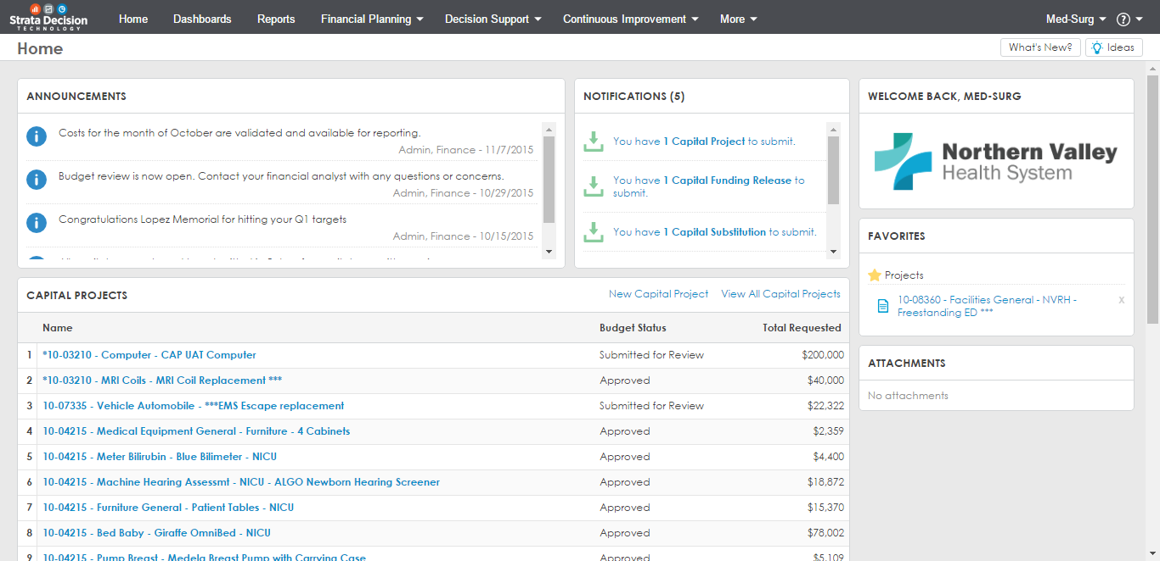
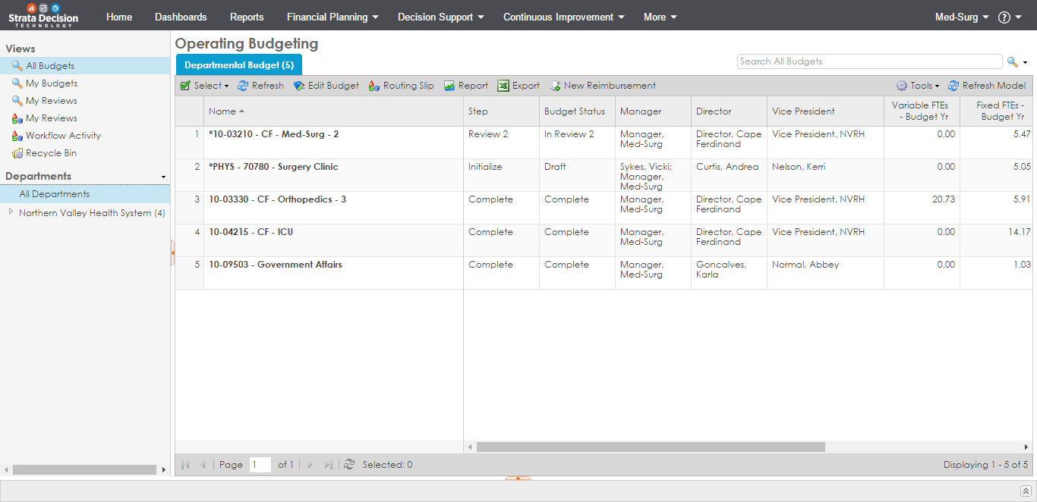
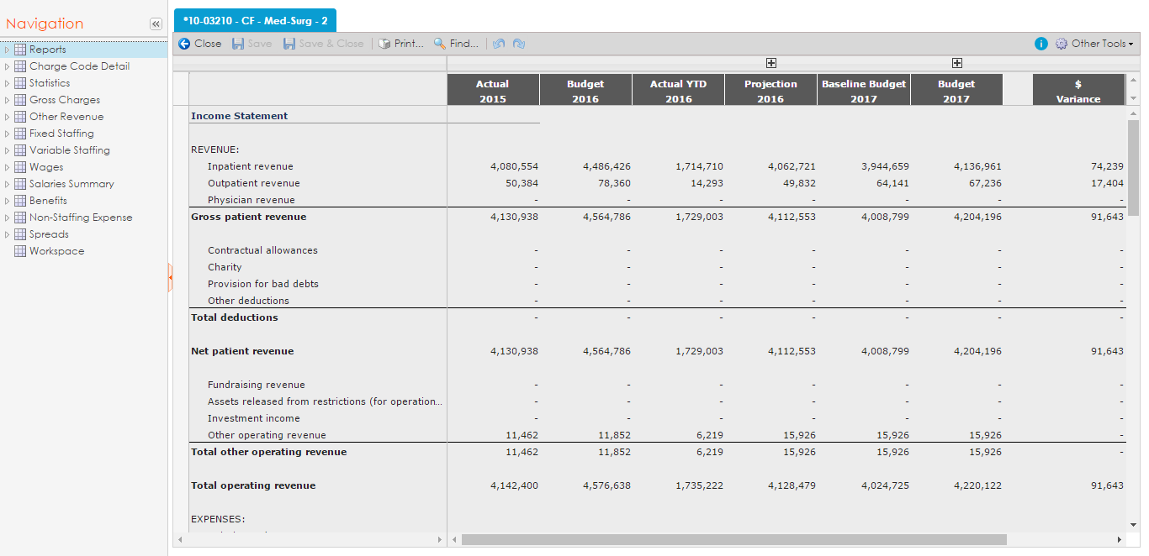
Agenda
Getting Started
Your Budgeting Process
Logging into StrataJazz
Demo & then practice
Completing Department Budget
Completing Revenue by Department/Fund
Completing Expenses by Department/Fund
Submitting Your Budget for Review
Use Additional Budget Tools
Running Reports
Budget Workflow

Slide 3
Creating Budgets in StrataJazz® Operating Budgeting
Current Fiscal Year
Upcoming Fiscal Year
Goal: Develop next year’s budget
Actuals
Projection
Need to understand current year performance to accurately develop next year’s budget
1 | 2 | 3 | 4 | 5 | 6 | 7 | 8 | 9 | 10 | 11 | 12
1 | 2 | 3 | 4 | 5 | 6 | 7 | 8 | 9 | 10 | 11 | 12
$$$
???
Projected performance for this year often impacts the baseline budget for next year
Budget
The most accurate way to determine how we will finish out this year is to use actual data to project out the remainder.
1 | 2 | 3 | 4 | 5 | 6 | 7 | 8 | 9 | 10 | 11 | 12

Slide 4
SOM Clinical Department Timeline
Dec 13 – Jan 11
Departments to complete Faculty Roster Budgets (FRB)
Jan 17-23
Strata training for SOM Clinical Departments
Jan 25
Strata go-live date for SOM Clinical Departments
Feb 22
ALL funds budgets due
Feb 13-15
FRB opens back up for additional department input
Mar 11-22
Clinical department ALL funds budget meetings
DUE BY NOON ON FRIDAY, FEB 15
DUE BY COB ON FRIDAY, JAN 11
System is live, but input should not start until 25th (updates are still being made)

Slide 5
Your SOM & UNCFP Contacts
Department | UNCFP Contact | SOM Contact
Allied Health | Oliver Noi | Kristen Beattie
Anesthesiology | Jon Angier | Holly Rudicil
CIDD | Oliver Noi | Kristen Beattie
Dermatology | Brittney Kass | Patsy Oliver
Emergency Medicine | Oliver Noi | Kristen Beattie
ENT | Sara Beland | Kristen Beattie
Family Medicine | Brittney Kass | Patsy Oliver
Medicine | Jon Angier | Holly Rudicil
Neurology | Oliver Noi | Kristen Beattie
Neurosurgery | Sara Beland | Kristen Beattie
OBGYN | Spencer Brady | Jennifer Blair
Ophthalmology | Jon Angier | Holly Rudicil
Orthopaedics | Sara Beland | Kristen Beattie
Pathology | Brittney Kass | Patsy Oliver
Pediatrics | Spencer Brady | Jennifer Blair
PM&R | Brittney Kass | Patsy Oliver
Psychiatry | Oliver Noi | Kristen Beattie
Radiation Oncology | Spencer Brady | Jennifer Blair
Radiology | Spencer Brady | Jennifer Blair
Surgery | Jon Angier | Holly Rudicil
TEACCH | Oliver Noi | Kristen Beattie
Urology | Sara Beland | Kristen Beattie
Contact your analyst for:
Additional access if necessary
Department specific questions
Weekly Meetings
An opportunity for departments to ask questions/get clarification

Slide 6
The Funds in Strata, and Where the Historic Data Comes From
PS Fund | Strata "Entity" | Revenue | Expense | SOM Dashboard Data Fund Description
285 | UNCFP | GL | GL | FP
201 | SOM - State AA | GL + Expense Budget | GL | State
211 | SOM - State HA | GL + Expense Budget | GL | State
221 | SOM - State AHEC | GL + Expense Budget | GL | State
241 | SOM - Residuals | GL | GL | Gifts, Endowment Inc and Other
252 | SOM - Contracts and Grants | GL | GL | Contracts and Grants
271 | SOM - Overhead | GL + Expense Budget | GL | Overhead
281 | SOM - Endowment Inc Unrestr | GL | GL | Gifts, Endowment Inc and Other
282 | SOM - Endowment Inc Restr | GL | GL | Gifts, Endowment Inc and Other
291 | SOM - Gifts-Endowment Inc and Other Unrestr | GL | GL | Gifts, Endowment Inc and Other
292 | SOM - Gifts-Endowment Inc and Other Restr | GL | GL | Contract Trust or Gifts, Endow Inc and Other
295 | SOM - Auxiliary-Recharge-Core Facilities | GL | GL | Auxiliary/Recharge-Core Facilities
Notes:
Entity equals department + fund type.

Slide 7
Logging, Reviewing the Home Page, and Accessing Your Department Budgets

Slide 8
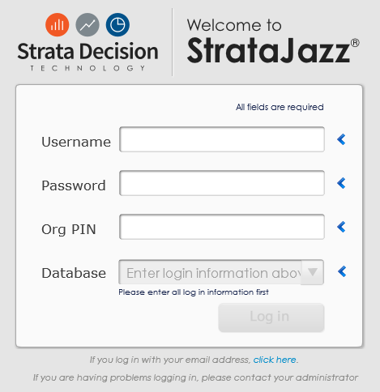
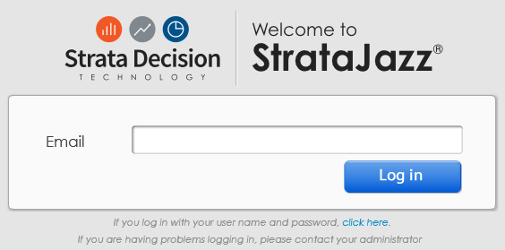
Logging In
Open Internet Explorer.
Type “secure.stratanetwork.com” into the address bar.
Under the credentials tile, click the small link that says “click here”. You will be redirected to a login screen that requires only your email address.
Enter your primary email address.
Press Tab.
If you are redirected to a login screen for your organization, fill in your credentials as instructed.
Bookmark this page to your browser.

Slide 9
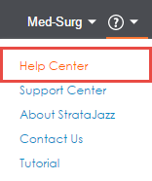
Additional Resources

Slide 10
Accessing & Navigating on the OB Home Page
Once logged into Strata, navigate to Financial Planning > Operating Budgeting
Begin to enter the department ID you want to review. Click the magnifying glass to search on what you’ve entered or hit enter on your keyboard.
Click on the entity you want to edit so that it is highlighted blue. Then click the “Edit Budget” tab. Alternately, double click the entity you want to edit, and from the new window that appears, click “Edit Budget”.

Slide 11
Reviewing the UNCFP and SOM Income Statement Reports

Slide 12
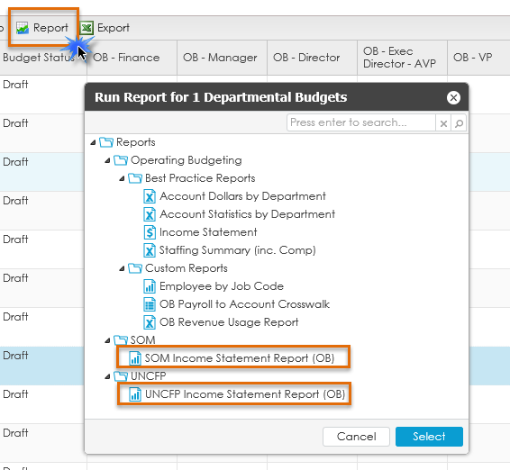
UNCFP & SOM Income Statement Overview
There are two Income Statement reports. Data in these reports will be updated once edits are made to your budget.
SOM Income Statement: mirrors the account rollup in our SAS “SOM Budget vs Actuals Report”
FP Income Statement: mirrors the account rollup in our SAS “UNCFP Budget vs. Actuals Income Statement”
From the OB home page, click the “Report” tab. A new window will appear. Select either the “UNCFP Income Statement” or “SOM Income Statement” depending on the entity you are viewing.

Slide 13
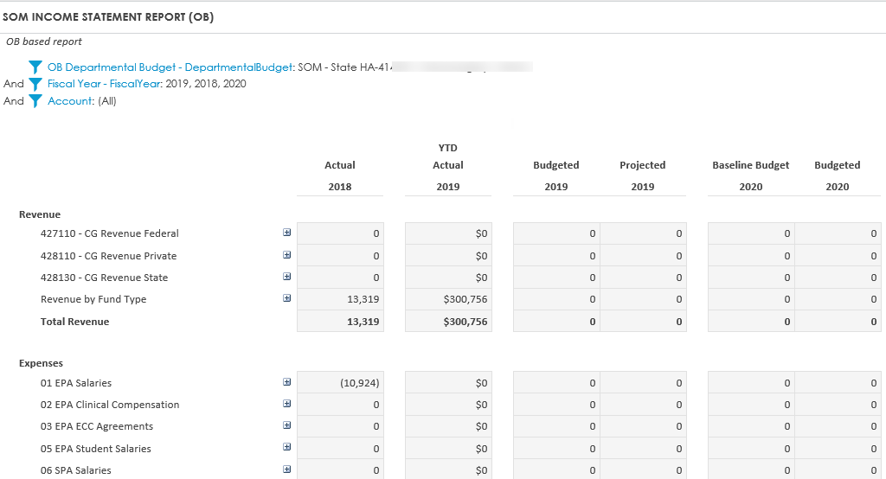
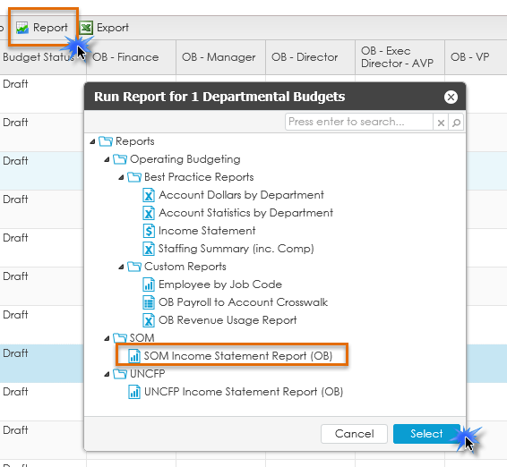
UNCFP & SOM Income Statement Overview, cont.
Select the SOM or UNCFP Income Statement reports depending on the entity originally selected to review. For example, I selected to view the SOM-State HA entity, so the report selection I made was for the SOM Income Statement.

Slide 14
Navigating within Operating Budgeting for a Given Entity

Slide 15
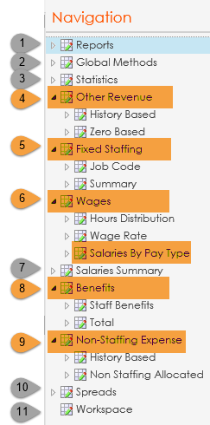
Tab Overview – UNCFP & SOM entities (your department ID)
Shows the Income Statement and other reports used by the HCS
Shows the projection methods applied to the different sections within the workbooks
Forecast volumes which drives revenue and expense
Where you will enter your revenue/budget for a given entity
Where adjustments can be made to FTE for employees you fund from a given entity
I.E. if Research Assistant Randy is moving from .5 to .75 FTE, input this adjustment here
Where adjustments can be made to the overall wage for a given employee group. We are using the “Salaries by Pay Type” sub-tab
I.E. if Admin Ann is getting a $5,000 increase on a given entity, input the amount here
Shows a consolidated total salary expense in multiple ways
Where adjustments to benefits can be made
Where adjustments can be made to non-personnel line items
Lays out the different spread options used in the budget
To be used as a “scratch pad” if needed or wanted
ADMIN/REVIEW ONLY INPUT IS REQUIRED BY DEPARTMENT

Slide 16
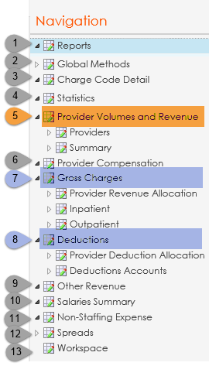
Tab Overview – UNCFP Revenue (4106XX, EPIC clinical revenue)
Shows the Income Statement and other reports used by the HCS
Shows the projection methods applied to the different sections within the workbooks
Shows the historical, projected, and budgeted charge units, rate, and dollars
Forecast volumes which drives revenue and expense
Where revenue by bill area by Provider will be entered (wRVUs/ASA)
Not applicable
Calculates revenue by patient class, separated into GL accounts, based on the patient class statistic volumes and the dollars per unit
Forecasts the total deductions that the model applies to the gross charges total
Not applicable
Not applicable
Not applicable
Lays out the different spread options used in the budget
To be used as a “scratch pad” if needed or wanted
NOT USED IN 4106XX IDs REVIEWED BUT NOT USED INPUT IS REQUIRED BY DEPARTMENT

Slide 17
UNCFP Revenue Department ID Logic Example
Dept | Current GL Dept Mapping for EPIC Revenue | Old GL Dept Mapping for EPIC Rev (Bill Area) | STRATA Department
4136XX | 410636 | 413602 | 41063602
 |  | 413603 | 41063603
 |  | 413604 | 41063604
 |  | 413605 | 41063605A
 |  |  | 41063605B
 |  | 413606 | 41063606
 |  | 413607 | 41063607A
 |  |  | 41063607B
 |  | 413608 | 41063608A
 |  |  | 41063608B
 |  |  | 41063608C
 |  | 413609 | 41063609
 |  | 413613 | 41063613
 |  | 413621 | 41063621A
 |  |  | 41063621B
 |  | 413623 | 41063623
 |  | 415016 | 41065036
"A" and "B" are used to further break out departments where Provider count is > 100
Break out is based on the Provider’s last name

Slide 18
Budget Year Structure
Expand to see monthly detail for Projection and Budget
Last Year Historicals
This Year Budget
(where possible)
This Year Historicals
(thru Dec. 2018)
YTD Historicals + Projection for Remaining Months
Next Year Budget Before Adjustments
Next Year Budget After Adjustments
Notes:
Focus on the “Budget 2020” column for your bottom line, as some items are not populated in the Baseline Budget 2020 (I.E. Roster Budget)

Slide 19
Global Methods
Universal
Staffing: Annualized
UNCFP Entities
Provider Volume
SOM Entities
Other Revenue: Rolling 12
Increase Assumptions: - 1% University employees (beginning July 2019) **** DOES NOT apply to Faculty - 2% for HCS employees (beginning January 2020)
Non-Staffing: Even
Other Revenue: Even
FY19 Projection: Rolling 12
FY20 Budget: Based on average of FY17 and FY18 Practice Plan charge spread
Benefits: Rolling 12
Notes:
Strata is loading in new living wage rate for the HCS employees (as of January 31st) soon.

Slide 20
Revenue Provider Volumes & Revenue

Slide 21
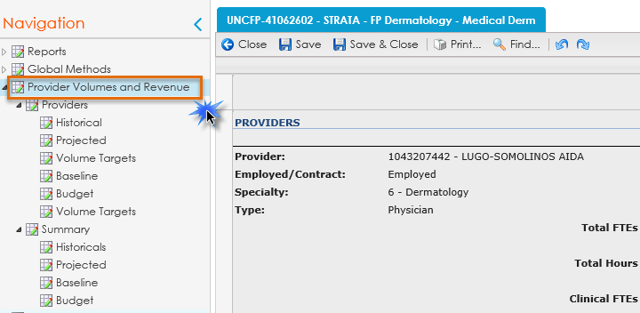
Provider Volumes & Revenue
UNCFP Revenue is housed in the 4106XX departments/bill area. When searching for your revenue department you will see a list. The difference is detailed below.
Entities with “STRATA” in the title are where your Provider volumes will need to be input
Entities without “STRATA” in the title DO NOT have Providers listed
If entering Provider Volumes, select the appropriate department with “STRATA” in the title, and navigate to the “Provider Volumes and Revenue” section.
** Please note, if you have more than 60 Providers within one department/bill area the workbook will open in Excel vs. in the Strata system.
Notes:
More than 60 Providers in a bill area:
Anesthesiology
Emergency Medicine
Medicine
Pediatrics

Slide 22
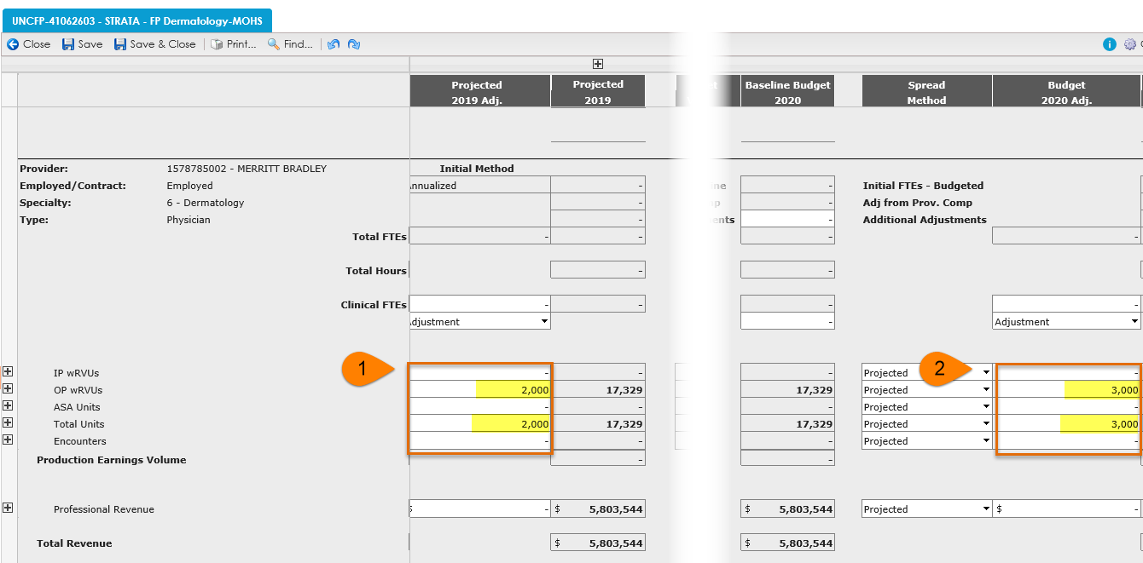
Provider Volumes & Revenue, cont.
Input the anticipated wRVUs in the “Projected 2019 Adj” column. Total Units does not automatically populate when OP/IP wRVUs are input. The amounts entered in the “Projected 2019 Adj” will populate the “Budget 2020” column.
If further updates need to be made to the “Budget 2020” column make these adjustments in the “Budget 2020 Adj.” column.

Slide 23
Gross Charges & Deductions
Gross Charges
Based on department historical account posting
Deductions
Based on department historical account posting
Using FY19 closed collection rate

Slide 24
Other Revenue UNCFP & SOM Entities

Slide 25
Other Revenue: UNCFP
Examples of what is considered Other Revenue in UNCFP entities
Contracts
Expert Witness
CIC Funding
Transfers (48xxxx)

Slide 26
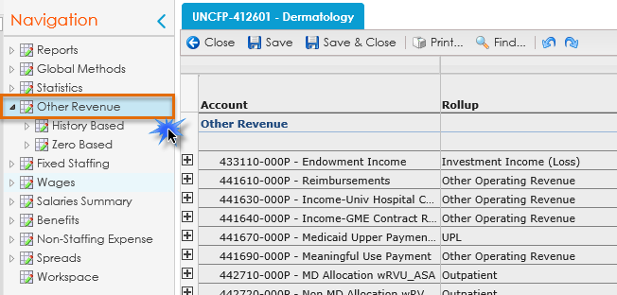
Other Revenue: UNCFP, cont.
UNCFP Other Revenue is housed in your department IDs (i.e. 4126XX for Dermatology).
If budgeting Other Revenue, select the appropriate entity, and navigate to the “Other Revenue” section within this entity.

Slide 27
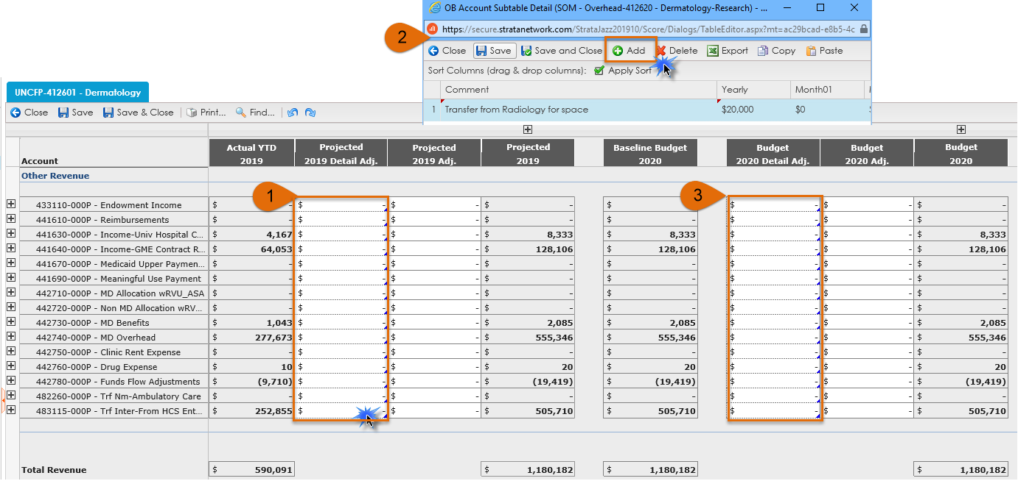
Other Revenue: UNCFP, cont.
To enter an amount, double click within the “Projected 2019 Detail Adj” cell. This will open another window where you will enter the revenue amount. Comments are required for this.
Click the “Add” button. This will populate a line where you can enter amounts and comments. Click “Save and Close”.
If further updates need to be made to the “Budget 2020” column make these adjustments in the “Budget 2020 Detail Adj.” column.

Slide 28
Other Revenue: SOM
All revenue for SOM funds will be budgeted in the “Other Revenue” section within your department ID’s. Budgeting for this will be very similar to the process for “UNCFP Other Revenue”.
This applies to the following funds types:
State
Overhead
Contracts & Grants
Residuals
Endowment Income Unrestricted
Endowment Income Restricted
Auxiliary-Recharge-Core Facilities
Gifts-Endowment Inc and Other Unrestricted
Gifts-Endowment Inc and Other Restricted

Slide 29
Fixed Staffing, Wages, Benefits, and Non-Staffing

Slide 30
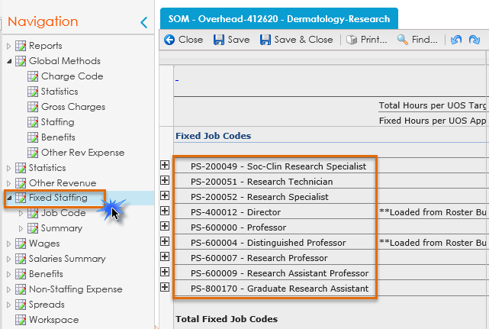
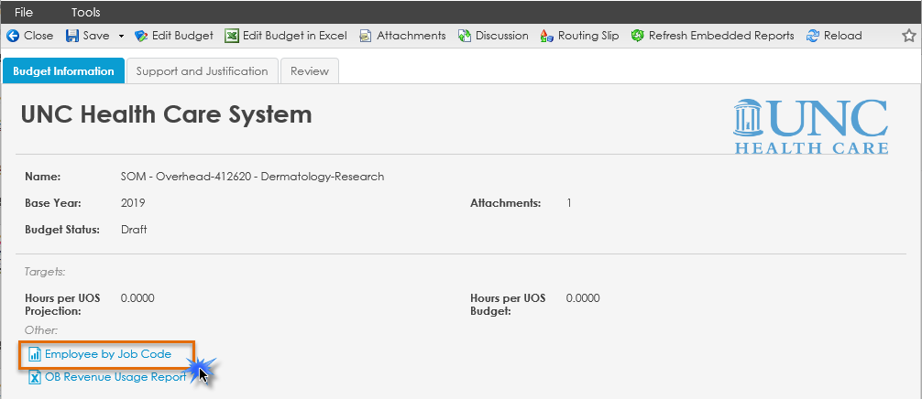
Fixed Staffing
Navigate to “Fixed Staffing” within your Strata workbook. This will display a list of job codes and their corresponding FTEs associated with this entity.
Note: those with a ** are loaded from Faculty Roster Budgeting (FRB). You will NOT be able to edit these employees in Strata.
If you’d like to see who is within a given job code, you can run the “Employee by Job Code Report” from the Edit Budget window popup.

Slide 31
Fixed Staffing, cont.
Navigate to the job code where you want to increase or decrease the FTE
Enter the FTE change in the “Projected Total Adj.” column
If you want to input the FTE change in a specific month, click the Projected Total Adj + to expand the months.
Input the FTE change in the month the change will take effect and it will project to the end of the FY

Slide 32
Fixed Staffing, cont.
Once the FTE has been updated this will update the amount associated with the job code on the Wages tab
Contact your analyst to add a new job code for a given entity

Slide 33
Wages > Salaries By Pay Type
Navigate to the job code where you want to apply an overall increase/decrease in salary. Expand the job code.
Enter the overall increase/decrease amount for this job code in the “Projected 2019 Dollar Adj.” column.
Enter the overall increase/decrease amount for this job code in the “Budget 2020 Dollar Adj.” column.

Slide 34
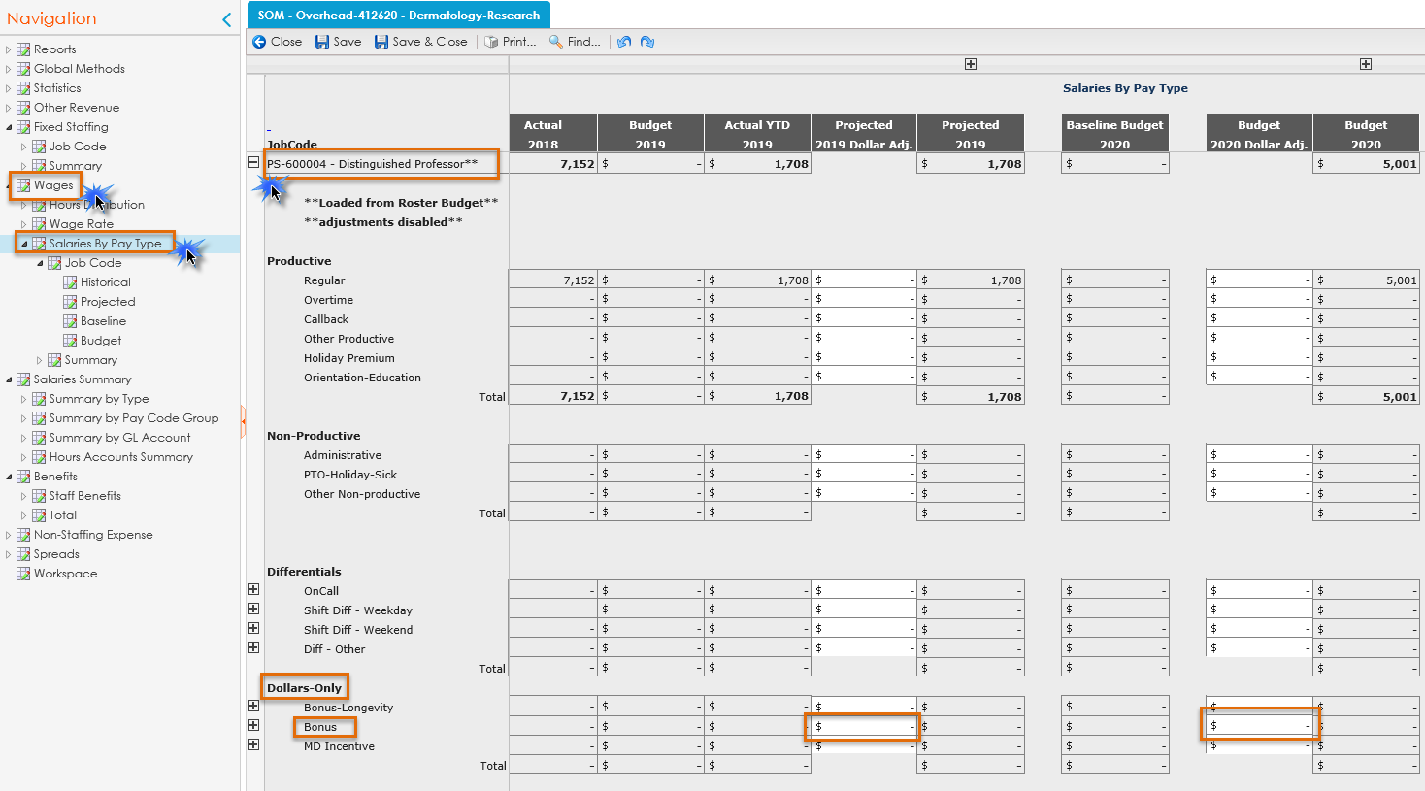
Wages > Salaries By Pay Type, cont.
For Faculty from FRB you will NOT input any additional amounts directly in Strata. The only exception to this is for Extra Clinical Care agreements (ECC) associated with account code 511330. To enter these amounts, navigate to Wages > Salaries by Pay Type > appropriate job code > Dollars – Only > Bonus. Enter an amount in “Projected 2019 Dollar Adj” or “Budget 2020 Dollar Adj.” if applicable.

Slide 35
Salaries Summary
There could be difference in the amounts depending on which salary summary you are reviewing. This is due to where the data comes from.
The “Summary by Type” tab is an accrual view for bi-weekly employees and does not include PAATs
The “Summary by GL Account” is a financial view and will tie to your Income Statement reports

Slide 36
Benefits
To update the benefits, navigate to the “Benefits” section of the workbook, and increase/decrease the benefits as necessary.

Slide 37
Benefits, cont.
Benefits will update based on the FTE and salary amount changes, but there could be additional input required
I.E. if you notice there are negative benefits due to PAAT actions, or FP benefits applied where there are no Faculty in an entity, etc.
Calculates a monthly percentage for each benefit account (rolling 12)
Formula:
Total Salaries
Annual Percentage
FY20 Budget for benefit accounts
=

Slide 38
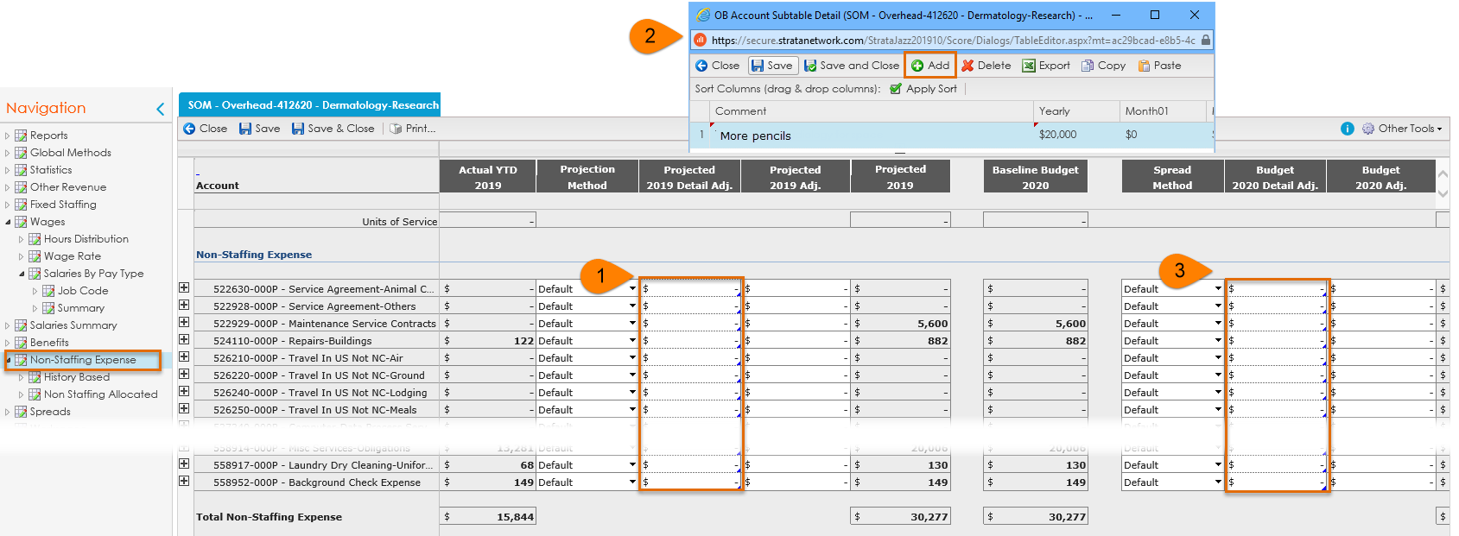
Non-Staffing Expense
To enter an amount, double click within the “Projected 2019 Detail Adj” cell. This will open another window where you will enter the non-staffing expense amount. Comments are required for this.
Click the “Add” button. This will populate a line where you can enter amounts and comments. Click “Save and Close” once adjustments have been made.
If further updates need to be made to the “Budget 2020” column make these adjustments in the “Budget 2020 Detail Adj.” column following the same process as above.

Slide 39
Submitting your Budget for Review

Slide 40
Budget Approval Process
Draft
Manager Review
Director Review
Exec Dir AVP Review
Finance Review
Approval

Slide 41
Workflow Security
Plan Workflow
Step 1
Step 2
Step 3
Plan
Plan
Plan
Manager Role
Write
Read
Read
Director Role
Read
Write
Read
VP Role
Read
Read
Write

Slide 42
Appendix
Additional reference material

Slide 43
Terminology
Actual – Values Recorded in the Source System (imported data from client)
Budgeted – Values Budgeted for the next Fiscal Year
Projection – Values Forecasted for the End of the Current Fiscal Year
Plans – The building blocks of the budget; usually is equivalent to a department
Plan Form – The screen on which general assumptions for the Plan is entered. Examples of actions the user can take on this screen: write narratives about the budget, attach documents, launch financials , enter productivity standards, promote the Plan to the next step in the workflow, etc.
Spread(s) – The manner in which the values are distributed among the 12 months of a year. For example, one might choose to spread Medical Supplies Expense based on the spread of the Patient Days, or one might choose to spread Travel Expense to every third month
Units of Service (UOS) – The statistical driver for a budget plan; Examples are: Days, Cases, Tests, Visits, Calendar Days, Square Feet, etc.
Workflow – The budget process simulated within the system. Workflow will dictate which users have access to the Plans during the various steps of the budget process, who approves the budgets. Workflow will also send emails to users when action is required
Skill Mix – the manner in which productive hours are distributed among Job Codes
Run Rate – the rate of resources used or revenue earned per UOS (e.g. Patient Day)
Baseline – the data used to calculate current run rate – usually expressed as a period of time like YTD or Rolling 12 months. So, as an example, if the projection is calculated based on the Current YTD run rate (the first six months of the current fiscal year) then it is proper to say that one is using Current YTD as the baseline
Rolling 12 – A period of time which includes prior, continuous 12 months. The concept of Rolling 12 ignores calendar year or fiscal year barriers/thresholds. For example, say the fiscal year ends on June 30, 2013 and the current month is April 2013, Rolling 12 could be the time period from April 2012 to March 2013, inclusively.
Annualization – (or Annualize) a method of projecting where the YTD balance is projected forward using a straight line [ YTD balance ÷ YTD months * 12 ]

