Slide 1
End User Training
StrataJazz® Operating Budgeting
January 2020

Slide 2
Agenda
Overview
Your Budgeting Process
Timeline
Contacts
Getting Started
Logging into Strata
Navigating in Strata
Completing Department Budget
Completing Revenue by Department/Fund – demo & then practice
Completing Expenses by Department/Fund – demo & then practice
Use Additional Budget Tools
UNCFP and SOM Income Statement Reports
Running Other Reports
Notes:
Everyone in same role, so once submitted “locked” in theory

Slide 3
Creating Budgets in StrataJazz® Operating Budgeting
Current Fiscal Year
Upcoming Fiscal Year
Goal: Develop next year’s budget
Actuals
Projection
Need to understand current year performance to accurately develop next year’s budget
1 | 2 | 3 | 4 | 5 | 6 | 7 | 8 | 9 | 10 | 11 | 12
1 | 2 | 3 | 4 | 5 | 6 | 7 | 8 | 9 | 10 | 11 | 12
$$$
???
Projected performance for this year often impacts the baseline budget for next year
Budget
The most accurate way to determine how we will finish out this year is to use actual data to project out the remainder.
1 | 2 | 3 | 4 | 5 | 6 | 7 | 8 | 9 | 10 | 11 | 12

Slide 4
SOM Clinical Department Timeline
Dec 9 – Jan 13
Departments to complete Faculty Roster Budgets (FRB)
Jan 15, 16
Strata training for SOM Clinical Departments
Jan 21
Strata go-live date for SOM Clinical Departments
Feb 18
ALL funds budgets due
FINAL budget hearings with leadership
DUE BY 5 pm ON MONDAY, JAN 13
Feb 24-28
Budget pre-meetings with departmental finance
Mar 23-27
Time to be communicated on the 21st
Notes:
We will show you everything in production today (IMPL). Please do not use the testing environment if you have this option when you login into Strata. The data entered today will be “wiped” out on January 19th. We go live on the 21st
Deadline for NEW employee requests going forward: Wednesday at noon
Closes, Thursday, 1/30 at 2 pm
Reopens Friday, 1/31 at 8 am
Closes Thursday, 2/6 at 2 pm
Reopens Friday, 2/7 at 8 am
Closes Thursday, 2/13 at 2 pm
Reopens Tuesday, 2/25 at 8 am
Closes Thursday, 3/5 at 2 pm

Slide 5
Your Contact
Department | Contact
Allied Health | Sam Smith
Anesthesiology | Sam Smith
CIDD | Sam Smith
Dermatology | Sarah Shipp
Emergency Medicine | Sam Smith
ENT | Brittney Kass
Family Medicine | Brittney Kass
Medicine | Suzanne Scott
Neurology | Sam Smith
Neurosurgery | Hannah Gardner
OBGYN | Hannah Gardner
Ophthalmology | Hannah Gardner
Orthopaedics | Sam Smith
Pathology | Hannah Gardner
Pediatrics | Spencer Brady
PM&R | Hannah Gardner
Psychiatry | Hannah Gardner
Radiation Oncology | Hannah Gardner
Radiology | Sam Smith
Surgery | Hannah Gardner
TEACCH | Sam Smith
Urology | Sam Smith
Contact your analyst for:
Additional access if necessary
Department specific questions
Weekly Meetings
An opportunity for departments to ask questions/get clarification

Slide 6
The Funds in Strata, and Where the Historic Data Comes From
PS Fund | Strata "Entity" | Revenue | Expense | SOM Dashboard Data Fund Description
285 | UNCFP | GL | GL | FP
201 | SOM - State AA | GL + Expense Budget | GL | State
211 | SOM - State HA | GL + Expense Budget | GL | State
221 | SOM - State AHEC | GL + Expense Budget | GL | State
241 | SOM - Residuals | GL | GL | Gifts, Endowment Inc and Other
252 | SOM - Contracts and Grants | GL | GL | Contracts and Grants
271 | SOM - Overhead | GL + Expense Budget | GL | Overhead
281 | SOM - Endowment Inc Unrestr | GL | GL | Gifts, Endowment Inc and Other
282 | SOM - Endowment Inc Restr | GL | GL | Gifts, Endowment Inc and Other
291 | SOM - Gifts-Endowment Inc and Other Unrestr | GL | GL | Gifts, Endowment Inc and Other
292 | SOM - Gifts-Endowment Inc and Other Restr | GL | GL | Contract Trust or Gifts, Endow Inc and Other
295 | SOM - Auxiliary-Recharge-Core Facilities | GL | GL | Auxiliary/Recharge-Core Facilities
Notes:
Entity equals department + fund type.

Slide 7
Logging, Reviewing the Home Page, and Accessing Your Department Budgets

Slide 8
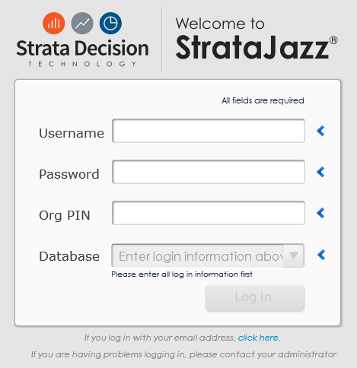
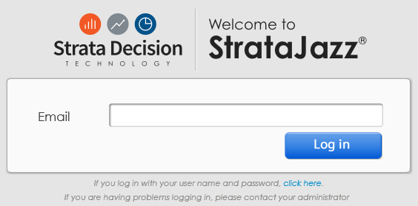
Logging In
Open Internet Explorer.
Type “secure.stratanetwork.com” into the address bar.
Under the credentials tile, click the small link that says “click here”. You will be redirected to a login screen that requires only your email address.
Enter your primary email address.
Press Tab.
  If you are redirected to a login screen for your organization, fill in your credentials as instructed.
Bookmark this page to your browser.

Slide 9
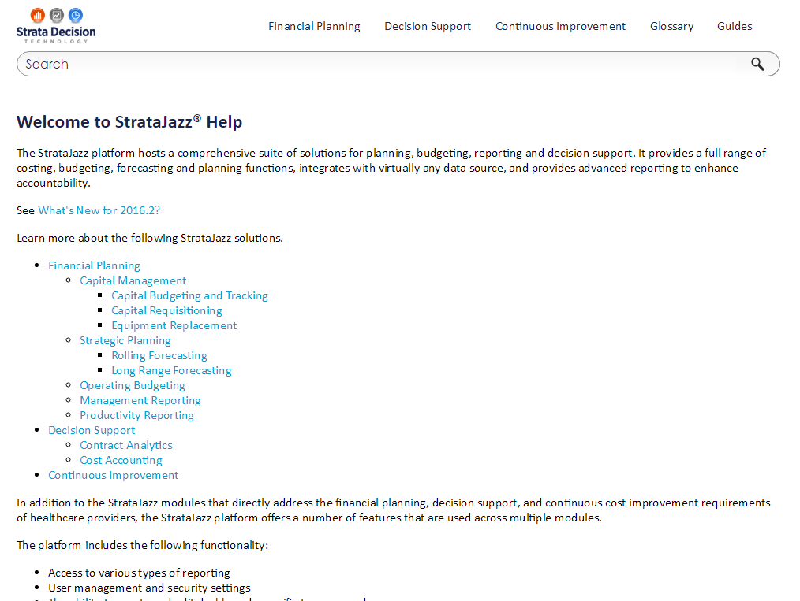
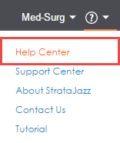
Additional Resources

Slide 10
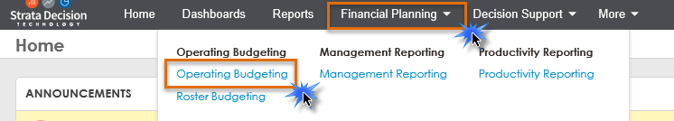
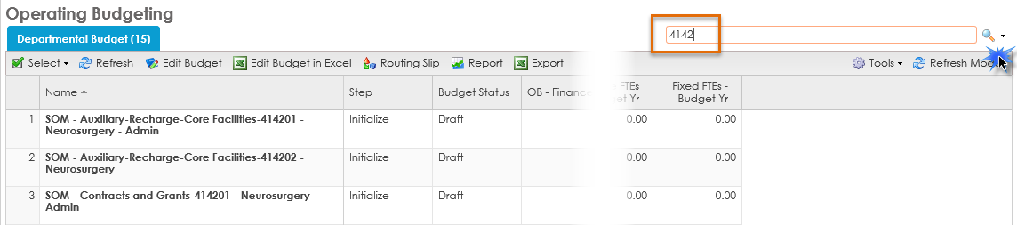
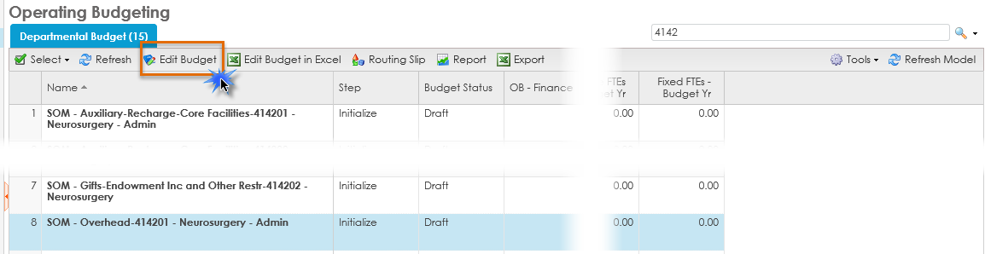
Accessing & Navigating on the OB Home Page
Once logged into Strata, navigate to Financial Planning > Operating Budgeting
Begin to enter the department ID you want to review. Click the magnifying glass to search on what you’ve entered or hit enter on your keyboard.
Click on the entity you want to edit so that it is highlighted blue. Then click the “Edit Budget” tab. Alternately, double click the entity you want to edit, and from the new window that appears, click “Edit Budget”.

Slide 11
Navigating within Operating Budgeting for a Given Entity

Slide 12
Budget Year Structure
Expand to see monthly detail for Projection and Budget
Last Year Historicals
This Year Budget
(where possible)
This Year Historicals
(thru Dec. 2019)
YTD Historicals + Projection for Remaining Months
Next Year Budget Before Adjustments
Next Year Budget After Adjustments
Notes:
Focus on the “Budget 2021” column for your bottom line, as some items are not populated in the Baseline Budget 2021 (I.E. Roster Budget)

Slide 13
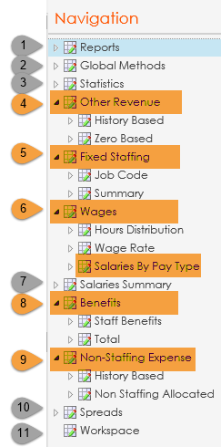
Tab Overview – UNCFP & SOM entities (your department ID)
Shows the Income Statement and other reports used by the HCS
Shows the projection methods applied to the different sections within the workbooks
Forecast volumes which drives revenue and expense
Where you will enter your revenue/budget for a given entity
Where adjustments can be made to FTE for employees you fund from a given entity
  I.E. if Research Assistant Randy is moving from .5 to .75 FTE, input this adjustment here
Where adjustments can be made to the overall wage for a given employee group. We are using the “Salaries by Pay Type” sub-tab
  I.E. if Admin Ann is getting a $5,000 increase on a given entity, input the amount here
Shows a consolidated total salary expense in multiple ways
Where adjustments to benefits can be made
Where adjustments can be made to non-personnel line items
Lays out the different spread options used in the budget
To be used as a “scratch pad” if needed or wanted
ADMIN/REVIEW ONLY INPUT IS REQUIRED BY DEPARTMENT

Slide 14
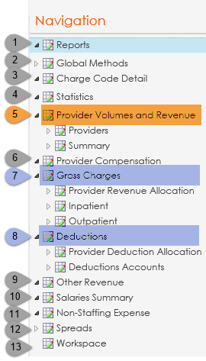
Tab Overview – UNCFP Revenue (4106XX, EPIC clinical revenue)
Shows the Income Statement and other reports used by the HCS
Shows the projection methods applied to the different sections within the workbooks
Shows the historical, projected, and budgeted charge units, rate, and dollars
Forecast volumes which drives revenue and expense
Where revenue by bill area by Provider will be entered (wRVUs/ASA)
Not applicable
Calculates revenue by patient class, separated into GL accounts, based on the patient class statistic volumes and the dollars per unit
Forecasts the total deductions that the model applies to the gross charges total
Not applicable
Not applicable
Not applicable
Lays out the different spread options used in the budget
To be used as a “scratch pad” if needed or wanted
NOT USED IN 4106XX IDs REVIEWED BUT NOT USED INPUT IS REQUIRED BY DEPARTMENT

Slide 15
UNCFP Revenue Department ID Logic Example
Each workbook will be limited to 50 Providers and listed alphabetically
New Provider “Dummy" PIDs will always exist in the “A” workbook if there is an “A” workbook available
FY21 New Provider ID’s will start with “21”
FY20 New Provider ID’s begin with “99” and SHOULD NOT BE USED
Notes:
Dummy PID logic of FY-DEPTID-A, example: 21411401A

Slide 16
Global Methods
Universal
Staffing: Annualized
UNCFP Entities
Provider Volume
SOM Entities
Other Revenue: Rolling 12
Increase Assumptions:
- 2% University employees (beginning July 2020) **** DOES NOT apply to Faculty
- 2% for HCS employees (beginning February 2021)
Non-Staffing: Even
Other Revenue: Even
FY20 Projection: Rolling 12
FY21 Budget: Based on FY18 Practice Plan charge spread
Benefits: Practice Plan benefit spread
Notes:
Strata is loading in new living wage rate for the HCS employees (as of January 31st) soon.
The increase assumption for HCS could change, but for now it’s set at 2%

Slide 17
In Summary, Here’s What Changed:
50 Providers per workbook vs. 100
More job code options if needed
FRB will be loaded more frequently
One role for access (OB – Manager)

Slide 18
Revenue
Provider Volumes & Revenue

Slide 19
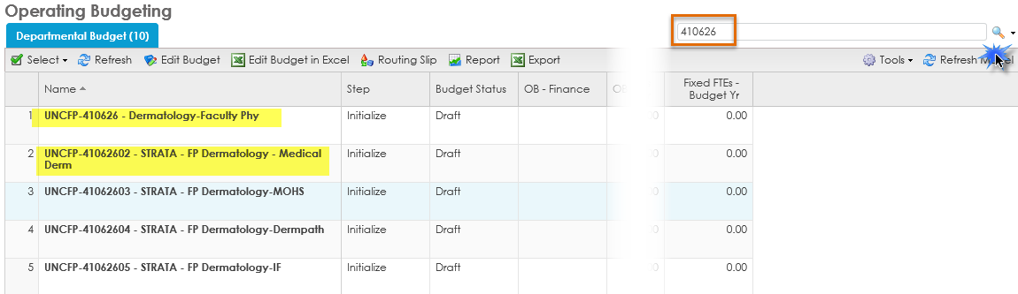
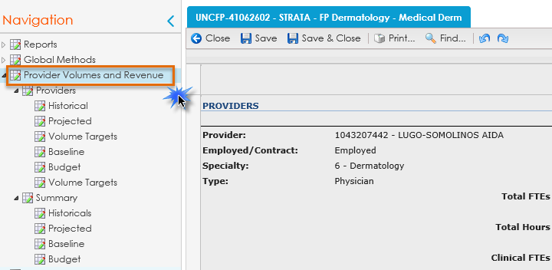
Provider Volumes & Revenue
Departments in Funds Flow:
UNCFP Revenue is housed in the 4106XXXX departments/bill area. When searching for your revenue department you will see a list. The difference is detailed below.
  Entities with “STRATA” in the title are where your Provider volumes will need to be input
  Entities without “STRATA” in the title DO NOT have Providers listed
If entering Provider Volumes, select the appropriate department with “STRATA” in the title, and navigate to the “Provider Volumes and Revenue” section.

Slide 20
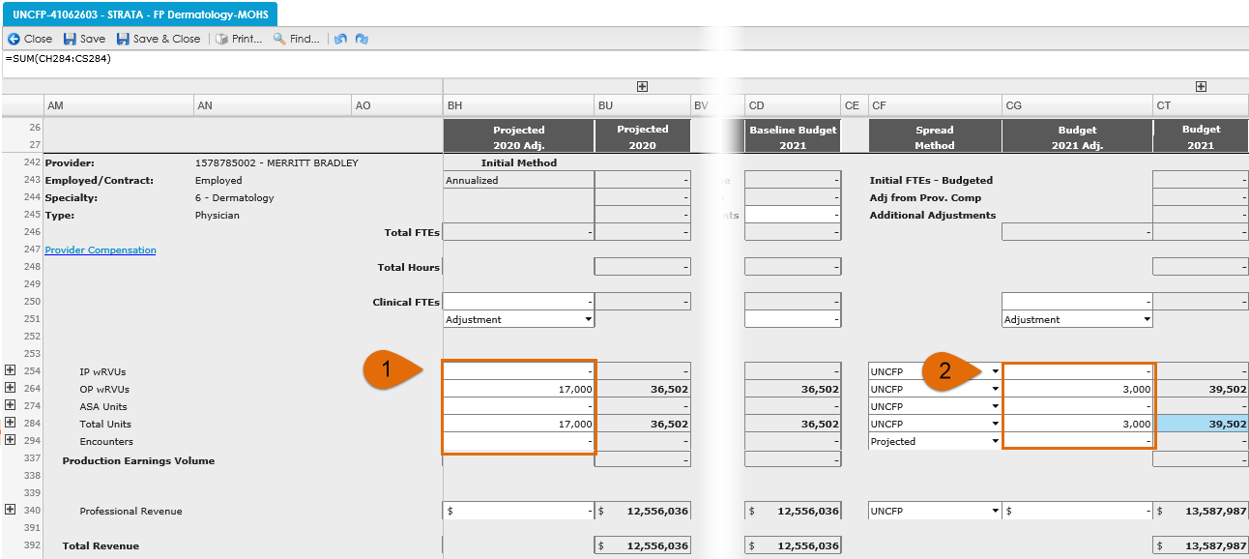
Provider Volumes & Revenue, cont.
Input the anticipated wRVUs in the “Projected 2020 Adj” column. Total Units will not automatically populate when OP/IP wRVUs are input, so you must manually input this. The amounts entered in the “Projected 2020 Adj” will populate the “Budget 2021” column.
If further updates need to be made to the “Budget 2021” column, make these adjustments in the “Budget 2021 Adj.” column.

Slide 21
Gross Charges & Deductions
Gross Charges
  Based on department historical account posting
Deductions
  Based on department historical account posting
  Using rolling 12 month closed collection rate

Slide 22
Other Revenue
UNCFP & SOM Entities

Slide 23
Other Revenue: UNCFP
Examples of “Other Revenue” in UNCFP entities
Contracts
Expert Witness
CIC Funding
Transfers (48xxxx)

Slide 24
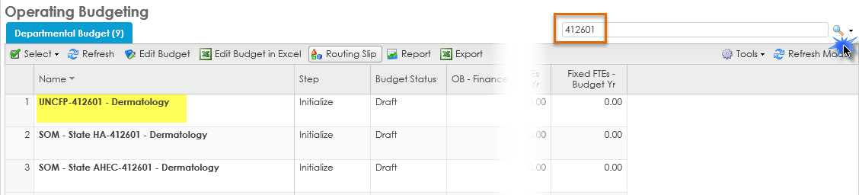
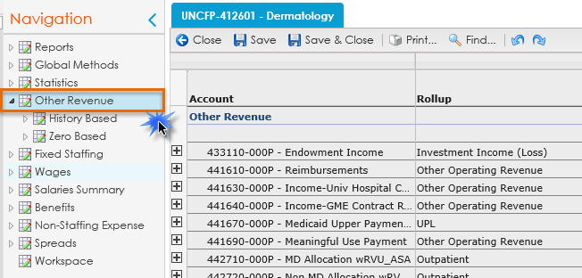
Other Revenue: UNCFP, cont.
UNCFP Other Revenue is housed in your department IDs (i.e. 4126XX for Dermatology).
If budgeting Other Revenue, select the appropriate entity, and navigate to the “Other Revenue” section within this entity.

Slide 25
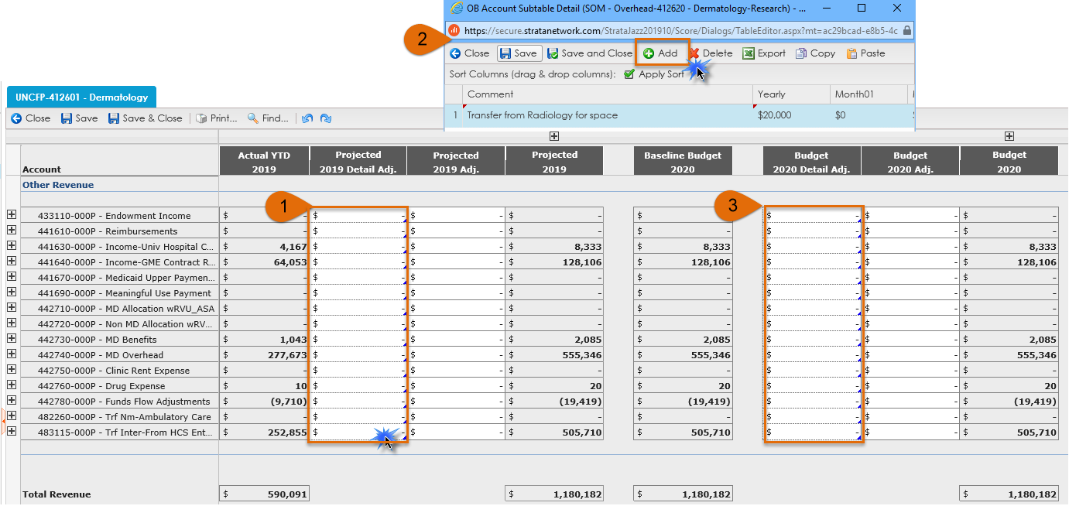
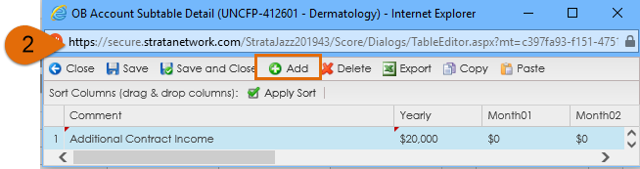
Other Revenue: UNCFP, cont.
To enter an amount, double click within the appropriate “Projected 2020 Detail Adj” cell. This will open another window where you will enter the revenue amount. Comments are required for this.
Click the “Add” button. This will populate a line where you can enter amounts and comments. Click “Save and Close”.
If further updates need to be made to the “Budget 2021” column, make these adjustments in the “Budget 2021 Detail Adj.” column.

Slide 26
Other Revenue: SOM
All revenue for SOM funds will be budgeted in the “Other Revenue” section within your department ID’s. Budgeting for this will be very similar to the process for “UNCFP Other Revenue”.
This applies to the following funds types:
State
Overhead
Contracts & Grants
Residuals
Endowment Income Unrestricted
Endowment Income Restricted
Auxiliary-Recharge-Core Facilities
Gifts-Endowment Inc and Other Unrestricted
Gifts-Endowment Inc and Other Restricted

Slide 27
Fixed Staffing, Wages, Benefits, and Non-Staffing

Slide 28
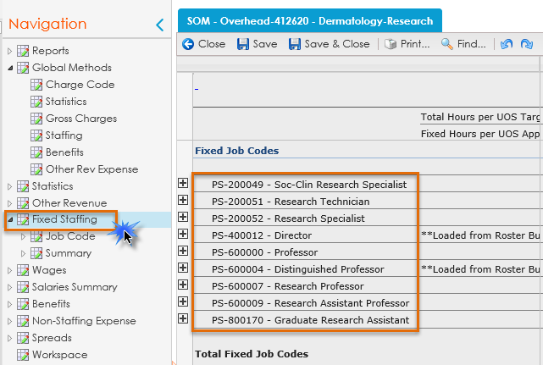
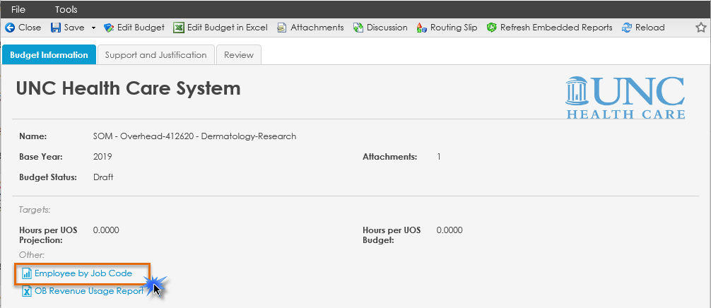
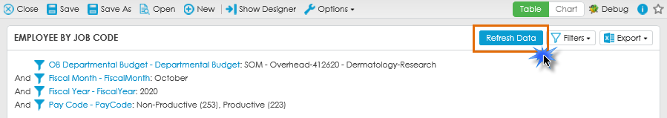
Fixed Staffing
Navigate to “Fixed Staffing” within your Strata workbook. This will display a list of job codes and their corresponding FTEs associated with this entity.
Note: those with a ** are loaded from Faculty Roster Budgeting (FRB). You will NOT be able to edit the Regular and MD Incentive amounts for these employees in Strata.
If you’d like to see who is within a given job code, you can run the “Employee by Job Code Report” from the Edit Budget window popup.
Be sure to click “Refresh Data” when the report window opens.

Slide 29
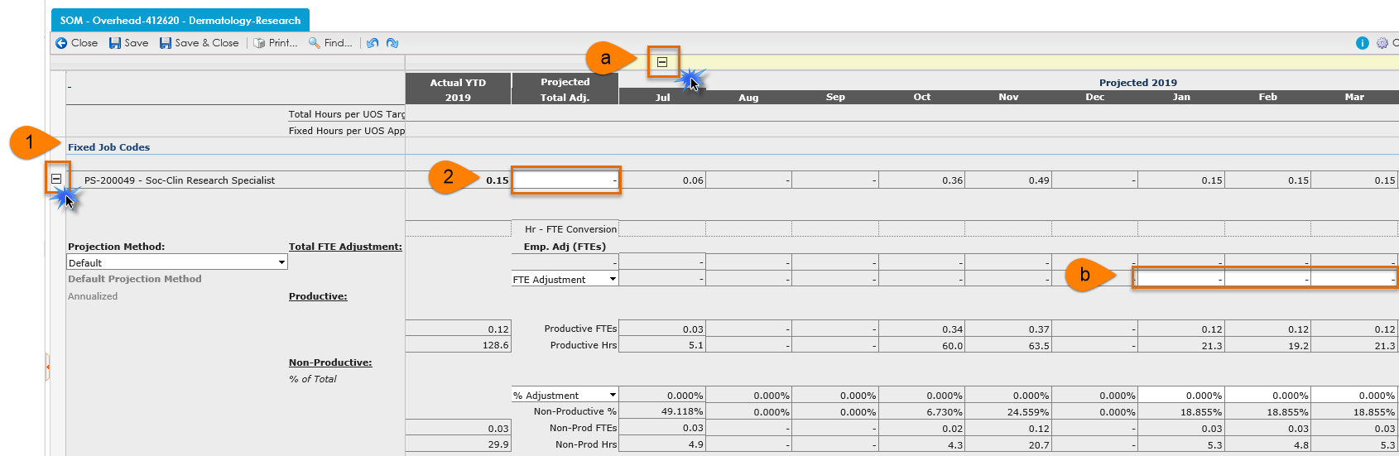
Fixed Staffing, cont.
Navigate to the job code where you want to increase or decrease the FTE
Enter the FTE change in the “Projected Total Adj.” column
  If you want to input the FTE change in a specific month, click the Projected Total Adj + to expand the months.
  Input the FTE change in the month the change will take effect and it will project to the end of the FY

Slide 30
Fixed Staffing, cont.
Once the FTE has been updated this will update the amount associated with the job code on the Wages tab
Contact your analyst to add additional job codes
Only add job codes that begin with “PS” (University) or “PSH” (Health Care System).

Slide 31
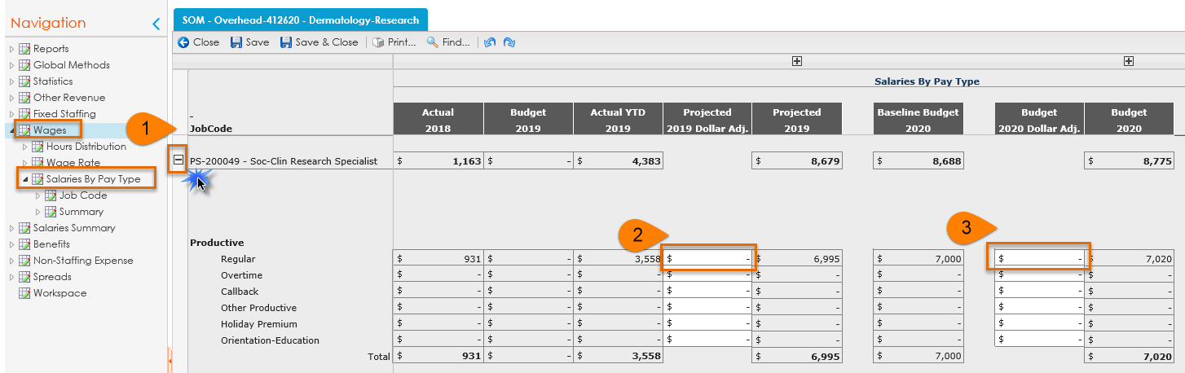
Wages > Salaries By Pay Type
Navigate to the job code where you want to apply an overall increase/decrease in salary. Expand the job code.
Enter the overall increase/decrease amount for this job code in the “Projected 2020 Dollar Adj.” column.
Enter the overall increase/decrease amount for this job code in the “Budget 2021 Dollar Adj.” column.

Slide 32
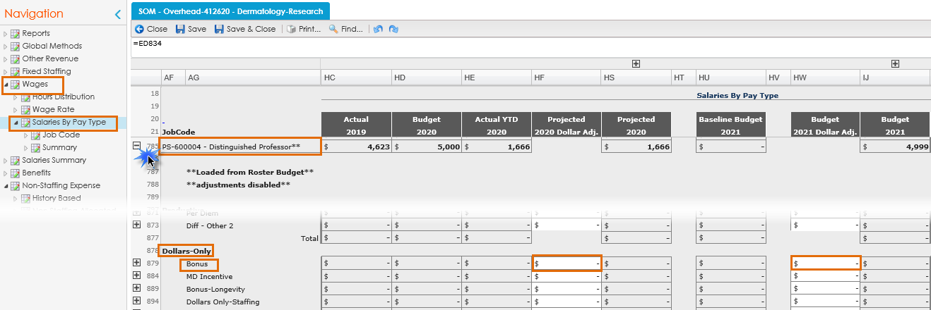
Wages > Salaries By Pay Type, cont.
For Faculty from FRB you will NOT input any additional amounts directly in Strata. The only exception to this is for Extra Clinical Care agreements (ECC) associated with account code 511330.
To enter these amounts, navigate to Wages > Salaries by Pay Type > appropriate job code > Dollars – Only > Bonus. Enter an amount in “Projected 2020 Dollar Adj” or “Budget 2021 Dollar Adj.” if applicable.

Slide 33
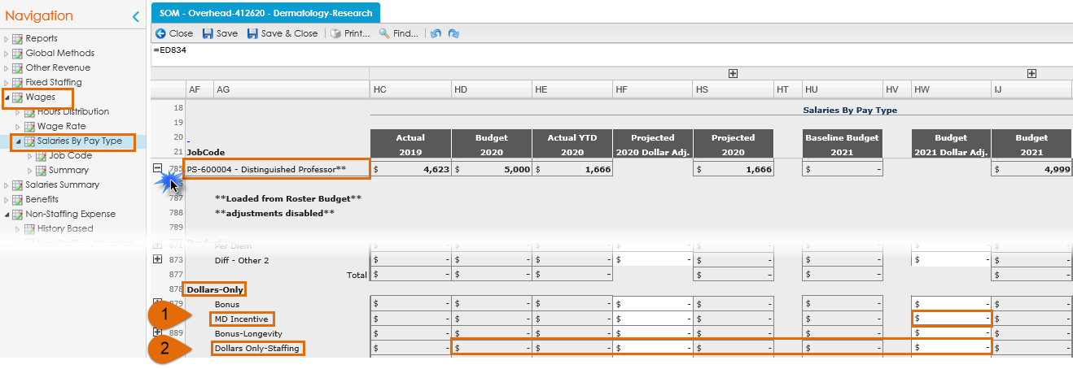
Wages > Salaries By Pay Type, cont.
“Dollars-Only > MD Incentive” is where the clinical incentives will populate from FRB.
“Dollars-Only > Dollars Only – Staffing” is where the Medical Insurance Reimbursements (MPR’s) will populate. Adjust as necessary.

Slide 34
Salaries Summary
There could be difference in the amounts depending on which salary summary you are reviewing. This is due to where the data comes from.
  The “Summary by Pay Code Group” tab is an accrual view for bi-weekly employees and does not include PAATs
  The “Summary by GL Account” is a financial view and will tie to your Income Statement reports

Slide 35
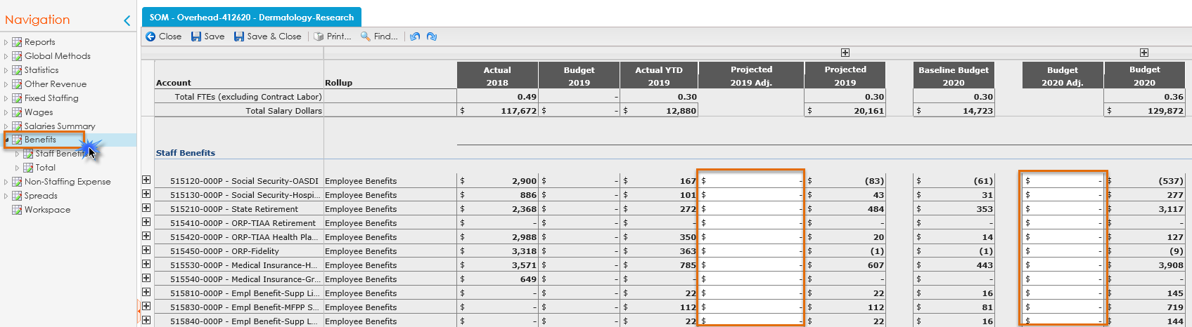
Benefits
To update the benefits, navigate to the “Benefits” section of the workbook, and increase/decrease the benefits as necessary in “Projected 2020 Adj” or “Budget 2021 Adj.”.

Slide 36
Benefits, cont.
Benefits will update based on the FTE and salary amount changes, but there could be additional input required
  I.E. if you notice there are negative benefits due to PAAT actions, or FP benefits applied where there are no Faculty in an entity, etc.
Calculates a monthly percentage for each benefit account (rolling 12)
Formula:
Total Salaries
Annual Percentage
FY21 Budget for benefit accounts
=

Slide 37
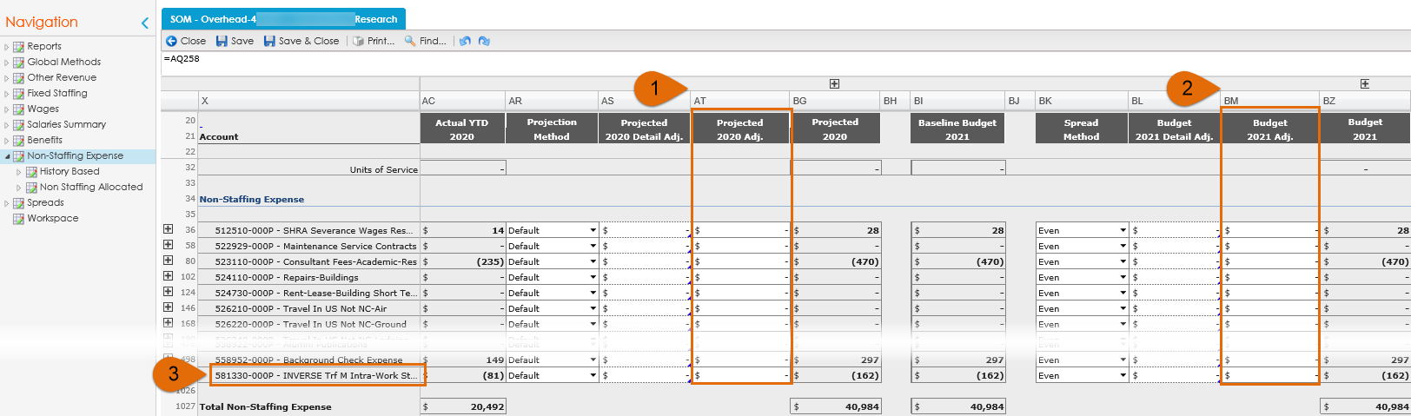
Non-Staffing Expense
Add/decrease the amount in each account code line by entering the amount in the “Projected 2020 Adj.” column.
If further updates need to be made to the “Budget 2021” column, make these adjustments in the “Budget 2021 Adj.” column following the same process as above.
To note: you will need to enter the opposite sign for account codes with “INVERSE” in the description

Slide 38
Reviewing the UNCFP and SOM Income Statement Reports & Other Reports

Slide 39
UNCFP & SOM Income Statement Overview
There are four Income Statement reports. Data in these reports will be updated once edits are made to your budget.
SOM Reports
  SOM Income Statement: mirrors the account rollup in our SAS “SOM Budget vs Actuals Report”
  SOM Income Statement – Account Detail: mirrors the account detail in our SAS “SOM Budget vs Actuals Report
FP Reports
  FP Income Statement: mirrors the account rollup in our SAS “UNCFP Budget vs. Actuals Income Statement”
  FP Income Statement: mirrors the account detail in our SAS “UNCFP Budget vs. Actuals Income Statement”

Slide 40
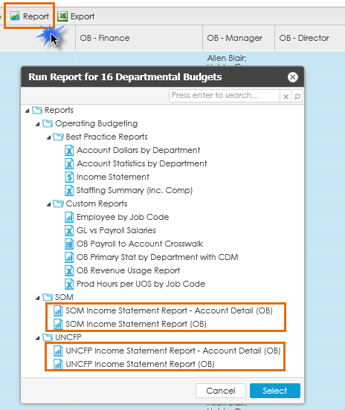
UNCFP & SOM Income Statement Overview
From the OB home page, click the “Report” tab. A new window will appear. Select either the “UNCFP Income Statement” or “SOM Income Statement” depending on the entity you are viewing.
Please note: the report will pull the data for the entity you have selected (i.e. highlighted blue on your OB Home screen). If you want to see multiple entities at once in the Income Statement reports, select multiple entities before clicking “Report”. Be mindful which are UNCFP entities and which are SOM entities.

Slide 41
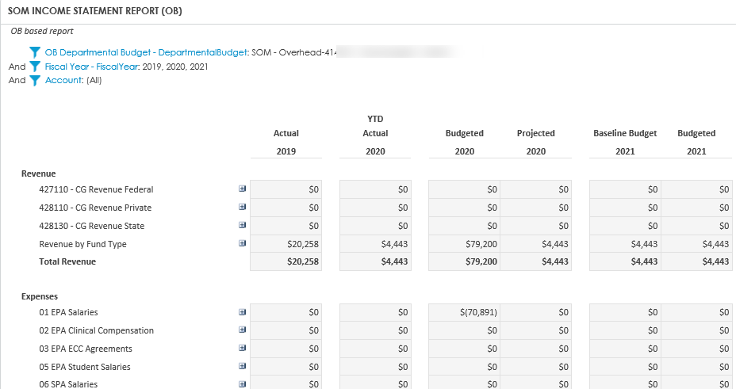
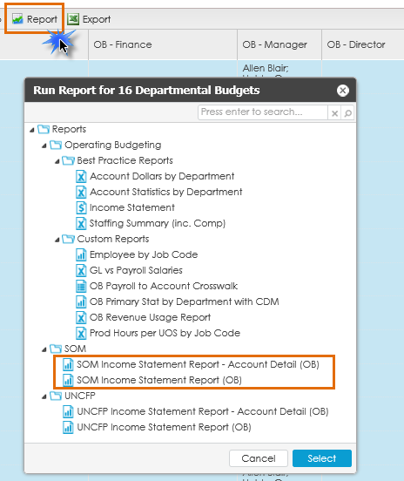
UNCFP & SOM Income Statement Overview, cont.
Select the SOM or UNCFP Income Statement reports depending on the entity originally selected to review. For example, I selected to view the SOM-Overhead entity, so the report selection I made was for the SOM Income Statement.

Slide 42
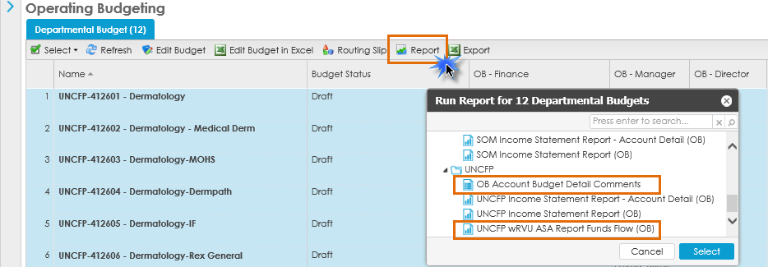
Other Strata Reports
OB Account Budget Detail Comments
To view the comments entered in “Other Revenue” and “Non-Staffing Expense” tabs vs. going through each individually
UNCFP wRVU ASA Report Funds Flow (OB)
Used to see wRVU and ASA Units by Provider vs. going through each individually
Navigate to the “Reports” link. Scroll down to the “UNCFP” reports. Click the report name to open.

Slide 43
Other Reports (Outside of Strata)
SOM Budget Report (SAS)
Use this report to review non-UNCFP funds, and to tie your actuals in each Strata entity to a source and/or fund type
Use this report to review actuals on how a person was funded and to project out how they will be funded
Pivot table template created to utilize when running this report
FRB Funding Report
Use this report to tie out what you’ve input in FRB to what’s loaded in Strata
Pivot table template created to utilize when running this report
SOM Funding Report (SAS)

Slide 44
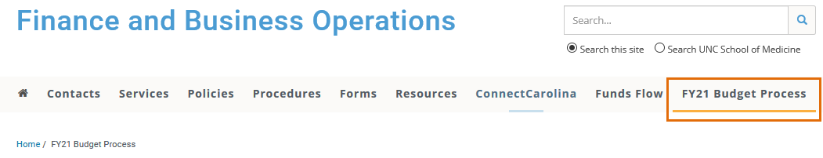
FY21 Budget Website

Slide 45
Appendix
Additional reference material

Slide 46
Terminology
Actual – Values Recorded in the Source System (imported data from client)
Budgeted – Values Budgeted for the next Fiscal Year
Projection – Values Forecasted for the End of the Current Fiscal Year
Plans – The building blocks of the budget; usually is equivalent to a department
Plan Form – The screen on which general assumptions for the Plan is entered. Examples of actions the user can take on this screen: write narratives about the budget, attach documents, launch financials , enter productivity standards, promote the Plan to the next step in the workflow, etc.
Spread(s) – The manner in which the values are distributed among the 12 months of a year. For example, one might choose to spread Medical Supplies Expense based on the spread of the Patient Days, or one might choose to spread Travel Expense to every third month
Units of Service (UOS) – The statistical driver for a budget plan; Examples are: Days, Cases, Tests, Visits, Calendar Days, Square Feet, etc.
Workflow – The budget process simulated within the system. Workflow will dictate which users have access to the Plans during the various steps of the budget process, who approves the budgets. Workflow will also send emails to users when action is required
Skill Mix – the manner in which productive hours are distributed among Job Codes
Run Rate – the rate of resources used or revenue earned per UOS (e.g. Patient Day)
Baseline – the data used to calculate current run rate – usually expressed as a period of time like YTD or Rolling 12 months. So, as an example, if the projection is calculated based on the Current YTD run rate (the first six months of the current fiscal year) then it is proper to say that one is using Current YTD as the baseline
Rolling 12 – A period of time which includes prior, continuous 12 months. The concept of Rolling 12 ignores calendar year or fiscal year barriers/thresholds. For example, say the fiscal year ends on June 30, 2013 and the current month is April 2013, Rolling 12 could be the time period from April 2012 to March 2013, inclusively.
Annualization – (or Annualize) a method of projecting where the YTD balance is projected forward using a straight line [ YTD balance ÷ YTD months * 12 ]

