Slide 1
Funds Flow Session
Bondurant G-030
June 11, 2019

Slide 2
Agenda
Review
Resources
Website
FF Calculations/SAS Reports
FF Accounts
FF Qualifications
GME
FF Educations

Slide 3
Review

Slide 4
Funds Flow Accounts
Listed below are the contra revenue accounts, where you receive your Funds Flow reimbursement dollars.
442710
442730
442740
442720
MD Allocation - wRVU/ASA Productivity Reimbursement
Non MD Allocation - UPL and Net Receipts
Benefits
Overhead
442750
442760
Clinic Expense/Rent Expense - 70%
442770
Drug Expense - 100%
442780
Technical
Adjustments

Slide 5
Funds Flow Qualifications
Who is included in Funds Flow?
Determined by the Peoplesoft HR Degree table
MD, DOM, and FDCH degrees are all considered “MD”
Maintained by the Background Check Team
Primary job pay group = ‘EHRA – Faculty’
University payroll activity exists in the current fiscal year for the PID

Slide 6
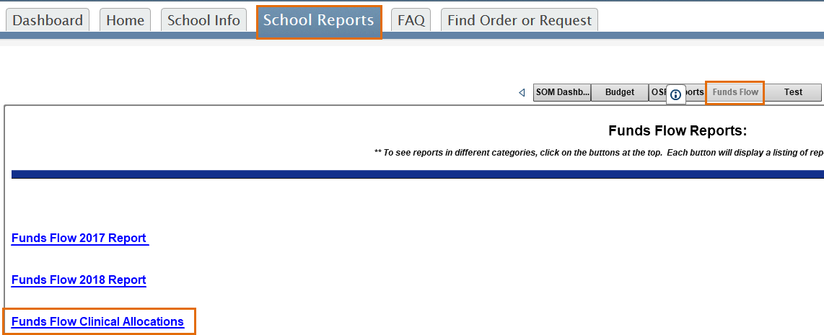
Funds Flow SAS Reports

Slide 7
Funds Flow SAS Reports Summary
FF Summary by Department
Displays all Funds Flow reimbursements at a department level by month

Slide 8
Funds Flow Calculations/SAS Reports 442710: MD Allocation
MD Allocation Detail by Provider with Dept ID
3 year rolling average of MGMA median salary/ 3 year rolling average of MGMA median wRVUs (or ASA Units for Anesthesiology)
If the “N” value is less than 45 in the MGMA survey then the $$ per wRVU moves from sub-specialty to specialty
Reimbursement rate for Children’s services across all departments will be boosted 25%
Denials that result in a write-off receive 50% credit
Self-pay wRVUs that have payments that are less than 25% of the charge receive a 50% credit
wRVU data is run by post date
Surrogate wRVUs assigned for CPT codes that do not have wRVUs but involve Physician work

Slide 9
Funds Flow Calculations/SAS Reports 442720: Non MD Allocation
Non MD Allocation Detail by Provider with Dept ID
Departments employ and receive associated revenue (including UPL) for APPs, including CRNAs, psychologists, and MSWs
Receipts and UPL taxed at 21%

Slide 10
Funds Flow Calculations/SAS Reports 442730: Benefits Allocation & 442740: Overhead Allocation
442730: Benefits Allocation
Benefits (University and FP benefits) * cFTE
Adjusted for start/end dates
442740: Overhead Allocation
Overhead * Job FTE * cFTE
Adjusted for Job FTE
Adjusted for start/end dates
FY20 rate per cFTE = $35,849

Slide 11
Funds Flow Calculations Department Level Allocations
442750: Clinic/Rent Expense
Not including APPs, malpractice, and scribes which will continue to be paid by the departments
442760: Drug Expense Reimbursement
100% of drug expense is reimbursed
442770: Technical Expense Reimbursement
Retained at central FP
Full cost of providing technical services is reimbursed
There is a set list of accounts to be reimbursed
Clinical & Rent Expenses (70%)
442780: Funds Flow Adjustments
Out of cycle adjustments

Slide 12
441640 – GME
All resident and GME contracts are collected centrally vs. through the departments
Any overhead associated with these contracts flows to the department, however the portion to cover salaries is transferred to the hospital
Salaries and benefits for Program Directors and Coordinators for Core Residency Programs (see committee approved grids below)
5.5% tax is not applied
Number of Residents | Coordinator Effort
Less than 10 | 0.50
10-19 | 0.75
20-39 | 1.00
40-49 | 1.25
50-60 | 1.50
Over 60 | 2.00
Number of Residents | Director Effort
Less than 10 | 0.15
10-19 | 0.25
20-29 | 0.35
30-39 | 0.50
40-49 | 0.75
50-59 | 1.00
60-70 | 1.25
Over 70 | 1.50

Slide 13
Resources

Slide 14
Funds Flow Resources
Monthly Training for ACAs/Business Managers and other applicable staff
Funds Flow Website https://www.med.unc.edu/fbo/funds-flow/
Infoporte Funds Flow Reports published monthly
Departmental Monthly Financial Meetings with FP
Department leadership meetings upon request
Division Chief/Faculty meetings upon request
Future education strategy
Creating ACA education committee
Funds Flow quick reference
What other resources would be helpful?

Slide 15
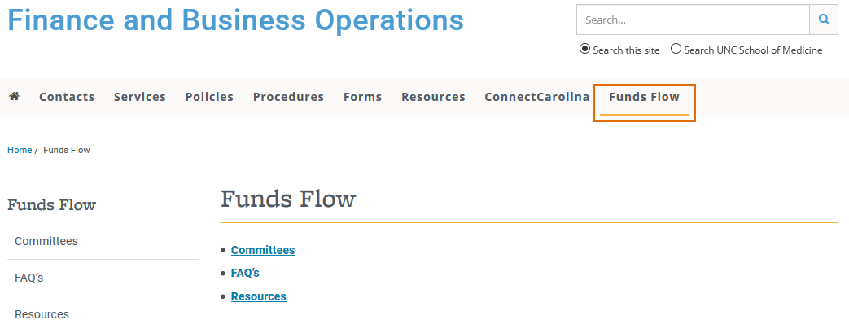
Funds Flow Website
Website includes:
Committees: submission deadlines (if applicable), upcoming committee meetings, as well as other information
FAQs: collected from previous Funds Flow sessions
Resources: slides from previous Funds Flow sessions
https://www.med.unc.edu/fbo/funds-flow

