Slide 1
FY25 Budget
Medical Center Guidelines

Slide 2





Our mission is to improve the health and well-being of North Carolinians and others whom we serve
Our new
North Star
An academic and community powerhouse with patients at the center of all we do
UNC Health System Strategy – Forward Together 2030
Patients First
Amplified Academics
Strengthened Core Operations
Reimagined Solutions
UNCMC Strategy
3-5 Year Objectives
Become the Best Place to Work
Deliver Unparalleled Quality
Optimize our Clinical Portfolio
Accelerate Targeted Clinical Growth
Enhance our World-Class Teaching and Research Enterprise
Lead in Transformative Innovation
UNCMC Operating Plan and Strike Teams
Annual Goals and Objectives
2

Slide 3
A mature planning process incorporates strategic and operational planning into budgeting
There is an opportunity to better align our strategic, operational, and budget planning to streamline future planning efforts and support coordinated action and results
Our strategy should inform our operating plan
Our operating plan should inform our budget
Our budget supports our mission
Due to timing, the operating plan has historically emphasized execution (i.e., how do we meet budget); this year, we will use our strategic and operating plans to inform the FY25 budget
Planning
(Strategic, Operational,
Budget)
Execution
Review &
Reflection

Slide 4
FY25 Budget Guiding Principles
The budget is a planning document based on assumptions from the strategy and operating plans. Assumptions are made with the best knowledge that is available at the time, and with the participation and input of all key stakeholders.
Each area has responsibility and accountability to complete their budget within the timeline, adhering to guardrails and their assigned margin target. Budgets will be prepared with the support of the Finance team, but ultimately owned by each department and respective operational leader. See Roles & Responsibilities.
Entity margin targets are determined by Entity Senior Leadership in conjunction with System Senior Leadership. Items considered include long range plan, entity and organizational priorities, expected cash requirements, current run rates and overall sustainability.
All gaps in meeting the budget target will be identified and closed prior to final budget.
Resource allocation will be driven by identified organizational priorities. All requests should have been submitted via request the FY25 Operating Plan initiative submission in December 2023 to ensure direct alignment with these priorities. These will be reviewed and approved by UNC Medical Center Chiefs.
Prioritization discussions and resource allocation discussions will be data driven.
We will be balanced, as efficient as possible, and accountable to ourselves.
We will make decisions based on what is best for the organization as a whole and not silos.
Feedback loop will be efficient and effective, between all parties.
Please note that changes to timelines and major assumptions are expected to be minimal but can occur. Any changes will be communicated.

Slide 5
FY25 Budget- Medical Center- High Level Timeline
Note- UNCFP and UNCH detailed calendars located in Appendix I.

Slide 6
Major Assumptions for FY25 Budget – Entity Targets
    Entity operating margin targets are determined by Entity Senior Leadership in conjunction with System Senior Leadership. Items considered include long range plan, entity and organizational priorities, expected cash requirements, and overall sustainability.
    Entity operating margin targets are cascaded to Executive Team based on several factors including:
        Projected volume
        Historical performance
        Targeted areas of growth, savings and strategic investment
Faculty Practice:
Productivity: Should be = or > 110% of FY22 survey results for each faculty member
Compensation: will be determined later based on updated survey results in January
% of incentives: Align with your Department’s Master Agreement verbiage
% of non-clinical spend: = or < 10% remains in place
UNC Hospitals:
Targets will be met through FY25 Operating Plan Prioritization.

Slide 7
Major Assumptions for FY25 Budget – Volumes
    At minimum baseline FY24 volume budget paired with favorable variances in rolling 12 month run rate. With additional consideration to incorporate inputs jointly from hospital and FP leaders based on projected volumes and volume spreads by dept/service lines, guided by Strategy & Operational plans
    Wave 1 & 2 initiatives in December will be primary process for programmatic / volume additions to be considered for FY25 along with Triangle West Strategic Committee decisions.
    Budget meetings with Strike Teams and other service lines/depts will be established in January to solidify the volume assumptions for FY25 budgets.
    FY25 volume increases must be approved during service line planning process. Chief approval will be required for any volume changes thereafter on exception basis.
Faculty Practice:
PB Faculty volume assumptions will be built and budgeted by provider to achieve 110% or greater of median productivity for existing providers. Volumes will be reviewed with department.
For signed as of 1/3/24 or TWSC/FY25 approved positions, volumes will be based on approved proformas.
CMS, Payor Rate, Payor Mix Changes and other known revenue modeling assumptions will be done centrally.
UNC Hospitals:
Hospital volume assumptions will be built from a stacked model starting with Service Line, cascading down to Acute, Ancillary and Outpatient. Other methodology may be used where it is more appropriate.
Revenue and flex expenses will be driven by projected volume.
Service line modeling will yield volumes for ancillaries, procedural areas & clinics. Review meetings to be established.

Slide 8
Major Assumptions for FY25 Budget – Labor Expenses
    FTEs will be based on FY24 budget. Adjustments will be made for unbudgeted FY24 FTEs approved.
    Benefits will be modeled based on historical run-rate of employee mix and % of Salaries adjusted for inflation factors
Faculty Practice:
    Faculty & APPs:
For a new position to be added to the FY25 budget it must either be:
      New unbudgeted position explicitly approved in Wave 1 and 2 initiative reviews or TWSC approved OR
      FY24 unbudgeted positions approved by LRC on or before January 3rd.
        All approved positions will have a Vacancy ID as their "dummy PID"
Vacancy factor FTEs budgeted in FY24 will remain in the FY25 budget. The final level of FY25 budgeted vacancy FTEs will be re-evaluated towards the end of the budget process.
Request for new positions SHOULD NOT be entered into Strata by end users or Finance.
Movement of positions between departments (i.e. utilizing PAC/MOB) should be done in the workbook working with your Finance Partner. These changes should be net neutral dollars, hours, FTEs and position titles.
FY25 premiums such as contract labor, critical staffing $ and OT will be a review focal point
Chiefs review labor/FTEs and approve with reference to projected volumes
UNC Hospitals:
Strata will calculate FTEs based on volume projection utilizing FY24 budgeted hours per unit of service for variable positions. Fixed positions will be projected based on FY24 budget.
For a new position or promotion (excluding clinical ladders) to be added to the FY25 budget it must either be:
      FY24 unbudgeted positions approved by LRC on or before February 9th, 2024 (Friday before workbooks opened to end users) will be added by operational finance during the open workbook dates. This cumulative list will be reviewed with Chiefs before importing into the workbooks. OR
      New unbudgeted position(s) explicitly approved in Wave 1 and 2 initiative reviews.
Other known corrections and adjustments will be made by Finance prior to budget opening to end users.
There will be continued use of vacancies factors in the FY25 budget. The exact method is being reviewed and will be provided prior to releasing the FY25 workbooks to end users.
Request for new positions SHOULD NOT be entered into Strata by end users or Finance.
Movement of positions between cost centers should be done in the workbook working with your Finance Partner. These changes should be net neutral dollars, hours, FTEs and position titles.
FY25 premiums such as contract labor, critical staffing $ and OT will be a review focal point.
FY25 budgets will not have McKenzie/Vizient ODB changes at initial rollout.
Chiefs review labor/FTEs and approve with reference to projected volumes.

Slide 9
Major Assumptions for FY25 Budget –
All Other Revenue and Other Non-Labor Expenses
Contracts- Expense/Revenue: should remain the same or if recently re-negotiated with a signed contract amount should be added/adjusted. Similar with Medical Directorships. Use FY24 Statement of Truth (“SOT”) for FP/UNCH agreements.
Fixed expenses will be based on FY24 projected with adjustments for known changes (one-time/non-recurring exps)
Additional investments will be based on FY24-25 Organizational Priorities.
Faculty Practice:
In general, we will be reviewing non-personnel expenses to grow in tandem with increases in volume (i.e. increases in drug expenses should be proportional with increases in pharmacy charges)
Prorates will be added centrally after budgets are finalized
Rent should match the schedules in Lease Query and will be provided by finance in advance of budget
Academic expenses previously expensed on 28542 will be reviewed by department and central finance partner
UNC Hospitals:
These revenues and expenses should align to FY25 Operating Plan.
FY25 workbooks will utilize the INFOR accounts. Special attention needs to be given to new accounts and run rates since INFOR conversion on 04/01/23.
For Contract Services and Other Supplies and Services, the FY25 workbooks with generally double the first half of FY24 as the baseline for FY25. The YTD FY24 will over-project once/year expense paid in first half (doubling them), and under-project the once/year expenses due in the second half. Make sure adjustments are made as needed.

Slide 10
Major Assumptions for FY25 Budget – Centrally Managed Expenses
The below additional assumptions will be added by Finance prior to close of the budget. Please DO NOT add/adjust these to your workbooks:
Faculty Practice:
Revenue modeling
GME contracts
UPL
CIC Revenue
LITF, Taxes, any vacancy, spreads
Shared Services Allocation
UNC Hospitals:
Revenue deductions i/c cost report settlements, UPL and HASP
Shared Services Allocation
Interest expense

Slide 11
Major Assumptions for FY25 Budget – Inflation Assumptions
Faculty Practice:
Projected to receive inputs from UNC HCS by Jan. 26, 2024.
Operating Expense Inflation Assumptions ranges (subject to change):
    Salaries & Wages – TBD%
    Benefits – TBD to TBD %
    Medical Supplies – TBD to TBD %
    Drugs – TBD to TBD %
    Utilities – TBD to TBD %
    Other –TBD% (exception: food costs @ TBD%)
UNC Hospitals:
Projected to receive inputs from UNC HCS by Jan. 26, 2024.
Operating Expense Inflation Assumptions ranges (subject to change):
    Salaries & Wages – TBD%
    Benefits – TBD to TBD %
    Medical Supplies – TBD to TBD %
    Drugs – TBD to TBD %
    Utilities – TBD to TBD %
    Other –TBD% (exception: food costs @ TBD%)

Slide 12
End User Access and Other General Guidelines
Faculty Practice:
DO NOT Change in Strata
    Prorates (582640, 582650, 582660, 582680)
    442389 (AR)
    442060 (Pre AR)
    511910, 515050 (incentive accrual and benefits)
    Faculty wages (will load from FRB)
    Funds flow accounts
UNC Hospitals:
Access Allowed in Strata
Other Revenue
Non-Staffing expenses
DO NOT Change in Strata
Charge Code detail tab
Statistics tab
Gross Charges tab
Fixed Staffing tab (included Vacancy Rate)
Variable Staffing tab (including WHPUOS)
Wages tab
Benefits Tab

Slide 13
Roles and Responsibilities
Purpose: Clarify roles and responsibilities to coordinate efforts, eliminate confusion and generate a greater product outcome with accountability.
Executive Team –
President, COO and CFOs
Operational Owners: Department or Unit Owner – Chair/ACA, Hospital VP and FP Operations
Finance Partner to Operational Owners
(UNCH or FP Analyst or FP Department Finance)

Slide 14
Roles and Responsibilities- Executive Team
Executive Team –
Presidents, COO and CFOs
      Responsible and accountable for the final budget at the UNCH, UNCFP and combined UNC Med Center levels while ensuring that all aspects of the budget are in line with System and Triangle West Strategy and Medical Center Operating Plan.
    Communicate and set expectations for budget
    Inform targets at Department or Unit level
    Final decision maker in prioritization of investments and ability to afford
    Coordinate and communicate collective Operating & Financial story for the next fiscal year to Board Committees

Slide 15
Roles and Responsibilities- Operational Owners: Department or Unit Owner – Chair/ACA, Hospital VP and FP Operations
Operational Owners: Department or Unit Owner – Chair/ACA, Hospital VP and FP Operations
      Responsible and accountable for the completing budget at the Department or Unit level while ensuring that all aspects of the budget are in line with System and Triangle West Strategy and Medical Center Operating Plan.
    In partnership with the Finance, drive the budget process for the Department or Unit
    Manage timeline
    Communicate and partner on the expectations to Operations.
    Collaborate with Finance to gather data to project volumes jointly b/w UNCH & UNCFP
    Responsible for budget workbook quality review including all labor (i.e. FTES, PTO, Vacancy factor, contract labor, overtime, critical staffing) and non-labor expense.
    In collaboration with key Finance Leader, ensure budget spread is appropriate.
    Prioritize capital budget submission
    On point to assist Key Finance Leader coordinate process
    Work collaboratively with Finance and Department or Unit Owner teams to resolve all questions/issues of the impact of Operations
    Assist Department or Unit Owners with staffing plans in workbooks
    Representative of Operations at meetings, in partnership with Department or Unit Owner
    Ensure inclusion of Operating Plans into budgets
    MUST COLLECTIVELY SIGN BUDGET WORKBOOKS AT SUBMISSION

Slide 16
Roles and Responsibilities- Finance Business Partner to Operational Owners (UNCH or FP Analyst or FP Department Finance)
Finance Partner to Operational Owners
(UNCH/FP Analysts and Finance leaders)
      Partner with Operational Owners to drive the budget process for the Department and Unit, aide in managing budget timeline and reasonableness of assumptions.
    Liaison between operations & finance resources
    Communicate expectations to Department or Unit Owner and monitor progress towards targets
    In collaboration with Department or Unit Owner, gather data to project volumes.
    Guide cost savings and achieve target
    Understand impacts of final budget decisions and communicate to impacted parties.
    Provide expert counsel and advice including partnering with quality review and challenging assumptions.
    Facilitate incorporating proformas as they are approved. Reconcile all newly added proformas and initiatives.
    Run and understand reports
    Partner and coordinate with external departments that influence the financial outcomes; Shared Services, Revenue Cycle, Benefits/HR
    Provide analysis to guide good decision making
    Synthesize and communicate budget impact to Operational Owners and Executive Team

Slide 17
Roles and Responsibilities- Finance Business Partner to Operational Owners (UNCH or FP Analyst or FP Department Finance)
Finance Partner to Operational Owners
(UNCH/FP Analysts and Finance leaders)
      Provide general support to cost center owners and Finance Business Partners for all workbook issues; fixing errors, adding new accounts, adjusting average hourly rates, researching historical information, and ad hoc training. Managing all central functions.
    Work collaboratively with other Finance teams to resolve all questions/issues from cost center owners and provide excellent customer service
    Expenses Handled Centrally: Depreciation, Employee Benefits, Rental Income/Expenses, Interest Income/Expense, Research Funding, CIC, Gainshare
    Review average hourly rates (ensure all hours have salary dollars)
    Conduct high level consolidated reviews of depts or unit revenues and expenses as needed
    Review stats for reasonableness
    Provide imputed volumes to Revenue (FP)
    Final Gross Revenue
    Reconcile Gross Rev with Revenue team
    Spread and all allocations (FP)
    Provide slides for BOD presentation
    Collaborate with Managed Care, Revenue Cycle and Revenue Team on Net Revenue assumptions (FP)
    Ensure CMS changes are included in Rev.Model (FP)
    Develop NY HB & PB and IP & OP charges (FP)
    Collaborate with Revenue team to incorporate new charges and prices
    Provide NY wRVU stat updates to Revenue and reconcile (FP)
    Assist with high level review of gross revenue at a Department or Unit level
    Work collaboratively with the Department or Unit Owners to reconcile volume growth with the revenue and expense growth

Slide 18
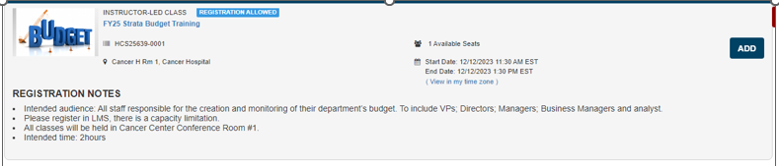
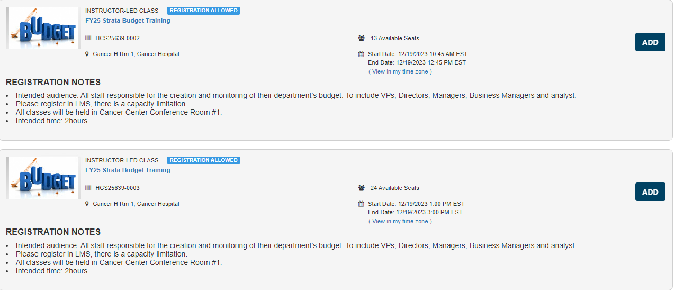
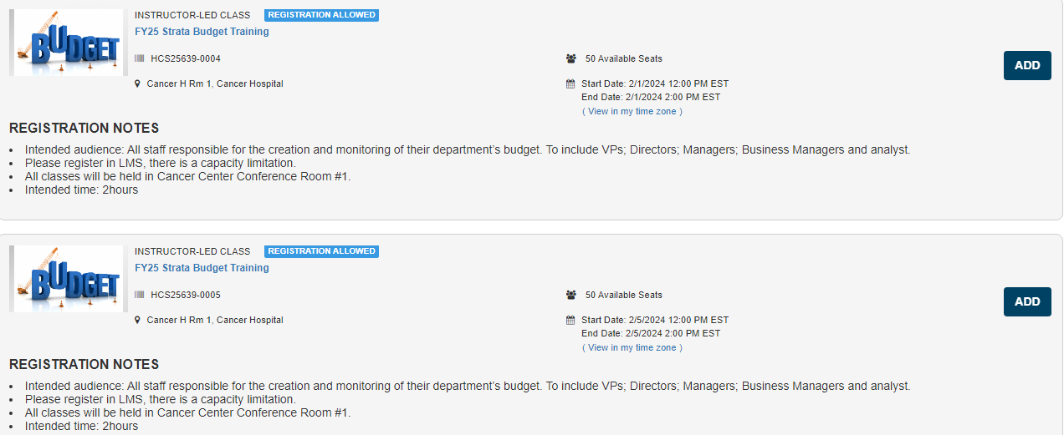
UNC Hospitals- Strata Training in LMS
Operational Finance will be holding 3 in-person training sessions.
Registration to be done in LMS.
Course name: FY25 Strata Budget Training
Training will be held at UNC Hospital Cancer Conference room 1
Dates will be:
12/12/23 11:30am – 1:30pm
12/19/23 10:45am – 12:45pm
12/19/23 1:00pm – 3:00pm
02/01/24 12:00pm – 2:00pm
02/05/24 12:00pm – 2:00pm

Slide 19
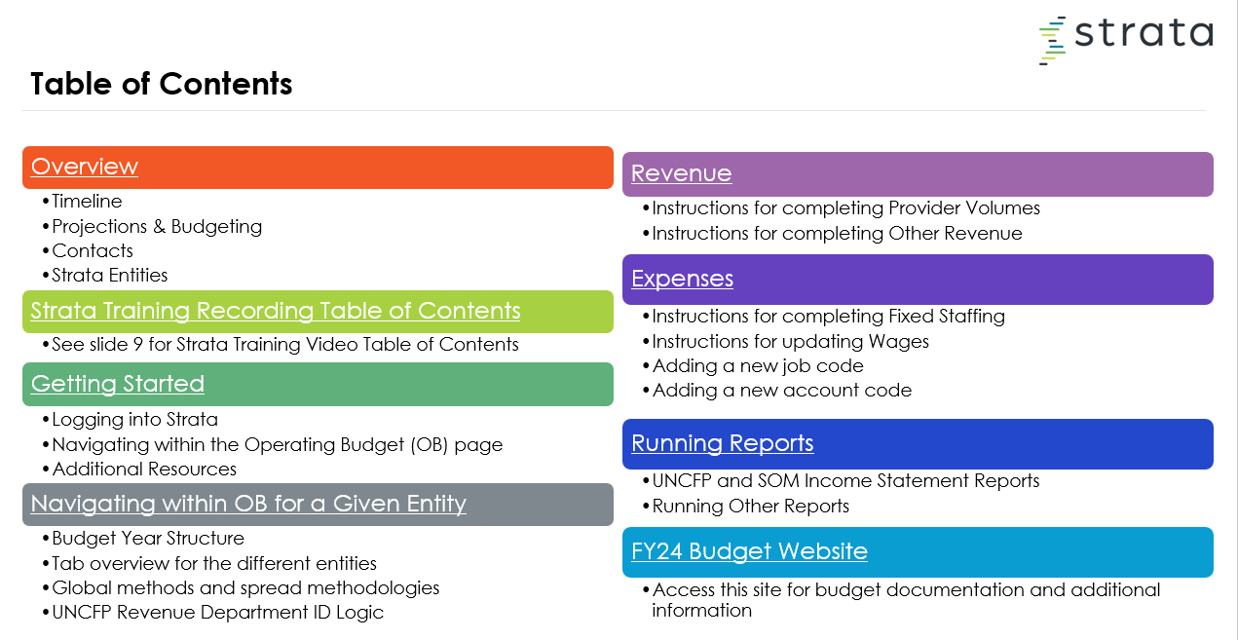
UNC Faculty Practice - Strata and FRB
Operational Finance sending out the standard Strata & FRB communication material and associated video as in past years, updated for any new year changes.
1:1 training will be hosted for new ACAs, who will be contacted directly.

Slide 20
Appendix I- FY2025 Detailed Budget Calendars
-UNC Faculty Practice
-UNC Hospitals

Slide 21
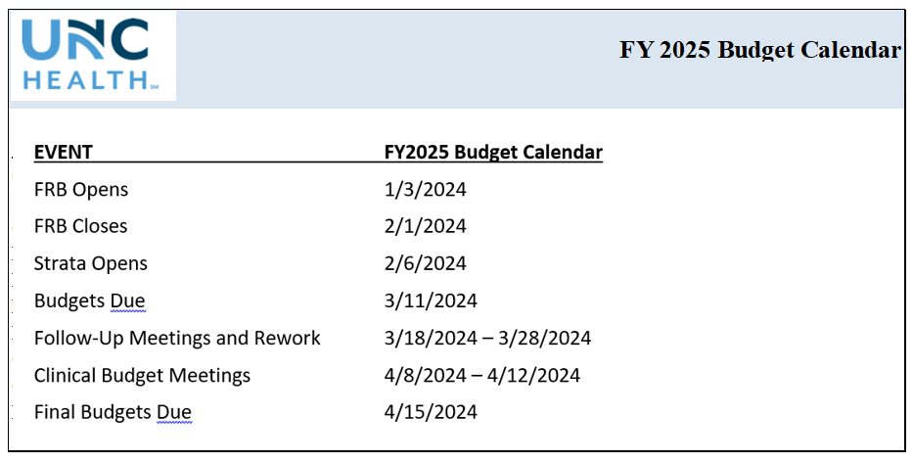
UNC Faculty Practice- FY2024 Operating Budget Calendar

Slide 22
UNC Hospitals- FY2024 Capital Budget Calendar

Slide 23
UNC Hospitals- FY2024 Operating Budget Calendar

Slide 24
UNC Hospitals- FY2024 Operating Budget Calendar

