Slide 1
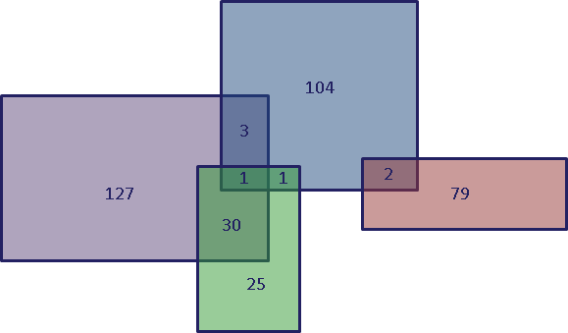
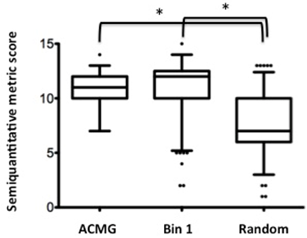
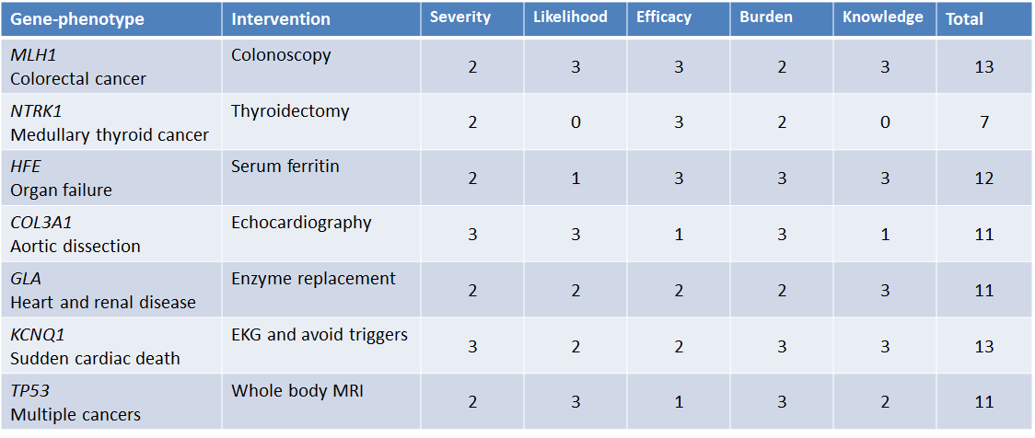
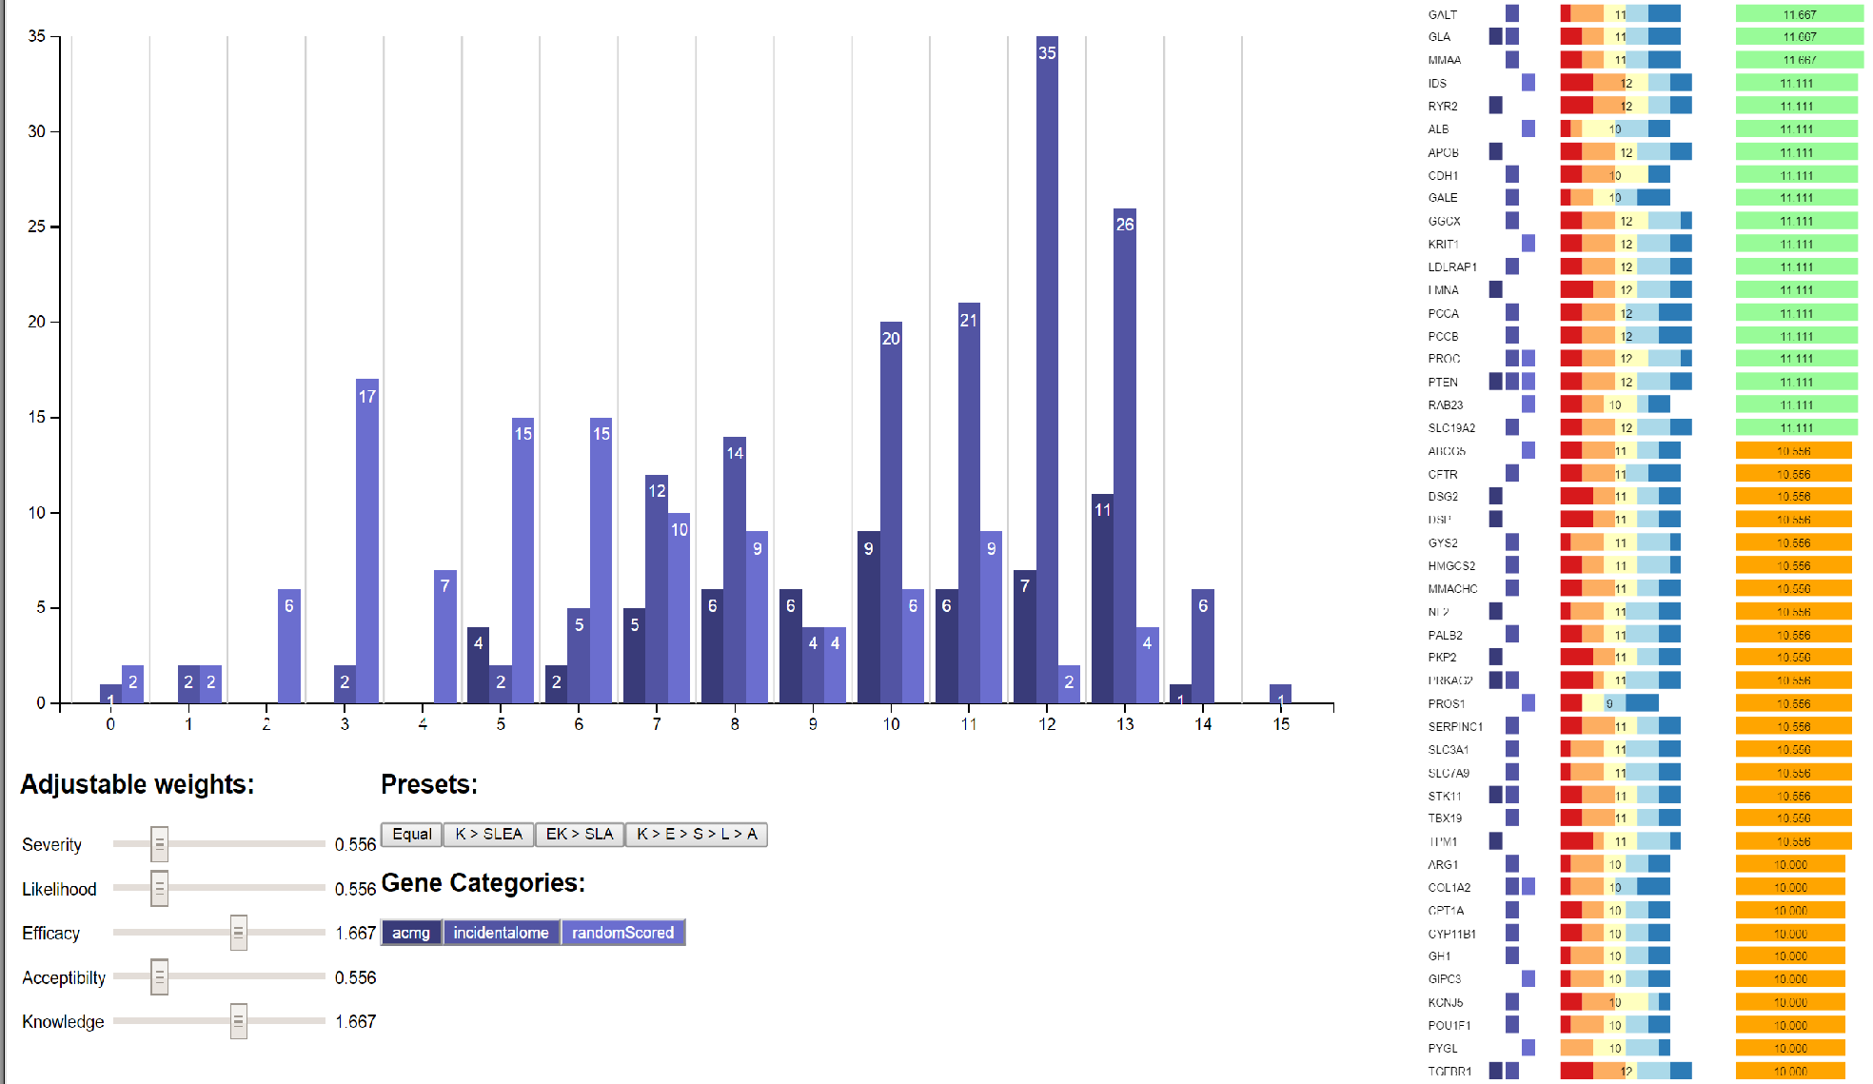
Clinical Actionability of Incidental Findings: Application of a semi-quantitative metric to assess actionability in over 1200 genes
A.K.M. Foreman, J.K. Booker, L. Boshe, K.R. Crooks, J.P. Evans, B.C. Jensen, K. Lee, D.K. Nelson, J.M. O’Daniel, B.C. Powell, C.M. Powell, M.I. Roche, C. Skrzynia, T. Strande, K.E. Weck, K.C. Wilhelmsen, J.S. Berg
University of North Carolina at Chapel Hill
Introduction
Application of the Metric in Over 1200 Genes
As exome and genome sequencing are increasingly applied in clinical scenarios, incidental findings (IFs) are discovered as a matter of course. Debate about the most appropriate handling of such findings is ongoing, but it is widely recognized that IFs vary in their clinical utility or actionability. Evaluating actionability is critical to identifying genes for routine return and enabling informed decision-making by patients. The NCGENES (North Carolina Clinical Genomic Evaluation by NextGen Exome Sequencing) study returns clinically actionable IFs to patient-participants undergoing exome sequencing.
In defining the set of gene-phenotype pairs to be returned routinely as IFs in NCGENES, we recognized that a consensus-based approach lacking a clear definition and framework for adjudicating actionability could lead to inconsistent and contentious results. We thus developed a semi-quantitative metric to assist in defining the actionability of gene-phenotype pairs (figure 1). This metric explicitly recognizes that actionability is not a binary state, but a continuum (Lindor et al. 2013; Berg 2013).
We initially scored 161 genes selected from OMIM as plausible candidates for routine return as medically actionable IFs (the NCGENES “provisionally actionable” set). To investigate the robustness of the metric, we then scored a random sample of 1000 genes in RefSeq. The majority of those genes scored 0 by default because an associated phenotype either did not exist in OMIM or OrphaNet, was caused by somatic mutation, or was simply a modest influence on disease risk based on association studies. The remaining 111 genes were formally scored using the metric. The metric was also applied to the 56 genes recommended by the ACMG for routine return when discovered as IFs (Green et al. 2013).
Overlap between these lists is depicted in figure 2. Score distributions by list are presented in figures 3 and 4, and table 1.
Figure 2
Overlap between lists of gene-phenotype pairs scored. The greatest overlap is between the two lists intended to contain gene-phenotype pairs with high actionability.
Key: NCGENES “provisionally actionable”
ACMG
Random
Other
Figure 3 Table 1
A
B
The semiquantitative metric was able to distinguish between lists selected for high suspicion of actionability and a random list of genes. Inflection points on the graph may suggest a natural cut-off for separating gene-phenotype pairs appropriate for routine return from those that may be considered for return based on patient preference.
Figure 4
Example Scores
Discussion
Table 2: Selected gene-phenotype pairs from ACMG and NCGENES
Our presented framework explicitly defines five critical aspects of clinical actionability, each of which are evaluated qualitatively. The resulting scores establish a semiquantitative metric that effectively distinguishes between lists of genes deemed to be potentially actionable by expert opinion and a randomly selected list of genes.
The framework provides a way to rationally compare the clinical actionability of disclosing IFs in genes with disparate phenotypes. It is highly flexible and can be adapted to different contexts by differential weighting of selected components. The inherent transparency allows for comparison among different efforts, critical evaluation, and updating of the scores as new knowledge accumulates. In the future, this metric, or one like it, could be used to evaluate all human disease genes to guide the application of genomic medicine. See poster 2586M for use of this metric for selection of newborn screening targets.
The Scoring Framework
Severity
What is the nature of the threat to health for individuals with a deleterious mutation(s) in this gene?
Sudden death (3), possible death (2), serious morbidity (1), modest or no morbidity (0).
Weighting and Customization
Knowledge
Figure 5: Depending on the application, the metric can be customized by weighting certain components more heavily. For example, for identifying targets for routine return as Ifs, knowledge and/or efficacy may be seen as more critical. Here, efficacy and knowledge are preferentially weighted.
Likelihood
What is the chance the threat will materialize?
Essentially equivalent to the penetrance of the phenotype. >50% (3), 5-49% (2), 1-4% (1), <1% (0).
Efficacy
How effective are interventions for preventing the anticipated harm?
Highly effective (3), moderately effective (2), minimally effective (1), ineffective (0).
Burden
How acceptable are the interventions in terms of burdens or risks placed on the individual?
Little burden / highly acceptable (3), moderate burden (2), high burden (1), very high burden / minimally acceptable (0).
Knowledge
How much is known about the gene, condition, and intervention to allow scoring of each category?
Substantial evidence (3), moderate evidence (2), minimal evidence (1), controversial or poor evidence (0).
Figure 1: The semiquantitative metric incorporates five aspects of clinical utility to assign gene-phenotype pairs an “actionability score” of 0-15. Higher scores suggest greater actionability.
Funding Sources & Disclosures
References
Berg JS, Adams M, Nassar N, Bizon C, Lee K, Schmitt CP, Wilhelmsen KC, Evans JP. An informatics approach to analyzing the incidentalome. Genet Med. 2013 Jan;15(1):36-44.
Green RC, Berg JS, Grody WW, Kalia SS, Korf BR, Martin CL, McGuire AL, Nussbaum RL, O'Daniel JM, Ormond KE, Rehm HL, Watson MS, Williams MS, Biesecker LG; American College of Medical Genetics and Genomics. ACMG recommendations for reporting of incidental findings in clinical exome and genome sequencing. Genet Med. 2013 Jul;15(7):565-74.
Lindor NM, Johnson KJ, McCormick JB, Klee EW, Ferber MJ, Farrugia G. Preserving personal autonomy in a genomic testing era. Genet Med. 2013 May;15(5):408-9.
CSER U01 HG006487-01
The following relationship(s) exist related to this presentation: No relationships to disclose.

