Slide 1

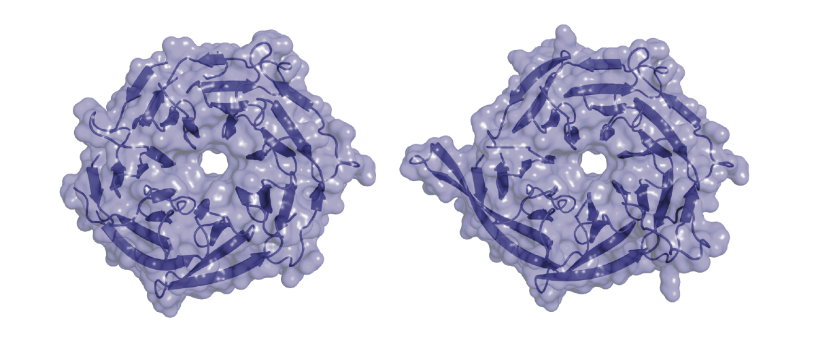
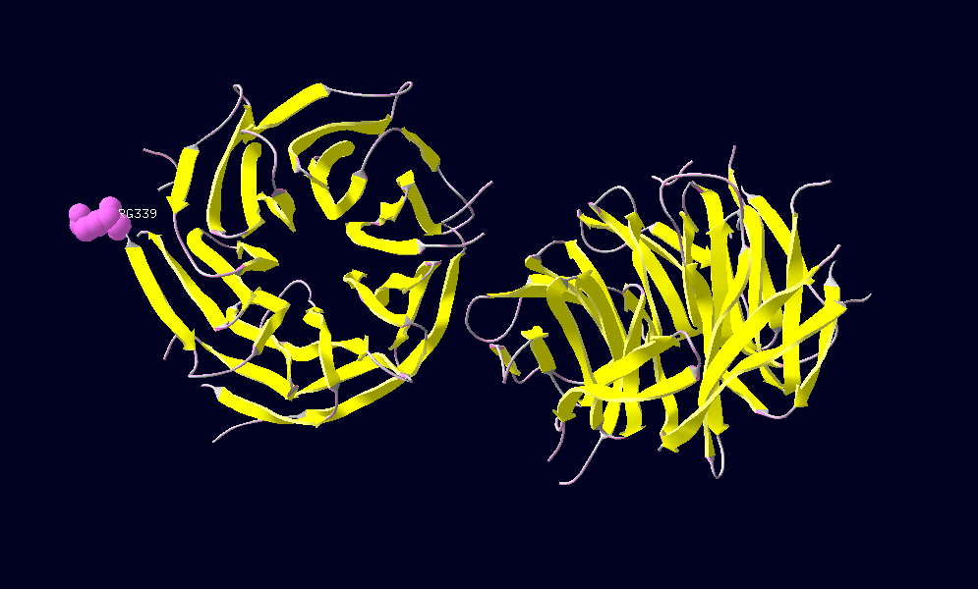
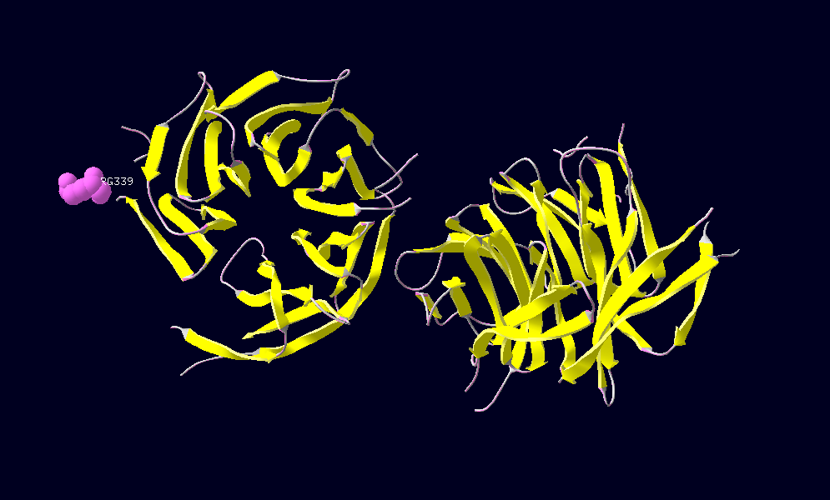
Identifying Genetic Determinants of Mitral Valve Prolapse
Gloria T. Haskell¹, Daniel Marchuk¹, Cecile Skrzynia¹, Ethan Lange¹, Chris Bizon², Laura Milko¹, Kristy Lee¹, Ann Katherine Foreman¹, Jason Reilly², Dylan Young², Daniel Gillis², Kirk C. Wilhelmsen^{1,2}, Brian C. Jensen³, James P. Evans¹ and Jonathan S. Berg¹
1. Department of Genetics, UNC-Chapel Hill 2. Renaissance Computing Institute, Chapel Hill, NC, 3. UNC Division of Cardiology
INTRODUCTION
Mitral valve prolapse (MVP) is a common condition that sometimes leads to serious complications such as regurgitation, endocarditis, and heart failure. Determining the molecular etiology of MVP could aid in risk stratification of patients, facilitate counseling of patients and family members, and may identify novel treatment targets.
Genetic testing of patients with Ehlers-Danlos, Loeys-Dietz, and Marfan syndrome, who often have MVP as part of their clinical picture, has demonstrated the importance of mutations in collagen genes, TGFβ genes, as well as the FBN1 gene. The FLNA gene has also been linked to genetic valvular disease. Comprehensive gene sequencing in select individuals may uncover as yet unrecognized genetic contributions to familial MVP. We hypothesize that rare, deleterious variants in genes related to heart development, connective tissue, or known MVP genes may underlie some of the currently unexplained cases of genetic MVP.
Automated custom workflow created by RENCI returns all variants in known disease genes, A-F
No variants with MAF <.001 that could explain the patients’ phenotypes were found in 7 genes known to be associated with MVP: ACTA2, CBS, COL3A1, FBN1, FBN2, MYHL1, and MYLK
We queried the variant database using Python to return all potentially deleterious variants with MAF <.001 in the entire exome. These variants were manually curated.
Relevant parameters include MAF in 1000 genomes and Exome Variant Server, ConDel score, published gene information, Gene Ontology and Function, and Protein Domains Affected
We generated Research Diagnostic (RDx) Lists of Genes from in silico databases in order to systematically evaluate variants in genes that could be associated with MVP.
In NCG_00157, we identified a heterozygous truncating variant in NUP43 found at MAF .0001 in exome variant server.
NUP43 is a component of the Nuclear Pore Complex which controls nucleo-cytoplasmic transport.
Hypothesis: Impaired transport of TGFβ signaling molecules such as Smads may contribute to MVP/TAA
NCG_00157
*
Sanger confirmation of WES-identified nonsense variant
Two models showing the resulting truncated protein (right side in both panels) would be missing several β strands found at the 3’ end of wild-type NUP43 (left side in both panels), thereby affecting its surface structure.
NCG_00354
Summary of candidate WES-identified variants
HGNC GENE | Description | Variant | In Silico Predictions & Domains Affected | On RDx List | Conserved Residue | ConDel Score | EVS MAF | Phenotype Association
TAB2 | TGF-beta activated kinase 1/MAP3K7 binding protein 2 | R347Ter | Missing NZF domain which binds Ubiquitin | TGF-beta Signaling genes |  |  | 0 | Outflow tract defects; aortic stenosis and cardiac arrhythmias; residual aortic regurgitation; HF; bicuspid aortic valve; aortic dilation
FILIP1L | filamin A interacting protein 1-like | R156Ter | Coiled-coil region; low complexity | No |  |  | 0 | FLNA is assoc. with X-linked cardiac valvular dysplasia; When overexpressed in endothelial cells, FILIP1L leads to inhibition of cell proliferation and migration and an increase in apoptosis.
ATP2A1 | SERCA1; cardiac muscle; fast-twitch | R989L | Very near 3' end of protein; Cytoplasmic domain per Uniprot; Not in MSV3d; Mut. Taster says DP | 16p12.1-11.2 MMVP1 locus | Highly Conserved | 0.99 | 0 | May be associated with AR Brody Myopathy; SERCA defects assoc. with a number of conditions: HF, sperm motility defects, cataracts, carcinogenesis, diabetes, cardiac hypertension and hypertrophy
COL6A3 | Collagen type 6, alpha 3 | D253H | VWA -MIDAS (metal ion mediated cell adhesion); Not in MSV3d; Mutation Taster says Disease Predicting | ECM | Highly Conserved | 0.718 | 0 | Bethlem myopathy; Ulrich congenital myopathy, neither of which have MVP, but do have joint problems; Collagen abnormalities are often present in both MVP and Joint Hypermobility
DCHS1 | cadherin superfamily of cell-cell adhesion molecules | S667C | Cadherin-6 domain; MSV3d= VUS; Sift (D); Mutation taster says disease predicting; | 11p15.4 MMVP2 locus | Highly conserved | 0.896 | .00035 | Per S. Slaughenhaupt at HMS, MVP is part of mutant phenotype; atrial septal defect in knockout mouse
ITGA6 | Integrin alpha 6 | K1082N | "GFFKR" motif, involved in α and β subunit stabilization; Not in MSV3d; MT says DP | FBN1 String | Conserved but not in Chicken | 0.764 | 0 | Integrins are known to participate in cell adhesion as well as cell-surface mediated signaling; OMIM=Junctional Epidermolysis Bullosa with Pyloric Atresia
PRRT2 | Proline-rich Transmembrane protein 2 | D143E | Low complexity | 16p12.1-11.2 MMVP1 locus | Not particularly conserved | 0.653 | 0 | OMIM=Seizures, dyskinesia; interacts with Snap-25
HABP2 | Hyaluronan Binding Protein 2 | D87Y | EG-like domain | No | Not Conserved | 0.666 | 0 | OMIM=one variant assoc. with reduced activation of pro-urokinase and strong risk for carotid stenosis; PLAU has been linked to MVP; some literature exists re:hyaluronan and valve formation, MVP
Intersection of Genes Harboring Rare Variants with RDx List Genes
Genes within MMVP Loci in OMIM (802)
Extracellular Matrix Genes from AmiGO (171)
Genes in TGFβ Signaling Pathway
(KEGG, 130 genes)
Proteins predicted to Interact with FBN1 in STRING (21)
Proteins predicted to Interact with Filamin-A in STRING (21)
METHODS
Due to the clinical heterogeneity of MVP, we used whole exome sequencing (WES) to identify genetic causes in 3 patients suspected of having a genetic form of MVP. Patients were enrolled in the North Carolina Genomic Evaluation by Next Generation Exome Sequencing clinical trial, NCGENES. We are using bioinformatics-based as well as biological tools to evaluate candidate MVP genes and variants.
We examined three patients with varying presentations of MVP who were suspected of having a genetic cause based on age of onset, severity, and family history.
NCG_00261: 15 year old female Dx with MVP at age 3 necessitating repair; multiple affected individuals in the family (see pedigree); no apparent connective tissue problems, but some family members with MVP also have A fib.
NCG_00157: 42 yr. old male Dx with Thoracic Aortic Aneurysm and MVP; working diagnosis of Loeys-Dietz, but no TGFβR mutations identified by clinical testing.
NCG_00354: Male with early-onset MVP necessitating repair; also has patellar subluxation and loose skin; Mother is similarly affected.
NCG_00261 Summary of Linkage Analysis and WES-identified candidate variants
Candidate MVP genes in embryonic and adult mouse heart
GAPDH
Total RNA was isolated from embryonic or adult mouse hearts and 1μg was reverse transcribed into cDNA. 75ng of cDNA was used as template in PCR to screen for expression of a subset of candidate genes in relation to the housekeeping gene, GAPDH
TAB2
FILIP1L
DCHS1
ITGA6
PRRT2
HABP2
COL6A3
No RT
TAB2
ATP2A1
NUP43
150bp
E11.0
100bp
Adult
50bp
GAPDH
ATP2A1
TAB2
FILIP1L
DCHS1
ITGA6
800bp
No RT
PRRT2
COL6A3
NUP43
A linkage analysis was done using an snp chip to genotype NCG_00261 and her family members. rs4663726 obtained significant LOD score in all 4 family schemes we analyzed.
rs4663726 Falls within COL6A3 gene on 2q37.3
WES did not identify any variants in COL6A3 with MAF < 0.48 for NCG_00261.
We looked for evidence of a micro deletion by applying a statistical outlier algorithm to exonic coverage data in NCG_00261 compared to 145 other NCGENES participants. We found no evidence of an exonic deletion in COL6A3.
We are now sequencing regions of the COL6A3 promoter, paying special attention to genomic regions with identified ENCODE marks.
Because the proband in this family, NCG_00261, is the most severely affected, we are focusing on identifying candidate MVP variants from her WES data (see summary of candidate variants below)
150bp
HABP2
100bp
50bp
CONCLUSIONS & FUTURE DIRECTIONS
NCGENES provides a mechanism to identify potential genetic causes in undiagnosed patients presenting with clinically heterogeneous cardiac disorders.
Rare, predicted deleterious variants were identified in genes that make interesting MVP candidate genes based on their apparent biological context.
Many of these genes are expressed in the developing heart, and some may be developmentally regulated.
We plan to determine whether WES-identified candidate variants segregate with disease in affected family members.
We will validate candidate genes by doing functional studies in animals or cell lines - ex. Knockdown of NUP43 in zebrafish or cultured cardiac cells.
We plan to directly examine MVP patient tissue to determine pathological characteristics associated with specific genotypes.
WES workflow and Variant Calling Pipeline
Yes
Known Disease Causing?
HGNC GENE | Description | Variant | In Silico Predictions & Domains Affected | On RDx List | Conserved Residue | ConDel Score | EVS MAF | Phenotype Association
PALLD | Palladin | E446Ter | Numerous domains affected which may disrupt interactions with VASP, SRC and ezrin at focal adhesions | No |  |  | 0 | Actin regulatory protein; No conclusive demonstration of disease association in humans
HABP2 | Hyaluronan binding protein 2 | R203Q | Within Kringle domain; Mutation taster predicts disease-causing | No | Highly conserved | 0.865 | 0 | Polymorphisms in this gene have been associated with carotid stenosis and venous thromboembolism
SOWAHB (ANKRD6) | Ankyrin repeat domain containing protein | R13H | Within an ankyrin repeat normally involved in protein interactions; Poly-phen2 predicts probably damaging | No | Highly conserved | 0.932 | 0.0013 | Affects Planar cell polarity in Drosophila and fusion of cardiac precursors in zebrafish
IQGAP1 | IQ motif containing GTPase activating protein 1 | I1071F | Within Ras-Gap domain; Mutation taster predicts disease-causing | Filamin-A STRING | Highly conserved | 0.836 | 0 | Regulates integrin-mediated cell migration and adhesion via interaction with filaminA
FAT3 | FAT Tumor suppressor homolog 3 | A3418S | Within cadherin domain; Poly-phen-2 predicts benign; Mut. Taster predicts disease-causing | No | Highly conserved | 0.966 | 0.002 | Paralog of DCHS1; Atypical cadherin; Mouse mutant has abnormal dendritic morphology; authors did not look at heart
A
100%
No
Break up DNA and keep exomic regions
Allele Frequency
E
F
5%
D
E
Sequence end to end
1%
B
C
Nonsense,
Splice-site Frameshift
Missense
Other Indel
Silent
UTR
Intronic
Align to Human Genome
Reads are stored and annotated in VarDb, our in-house variant database.
This work was supported by a U01 from the NHGRI to J.S.B., K.W., and J.P.E. (U01HG006487-02) and an NHGRI Reentry grant awarded to G.T.H. (supplement to U01HG006487).

