Slide 1


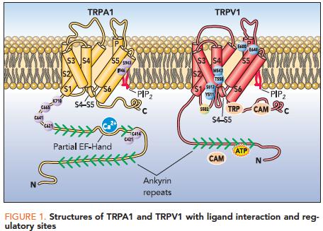
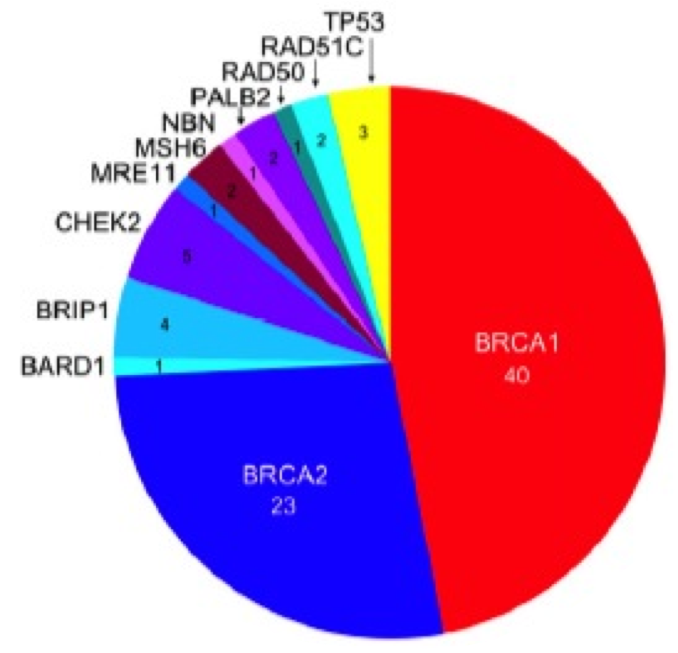
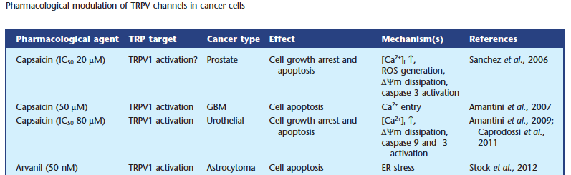
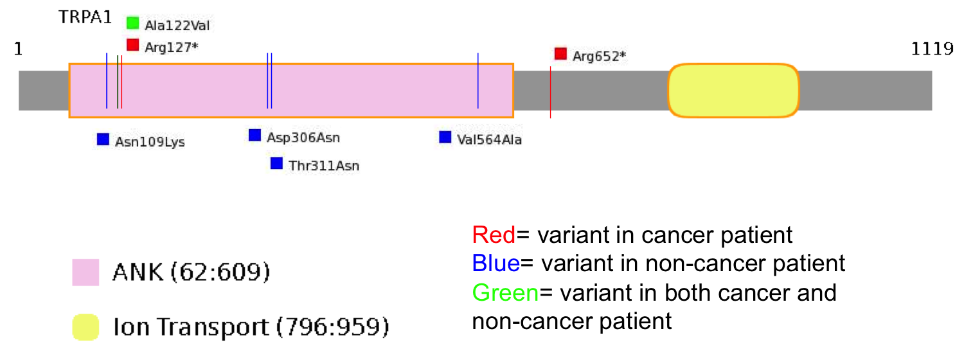
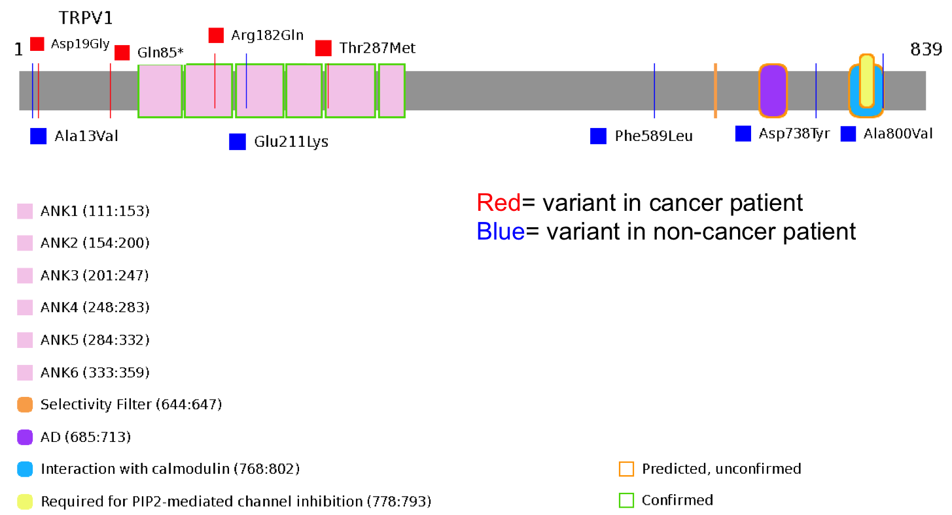
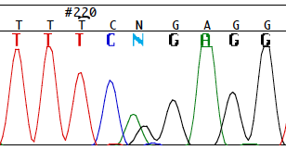
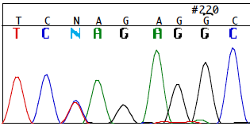

Research Sweep of Simplex Breast Cancer Reveals TRP Channel Variants
Sarah Brnich, Gloria T. Haskell, Daniel Marchuk and Jonathan S. Berg Department of Genetics, UNC-Chapel Hill
INTRODUCTION
Transient Receptor Potential (TRP) Channels
TRPA1 Protein Variants in NCGENES Subjects
Hereditary Breast & Ovarian Cancer
Potentially damaging mutations with minor allele frequency <0.005
Voltage-independent, integral membrane proteins with 6 transmembrane domains
Widely expressed in non-excitable cells, main route of Ca²⁺ entry
TRP Channels can be activated by:
  Temperature
  Oxidative stress
  Mechanical and chemical stimuli
  Changes in the local environment
ID | Diagnosis | Age | Sex | HGVS Protein Change | dbSNP ID | Allele Frequency | Condel
NCG_00192 | Cancer | 29 | F | NP_015628.2:p.Arg127* | rs151030022 | 0.000233
NCG_00284 | Cancer (ovarian dx30, paternal fhx breast) | 30 | F | NP_015628.2:p.Arg652* |  | 0.000227
NCG_00392 | Cancer (ovarian dx67, daughter breast dx44) | 67 | F | NP_015628.2:p.Ala122Val | rs61758122 | 0.001628 | deleterious
NCG_00527 | Mitochondrial,Myopathy, Cytopenia | 46 | F | NP_015628.2:p.Ala122Val | rs61758122 | 0.001628 | deleterious
NCG_00448 | Neuromuscular Disorders,Spastic Paraplegia,CNS | 7 | M | NP_015628.2:p.Asp306Asn |  | 0.000116 | neutral
OPH_00218 | Retina | 55 | M | NP_015628.2:p.Asn109Lys | rs61753713 | 0.004302 | neutral
NCG_00224 | Skeletal Dysplasia | 39 | M | NP_015628.2:p.Thr311Asn |  |  | deleterious
NCG_00243 | Spastic Paraplegia | 40 | F | NP_015628.2:p.Val564Ala |  | 0.000116 | deleterious
Fernandes et al., BJP, 2012
Most known monogenic cancer predisposition syndromes are dominant
Recessively inherited cancer syndromes have been described
TRPA1 and TRPV1 may form complex on plasma membrane of sensory neurons (co-regulation)
Walsh et al., PNAS, 2011
METHODS
We used whole exome sequencing (WES) to identify genetic causes in patients suspected of having hereditary breast cancer. Patients were enrolled in the North Carolina Genomic Evaluation by Next Generation Exome Sequencing clinical trial, NCGENES. We are using bioinformatics-based as well as biological tools to evaluate candidate breast cancer genes and variants. To identify known causative variants, patient WES results were run against a list of known hereditary cancer gene variants and no causative mutations were found.
We examined young simplex breast cancer cases:
  Negative for known BRCA1/2 mutations
  5 participants with breast cancer < age 35
  No family history of breast cancer
TRPV1 Protein Variants in NCGENES Subjects
Gautier et al., BJP, 2013
Potentially damaging mutations with minor allele frequency <0.005
Cancer involves increased proliferation, migration, invasion, and apoptosis evasion
TRPV1 activators have been demonstrated to induce apoptosis in several cancer cell lines
ID | Diagnosis | Age | Sex | HGVS Protein change | dbSNP ID | Allele frequency | Condel
NCG_00135 | Cancer (breast dx29) | 29 | F | NP_542435.2:p.Gln85*
NCG_00380 | Cancer (melanoma dx28, breast dx30) | 30 | F | NP_542437.2:p.Thr287Met |  | 0.002566 | neutral
NCG_00380 | Cancer (melanoma dx28, breast dx30) | 30 | F | NP_061197.4:p.Arg182Gln |  | 0.000235 | neutral
NCG_00286 | Cancer (breast BRCA2 mutation) |  | F | NP_542437.2:p.Asp19Gly |  | 0.002915 | neutral
NCG_00151 | Immunodeficiency | 29 | M | NP_061197.4:p.Phe589Leu | rs9913209 | 0.001441 | neutral
NCG_00508 | Intellectual Disability and Autism,CNS | 5 | F | NP_542435.2:p.Ala13Val | rs144405153 | 0.001433 | neutral
NCG_00183 | Neuropathy,Myopathy,Neuromuscular Disorders | 61 | M | NP_542435.2:p.Asp738Tyr |  | 0.000119 | deleterious
OPH_00217 | Retina | 44 | M | NP_542436.2:p.Glu211Lys |  | 0.000231 | deleterious
NCG_00261 | Thoracic Aneurysm And Dissection | 14 | F | NP_061197.4:p.Ala800Val |  | 0.000241 | neutral
Novel hypothesis
  NCG_00135: dx age 26, (-/-/-)
  NCG_00192: dx age 29
  NCG_00216: dx age 24
  NCG_00248: dx age 32
  NCG_00380: melanoma dx 28, breast dx 30
If activation induces apoptosis, disrupting function in these genes could inhibit apoptotic ability in cells
Aims:
  Confirm variants
  Is variant present in other cancer patients?
  Is variant present in control groups?
Variants detected by WES
Filtering Gene List
Sanger Sequencing Confirms Variants
80-100,000 variants detected per person
23,000 in coding regions
10,000 missense
100 nonsense
200 splice site
Missense vs. non-missense
Discard those on exclusion list
Filter out variants in unconfirmed genes (XM)
Filter out high frequency (>1%)
Filter out likely artifacts
Sift through what is left, starting with nonsense, truncating variants
TRPA1
TRPV1
Red= variant in cancer patient
Blue= variant in non-cancer patient
E
Confirms truncating variation in NCG_00192
TRPA1: G>A
Confirms truncating variation in NCG_00135
TRPV1: C>T
CONCLUSIONS & FUTURE DIRECTIONS
Rare, predicted deleterious variants were identified in TRP channel genes that make interesting candidates for hereditary breast cancer susceptibility based on their apparent biological context.
Potential follow-up experiments include:
  determine whether WES-identified candidate variants segregate with disease in affected family members
  validate candidate genes through functional studies in animals or cell lines - ex. Introduce mutant cDNA into cells and see how this alters calcium homeostasis and apoptosis
  examine the pathways these genes are involved in, including binding partners and other genes in the same cascade
  expand the numbers of cases and controls to be examined
E
Looking for 1-2 variants per person that are deemed to be “causing” a monogenic disorder
Hypothesis #1
Hypothesis #2
REFERENCES AND ACKNOWLEDGEMENTS
Some cases of very early onset breast cancer could be due to recessive mutations in a novel gene
No potentially biallelic mutations were identified in strong candidate genes
Single damaging mutation in a gene
  Since simplex cases, possibly de novo or paternally inherited
Identified two unrelated participants with interesting candidate variants (both nonsense) in the TRP gene family
I am grateful to the entire Berg lab, with special thanks to Gloria Haskell and Daniel Marchuk for their assistance with my project. Additionally, I would like to thank the UNC MD-PhD Program for their support. This work was supported by a U01 from the NHGRI to J.S.B., K.W., and J.P.E. (U01HG006487-02) and a NRSA training grant (2T32GM008719-16).
Fernandes et al., BJP, 2012
Gautier et al., BJP, 2013
Ouadid-Ahidouch et al., Trends in Molecular Medicine, 2013
Walsh et al., PNAS, 2011

