Slide 1
Integrated Genomics Cores
Overview and Capabilities:
High Throughput Sequencing Facility (HTSG)
Functional Genomics Mammalian Genotyping Core (MGC)
Piotr Meiczkowski
Technologies Director
Corbin Jones
Faculty Director
Gregory W. Bowen
Director
Hemant Kelkar
BioInformatics Director

Slide 2
Integrated Genomics Core (IGC) Mission
Apply the tools of high throughput sequencing technology and experience to enrich medicine and basic biological research at The University of North Carolina.
To help identify the causes of complex diseases such as cancer, diabetes and cardiovascular disease and demonstrate the underlying bases for multiple types of infectious diseases.
To support UNC researchers, students, and their collaborators in their work with our state-of-the-art technology to make medical and scientific breakthroughs happen.
Apply these tools to provide unique data and insights and solve problems for Government, industry, and academic partners throughout the world.

Slide 3

How We Got Here:
Merger of Existing Cores
Genome Analysis Facility
Lineberger Cancer Center Genomics
High-throughput Sequencing
Functional Genomics
Mammalian Genotyping
Notes:
Also note that we work in close conjunction with other cores on campus

Slide 4
Vice-Chancellor for Research
Executive Vice-Dean for Research
Integrated Genomics
Cores
High-throughput Sequencing
Affymetrix Arrays
Illumina Arrays
Illumina Platforms
Long Read Sequencing
Library Development
R&D/Robotics
High-volume low-cost SNP-typing, chromosome aberrations, HLA, mouse diversity, model organisms
Methylation and CpG islands, SNP-typing, highly customizable, agricultural systems, CNVs and structural variants

Slide 5
UNC Full Service Genomics
Experts in RNA-seq, especially from difficult samples
  Main RNA-seq center for TCGA
  The NCI Genomic Characterization Center for RNA-seq
  Total RNA, Small RNA, and mRNA
Early innovators in Dual RNA-seq
  Dual RNA-seq measures gene expression in both host and pathogen
  Captures the interplay between the hosts genome and that of the pathogen
  Expertise in design and analysis
Key contributors to the use of unique molecular tags to capture mutations, single cell genotype diversity, and pathogen diversity
  Reveals how pathogens evolve in response to drug and immune pressure
  Uncovers underlying mutational bias and cell specific patterns

Slide 6
Technology Areas
The Integrates Genomics Cores provide an integrated platform of technology, expertise, education, and infrastructure that creates an accessible environment for researchers to undertake both cutting edge and traditional genomics projects.
The Core specializes in six major technologies:
NextGen short read sequencing (Illumina)
Third-generation long-read sequencing and genomic mapping, e.g. Oxford Nanopore Technologies and BioNano Inc.
Single-cell genomics, single molecule mutation detection
Affymetrix Microarrays
Illumina bead array genotyping
RNAi screening for functional validation.

Slide 7



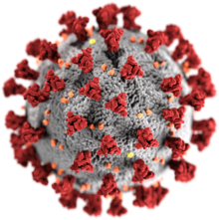

Example: Dual RNA-seq to see how immune pressure or drug changes gene expression
SARSCov2 is an RNA virus
Collaborators provide lung tissue organoid that is a good model for viral infection
From RNA isolated over a time course experiment we can see how both the host and the virus respond to infection, how immune pressure alters that response, and MOA of drug treatment if it alters the course of infection.
immunodeficient
Human immune system
immunodeficient
COVID-19
COVID-19
COVID-19
Drug XXX
Samples from human lung xenograft mouse model
Human lung tissue in a mouse to model SARSCov2 infection
Time course experiment
RNA extraction (Trizol)
ds cDNA synthesis
NEBNext Ultra II RNA kits (NEB)
Estimation of COVID-19 abundance - qPCR
NovaSeq 6000 SP/S1 PE 2x150 (Illumina)

Slide 8

What We’ve Done
TCGA- Perou /Hayes
CEGS- Pardo Manuel de Villena / Sullivan
CSER- Evans, Berg, Weck, Henderson, Wilhelmsen
PAGE- North
NoVa- Laederach / Weeks
ENCODE- Lieb / Furey
NSIGHT- Berg / Powell
$1000 Genome- Ramsey
modENCODE- Lieb / Furey /McKay
HapMap- Y Li
GAIN- Sullivan
Prenatal WGS –Vora
AURORA - Perou/Hoadley
NCI Genomics Characterization.…

Slide 9
Why We Are Good
We are a research facility
  We love new protocols!
  Technical experts
  Automation
  In-house bioinformatics
Beta test and development site
  Illumina
  TECAN
  BD
  PerkinElmer
  IDT
  BioNano
  Small Inc.s
We ask “why”
  Cooperatively with PIs
  Technically
  Biologically

Slide 10

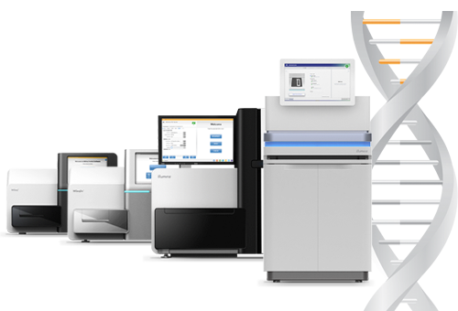
Technologies
NovaSeq 6000
  High Volume Projects
  Fast Turn-around
  “Weird sequencing runs”
HiSeq (2500/4000)
  Moderate scale projects
  Some quick turnaround
  Legacy projects
MiSeq
  Bacteria
  Pilot Projects
  Protocol testing “Nano runs”

Slide 11
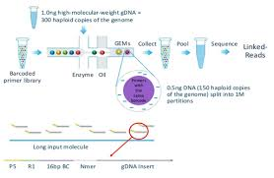
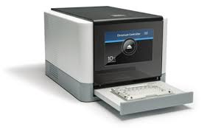
Innovative Technologies
Single-cell (10X genomics)
  Also Fluidigm at AAC in CGIBD
  ATAC-seq
Genome Scaffolding/S.V.
  BioNano Saphyr
Long read
  Oxford Nanopore MinION/GRiDIon/PromeathION
  10X DNA
  PacBio Sequel (via NCSU)
Arrays
  Affymetrix
  Illumina BeadArray and Infinium assay technologies
10x Genomics
Notes:
Mention scott

Slide 12
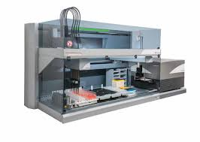
HTSF Supports 50+ Library Prep Protocols
Ask us!
HTSF probably makes it, some of the most common libraries are listed below
  DNA Kapa Hyper
  Kapa Ribo Erase for Total RNA
  Kapa mRNA
  16s Metagenomics
  TruSeq Ribo-Zero Gold for Total RNA
  Small RNA preps such as BioO Scientific and HTG Edge
  SMARTr XT plus Nextera
  Tecan Genomics/Nugen suite of libraries (great for non-standard, model organisms)
Large Project Automation
  5 Robotics systems
  Automation means highly consistent
  Illumina Nextera FLEX is automated!
  HTG system
    miRNA profiling direct from blood
HTSF has a BSL2 room to meet your sample needs

Slide 13
Future Plans
Acquire an ONT PromethION 24 system
  High-capacity long read sequencing technology capable of high production whole genome sequencing and transcriptomics. This technology allows for efficient resequencing whole genomes including repetitive elements, structural variation, and other problematic regions of the genome.
  Oxford Nanopore (ONT) sequencing provides reproducible detection of small, medium and large size structural variations and in the near future the detection of the 5mC.
Expand single cell genomics
  Single-cell profiling of both DNA and RNA can give deep insight into the signatures of cancer drivers in heterogenous tissue.
  We will expand our portfolio of single cell machines (second 10X in the BSL2).
  We are beginning a collaboration with TwinStrand Biosciences to apply their Duplex Sequencing Technology. This technology gives single cell level insight into tumor genome heterogeneity.

