Slide 1
How Physical Therapists Can Contribute to Transporting All Students Safely
Laurie Ray, MPT, PhD
PT & Medicaid Consultant, NC DPI ECD
laurie.ray@dpi.nc.gov
Thanks to Susan Englert Shutrump, OTR/L
Notes:
Kristine Lofton-

Slide 2
PT Collaborators!
Beginning of SY Training
Basic Disability information
Safe lifting & transfer technique
Securement
Evacuation
Individualization for Student Needs
Promoting Student Independence
Fixing What is Broken/Not working
Securement
Loading/Unloading

Slide 3
Transfers & Mobility Around/In Bus
Navigating to/from Bus Stop, Bus, School
Navigating within Bus (steps, seat, isle)
Efficiency/Safety
Modifications/Accommodations
Exploring transfer to typical bus seat (best & least restrictive)
Evacuation individualization for student/s & personnel

Slide 4
Seating, Positioning, Posture, Student Securement
Ensure each students’ least restrictive option
Follow manufacturer’s guidelines
Comply with procedural guidelines (have procedures established!!)
Use commercially available/conventional adaptation/equipment whenever possible
PT can specifically assist with:
Individualizing for student, staff and bus
Selection
Fit, Comfort & Use
Addressing posture/alignment & head/trunk control
Use of tilt/recline (avoid if at all possible, < 30°)
Training/Review
Quick checks

Slide 5
Safe Lifting, Body Mechanics & Protection
When compartmentalization is not enough:
Students who move out of seat/wheelchair and need individualized, effective occupant restraint
Physical
Behavior
Cognitive/Judgement
Students who have disabilities requiring modified seating/support, occupant restraint or individualized procedures
Assistance from related service providers to individualize (OT or PT or school nurse)
Preschoolers (all) or children too small for safe compartmentalization

Slide 6
Support for Mobility Devices, Wheelchairs (most equipment) & Securement
Conventional= purchase whenever possible (decreases unknowns, perhaps liability)
Least Restrictive= Less equipment, ‘just right’ principle
Familiar to the student and team
Tested= not the time for experimentation!
Identifying and marking securement points
Ensuring clear path
Assistance to ensure safe access to communication devices

Slide 7
Information on Disabilities & Specific Students
Understanding basics of student diagnoses and conditions
Alerting to specific signs, symptoms
Sharing how to ‘read’ this student
Individual safety considerations, precautions (like shunts, hemophilia, trachs, osteo bags, brittle bones, spinal rods).
Assisting with basic sensory, behavioral and communication needs & appropriate referrals
Document everything!!

Slide 8
Environmental Modifications & Accommodations
Bus steps
Transfers
Storing evacuation materials, equipment, aids for transport
Adapting securement
Identifying challenges (physical, cognitive, sensory, behavior, communication) & suggesting safe options

Slide 9
Solving Problems!
Houdinis
Brain-storming safe options, alternatives
Decreasing restriction
Promoting student independence
Individualizing for personnel’s specific physical abilities and needs
This Photo by Unknown Author is licensed under CC BY-NC
This Photo by Unknown Author is licensed under CC BY-NC
This Photo by Unknown Author is licensed under CC BY-NC
This Photo by Unknown Author is licensed under CC BY-NC

Slide 10
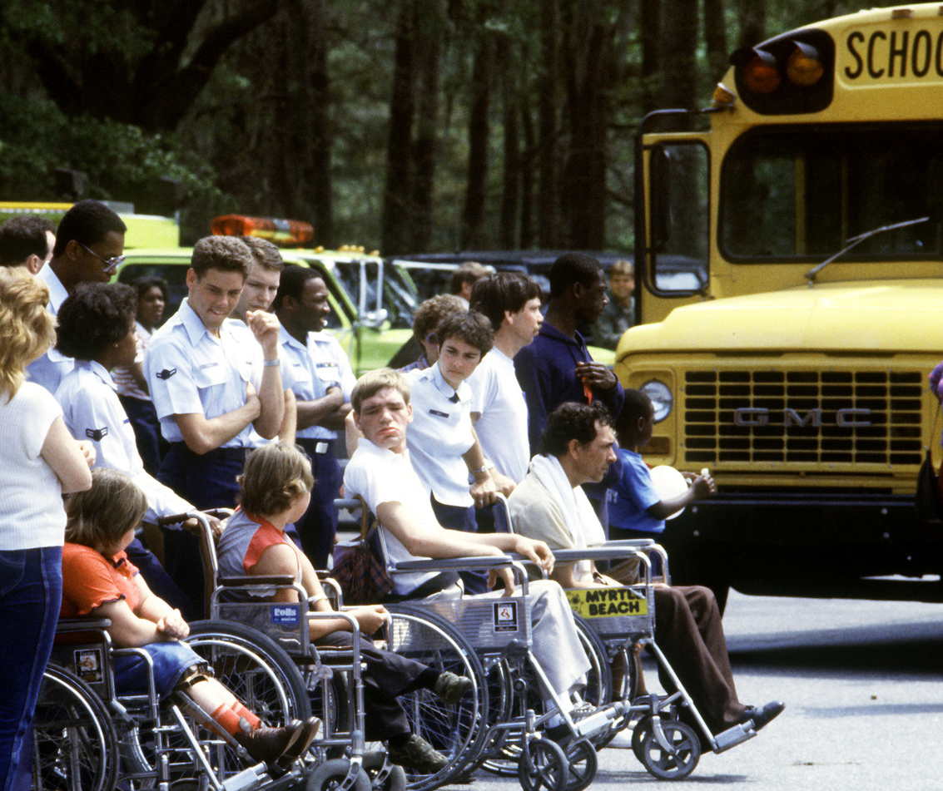
Transportation as a Related Service
Communication/ Collaboration
Who to go to for what?
Student
OT
Behavior specialist
Teacher
PT
SLP
Parent
IEP team
Principal

Slide 11
Resources
NC Resources-
NC DPI Transportation Services (Kevin Harrison)
Transporting Students with Special Needs/Manual
http://www.ncbussafety.org/contact.html
Shannon Ennis, Eastern Field Transportation Consultant
4386C US Hwy 31 South
Four Oaks, NC 27524
(919) 625-0947
Shannon.Ennis@dpi.nc.gov
Laurie Ray, PT & Medicaid Consultant
laurie.ray@dpi.nc.gov
Your district’s vendors

Slide 12
Cases!
This Photo by Unknown Author is licensed under CC BY
Partner up with 1 or 2 near you
Review these quick cases together, pick one
Read case, discuss and respond to the questions
Be prepared to share

Slide 13
SM is a 13 year-old boy recently released from the hospital, after prolonged treatment for medulloblastoma, grade IV. He had chemotherapy and radiation treatment and continues to receive radiation monthly. He does not have any modifications for positioning, restraint or mobility on the bus. He is not stable on the bus steps. SM is assigned to your route. What questions do you have? Any issues for safe transportation? If yes, what? Who can you contact for information/help?
BHW is a sweet, energetic little girl currently in kindergarten. She has had significant challenges with behavior this year. BHW has a history of abuse and intermittent counseling. BHW’s teacher reports that, on occasion, BHW has spontaneously taken off running toward the road and a PE teacher was able to run and catch up with her before BHW reached the road. BHW shows a similar lack of safety awareness on some of the playground equipment. Occasionally, when agitated BHW has hit herself and others. She will begin riding the bus in one month. Any issues for safe transportation? What needs to be considered or addressed? Who might assist? What would be your first step?
TT is a 18 year old girl with a medical diagnosis of spinal bifida (L2 myelomeningocele) and cognitive impairment. Her past medical history is significant for numerous surgeries and, more recently, a spinal rod stabilization T9-L1. ET reported that she takes two medications daily but cannot remember the names of the medications or what they are. She uses a wheelchair for mobility in the school environment. Any issues for safe transportation? Who might you partner with?
KMJ is 3.5 years old and has Costello Syndrome. He weighs 22 pounds. KMJ will begin riding the bus in the fall. Any questions or issues for safe transportation? Any equipment or accommodations to think about? Who might partner with you?
For all these cases, what evacuation planning needs to be in place, if any?

Slide 14
Discussion Questions & Answers

Slide 15
Thank you for your kind attention!
laurie.ray@dpi.nc.gov
919) 636-1827
www.med.unc.edu/healthsciences/physical/schoolbasedpt

