Slide 1
AHS Ambassadors 2014-15
Brenda Everett Mitchell, Advisor

Slide 2
Mission
To provide interdisciplinary student involvement by encouraging:
communication between students and administration
peer camaraderie
recruitment of prospective students
assistance to matriculating students and alumni involvement
community awareness of Allied Health disciplines

Slide 3
Requirements
Be currently enrolled in an undergraduate, graduate degree or certificate program in the department of allied health sciences.
Meet grade point average requirements for your specific program
Furnish names of two faculty who would be willing to recommend you to the organization
Demonstrate a history of involvement in campus activities in high school or your undergraduate school.
Participate in an interview with the Ambassadors advisor (Dr. Brenda Mitchell)
Be willing to volunteer for various student functions and communicate effectively with peers when necessary.

Slide 4
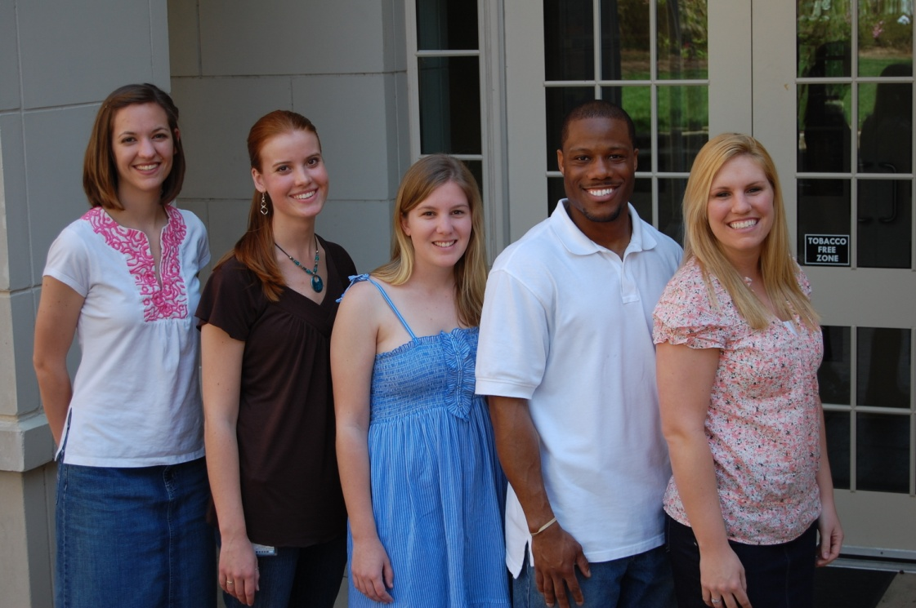
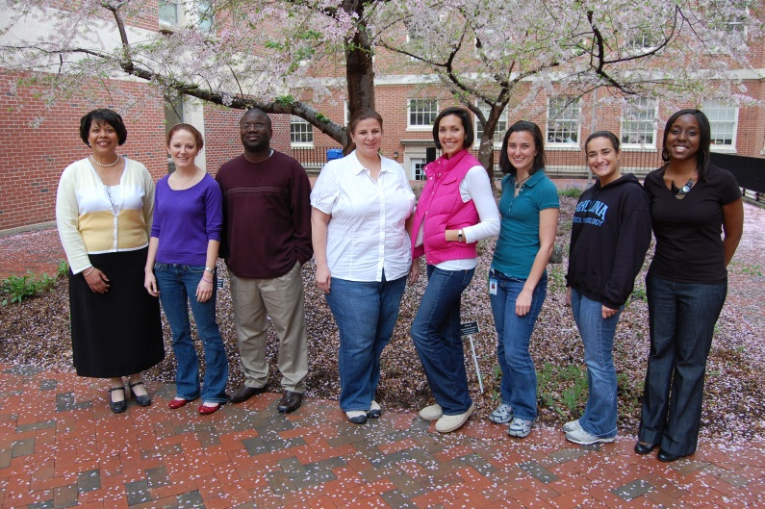
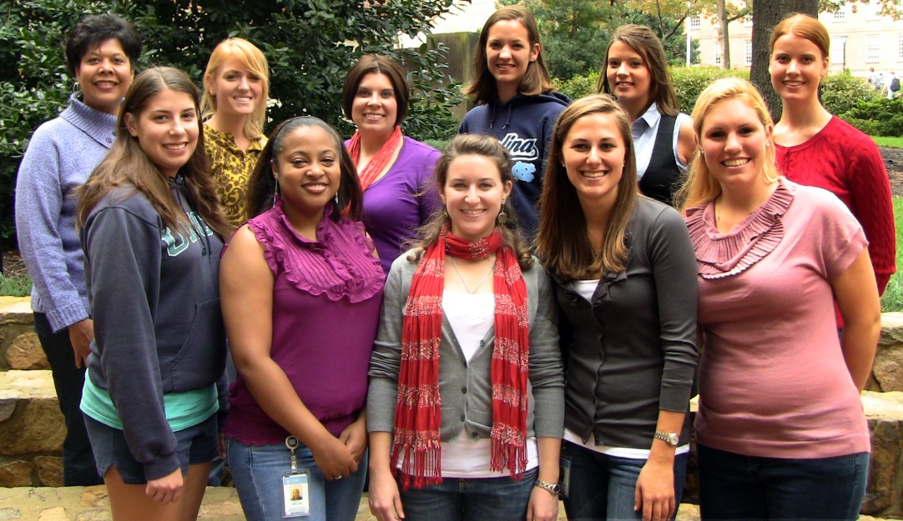
Ambassadors are a cut above the rest
2007 – Student Reps

Slide 5
Program Structure
Student run organization
Students meet to decide on activities
Students take assignments to accomplish tasks
Problem solve to be inclusive of all students
Recruitment activities
Excitement about professions
Able to share with other students and professionals
Retention Activities
Build teams across disciplines
Involve alumni and community

Slide 6
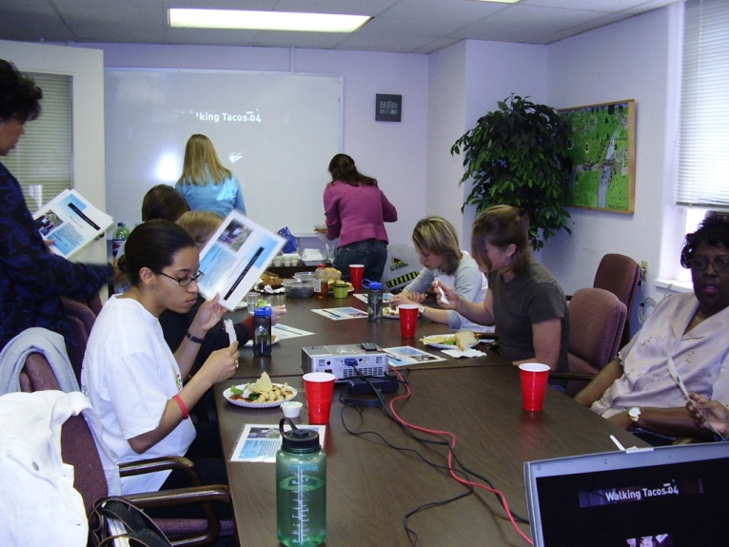
Ambassadors organize and inform!
2005
2006
2013

Slide 7
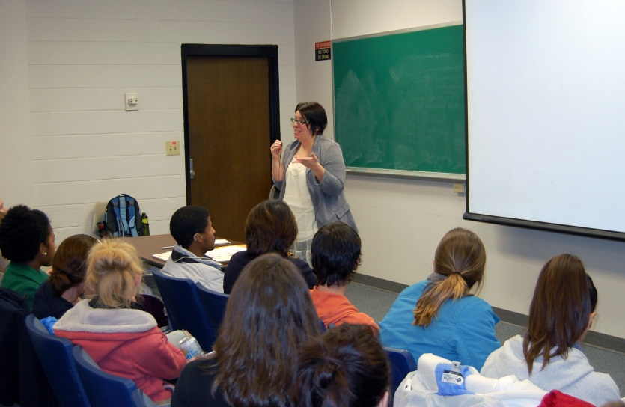
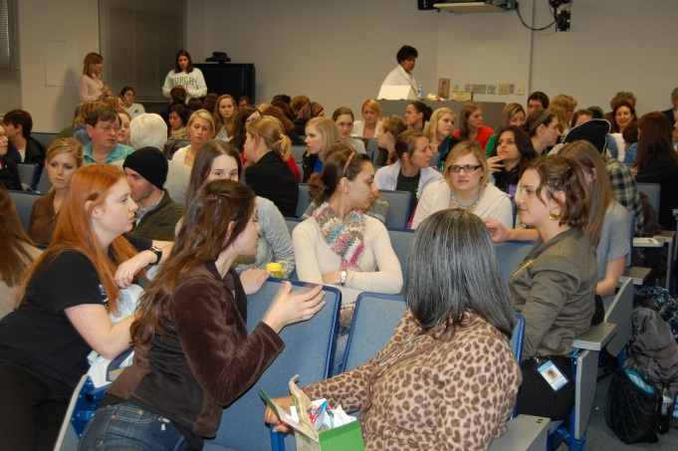
Ambassadors lead and share

Slide 8
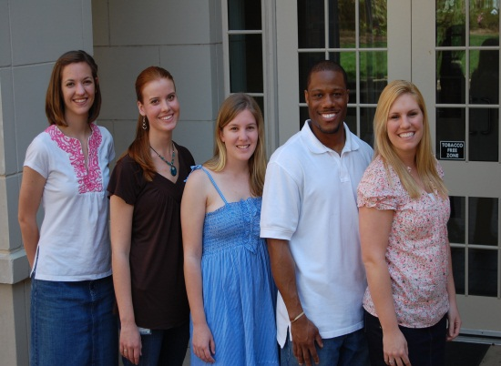
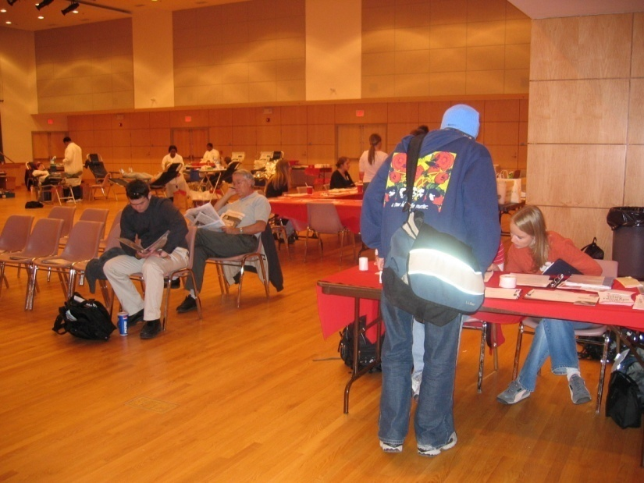
Ambassadors give back!

Slide 9
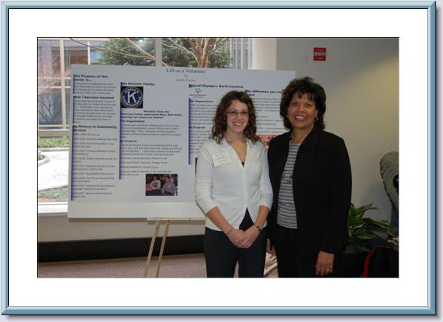
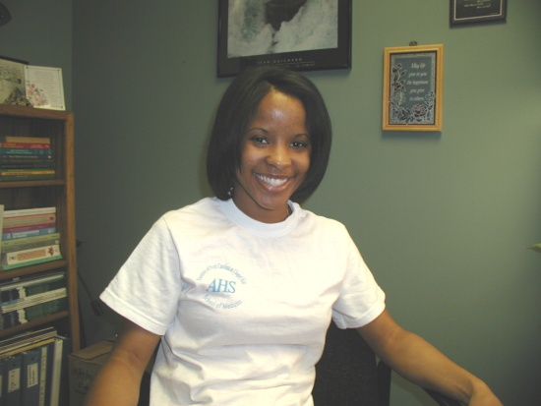
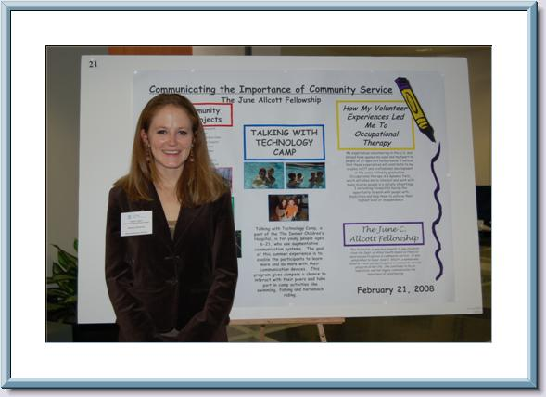
Honor each other

Slide 10
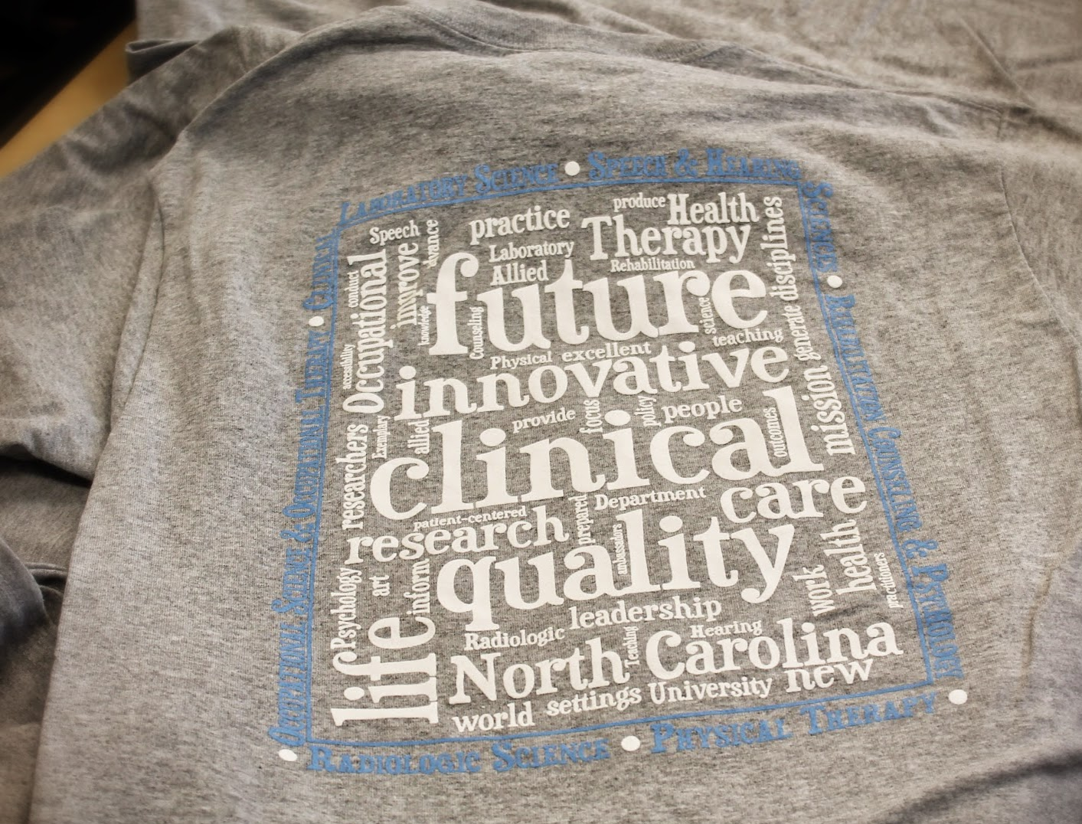
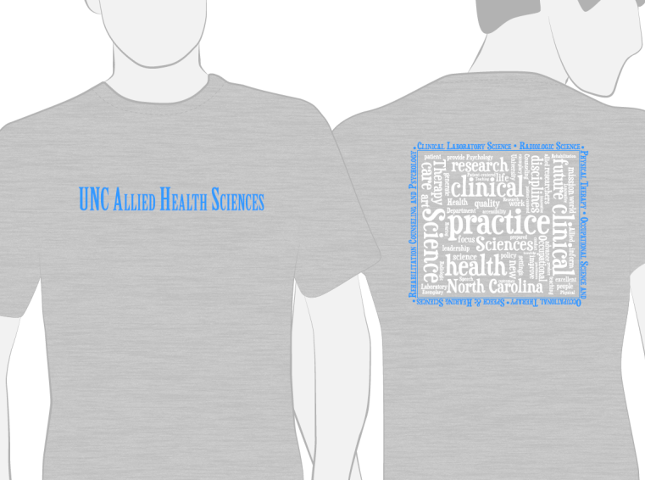
2014 t-shirt design
Created by Stephanie Ready (OT)

Slide 11
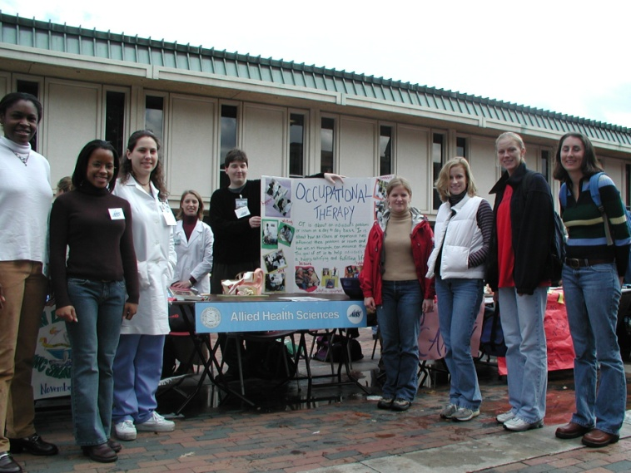
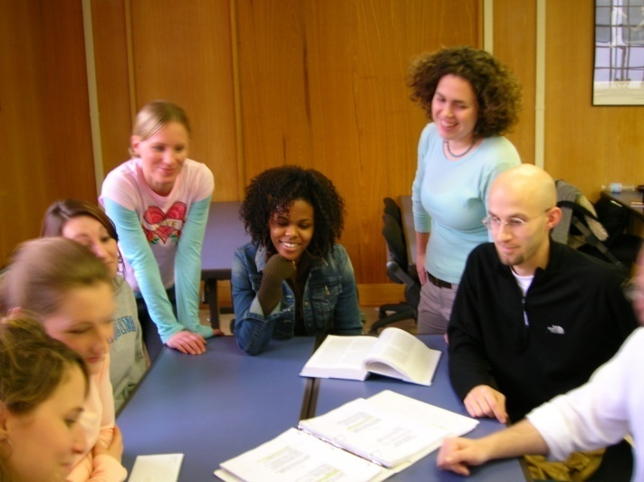
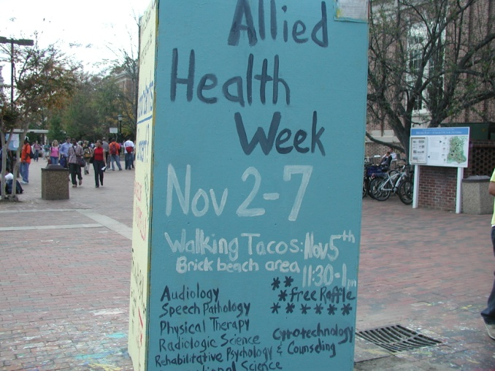
Recruiting

Slide 12
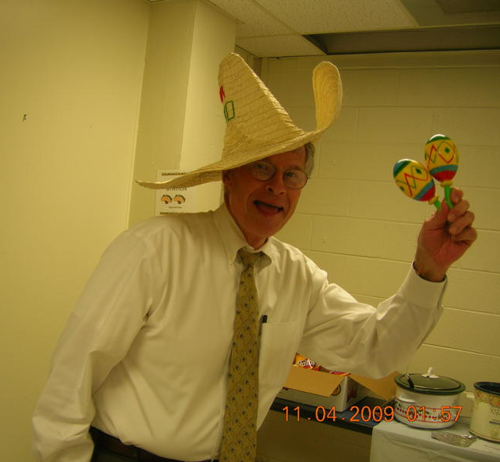
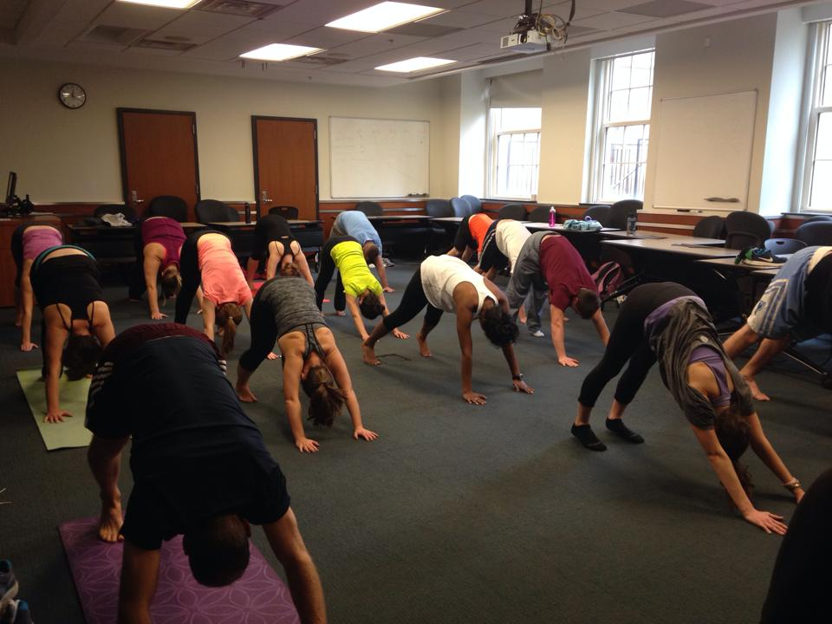
Ambassadors have fun!

Slide 13
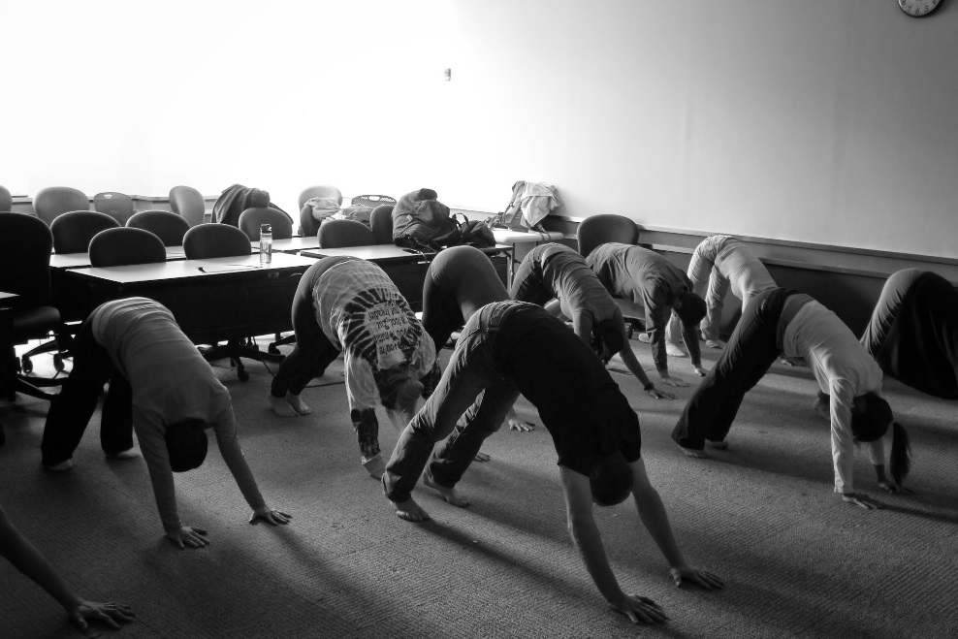
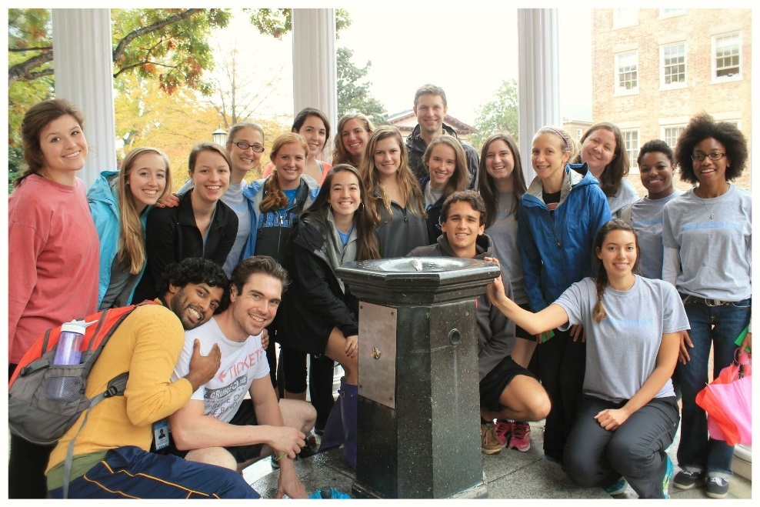
ALLIED HEALTH SCIENCES WEEK 2014
One mile Wellness Walk to the
Old Well
Students participating in a lunch break yoga class

Slide 14
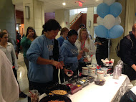
ambassadors celebrate!

Slide 15
2014-15 EVENTS
FALL 2014
Allied Health Open House
Difference Matters: Health Literacy
Financial Aid Lunch and Learn
National Allied Health Week
SPRING 2015
Difference Matters: Caregivers of People with Disabilities
Allied Health Job Fair (February 2015)
End of Year Celebration

