Slide 1

Office of Student Services
Fall 2021 Orientation
Dr. Brenda Mitchell
Associate Chair for Student Services and AHEC Operations

Slide 2
The University of North Carolina
Chapel Hill
School of Medicine
Department of Allied Health Sciences
AHS Divisions
↓
Disciplines of Study
Radiologic Science
Clinical Laboratory Science
Radiography
Clinical Laboratory Science
Occupational Therapy
Physician Assistant
Radiologist Assistant
Speech Language Pathology
Clinical Rehab
and Mental Health Counseling
Audiology
Occupational Science and Therapy
Physical Therapy
Speech Language Pathology

Slide 3
Student Services Administrative Roles
Student Services exists to support the mission of the Department of Allied Health Sciences (DAHS) by serving as an administrative foundation to students, faculty, staff and the community as related to Allied Health Science students’ success.
Admissions
Financial Aid
Student Life
Recruitment
Registration

Slide 4
AHS Diversity Statement
The Department of Allied Health Sciences, alongside the University's Office of Diversity and Inclusion and the Graduate School, is committed to recruiting and supporting a diverse student and faculty population, and to fostering an environment that is inclusive and welcoming for all. This commitment is founded on the beliefs that:
  The best solutions to health problems will be generated by the teamwork and collaboration of people who come from diverse backgrounds and different perspectives, and;
  Diverse populations of clients/patients will be served best when there is diversity amongst the health care providers.

Slide 5
Fall 2021 DAHS Total Enrollment by Division
Notes:
Updated as of 7/26/21

Slide 6
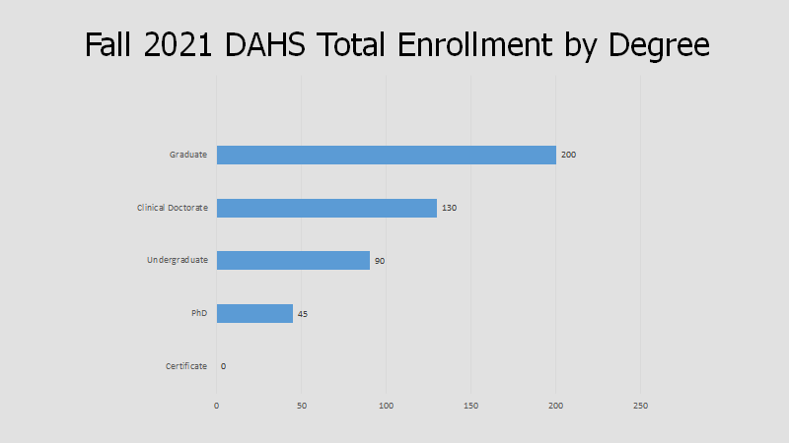

Slide 7
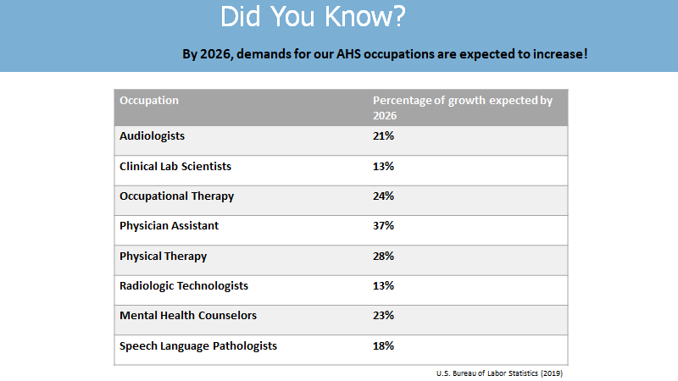

Slide 8
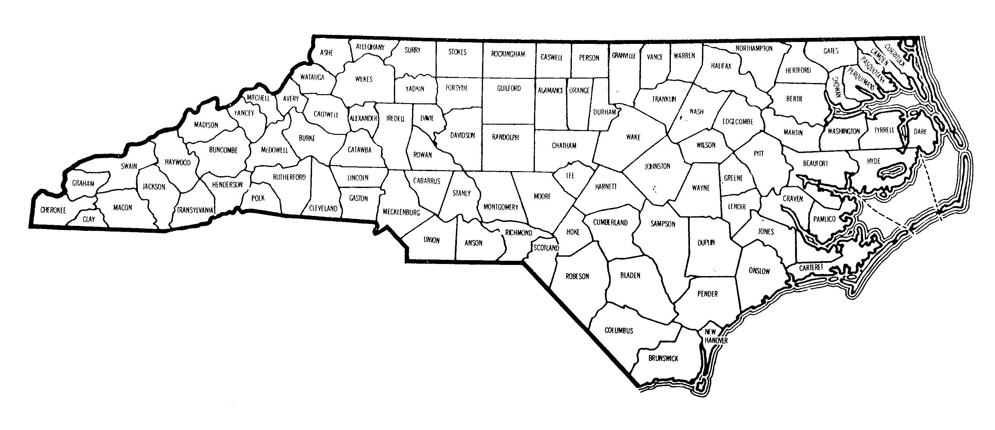
Legacy Healthcare Services Roxboro Healthcare and Rehabilitation Center
Duke University Hospital
Durham VA Medical Center
UNC Hospitals Pediatric Audiology Clinic
The Almac Group
Cheshire Center
UNC Health Care
Small World Therapy
Wake Forest Baptist Health
Western Carolina University
Benchmark Physical Therapy
Lillington Family Medicine
CarolinaEast Medical Center Rehabilitation Hospital
Where is our Class of 2020-2021 employed in North Carolina?
Goshen Medical Center
NC Division of Vocational Rehabilitation
Source: North Carolina County Map | Foliolip.com

Slide 9

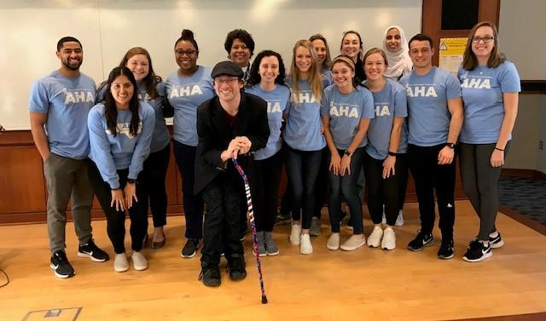
DAHS Ambassadors…
A dynamic team of student representatives from each discipline of the department focused on planning and executing special events, recruitment and building comradery among health professional students and the community.

Slide 10
UNC Student Resources
Accessibility Resources and Services
  haccessibility.unc.edu
CAPS
  campushealth.unc.edu/services/counseling-and-psychological-services/
Computer Labs/ITS Response Center
  help.unc.edu/subject/support/computer-labs/page/2/
Learning Center
  Learningcenter.unc.edu
Student Services Manual
  http://www.med.unc.edu/ahs/student-services/office-of-student-services-policies-and-procedures-manual
Learning Disabilities Services
  learningcenter.unc.edu/ldadhd-services
Student Mistreatment Report
  www.med.unc.edu/md/anonymous-report/
  https://www.med.unc.edu/md/governance/mistreatment/
Student Wellness
  studentwellness.unc.edu
University Career Services
  careers.unc.edu
UNC Writing Center
  writingcenter.unc.edu
Notes:
The Learning Center – helps students to learn more efficiently and perform better in course work. Services include academic counseling, peer tutoring, TESTPREP for standardized entrance exams, the Reading Program, group and individual speed reading courses, learning assistance in math and science, and Supplemental Instruction in chemistry and biology.
Learning Disability Services – All enrolled students , UG, G, P, cont. ed, are eligible for services at LDS once their documentation for their Learning Disability (LD) and/or Attn Deficit Hyperactivity Disorder (ADHD) has been reviewed by a university committee. Services include info about Dx assessment, direct services, accommodations, ADHD College Coaching, academic and support groups for students, and in-service training and consultation to the University members and community.
Writing Center - Provides free, non-credit avenues for students to use to improve his or her written communication skills. Services include individual tutorials, a grammar hotline, campus workshops, and a resource library. Assistance is available by appt and by dropping by as the schedule will permit. This service is open to all undergraduates.
Disability Services – this office works with programs, offices and departments throughout the University to ensure access. The philosophy of the office is to develop and provide services that permit students to (as independently as possible) meet the demands of University life at all levels of training. Assistance is available for registration, note-taking, interpreters for hearing-impaired students, additional time for exams and tests or Braille/large print, campus transportation, to name a few.
Computer Labs- 13 public computer labs available to student on campus, some are located in residence halls, The student Union has a bank of computers in the lobby so that students can access their email between classes.
IT Response Center- Information Technology Response Center is the central point of contact that any UNC faculty, staff, or student may access, free of charge, for assistance with technology issues. Available 24/7.
Career Services – Nash Hall (info in packet) This office provides an array of services and resources to hilp students prepare for their careers, learn job search skills, and find employment, UCS serves UG, G and alumni who have graduated within five years.

Slide 11
North Carolina Residency
How do I apply for North Carolina residency?
All students applying for NC Residency are required to apply online using the NC Residency Determination Service (RDS) - https://ncresidency.cfnc.org/
RDS decides a person's residency status based on the day the applicant initiates an online residency determination. As stated on the NC Residency Determination System website, "The residency statute mandates only those who can demonstrate a minimum of twelve months of uninterrupted domicile (legal residence) in North Carolina are eligible for in-state tuition."

Slide 12
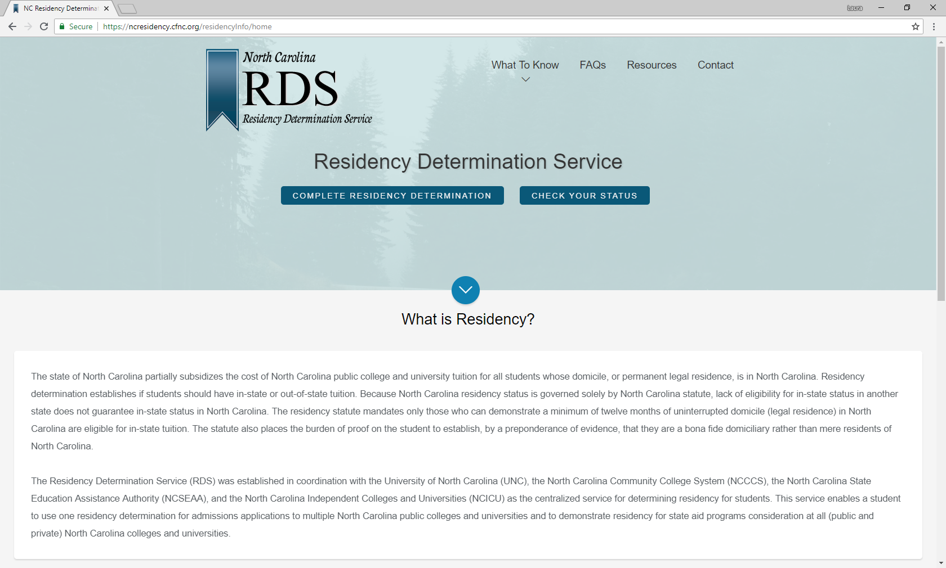

Slide 13
North Carolina Residency
You should wait until you believe that you are a NC resident BEFORE initiating a residency determination online interview (application).
You are encouraged to read through all of the residency guidelines and policies BEFORE you begin your online interview.
Please be sure to carefully enter all requested information into the RDS system, as errors will cause delays.
Once you complete your residency determination interview, you will receive a Residency Certification Number (RCN) and an initial residency determination. It is your responsibility to update your residency status in ConnectCarolina by entering your RCN in your Student Center page.

Slide 14
Resources in an Emergency
CarolinaGO
Access via m.unc.edu
Download the app on your smartphone
Ability to report
Fire/Medical 911 Department of Public Safety Health link
  Rape Crisis Center
  Employee/Management Relations
Bondurant Hall has 4 Evacuation and Accountability Points
Health Sciences Library
  On the sidewalk in front of the sign for the Health Science Library (NOT across the street)
Carrington Hall
  On the sidewalk in front of the Carrington Hall Nursing School sign
The Beach/Oasis
  To the right rear of The Beach/Oasis near the back benches (as if you’re walking towards the Hospital)
Berryhill Hall
  On top of the stairs near the Berryhill Hall sign
Areas of Rescue Assistance include all stairway landings in Bondurant Hall

Slide 15
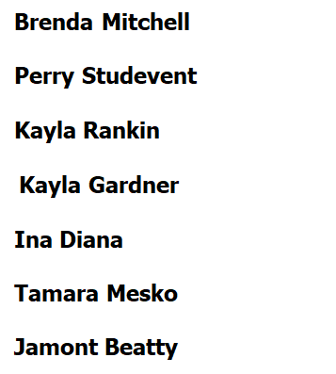
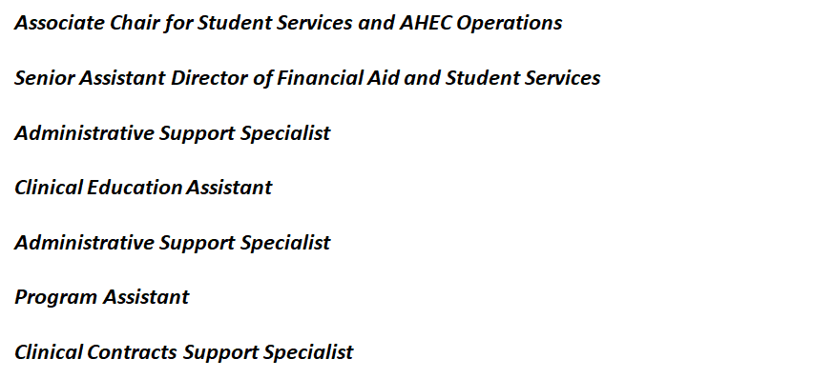
Your Student Services Team

Slide 16
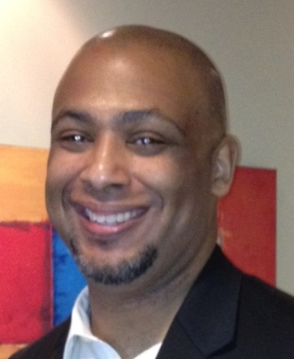
Assists with understanding financial aid resources
Serves as liaison between AHS and the Office of Scholarships and Student Aid
Assists staff with understanding and communicating important policies and procedures
Registrar/Student Services representative for the Division of Physical Therapy
Perry Studevent
Senior Assistant Director
for Student Services
and Financial Aid Officer
Doctor of Physical Therapy
PHD in Human Movement Sciences

Slide 17
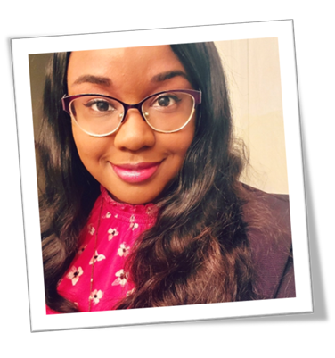
Coordinates admissions, enrollment, course management, classroom scheduling and graduation clearance for assigned divisions
Serves as point person for communication with prospective and current students
Coordinates professional development events and the Clinical Preceptor Appreciation Event (CPAE)
Serves as the departmental Course Evaluation System Manager and Residency Officer
Kayla S. Rankin
Student Services Specialist
M.D. in Audiology
MS in Clinical Laboratory Science
MS in Radiologic Science
Cert. in Radiography

Slide 18
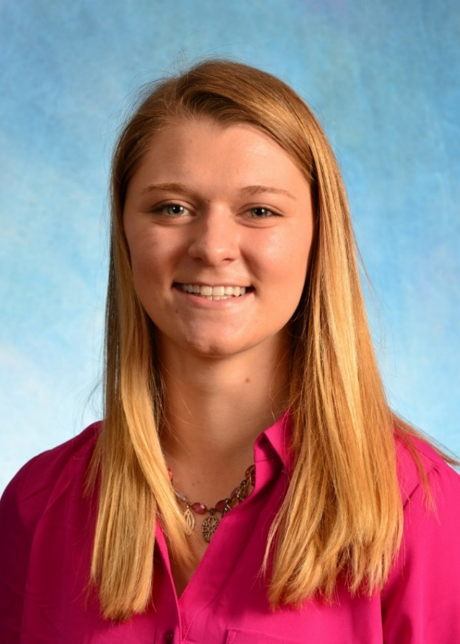
Assists with AHS immunization requirements and AHEC Housing
Serves as the department liaison with CastleBranch for students, faculty, and staff
Functions as the departmental Emergency Coordinator
Kayla Gardner
Clinical Education Assistant

Slide 19
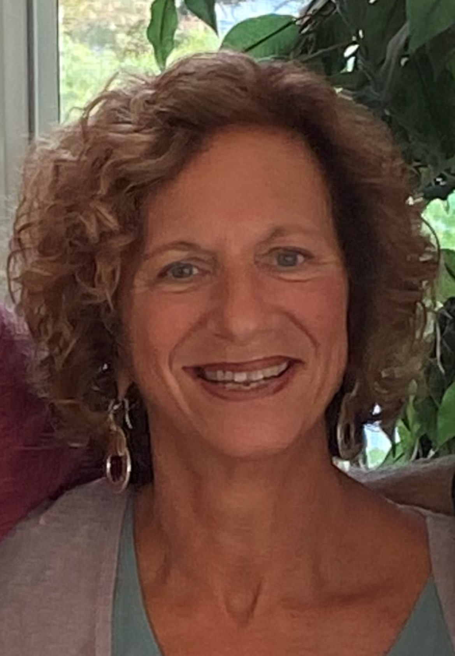
Serves as a liaison between students, faculty, and staff
Assists with student registration procedures
Serves as admissions and graduation coordinator
Assists in special event planning
Serves on Allied Health Course Evaluation Team
Pic
Ina Diana
Administrative Support Specialist
MS in Clinical Rehabilitation and Mental Health Counseling
MS in Speech Language Pathology

Slide 20
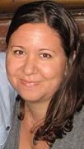
Coordinate admissions, registration, course management, classroom scheduling and graduation clearance processes
Point person for communication with prospective and current students
Coordinator for departmental PhD courses (AHSC)
Assist with transfer credit articulation for undergraduate students
Tamara Mesko
Student Services Specialist
BS in Clinical Laboratory Science
BS in Radiologic Science
MS in Occupational Therapy and Occupational Science
PhD in Occupational Science
PhD in Speech and Hearing Sciences

Slide 21

Manages departmental data and data visualization​
Coordinates clinical education affiliation agreements for student rotations​
Organizes departmental listservs and maintains locker assignments​
Jamont Beatty
Clinical Contracts Support Specialist

Slide 22




Follow DAHS on social media!
@UNC_AHS
@DeptAHS
UNC Department of Allied Health Sciences
@UNC_AHS
#uncahs
#uncosot
#uncpt
#uncpa
#unccls
#uncradsci
#unccrmhc
#uncshs
#uncahs

Slide 23
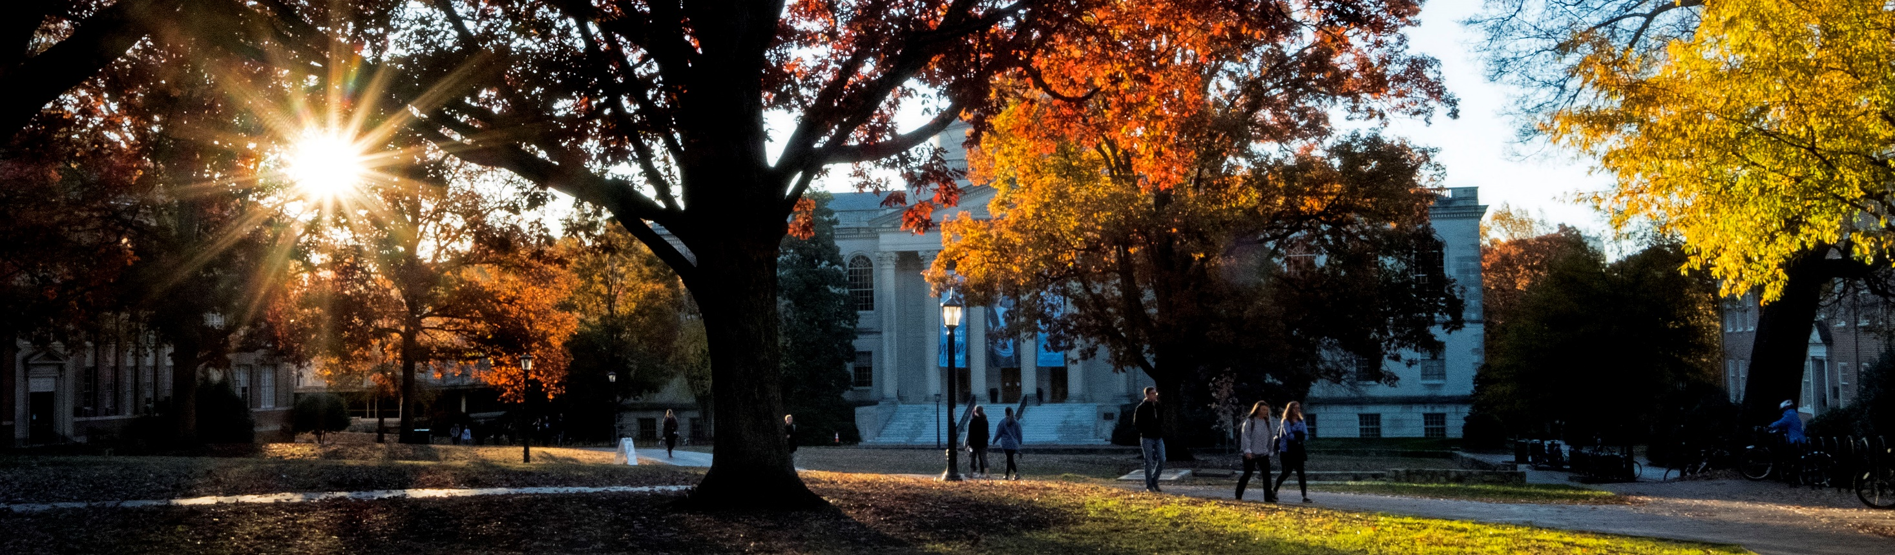
z
Questions?
Dr. Brenda Mitchell
Associate Chair for Student Services and AHEC Operations
brenda_mitchell@med.unc.edu

