Slide 1
Fall 2023 DHS Total Enrollment by Division

Slide 2
Fall 2023 DHS Total Enrollment by Degree

Slide 3
Did You Know?
By 2031, demands for our HS occupations are expected to increase!
Occupation | Percentage of growth expected by 2031
Audiologists | 16%
Clinical Lab Scientists | 7%
Occupational Therapy | 19%
Physician Assistant | 38%
Physical Therapy | 40%
Radiologic Technologists | 14%
Mental Health Counselors | 22%
Speech Language Pathologists | 21%
U.S. Bureau of Labor Statistics (2019)

Slide 4
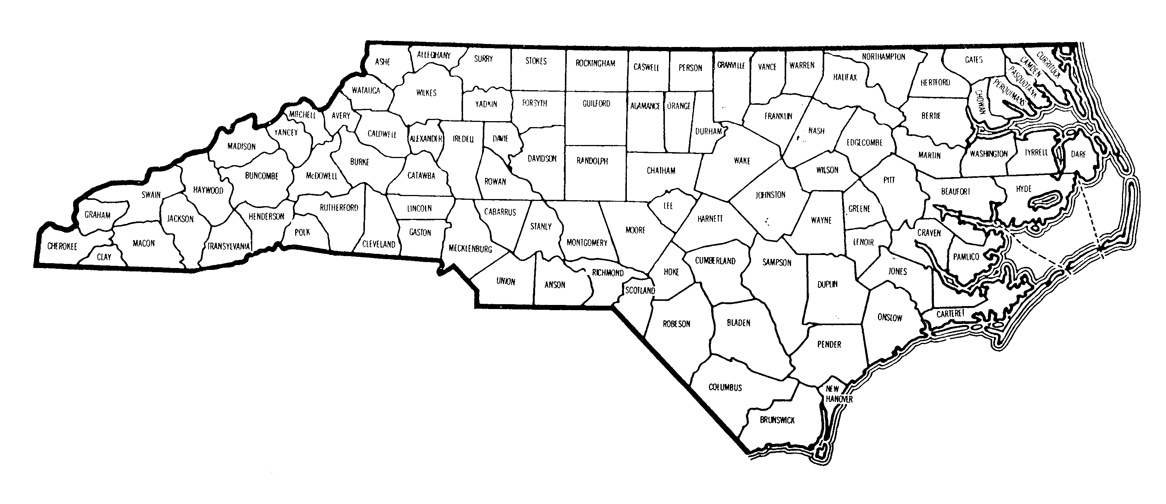
Legacy Healthcare Services Roxboro Healthcare and Rehabilitation Center
Duke University Hospital
Durham VA Medical Center
UNC Hospitals Pediatric Audiology Clinic
The Almac Group
Cheshire Center
UNC Health Care
Small World Therapy
Wake Forest Baptist Health
Western Carolina University
Benchmark Physical Therapy
Lillington Family Medicine
CarolinaEast Medical Center Rehabilitation Hospital
Where have our students been employed in North Carolina?
Goshen Medical Center
NC Division of Vocational Rehabilitation
Source: North Carolina County Map | Foliolip.com

