Slide 1
Office of Student Services
Fall 2023 Orientation
Kimberly Capri, EdM
Student Services Manager, Office of Student Services Department of Health Sciences

Slide 2
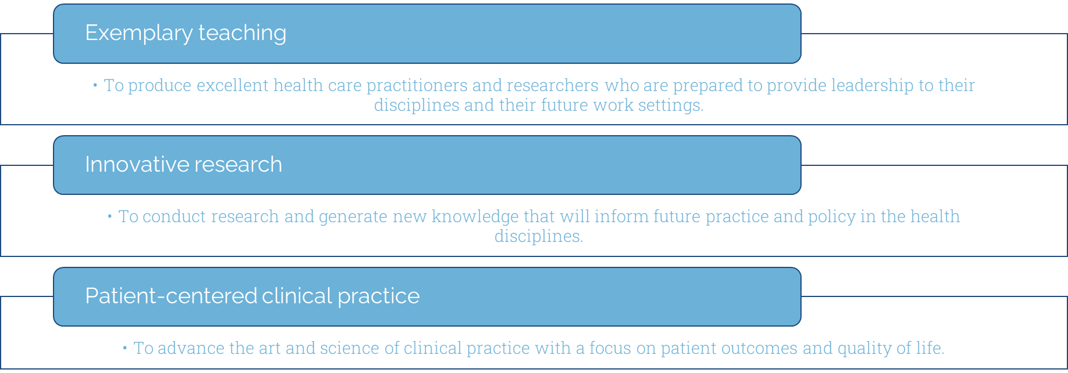
Our Mission
Notes:
Dr. Hooper

Slide 3
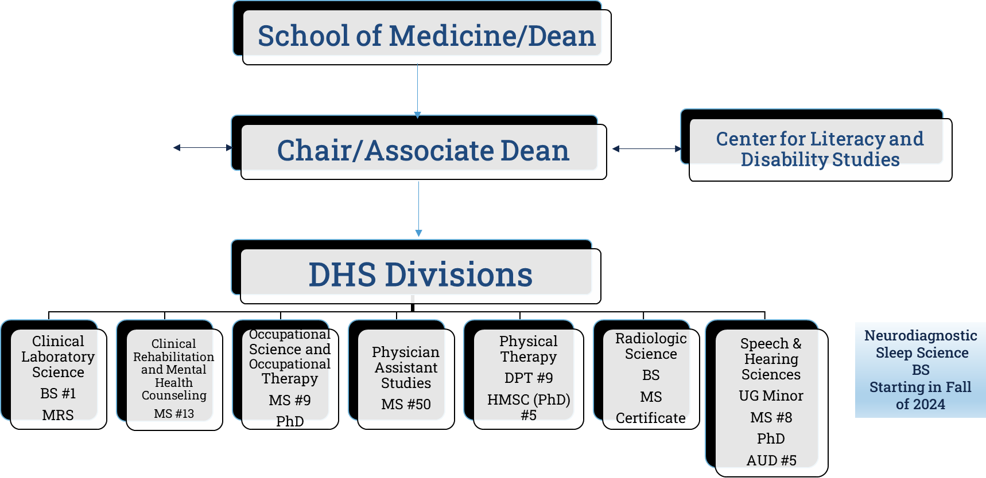
Notes:
Dr. Hooper

Slide 4
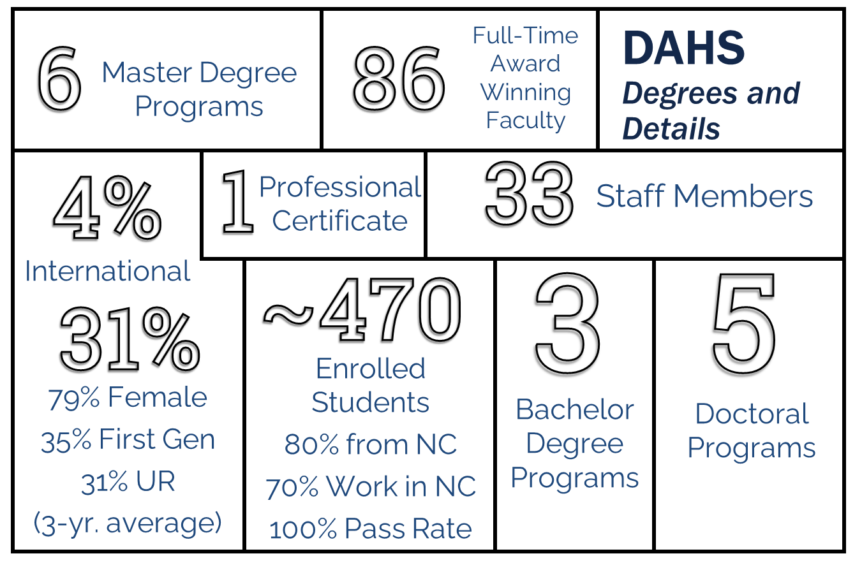
Notes:
Dr. Hooper

Slide 5
Final Thoughts...
Notes:
Dr. Hooper

Slide 6
The University of North Carolina Chapel Hill
School of Medicine
Department of Health Sciences
HS Divisions
↓
Disciplines of Study
Radiologic Science
Clinical Laboratory Science
Radiography
Molecular Diagnostic Science
Occupational Therapy
Physician Assistant
Radiologist Assistant
Speech Language Pathology
Clinical Rehab
and Mental Health Counseling
Audiology
Occupational Science and Therapy
Physical Therapy
Speech Language Pathology
Notes:
say something about how our students should understand campus communications: i.e., that if there’s a general message about classes being cancelled or whatever, we can’t necessarily do that.

Slide 7
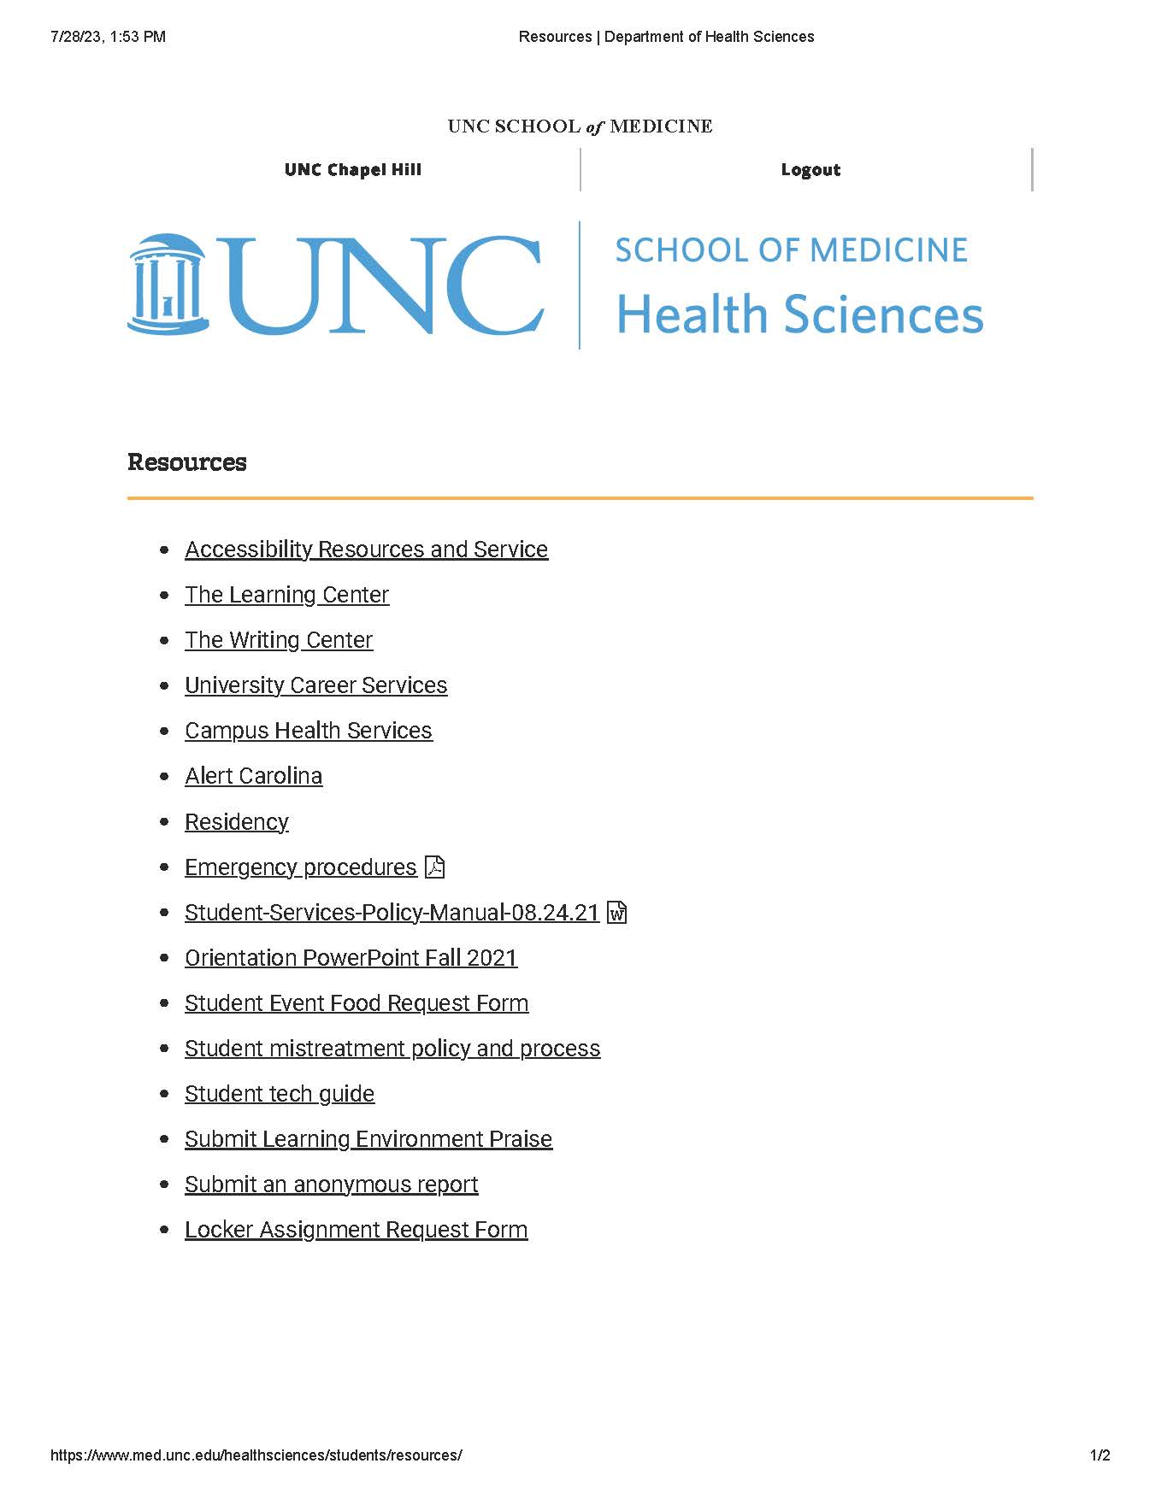
DHS Website/Resources
Resource Page on our website:
https://www.med.unc.edu/healthsciences/students/
Orientation Page:
https://go.unc.edu/DHSOrientation
Student Services:
https://go.unc.edu/DHSStudentServices
Notes:
The Learning Center – helps students to learn more efficiently and perform better in course work. Services include academic counseling, peer tutoring, TESTPREP for standardized entrance exams, the Reading Program, group and individual speed reading courses, learning assistance in math and science, and Supplemental Instruction in chemistry and biology.
Learning Disability Services – All enrolled students , UG, G, P, cont. ed, are eligible for services at LDS once their documentation for their Learning Disability (LD) and/or Attn Deficit Hyperactivity Disorder (ADHD) has been reviewed by a university committee. Services include info about Dx assessment, direct services, accommodations, ADHD College Coaching, academic and support groups for students, and in-service training and consultation to the University members and community.
Writing Center - Provides free, non-credit avenues for students to use to improve his or her written communication skills. Services include individual tutorials, a grammar hotline, campus workshops, and a resource library. Assistance is available by appt and by dropping by as the schedule will permit. This service is open to all undergraduates.
Disability Services – this office works with programs, offices and departments throughout the University to ensure access. The philosophy of the office is to develop and provide services that permit students to (as independently as possible) meet the demands of University life at all levels of training. Assistance is available for registration, note-taking, interpreters for hearing-impaired students, additional time for exams and tests or Braille/large print, campus transportation, to name a few.
Computer Labs- 13 public computer labs available to student on campus, some are located in residence halls, The student Union has a bank of computers in the lobby so that students can access their email between classes.
IT Response Center- Information Technology Response Center is the central point of contact that any UNC faculty, staff, or student may access, free of charge, for assistance with technology issues. Available 24/7.
Career Services – Nash Hall (info in packet) This office provides an array of services and resources to hilp students prepare for their careers, learn job search skills, and find employment, UCS serves UG, G and alumni who have graduated within five years.

Slide 8
North Carolina Residency
How do I apply for North Carolina residency?
All students applying for NC Residency are required to apply online using the NC Residency Determination Service (RDS) - https://ncresidency.cfnc.org/
RDS decides a person's residency status based on the day the applicant initiates an online residency determination. As stated on the NC Residency Determination System website, "The residency statute mandates only those who can demonstrate a minimum of twelve months of uninterrupted domicile (legal residence) in North Carolina are eligible for in-state tuition."
Questions? Email: rdsinfo@ncresidency.org
Notes:
Might be handling different (check with Perry) now all independent

Slide 9
Resources in an Emergency
CarolinaGO
Access via m.unc.edu
Download the app on your smartphone
UNC Carolina Ready Safety
Emergency contacts
Report tip
Support resources (Safe at UNC, Campus Health, UNC police)
Bondurant Hall has 2 Evacuation and Accountability Points
Health Sciences Library
On the sidewalk in front of the sign for the Health Science Library (NOT across the street)
The Beach/Oasis
To the right rear of The Beach/Oasis near the back benches (as if you’re walking towards the Hospital)
Areas of Rescue Assistance include all stairway landings in Bondurant Hall
Armed/Dangerous Person:
In the event of an armed or dangerous person on campus, you will need to assess your best option based on the circumstances. Unfortunately, there may not be a clear “right” answer. However, one of the following actions should be taken, listed in priority of consideration:
• Run: Find the best escape route, leave your belongings behind, and keep your hands visible.
• Hide: Hide in an area out of the individual's view, block entry to your hiding place and lock the doors, if possible. Turn off the lights and keep quiet
• Fight: As a last resort and only when your life is in imminent danger, attempt to incapacitate the individual. Be physical and aggressive. Use anything available around you to attack and throw things if possible.
Visit: https://campussafety.unc.edu/about/contact/
Notes:
Armed/Dangerous person: Take the time you need to identify the different exits in this room and our building. There are many ways in and out of this building. The next time you come to class, think about possible routes; try different routes so that you are aware. [Point to each exit in the room.] There is also The installation of additional hardware that provides the option to lock classrooms from the inside or lock doors automatically when closed.

Slide 10
Building Access
Rooms you will access to:
Bondurant Hall (exterior access)
Division Suite
Division Labs

Slide 11
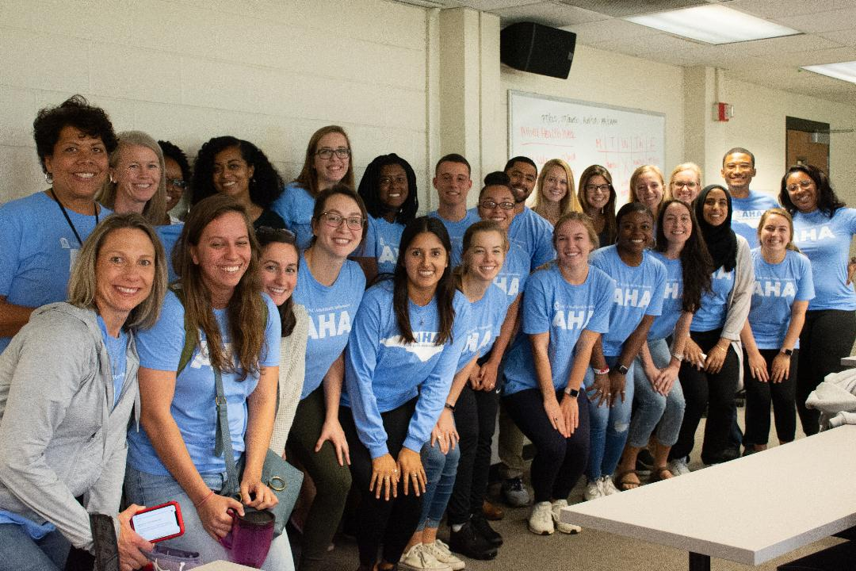
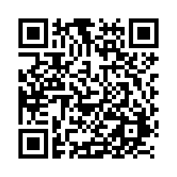
AHA Ambassador Program
Interest Meeting
TBD

Slide 12
Justice, Equity, Diversity, and Inclusion (J.E.D.I) Committee
Interested? Email: perrys@unc.edu

Slide 13
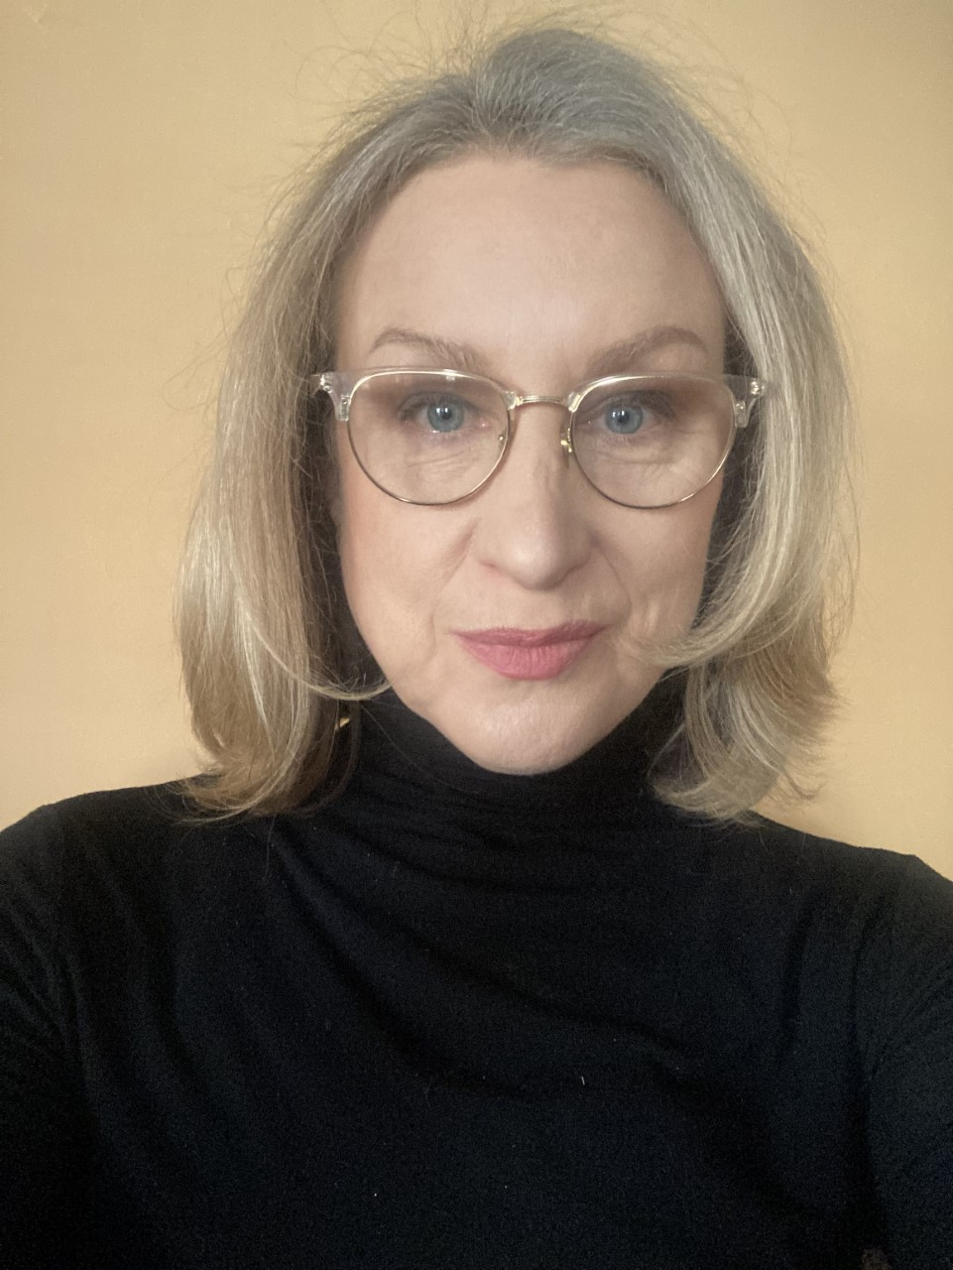
Health Sciences Global Partnerships Committee
Committee Chair:
Lisa Domby, M.S., CCC-SLP
Student Representative:
Janette Ramirez, M.S. Speech-Language Pathology Program
Rachana Gangwani, Ph.D. Human Movement Science Program
DHS Incoming International Student Numbers
TOTAL: 33
Division Breakdown -
CLS: 22
PT: 2
OT: 3
SPHS: 4
RadSci: 1
PA: 1
CMRH: 0

Slide 14
Office of Interprofessional Education and Practice (OIPEP)
IPEP @ UNC
What is IPE?
“When students from two of more professions learn about, from, and with each other to enable effective collaboration and improve health outcomes.”
WHO, 2010
Contact: Judy A. Schmidt, Ed.D., CRC, LCMHCA
Director, DAHS IPEP
judy_schmidt@med.unc.edu

Slide 15
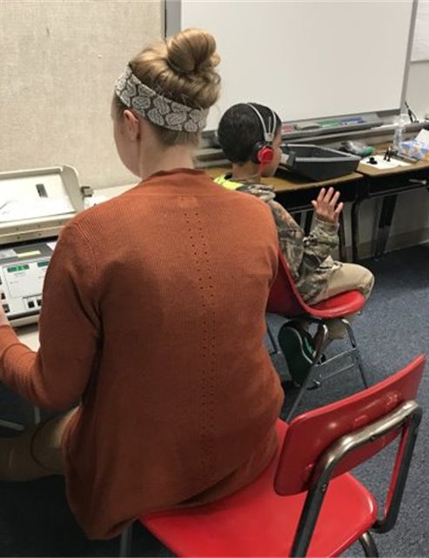
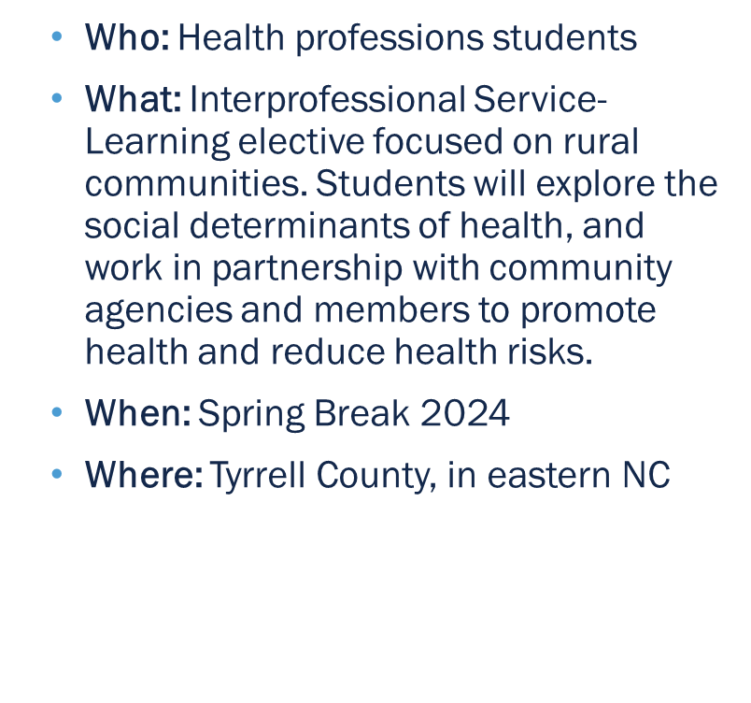
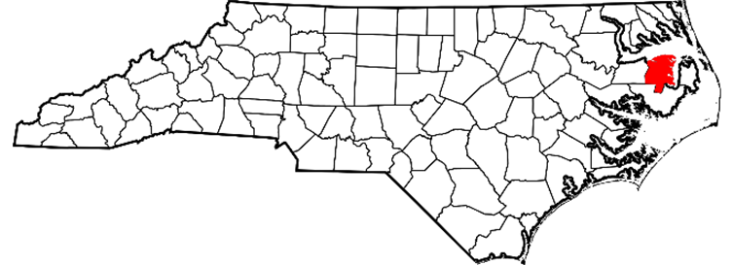
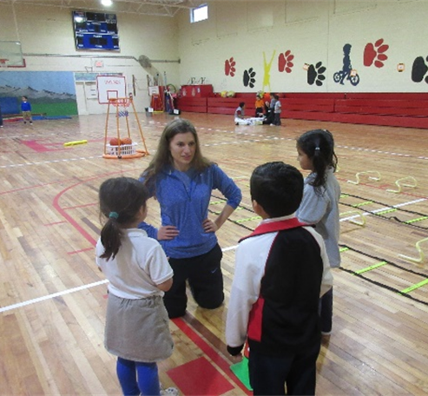
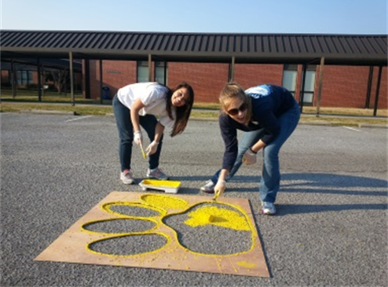
Inter-professional Service-Learning in Rural North Carolina

Slide 16
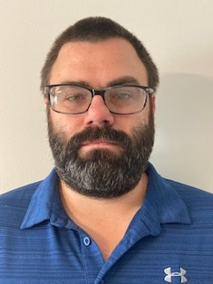
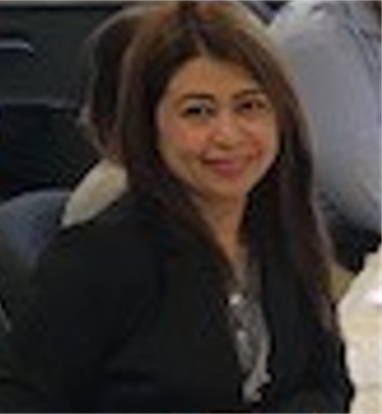
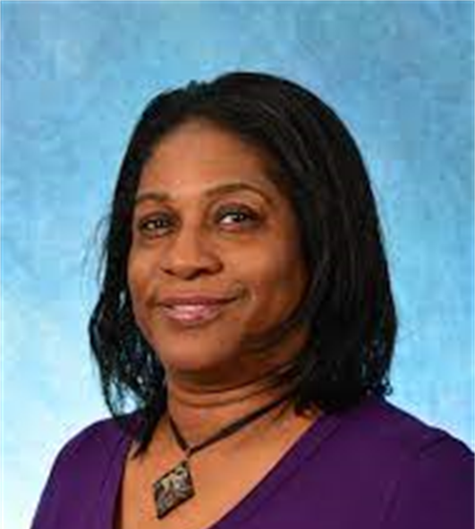
Business Office Team
Gradstar research funding
Student travel: PT, Speech and Hearing
GSHIP Insurance
Student travel: OT, CRMH
Student travel: RadSci, CLS, and Center For Literacy

Slide 17
Student Services Administrative Roles Student Services exists to support the mission of the Department of Health Sciences (DHS) by serving as an administrative foundation to students, faculty, staff and the community as related to Health Science students’ success.
Admissions
Financial Aid
Student Life
Recruitment
Registration

Slide 18
Student Services Team
Perry Studevent Senior Assistant Director of Financial Aid and Student Services
Kimberly Capri Student Services Manager
Barbara Hutchison Clinical Education Administrator
Carolyn Oakes Administrative Support Specialist
Tamara Mesko Administrative Support Specialist
Kayla Rankin Administrative Support Specialist
Juwan Watson Administrative Support Specialist
Phillip Hopkins Clinical Contracts Support Specialist
Stephen (Garrett) Nesmith Clinical Contracts Support Specialist
Notes:
Include Juwan?

Slide 19
Assists with understanding financial aid and financial planning resources
Serves as liaison between AHS and the Office of Scholarships and Student Aid
Assists staff with understanding and communicating important policies and procedures
Registrar/Student Services representative for the Division of Clinical Rehabilitation and Mental Health Counseling
Perry Studevent
Senior Assistant Director
for Student Services
and Financial Aid Officer
MS - Clinical Rehabilitation and Mental Health Counseling
Email: perrys@unc.edu

Slide 20
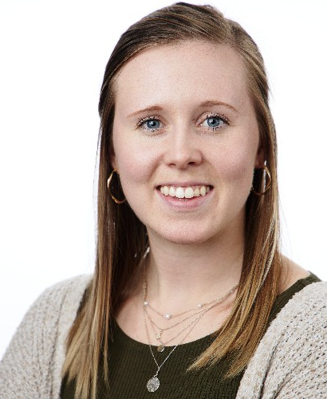
Supports and assist Office of Student Services Employees.
Helps to oversee the employees and the office environment within Student Services.
Assists staff with understanding and communicating important policies and procedures.
Kimberly Capri
Student Services Manager
Kimberly_Capri@med.unc.edu

Slide 21
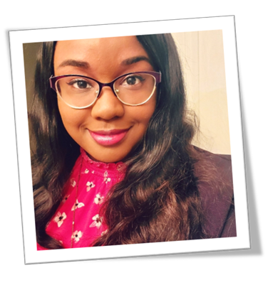
Coordinates admissions, enrollment, course management, classroom scheduling and graduation clearance for assigned divisions
Serves as point person for communication with prospective and current students
Serves as the departmental Course Evaluation System Manager and Residency Officer
Kayla S. Rankin
Student Services Specialist
AuD - Audiology
MS in Speech Language Pathology
Cert. in Radiography
Kayla_Rankin@med.unc.edu

Slide 22
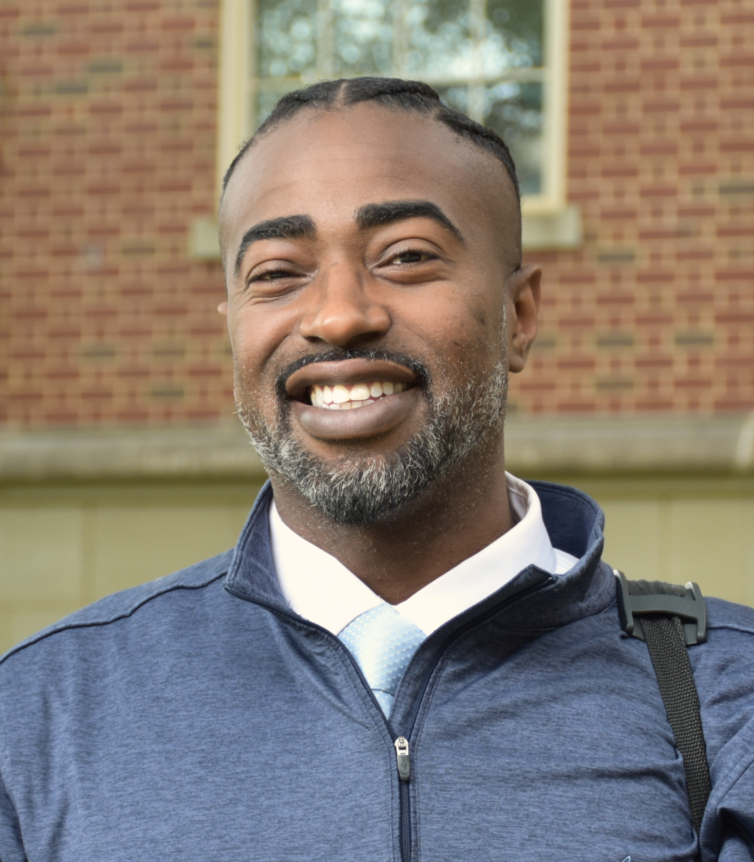
Coordinates admissions, enrollment, course management, classroom scheduling and graduation clearance for assigned divisions
Serves as point person for communication with prospective and current students
Juwan Watson
Student Services Specialist
PA – Physican Assistant
Juwan_Watson@med.unc.edu

Slide 23
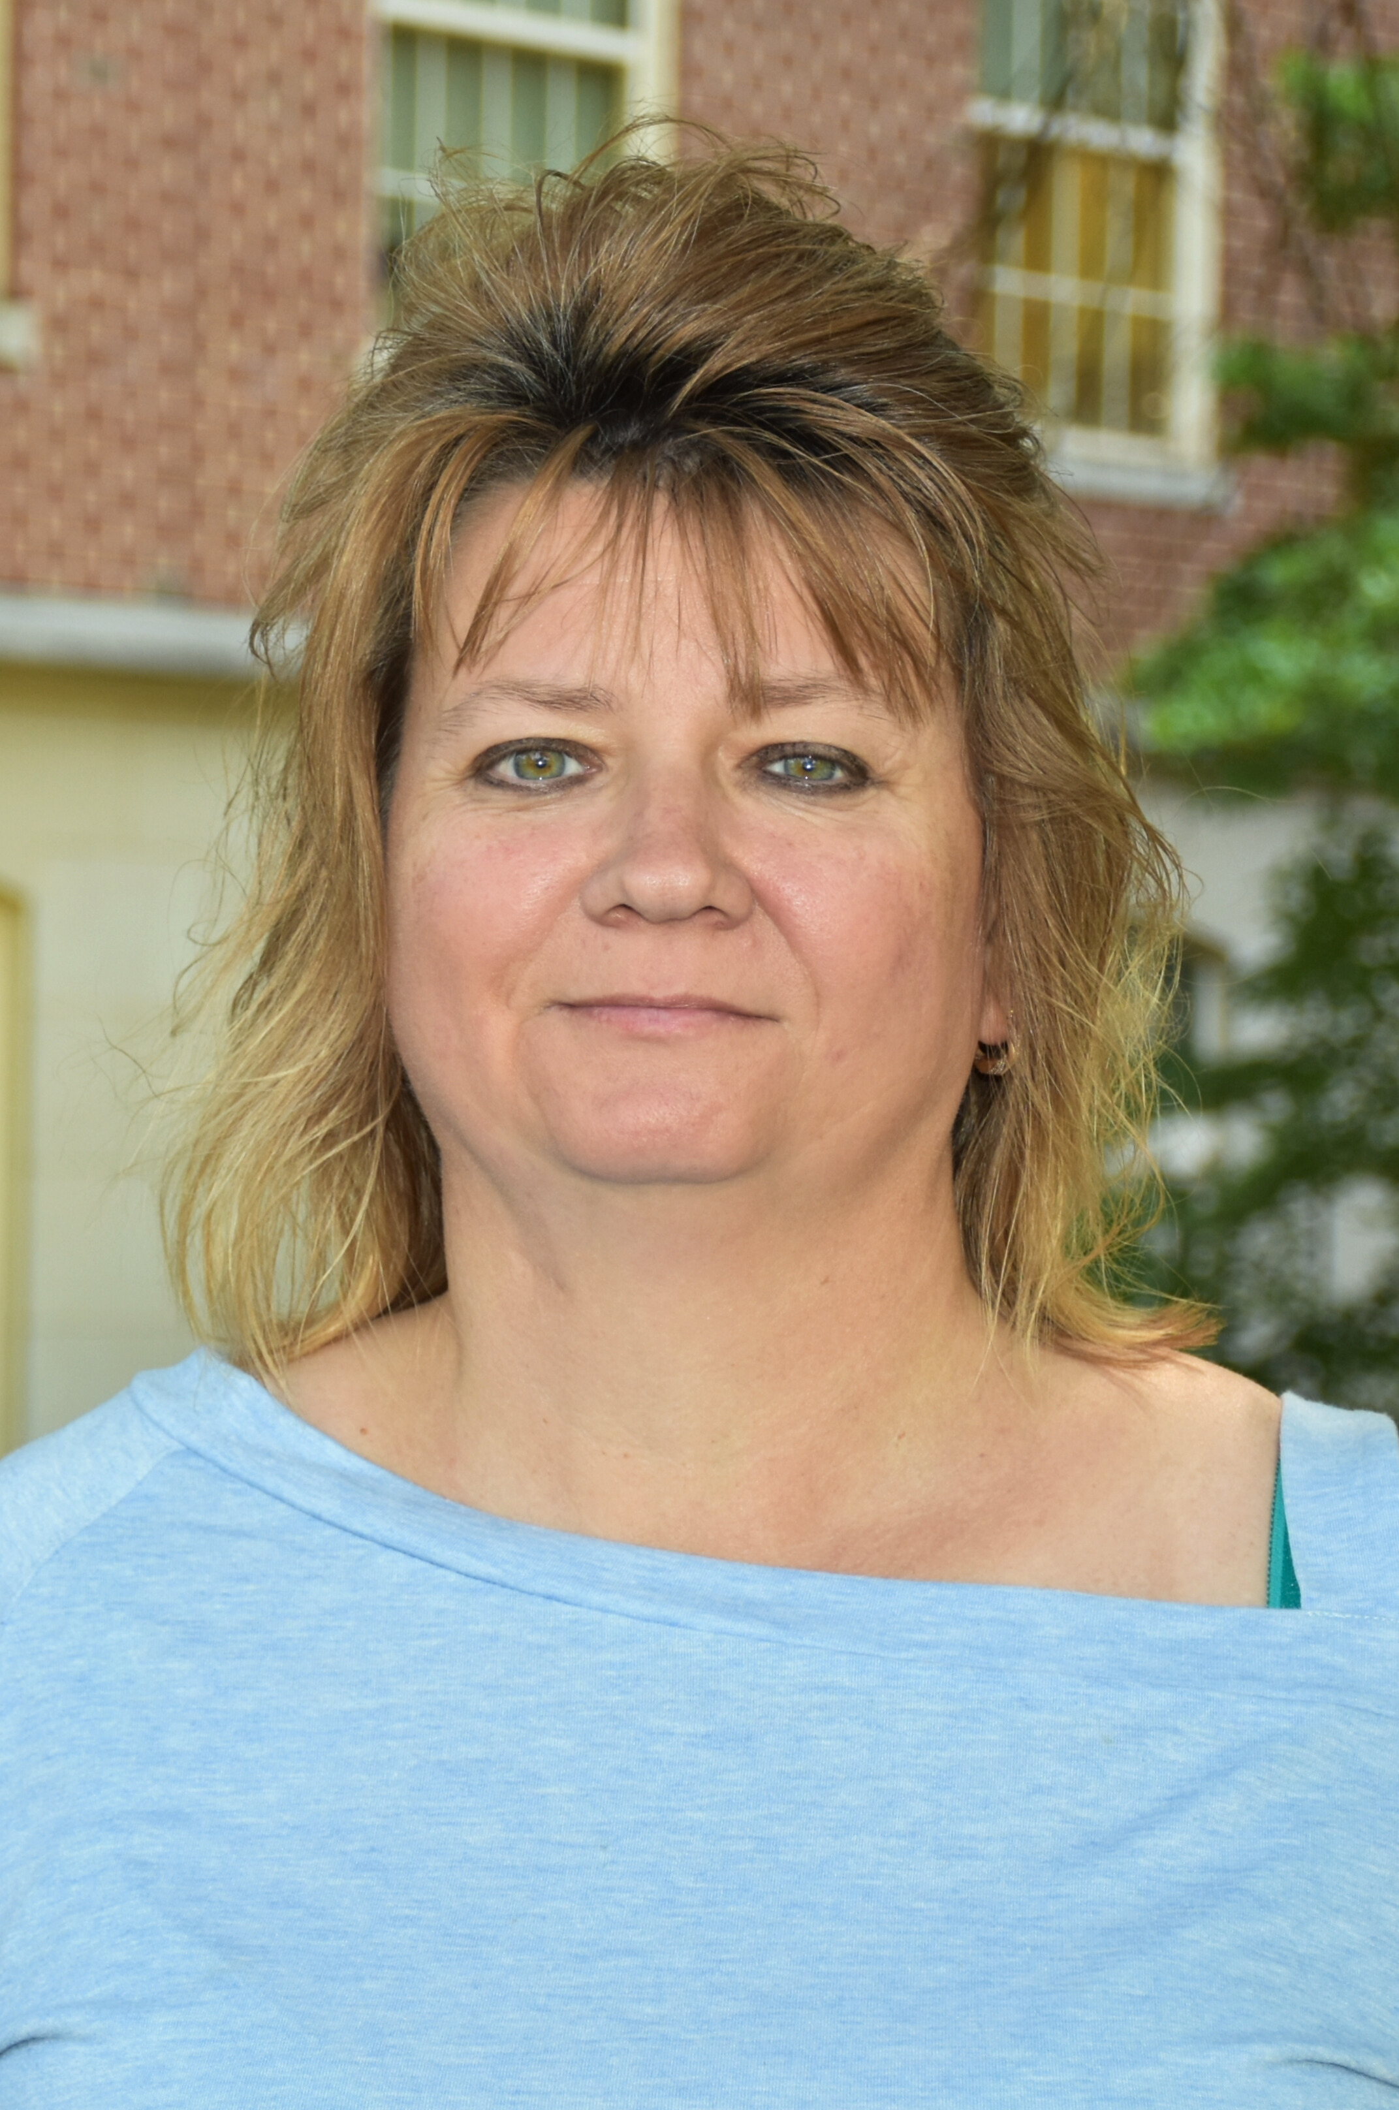
Serves as a liaison between students, faculty, and staff
Assists with student registration procedures
Serves as admissions and graduation coordinator
Assists in special event planning
Pic
Carolyn Oakes
Administrative Support Specialist
Physical Therapy DPT/HMSC, tDPT
MS in Clinical Laboratory Science
BS in Clinical Laboratory Science
Carolyn_Oakes@med.unc.edu

Slide 24
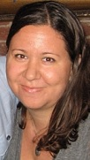
Coordinate admissions, registration, course management, classroom scheduling and graduation clearance processes
Point person for communication with prospective and current students
Coordinator for departmental PhD courses (AHSC)
Assist with transfer credit articulation for undergraduate students
Organizes departmental listservs
Tamara Mesko
Student Services Specialist
BS in Radiological Science
MS in Radiological Science
MS in Occupational Therapy and Occupational Science
PhD in Occupational Science
PhD in Speech and Hearing Sciences
Tamara_Mesko@med.unc.edu

Slide 25
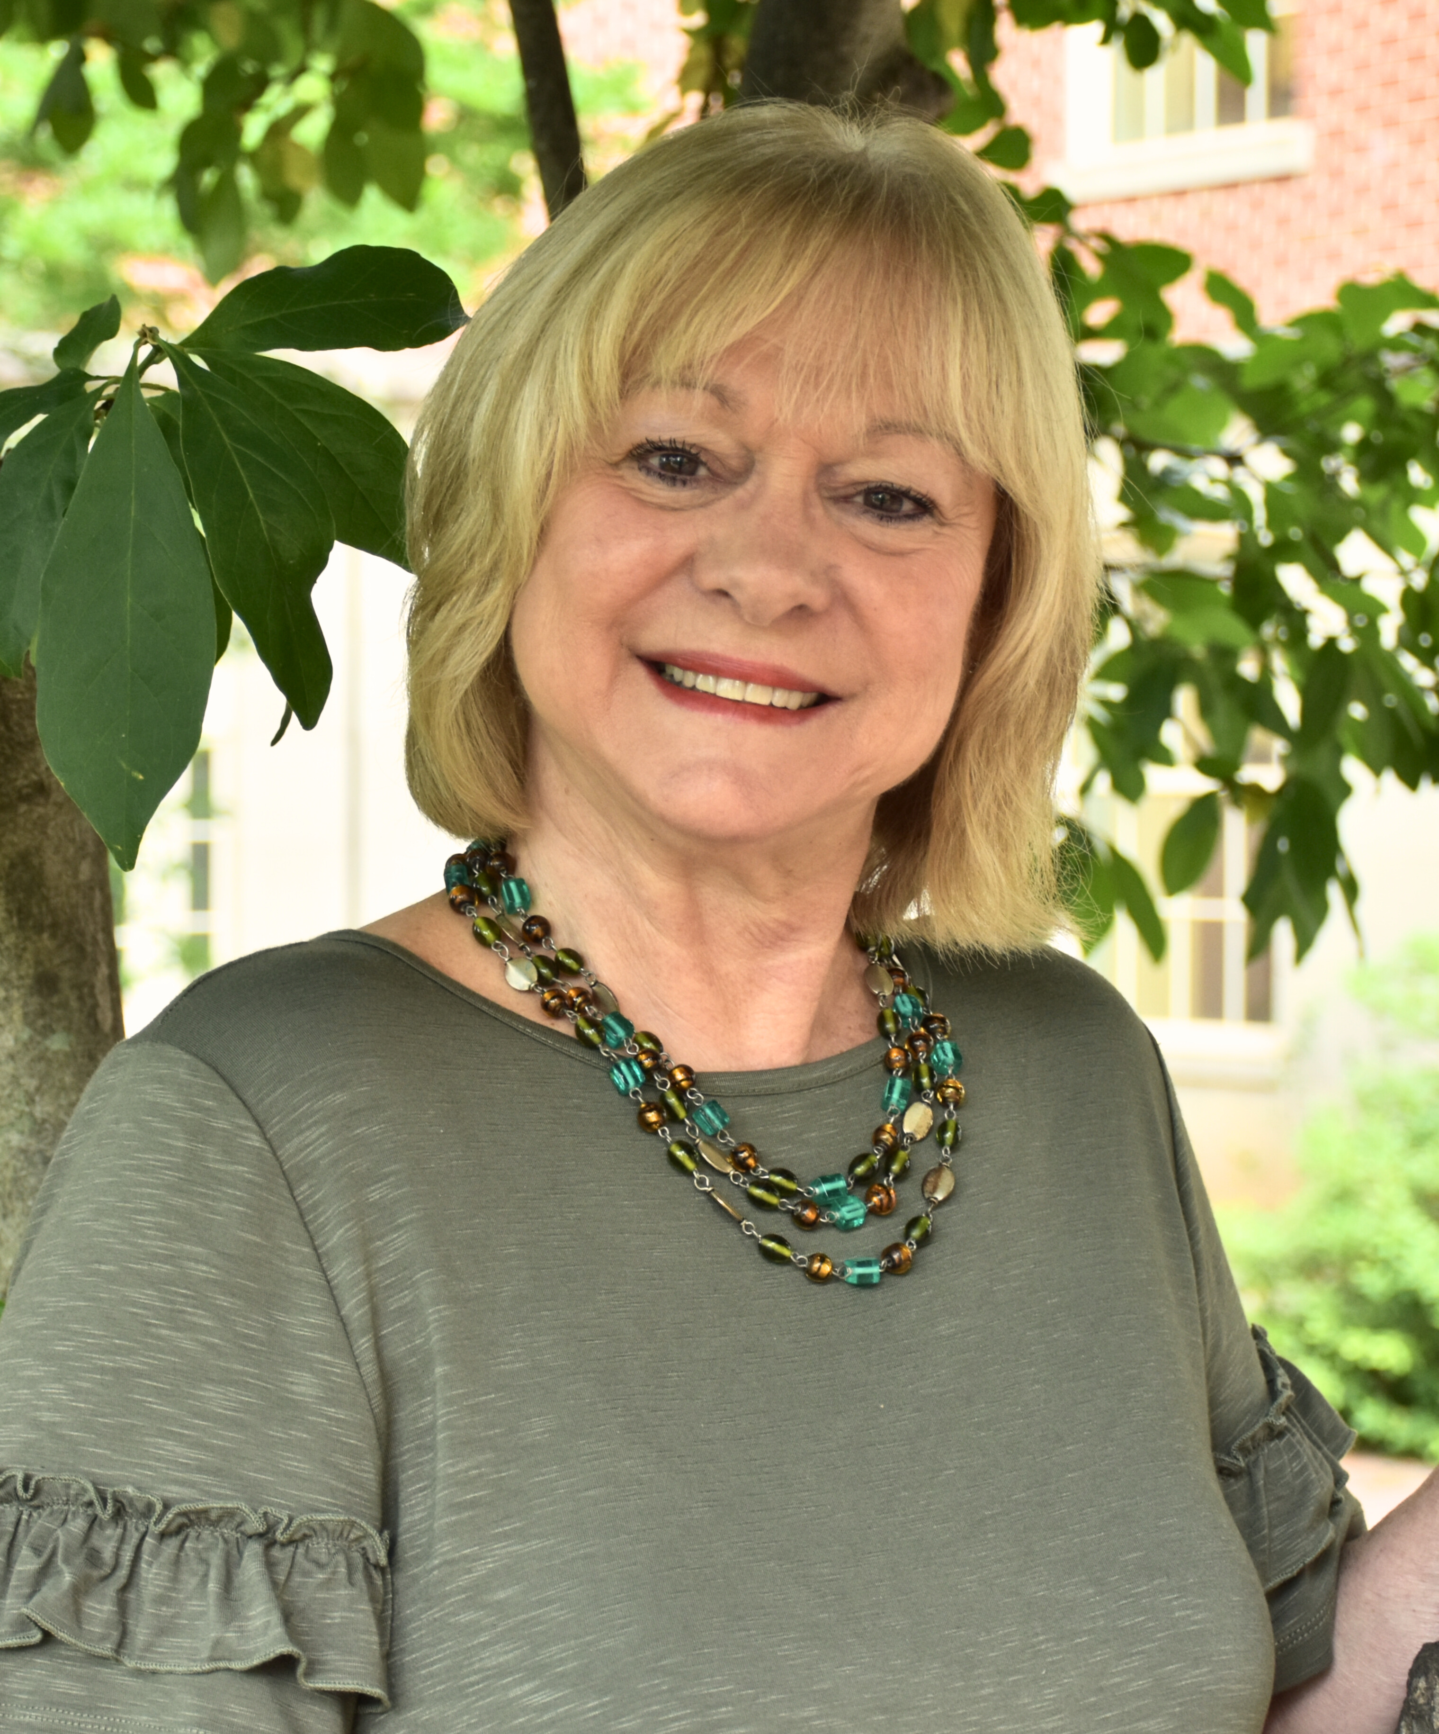
Assists with AHS immunization requirements and AHEC Housing
Serves as the department liaison with CastleBranch for students, faculty, and staff
Coordinates the Clinical Preceptor Appreciation Event (CPAE) and assists with IPE events in the Department
Barb Hutchison
Clinical Education Administrator
Barbara_Hutchison@med.unc.edu
Notes:
Change picture

Slide 26
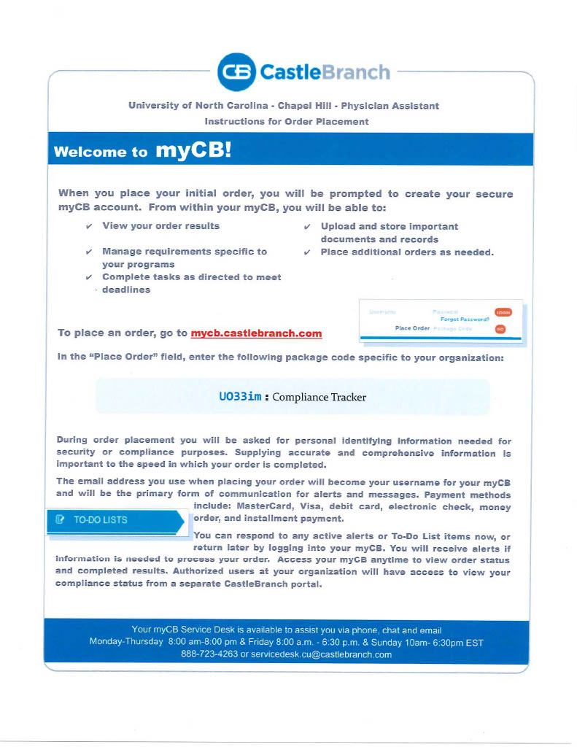

Slide 27
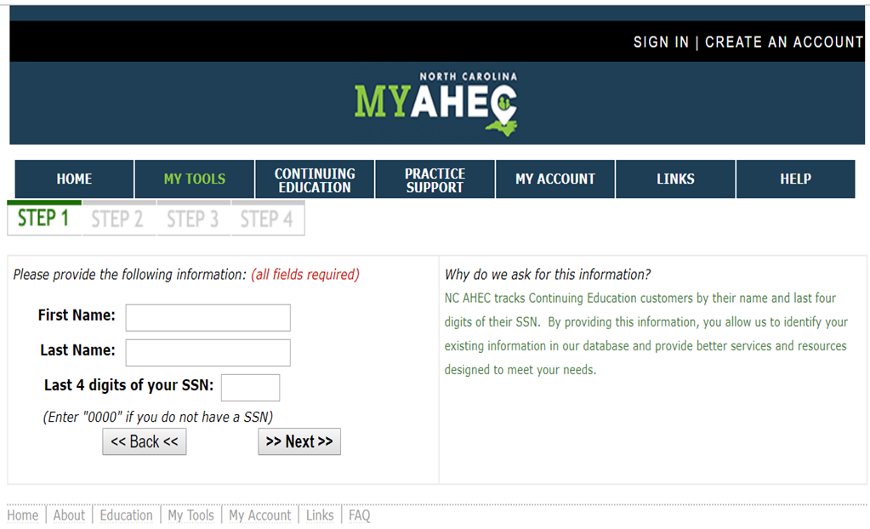
Area Health Education Centers (AHEC)
Housing
How to Apply?
Go to www.my.ncahec.net
Create an Account
When applying for housing, please request up to one day prior and one day post your clinical rotation dates
If your placement is canceled, please remember to cancel your housing request by accessing your profile
After AHEC reviews your request form, they will contact you in a few weeks with your housing information. It takes a while for them to place you into housing so, the sooner you can get a request in the more likely you'll be approved for housing in your requested region.
Housing will vary depending on the location you are in and is not guaranteed for all students.
Fill in the necessary information for Steps 2, 3 & 4
Notes:
Fill in the necessary information for Steps 1, 2, 3, & 4
The following information will be required when filling out your request form:
uStudent Name
uUniversity
uSchool/Dept
uCourse
uNC AHEC Region
uCity
uSite
uArrival
uDeparture

Slide 28
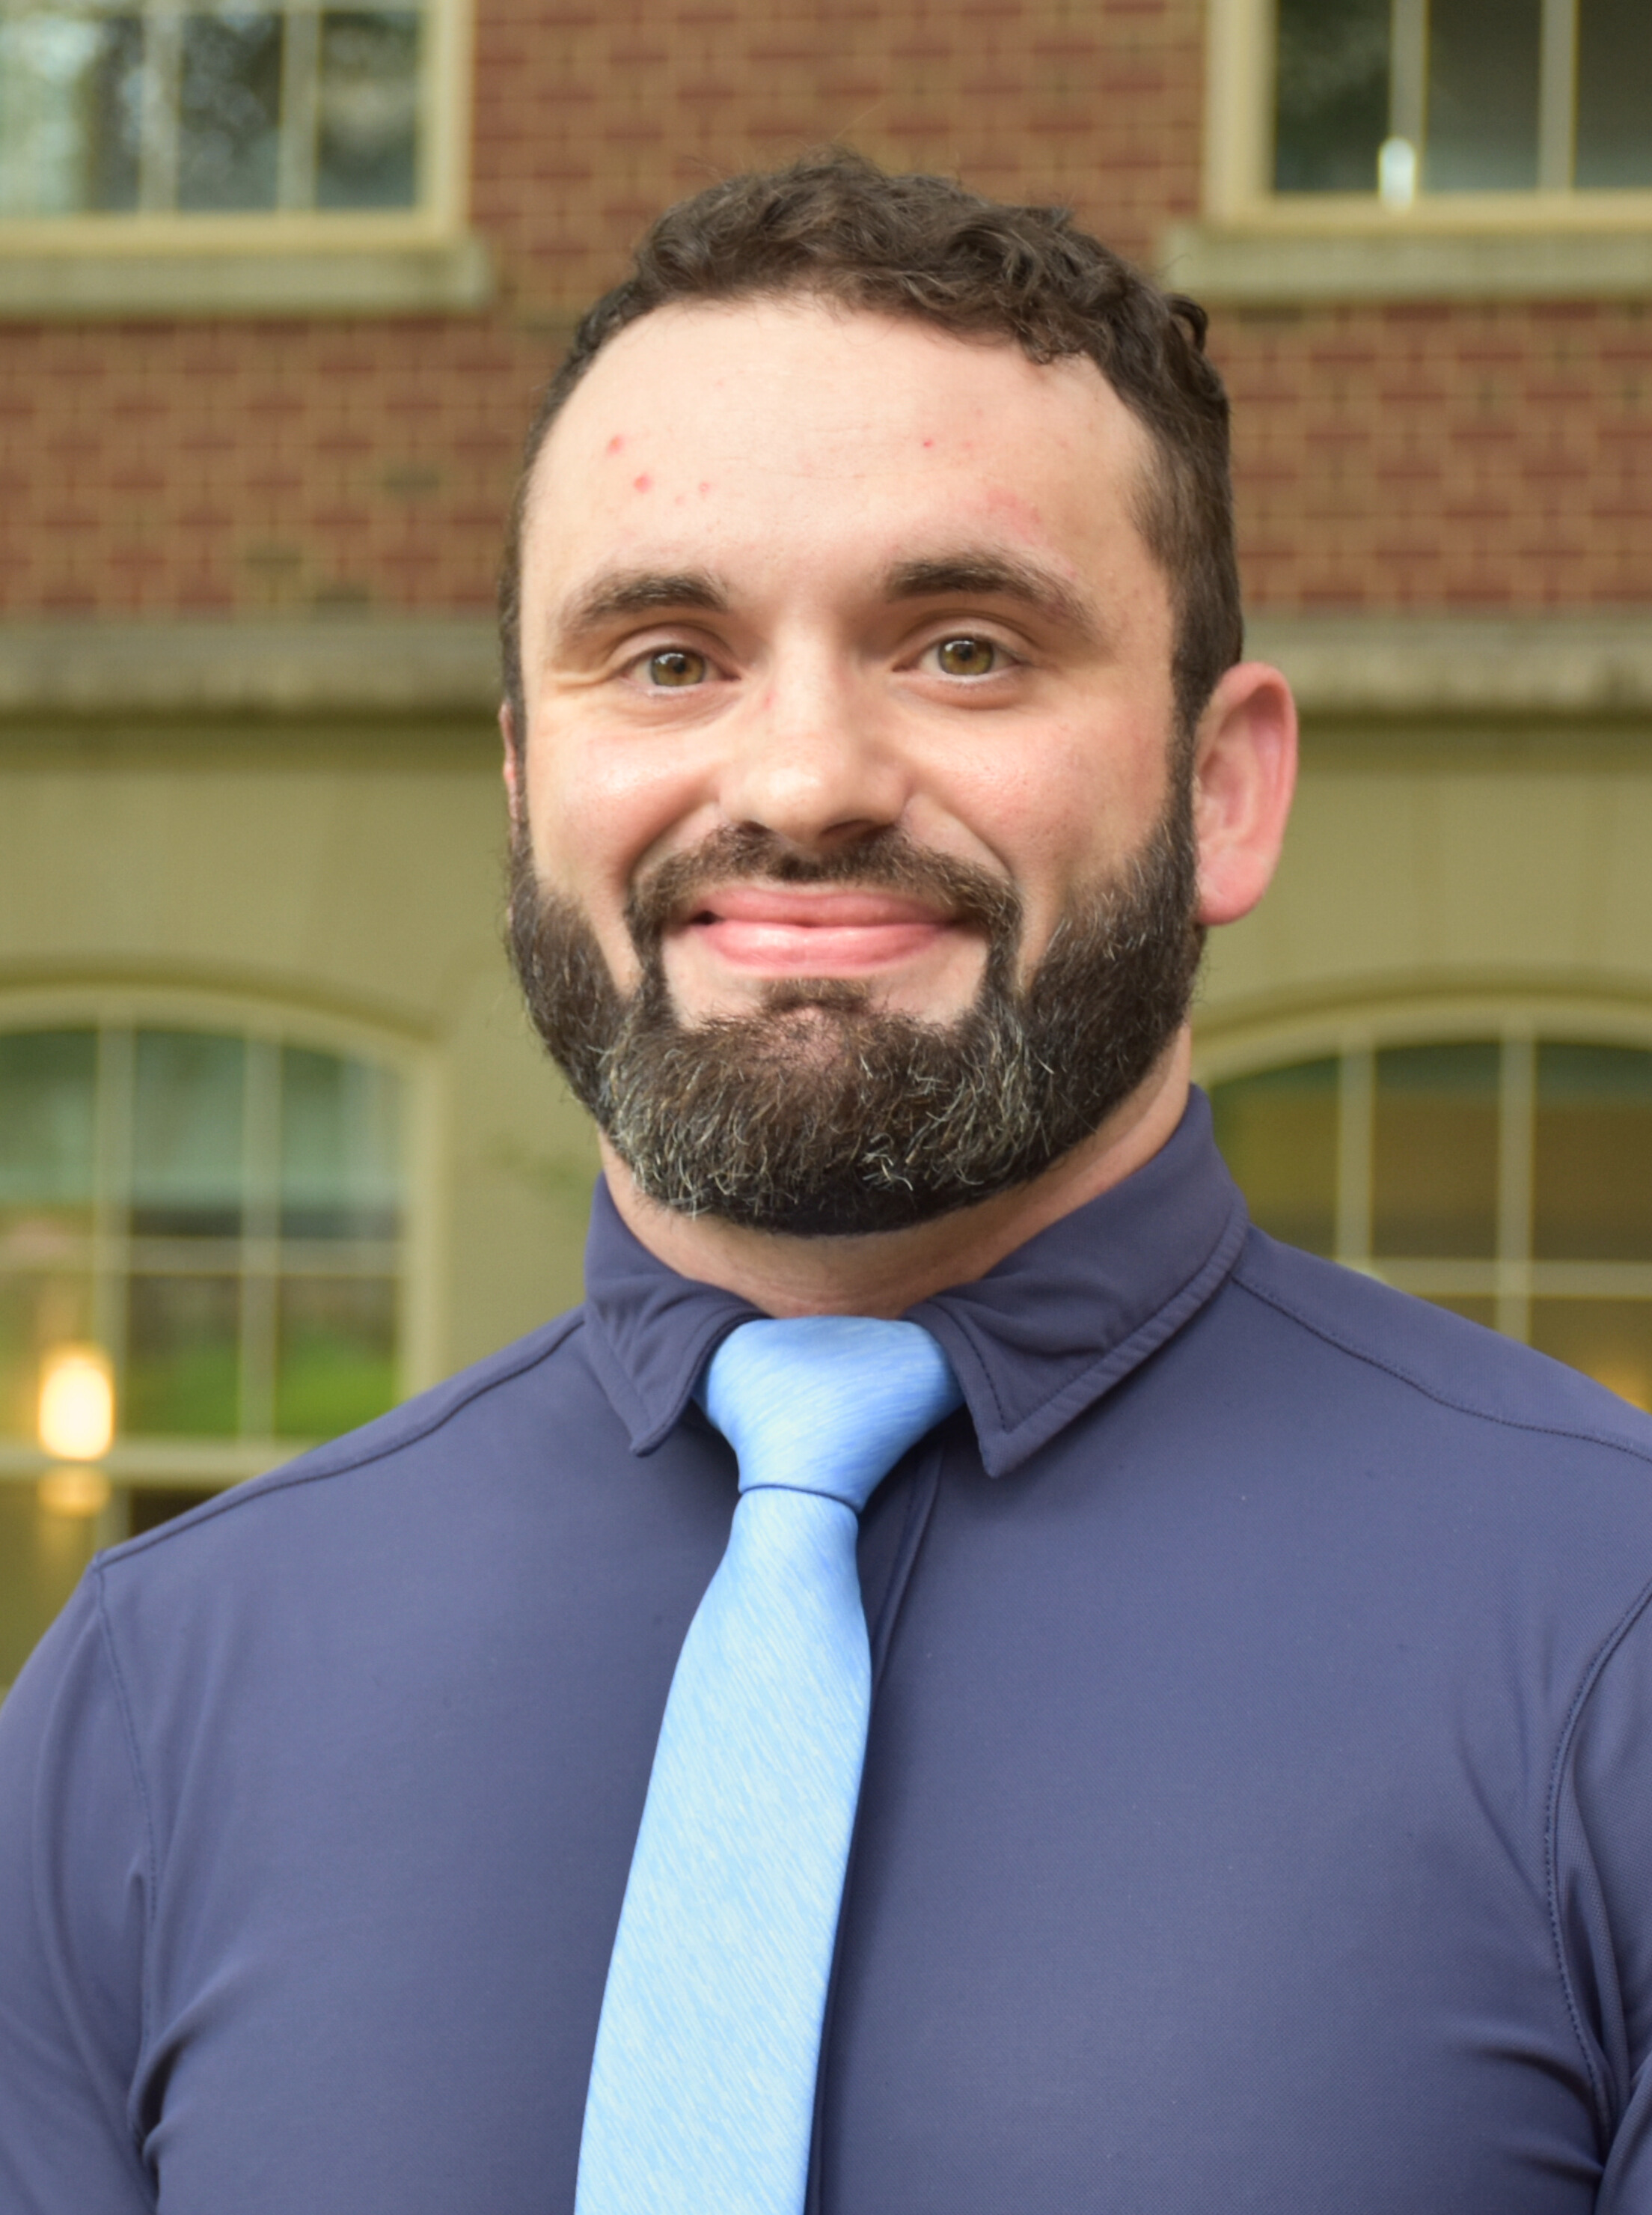
Manages departmental data and data visualization​
Coordinates clinical education affiliation agreements for student rotations in PT and OT
Maintains locker assignments​
Phillip Hopkins
Clinical Contracts Support Specialist
Phillip_Hopkins@med.unc.edu
Notes:
Change Picture

Slide 29
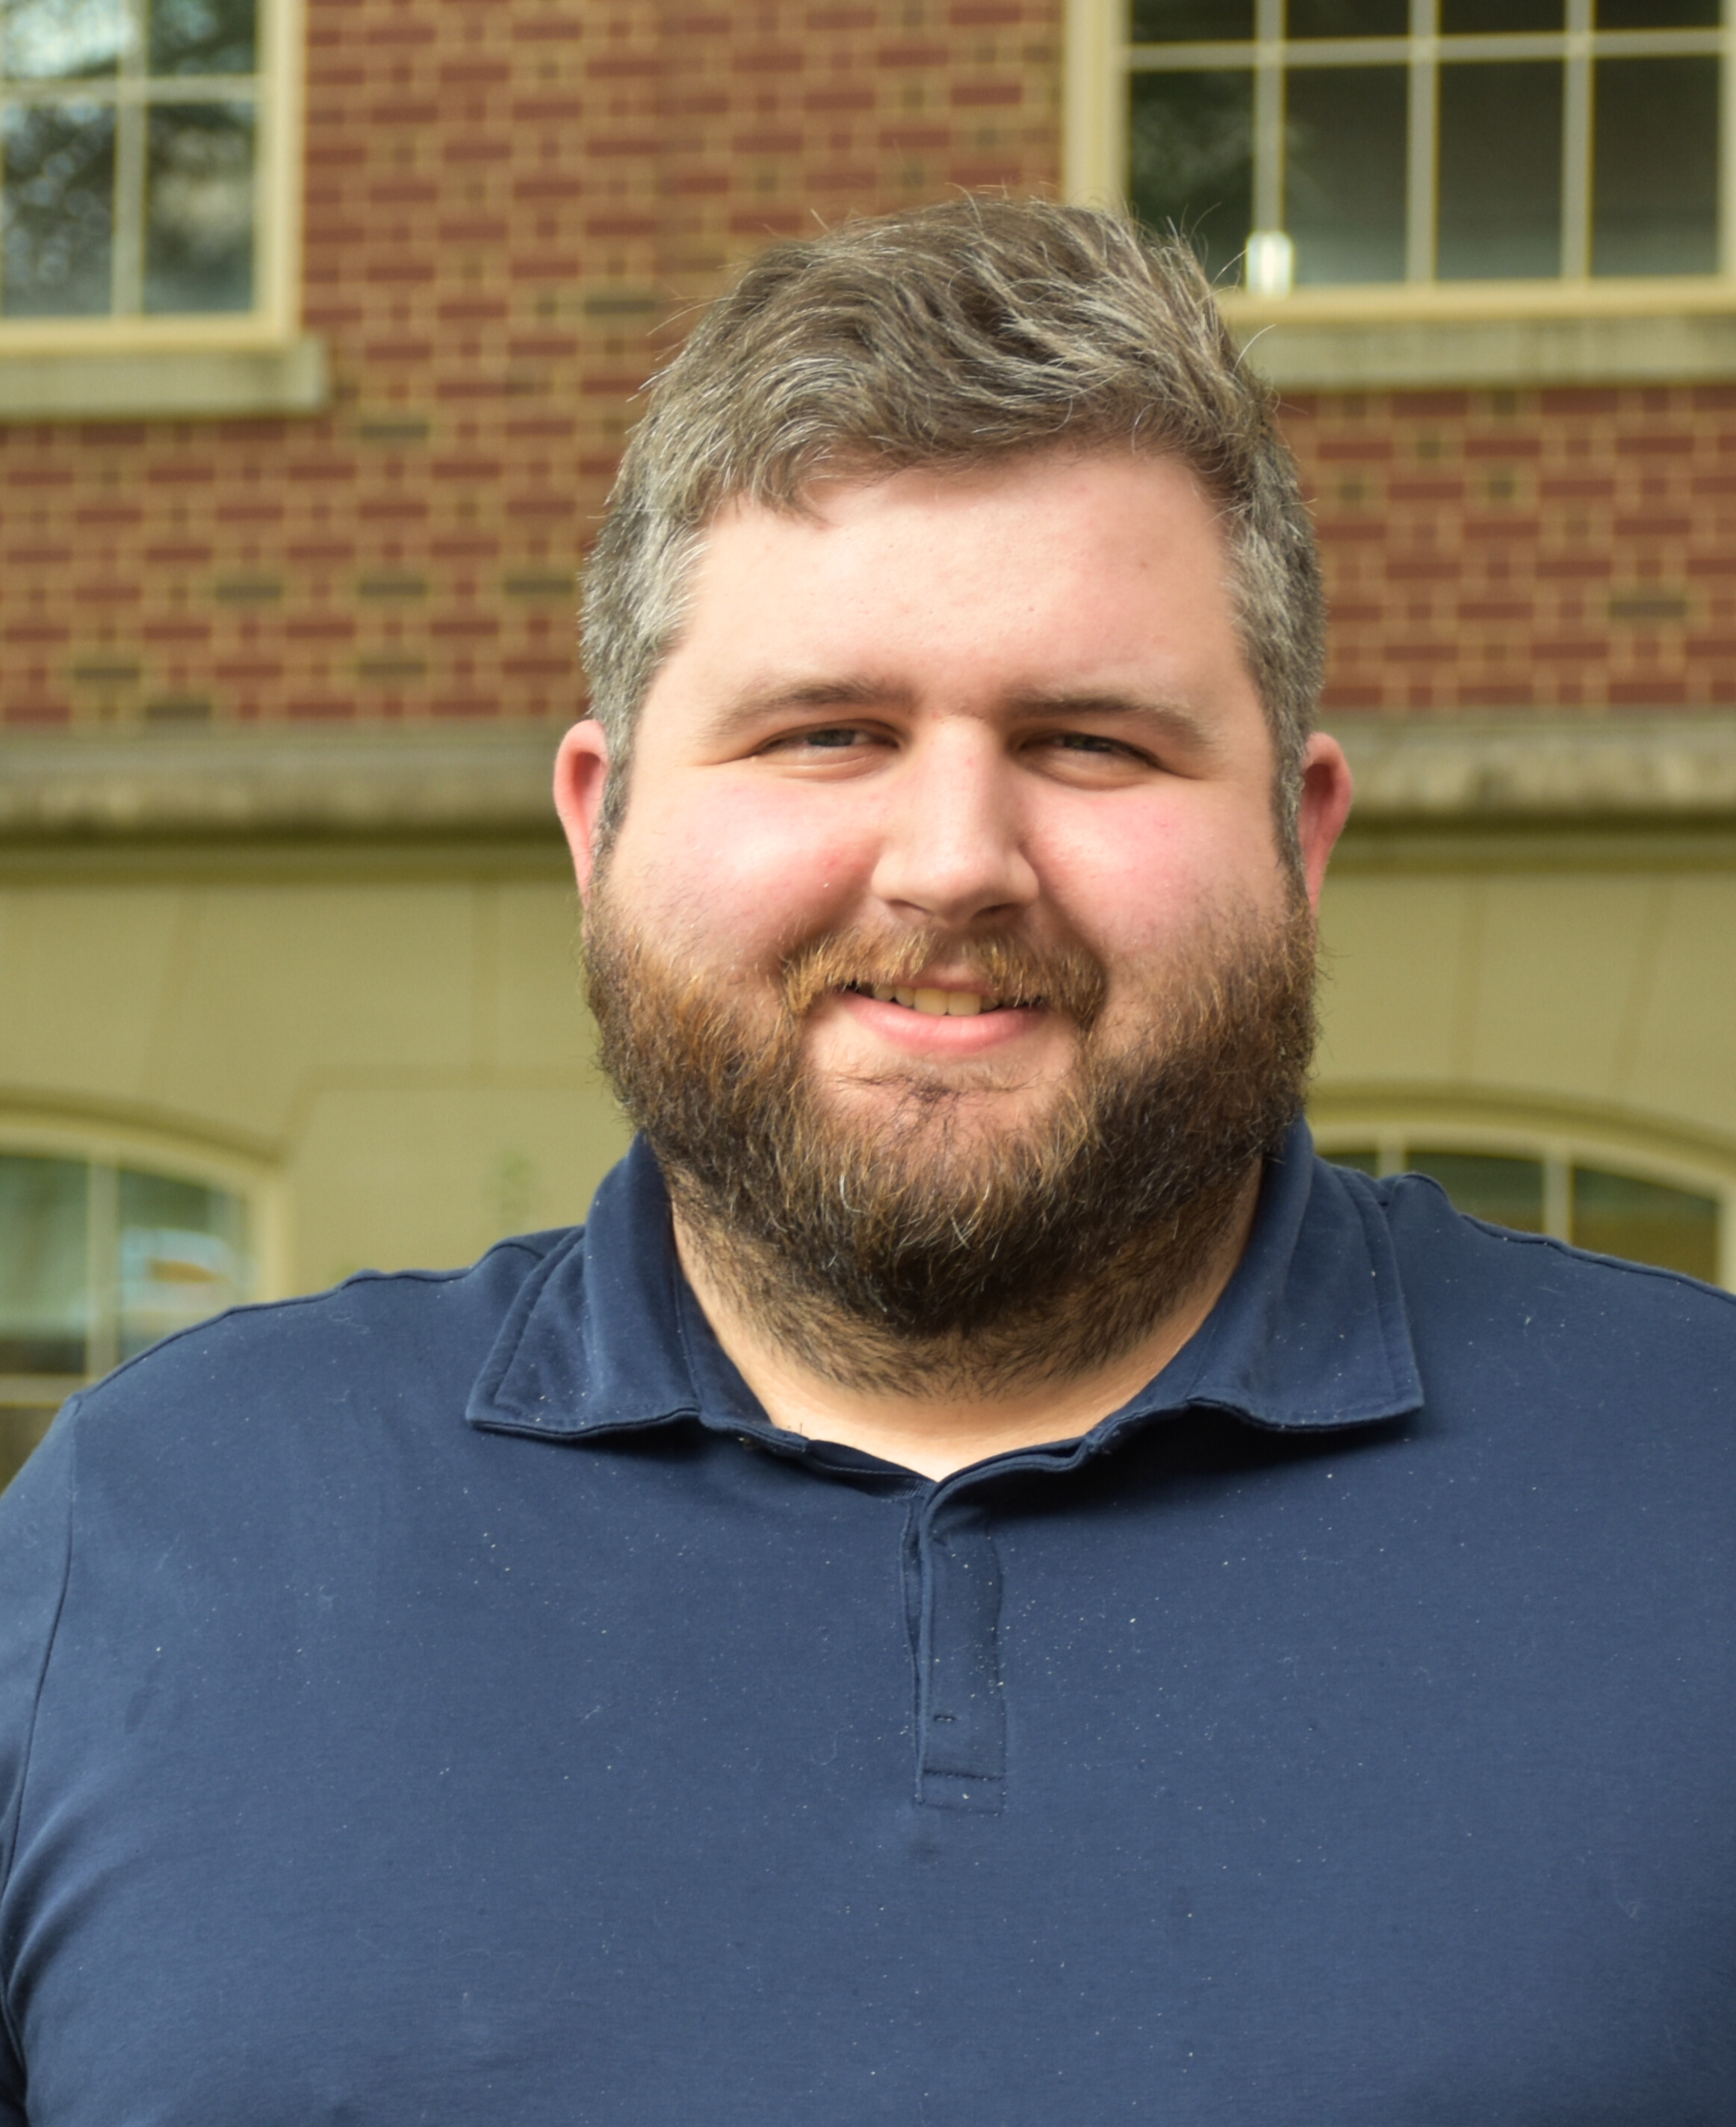
Manages departmental data and data visualization​
Coordinates clinical education affiliation agreements for student rotations in all other programs
Maintains locker assignments​
Stephen (Garrett) Nesmith
Clinical Contracts Support Specialist
sgn0007@email.unc.edu
Notes:
Change Picture

Slide 30
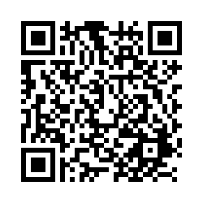
Locker Assignments

Slide 31
Follow DHS on social media!
@UNC_healthsciences
@UNCHealthSciences
UNC Department of Health Sciences
@UNC_HealthSci
#uncdhs
#uncosot
#uncpt
#uncpa
#unccls
#uncradsci
#unccrmhc
#uncshs
#uncdhs

Slide 32
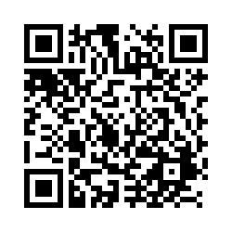
z
Questions?
Give us your feedback here:
Kimberly Capri, EdM
Student Services Manager
Kimberly_Capri@med.unc.edu

