Slide 1
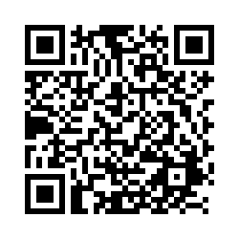
Fall 2025 Health Sciences Orientation
Check-in with the QR Code:

Slide 2
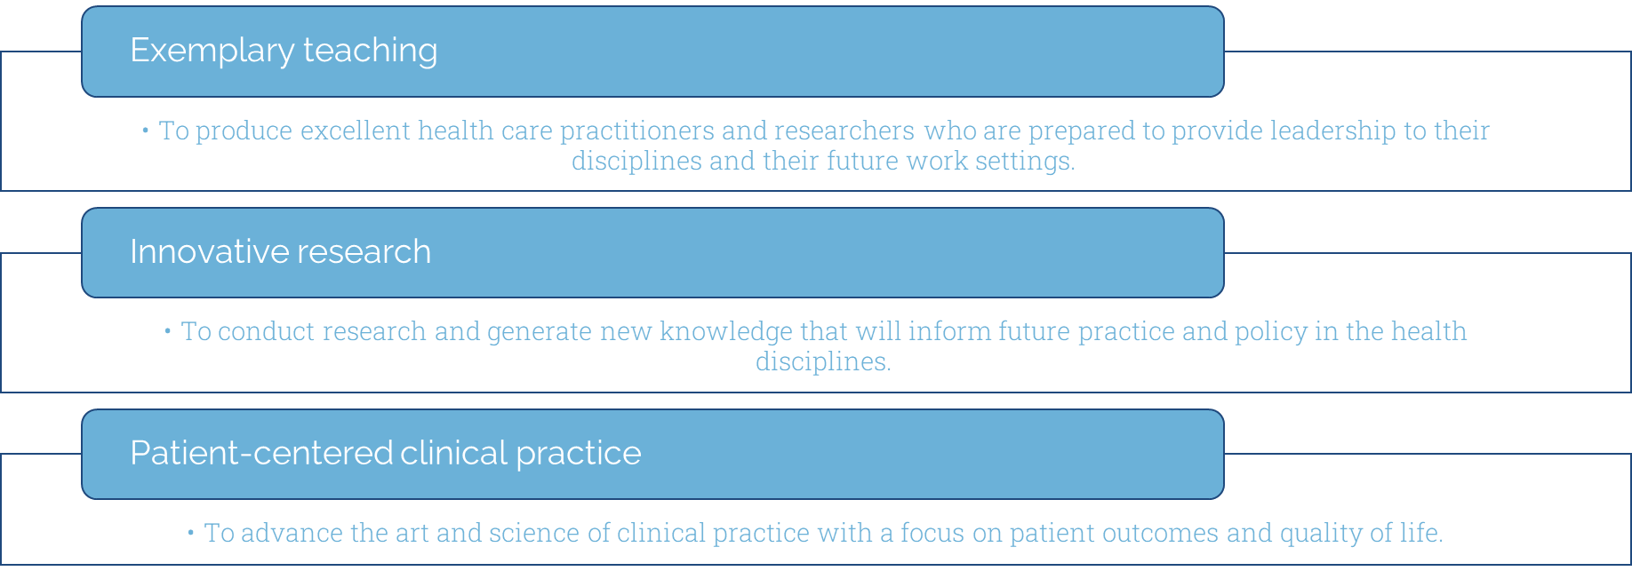
School of Medicine Mission

Slide 3
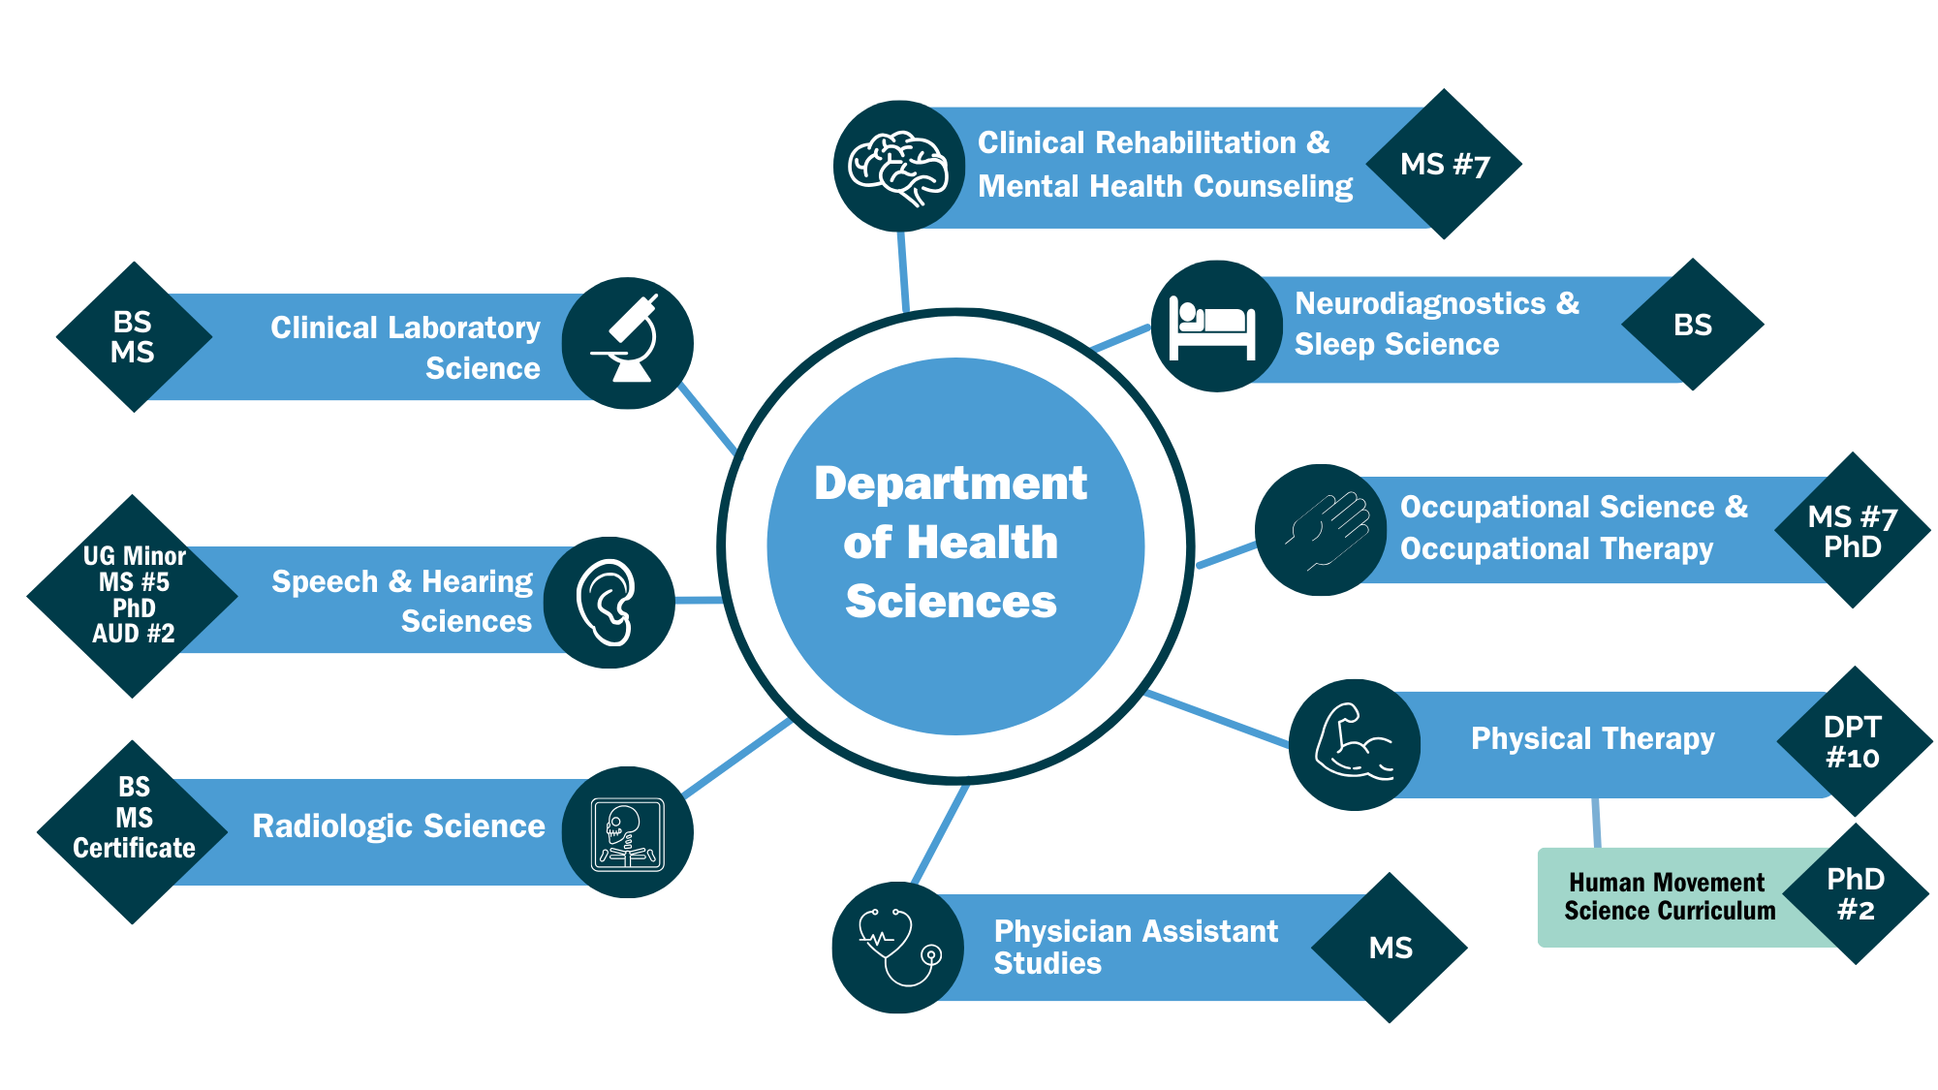
Department of Health Sciences Programs

Slide 4
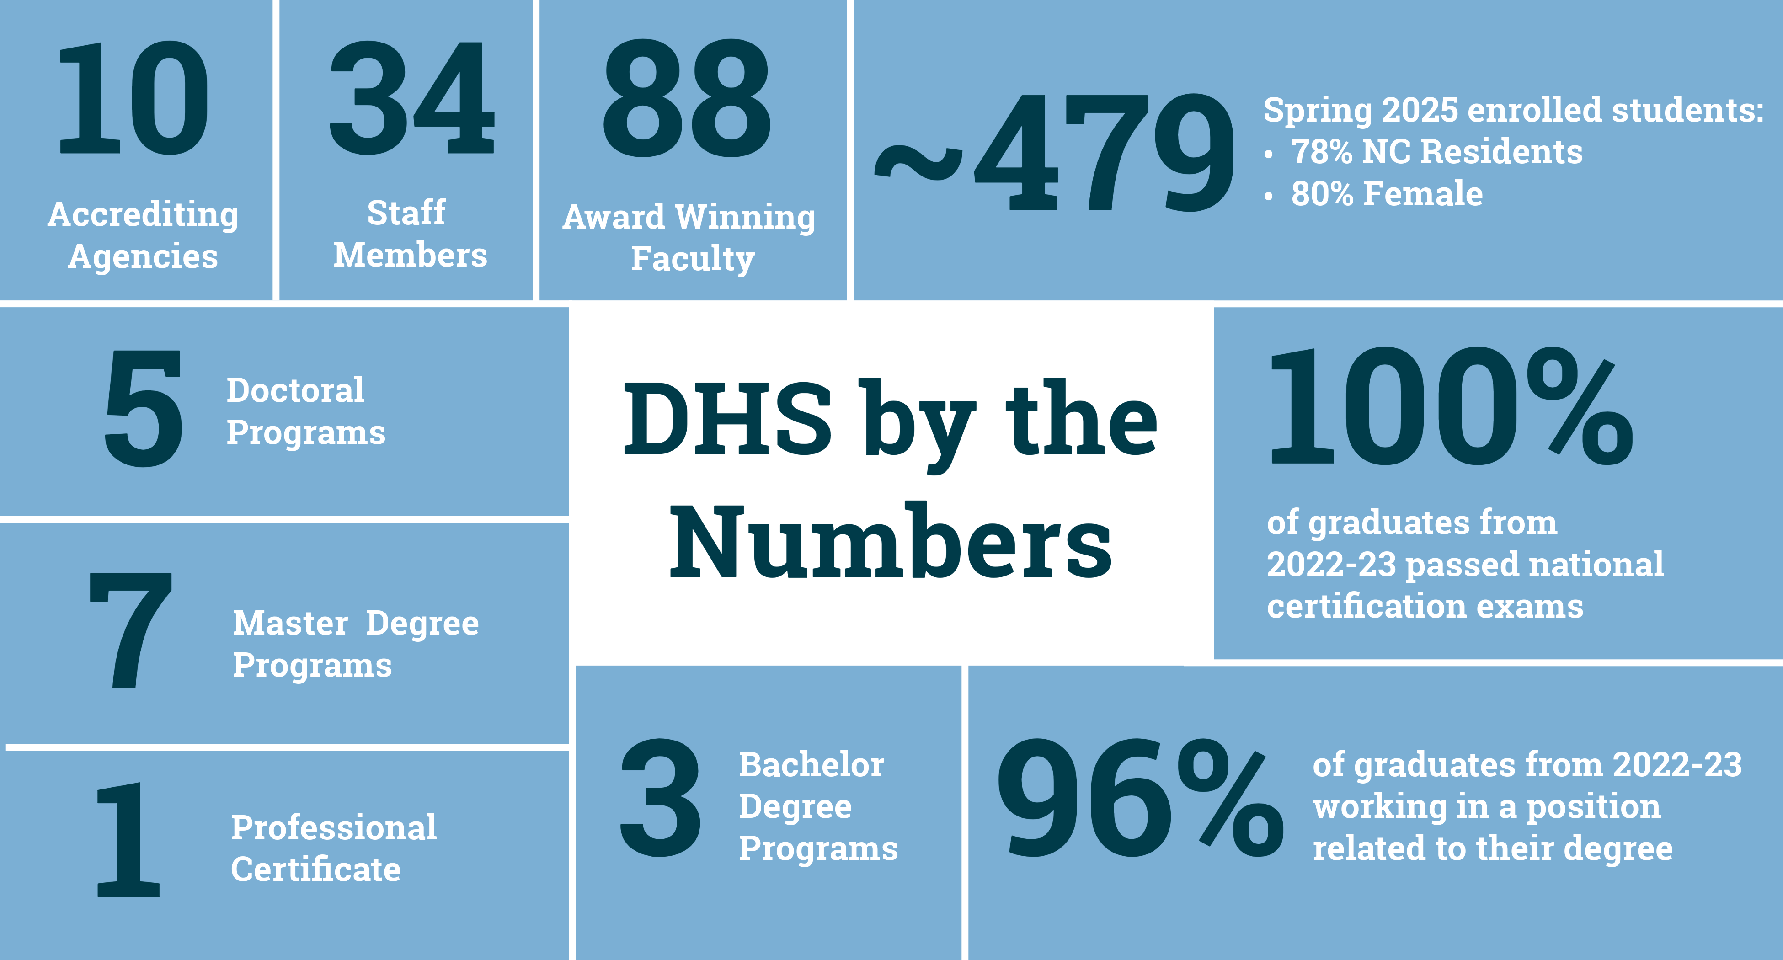
DHS by the numbers

Slide 5
Resources
Health Sciences Resource Page:
Accessibility Resources
The Learning Center
The Writing Center
University Career Services
Campus Health Services
Bondurant Food Pantry (1072)
Student Computer Rental
Student Tech Guide

Slide 6
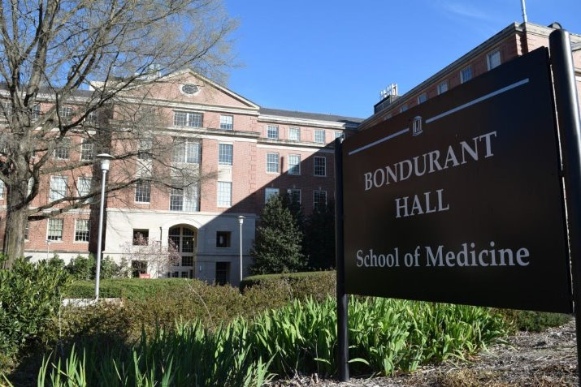
Bondurant Hall Access
All Students are provided with SOM Badge
Common Building Access:
Exterior Door to Bondurant
Division Suite
Division Labs

Slide 7
North Carolina Residency
How do I apply for North Carolina residency?
All students applying for NC Residency are required to apply online using the NC Residency Determination Service (RDS)
RDS decides a person's residency status based on the day the applicant initiates an online residency determination. As stated on the NC Residency Determination System website, "The residency statute mandates only those who can demonstrate a minimum of twelve months of uninterrupted domicile (legal residence) in North Carolina are eligible for in-state tuition."
Questions? Email: rdsinfo@ncresidency.org

Slide 8
Available Opportunities

Slide 9
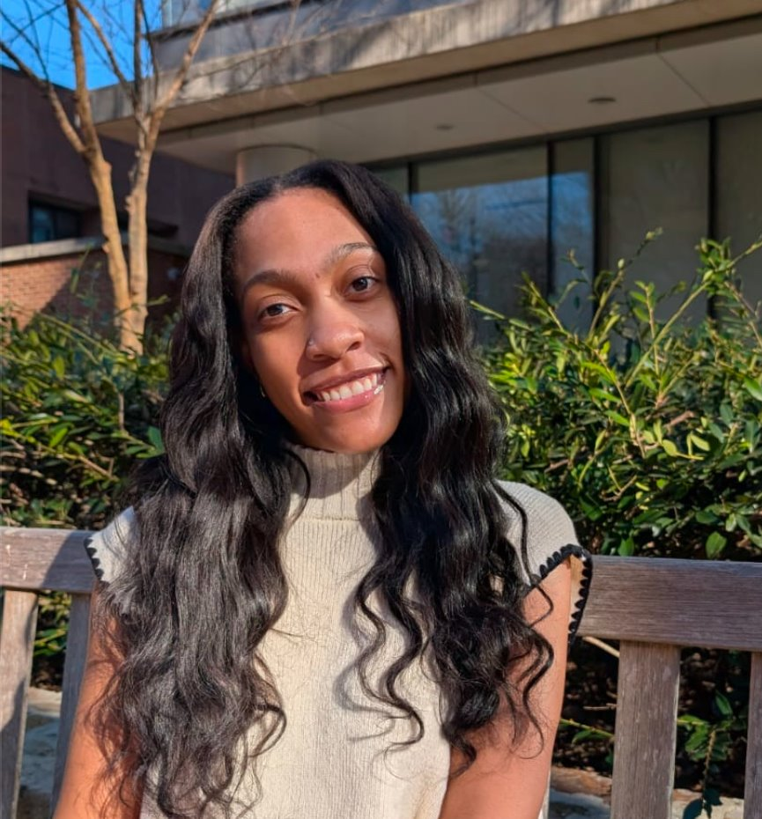
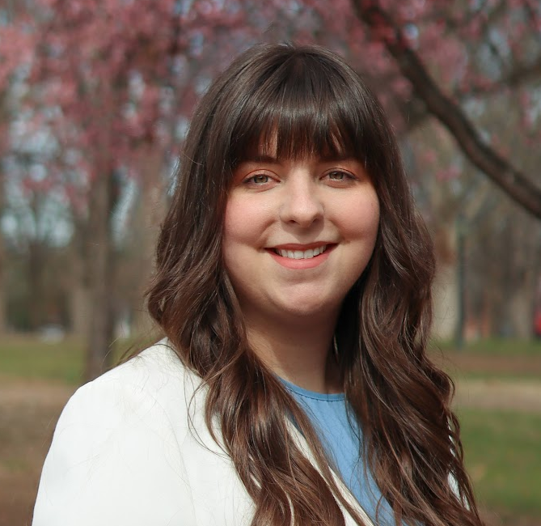

Graduate and Professional Student Government: We Represent Grads!
Free Funding Available for all Grads!
Travel Awards
Student Org. Awards
Emergency Funding
Funding for academic travel and conferences for students
Funding for social, professional, or academic events hosted by student groups
Funding for students encountering unexpected need
President Leah Frazier
Join our team!
Join our Senate
Register as a candidate on HeelLife in the second week of classes
External Appointments
Represent graduate students on special committees across campus
Multiple other positions with stipends available
Upcoming Events: Grad Cafes, Wellness Fairs, and the Pretty Huge Dance!

Slide 10
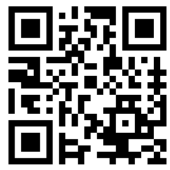
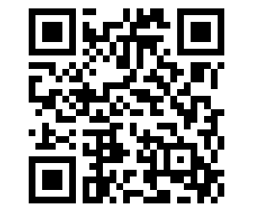


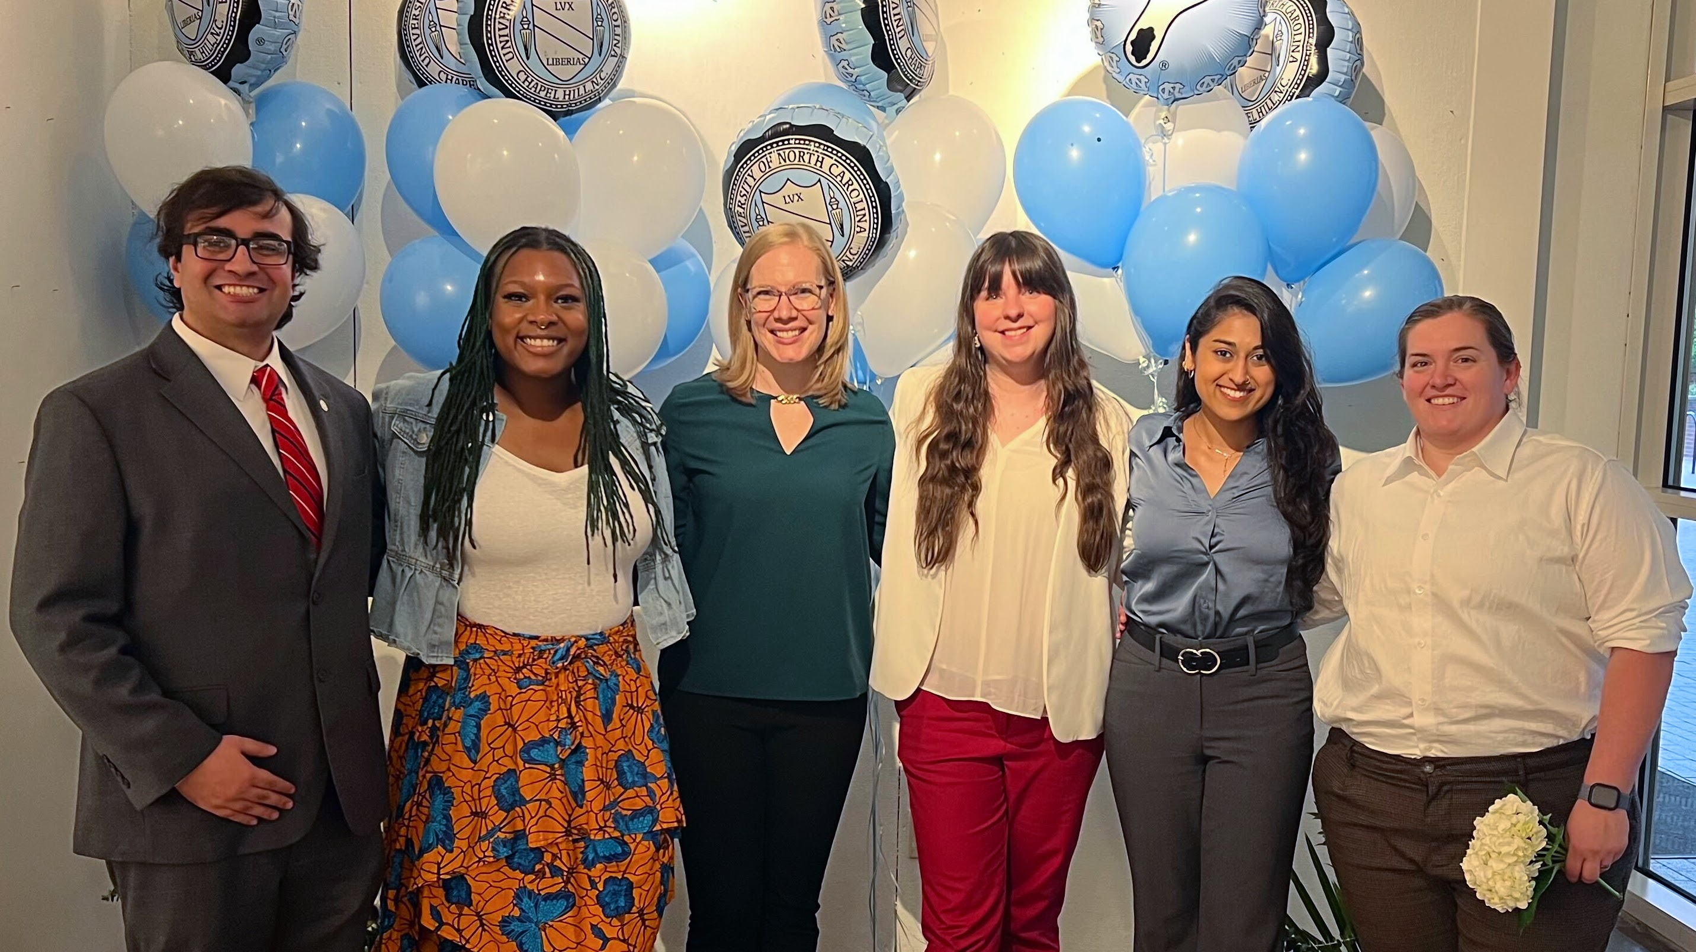
Get Connected with GPSG!
Find out about our funding and resources on our website
Follow our social media for events and updates
@GPSGatUNC
@uncgpsg
Learn more about us! Get Involved Form
www.gpsg.unc.edu

Slide 11
Safety & Security Committee
Resources in an Emergency
CarolinaGO
Access via m.unc.edu
Download the app on your smartphone
UNC Carolina Ready Safety
Emergency Contacts
Report Tips
Support Resources
Bondurant Hall has 2 Evacuation and Accountability Points
Health Sciences Library
On the sidewalk in front of the sign for the Health Science Library (NOT across the street)
The Beach/Oasis
To the right rear of The Beach/Oasis near the back benches (as if you’re walking towards the Hospital)
Areas of Rescue Assistance include all stairway landings in Bondurant Hall
Armed/Dangerous Person
Run
Hide
Fight

Slide 12

The Alliance Health Ambassadors (AHA)
Mission
To provide interdisciplinary student involvement.
Events
Kickball Tournament
Showcase for a Cause
Silent Auction
Difference Matters
High School Outreach
Interested? Contact: Kimberly_Capri@med.unc.edu

Slide 13
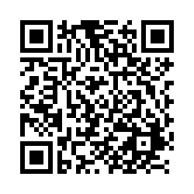
CABLE Connections
C.A.B.L.E:
Community
Advocacy
Belonging
Lifelong Engagement
We are always looking for Student Members to be involved.
Interested? Email Perry Studevent, perry_studevent@med.unc.edu
Belonging Survey:
Please share your perspective to guide our planning for SY25-26

Slide 14
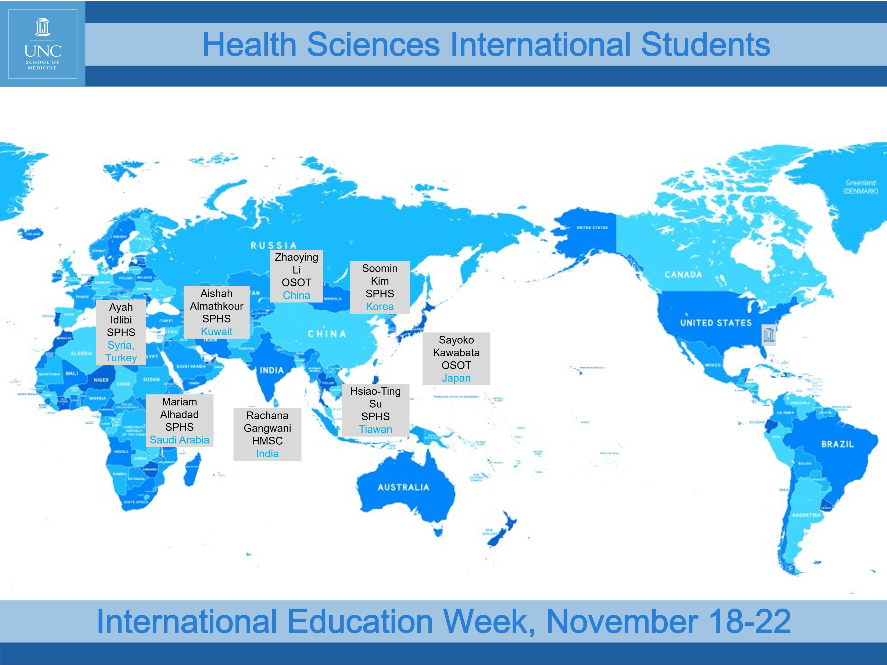
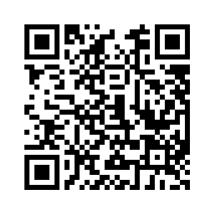
Health Sciences Global Partnerships Committee
Committee Chair:
Lisa_Domby@med.unc.edu
Student Representative:
TBD – let us know if interested
International Student Survey:
Fall 2025 Activities:
Interprofessional Global Exchange Event for IPEP Scholars and International Students in Health Sciences
International Education Week November 17-21
https://unc.az1.qualtrics.com/jfe/form/SV_bKKzKvCaA8CSBSK

Slide 15
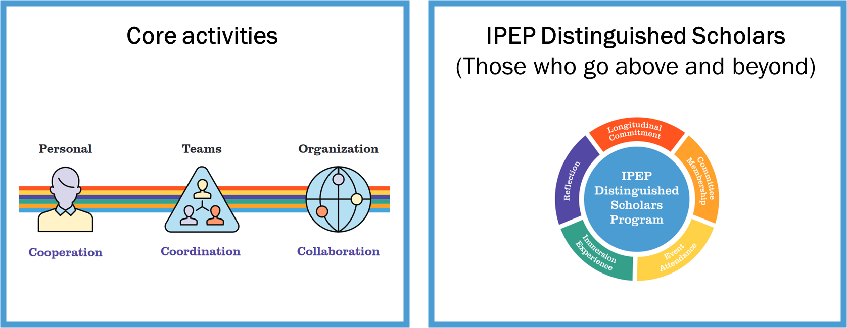
Office of Interprofessional Education and Practice (OIPEP)
IPEP @ UNC
What is IPE?
“When students from two of more professions learn about, from, and with each other to enable effective collaboration and improve health outcomes.”
WHO, 2010
Contact: Judy A. Schmidt, Ed.D., CRC, LCMHCA
Director, DHS IPEP
judy_schmidt@med.unc.edu

Slide 16
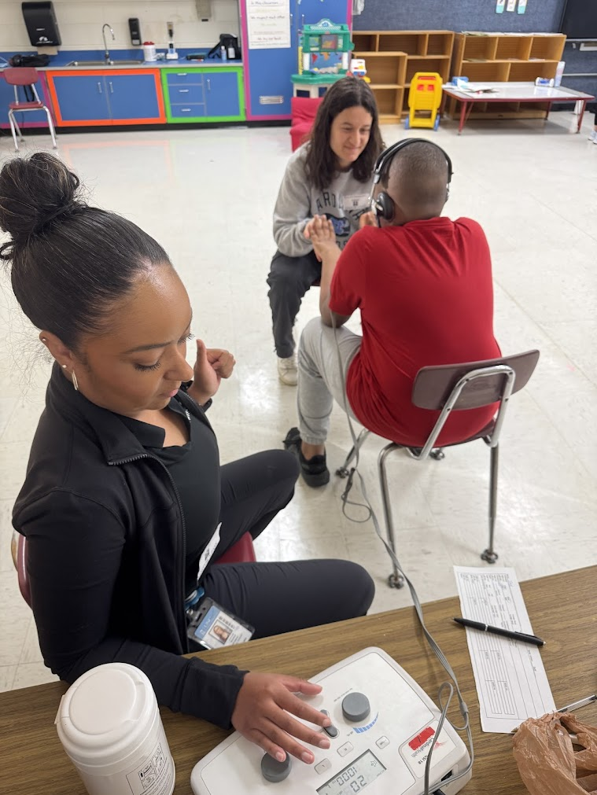


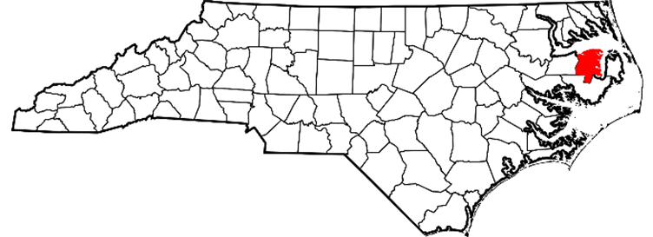
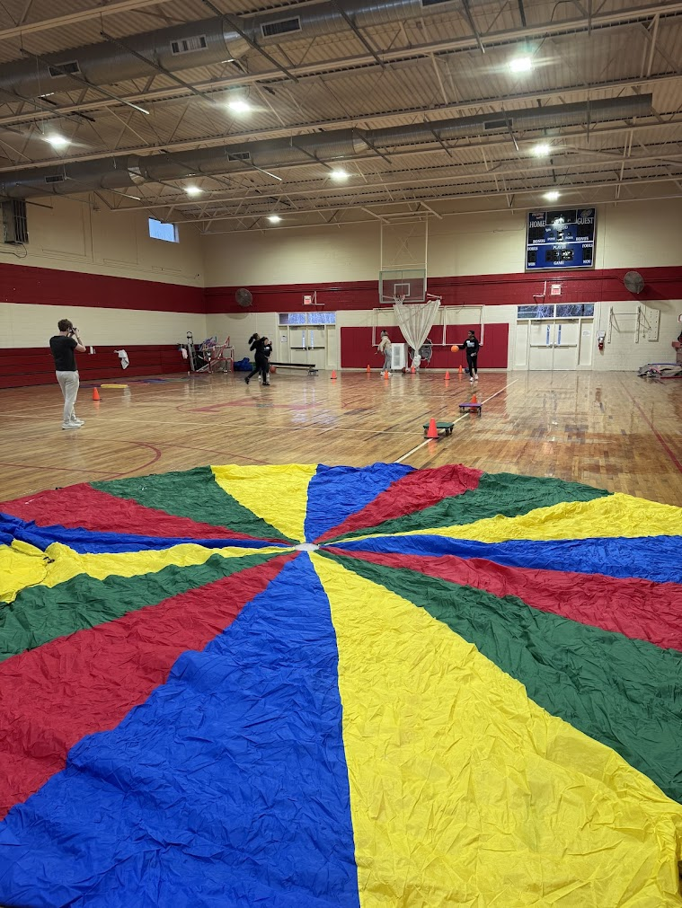
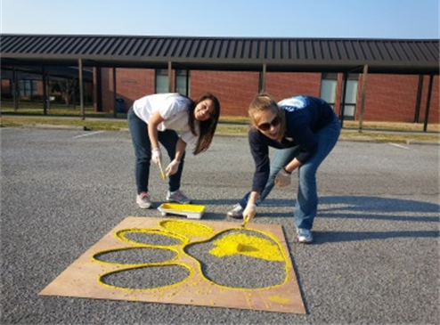
Inter-professional Service-Learning in Rural North Carolina
Who: Health professions students
What: Interprofessional Service-Learning elective focused on rural communities. Students will explore the social determinants of health, and work in partnership with community agencies and members to promote health and reduce health risks.
When: Spring Break 2026
Where: Tyrrell County, in eastern NC
Tyrrell County Service Learning Trip (2).mov

Slide 17
Accommodations
You have a federal right to reasonable accommodations…use them and don’t worry about stigma.
Accommodations from the classroom do not carry over to the clinic…you need a new approval.
If your accommodations have not been approved through University Compliance Office, you are not protected.
Don’t let your site overaccommodate you…think long term skill development.
Talk to your Clin Ed Coordinator as soon as possible…but you can apply anytime.
Contact: UCO.UNC.EDU

Slide 18
Available Support

Slide 19


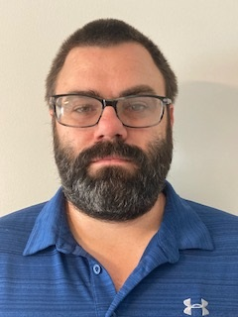

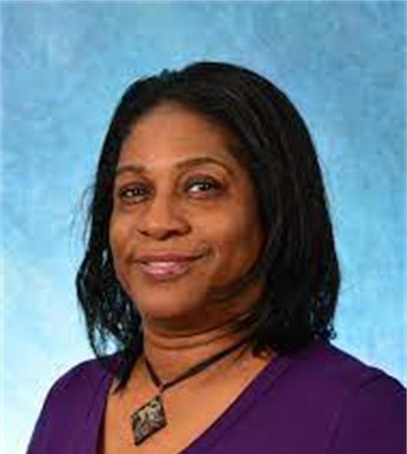
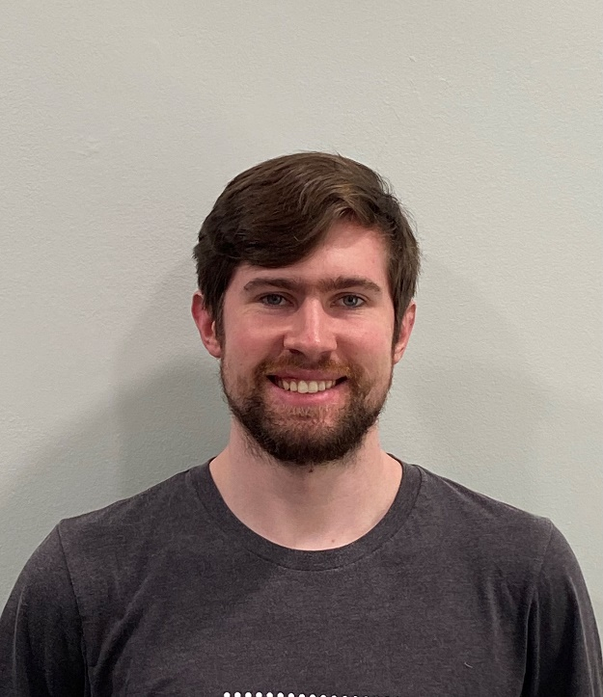
Business Office Team
Daniel Krupa
Gradstar research funding
Student travel: PT and SPHS
GSHIP Insurance
Student travel: NDSS and CRMH
Student travel: CLS and OT
Student travel: RadSci and Center For Literacy

Slide 20
Student Services Administrative Roles Student Services exists to support the mission of the Department of Health Sciences (DHS) by serving as an administrative foundation to students, faculty, staff and the community as related to Health Science students’ success.
Admissions
Financial Aid
Student Life
Recruitment
Registration

Slide 21
Student Services Team
Eileen Burker, Associate Chair for Student Services | Hannah Siburt, Director of AHEC Operations
Kimberly Capri, Admin Director of Student Affairs | Perry Studevent, Senior Assistant Director, Financial Aid and Scholarships
Carolyn Oakes, Administrative Support Specialist | Tamara Mesko, Administrative Support Specialist
Kayla Rankin, Administrative Support Specialist | Krislyn Nesmith, Administrative Support Specialist
Phillip Hopkins, Clinical Contracts Specialist | Garrett Nesmith, Clinical Contracts Specialists
Gabbie Kirby, Clinical Education Administrator | Amy McLemore, Communications Administrator
Belle Basnight, Staff Coordinator

Slide 22

Eileen Burker Associate Chair, Student Services
Works alongside the Student Services Manager to oversee the Office of Student Services
Mentor’s students and provides resources to help maximize students time at UNC.
Established the Student Services Newsletter.

Slide 23
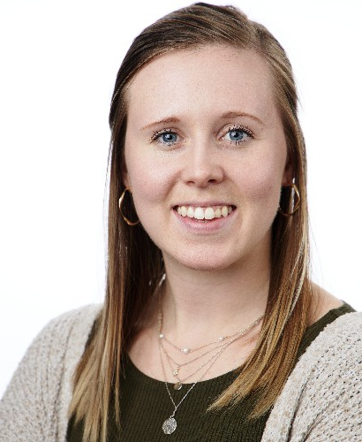
Kimberly Capri Administrative Director of Student Affairs
Supports and assists the Office of Student Services employees.
Helps to oversee the employees and office environment within Student Services.
Assists staff with understanding and communicating important policies and procedures.
Supports Neurodiagnostics and Sleep Science.

Slide 24
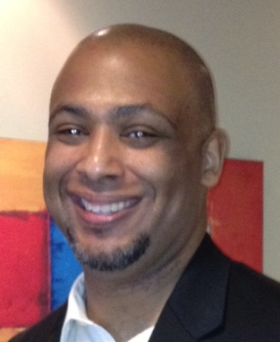
Perry Studevent Senior Assistant Director, Financial Aid and Scholarships Student Services Specialists, CRMH
Assists with understanding financial aid resources and processes.
Serves as the liaison between Health Sciences and the Office of Scholarships and Student Aid.
Registrar/Student Services representative for the Division of Clinical Rehabilitation and Mental Health Counseling.

Slide 25
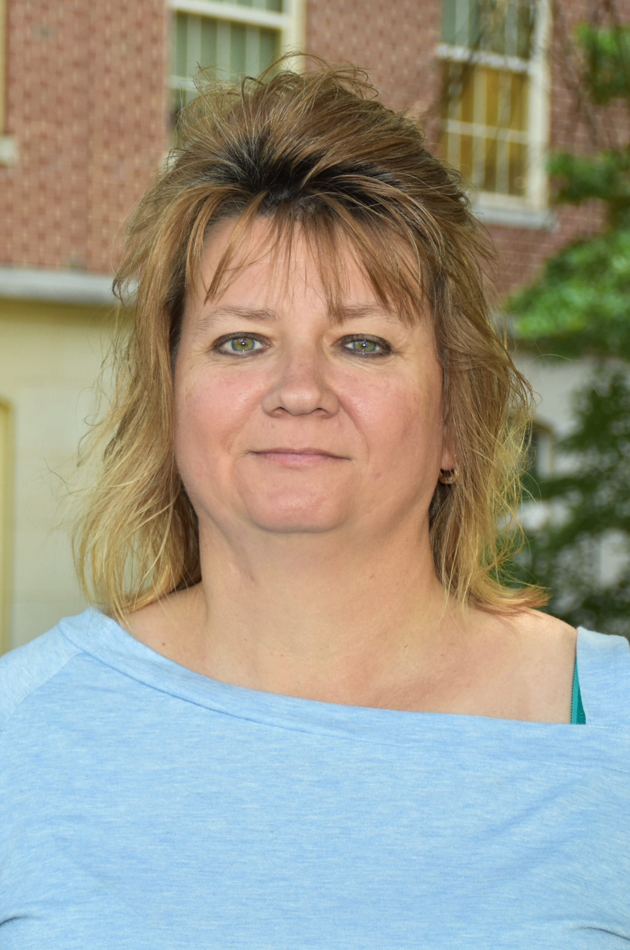
Carolyn Oakes Student Services Specialists, PT, HMSC, CLS
Supports Clinical Laboratory Science, Human Movement Science, and Physical Therapy
Serves as liaison between students, faculty, and staff.
Assists with student registration procedures.
Serves as admissions and graduation coordinator.

Slide 26

Kayla Rankin Student Services Specialists, SPHS, Certificate
Supports Speech Language Pathology, Audiology, and the Certificate program in Radiologic Science Division.
Serves as liaison between students, faculty, and staff.
Assists with student registration procedures.
Serves as admissions and graduation coordinator.
Course Evaluation Manager.

Slide 27
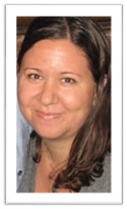
Tamara Mesko Student Services Specialists, PhD Programs, OT, Radiologic Science
Supports all PhD programs, Occupational Therapy, and Radiologic Science
Serves as liaison between students, faculty, and staff.
Assists with student registration procedures.
Serves as admissions and graduation coordinator.
Organizes student listserv.

Slide 28

Krislyn Nesmith Student Services Specialists, PA
Supports Physician Assistant.
Serves as liaison between students, faculty, and staff.
Assists with student registration procedures.
Serves as admissions and graduation coordinator.
Assists in Pre-Clinical Student onboarding.

Slide 29
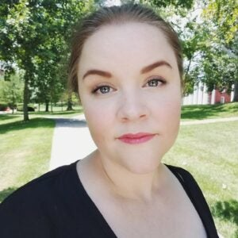
Belle Basnight Staff Coordinator
Front Office support for the Office of Student Services and Chair's Suite.
Support event coordination.
Assists with Course Evaluations.
Assists with immunization and CastleBranch compliance for Neurodiagnostics and Sleep Science students.

Slide 30
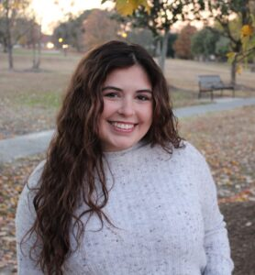
Gabbie Kirby Clinical Education Administrator
Assists with HS Immunization requirements and AHEC Housing.
Serves as the department liaison with CastleBranch and Exxat for students, faculty, and staff.
Coordinates the Clinical Preceptor Appreciation Event (CPAE) and SE Clinical Educator Symposium

Slide 31
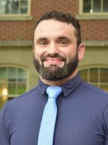
Phillip Hopkins Clinical Contracts Support Specialist
Manages departmental data and data visualization.
Coordinates clinical education affiliation agreements for student rotations in PT and OT.
Maintains locker assignments.

Slide 32
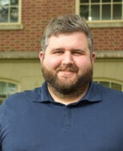
Garrett Nesmith Clinical Contracts Support Specialist
Manages departmental data and data visualization.
Coordinates clinical education affiliation agreements for student rotations for all other programs.
Maintains locker assignments.

Slide 33
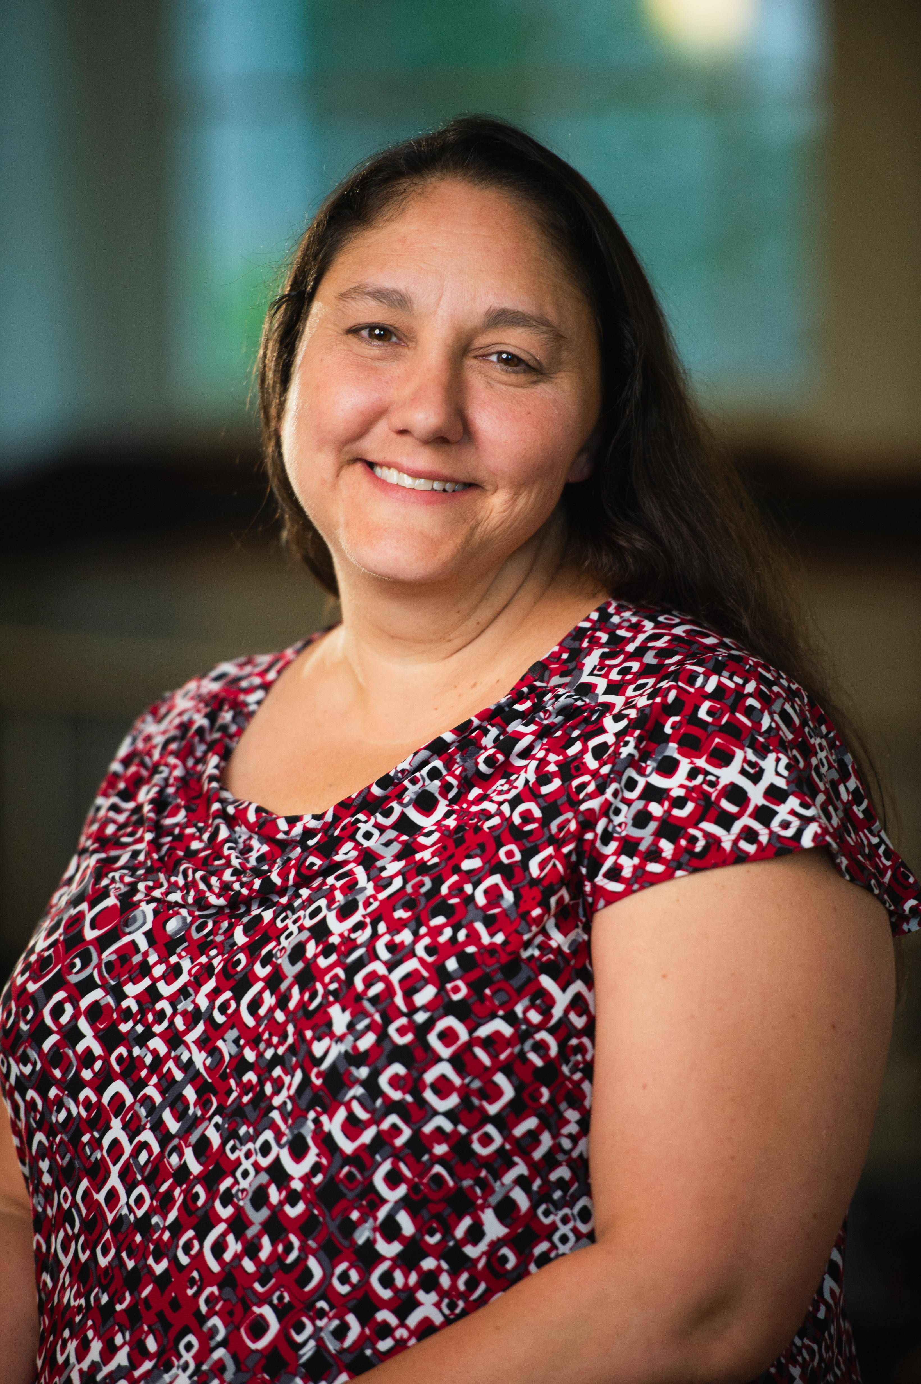
Amy McLemore Communication Administrator
Supports communication throughout the department.
Assists with program accreditation.
Assists with event coordination.

Slide 34
Financial Aid Resources
QUICK INFORMATION
RESOURCES
NC Forgivable Education Loan for Service: Eligible if you become an NC resident after Year 1
Apply for final year (3-year program) or final 2 years (4-year program)
VA Careers: Offers loan repayment & reimbursement for employees
Loan Repayment Info: Resources and Timelines
Health Insurance Waiver: Campus Health (Hard Waiver Process)
Aid Disbursement: Occurs beginning of each semester. Eligibility:
Enrollment of 6 hours for undergrad
Enrollment of 4.5 hours for graduate.
FAFSA: Complete every year, even if not using federal loans.
Spring Loan Reduction: Email by December 1, 2025
Summer Aid: Separate packages after summer registration

Slide 35


Compliance Requirements for Clinical Education: CastleBranch and EXXAT
Annually Renewing Requirements
Background Check
OSHA & HIPAA Training
TB Test
Health Insurance
Flu Vaccine
Drug Test (if required by clinical site)
Platforms
EXXAT: Upload docs, background & drug tests via Universal (PT and PA only)
CastleBranch: Upload docs, background via site, drug test via LabCorp
Reminder
Regularly monitor EXXAT & Castle Branch to stay in compliance.
If you have any questions or encounter issues navigating CastleBranch or EXXAT, please contact:
Gabbie Kirby at gabbie_kirby@med.unc.edu
Belle Basnight at Belle_Basnight@med.unc.edu — NDSS students only
Krislyn Nesmith at knesmith@email.unc.edu —
Pre-clinical PA students only
Notes:
Fill in the necessary information for Steps 1, 2, 3, & 4
The following information will be required when filling out your request form:
uStudent Name
uUniversity
uSchool/Dept
uCourse
uNC AHEC Region
uCity
uSite
uArrival
uDeparture

Slide 36
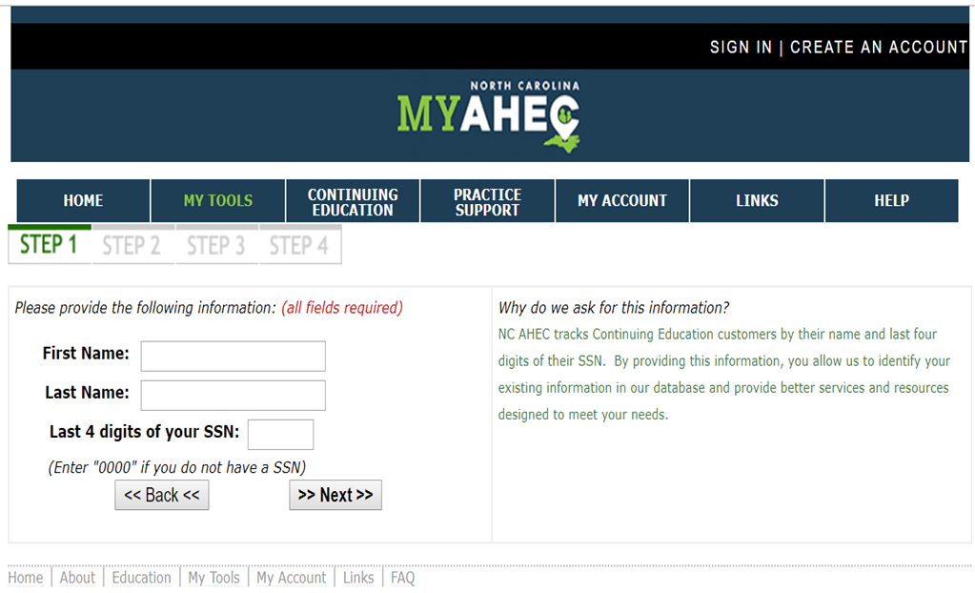
Area Health Education Centers (AHEC) Housing
How to Apply?
Go to www.my.ncahec.net
Create an Account
When applying for housing, please request up to one day prior and one day post your clinical rotation dates
If your placement is canceled, please remember to cancel your housing request by accessing your profile
After AHEC reviews your request form, they will contact you in a few weeks with your housing information. It takes a while for them to place you into housing so, the sooner you can get a request in the more likely you'll be approved for housing in your requested region.
Housing will vary depending on the location you are in and is not guaranteed for all students.
Fill in the necessary information for Steps 2, 3 & 4
Notes:
Fill in the necessary information for Steps 1, 2, 3, & 4
The following information will be required when filling out your request form:
uStudent Name
uUniversity
uSchool/Dept
uCourse
uNC AHEC Region
uCity
uSite
uArrival
uDeparture

Slide 37
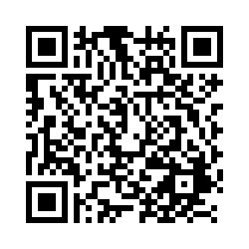
Locker Assignments

Slide 38
Questions?
Email Us:
Kimberly_capri@med.unc.edu
Eileen_burker@med.unc.edu

