Slide 1
SHRA Performance Management During COVID-19 Pandemic March 2021 Derek Hoar, Senior Employee Relations Consultant Lisa Bjornstad Voss, Senior Employee Relations Consultant UNC School of Medicine Human Resources

Slide 2
Overview of Performance Management Cycle Changes and Dates due to Covid-19 Pandemic
2020-2021
Annual performance cycle shortened to nine months due to COVID-19 (July 1, 2020 – March 31, 2021)
2021-2022
2021-2022 annual performance cycle will be twelve months (April 1, 2021 – March 31, 2022)

Slide 3
2020-2021 SHRA Performance and Probationary Reviews
Reviews must be completed and uploaded to by April 30, 2021
Employees must have been employed with the State prior to October 1, 2020 to receive a full annual review.
If employees were employed with the State on or after October 1, 2020, the employees must receive a probationary review.
Supervisors should set up a Performance Review meeting via video conferencing, phone or in-person.
Supervisors should send a signed copy of the review to the employees in advance of the meeting.
If the employee has the ability to digitally sign or physically sign and scan, Supervisors should ask for the employee to sign and return.
If obtaining a signature is not feasible, Supervisors should request that the employee reply via email receipt of the document.

Slide 4
Performance Management
Program Philosophy
The performance management program is a communications system designed to help the employee succeed
Goals of Communication System
Clarity on job duties and performance expectations
Clarity on dynamics of working relationship

Slide 5
Roles & Responsibilities
Employee
Actively participate & own the work
Ask questions & keep supervisor informed
Supervisor
Clarity in expectations & Honesty in appraisal
Invest time upfront & use available resources
Second-Level Supervisor
Review & sign all performance plans & performance reviews
Ensure expectations/ratings applied consistently

Slide 6
Supervisor Responsibilities

Slide 7
Performance Plans

Slide 8
Institutional Goals https://hr.unc.edu/files/2017/08/SHRA-Annual-Performance-Appraisal-Program-Institutional-Goals_08-16-2016.pdf
Standardized across campus-
5 key aspects of employee work (plus one additional for supervision)
Expertise, Accountability, Customer-Oriented, Team-Oriented, Compliance & Integrity, Supervision (if applicable)
Address all work product (both performance and conduct) of the employee for the performance cycle
This reflects “How” the employee performs their job duties, communicates, and conducts themselves as UNC-CH employees.
Expectations can be supplemented by other resources
Discuss Institutional Goals in conjunction with Position Description
Provide additional specificity as needed for certain job duties
SOPs, protocols, procedurals, policies

Slide 9
SHRA Institutional Goals https://hr.unc.edu/files/2017/08/SHRA-Annual-Performance-Appraisal-Program-Institutional-Goals_08-16-2016.pdf

Slide 10
Supervisor Responsibilities and Institutional Goals

Slide 11
SHRA Institutional Goals: Team-Oriented

Slide 12
Individual Performance Goals
3-5 individual goals defined each year
Organizational goals
Work unit goals
Individual/Position-based goals
Not intended to cover all aspects of employee work product
Focus on key results/outcomes, not steps in the process
Clarify meeting, exceeding, or not meeting expectations

Slide 13
Individual Goals by Function
Critical-Function / “Deal Breaker” Goals
Key deliverables that are essential to the position
Often compliance-driven
Project-Oriented / “Big Ticket” Goals
Time-specific work in current cycle (eg, grant phases)
Unique projects for current cycle (eg, hiring, “clean-up”)

Slide 14
SOM Standardized Individual Goals for positions https://www.med.unc.edu/hr/spa/som-standardized-individual-goals-inventory/

Slide 15
Calibration
Goal of Calibration
“Need” (Meets) vs. “Want” (Exceeds)
Equitable and Fair for all employees.
Avoid Rater-Bias
Calibration Sessions
Communication process in which peer supervisors within a defined unit establish goals and metrics to ensure consistent application of performance expectations and ratings across similar positions
Goal Calibration at beginning of performance cycle to review & clarify expectations for institutional goals & set individual goals
Rating Calibration at end of cycle to apply consistent, equitable & fair ratings for work performed in similar positions

Slide 16
Types of Rater Bias-General Examples

Slide 17
Resources – What resources will you commit to achieving your goal?
Achievable – Is your goal challenging but still realistic?
Relevant – Does your goal tie into your responsibilities?
Time-bound – Does your goal include a deadline?
Expectations – Is your goal ethical, exciting, and enjoyable?
Specific – List the details of what you want to accomplish.
Measurable – How will you evaluate your goal?
S
M
A
R
T
E
R

Slide 18
Weighted Goals
*No goal can be weighted lower than 5%

Slide 19
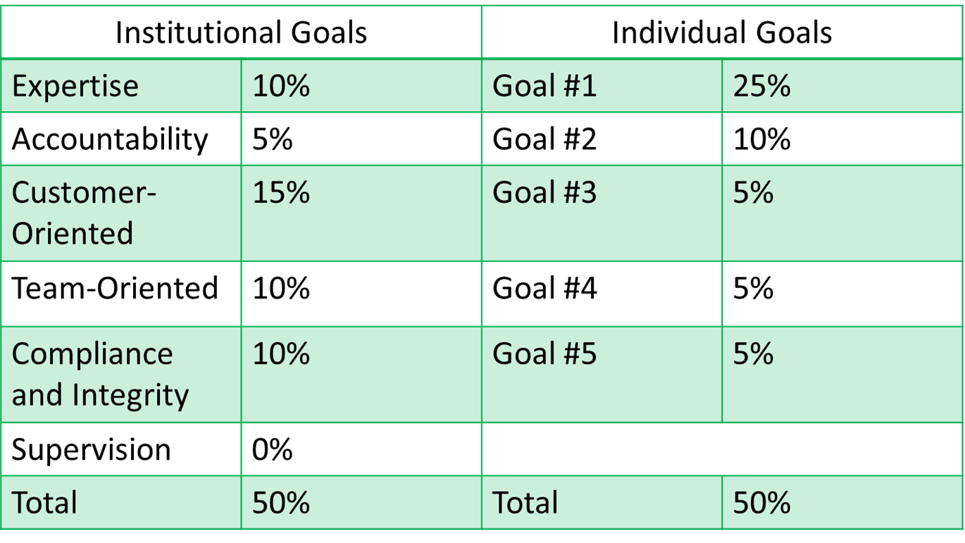
Weighted Goals Example

Slide 20
Appraisal Scoring
Institutional Goal and Individual Goal Scores
3 = Exceeding Expectations
2 = Meeting Expectations
1 = Not Meeting Expectations
Final Overall Rating
2.70 to 3.00 = Exceeding Expectations *
1.70 to 2.69 = Meeting Expectations
1.00 to 1.69 = Not Meeting Expectations
*If received disciplinary action and/or any rating of “Not Meeting,” then Final Overall Rating cannot be higher than “Meeting.”

Slide 21
Appraisal Scoring
Overall Score: 1.30 + 1.20 = 2.50
Meeting Expectations: 1.70-2.69

Slide 22
Performance Appraisal
Annual performance appraisals:
Appraisal Due: 4/30/21
Supervisor: Writes/edits appraisal
2nd-Level Supervisor: Quality Control
Covers totality of performance cycle (July 1, 2020 – March 31, 2021)
Preparation:
May request report/summary of accomplishments from employee
Suggested: Appraisal provided in advance
Employee must have worked for the State for at least 6 months to receive annual appraisal
Joined before October 1, 2020

Slide 23
Performance Planning Conference

Slide 24
Performance Planning for Conference
Preparation
Supervisor writes/edits performance plan
2nd-level supervisor reviews/signs
Suggested: Provide performance plan prior to conference
Performance Planning Conference
Supervisor meets with employee to discuss (required)
Discuss each Individual/Institutional Goal (revise if needed)

Slide 25
Performance Planning Conference
Performance Planning Conference (continued)
Keep it a dialogue: Listen as much as you speak
Employee/supervisor sign performance plan (be sure employee gets a copy)
Mid-year changes or further clarifications?
Follow same process, OR
Send employee an addendum (email/memo) to include with performance plan

Slide 26
Performance Appraisal

Slide 27
Performance Appraisal
Rate performance based on expectations
Give strong specific examples that reflect overall work
Avoid nit-picking minor infractions
Use more observation and less inference
Take steps to avoid rater bias
Emphasize work performed above and below “Meets” level
Overall performance comments
“Wrap-up” statement of overall contribution
May address achievements or concerns that fall outside Goals
Must hold a one-on-one review session with each employee

Slide 28
Performance Appraisal Meeting with Employee Comprehensive Annual Evaluation
Supervisors shall meet with each employee individually (virtually via video platform or in person if able) to discuss annual appraisal.
Ideally no surprises
Written overall comments explain the ratings.
Supervisor, Employee, and Second level supervisor sign form
Copy of the signed form is maintained by the department.
Employee receives a copy of the signed and completed form.
Appeals: Employees may dispute their annual performance appraisal under the SHRA Employee Grievance Policy, and the employee may choose to write a response.
http://hr.unc.edu/employee-management-relations/spa-grievance-policy-resources/

Slide 29
Best Practices Meeting with the Employee
Prepare, prepare, prepare:
Goal is clarification, appreciation for accomplishments, setting improvement goals for next cycle, and to increase employee engagement.
This is a comprehensive evaluation: Express sincere appreciation for contributions throughout the year.
Not “weaknesses,” but “areas for improvement.”
Appraisal and ratings are not personal but expected for the UNC position that the employee currently holds. Same expectations for anyone in the position.
Communicate specific examples
Highlight Positive contributions
Developmental goals- ways to improve: Be clear on steps for improvement

Slide 30
Performance Appraisal
Off-Cycle Reviews
Interim Reviews- Completed near the middle of cycle (around October)
Probationary Reviews- Completed quarterly
Other Reviews:
Employee-Requested Reviews
Employee can request once a cycle
Must be at least 60 days after last review
Transfer Reviews - Completed when supervisor or employee transfers

Slide 31
Performance Appraisal-Disciplinary Action Issued
If a Disciplinary Action Was Issued During Performance Cycle:
“Not Meeting Expectations” for Goal(s) relevant to active disciplinary action
Despite overall point total, employee cannot receive overall rating of “Exceeds Expectations” with any ratings of “Not Meeting Expectations”

Slide 32
Performance Appraisal
Employee Response
The form includes a box to indicate that there are comments attached
Can be attached to the appraisal document at anytime
There is no deadline, but normally completed within two weeks of review
Appeals deadline is 15 calendar days after receiving an overall rating of Not Meeting Expectations
Employee may request a Facilitated Conversation for Not Meeting Expectations for any goal

Slide 33
Probationary Employees -12 Months Probationary Period
Employee was hired prior to October 1, 2020: Should receive a full annual appraisal on the annual appraisal form, including individual ratings on all goals, an overall rating, and comments.
Employee was hired on or after October 1, 2020: Should receive an off-cycle review on the annual appraisal form (use Part 6 Off-Cycle Review rather than Part 7 Annual Appraisal), including examples of where employee is exceeding and/or not meeting expectations in performance plan and a narrative overview. The review should not include numerical ratings and/or an overall rating.

Slide 34
SHRA Employee Competency Assessment

Slide 35
Talent Development Plan

Slide 36
Corrective Action Plan
Mandatory if:
If the overall rating or the ratings on one or more institutional goals or individual goals does “Not Meet Expectations” on any appraisal; or
Employee must acquire new knowledge or skill to maintain performance at or above “Meets Expectations" level or achieve competency level required for position
Define in the annual appraisal and carry over to the Development/Talent Development Plan for the next PM annual cycle.

Slide 37
Talent Development Plan
Development Goals specifically designed for person, not position:
Employee’s personal career goals
Growth opportunities within unit or University
Developing/sustaining competencies needed in current position or employee’s career path
Must have one development goal if “Not Met Expectations”
Strong recommendation to have dynamic discussions with each employee
Required/career-path credentials/certifications
Work-related skill development/refreshers
Academic coursework or continuing education

Slide 38
Resources Management Toolkit Resource https://hr.unc.edu/managers/toolkit/

Slide 39
Resources Performance Management OHR Website https://hr.unc.edu/managers/performance/

Slide 40
Resources
Department/Division HR Consultant
Employee Relations (SOM)
Derek Hoar, Senior Employee Relations Consultant
Lisa Voss, Senior Employee Relations Consultant
Employee & Management Relations (OHR)
Chenise Crump, Senior Employee & Management Relations Consultant
Online Performance Management Toolkit
http://hr.unc.edu/managers/toolkit/
SOM Standardized Individual Goal Inventory
https://www.med.unc.edu/hr/spa/som-standardized-individual-goals-inventory/
Performance Management Summary and FAQ’s
Will be finalized and Distributed to SOM HR Consultants to distribute to SOM departments

