Slide 1

Improving Depression Remission in Internal Medicine Patients
Carol Bounajim, MS4
Sarah Smithson, MD, MPH

Slide 2
Depression
Burdensome on patients and health care system
75% sub-optimally dosed
83% of these patients did not have a follow-up appointment scheduled
Institutional needs: Increase depression remission rate and improve patient outcomes
Notes:
As many of you are well aware, depression leaves a heavy burden on patients and the health care system as it is the leading cause of mental health illness in the primary care population
When we began this project, we found that out of a sample of patients 75% were sub-optimally dosed on their antidepressants and that 83% out of that subset of patients did not have a follow-up appointment scheduled
Our institutional needs at UNC increase depression remission rate and improve patient outcomes

Slide 3
Depression
Patient and provider experience
  Focus on individual patient experiences as well as the population
Patient needs: Decrease burden and improve the quality of life Internal Medicine patients
Notes:
Prior to discussing patient needs, I would like to talk about a patient experience that I was able to read about throughout my chart reviews during this project
A 56 year old woman experiencing domestic violence and depression as a result. of course after resources were mobilized for her situation.
Apparent to us that she was sub-optimally dosed on her antidepressants and we were able to suggest AD changes to help manage her depression.
I found this was very impactful for me because we were able to increase the QOL for this patient and that with continued efforts we can continue to do so for many patients like this and improve the health of the population

Slide 4
AIM statement
In response to institutional and patient needs
Increase the remission rate of depression by 20% (from 14% to 17%) by April 2018 in patients seen in the UNC Internal Medicine Clinic
Notes:
In response to the need to decrease the depression burden and improve the quality of life of Internal Medicine patients, we aim to implement sustainable system-wide models of improvement

Slide 5
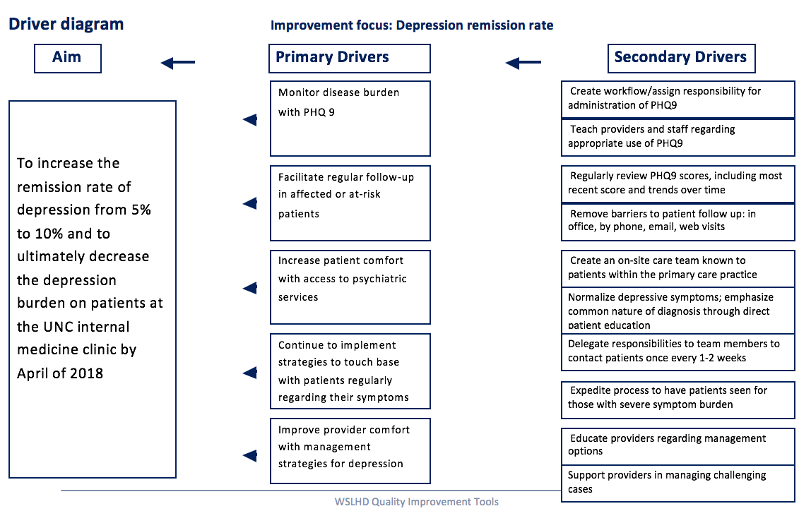
To implement sustainable system-wide models of improvement to increase the remission rate of depression by 20% (from 14% to 17%) by April 2018 in patients seen in UNC Internal Medicine clinic

Slide 6
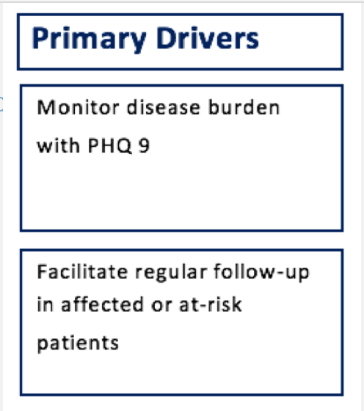
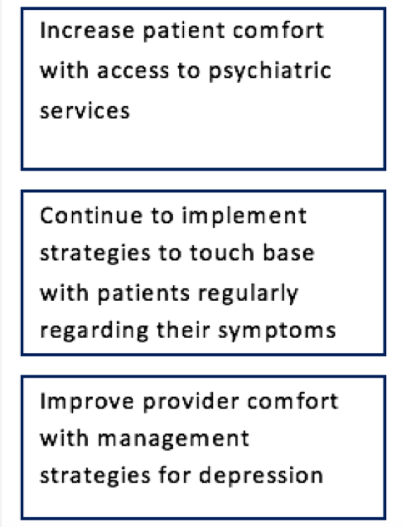
Driver Diagram
Notes:
Monitor disease burden with the use of screening tools
Increase patient comfort and provider comfort with handling depression
Facilitating regular follow up for at risk patients

Slide 7
Depression Registry and Metrics
~3,200 patients in depression registry
Inclusion criteria:
  All criteria have 18 month look-back
  Diagnosis of Depression
  PHQ-9 >9
Remission metric calculates the % of patients with index PHQ-9>9 in the past 18 months who have had PHQ-9<5 within 1-15 months after index PHQ-9
Notes:
Diagnosis of Depression (Problem List x1, Encounter diagnosis x3)
Remission: metric that calculates the % of patients >18 yo with index PHQ-9>9 in the past 18 months who have had PHQ-9<5 within 1-15 months after index PHQ-9

Slide 8
First Intervention
Patients with PHQ9 > 15
  On at least one antidepressant
  With upcoming appointments
Intervention: General reminder to providers in clinic schedule
  “Consider adjusting antidepressants”
Post-intervention Note and Medication Changes
% note/AD change
Notes:
The first intervention that we tried was a direct but unsustainable intervention and did not lead to the impact we had hoped for
We took patients with…
And we intervened in providers clinic schedules and made a note to “
What we found was that prior to the intervention 70-80% of providers were discussing depression with the patient and in their notes and about 40% were making AD changes. This did not change with the intervention in place
Baseline data
76% of providers mentioned depression in their note
38% of patients had medication changes made
Week 1
71% of providers mentioned depression in their note
28% of patients had medication changes made
Week 2
55% of providers mentioned depression in their note
33% of patients had medication changes made
Direct approach but not high yield or sustainable

Slide 9
Second Intervention: Problem List
Patients that DON’T have depression on the problem list (552)
  PHQ9 > 15 → 106 results
Providers sent Epic message – “Should depression be added to the problem list?”
  83% response rate
Intervention: Depression (RAF-HCC) code added to problem list
Focus → chart review
Notes:
Patients that DON’T have depression on the problem list and have been seen in the past 18 months (552)
Our n was so small in terms of follow up. Limited in the number of patients that had a return visit. Our ability to follow up in any change of care was limited
Although this intervention seemed like a sustainable method of improving outcome measures Difficult to demonstrate direct impact of problem list on depression management and in turn depression remission
Could have done more outreach but we have historically found high no-show rates. Something we could consider in the future. Found out in our work with diabetes that we struggled to get patients back consistently (while taking up provider schedules). Hesitation with taking that risk

Slide 10
Third Intervention
Inclusion criteria:
  Patients on at least one antidepressant
  PHQ-9 >9
  Upcoming appointment with a resident physician
Intervention: Specific recommendation to providers
  Repeat PHQ 9
  “Increase citalopram from 20 mg QD to 40 mg QD”
Next step: Best Practice Alerts (BPAs)

Slide 11
UNC IMC Depression Remission Rate
Remission Rate (%)
Notes:
This is the remission rate at the UNC internal medicine clinic since March 2017
We started at a remission rate of 13.7% and you can see where we began with chart review and data analysis
And then where our first, second, and the final interventions were done
We are now back up to 14% after dropping in the winter months but still not at our goal

Slide 12
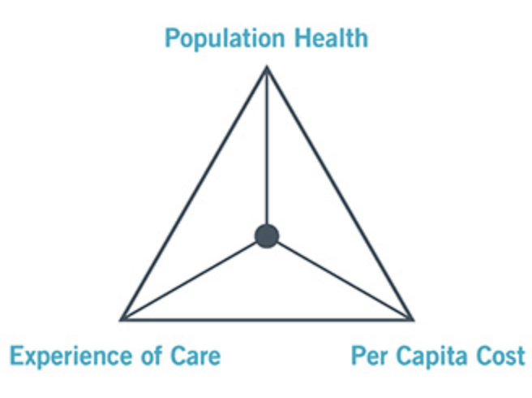
Return on Investment
Depression Remission will be considered one of UNC’s Primary Care Improvement Collaborative (PCIC) quality metrics
Dedication of resources and investment in increasing remission rate is now higher priority
Improving quality of care and health outcomes for patients with depression
  Distressed patients use health care twice as often as non-distressed patients
Notes:
In terms of return on investment, depression remission will be considered one of UNCs PCIC quality metric
Dedication of resources and investment in increasing the remission rate is now a higher priority
In terms of the IHI triple aim, this work improves the experience of patient care and health outcomes for patients with depression
Also, we know that non-distressed patients use health care services less than distressed patients decreasing the cost

Slide 13
Sustainability and Spread
Successful measures → efforts toward creating system-wide approaches
  Automatic reminders in the form of BPAs
  More efficient and less individual chart review required
Optimization of efforts to ensure depression is on the problem list
Notes:
In terms of sustainability and spread, we have found a successful measure that has the potential to be sustainable and system-wide
So we are now in the phase of putting our efforts toward implementing system wide approaches (again in the form of bpas)

Slide 14
Acknowledgements
Team Members
  Sarah Smithson, MD, MPH
  Kim Young-Wright, BA
  Diane Dolan-Soto, MSW, LCSW
  Madeline Waife, MSW candidate
UNC Division of General Internal Medicine
UNC School of Medicine

Slide 15
References
Annals of internal medicine: Screening for depression in adults: U.S. preventive services task force recommendation statement. American College of Physicians; 12/2009;151:784.
Ansseau et al. The prevalence of mental disorders in primary care. J Affect Disord. 2004;78(1):49.
Cepoiu et al. Recognition of depression by non-psychiatric physicians--a systematic literature review and meta-analysis. J Gen Intern Med. 2008;23(1):25. Epub 2007 Oct 26.
Harman et al. Primary care physician office visits for depression by older Americans. J Gen Intern Med. 2006 Sep;21(9):926-30.
Thase et al. Clin Psychiatry: Remission rates following antidepressant therapy with bupropion or selective serotonin reuptake inhibitors: a meta-analysis of original data from 7 randomized controlled trials. 2005;66(8):974.

Slide 16
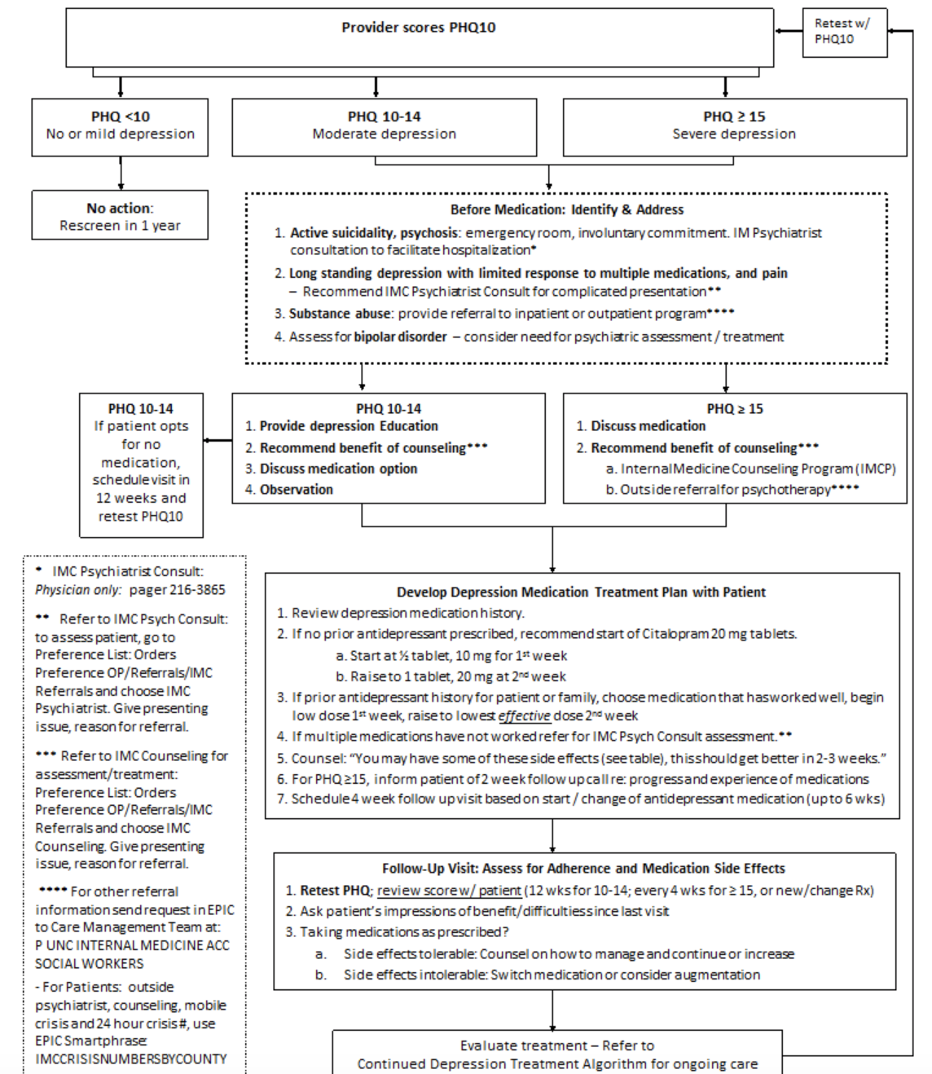
UNC initial depression treatment Algorithm

Slide 17
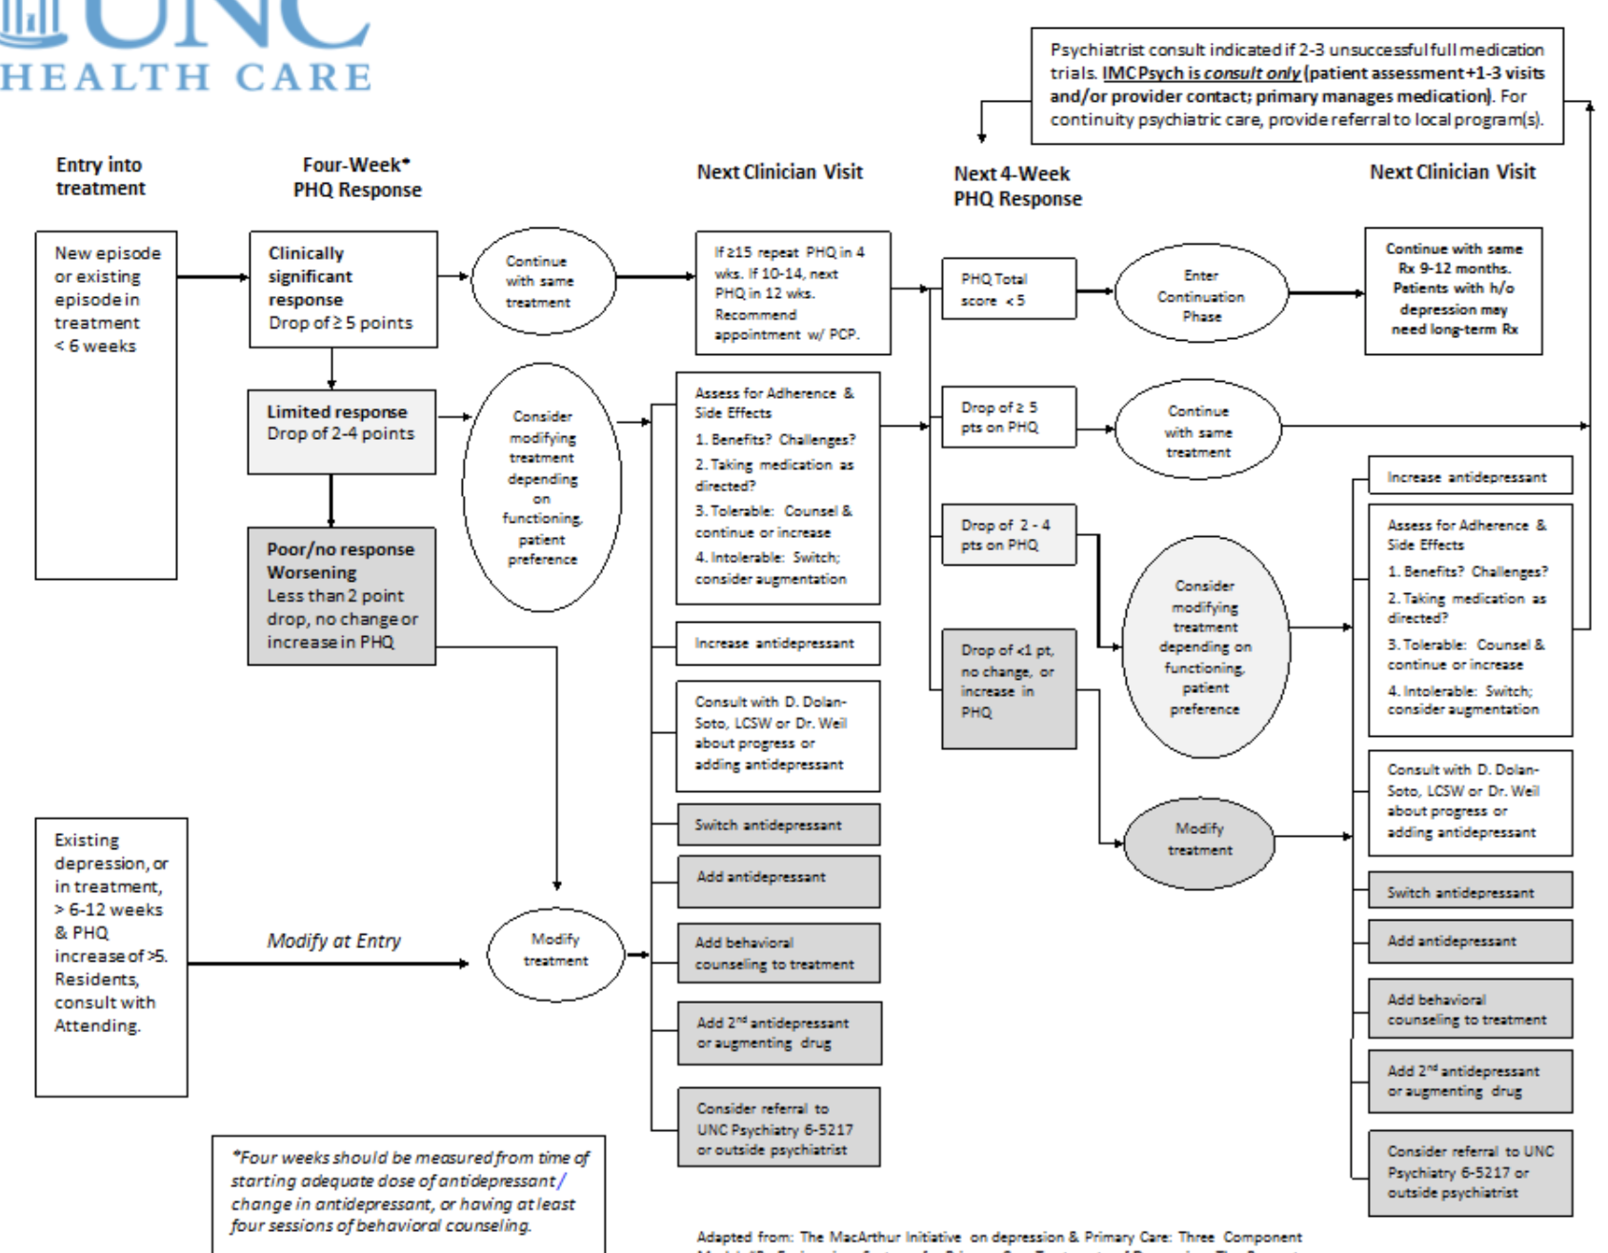
UNC continued depression treatment algorithm

Slide 18
Social Determinants of Health Screening and Resource Provision at
UNC Children’s Primary Care Clinic
Katie Schroeder, MS4
UNC School of Medicine
March 15, 2018

Slide 19
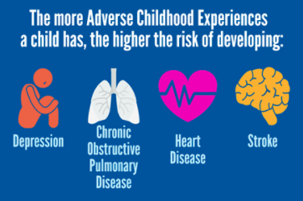
Background
American Academy of Pediatrics recommends focus on social determinants of health
  Exposure to toxic stress and adverse childhood experiences can affect a child’s developing brain, leading to long-term behavioral and health problems
  Nearly half of all children live in poverty or near poverty
  About one quarter of children have been impacted by at least one adverse childhood experience
AAP recommends using a written screen or verbally asking families about basic needs (food, housing, heat, etc)
November 2016: UNC Children’s Primary Care Clinic began screening for social determinants of health needs at each well child check
Notes:
https://www.aap.org/en-us/advocacy-and-policy/aap-health-initiatives/Screening/Pages/The-Importance-of-Screening.aspx
AAFP Survey:
83% of family physicians agree SDOH has significant impact on pt outcomes and should be addressed
80% feel they do not have the time to do this during routine consults
64% don’t believe they have staff or resources to do anything about risk factors even if they can identify them
https://healthitanalytics.com/news/pcps-lack-time-tools-to-address-social-determinants-of-health

Slide 20
Patient Experience
9 year-old boy comes for WCC and family is given various screening forms to fill out while they wait to be seen.
On SDOH screen, mother identifies the following concerns:
  Cell phone service is about to be disconnected
  Trouble putting enough food on the table each month
  Concerns that her child cannot keep up in school
  Lack of health insurance for children in their household
SDOH screen is never addressed during the visit and is documented as “negative” in the EMR.
Family likely leaves appointment feeling confused or embarrassed. Patient trust and satisfaction suffer.
Notes:
This can be two slides…. Consider breaking up
Let’s look at this from a cost perspective. Consider a child with difficult to control asthma that results in several emergency room visits per year. This may have several underlying causes, including triggering viral infections or reaction to outdoor air pollution. But what if I told you that this child often found cockroaches in his apartment and the carpets were damp and molding?

Slide 21
Patient Experience
2 month-old girl brought in for WCC and given the same SDOH screen.
Family identifies concerns regarding:
  Loss of phone service
  Food insecurity
  Lack of health insurance for patient’s parents
  Concern about ability to pay monthly rent
Her doctor carefully discussed each of these concerns, identified their level of acuity and provided appropriate resources.
Conversation and interventions were documented in EMR so that future providers and clinic social worker could track pending referrals and follow up at 4 mo WCC.
Notes:
Can you feel the difference between these two scenarios? Both are both based on real patient interactions at the UNC Children’s clinic on Franklin Street. The first scenario likely made the family uncomfortable and confused as to why their doctor asked those questions without acting upon them. The second scenario probably helped the family to feel supported as they make the already stressful transition into parenthood.
The goal of this project was to ensure that the interactions at the UNC Children’s Primary Care Clinic play out more like the second scenario than the first.

Slide 22
Project Aim
Improve referral/resource provision for patients at UNC Children’s Primary Care Clinic with with positive screen for social determinants of health needs by:
  Documenting 100% of positive paper-based social determinants of health screening forms in the EHR
  Increasing percentage of positive social determinants of health screenings with documented discussion of result to 90%
  Ensuring that all components of each SDOH screen are addressed through a referral or resource for 90% of children
Document (100%)
Discuss (90%)
Refer / Give Resource (90%)

Slide 23
Team Members
Dr. Kori Flower
  Associate Professor of Pediatrics, Project Lead
Dr. Martha Perry
  Medical Director, UNC Children’s Primary Care Clinic
Darragh Davis
  Outreach Specialist
Dr. Emily Vander Schaaf
  Associate Professor of Pediatrics
Mandy Blaede-Giulliano
  Former Clinic Social Work Intern
Madlyn Morreale, JD, MPH
  Staff Attorney, Medical Legal Partnership, Legal Aid of NC
UNC Pediatric Residents

Slide 24
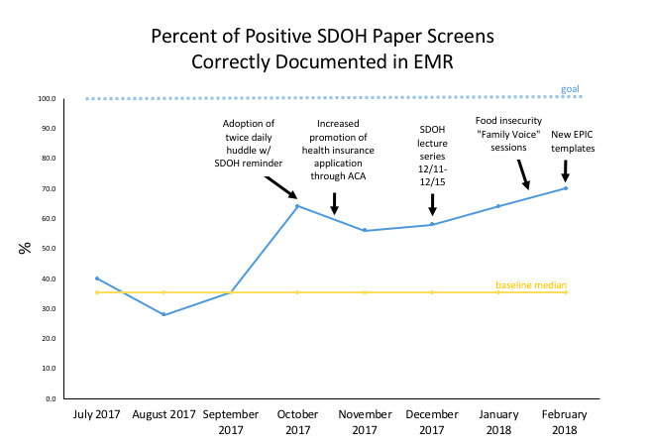
Notes:
Important process measure because the clinic is currently saving all positive paper screens and does not have clearly established workflow for how to address

Slide 25
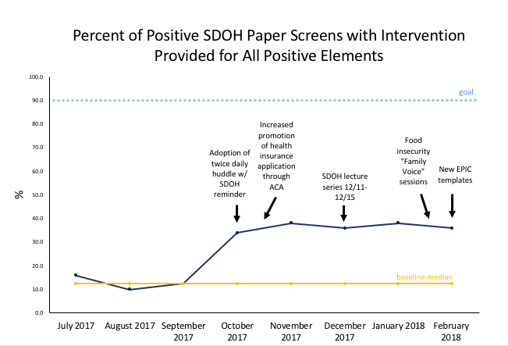

Slide 26
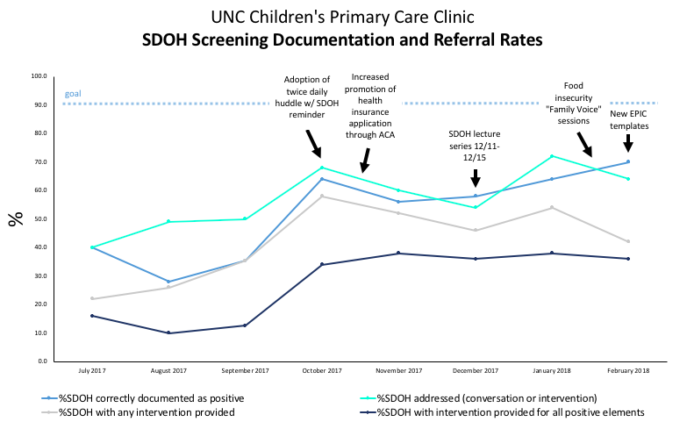

Slide 27
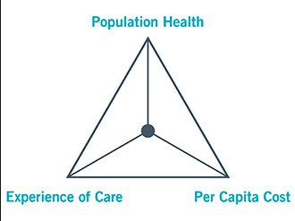
Return on Investment
Decreased cost per patient
  Fewer unnecessary emergency room visits and hospital admissions
  Better management of chronic conditions
  More effective interventions
Improved population health
  Higher utilization of available social services
  Decreased health disparities in our community
  Prevention of chronic disease in adulthood
Better experience of care
  Increased patient trust
  Higher patient satisfaction
Notes:
1-slide
Triple aim picture: http://www.ihi.org/Engage/Initiatives/TripleAim/Pages/default.aspx
The insurance company Humana recently examined food insecurity as part of its Bold Goal initiative to improve the health of its members. They found that people who are food insecure are 50 % more likely to be diabetic, 14% more likely to have hypertension and 60% more likely to experience heart failure.
http://www.healthcareitnews.com/news/social-determinants-health-and-17-trillion-opportunity-slash-spending
Major (OECD) countries spend on average about $1.70 on social services for each $1 on health services. The U.S. spends just 56 cents per health dollar. Research shows that basic measures of health are more closely and positively associated with social service spending than with health spending.
https://www.brookings.edu/opinions/social-spending-not-medical-spending-is-key-to-health/
Again this should align with institutional Goals-i.e. making more money or saving money
Consider triple aim
Short and Sweet

Slide 28

Sustainability
Ongoing focus on importance of SDOH to UNC Children’s Primary Care Clinic
Practical measures for sustainability and future directions
  Continued use of updated EPIC template
  Adoption of new validated screening tool
  SDOH gap analysis to identify additional community resources
  Adoption of new online tool to facilitate connection of patients to local resources

Slide 29
References
https://www.aap.org/en-us/advocacy-and-policy/aap-healthinitiatives/Screening/Pages/The-Importance-of-Screening.aspx
https://healthitanalytics.com/news/pcps-lack-time-tools-to-address-social-determinants-of-health
https://www.brookings.edu/opinions/social-spending-not-medical-spending-is-key-to-health/

Slide 30
Reducing Anesthesia Time in Infants and Children
Michael Greenberg, MS4

Slide 31
Background
FDA Statement
  [ 12-14-2016 ] The U.S. Food and Drug Administration (FDA) is warning that repeated or lengthy use of general anesthetic and sedation drugs during surgeries or procedures in children younger than 3 years or in pregnant women during their third trimester may affect the development of children’s brains.
  [ 4-27-2017 ] The U.S. Food and Drug Administration (FDA) is notifying the public that we have approved previously announced label changes regarding the use of general anesthetic and sedation medicines in children younger than 3 years
As an institution the Children’s Improvement Council voted to include this initiative as one of three major quality improvement initiatives for 2017-2018
A story of delayed emergence. . .

Slide 32
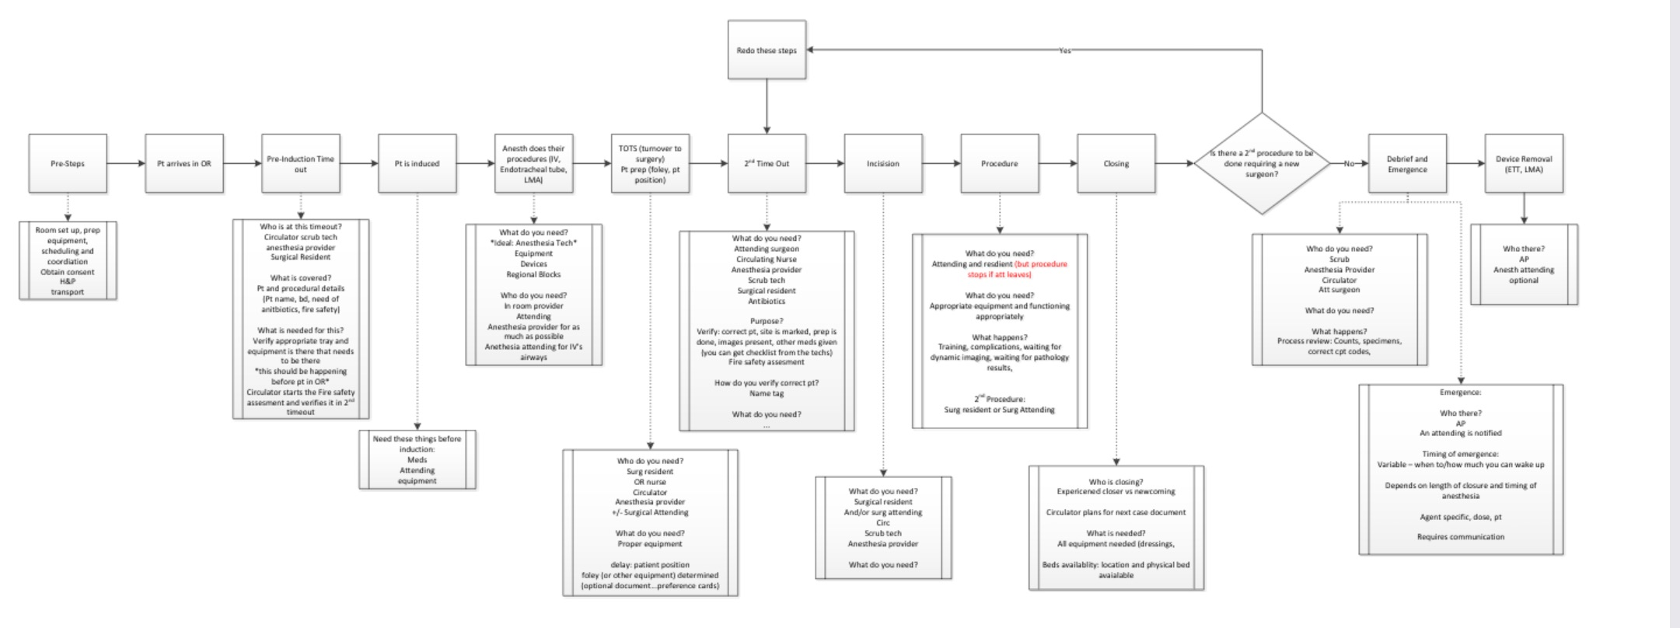
Process Map
Notes:
Showing process map and key driver to show the meat of what has been accomplished so far. Retrospecftivfe data and only a few more points on run chart without intervention so not including many there.
Want to use this slide to highlight the scope of the project and the many potential areas for improvement. Also note the “pre-work” is in itself worthy of a process map, as is each of the “time outs” etc.
Show here, too, how we are identifying intervals, and this helps isolate issues and be able to own them as teams. Data to follow

Slide 33
AIM
Reduce unnecessary prolonged anesthesia time in infants and children undergoing surgery at UNC Children’s Hospital by 10% by July 2018
Notes:
Given the scope of this issue, and noting the many places providers are continually witness to inconsistencies and inefficiencies, our primary aim is to . . .

Slide 34
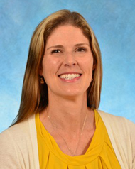


Team Members
Sara Pittenger – Pediatric Anesthesiology
Sherry Ross – Pediatric Urology
Christine Walsh-Kelly – pediatric EM
Nathan Woody – PSQI Manager and project coach
Clark McCall – PSQI Data Analyst
Jyoti Patel – COR patient service manager
Elizabeth Finch – operating room director
Notes:
Sara Pittenger is a pediatric anesthesiologist
Sherry Ross is pediatric urologist
Chris Walsh-Kelly is primarily in pediatric emergency trained has acted as our QI guru for this project
Nathan Woody is Patient Safety and Quality Improvement (PSQI) Manager and project coach for the Department of Anesthesiology at UNC Hospitals.
Clark is the PSQI Data Analyst for the Department of Anesthesiology
Beth is director of adult and pediatric operating rooms
Jyoti is patient service manager of COR

Slide 35
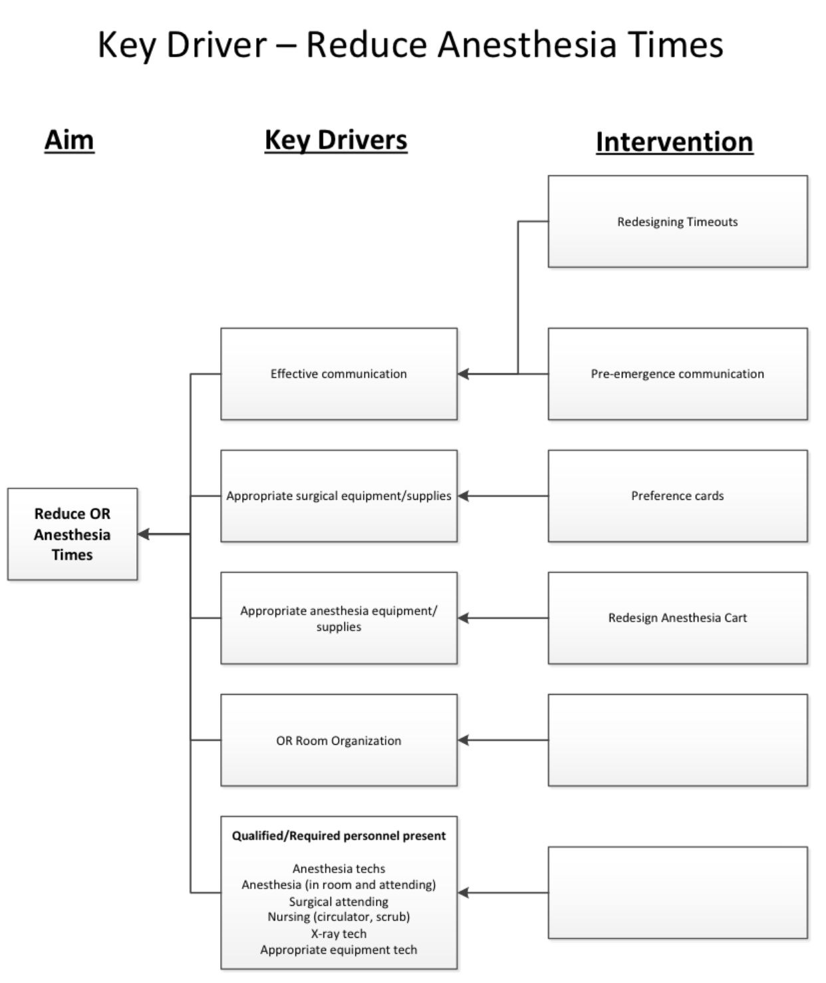
Key Driver Diagram
Redesign Timeouts
Effective Communication
Pre-emergence communication
Surgical Equipment
Preference Cards / Room access
Reduce OR Anesthesia Time
Anesthesia Equipment
Surgical Equipment
Redesign Anesthesia Carts
Focused Subgroups
Correct Equipment
Effective Communication
Organization of Space
OR Room Organization
Staff Present/
Ancillary Staff available

Slide 36
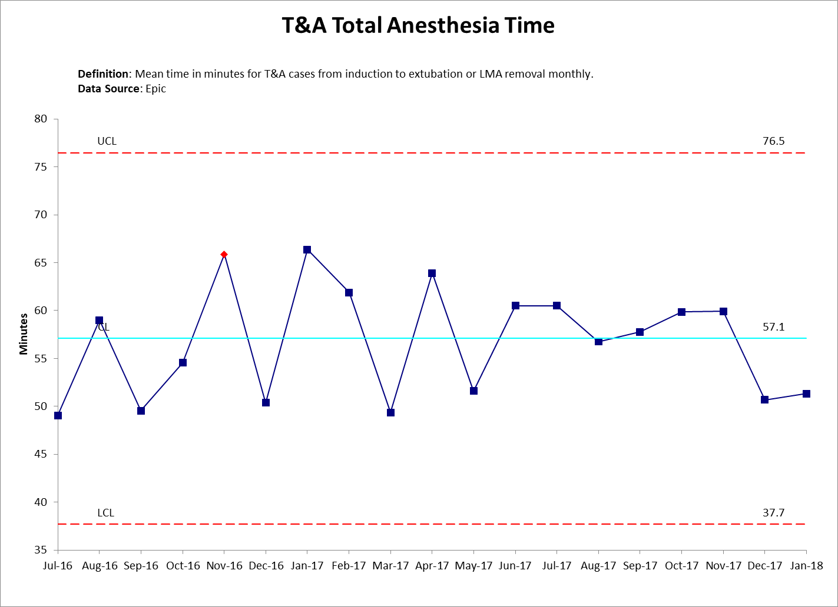
Run Charts
Anesthesia Cart Organization
Equipment Swipe Access
Notes:
Goal is to narrow the confidence intervals and reduce the mean time.

Slide 37
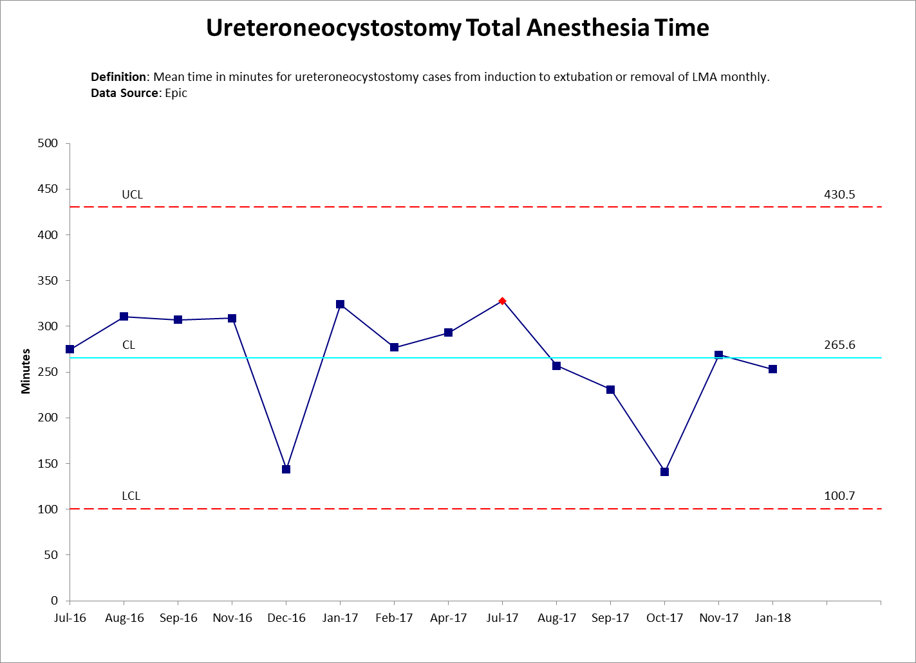
Run Charts
Images/data should help you verbally share PDSAs and changes
Can change the ‘layout’ of any of the slides as needed to fit images
  Click on the slide, then at the top click ‘layout’ and choose a new format
  Note that the background changes, so always check font coloring
  Contact Jake if you run into any technical problems with this powerpoint template
Preference Cards updated
Notes:
Goal is to narrow the confidence intervals and reduce the mean time.

Slide 38
Analysis
Return on Investment
  Shorter, more predictable OR times → improve scheduling efficiency and utilization
    Financial incentive
      Reduced waste in time and resources
  safety
Lessons Learned
  Benefits of unbiased observer
  Sponsors, buy in, management support is essential for sustainability
  Strong foundation

Slide 39
Sustainability & Spread
Sustainability:
  Executive sponsors include key hospital leaders
  Challenge: Project management
    Organization → continued improvement work
Spread:
  Children OR → adult OR
  Challenge: Culture shift (not change)
This is a large initiative in a complex system!
Notes:
Stay organized, continue to improve and spread, capitalize on moments that are ripe for change

Slide 40

Postoperative opioid prescribing in ERAS-managed patients following TAH
Evan Harmon, MS4
Lyla Hance, MPH
Lavinia Kolarczyk, MD
Notes:
Hi, my name is Evan Harmon and for the past year I’ve been working with Ms. Lyla Hance and Dr. Lavinia Kolarczyk on postop opioid prescribing in ERAS-managed patients following total abdominal hysterectomy. I hope this spilled pill bottle sets the type of ominous tone I was going for.

Slide 41
Background
Enhanced Recovery After Surgery (ERAS)
  *Not to be confused with Electronic Residency Application Service
ERAS patients do better postoperatively
ERAS patients require less postoperative opioid
  Inpatient data
Outpatient outcomes?
How are surgeons managing outpatient pain?
  No standard approach
Notes:
I wanted start by giving all of you some background on this project and how it came to be so that hopefully what we’re doing makes sense. So Lyla and Dr. Kolarczyk are the founders and managers of the enhanced recovery after surgery (ERAS) program here at UNC, which is not to be confused with the residency application service that currently has a stranglehold on my future. Instead, ERAS is a set of guidelines for the pre-, intra-, and postoperative anesthetic management of surgical patients. ERAS pathways have gained a lot of attention nationally, primarily because they have been associated with multiple improved post op outcomes such as reduced morbidity and mortality, reduced pulmonary and GI complications, and shorter hospital length of stay. Additionally, we know that these patients require less postoperative opioid than non-ERAS managed patients. However, to this point data has been limited to the inpatient setting, either in the immediate postop period in the PACU or as patients recover on the floor. To date, no one has evaluated outcomes for ERAS-managed patients once they have left the hospital. As you can imagine, an important outcome measure for surgeons, anesthesiologists, and especially patients is postop pain. However, there currently is no standard for postoperative analgesic prescribing, which I will talk more about in a little bit.

Slide 42
AIM Statements
Aim #1: By January 2018, develop a standardized opioid prescribing protocol (SOPP) for ERAS patients undergoing laparoscopic and robotic total abdominal hysterectomy (TAH) to reduce total doses of postoperative prescriptions by 50% without significant difference in patient pain or satisfaction in three months following SOPP implementation
Aim #2: Assess surgeon SOPP compliance with goal compliance rate of 70% by April 2018.
Notes:
So these were the original aims for my project. Looking at Aim 1, you can see that we wanted to introduce an evidence-based standardized opioid prescribing protocol (SOPP) for the specific surgical population of patients undergoing TAH. In essence, we wanted to provide surgeons with real guidance when it comes to postoperative opioid prescribing, and we wanted our recommendations to be based on the actual pain requirements and experiences of postoperative patients once they have left the hospital and returned home. Our second aim was to assess surgeon compliance with that prescribing protocol.

Slide 43
Driver Diagram
Notes:
Oxy 5 mg: $6-8/tab (240)
Dilaudid 2 mg: $10-15/tab (150)
About $400
Here is my driver diagram. I don’t want to spend much time here, but briefly, you can see I’ve identified surgeon over-prescribing and medication diversion as two of the primary drivers of the opioid epidemic, though there are clearly many other contributing factors which I haven’t listed. We do know, however, that the majority of abused opioids originate from physicians, either through direct prescribing or diversion. Additionally, the increase in rates of opioid prescribing by surgeons is second only to pain physicians, and many common surgeries are associated with increased risk of chronic opioid use. None of that should be surprising; after all, surgery is painful, and surgeons have to adequately control their patients’ pain. What is surprising, though, is that we have failed to provide surgeons with any evidence-based guidance in providing appropriate analgesia once their patients have left the hospital. That’s what my project is trying to correct.

Slide 44
Measures: Outcome measures
Post-discharge opioid use (daily and cumulative dose, measured in MME) during the first two weeks after discharge both pre and post implementation of a standardized opioid prescription.
Post-discharge NSAID use (daily and cumulative, measured in MME) during the first two weeks after discharge both pre and post implementation of a standardized opioid prescription.
Post-discharge numerical pain scores during the first two weeks after discharge both pre and post implementation of a standardized opioid prescription.
Percentage of unused prescription opioids properly disposed in a responsible fashion.
Notes:
Here are my outcome measures. We’re planning to look at postop opioid and NSAID use before and after SOPP implementation. We also want to look at pain scores before and after SOPP implementation

Slide 45
Measures: Process measures
Percentage of REDCap surveys successfully sent/received
Response rate to REDCap surveys
Surgeon compliance to standardized prescription recommendation
Percentage of patients present for first postoperative follow-up appointment
Compliance rate of patients bringing analgesic prescriptions to first postoperative follow-up appointment
Notes:
. Process measures will focus primarily on survey administration and response rate, in addition to surgeon SOPP compliance.

Slide 46
Measures: Balancing measures
Numerical outpatient pain scores, pre- and post-implementation of a standardized opioid prescription recommendation
Postoperative follow-up appointment compliance
Notes:
Finally, I already mentioned this as an outcome measure, but we want to make sure that patients aren’t having significantly more pain as a result of SOPP implementation.

Slide 47
Project Overview
Quantify outpatient opioid use and pain scores
Implement SOPP
1) Measure surgeon adherence
2) Quantify outpatient opioid use and pain scores
Notes:
As you can see, my project basically had three phases. I’ll start by explaining the first phase, which involved quantifying outpatient opioid use, pain, and satisfaction. We wanted to use that data to guide our recommendation for the prescribing protocol. Following protocol implementation, we needed to do two things. First, we wanted to make sure that reducing the average number of postoperative opioid doses didn’t result in poor pain control and patient dissatisfaction. Second, we wanted to know whether or not our surgeons were actually adhering to the protocol. I’ll start by describing the first part of my project.

Slide 48

REDCap Surveys
How to quantify outpatient opioid use and pain scores?
Standardized telephone surveys
Length depends on patient responses (~30 questions)
106 patients called, 32 patients completed surveys
Notes:
So how do you quantify how much opioid patients are using once they’ve returned home? Well, it turns out you just pump up a fourth year medical student and have him call all of them at home, which is exactly what I did. We used a standardized telephone survey through a program called REDCap which some of you may be familiar with. I’ve included an example of what the survey looks like here. The number of questions can vary based on patients’ answers, but usually ends up being around 30 questions taking 5-10 minutes to complete. I ended up calling over 100 patients from July through November, with 32 patients completing the survey, which resulted in a survey response rate of about 30% which was above our goal.

Slide 49
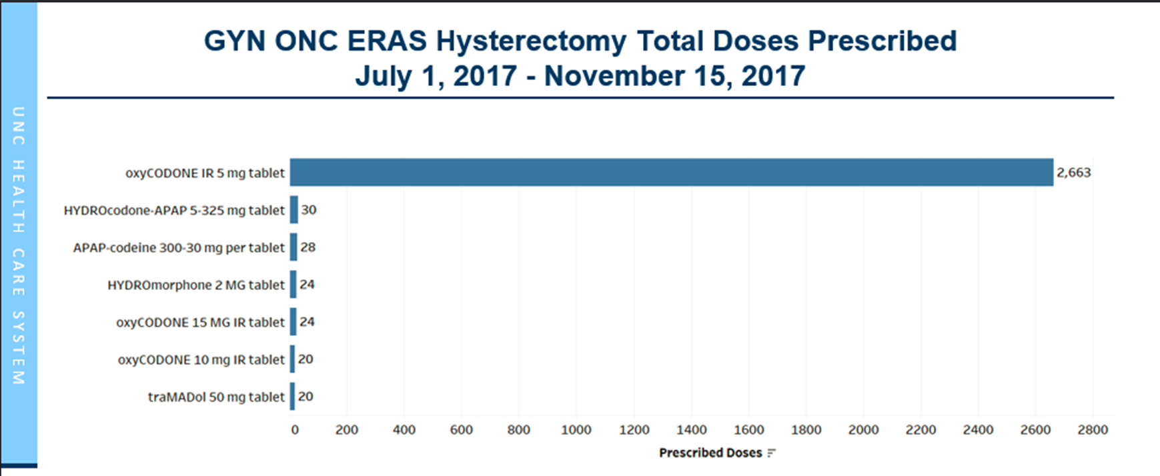

Slide 50
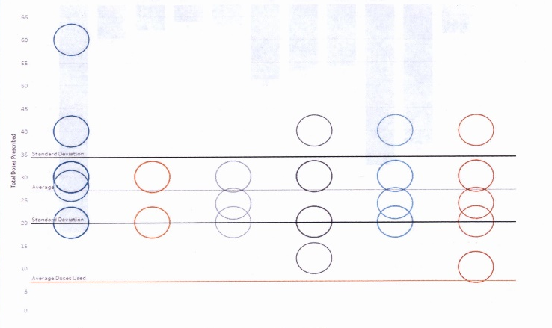
GYN ONC Hysterectomy CPT Group Opioid Doses by Surgeon
27
8
Notes:
So first, let’s look at what patients were actually being prescribed. The vast majority (94%) of patients were prescribed oxycodone 5 mg as their opioid analgesic, along with acetaminophen and ibuprofen. So in this graph we see the total doses of opioid prescribed on the Y-axis, and each column of circles represents one of the six GYN-ONC surgeons we have here at UNC. The take-home point of this slide is that there was no consistency between or really even among surgeons in their postop opioid prescribing habits. Also it’s important to notice that while patients on average are being prescribed around 27 tablets, they typically only use around 8 tablets. So this data gives us an idea of what the average patient was using at home, but we wanted to know whether that’s truly representative of MOST patients.

Slide 51
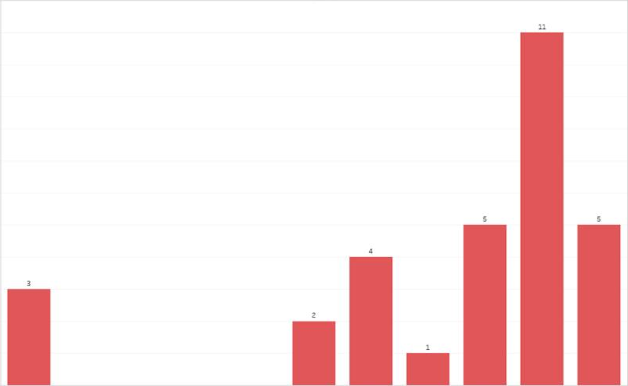
Leftover Prescribed Doses
12
11
10
9
8
7
Patient count
6
5
4
3
2
1
0
0% 10% 20% 30% 40% 50% 60% 70% 80% 90% 100%
Notes:
Again, we see the data for those 32 patients, but now with patient count on the Y axis and above each bar. Here, patients are grouped by what percentage of their total prescribed opioid was leftover. As you can see, the vast majority of patients use less than half of what is being prescribed. What’s more, 65% of patients had over 80% of their prescription leftover. These numbers are pretty worrisome because most patients I talked to had taken minimal or no measures to ensure proper storage or disposal of their leftover opioid, putting them at high risk for abuse or diversion.

Slide 52
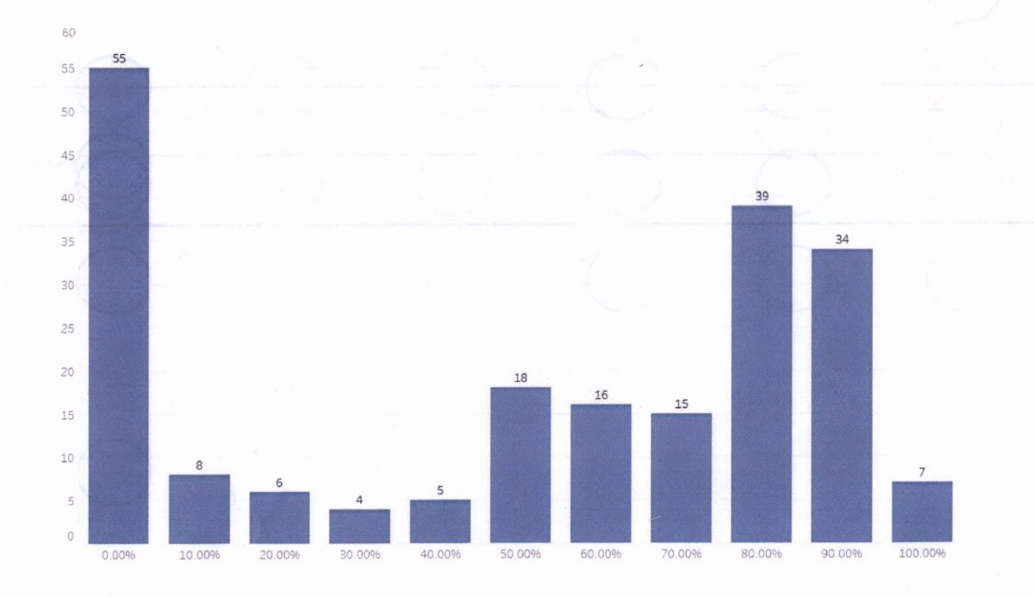
Leftover Prescribed Doses – All Patients
62%
Patient count
Notes:
129 >/= 50%
78 < 50%
I wanted to briefly include this slide to just to show that I’m not the only person calling patients here at UNC, and that we have multiple individuals doing what I do for multiple surgical groups. This is a graph showing the cumulative data for all patients who have been called across all surgical groups to date. As you can see, this data closely resembles what we found in our GYN-ONC group in that most patients use only half of their prescriptions or less. Interestingly, the data clusters into basically two groups: patients who use little to none of their prescribed opioid, and those who use every last dose of their prescription.

Slide 53
Project Overview
Quantify outpatient opioid use and pain scores
Implement SOPP
1) Measure surgeon adherence
2) Quantify outpatient opioid use and pain scores
Notes:
Using this data, we were able to move onto the second phase of my project, which was actually writing and implementing a standardized opioid prescribing protocol for GYN ONC patients undergoing TAH.

Slide 54
Standardized Opioid Prescribing Protocol
“For patients undergoing robotic or laparoscopic total abdominal hysterectomy, we recommend prescribing 10 doses of oxycodone 5 mg tablets.”
*Average used + 1 SD
Notes:
So here it is, the much-anticipated Standardized Opioid Prescribing Protocol. You can see that based on our data, we recommend 10 doses of oxycodone 5 mg tablets for patients undergoing robotic or laparoscopic TAH. This was derived from the average used plus 1 SD in an effort to cover the analgesic needs of the vast majority of patients.

Slide 55
Project Overview
Quantify outpatient opioid use and pain scores
Implement SOPP
1) Measure surgeon adherence
2) Quantify outpatient opioid use and pain scores
Notes:
So our SOPP for the GYN ONC group had a go-live date of February 1st of this year, and that allowed us to start moving into the third phase of my project.

Slide 56
Go-live date: 2/1/18
February 2018:
  27 cases
  55% adherence
March 2018:
  13 cases
  61.5% adherence
Cumulative:
  40 cases
  60% adherence
Notes:
Here is the data we have so far on the GYN ONC surgeon adherence to our newly implemented prescribing protocol which had a go-live date of 2/1 of this year. As you can see, compliance has been so-so, cumulatively measured to be 60%. However, the protocol has only been in place for about 6 weeks, and it is encouraging to see that at least there appears to be a trend upward in the compliance rate thus far in March compared to February.

Slide 57
Potential Impact of SOPP
2809 tablets prescribed during project
7491 tablets annually
Using SOPP, would have reduced prescribed opioids by 1802 tablets
Annualized: Reduction by 4805 tablets
Notes:
And I really hope that compliance continues to trend upward because our projections suggest the GYN ONC prescribing protocol could have a tremendous impact on our community. Our analysis suggests that had this protocol been in place in the four months prior to its development, we would have reduced the total doses of opioids in that time frame by 1802 tablets. If you extrapolate that out, that’s 4800 oxycodone tablets that we are preventing from needlessly entering the community every year. That, to me, is really the most powerful part of this entire project.

Slide 58
Future Directions
Re-analyzing patient experiences
Continue to monitor surgeon adherence
ERAS vs non-ERAS managed patients
For every surgery, a SOPP
Notes:
So where do we go from here? First, we need to ensure that reducing the amount of opioids patients are receiving is not resulting in worsened outpatient pain and patient dissatisfaction. Three awesome pre-med students here at UNC are in the process of collecting that data now. Second, monitoring surgeon adherence will be key, as will identifying the factors contributing to non-adherence. This challenge may represent a QI project of its own one day. Third, this data was all collected in ERAS managed patients. However, it might be interesting to investigate non-ERAS managed patients undergoing TAH as well, as these patients may have different postoperative pain requirements. Finally, our ultimate goal is to provide evidence-based recommendations for every surgery performed by every surgical group here at UNC. Or, stated differently, for every surgery, a SOPP.

Slide 59
Thank You!
Team Member | Role
Lavinia Kolarczyk, MD | Mentor, Project Sponsor
Lyla Hance, MPH | Mentor, Project Sponsor
Nathan Woody | PSQI Manager
Clark McCall | PSQI Data Analyst
Brooke Chidgey, MD | UNC Opioid Project Lead
Peggy McNaull, MD | Vice Chair of Patient Safety and QI
Rob Isaak, DO | Assistant Director of ERAS
Linda Van Le, MD | GYN-ONC ERAS Surgeon Champion
Additionally, Dr. Amy Shaheen, Jake Reardon, and everyone else involved in the PLQS course!
Notes:
Finally, I want to thank everyone involved in this project, as it has truly been a remarkable experience for me as a fourth year student trying to improve my understanding of quality improvement. Thanks for listening, and I’m happy to take any questions.

Slide 60
Lessons Learned
Most patients use less than half of the prescribed dose
On average, about 25% of prescribed dose
No standardized method of opioid prescribing following TAH
High degree of variability among and between surgeons
Notes:
So far what I’ve basically learned is that patients are taking far fewer doses of opioid than they are being prescribed. Additionally, there is no standardized prescribing protocol and this is reflected in the high degree of variability among postoperative prescribing.

Slide 61


Future Plans
SCHEDULE
Project Task | Jul 2017 | Aug 2017 | Sept 2017 | Oct 2017 | Nov 2017 | Dec 2017 | Jan 2018 | Feb 2018 | Mar 2018 | Apr 2018
Baseline chart review
REDCap survey distribution, initial
Initial pain score/duration analysis
SOP creation
SOP implementation
REDCap survey distribution, secondary
Disposal bags introduced to postop clinic
Disposal data tracking/analysis
Present at student symposium
Notes:
It’s hard to believe we’re already to December, but the next step will be writing what will be an evidence-based SOPP and taking that to the GYN-ONC group for their input. We plan to implement that January 1st and measure surgeon compliance to that protocol in addition to re-evaluating patient pain and satisfaction again using telephone surveys. Thanks for your time.

Slide 62
Trust the Process: Reducing Children’s Hospital Readmissions
Chris Iskander, MPH
Dr. Walsh-Kelly, MD
Dr. Lindsay Chase, MD

Slide 63
Background
In 2016 NC Children’s Hospital had multiple cases of patient harm secondary to discharge medication errors.
  Morbidity & Mortality conference identified the absence of a standardized discharge process as a driving factor in these errors.
The lack of a standardized discharge process to facilitate the transition from hospital to home resulted in high variability and numerous errors

Slide 64
Patient Experience
Looking at national data, 6.5-8% of pediatric admissions result in a readmission.¹
These numbers go up when you adjust for patients with chronic illness with some patient populations having rates as high as 20.1%²
^{1, 2} Berry, Jay G., et al. “Pediatric Readmission Prevalence and Variability Across Hospitals.”Jama, vol. 309, no. 4, 2013, p. 372., doi:10.1001/jama.2012.188351.

Slide 65
AIM statement
Global Aim:
  to develop a standardized process for discharge medications that results in an accurate and complete medication list and correct AVS medication instructions at the time of discharge.

Slide 66
AIM statement (cont.)
Specific aim # 1:To increase the percentage of patients discharged with an accurate and complete medication list including correct medication, dose, frequency, formulation, and route to 80% by April 2018.
Specific aim # 2: To perform multidisciplinary discharge medication reconciliation for 80% patients discharging from the Ped Pulmonary service by April 2018.
Specific aim #3: To decrease the percentage of patients with after discharge medication issues resulting in call to medical provider by 50% by April 2018.
Phase 1: Population for improvement efforts will focus on the Pediatric Pulmonary (PMP/Blue) Serve.

Slide 67
Team Members
Lindsay Chase MD- Project Lead, peds hospitalist
Katie Westreich MD- Physician, Lead of Standardize Discharge Project
Yolanda Yu MD- Pulm Fellow
Meredith Cuthriell RN- Ward Team Coordinator for Ped Pulm
Kathy Riley- pharmacy
Chris Falato- pharmacy
Sara Duffus MD- resident
Amy Bowen RN- nursing
Heidi Troxler RN- nursing
Chris Walsh-Kelly MD- Resource, QI expert support
Ashley Kellish RN- Resource, QI and logistical support
George Guthrie- Resource, QI and logistical support
Kathy Bradford MD- QI expert
Chris Iskander- Medical student
Carl Seashore- Epic/IS expert

Slide 70
Return on Investment
Economic
  In 2017, pediatric patients with a readmission had a total cost that was 2.3x higher ($12 250 vs $5340) than pediatric patients who were not readmitted
Social
  Patient satisfaction is improved with lower readmissions
¹ Markham, Jessica L., et al. “Length of Stay and Cost of Pediatric Readmissions.” Pediatrics, 2018, doi:10.1542/peds.2017-2934.

Slide 71
Sustainability & Spread
At this time we are still working to refine the discharge process to ensure that residents feel comfortable
This process improvement is still focused on the PMP Blue (Peds Pulmonology) service, with hopes that we can spread it to the entire NC Children’s Hospital by the end of 2018.

Slide 72


Diabetes: Eye Exam
UNC Internal Medicine Chapel Hill
Tam Le
Christina McMillan
Shana Ratner, MD, FACP

Slide 73


Problem
Diabetic retinopathy is the leading cause of blindness among adults between 20 and 74 years of age.
90% are preventable
Annual dilated eye examinations are a cost-effective intervention and prevent vision impairment
<50% of diabetic patients in the US have received the exam⁴⁻⁶.

Slide 74
Problem
As of March 2017, only 36.3% of active diabetic patients at UNC Internal Medicine completed the annual exam.
Project Aim 1: Increase the rates of annual retinal screening among established diabetic patients at UNC IMC to 48%.

Slide 75
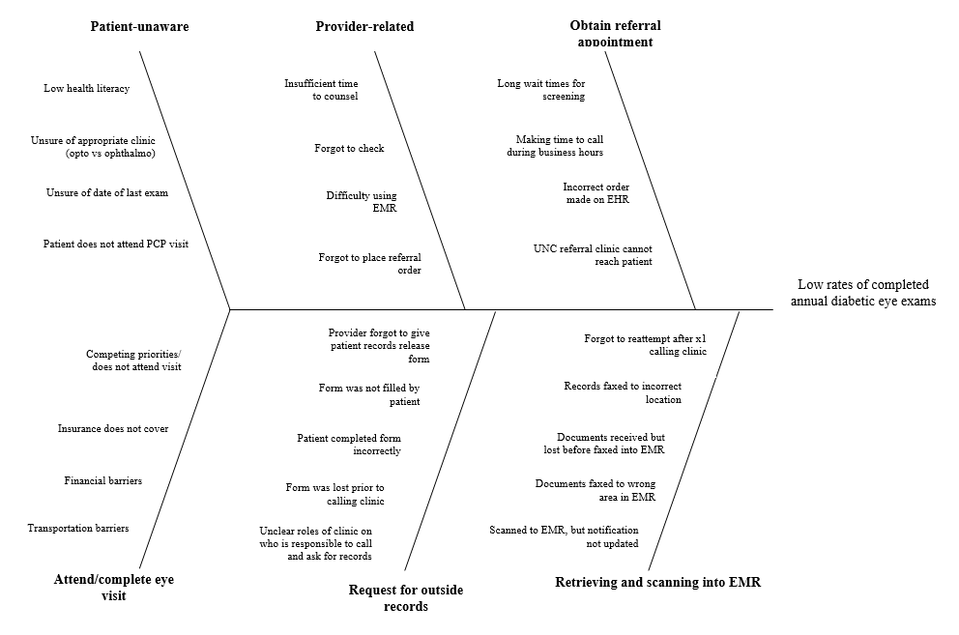

Slide 76






Process to Receive an Annual DR Eye Screening
Knowledge of Overdue Exam
Referral Process &
DR Screening Attendance
Result Retrieval
Notes:
But when we look into the process of receiving an annual retinal screening, the entire steps can be summarized into three main categories:
Knowledge or awareness of overdue exam
System process of referring patients and receiving the screening exam
Care coordination and retrieving referral results of the exam since UNC IMC does not perform their own retinal exams in site.
In my QI project with UNC IMC, we wanted to perform interventions to address each part of the process that I mentioned above.

Slide 77
Process to Receive an Annual DR Eye Screening
Knowledge of Overdue Exam
Referral Process &
DR Screening Attendance
Result Retrieval

Slide 78
Patient Outreach
Outreach mailing
  Created outreach letter
  EPIC QI Dashboard
  1239 mailings in bulk on June 2017
    665 by mail and 574 patient portal
Staff training
  Response manual for staff to respond to patient replies
Table 1. Outreach Results Nov 2017
 | Patient Portal
Amount sent | 574
Letter Opened by Patient | 284 (49.5%)
Patients who asked for referral | 40 (7%)

Slide 79
Patient Outreach via Telephone Encounters
Table 2. Results of Telephone Encounters
 | n (%)
Patients with overdue exams (Oct 2017) | 1185
Patients called | 785
Patient answered | 71 (9.0%)
Report completed eye exam | 15 (21%)
Has an upcoming eye appointment | 10 (14%)
Interested in referral | 11 (14%)
Self-reported barriers for eye exams:
Poor literacy. “…I can’t read good. I usually give my neighbor important letters to read for me…”
Financial concerns
Competing priorities (job, family, etc) “…I just haven’t gotten around to it yet…”

Slide 80
Process to Receive an Annual DR Eye Screening
Knowledge of Overdue Exam
Referral Process &
DR Screening Attendance
Result Retrieval
Notes:
We met with the medial director of ophthalmology

Slide 81
Process to Receive an Annual DR Eye Screening
Knowledge of Overdue Exam
Referral Process &
DR Screening Attendance
Result Retrieval
Notes:
Lastly, we spent a large time of our efforts this year working on an intervention that will improve retrieving eye exam screening results from outside clinics.
This is especially important as the UNC IMC clinic does not perform retinal screenings in house and is required to refer all of their patients to a specialist, whether UNC Eye (which is located off site), or another location.

Slide 82
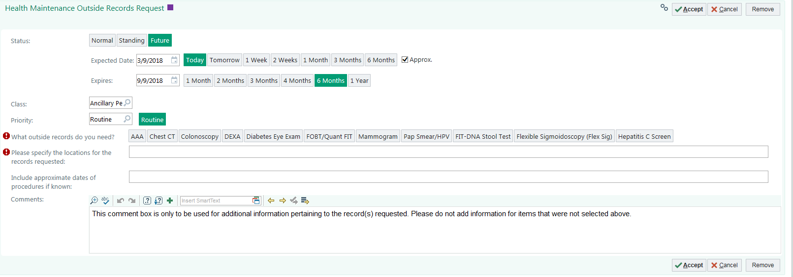
Health Maintenance Records Request (HMRR)
Notes:
To that respect, we launched a health maintenance records request, a new order in EPIC to help facilitate records retrieval for all health maintenance screening exams.
This records request can be ordered by all administrative staff, nursing and providers and is very easy to use and self-explanatory to submit.
When the order is sent, the order is sent to ___ whose only role is to process these orders by calling outside clinics and putting the faxed results into EPIC.

Slide 83
HMRR Preparation and Design
March
April
May
June
July
2017
Pilot of HMRR
Data review on HMRR pilot
Developed standard work
“Train the trainer”
Training
July 7: HMRR launched for all providers
Notes:
And since we’ve started, ---- orders have been made.

Slide 84
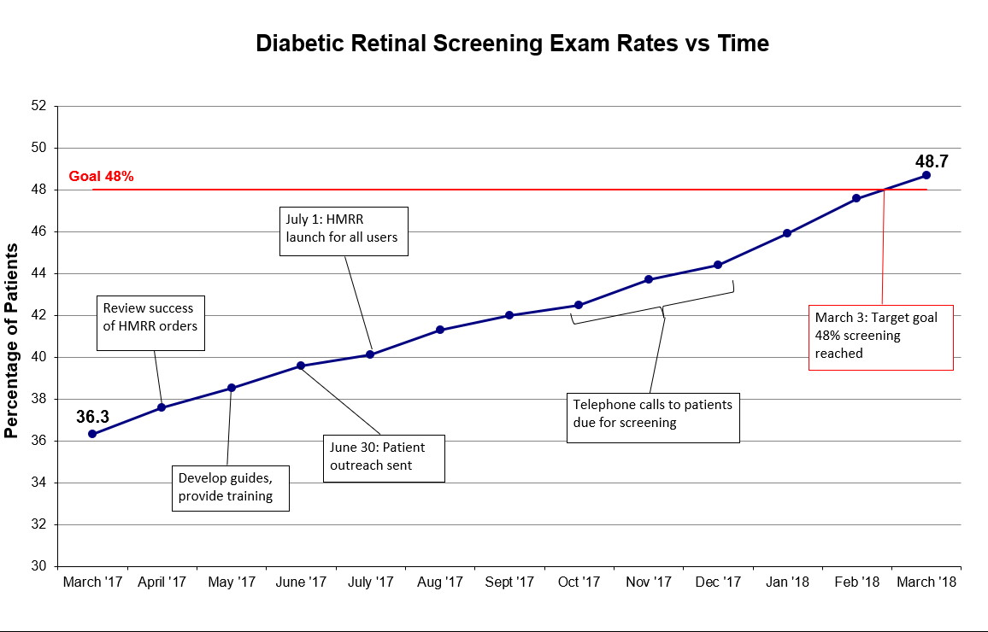
Notes:
Change so all timeline is on graph
I just wanted to highlight an outcome measure of the percentage of our patient who were screened for diabetic retinopathy.
We had an increase from 36% to 48%, which is an absolute increase of 12%.
It is also notable that we had a steady increase monthly and are now meeting our goal of 48%
Well the numerators and denominators have shifted, but this means that ___ have been

Slide 85
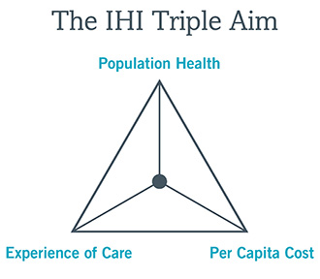
Return on Investment
Increasing rates of annual diabetic eye exams
Patient follow-up and assistance
Improvement of care coordination of UNC eye referrals
Ambulatory Organizational goal for 2018
ACO quality goal
Notes:
Improving the patient experience of care (including quality and satisfaction);
Improving the health of populations; and
Reducing the per capita cost of health care.
And as you’ve heard, we’ve impacted the population and the patient experience.
It also impacts the financial wellbeing of the institution as an ambulatory org goal and an ACO quality measure.

Slide 86
Take Home Points & Sustainability
Lessons Learned:
Combined efforts of various outreach initiatives have significantly increased eye exam rates
Care coordination and scheduling is a patient-reported barrier for completing the screening exam
HMRR team-based care
Sustainability & Spread
Adding diabetes retinal screening to patient’s birthday outreach
Managing care coordination of scheduling with UNC Ophthalmology
Presented to UNC Primary Care Improvement Collaborative
National meeting: SGIM April 2018
Notes:
“to share these best practices across the UNC network” and will be spreading our work nationally at the upcoming SGIM national meeting.

Slide 87
Acknowledgements
Thank you to Dr. Shana Ratner and Christina McMillan
UNC Internal Medicine Ambulatory Care Clinic
Derek Cain
Jamie Cavanaugh
Sarah Landis
Martin Rose
Christy Coryell
UNC Ophthalmology
Dr. Kathleen Gordan

Slide 88
Online Resources
https://www.aao.org/preferred-practice-pattern/diabetic-retinopathy-ppp-updated-2016
https://www.aao.org/summary-benchmark-detail/retina-summary-benchmarks-2016#Introduction
Klein BE. Overview of epidemiologic studies of diabetic retinopathy. Ophthalmic Epidemiol 2007;14:179-83.
Kempen JH, O'Colmain BJ, Leske MC, et al. The prevalence of diabetic retinopathy among adults in the United States. Arch Ophthalmol 2004;122:552-63.
Klein R, Klein BE, Moss SE, et al. The Wisconsin Epidemiologic Study of Diabetic Retinopathy. II. Prevalence and risk of diabetic retinopathy when age at diagnosis is less than 30 years. Arch Ophthalmol 1984;102:520-6
Klein R, Klein BE, Moss SE, et al. The Wisconsin Epidemiologic Study of Diabetic Retinopathy. III. Prevalence and risk of diabetic retinopathy when age at diagnosis is 30 or more years. Arch Ophthalmol 1984;102:527-32.

Slide 89
Question & Answer
Increasing the Rate of Depression Remission in Internal Medicine Patients
  Carol Bounajim
Social Determinants of Health Screening and Resource Provision at
UNC Children’s Primary Care Clinic
  Katie Schroeder
Reducing Anesthesia Time in Infants and Children
  Mike Greenberg
Postoperative opioid prescribing in ERAS-managed patients following TAH
  Evan Harmon
Trust the Process: Reducing Children’s Hospital Readmissions
  Chris Iskander
Retinopathy Screening for Diabetic Patients
  Tam Le

Slide 90
Improving COPD Care in Primary Care Clinics
Katherine Lee, MS4
Project Mentor: Amy Shaheen, M.D., M.Sc.

Slide 91
Background
COPD is common and costly
  2011 US patient-reported prevalence: 6.3%¹
    65-74 years: 12.1%
  $13.1 billion in hospital costs²
  1 in 5 are readmitted within 30 days of inpatient stay for COPD exacerbation³
Barriers to treatment
  Inhalers expensive and used incorrectly ⁴
  Undertreated – 60% of high-complexity COPD patients on no meds ⁵
  Spirometry availability for correct diagnosis
COPD admissions as target for health savings
  “Ambulatory care sensitive” quality indicator by AHRQ

Slide 92
COPD Care in Clinic
80-year-old woman with COPD, former smoker, diabetes, and hypertension presents to clinic for regular follow-up.
  Worried about upcoming trip because she gets winded in airport.
  Has “a few” inhalers at home.
  “Pretty sure” she knows how to use the inhalers.
  Hospitalized once in the last year for COPD exacerbation.
  Has never had pulmonary function testing to confirm diagnosis.
Where to start?

Slide 93
AIM Statement
To improve the care of COPD patients in a primary care setting by
  Implementing office-based spirometry
  Increasing the % of COPD patients with…
Measure | Goal
Diagnostic spirometry | 30%
Symptom assessment | 20%
Prescribed rescue inhaler | 80%
Successful inhaler education | Unspecified
Referral to pulmonary rehab | 30%

Slide 94
Team Members
Rex Primary Care at Cary - Community Family Medicine
  New to spirometry and COPD measures
    Amy Shaheen, MD, MSc – Project mentor (IHQI grant)
    Shane Hemphill, MD – Physician lead
    Michelle Walsh, RN – Spirometry, nurse lead (process owner)
    Stephanie Edwards, MHA – Practice manager (process owner)
    Candice Hunt, MHA – IHQI project manager, data analyst
    Christine Reed, MHA – Quality coach
    Katherine Lee – Flex/student
UNC Internal Medicine Clinic - Academic
  Spirometry implemented, improving processes
    Amy Shaheen, MD, MSc – Physician COPD lead
    MeKayla Mclean – Care assistant COPD lead
    Brooke McGuirt – Epic support
    Annie Whitney – Epic support
    Katherine Lee – Flex/student

Slide 95
RPCC - Spirometry
Schedule notes and provider msg for upcoming high-risk patients without rescue inhaler
BPA started
RN called high-risk patients with upcoming visits to schedule spirometry

Slide 96
RPCC - Symptom Assessment

Slide 97
RPCC - Rescue Inhalers
Individual MD given patient list with suggested actions
Practice given patient list with suggested actions
Requested report update (ipratropium/ albuterol)
Requested report update (levalbuterol)
BPA started
MS4 data deep dive
Schedule notes and MD/APP msg for upcoming high-risk patients without rescue inhaler

Slide 98
IMC - Inhaler Education
Process in place from past QI projects
Care assistants providing inhaler education and adjusting process
Medical student month
Provider activation – Schedule notes
Patient activation – MyChart messages to bring inhalers
Real-time feedback – Student followed up with nurses and MD/APP same-day to see why or why not inhaler education was provided
Retroactive provider education – Inbox messages after missed opportunity to teach process

Slide 99

IMC - Inhaler Education
MyChart msg to high-risk pts, real-time feedback
MyChart msg to high- and mod-risk pts
Schedule notes
Retroactive provider education
Stopped schedule notes

Slide 100
IMC - Inhaler Education

Slide 101
Payors care!
No current ROI data but…
UNC Senior Alliance, Next Generation ACO
  Shared savings or financial risk
    Actual cost-of-care vs. predicted cost of care
    Quality measures - Composite COPD measure
COPD admissions counted in Medicare’s Hospital Readmissions Reduction Program since FY 2015
  Estimated $2.1 million FY2018 penalty for UNC⁶

Slide 102
Sustainability & Spread
From temporary assistance to sustained work
  Stop time-consuming interventions
  Partner with process owner/permanent staff in PDSAs
  Teach interventions to permanent staff
Next steps
  Pulmonary rehabilitation
  Incorporating readmissions data
Going live across UNC PN primary care in July 2018
  Quality measures, BPAs, and guidance implementing spirometry

Slide 103
References
Centers for Disease Control and Prevention (CDC). Chronic obstructive pulmonary disease among adults–United States, 2011. MMWR Morb Mortal Wkly Rep. 2012. 61(46): 938–43.
National Institutes of Health, National Heart, Lung, and Blood Institute. Morbidity & mortality: 2012 chartbook on cardiovascular, lung, and blood diseases. National Heart, Lung and Blood Institute website. https://www.nhlbi.nih.gov/files/docs/research/2012_ChartBook_508.pdf. Accessed 3/13/18.
Shah T, et al. Understanding Why Patients With COPD Get Readmitted: A Large National Study to Delineate the Medicare Population for the Readmissions Penalty Expansion. Chest. 2015. 147(5): 1219-26.
Chrystyn H, et al. Device errors in asthma and COPD: systematic literature review and meta-analysis. NPJ Prim Care Respir Med. 2017. 27(1): 1-10.
Make B, et al. Undertreatment of COPD: a retrospective analysis of US managed care and Medicare patients. Int J Chron Obstruct Pumon Disease. 2012. 7:1-9.
Advisory Board. 2,573 hospitals will face readmission penalties this year. Is yours one of them? 7 Aug 2017. https://www.advisory.com/daily-briefing/2017/08/07/hospital-penalties#map. Accessed 3/8/18.

Slide 104
Making a FUS (Family Update Sheet) for Family Communication in the Neurosciences ICU: First Step to Improve Family Engagement
Sean Miller, MS4
Casey Olm-Shipman, M.D.

Slide 105
It started with a Daily Goals Tool…
Notes:
Talk briefly about concept of Daily goals tool, high compliance, decrease in CAUTIs and VAPs

Slide 106
It started with a Daily Goals Tool…
Notes:
Talk briefly about concept of Daily goals tool, high compliance, decrease in CAUTIs and VAPs

Slide 107
It started with a Daily Goals Tool…
BEFORE:
AFTER:
Notes:
Talk briefly about concept of Daily goals tool, high compliance, decrease in CAUTIs and VAPs

Slide 108
What we achieved…

Slide 109
What we achieved…

Slide 110
What we achieved…

Slide 111
Need for further improvement…
Daily Goals Tool Compliance
Date | FAMILY MEETING
Apr-16 | 68.18%
May-16 | 78.88%
Jun-16 | 74.86%
Jul-16 | 71.35%
Aug-16 | 82.67%
Sep-16 | 79.63%
Oct-16 | 78.04%
Nov-16 | 69.95%
Dec-16 | 76.20%
Jan-17 | 79.67%
Goal Average | >85%
Actual Average | 75.94%
Needs More Patient-Family Engagement
“…One thing lacking I think is family involvement…”
“Would like for more family involvement in rounds if possible”
Notes:
Surveys assessing effectiveness of daily goals tool suggested need for improvement in family engagement

Slide 112
In Our Own NSICU:
35 year-old female with pontine hemorrhage transferred from an outside hospital with waxing and waning mental status.
Scheduled for a tracheostomy and percutaneous endoscopic gastrostomy.

Slide 113
Why else should I care?
Needham et al. CCM 2012 40(2); 502-9
Davidson et al. CCM 2017; 45; 103-28
Notes:
Improved survival in ICUs means increased morbidity. Family members carry significant burden of caregiving for over 50% of ICU survivors. 25-50% family members experience psychological symptoms during and after critical illness of a loved one.

Slide 114
AIM statement
Improve daily engagement of families surrounding communication of goals of care and daily treatment plans for patients in the NSICU.
  Identify barriers and opportunities for daily communication with families of NSICU patients
  Define and prioritize information that should be communicated from both provider and family member perspectives
  Describe the current state in communication of treatment plan and goals of care
  Implement a standardized method for communicating with families
  Obtain fidelity with the new communication method (>50% use by both families and staff)

Slide 115
Barriers identified…
Health provider availability
Multiple responsibilities for all clinicians
High patient:physician ratio
Staff identified
Family availability
Many family members
Clustering and timing of information difficult to coordinate
Lack of standardized process for family communication
Complex care plans
Poor understanding of what to communicate
Discomfort with providing certain types of information
Family identified
Health literacy of family
Medical exposure
Education level

Slide 116
Primary Drivers
Secondary Drivers
Health provider availability
Multiple responsibilities for all clinicians
High patient:physician ratio
Variable family-healthcare provider interactions
AIM:
Improve daily communication with family in the NSICU.
Family availability
Many family members
Clustering and timing of information difficult to coordinate
Inefficient communication
Low family understanding of daily care goals
Lack of standardized process for family communication
Complex care plans
Poor understanding of what to communicate
Discomfort with providing certain types of information
Outcomes:
Compliance with standardized process >50%
Improved daily family engagement
Increased understanding of daily care goals by family
Health literacy of family
Medical exposure
Education level

Slide 117
Finding an intervention…
Goal: Ensure daily family communication
 | Easy | Difficult
High Impact | Assign Family spokesperson Standard sheet for family updates and questions/concerns | Allow families to join rounds Daily “Family Clinic/Rounds” by Physicians/NPs Daily goals sheet to prompt physician update based on significant change in patient status
Low Impact | Create an NSICU orientation document | Revamp use of whiteboards MyChart to provide information to family members

Slide 118
Current State
RN = nurse
MD = doctor
NP = nurse practitioner
Res = resident
Fel = fellow
Procedures
Short-term plan
+/- Long-term plan
Vitals
Neuro exam
Device orientation
Short-term plan
Procedures
Long-term plan
Short-term plan
Initial goals of care discussion
Prognosis
Long-term plan
Ongoing goals of care discussions
Procedures
Short-term plan
Long-term plan
Initial goals of care discussion

Slide 119
Process Overview
Admission
Throughout ICU Stay
PM or next AM
Concerns addressed
View updates
List concerns
AM
Sheet filled during rounds
Concerns addressed
HUC/CST gives education
Family spokesperson chosen
HUC/CST = unit clerk/nurse assistant
RT = respiratory therapist
PharmD = pharmacist
Update provided
Notes:
Adjust fonts on people

Slide 120
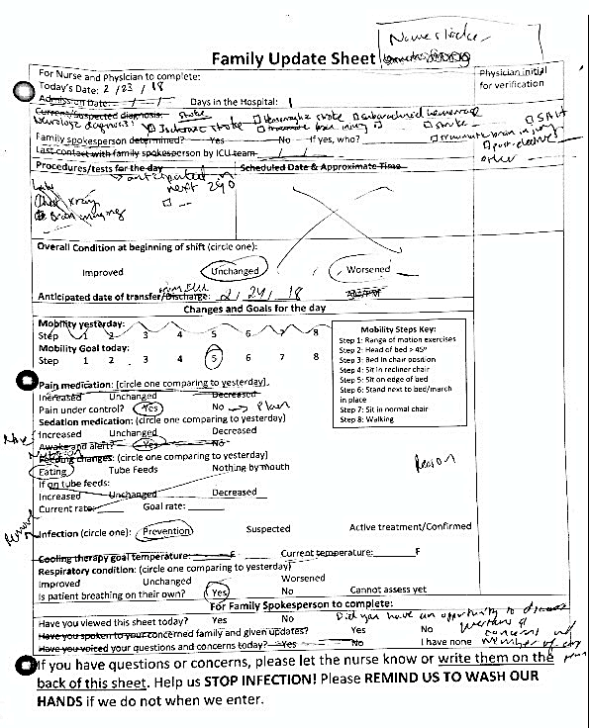
PDSA #1 - 7
Notes:
Change to more readable scan

Slide 122
Assignment of Family Spokesperson
Room turnover
Provided education
Room turnover
Provided education
Provided Family education

Slide 123
Team Compliance with Family Update Sheet
Weekend – Nurse manager not present to ensure sheets are present
Early PDSAs – Single sheet use resulted in revisions
Team behind on rounds
Nurse unsure about how to fill sheet

Slide 124
Return on Investment
Timely updates may help decrease family member anxiety
Ideally: Better communication and engagement with families = Decreased unnecessary/aggressive procedures = $$$
From our patient example – cost of tracheostomy
Estimated cost of trach: $1,700 (largely OR/personnel costs)¹
Estimated cost of ICU stay: $2,500– 4,300²
Herritt B., Chaudhuri D., Thavorn K., Kubelik D., and Kyeremanteng K.: Early vs. late tracheostomy in intensive care settings: Impact on ICU and hospital costs. J Crit Care 2018; 44: pp. 285-8
Bowen C.P., Whitney L.R., Truwit J.D., Durbin C.G., and Moore M.M.: Comparison of safety and cost of percutaneous versus surgical tracheostomy. Am Surg 2001 Jan; 67: pp. 54-60

Slide 125
Sustainability
Continued staff and family education
Leverage Nursing Assistants and HUC to provide initial Family education
Expansion plan
  Unit-wide education on roles and expectation with process
  >50% compliance for 3 consecutive days – Expand to ½ unit, ¾ unit, entire unit
  Monthly goal >85%
Expand Family Engagement Tools: NSICU Orientation Booklet, PICS educational materials, build family-oriented culture
Further outcome measures:
  Palliative care
  Number of Procedures (e.g. trach, PEG, etc.)
  Family satisfaction
  Family anxiety

Slide 126


Thank You!
Team Members and Acknowledgements
Emily
Ryan, MSN, RN-BC, SCRN
Clinical Nurse IV – Neuroscience ICU
Sharmila Soares-Sardinha, MSN, CCRN, CNRN
Patient Services Manager III- Neuroscience ICU
Casey
Olm-Shipman, MD, MS
Assistant Professor of Neurology and Neurosurgery
Big THANKS to all the nurses, fellows, residents, nurse practitioners, and families in the unit that contributed their helpful advice and feedback

Slide 127
Creating a Collaborative Palliative Care Model for Patients with Advanced Cancer
Allison Cummings, MS4
March 15, 2018

Slide 128
Background
RCTs have shown that patients with stage IV cancer benefit (quality of life, longevity) from getting palliative care early in the disease course
Implementation Barriers
Not enough time / palliative care providers
No existing coordinated (collaborative) model
Notes:
Chart review (Madeline Waife, MSW)
Out of a randomly-selected sample size of 50 on AD from depression registry
37 patients had no change in any of their ADs
75% sub-optimally dosed
83% of these patients did not have a follow-up appointment scheduled

Slide 129
Project Aims
Increase Goals of Care Conversations
  Prognosis
  Goals
Create and Implement a Collaborative Palliative Care Model for Patients with Advanced (Stage IV) Cancer
Patient
System
Family
Provider
Notes:
Chart review (Madeline Waife, MSW)
Out of a randomly-selected sample size of 50 on AD from depression registry
37 patients had no change in any of their ADs
75% sub-optimally dosed
83% of these patients did not have a follow-up appointment scheduled

Slide 130

Why do Goals of Care Conversations Matter?
Understanding our patients’ goals is the key to providing meaningful care
What I mean by that…
Care that enables patients to make the most of the the time they have left, and prioritizes what patients consider important
Notes:
Graduation hat… not just excited about graduating, but want to talk about a specific patient case shared by Dr. Jennifer McEntee during our Capstone session on Palliative Care, where a patient with advanced cancer wanted to see her child graduate, but it was not reasonable… likely wouldn’t make it that long! She reached out to App State and they were able to have a graduation ceremony early here at the hospital, deans came, there were graduation robes, they were able to have a ceremony and it was very meaningful to the patient, who died 2 days later, much at peace
The family later came back and showed the staff the diploma, shared cookies, etc. Meaningful to patient, family and staff.

Slide 131
Planned Interventions
Systematic Tracking of high risk Stage IV cancer patients to offer specialty palliative care (April 2017-Ongoing) Baseline Data
Palliative Care Skills Training for Medical Oncologists and PCPs (January 2018)
Improved care communication between palliative care, inpatient oncology team, primary oncology team (Ongoing)
  Use of ACP Note
Outpatient palliative care coordination to meet ongoing needs (Ongoing)
Notes:
Chart review (Madeline Waife, MSW)
Out of a randomly-selected sample size of 50 on AD from depression registry
37 patients had no change in any of their ADs
75% sub-optimally dosed
83% of these patients did not have a follow-up appointment scheduled

Slide 132
No Goals of Care Discussion from Med E admission to 60 days: 54%
Similar proportions of GoC (14%, 13% and 12%) by palliative care, primary medical oncologists, and inpatient oncology team
Notes:
Did a LOT of chart reviews… shout out to Hannah Chen & Kathryn Wessel
Of 224 from all cancer subgroups, 122 (54%) had no goals of care discussion documented.
Palliative care, primary medical oncologists, and the inpatient oncology team led similar proportions of discussions (14%, 13% and 12% respecitvely).
A minority of discussions (6%) were either led by another type of provider (radiation oncology, neurology, etc.) or collaboratively.
Point out a limitation… PCPs, we aren’t really seeing this documented, but there may be a bias as the patients do not necessarily have a UNC PCP; we are also looking at time from Med E admission, so there may be some bias there as well

Slide 133
Similar findings in intervention subgroup, 58% with no GoC discussion
14%, 11% and 11% of first GoC discussions led by palliative care, primary medical oncology, and other oncology team respectively

Slide 134
n = 45
Notes:
This does not show the 122 patients that did not have a GoC converation
Of the conversations we did see, the majority are happening while the patient is hospitalized
Initial Hosp
Primary Outpatient Oncologist 4 9%
Other Oncology Team 13 29%
Palliative Care 17 38%
Collaborative Led 7 16%
Other 4 9%
Total 45
Subs Hosp
Primary Outpatient Oncologist 3 10%
Other Oncology Team 12 40%
Palliative Care 12 40%
Collaborative Led 0 0%
Other 3 10%
Total 30
Outpatient
Primary Outpatient Oncologist 23 85%
Other Oncology Team 1 4%
Palliative Care 3 11%
Collaborative Led 0 0%
Other 0 0%
Total 27

Slide 135
Run Charts (P-Chart)
Notes:
P Chart I made with QI Macros… we recognize there’s variation and that we have room to improve
This graph depicts a standardized fraction of patients without any documented goals of care (GoC) discussion. Ideally, post-intervention, data points will fall beneath the control limit (CL), indicating that a majority of patients have documented GoC.
Note: The CL was set at 0.40 because it is expected that a subgroup of patients may not need to have GoC dicussions.

Slide 136
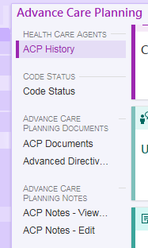
ACP = Advanced Care Planning
Notes:
P Chart I made with QI Macros… we recognize there’s variation and that we have room to improve
This graph depicts a standardized fraction of patients without any documented goals of care (GoC) discussion. Ideally, post-intervention, data points will fall beneath the control limit (CL), indicating that a majority of patients have documented GoC.
Note: The CL was set at 0.40 because it is expected that a subgroup of patients may not need to have GoC dicussions.

Slide 137
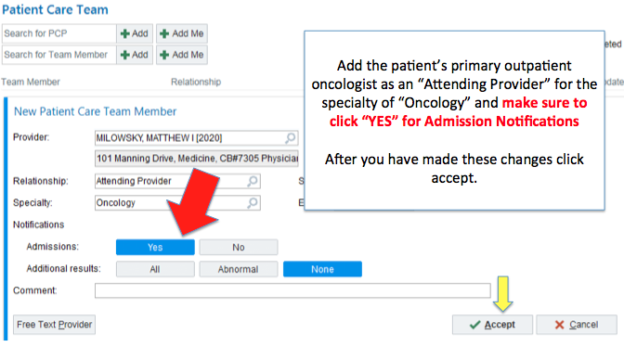
Adding the Provider to the Care Team
Notes:
Talk about our effort to do this on Med E
Idea is to get the high yield patients
Still in the process of rolling this out
Also talk about using the ACP note more frequently

Slide 138
Sustainability & Spread
Is adding the provider to the care team manually sustainable?
  Possibility of an automated process?
  Could automation lead to development of useful tools (ability to run reports, etc.)
Other groups are using “Patient Care Coordination” note function… could this apply to our project?
Use of ACP note! Making this the standard of practice…
Notes:
Chart review (Madeline Waife, MSW)
Out of a randomly-selected sample size of 50 on AD from depression registry
37 patients had no change in any of their ADs
75% sub-optimally dosed
83% of these patients did not have a follow-up appointment scheduled

Slide 139
Value of Collaborative Palliative Care
Improving quality of patient care
We already have people interested in our baseline data, aligns with the UNC’s educational mission
Secondary outcomes include impact on readmissions and ICU transfers ($$$)
Notes:
Chart review (Madeline Waife, MSW)
Out of a randomly-selected sample size of 50 on AD from depression registry
37 patients had no change in any of their ADs
75% sub-optimally dosed
83% of these patients did not have a follow-up appointment scheduled

Slide 140
Many Thanks to the GIANT Team!
Dr. Laura Hanson (QI Project Mentor, Palliative Care)
Hannah Chen, MS4
Dr. Fran Collichio (Medical Oncology)
Dr. Darren DeWalt (Internal Medicine)
Jenny Hanspel (New Collaborative Coordinator)
Dr. Kyle Lavin (Palliative Care)
Dr. Matthew Milowsky (Medical Oncology)
Dr. Donald Rosenstein (CCSP)
Dr. Gary Winzelberg (Palliative Care)
Dr. William Wood (Medical Oncology)
Kathryn Wessell (Research Coordinator, Project Manager)
Alison Amos, PhD (QI Coach)
Dr. Amy Shaheen, Laura Brown, Jake Reardon, and all of my wonderful classmates!
Notes:
Team Member Side

Slide 141
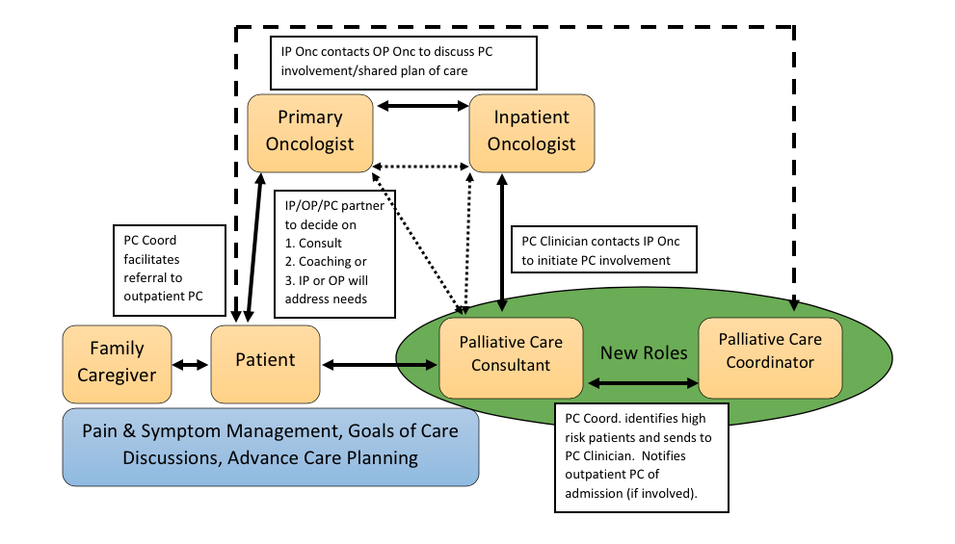
Model Concept
Notes:
Palliative care coordinator is a new role, Jenny Hanspel
We are still figuring out how we coordinate communication
Conspicuously absent right now → primary care providers!

Slide 142
Continued Quality Improvement of Screening and Interventions for Unhealthy Alcohol Use in the UNC Internal Medicine Clinic
Garrett Thompson
March 15, 2018
Notes:
- Good afternoon everyone! My name is Garrett Thompson
- I will be talking to you about a quality improvement project aimed at improving screening and subsequent interventions for unhealthy alcohol use in the UNC internal medicine clinic

Slide 143
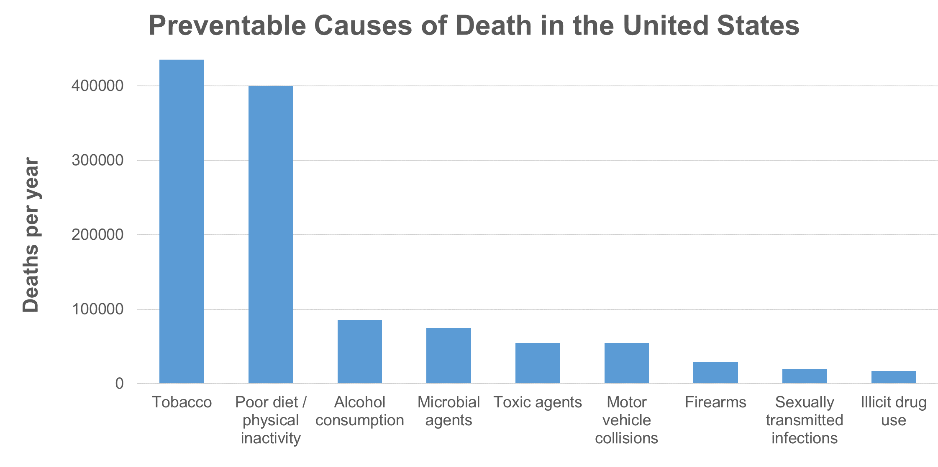
Background
>20% of U.S. adults drink more alcohol than recommended¹
AUDs common, cause substantial morbidity, result in ↑ risk of early mortality
85,000 deaths/year²
Vincent et al., 2010
Mokdad et al., 2004
Notes:
- Over 20% of U.S. adults drink more than the recommended daily, weekly, or per-occasion amounts
- Alcohol use disorders (AUDs) are common, cause substantial morbidity, and result in increased risk of early mortality
- Unhealthy alcohol use is 3rd leading cause of preventable deaths among adults in the U.S. after tobacco smoking and obesity
- ~85,000 deaths/year can be attributed to alcohol, equivalent to 3.5% of all U.S. deaths
_____________________________________________________________________________
-AUDs:
--Associated with hypertension, heart disease, stroke, cancer, liver cirrhosis, amnesias, cognitive impairment, sleep problems, peripheral neuropathy, gastritis and gastric ulcers, pancreatitis, decreased bone density, anemia, depression, insomnia, anxiety, suicide, and fetal alcohol syndrome.
-Other statistics:
--Number of alcoholic liver disease deaths: 19,388
--Number of alcohol-induced deaths, excluding accidents and homicides: 30,722
--Of the 10,265 people who died in alcohol-impaired-driving crashes in 2015, there were 6,424 drivers (63%) who had BACs of .08 g/dL or higher. The remaining fatalities consisted of 2,908 motor vehicle occupants (28%) and 933 nonoccupants (9%)

Slide 144
National recommendations and current clinical practice
USPSTF and others recommend screening adults for unhealthy alcohol use and providing persons engaged in risky drinking with brief behavioral counseling interventions³
National data:
  < 1/3 patients asked about alcohol use by PCP
  < 1/5 adults report discussing alcohol use with health care professional
After implementing EPIC, the UNC internal medicine clinic did not have system to screen for unhealthy alcohol use
3. Moyer et al., 2013
Notes:
- The USPSTF among others recommends screening adults for unhealthy alcohol use and providing persons engaged in risky drinking with brief behavioral counseling interventions
- Despite this recommendation, national data show that less than a third of patients are asked about alcohol use by their primary care providers, and less than 1/5 of adults report ever discussing it with a health care professional
- After implementing the new electronic health record, UNC internal medicine clinic did not have a system to screen for unhealthy alcohol use →
- Over the past year, I’ve been assisting with a QI project to fill this gap

Slide 145
Aim statement
Overall aim
  To implement, test, and refine an evidence-based system for delivery and tracking of high-quality screening and interventions for unhealthy alcohol use
Several specific sub-aims based on process measures (examples in table below):
Measure name | Measure calculation | Target*
Patients screened | N = pts completing initial screen D = all clinic pts w/o measure exclusion | 50%
Patients with positive screen who complete AUDIT | N = pts completing audit D = patients with (+) initial screen | 80%
Patients appropriately offered counseling for risky drinking | N = Pts offered counseling D = Pts with risky drinking but w/o AUD | 80%
BPA use | N = BPAs opened and completed D = Visit in which BPA is deployed | 70%
*Timeframe for targets vary
Notes:
- The overarching aim of this project is to implement, test, and refine an evidence-based system for delivery and tracking of high-quality screening and interventions for unhealthy alcohol use in the UNC general internal medicine clinic
- Several specific aim statements were developed based on process measures, for instance, those related to the number of patients completely an initial screen, the proportion of patients with a positive initial screen completing a secondary screen, the proportion of patients with a positive screen offered counseling for risky drinking, and the rate of best practice alert use

Slide 146
Systematic approach
1. INITIAL SCREEN
2. SCREENING-RELATED ASSESSMENT
3. INTERVENTION
Notes:
- I’d now like to discuss the systematic approach to screening/counseling that has been implemented in the IMC.
- Later on, I’ll touch on a few of the EPIC tools and other improvements that have been made to the process
- The basic approach is 3-fold:
1) Eligible patients first complete an initial screen composed of 2 sequential questions
2) Patient with a positive screen compete a secondary-related assessment, the Alcohol Use Disorders Identification Test (or AUDIT)
3) And then are offered an appropriate intervention based on this assessment

Slide 147
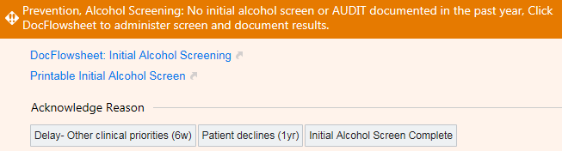
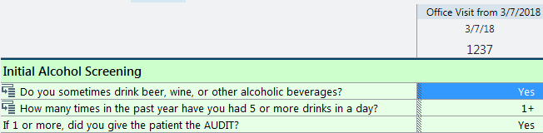
1. INITIAL SCREEN
● Question 1: “Do you sometimes drink beer, wine, or other alcoholic beverages?” ● If No → no further action. If Yes → follow-up question: ● Question 2: “How many times in past year ≥4 (♀18+, ♂ 65+) or ≥5 drinks in a day (♂<65)?” ● Positive screen = response ≥1 → Patient completes AUDIT
Nursing BPAs and EPIC Flowsheet implemented in April 2017
Notes:
- The process for the initial screen has now been fully automated
- 2 nursing Best Practice Alerts (BPAs), or visit-Based Reminders (VBRs), were implemented in April 2017
- The First BPA flags appropriate patients for initial screening (exclusions: have been screened in past year, have terminal illness, previously diagnosed with AUD, under 18)
-The Second BPA (not depicted), fires when patient has had positive initial screen, but no secondary assessment documented. It prompts the nurse to provide the patient with this assessment

Slide 148
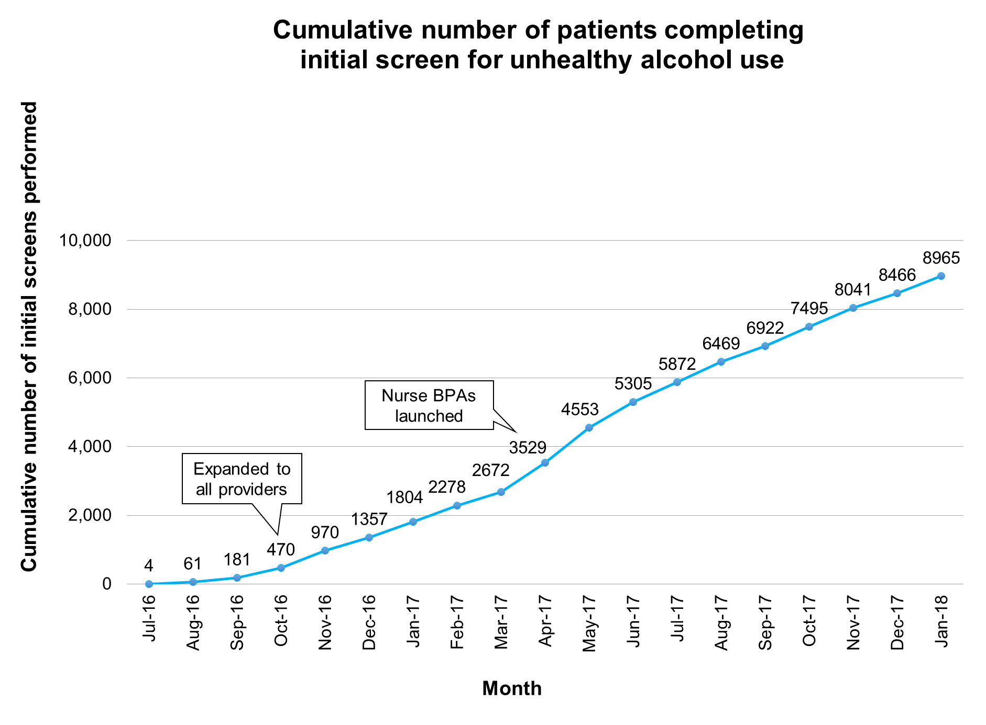
Since project start date:
8706 unique patients screened
~12600 active IMC patients
= ~69% of all clinic patients
Within past year (2/1/17-1/31/18):
6556 unique patients screened
~12600 active IMC patients
= ~52% of all clinic patients
Notes:
- This run chart shows cumulative number of patients over time.
- To date, approximately 9000 screenings have been completed representing 8700 unique patients. This represents approximately 69% of all active clinic patients.
- Within the past year, approximately 52% of all active clinic patients have been screened

Slide 149
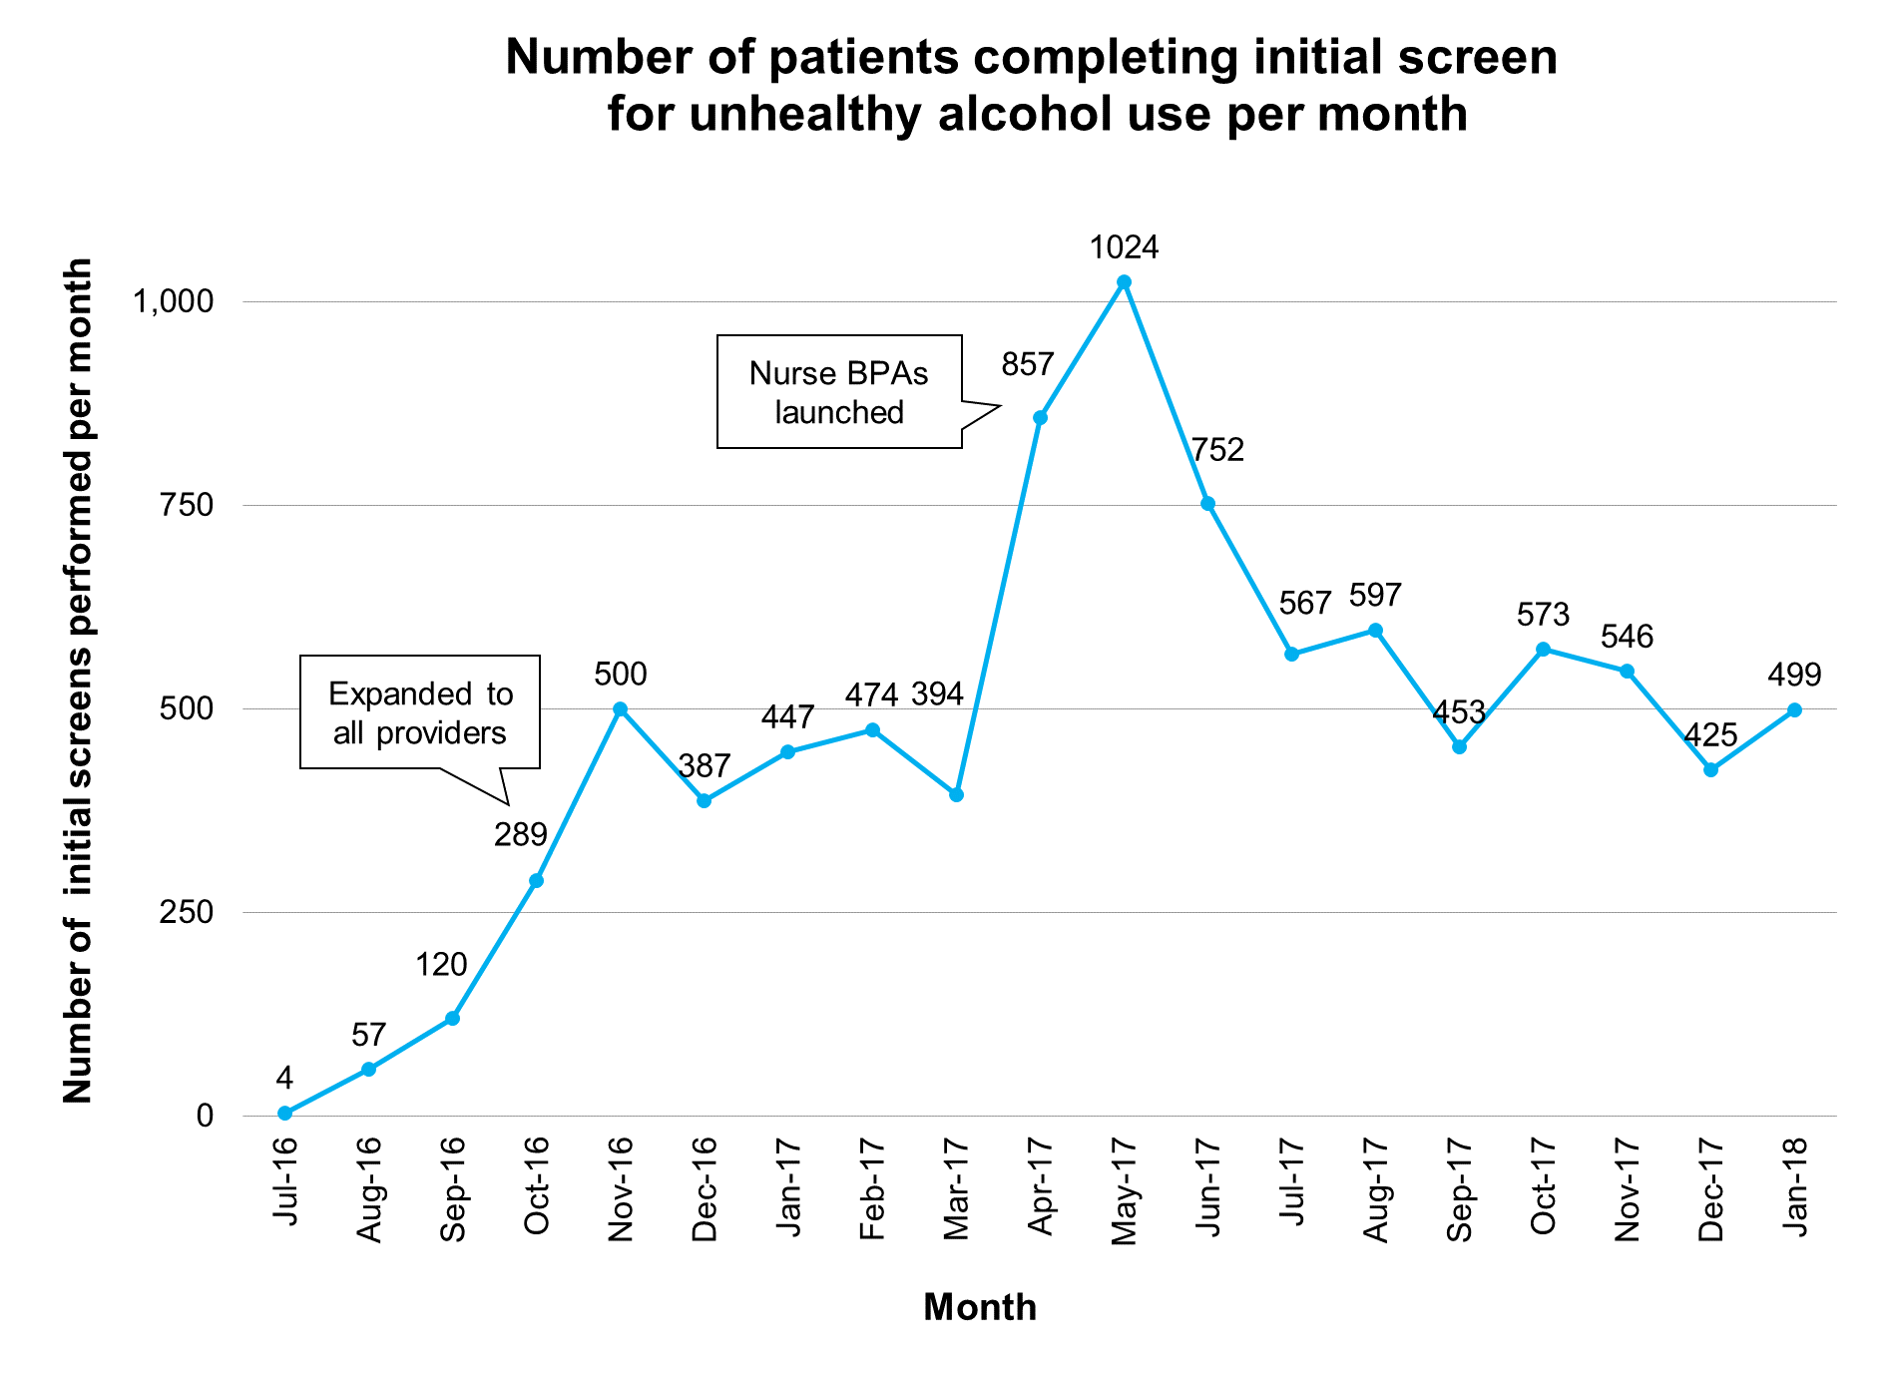
Notes:
- The run chart shows the number of patients who completed the initial screen per month
- Initially, the screening process was tested with a few providers and nurses
- After October, 2016, the screening process was expanded to all providers which led to an increase in the number of patients screened per month
- After the implementation of the nursing BPAs, the number of patients screened per month again increased
- Notably, the number of screenings per month has begun to decrease, which is expected because the BPA is suppressed for 1 year after the screen is completed and an increasing proportion of all clinic patients have been screened

Slide 150
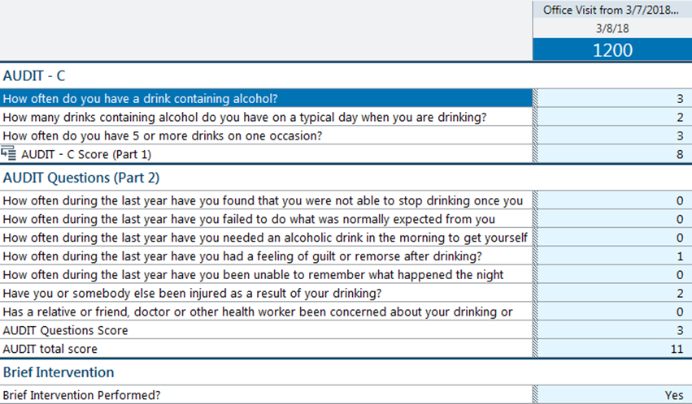
2. SCREENING-RELATED ASSESSMENT USING THE AUDIT
● Provider reviews and scores the AUDIT ● Score assists in identifying patients with likely AUD versus risky drinking behavior
1
4
6
0
11
Notes:
- Further assessment of a positive initial screen is conducted with the AUDIT, shown here
- It is a 10-item questionnaire with score ranging from 0 to 40
- Bright salmon colored paper serves as a visual cue for the provider review and score AUDIT
- The score assists in determining whether patient likely has an AUD or risking drinking without an AUD
- After the visit, the AUDIT is inputted into an EPIC flowsheet

Slide 151
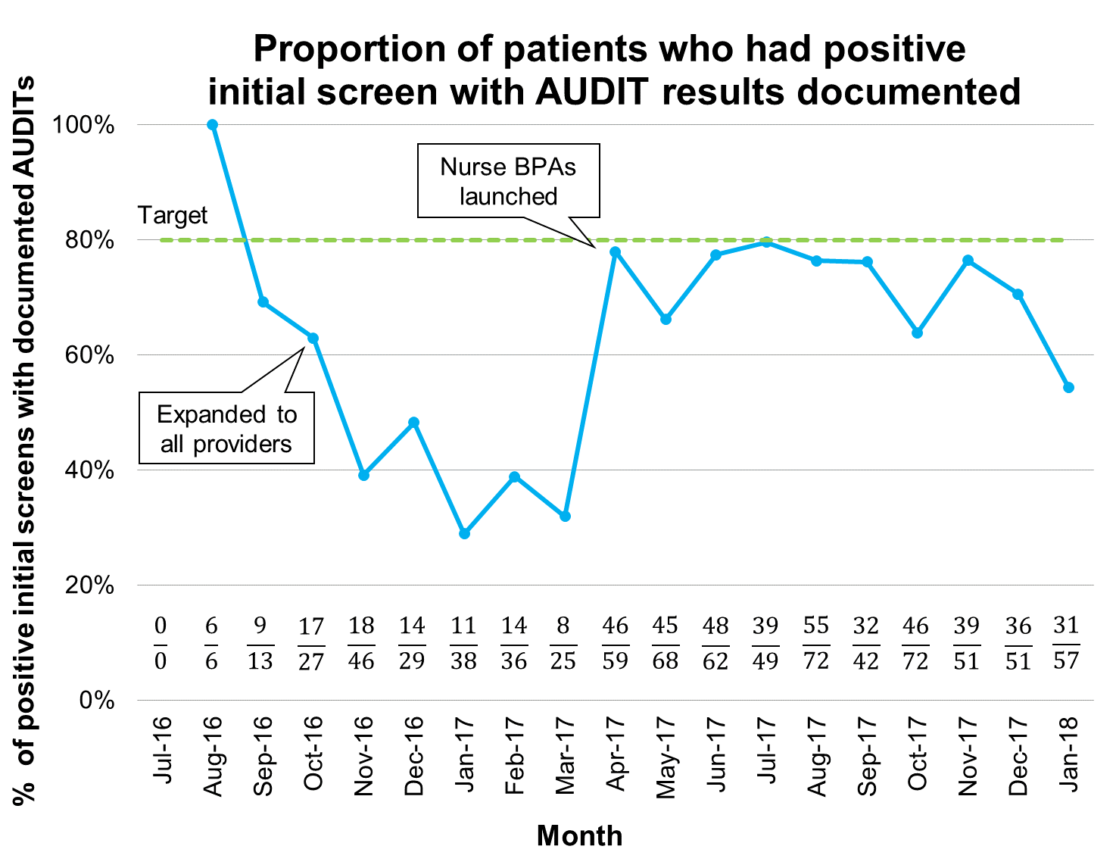
Cumulative: 64.0% (514/803)
Notes:
- This chart shows the proportion of patients with a positive initial screen who had AUDIT results documented
- Note that after expansion of the screening process to all patients, the rate of AUDIT documentation dropped
- After implementation of the nurse BPAs, however, the rate rebounded to near the target of 80%. The rate has remained relatively stable since then and near our target (with a few outlier months)

Slide 152
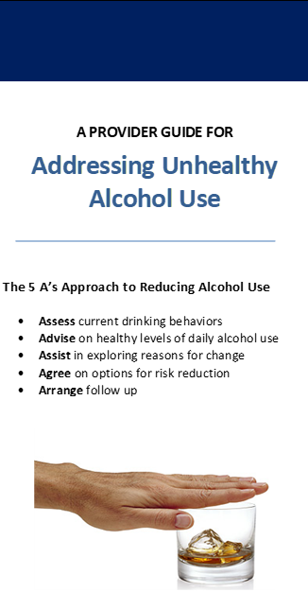


3. INTERVENTION
Risky drinking | Likely alcohol use disorder
● Counseling intervention using motivational interviewing techniques | ● Assess patient goals ● Brief motivational interview ● Shared decision making re: more intensive treatment/therapy
• Brief outline for approaching counseling (back of AUDIT)
• More extensive pamphlets to guide counseling
• Succinct standardized phrasing for documenting counseling
Notes:
- Depending on AUDIT score, the next step is to provide an appropriate intervention for risky drinking or likely AUD
- For sake of time, I will focus on risky drinking
- Examples of a few of the tools created to improve rates of counseling include:
1) a brief outline of an approach to counseling for risky drinking behavior included on back of AUDIT along with other resources
2) the development of a more extensive pamphlet to guide counseling interventions
3) and the development of succinct dot-phrases to document counseling and provide patient information in after visit summaries

Slide 153
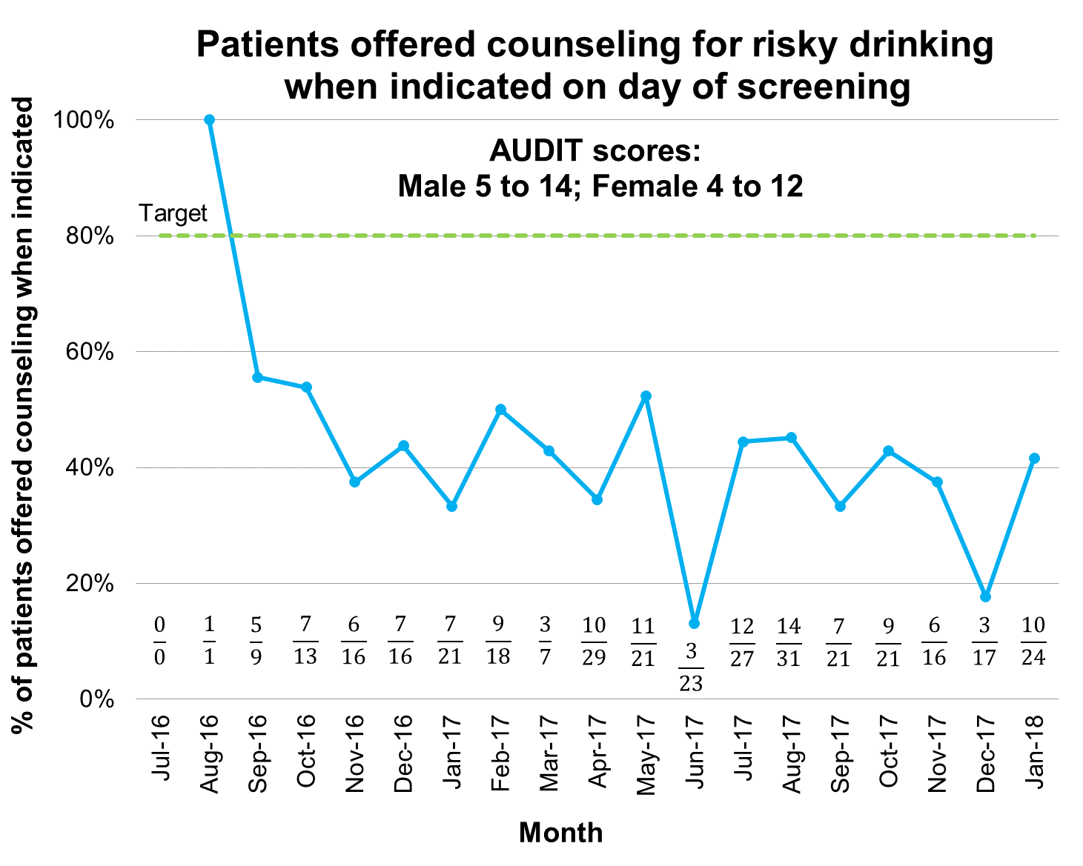
Cumulative: 39.3% (130/331)
Notes:
- This run chart shows the percentage of patients offered counseling for risky drinking when indicated by month
- Except for a few outlier months, the rate of counseling has remained around 40% for most of the project period
- While this rate is below our target and indicates room for improvement, the cumulative rate of 39.3% is above national rates

Slide 154
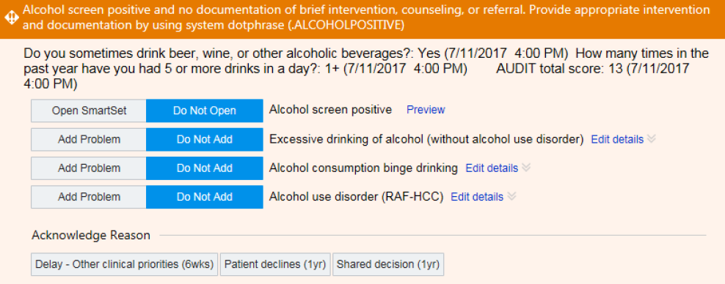
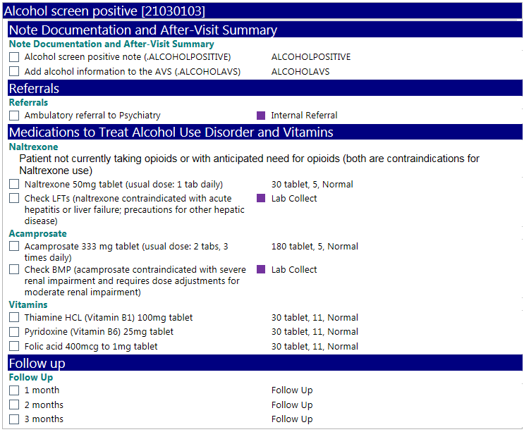
Provider Best Practice Alert
Implemented September 2017
Fires at subsequent visit if no documentation of intervention
Cues provider to offer and document appropriate intervention for patients with positive screen
Notes:
- To improve the rate of appropriate interventions offered to patients with positive screens for unhealthy alcohol use, a best practice alert directed at providers was implemented in September 2017
- If a patient with a positive screen for unhealthy alcohol use has no documentation of an appropriate intervention, the BPA is programmed to fire at the patient’s next visit
- The BPA cues provider to offer/document an appropriate intervention at that visit
- It includes a SmartSet with dot phrases for documentation, common medications to treat AUD, and options to schedule follow-up visits or make referrals

Slide 155
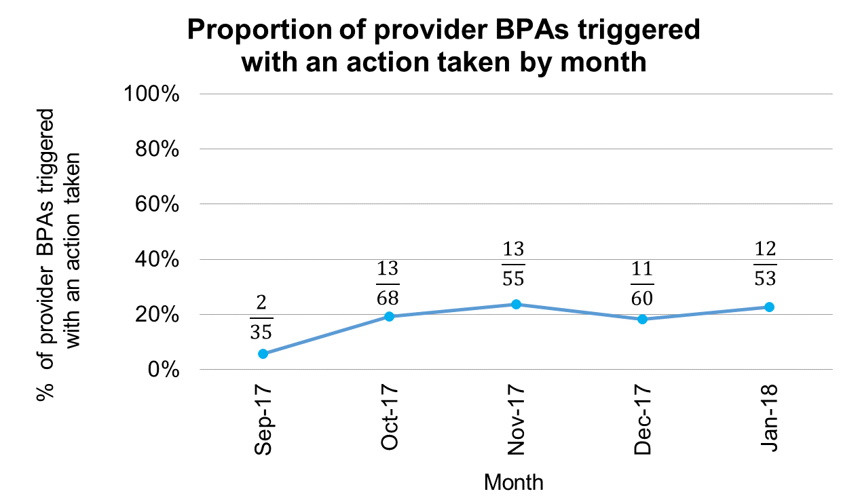
Provider Best Practice Alert
Cumulative: 18.8% (51/271)
Notes:
- In the first five months after its release, the provider BPA was acted upon about 19% of the time it was deployed suggesting it may be having an effect on rates of counseling

Slide 156
Return on Investment
Systematic method for screening and providing subsequent interventions → potential to ↓ morbidity and mortality from unhealthy alcohol use
  Hits on all three dimensions of IHI Triple Aim
    Decreased health care costs
    Improved health of populations
    Improved patient experience of care
Screening for unhealthy alcohol use = USPSTF recommended service
  In future, could join other preventive services as a quality focus with associated incentives
Notes:
- The larger purpose of implementing a system for screening and providing subsequent interventions is to reduce morbidity and mortality from unhealthy alcohol use
--This hits on all three dimensions of IHI triple aim:
---Improved morbidity/mortality from unhealthy alcohol use may lead to decreased health care costs AND improved health of populations affected by unhealthy alcohol use
---The streamlined process for screening/providing interventions may lead to improved patient experience of care
- Additionally, Given that screening for unhealthy As a USPSTF recommended service, it may one day join other preventive services as a quality focus with associated incentives

Slide 157
Sustainability
Many processes in workflow have been automated
  Nursing BPAs automatically prompt screening of eligible patients
  Paper AUDIT cues provider to offer intervention
Continued need for improvement in rate of counseling after positive screen
  Provider BPA prompts intervention at subsequent visits
Notes:
- I’d now like to speak for a moment about the sustainability of this project
- Many of the processes involved in the workflow for screening and providing interventions for unhealthy alcohol use have been automated
-- For instance, nursing BPAs automatically prompt screening of eligible patients
-- The paper AUDIT cues physicians to offer an intervention
- There is a continued need, however, for improvement in rate of counseling after positive screen
-- Provider BPA prompts provider to offer counseling at subsequent visits and may help with this gap

Slide 158




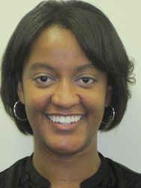
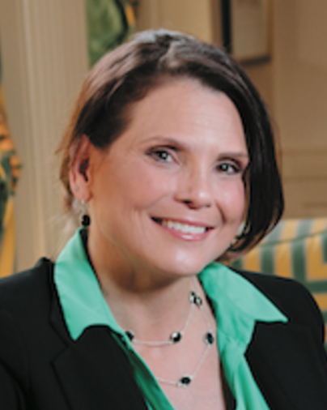

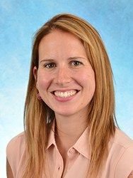
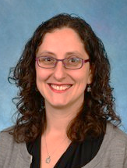
Team Members
Dan Jonas, MD, MPH
Colleen Barclay, MPH
Julia Tompkins, MSW, LCSW-A
Bailey Minish
Tamrah Watson, MSN, RN, FNP
Not pictured:
Eve Schon, RN;
Nancy McElveen,
Patient Advisor
Britta Starke, MSW, LCSW
Scott Rose, MD
Katie Doss, MD
Shana Ratner, MD
Notes:
- Finally, I’d like give a shout-out to the multidisciplinary set of providers, residents, nurses, social workers, public health professionals, and care assistants who have been involved in this project.
- This year, I’ve worked most closely with Dr. Jonas (project leader) and Colleen Barclay (Sheps Center Research Associate)
- I’d like to thank both of them for their mentorship, positivity, and enthusiasm for the project as well as for providing me with the opportunity to be involved in it
___________________________________________________________________________________
-Project leader: Dan Jonas (MD, MPH)
-Administrative management: Colleen Barclay, Sheps Center Research Associate
-Heaving lifting: Care assistant, Bailey Minish
-Project sponsor: Medical Director of the GIM Clinic, Shana Ratner
-Nursing perspective: IMC Clinic Nurse Manager
-GIM clinic social worker
-ASAP social worker liaison; ASAP = Alcohol and Substance Abuse Program
-Internal medicine resident contributions (Scott Rose; Katie Doss)
-Patient advisor
-Late add-on: Me (medical student)

Slide 159
Thank you!

Slide 160
References
Vinson DC, Manning BK, Galliher JM, et al. Ann Fam Med. 2010;8:484-92
Mokdad AH, Marks JS, Stroup DF, Gerberding JL. Actual causes of death in the United States, 2000. JAMA. 2004;291(10):1238-1245. doi:10.1001/jama.291.10.1238.
Moyer VA, Preventive Services Task Force. Screening and behavioral counseling interventions in primary care to reduce alcohol misuse: U.S. preventive services task force recommendation statement. Ann Intern Med. 2013;159(3):210-218. doi:10.7326/0003-4819-159-3-201308060-00652.

Slide 161
Supplementary Slides

Slide 162
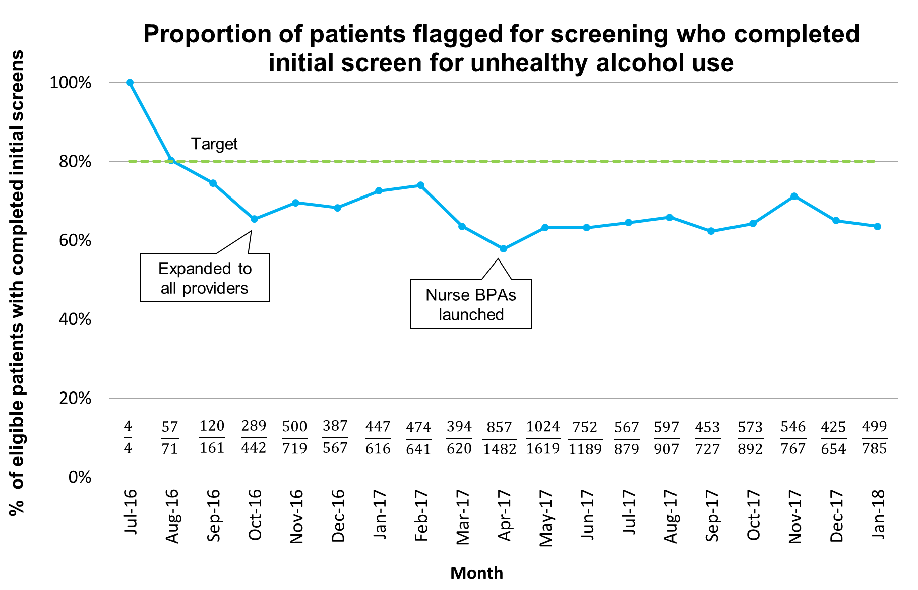
Cumulative: 65.3% (8965/13472)
Notes:
- This chart show the proportion of patients flagged for screening who completed the initial screen for unhealthy alcohol use
- Prior to implementation of the nursing BPAs, patients were individually flagged for screening by a care assistant.
- After implementation of the nursing BPAs, patients were automatically flagged in EPIC for screening
- The proportion of patients who completed the initial screen for unhealthy alcohol use remained stable after implementation of the BPAs. Cumulatively, 65.3% of patients flagged for screening have completed the initial screen - near the goal of 80% - even as the total number of patients screened per month increased after implementation of the nursing BPAs.

Slide 163
Integration of Outpatient Intake Process with My UNC Chart and PROMIS
Everett Young, MPH
March 15th, 2018
Mentor: Josh Tennant, MD, MPH
Champion: Kelsey Divers, MS, LAT, ATC

Slide 164

Background and Gap
Clinical staff time was being used inefficiently to input data from paper intake forms into Epic
Patient data was not available to provider at time of visit
Providers were not able to measure and track patient-reported outcomes
Metric | Baseline
Average time for staff to input info into Epic | 80 min/day
Patient info available for provider in Epic | 64%
My UNC Chart provider activation rate | 54%

Slide 165
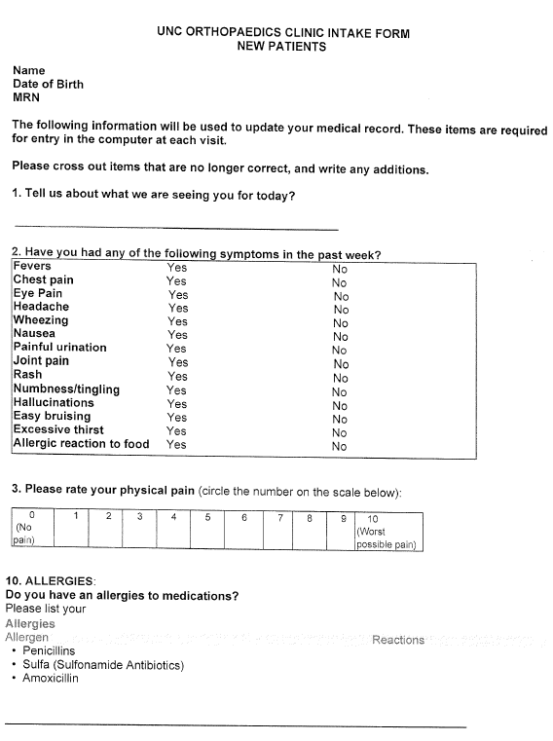
Previous State – Paper Intake Form

Slide 166
AIM Statement
Problem
  Scope: UNC Orthopaedics at Weaver Crossing
  Average time to input (transfer) data from paper intake form 80 minutes per day
  Patient data available in Epic when the provider entered the room 64% of the time
Goals
  Improve speed and efficiency of intake process
  Improve staff productivity and efficiency and
  Make data available for provider evaluation prior to the patient encounter
Big Why
80 minutes/day of staff time
Patient data unavailable for provider
Track patient-reported outcomes

Slide 167
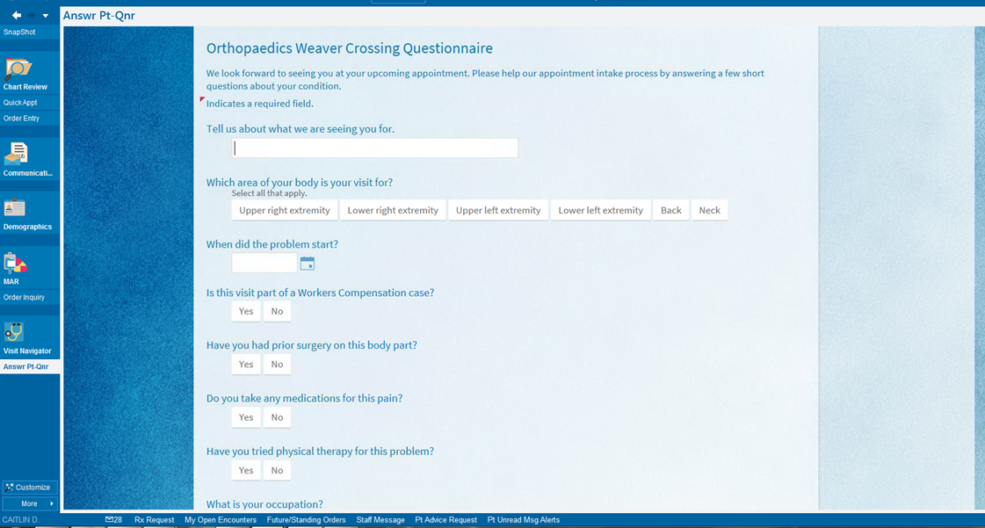
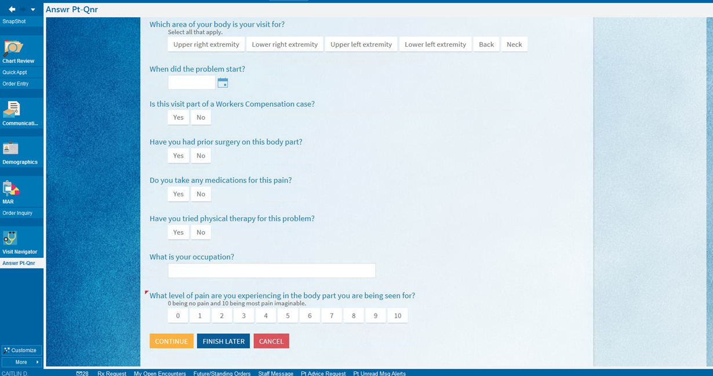

Slide 168
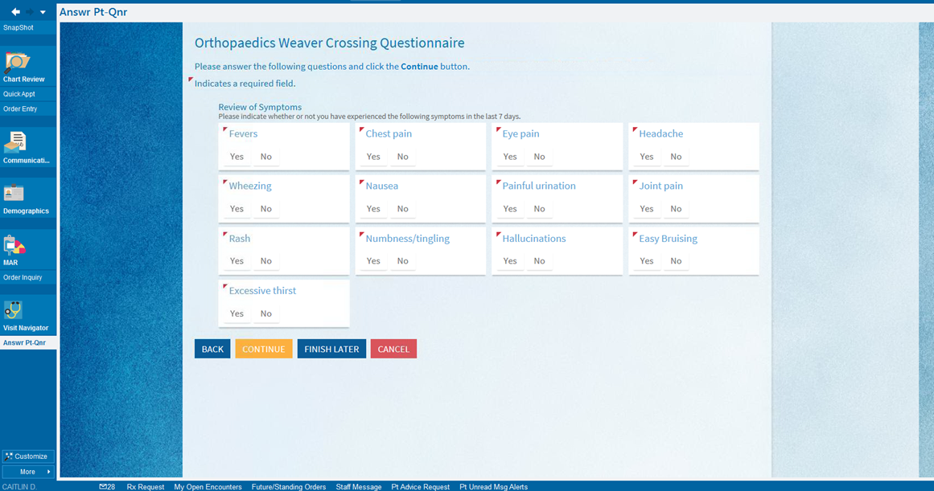

Slide 169
Front Desk Standard Work
Check In Complete
Survey Done?
Yes
My Chart Activated?
Yes
Ask to Complete Survey on Phone or Tablet
No
No
Give Paper Intake Form
Give My UNC Chart Brochure
Provider-Driven Activation

Slide 170
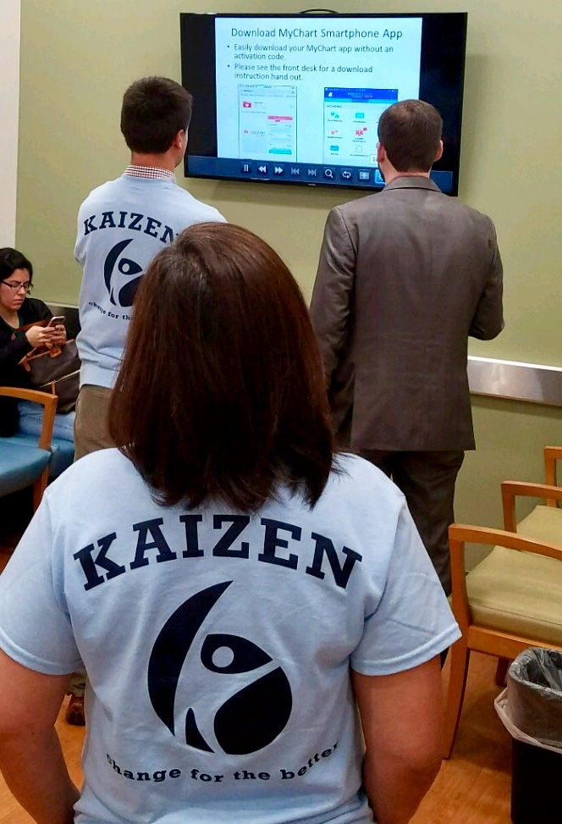


Patient Engagement

Slide 171
My UNC Chart Activation
WC Goal = 90%
UNC Goal = 70%
Notes:
Jennie: The primary goal of our project was to more efficiently capture patient data saving staff time and make it electronically available for the provider at the time of the encounter. As the project evolved to utilize My UNC Chart, a secondary benefit was increased My UNC Chart activation rates.

Slide 172
February My UNC Chart Activation

Slide 173
Online Check In Usage
Kaizen

Slide 174
Staff Time Utilization
Kaizen
Minutes
Goal = 20 min

Slide 175

Return on Investment
Reduced wasted staff time
  Increased staff satisfaction
Increased patient engagement and communication with activation of My UNC Chart patient portal
Ability to collect and track patient-reported outcomes within Epic

Slide 176

UNC Lean Six Sigma Purple Belt
UNC Institute for Healthcare Quality Improvement
  Department of Operational Efficiency
3 Planning Days
  Lean Value, A3, Gemba, Root Cause Analysis, Process Maps
3 Day Kaizen
Monthly follow-up
Team
  Kelsey Divers
  Josh Tennant
  Jennie Woody
  Nicole Rodevick
  Deanna Zolfo
  Shannon Tansey
  Everett Young
  Callie Moore
  Che Adriano-Evangelista
  Adam Lee
  Kelly Wilson
  Jane Dejesus
  Beth Hunt
  Peg Miller
  Tina Thornhill
  Delores Daniel

Slide 177






Purple Belt and Kaizen Results

Slide 178

Challenges and Lessons Learned
Customizing Epic and My Chart to specific clinic workflows is difficult and slow
  Email notification and data presentation
  Must have IT support
  Need to be patient with IT support
UNC Department of Operational Efficiency
  Purple Belt
Tablet size
Value of unaffiliated
perspectives
Importance of staff
and leadership buy in
Data uploads quickly
  History, ROS, PRO

Slide 179


Sustainability & Spread
More patients than expected were eager to use My UNC Chart
  Provider-driven sign-up process
Weaver Crossing Orthopaedics
  Purple Belt → Culture of CQI
Spread to UNC Orthopaedics
clinics
Spread to other UNC clinics
  Internal Medicine
PROMIS CAT vs. short form
https://www.assessmentcenter.net/documents/PROMIS%20Physical%20Function%20Scoring%20Manual.pdf

Slide 180
Question & Answer
Improving COPD Care in Primary Care Clinics
  Katherine Lee
Making a FUS for Family Communication in the Neurosciences ICU: First Step to Improve Family Engagement
  Sean Miller
Creating a Collaborative Palliative Care Model for Patients with Advanced Cancer
  Allison Cummings
Continued Quality Improvement of Screening and Interventions for Unhealthy Alcohol Use in the UNC Internal Medicine Clinic
  Garrett Thompson
Integration of Outpatient Intake Process with My UNC Chart and PROMIS
  Everett Young

