Slide 1
OPTIMISING PERFORMANCE THROUGH IN-DEPTH PROCESS MAPPING
KK Lim
Managing Consultant
BP+ Pte. Ltd.

Slide 2
Content
What is Business Process Mapping?
Why is it required?
Types of Business Process Maps
Common Pitfalls in Process Mapping
How to leverage on Business Process Mapping in your transformation / process improvement initiative?

Slide 3
What is Business Process Mapping?
Visual description of business process, related activities, input and output
Model of the business process
Governance
Supplier
Input
Process
Output
Customer
Resources

Slide 4
Why is it Required?
Document the business process, which could include the operations/activities, inputs, outputs and roles involved in the business process.
Provide an “official reference” on the business process and a common understanding of what is involved.
Facilitate the analysis of current process (As-Is) and redesign of improved process (To-Be).
Aid in the identification of critical process parameters.

Slide 5
Types of Business Process Maps
Process can be modelled at different levels, from the high strategic level to the operational / tactical level.
Variety of process maps and methodologies:
Process Landscape Diagram
Supplier-Input-Process-Output-Customer (SIPOC) Diagram
Process Flow Diagram
Swim-lane Flow Chart
Process Flow with RACI matrix
Value Stream Map

Slide 6

Standard Convention in Process Mapping
Operation
Decision
On-page Connector
Start / End
Off-page Connector
Sub-process
Document
Input / Output
End-to-end Process

Slide 7
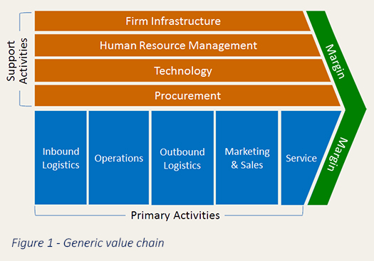
Process Landscape Diagram
Based on Porter’s value chain concept
Typically formulated based on strategic intent of the business

Slide 8
Process Landscape Diagram
Vision to Plan
Market to Business
Idea to Technology
Core
processes
Idea to Product
Demand to Stock
Order to Cash
Finance &
Accounting
Human Resources
Purchasing
Relations Management
Infrastructure Management
Enabler processes

Slide 9
Process Landscape Diagram: Next Level of Granularity
Market analysis
Sales/marketing strategy
Acquisition & BOD
Design In to Contract
Portfolio management
Customer care
Sales strategy & plan
Target customers and applications
Classified customers
Customer development plan
Allocation plan
Design win/loss
Contract
Customer requirements
Business Ideas
Market information (volumes, customer and competitor pro-files, own market position products)
Customer require-ments
Business ideas
Design In opportunity
Customer requirements
Potential new customers
Product and technology road-maps
IP/core roadmap
Milestone decisions
Demand for cooperation
Overview of customer satis-faction and development; proposals for corrective action
Solved customer problems

Slide 10
SIPOC Diagram
Macro level of end-to-end process
A
goods out process
B
transport
C
goods in process
Production
Transit
Pick from stock
Ship material
Transport material
Put away
to stock
DC Stock
Receive
material
Finished goods stock
T0
T1
T2
T3
t4
T4
t1
t2
t3
TT = Transit Time

Slide 11
Process Flow Diagram
Example (Page1/2)

Slide 12
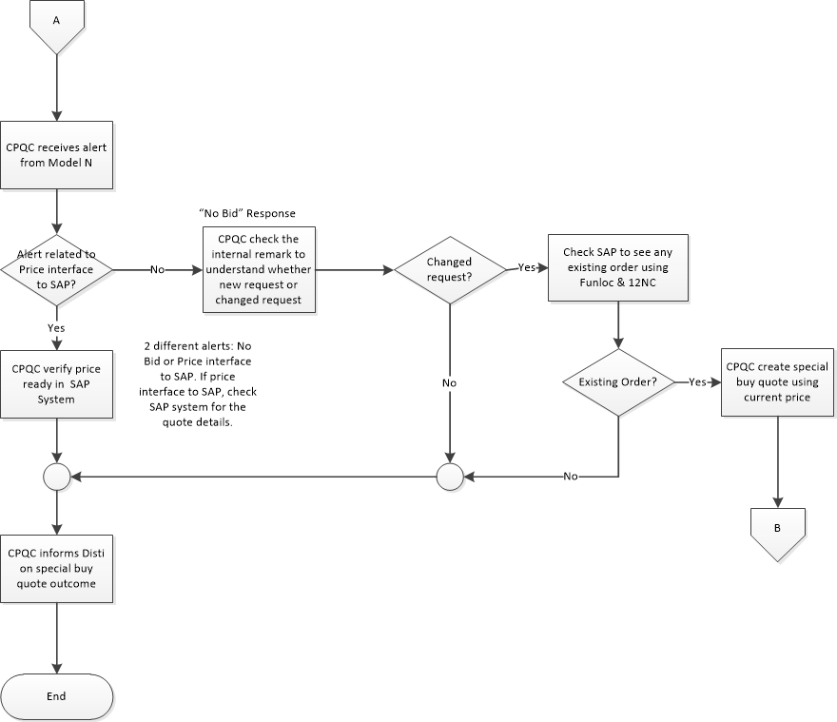
Process Flow Diagram
Example (Page2/2)

Slide 13
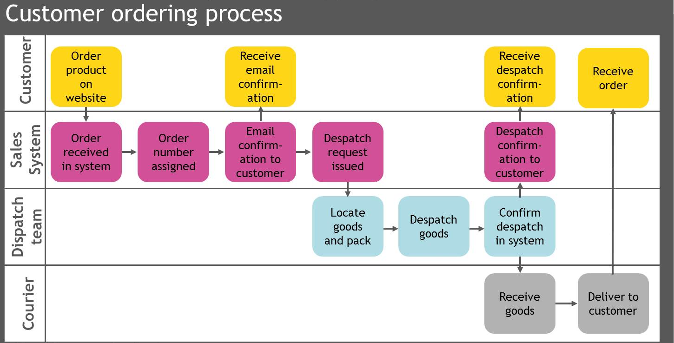
Swim-Lane Flow Chart

Slide 14
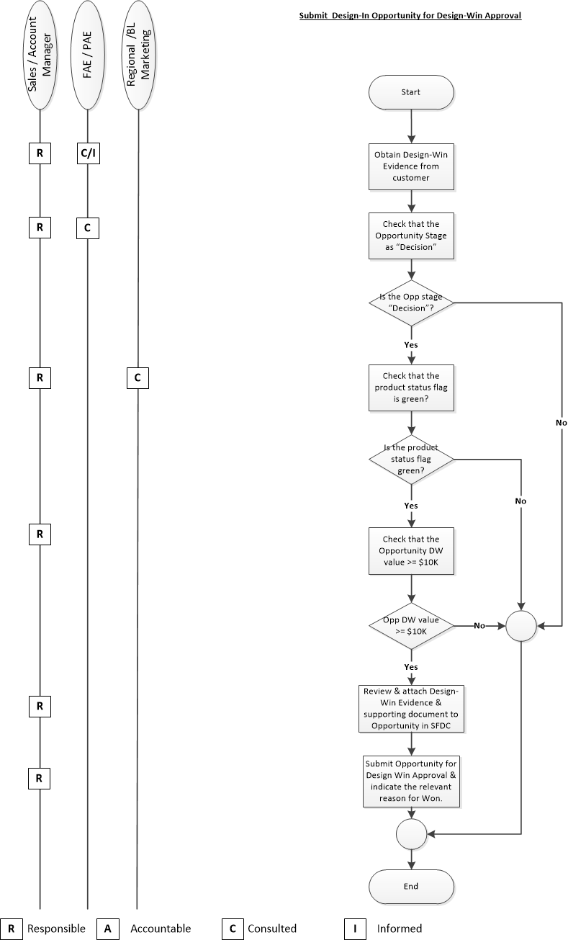
Process Flow Diagram with RACI Matrix

Slide 15
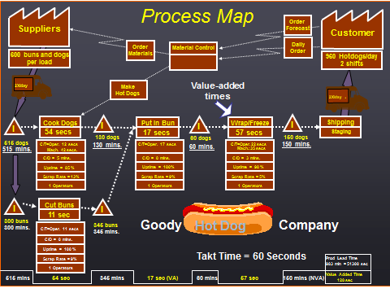
Value Stream Map

Slide 16
Value Stream Map applied to Transactional Process

Slide 17
Common Pitfalls in Process Mapping
Not defining the start and end of the process clearly
Confusing the use of operation block and decision block
Poor discipline in using a consistent convention
Criss-cross of process flow arrows leading to confusion
Mapping without involving the right stakeholders
Failure to perform a process walkthrough to verify the accuracy of the process mapped
Failure to update the process map document as a “live” reference

Slide 18
How to leverage on Business Process Mapping in your transformation /process improvement initiative?
Use the process map to identify the value-added and non-value-added activities.
Collect and document the data on process parameters e.g. process cycle-time, pass-through rate and waiting time.
Identify opportunities for improvement based on ECRS framework

Slide 19
Process Analysis Example: Current Inbound Process Flow
Type 1 NVA
Type 2 NVA

Slide 20
Process Analysis Example: New Inbound Process Flow
Type 1 NVA

Slide 21
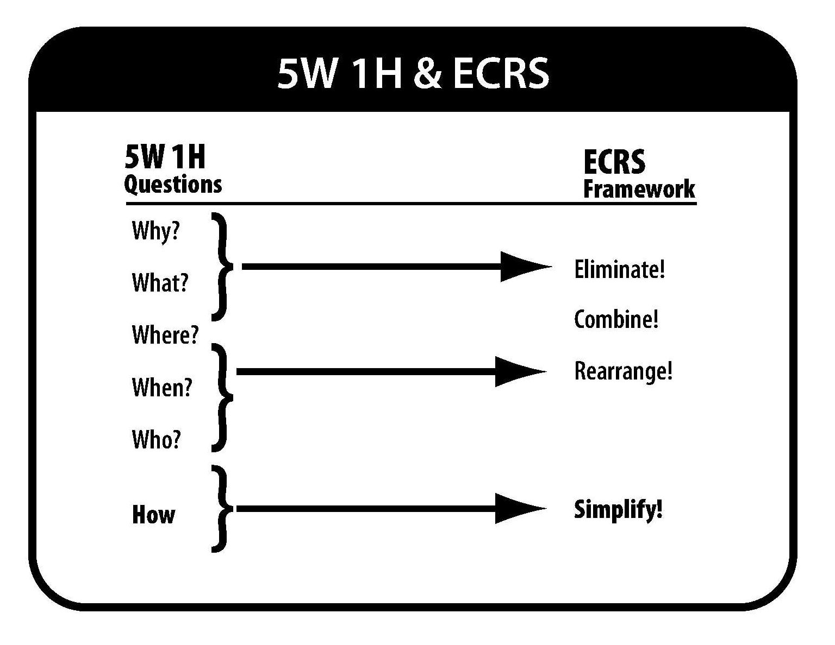
Approach to Streamline the Process

Slide 22
ECRS Framework for Process Streamlining
Eliminate
Remove redundant or non-value-added step
Combine
Integrate the process step with the next
Perform the process step in parallel with another
Re-Arrange
Change the sequence of the process steps
Simplify
Maintain the process step but simplify the work content

Slide 23

Sometimes Parallel Processing Does Not Work!

Slide 24
Conclusion
Process mapping is an essential tool to understand the current state of the process (As-Is) and to design the future state of the process (To-Be).
Disciplined use of process mapping will facilitate the identification and resolution of process issues.

