Slide 1

Implementation of Antibiotic Time Outs at UNC Medical Center
September 19, 2019
Project Lead: Zach Willis Project Manager: May-Britt Sten
Project Team Members: Ronald Davis, Donna Krzastek, Lindsay Daniels, Jon Juliano, Clare Mock, Will Stanley, Michael Swartwood
Project Sponsor: David Weber Faculty Coach: Jennifer Elston-Lafata
Notes:
Good afternoon, and thank you all for sticking around to the very end. My name is Zach Willis. I’m used to being alphabetized last, and I think about it as running the anchor leg. I’m going to talk to you about our project, implementation of antibiotic time outs at UNC Medical Center. Our amazing project manager was May-Britt Sten, and we had a really strong team making this project work. We were sponsored by Dr. David Weber and coached by Dr. Elston-Lafata.

Slide 2
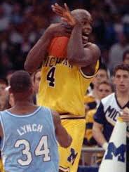
Antibiotic Time Out
A structured review of a patient’s antibiotic regimen after 48 hours
Goal: progress from empiric to targeted antibiotics
  Empiric: broad-spectrum, toxic, expensive
  Targeted: narrow(er)-spectrum, safer, cheaper
Completely independent of the central stewardship team
Recommended by CDC as core element of antibiotic stewardship
  Joint Commission standards refer to CDC core activities
Notes:
So, first of all, what is an antibiotic time out? Unlike poor Chris Webber, we can always take more time outs. An antibiotic time out is a structured review of a patient’s antibiotic regimen after 48 hours.
The goal of the time out is to switch from empiric to targeted antibiotics, because empiric antibiotics tend to be broad-spectrum, more toxic, and more expensive, while targeted antibiotics tend to be narrower, safer, and cheaper in general.
How does this fit into other stewardship activities? Time outs are completely independent of the central stewardship team, while most of our activities are centralized.
From a regulatory standpoint, this is important because CDC recommends it on their checklist of 25 or so stewardship activities. Joint Commission’s antimicrobial stewardship standard requires that institutions follow the CDC checklist.

Slide 3
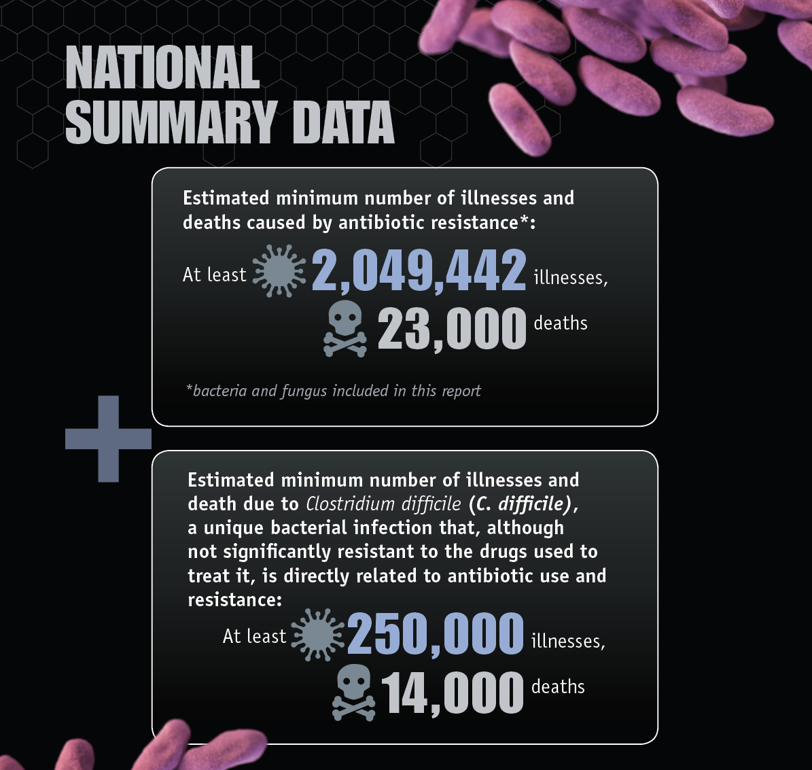
Centers for Disease Control and Prevention. Antibiotic Resistance Threats in the United States. 2013
Notes:
This is a dramatic figure from the CDC’s 2013 report about the growing threats of antibiotic resistance and C-diff infections. These are quoted frequently: 2 million antibiotic-resistant infections and 23,000 deaths per year in the US. Antibiotics also are largely responsible for the estimated 250,000 cases and 14,000 deaths due to C-diff.

Slide 4


Why does it matter?
Elderly female admitted to Hillsborough, concern for urosepsis based on urinalysis
Broad-spectrum antibiotics started on admission
Results: UA suggestive of UTI, blood culture positive, and C-diff assay positive
Plan: broad-spectrum antibiotics continued, C-diff antibiotics started
Patient develops hypotension and AKI and goes to MICU
Elderly female admitted to Hillsborough, concern for urosepsis based on urinalysis
Broad-spectrum antibiotics started on admission
Results: UA suggestive of UTI, blood culture positive, and C-diff assay positive
Time out is done: UTI ruled out, blood culture recognized as contaminant, C-diff antibiotics continued aloune
Patient is discharged two days later
Notes:
So how can a time out make a difference? Let’s take a patient that we saw in our data set from this project. This is an elderly female, a nursing home resident, who’s been admitted a few times at Hillsborough. She develops fever and disorientation and is brought to the Hillsborough ED and admitted. The UA looks suspicious, a blood culture is pending, her WBC is elevated. She gets started on broad-spectrum antibiotics. She’s also having diarrhea, and they do a C-diff test. After 48 hours, the urinalysis suggests UTI but the culture just grows mixed flora, the blood culture is positive but they’re calling it a coagulase-negative Staph, and her C-diff is positive. She’s still febrile and really not much better than when she came in. She continues on broad-spectrum antibiotics and the oral vancomycin that was started for the C-diff. Two days later, her creatinine is rising, she develops hypotension, and she goes to the MICU.
Now let’s talk about what actually happened. At 48 hours, the team did a time out and determined that the blood culture was a contaminant, the urine culture didn’t meet UTI criteria, and what was really making her sick was just C-diff. They dropped everything but the oral vancomycin. Two days later, she was discharged back to the nursing home.

Slide 5
Aim
Implement routine, documented, meaningful antibiotic time outs for medical patients at UNC Hospitals Hillsborough Campus.
Notes:
Our initial aim was to implement routine, documented, meaningful antibiotic time outs for medical patients at UNC Hospitals Hillsborough Campus. Why did we pick Hillsborough? Our initial consultation was with Tina Willis before she left, and she said that the folks at Hillsborough would likely be the most willing to implement changes. The smaller size at Hillsborough is also more favorable. We found that she was absolutely right, and we had a great team at Hillsborough. Because of that, we were able to actually go a little bit beyond our initial aim.

Slide 6
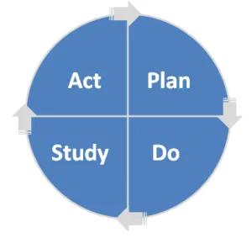
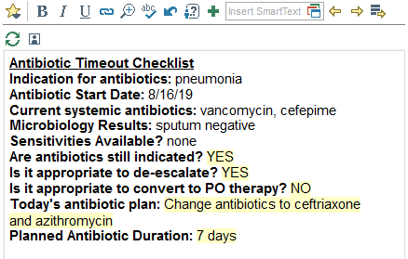
Antibiotic Time Out Workflow
Team pharmacist identifies patient who has been on antibiotics for at least 36 hours
Pharmacist calls antibiotic time out, usually during rounds
Team discusses questions using antibiotic time out checklist SmartPhrase, determines plan
Pharmacist documents in a note using SmartPhrase
Team makes planned changes
Notes:
So here is the workflow for our antibiotic time outs. The team pharmacist identifies a patient who has been on antibiotics for at least 36 hours. That day, typically on rounds, they’ll call an antibiotic time out. The team will use the SmartPhrase to the right to answer some questions: what does the patient have? What antibiotics is she on? What culture results do we have? Does she still need antibiotics? Can we narrow antibiotics? Can we switch to PO? What are we going to do today? The pharmacist records all of these answers, saves it in a note, and the team makes the planned changes. Each patient on antibiotics only needs one time out.

Slide 7
Challenge: Identifying Eligible Patients
Method | Comments | Status
iVent initiated by pharmacist approving initial order | iVent can communicate with other pharmacists and be timed; requires participation by all pharmacists at all hours | Not being used
Crystal report of all patients on antibiotics, sorted by order age | Effective, but added step in pharmacist’s workflow | Not being used
Pharmacy Sign Out | Replacing iVents. Still only visible to pharmacists and relies on initial input. | Some pharmacists are using this.
Add reminder to physician sign-out SmartPhrase | Checkbox reminder in the patient’s signout; team fills in the date of eligibility | Modest success in pilot testing
Notes:
Our biggest implementation challenge is identifying eligible patients. The pharmacists on our team started by using the iVent system, which is a mechanism for pharmacists to send each other alerts. The initial plan was for whichever pharmacist approved the initial antibiotic order to put in an iVent alerting the rest of the pharmacists that a time out would be due in 2-3 days. We have also tried an Epic Crystal report that would show a pharmacist all the antibiotic orders on their service, sorted by the age of each order. This was somewhat helpful, but it required the pharmacist to go into reporting and execute the report on a daily basis. The best system currently used is similar to the iVents, which is Pharmacy sign out. Pharmacy sign out is like the individual sticky notes but can be seen by all pharmacists, and I have some screen shots.
Finally, we have tried one pharmacist-independent method, which worked somewhat. We had one of the general pediatrics teams put a check-box into their signout template. This worked pretty well but was in the way for patients not on antibiotics.

Slide 8
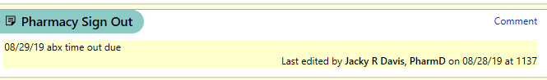
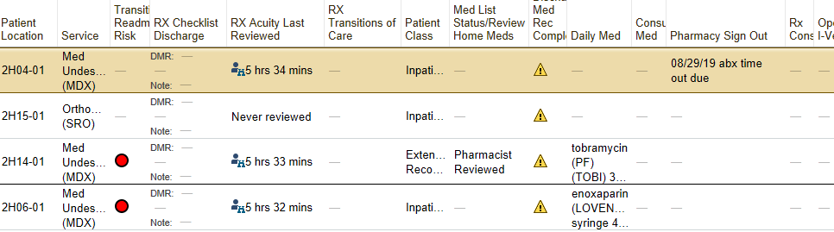
Pharmacy Sign Out
Notes:
This is how Pharmacy sign out looks. The top image appears in the Patient Summary section on the front page. The bottom image is how this looks on the pharmacist’s screen, which I really like.

Slide 9
Results: Time Out Uptake
Pilot testing
Official MDA and BEST participation
Family Medicine (Blue and Green) added
HBB and HBC added
Weekends added
Notes:
So that’s our process, and now I want to show you what this looks like on our run chart. You can’t see those dates, but the x-axis is each week of the project. The y-axis is the percentage of time-out-eligible patients who had a time out done during that week. We started off with some pilot-testing with our two pharmacy champions trying out the time out process on their teams. We then officially went live at the very end of October in two services, the MDA and BEST teams at Hillsborough. As you can see, we had pretty good success reaching our target of 80% and changed our centerline right around New Year. The next big step was that we added time outs on patients who became eligible on the weekend. We were worried about more missed opportunities but didn’t see that. Next we added HBB and HBC hospitalist services, bring us up to four services total. We continued to have strong performance and at the end of April recruited the Family Medicine services here in Chapel Hill. They have one pharmacist covering two full services, but she’s done an amazing job. Performance has remained high through the present.

Slide 10
Results: Impact of Time Outs
~35% of time outs result in some change
23% result in de-escalation of antibiotics
  5%: antibiotic discontinuation
  18%: IV-to-PO conversion
Occasional time outs result in addition of antibiotics or PO-to-IV conversion
Notes:
We’ve been tracking what happens after each time out. 40% are marked “no change” and 25% “already de-escalated,” so that leaves 35% of cases in which some change is made. 23% are clear de-escalations: with 5% being discontinuations and 18% being IV-to-PO conversions. There are a variety of other changes, such as IV-to-IV conversions, and occasionally antibiotics are escalated. If the team talks about the patient for a little while and decides to escalate antibiotics, that is not at all a failure to me.

Slide 11
Results: Safety
505 Time Outs Reviewed
348 with no changes
Balancing metric: Antibiotic time outs with changes recommended followed within 7 days by re-escalation of antibiotics
All time outs reviewed through 6/10/19.
157 with changes made (31.1%)
138 with no re-escalation
19 with antibiotic re-escalation
14 re-escalations not related
5 re-escalations were related to the time out
(1% of all time outs)
Notes:
We did want to ensure that time outs were not inducing de-escalation that happened too fast. So we have kept track of antibiotic time outs in which changes were made followed within 7 days by re-escalation of antibiotics. So we started by looking at all time outs with changes through 6/10/19. At that point, that was 157 time outs. I reviewed those and looked at the MAR to see if antibiotics escalated within 7 days. I found 19 cases of that. Clare Mock, who is a Hillsborough hospitalist and team member, and I reviewed all of those and we agreed on 5 cases in which de-escalation appeared to happen too fast. That was 1% of all time outs, and 3% of all time outs in which a change was recommended.

Slide 12
Potential Cost Savings
Time out takes <1 minute
Common de-escalation for pneumonia:
  Vanc and pip-tazo → ceftriaxone and azithromycin
  $80/day → $18/day
IV-to-PO conversion saves $60 per patient (Sallach-Ruma et al., 2014)
  Occurred in 88 patients on MDA/BEST (84 team-weeks) → $5,280 saved
  Comparable teams at Chapel Hill: 7 Internal Medicine, 2 Family Medicine, 2 Pediatrics
  13 services with 1 additional IV-PO conversion per week → 676 per year → $40,560
De-escalation of antibiotics may facilitate:
  Earlier discharge
  Avoidance of central lines
  Less drug monitoring and toxicity
  Reduced risk of C-diff
Notes:
To dig further into impact, we wanted to try to estimate what sort of cost savings could result. To start with, we found that time outs take less than a minute to execute. Literature suggests that an IV-to-PO conversion saves $60 per patient. This happened 88 times over 84 team-weeks on MDA and BEST, which would save $5,280. There are 11 comparable services at Chapel Hill: 7 Internal Medicine, 2 Family Medicine, and 2 Pediatrics. If 13 services each have one additional IV-to-PO conversion per week, we might save $40,000 on antibiotics. For example, for pneumonia, we see a lot of patients on vanc plus pip-tazo, which costs $80/day just for the drugs. If we convert them to ceftriaxone and azithromycin, which costs $18/day, that saves $62 per day.
In addition, we believe that antibiotic de-escalation may facilitate earlier discharge, avoidance of central lines, less drug monitoring and toxicity, and reduce the risk of C-diff. We plan to dig deeper into that data as we move forward.

Slide 13
Sustainment and Spread
Sustainment:
  Antimicrobial Stewardship Program will continue data monitoring, feedback, and engagement
Spread:
  Continued expansion to additional teams, including surgical services, ICUs
  Challenges:
    Efficient data collection and management
    Engagement with partner services
    Reliable systems to identify eligible patients
Notes:
So finally, I wanted to talk about sustainment and spread. The antimicrobial stewardship program is going to continue to sustain the program with data monitoring, feedback, and engagement with teams. We are planning to continue to spread the project to additional teams, including surgical services and ICUs. We are launching with one of the pediatric hospitalist services next week. The challenges that we have will continue to be efficient data collection and management, the time involved in engagement with our participating services, and reliable systems to identify eligible patients. We have explored some solutions that leverage Epic, but there’s still a lot of work to be done

Slide 14
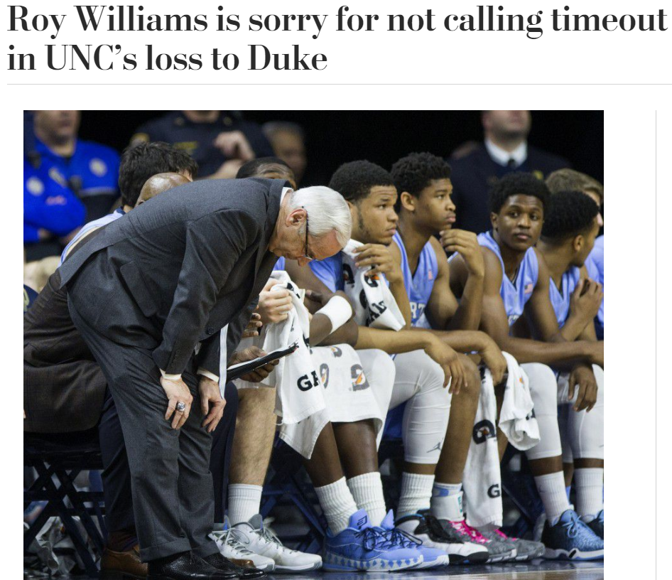
Questions?
Washington Post, 2/18/16
Notes:
So in conclusion, don’t be like Roy Williams and regret not calling time out. I’ll be happy to take any questions now.

