Slide 1
Project Lead: Mike Phillips Project Sponsor: Peggy McNaull, Andrea Hayes-Jordan Project Team Members: Robin Koonce, Amy Lamm, Kristen Cole, Lisa Richardson, Karen Wood, Carol Hubbard, Claire Barber, Brandy Agahajanian, Martha Perry
Reducing the Length of Stay for Pediatric Gastrostomy Tubes

Slide 2
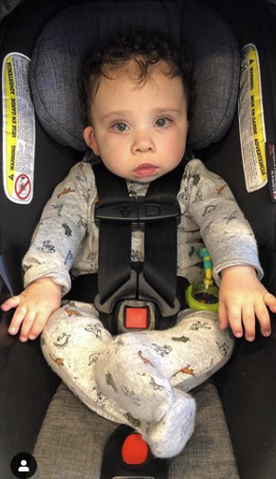
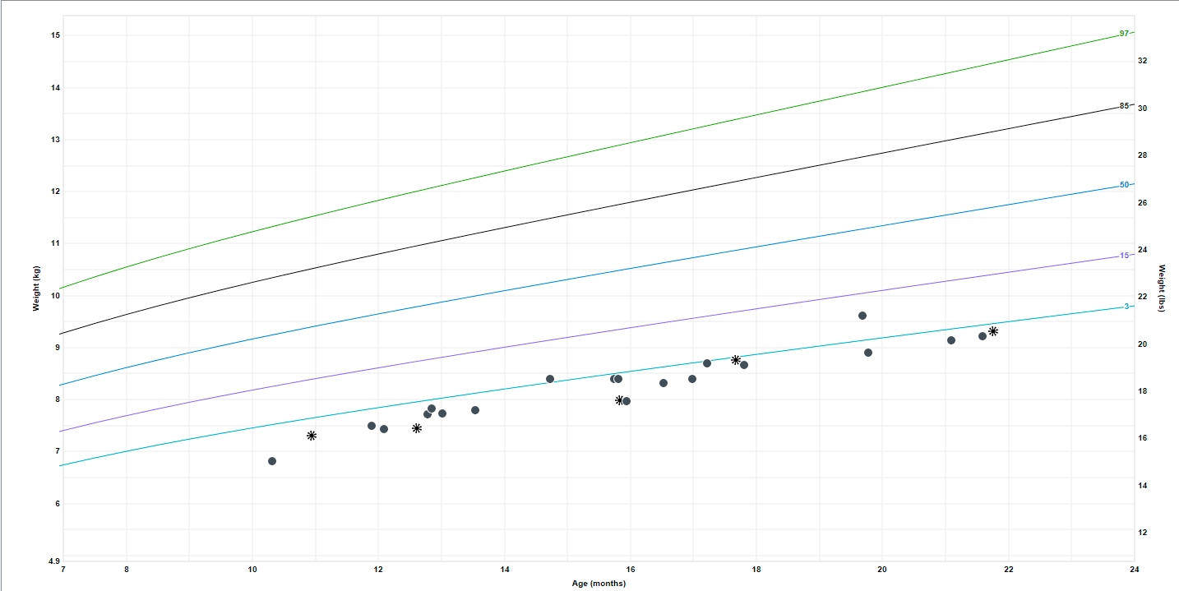
Why would anyone need a feeding tube?
Lots of reasons
Patient Presentation:
Malnourished
Dehydrated
UNC Management:
Surgery
Inpatient nutrition consult
Wait 12-24 hours and feed
Advance to goal over 24-48 hours
Shared with permission
Notes:
There are a lot of reasons pediatric patients need feeding tubes to be placed surgically. From congenital anomalies, to comorbid conditions, to acute illness like trauma that require them need feeding tubes. Historically this looked something like this, where a patient who started small would hang in for a while, and once in nutritional failure they’d present to us malnourished and dehydrated. But what the growth chart doesn’t show is all the difficulties children pass through to get to that point, and this growth chart isn’t any growth chart it’s Harrison’s. Harrison presented to us as a 15mo with Kabuki syndrome that is a rare complex syndrome of which feeding difficulties are frequently a part. What his growth curve doesn’t show is the hours his parents spent each day trying to get him to feed more. When he presented to us his meals were taking 2.5 hours every single day 3 times a day 7 days a week. His parents did an incredible job just maintaining his weight! Historically a child like Harrison would have surgery for a gastrostomy tube, get an inpatient nutrition consult, wait 12-24 hours post-op to feed and advance his feeds to goal slowly over 24-48 hours. When we examined this practice over a year ago, we noted that this led to a longer length of stay…..

Slide 3
Importance
Gastrostomy tube placement at UNC (days)
NSQIP-P Institutional Median LOS | 11.0
NSQIP-P Institutional National Median LOS | 8.0
Notes:
When we looked closely at all of our children who have a g-tube placed at UNC, using the National Surgical Quality Improvement Program for Pediatrics database (a risk adjusted database that shows you your outcomes compared to similar children at other hospitals), we learned that our Medial LOS was 11 days compared to a national median of 8 days. We realized for kids like Harrison we wanted to do better.

Slide 4
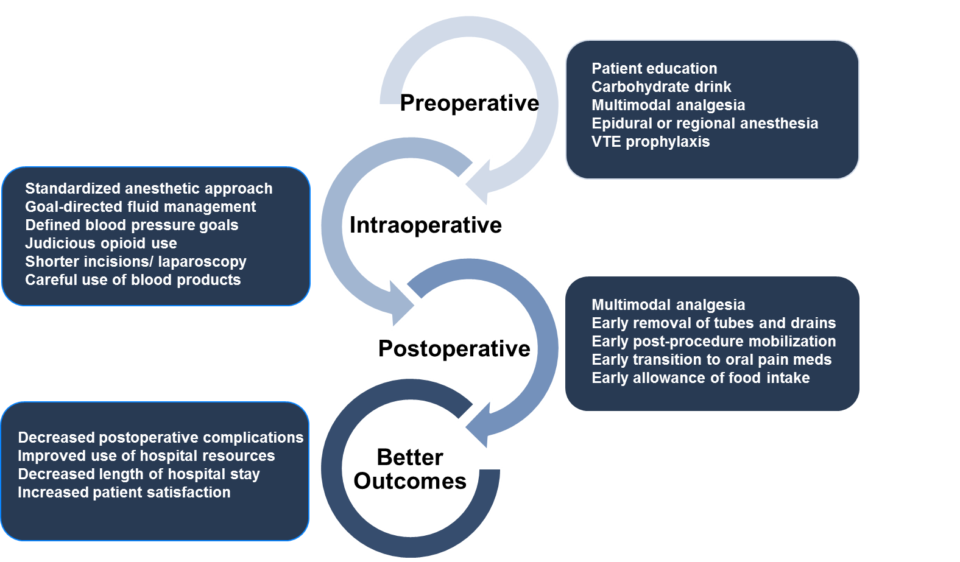
Enhanced recovery after surgery
Pediatric Gastrostomy Tubes
Notes:
So building off of the institutional framework and with the support of the MC and the HCS we designed an ERAS pathway. ERAS is a standardized, integrated, approach to surgical care that aligns pre-op, intra-op, and post-operative goals to improve outcomes after surgery.

Slide 5
Pediatric Gastrostomy Tube Global Aim
Reduce LOS for pediatric G-tube patients by 10%
SMART AIMS
1) Pre-op G-Tube Checklist complete in 80% of patients (NCCC)
2) NG tube feeding trials in 50% of pts scheduled for g-tubes (outpatient clinic)
3) Standardized post-op feeding to reach goal within 12 hours post-op in 80% of patients
Pediatric Gastrostomy Tubes
Notes:
While we identified and addressed each of the components of a true ERAS Pathway, we spent the bulk of our time on 3 specific pieces. 1) Pre-op checklist to standardize the approach and education for patients and families 2) Implementated the use of nasogastric feeding trials to optimize patients prior to surgery and 3) standardized our approach to post-operative feeding with an emphasis on earlier initiation of feeds and advancing more quickly to goal.

Slide 6
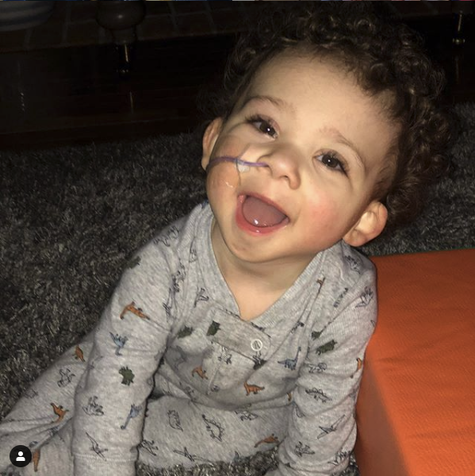
Results
Pre-op Checklist
Implemented in NICU
20 Checklists completed
27 Total patients have received GTs
NG Trials
25 total NG tube trials
16 discharged with an NGT
9 have gone on to GT
4 have weaned off of their NGT
3 are pending
1 died from an unrelated cause
Shared with permission
Pediatric Gastrostomy Tubes
Notes:
After instituting the use of the pre-op checklist in the NICU, we had 20/27 patients who had a GT placed complete the checklist. We reviewed the use of these checklists at a monthly multi-disciplinary meeting with our NICU colleagues. We started to use NG trials for patients when they were at risk prior to GT placement. Harrison was one of these patients, and after initial concerns that this would be more difficult at home than a surgically placed tube (which Harrison obviously disagrees with) we performed a total of 25 total NG tube trials, and developed a pathway for these kids to be seen within 2 weeks of discharge by our amazing feeding team. 16 patients were discharged to the outpatient world….

Slide 7
Results
Early Feeding
19/35 patients (54%)
LOS if early feeding decreased by 60%
Shared with permission
Pediatric Gastrostomy Tubes
Notes:
There are a variety of reasons not to feed early, but in patients who fed early after surgery LOS was decreased by 60%. Harrison was one of those early feeders, and he was discharged the same day as his GT

Slide 8
Results – Length of Stay
301 total patients evaluated
86 outpatients
177 inpatients ≤1 yo
Outpatients
 | Average of IP LOS | Count
Pre-ERAS | 4.1 | 67
ERAS | 2.8 | 19
Difference | 1.3
Inpatients ≤1yo
 | Average of IP LOS | Average of GT LOS | Average Pre-op LOS | Count
Pre-ERAS | 88.8 | 34.4 | 54.5 | 121
ERAS | 83.7 | 29.5 | 54.3 | 46
Difference | 5.1 | 4.9 | 0.2
Pediatric Gastrostomy Tubes
Notes:
When we examined our data for the year 2 years pre-implementation and the period since we started our ERAS Pathway. We noted a decreased outpatient LOS of 1.3 days across almost 20 patients. When we examined our inpatients ≤1yo we noted a decreased LOS of 5 days. We looked at the period of time before the feeding tube was placed and after and noted that across these 46 patients the decrease occurred almost entirely after the GT was placed.

Slide 9
Sustainment
GT Pathway in Epic – integrate the entire pathway for all patients
Multidisciplinary meetings monthly
Feeding Team/GI/Nutrition/Complex Care
NICU to discuss feeding
Data review and automation
7CH Education, NICU, Surgery, Anesthesia
Pediatric Gastrostomy Tubes

Slide 10
Acknowledgements
IHQI Candice Hunt
Kelly Reilly
Matt Nielsen
Laura Brown
Will Stanley
Program Sponsors
Andrea Hayes-Jordan
Peggy McNaull
Team
Amy Lamm and Robin Koonce, Pediatric Surgeons
Karen Wood, Carol Hubbard, Claire Barber, Brandy Agahajanian, NICU Attendings and Nursing Staff
Kristen Cole, Lisa Richardson, GI Division
Martha Perry and Mike Steiner, Complex Care
Aaron Low, Dan Moyles, Peds Anesthesia
Monica Mohe, Gina Thompson, 5CH, 6CH, and 7CH nursing staffs and nurse educators
Pediatric Gastrostomy Tubes

